Slide 1
“A Nursery for Militant Suffragists”
The History of the Women’s Suffrage Movement at Goucher College
Notes:
Tina.

Slide 2
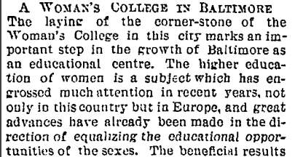
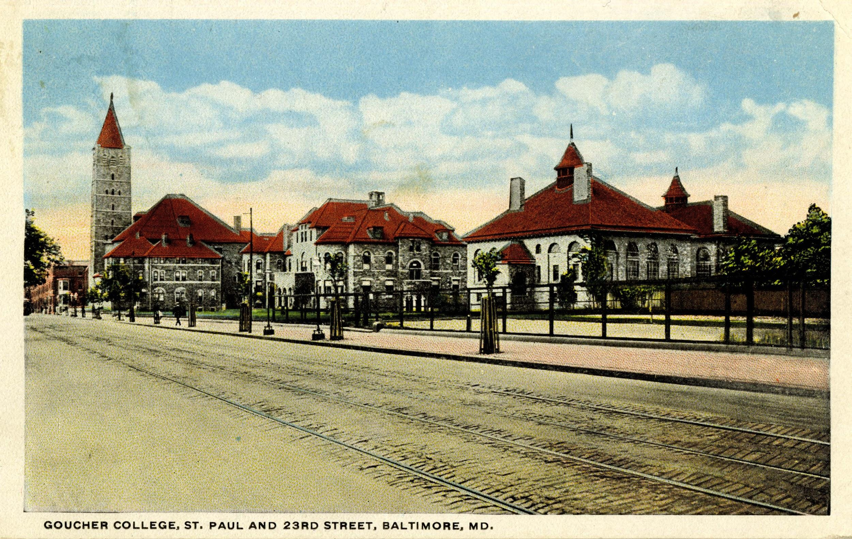
The Beginning
“This was to be a college to break down the prejudice against higher education for women among women of Baltimore.”
Notes:
Hannah.

Slide 3
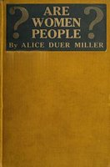
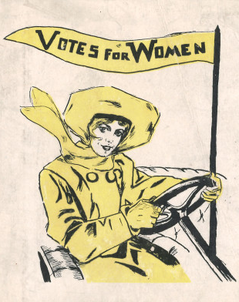
“‘The proper sphere of a woman is in doing what is right. When you say that women are not fit to vote and that men are, you admit that we are inferior...a visit to the polls will not be anymore an interruption of duties there than it is to the business men.’”
“Suffrage diminish[es] man’s respect for her and [will] degrade her moral nature...women [will lose] their good looks by engaging in political life.”
Thaddeus Thomas + The Suffrage Debate
Notes:
Hannah.

Slide 4
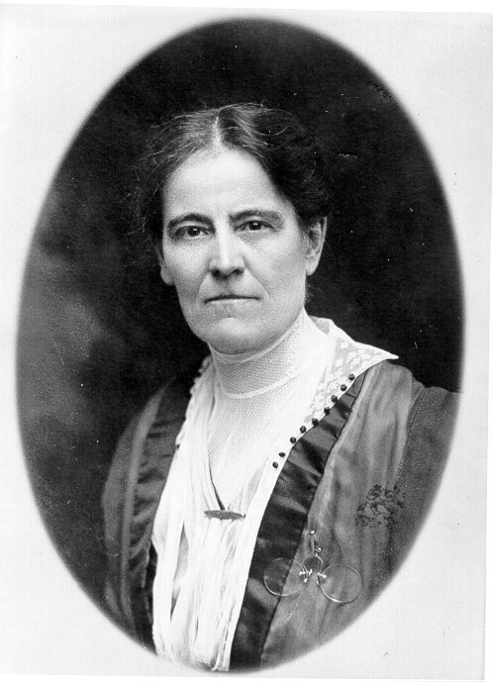
"It was a rude awakening when I found that ‘we, the people,’ did not include women."
Lilian Welsh, Professor Emeritus of Physiology and Hygiene (1894-1925)
Notes:
Emily.

Slide 5
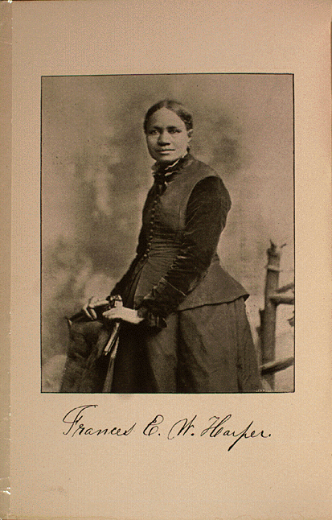
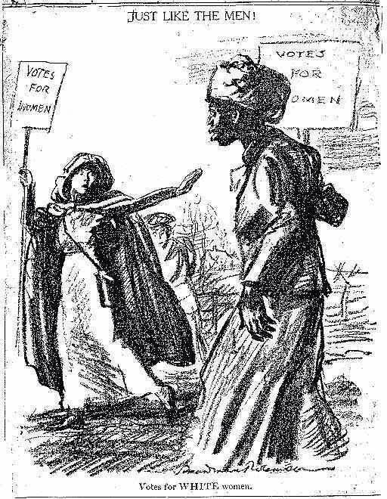
Role of African American Women
“Much as white women need the ballot, colored women need it more.”
Notes:
Laura.

Slide 6
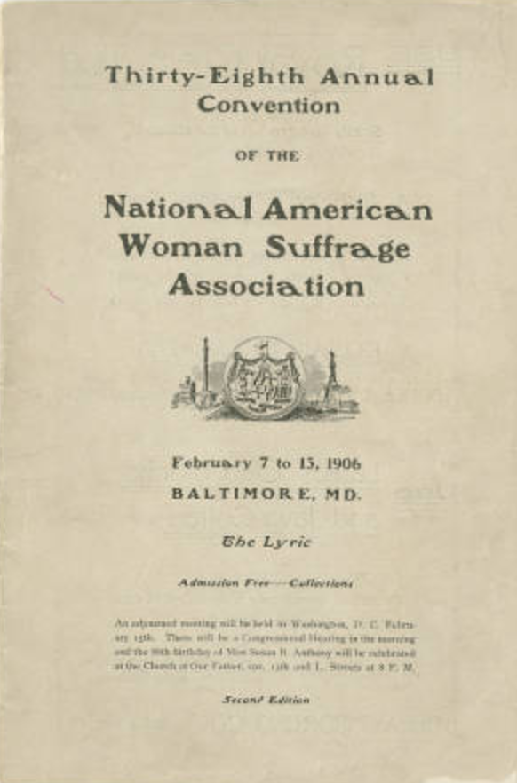
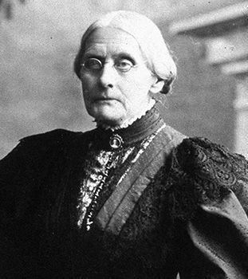
1906 NAWSA Convention
“The fight must not cease; you must see that it does not. Failure is impossible.”
Notes:
Nick.

Slide 7
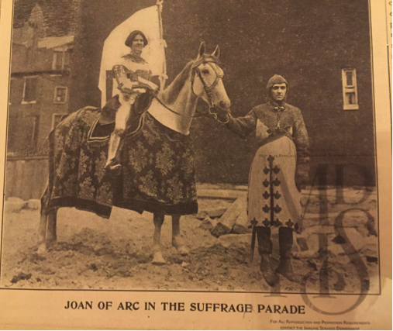
"The most spectacular feature of convention week.”
Baltimore Suffrage Parades of 1912 + 1913
Notes:
Hannah.

Slide 8
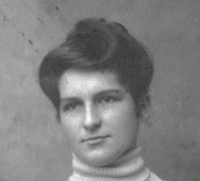
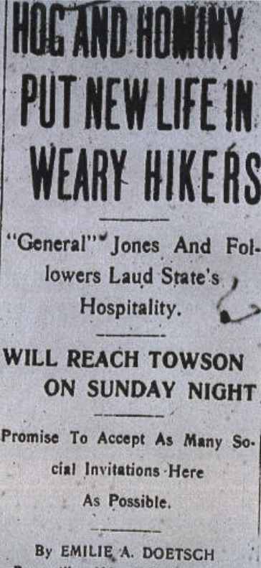
Emilie Doetsch +
The Suffrage Army March
“I hope, if any of the rest of you have a chance to run for public office, that you won't be scared, but will jump right in. Women are needed in politics, and college women in that respect have bigger responsibilities than others. And whatever the outcome, the experience is worth­while.”
Notes:
David.

Slide 9
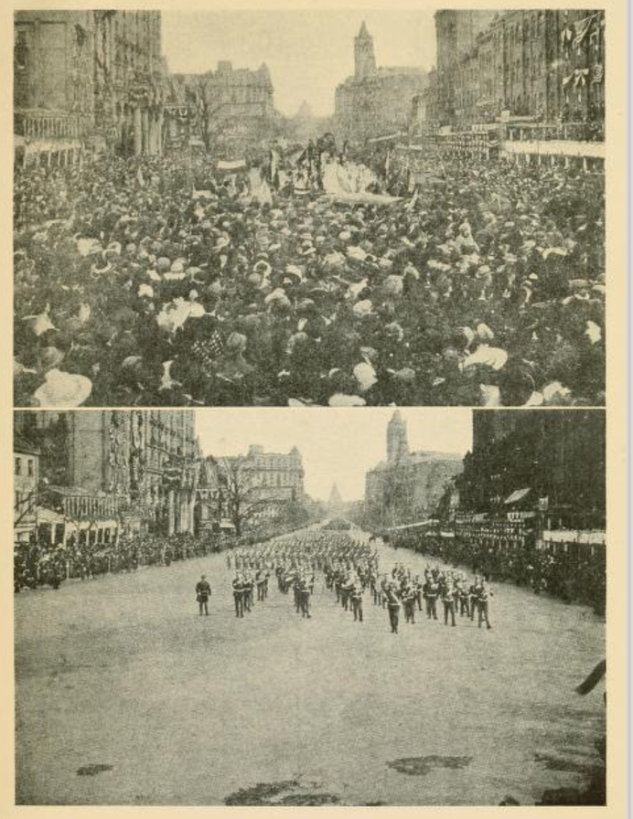
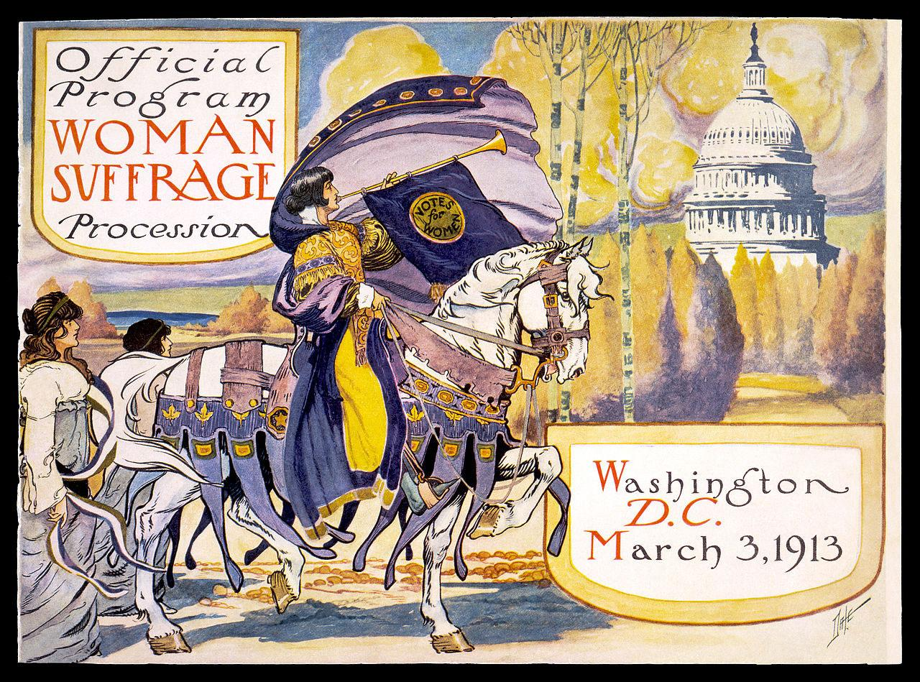
Inauguration Suffrage Parade
Notes:
Hannah.

Slide 10
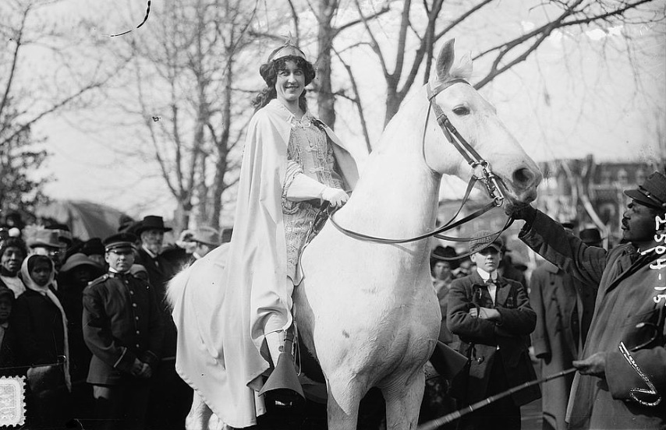
Suffrage Visits on Campus
“‘Is there a woman opposed to suffrage here? And if there is will she say so?’
Not one feeble sound resembling a dissent broke the silence.”
Notes:
Hannah.

Slide 11
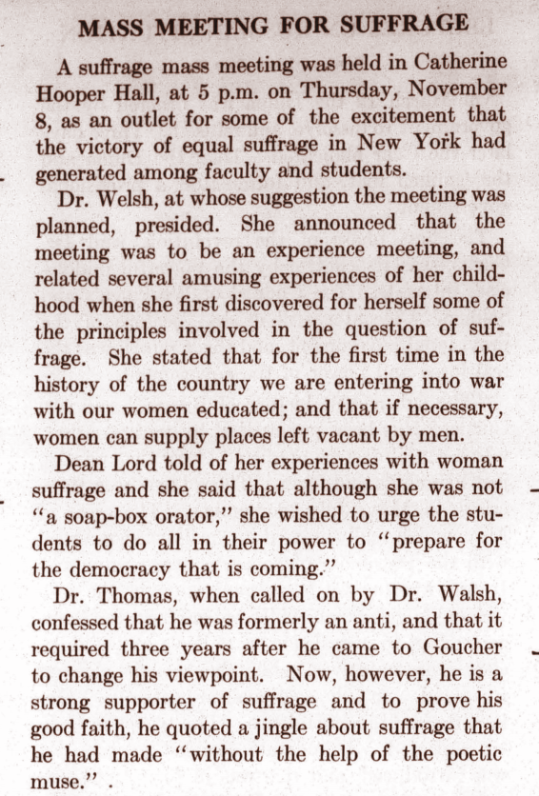
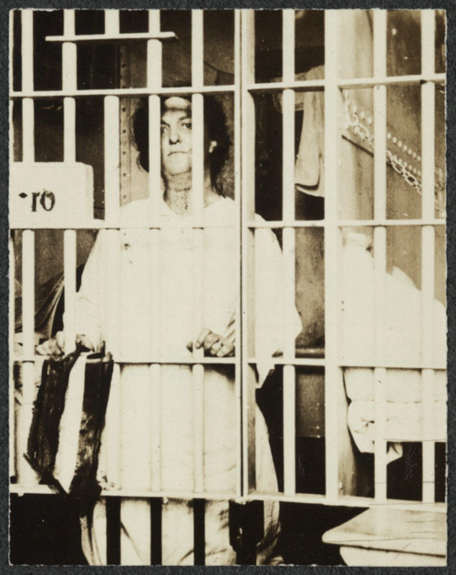
Student Activism + The Militant Suffrage Era
“Mr. President, How Long Must Women Wait for Liberty?”
“Prepare for the democracy that is coming.”
Notes:
Hannah.

Slide 12
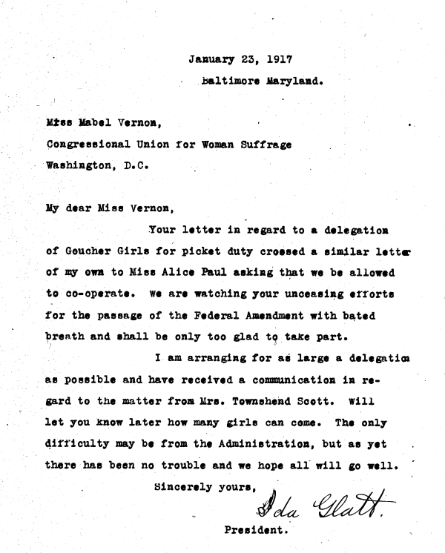
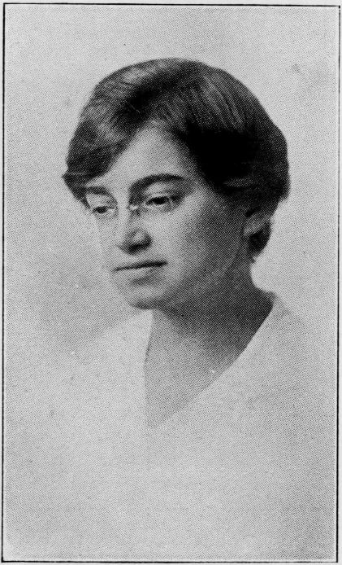
1917 Pickets on the White House
"We are watching your unceasing efforts for the passage of the Federal Amendment with bated breath and shall be only too glad to take part."
Ida Glatt’s correspondence with the NWP
Notes:
Clara.

Slide 13
Administration Disapproval
“If Goucher is to be considered merely a nursery for militant suffragists, it will be apt to suffer and its expanding usefulness might be greatly checked.”
“Time to Call Them Down,” Sun, Jan. 29, 1917
Notes:
Clara.

Slide 14
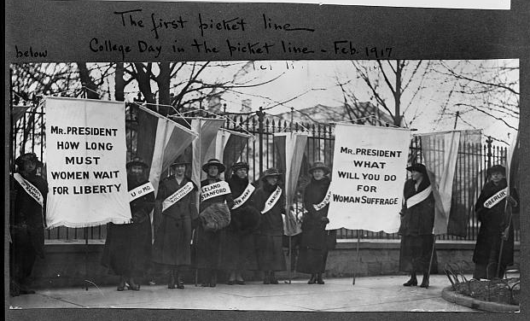
"The long line was a splendid and impressive one….The largest number of pickets from one college were a group of about thirty undergraduates from Goucher College, Baltimore, whose fire of young enthusiasm was much appreciated at Head-quarters.”
February 3, 1917: “College Day”
Notes:
Clara.

Slide 15
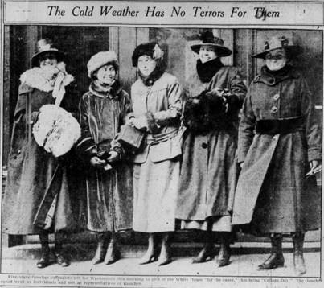
“Five brave Goucher suffragists left for Washington this morning to picket the White House ‘for the cause,’ this being ‘College Day.’”
Baltimore Sun, Feb. 3, 1917
Notes:
Clara.

Slide 16
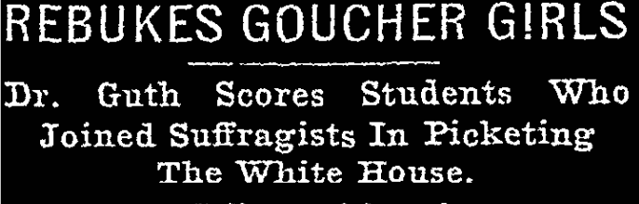
President Guth’s Rebuke
“When a danger as alarming as our country has ever faced was imminent, when the President was carrying a burden as great as ever was pressed upon the shoulders and soul of any ruler, a few misguided women stood ready to flaunt banners in his face and annoy him by their presence.”
Notes:
Clara.

Slide 17
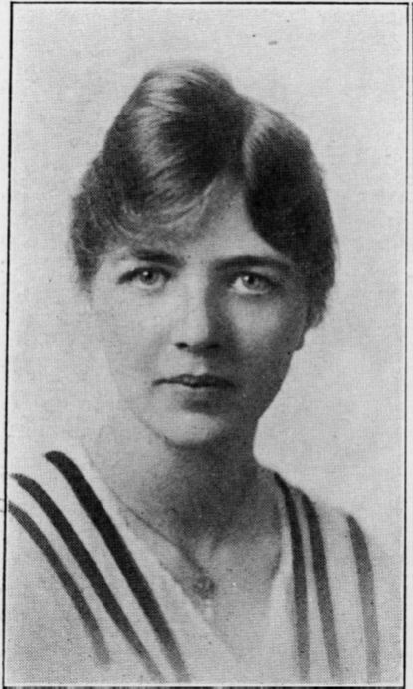
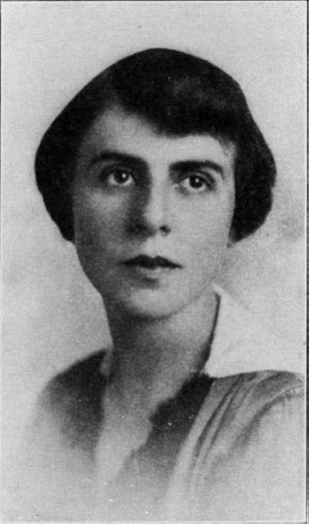
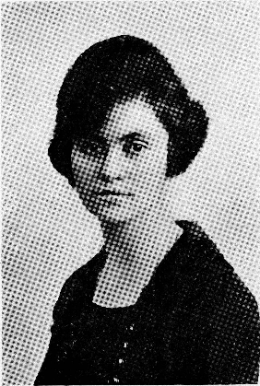
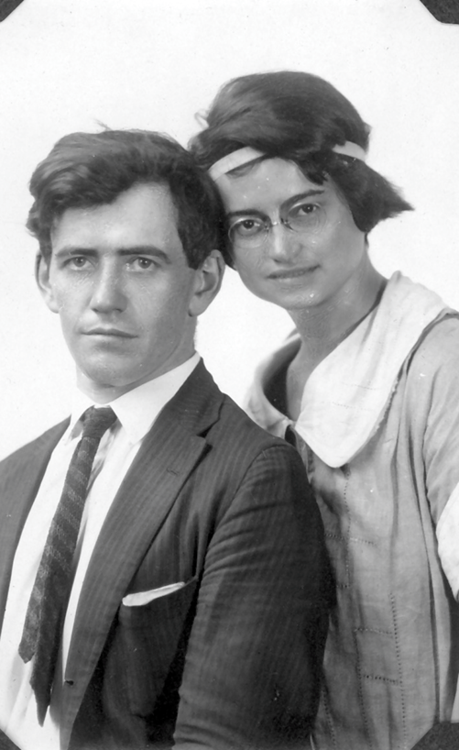
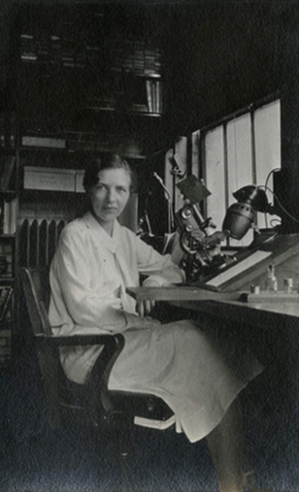
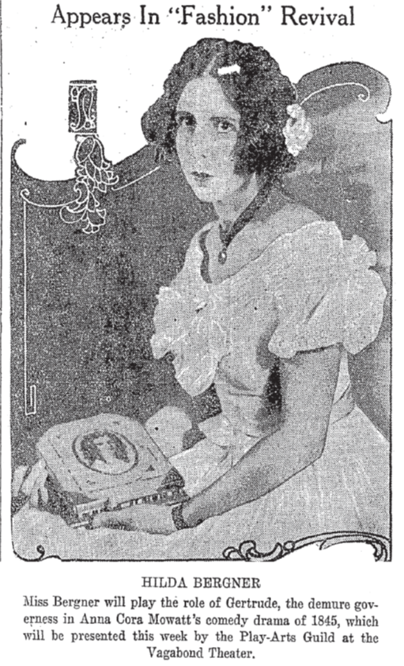
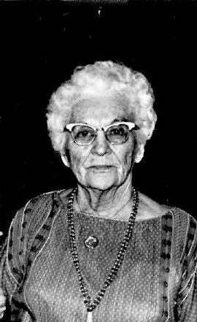
Ida Glatt + Lucy Graves + Hilda Bergner + Christina Flint
Notes:
Clara.

Slide 18
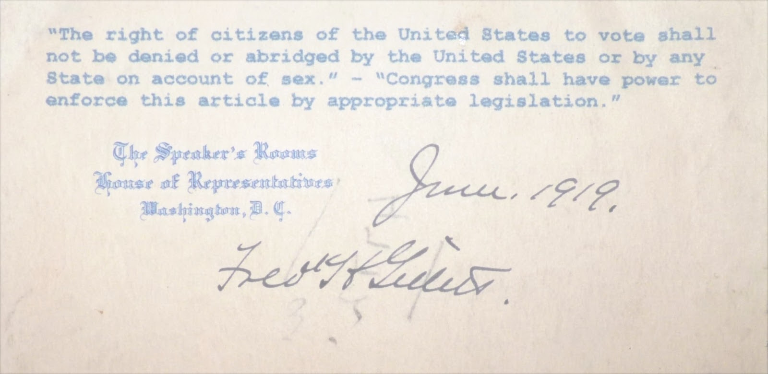
Suffrage during the Great War
+
The Passage of the 19th Amendment
Notes:
Hannah.

Slide 19
What will happen to this history?
Notes:
Hannah.

