Slide 1

Repurposing descriptive data: PastPerfect, EAD3, & PHP
Lindsey Loeper
@lindseyloeper
Mid-Atlantic Regional Archives Conference, April 16, 2016

Slide 2

NHPRC Access to Historical Records grant
“Implementing an EAD-XML compliant workflow at the University of Maryland, Baltimore County (UMBC)”
Describing unprocessed collections and implementing a description workflow that limits future backlogs
Project work ends May 31
Notes:
NHPRC Access to Collections grant to create collection level records for all archival collections; also implement EAD.
“Significant” - ~30 that were completely undescribed; number has doubled.
Applied and awarded NHPRC grant, project period 2014-2016 - happy to share any documentation on grant application and process

Slide 3
Goals for the new workflow
Repurpose data across platforms
Include creation of MARC records
Minimize potential for future backlogs
Make our work accessible and adaptable
  GitHub: /UMBC-Library/EAD-XML
  bit.ly/umbcead
Notes:
Goals for the workflow:
Repurpose data across platforms
Include creation of MARC records
Minimize potential for future backlogs
Make our work accessible and adaptable (for ourselves and other orgs)

Slide 4
Pro: Lots of access points
Collection level record in PastPerfect and PastPerfect Online
Collection level record in MARC - University catalog and Worldcat
Multi level finding aid in Word and PDF
Multi level finding aid in PHP
Pro: Existing relationships
Special Collections and Bibliographic and Metadata Services
Including the analysis and review of metadata creation and procedures
Supervision of undergraduate and graduate students
Overcome barrier of archivist QC time suck!
Notes:
Archival description at UMBC before.
Access points: Had focused on increasing access points for discoverability. Increased from web finding aids for processed collections only to add MARC, PastPerfect, including some unprocessed collections.
All entered by hand - or copy/paste
Each step requires careful QC by archivist
Very time consuming
Had skills on staff to develop and create each step but did not have staff time to maintain; any updates required archivist to update at each level, even student assistance needed to be reviewed at each step. Everything done by hand! Copy/paste from one platform or format to the next. Lots of places to make mistakes!
Also, because it is time consuming, led to secondary backlog after processing

Slide 5
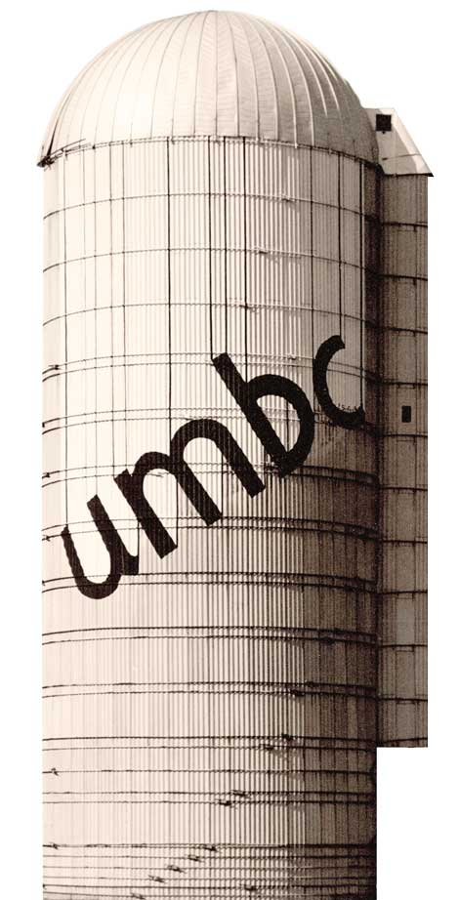
Why PastPerfect?
Library Administration
Collection Management
Gallery
Special Collections
Researcher registration
Contacts and mailing lists
In-kind donations
Monetary and collections funds
Photo, book, and archives donations
Temporary loan tracking
Accessioning and giftwork
Item and collection description
Location tracking for non-book items
Online catalog
Notes:
Another barrier:
Data starts in PastPerfect; explain why, and reasons for keeping.
Part of the larger Library infrastructure. One goal of the project is to be adaptable - not just for people at other institutions, but also for ourselves! Migration is not out of the question.
No silo!

Slide 6
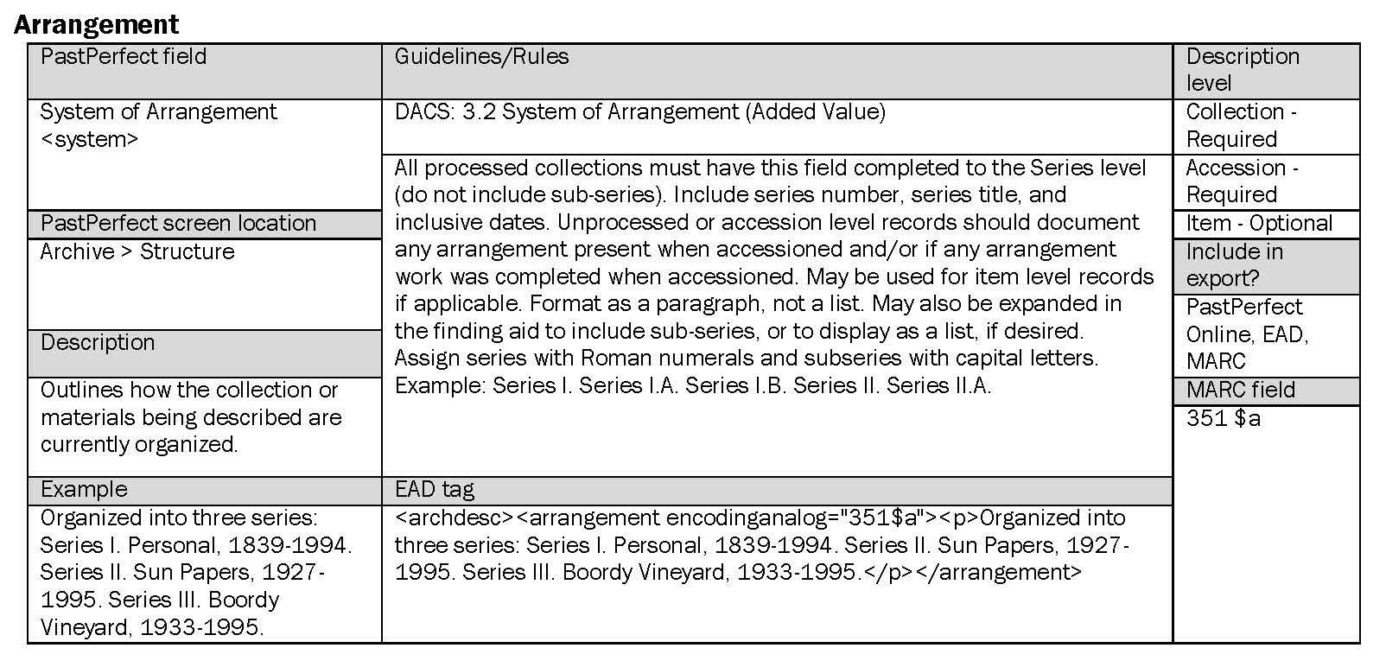
Data guidelines and clean-up
Notes:
Created field descriptions for each - PP, EAD, MARC mapping, DACS citation, required at what levels, examples, and general guidelines. Part of larger description manual.

Slide 7
<date>1839-1995; bulk 1942-1989</date>
<earlydate>1839</earlydate>
<latedate>1995</latedate>
<unitdate unitdatetype="inclusive">1839-1995</unitdate>
<unitdate unitdatetype="bulk">bulk 1942-1989</unitdate>
<unitdatestructured unitdatetype="inclusive">
<daterange>
<fromdate>1839</fromdate>
<todate>1995</todate>
</daterange>
</unitdatestructured>
<table>
<tr><td>Dates:</td>
<td>1839-1995; bulk 1942-1989</td></tr>
</table>
Notes:
Export and use of XSLT. No cut and paste!
PP to PP-XML
PP-XML to EAD-XML
EAD to PHP
PHP to PDF
Also PP-XML to MARC XML to MARC

Slide 8
XSLT
<!-- Separation of Bulk and Inclusive Dates -->
<xsl:choose>
<!-- If bulk date delimiter (;) exists -->
<xsl:when test="contains(date,';')">
<unitdate unitdatetype="inclusive" encodinganalog="245$f">
<xsl:value-of select="normalize-space(substring-before(date, ';'))"/>
</unitdate>
<unitdate unitdatetype="bulk" encodinganalog="245$g">
<xsl:value-of select="normalize-space(substring-after(date, ';'))"/>
</unitdate>
</xsl:when>
<!-- If only inclusive dates exist -->
<xsl:otherwise>
<unitdate unitdatetype="inclusive" encodinganalog="245$f">
<xsl:value-of select="date"/>
</unitdate>
</xsl:otherwise>
</xsl:choose>
Notes:
XSLT

Slide 9
Room for improvement: Subjects
<subjects>Universities and colleges -- History;
Universities and colleges -- Planning;
Schamp, H. W. (Homer Ward), 1923-;
Dorsey, John W., 1936-;
University of Maryland, Baltimore County;
Lee, Calvin B. T.;</subjects>
Thesauri information and XML tags not exported from PastPerfect. Requires hands-on clean up post export and careful review by the Catalog Librarian.
Notes:
Hands-on work still required, especially for subjects. This is the bulk of the work done by the catalog librarian. Due to PastPerfect not distinguishing between types of subjects or theasauri. XSLT can help a bit.
We will continue to look at ways to streamline this moving forward. May adapt workflow to PP>EAD>MARC-XML (after grant)
Also by hand: Multi level records are expanded in the EAD to include longer scope and content notes, biographical notes, and container lists. PP and MARC are single level only, more concise.
Container lists are added using a workflow adapted from the Naval Academy

Slide 10
Single level / collection level records
Multi level records / finding aids
PastPerfect Online (+ search engines)
MARC records in USM ILS
MARC records in UMBC discovery layer
MARC records in WorldCat
MARC records in ArchiveGrid
EAD-XML files
EAD-XML files in ArchiveGrid
EAD-XML files in NLM consortium
PHP files (+ search engines)
PHP files linked from all single level records
PDF files for printing
Notes:
Results in multiple access points
Single level, collection level records
PastPerfect Online http://umbc.pastperfectonline.com/
Also in online search engines
As MARC records through the University System’s ILS http://catalog.umd.edu/search=advanced&base=bc
As MARC records through the University’s discovery layer http://search.ebscohost.com/login.aspx?authtype=cookie,ip,guest&custid=baltcnty&groupid=main&profile=onesearch
As MARC records through WorldCat and ArchiveGrid
Multi-level records (unprocessed and processed collections)
EAD-XML files http://library.umbc.edu/speccoll/findingaids/ead/
EAD crawled by NLM for medical history consortium
PHP files http://library.umbc.edu/speccoll/findingaids/index.php
PHP linked from all single level records listed above
Also in online search engines
And PDF files for printing (linked from the PHP file)

Slide 11
For more information…
GitHub: /UMBC-Library/EAD-XML
bit.ly/umbcead
Lindsey Loeper
lindseyloeper@umbc.edu
@lindseyloeper
Notes:
Sharing resources: on website and on Github. And contact info.

