Slide 1




Moving Image Preservation 101
Siobhan C. Hagan
Audiovisual Archivist
University of Baltimore>Langsdale Library>Special Collections
Notes:
Welcome and thank you for attending this webinar.

Slide 2
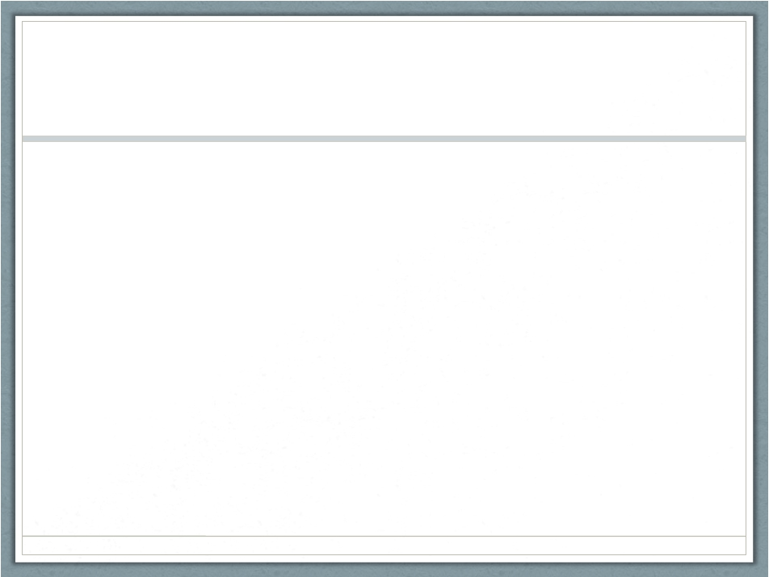
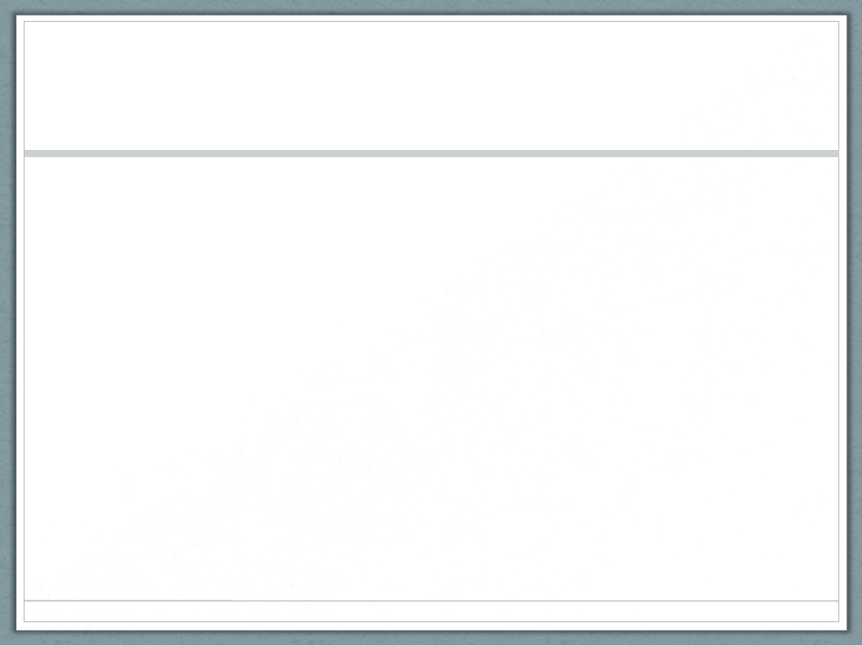
Audio. Video. Disco.
• Wavelengths
Sound
Light
Recording wavelengths
Analog signal: analogous to the original
Digital signal: 1’s and 0’s
Recording onto…
Physical
Born-digital
Hosted by ALCTS, Association for Library Collections and Technical Services
Notes:
Audio, video, disco. I hear, I see, I learn.
What we see and hear are wavelengths of varying frequencies.
There are two ways to record these wavelengths: as an analog signal and a digital signal. explain. You can copy digital signals as many times as you want with no loss of resolution, but not so with analog signals. Then you can record these signals into 2 types of basic media: the physical type, which is mostly analog but you can also have digital signals recorded onto a physical tape, for example, and then born-digital, which means the signal was recorded digitally as a digital file.

Slide 3
Poll # 1
Notes:
I would like to start off with a question to you all:
Q: Why are you taking this webinar?
A. I want to recognize the AV formats that I take care of and learn more about their inherent preservation problems
B. I know the formats I have but I need to learn the next steps in their preservation
C. I am curious about this topic and don’t have any specific objective
D. Other

Slide 4
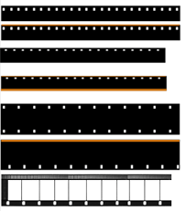
Film: Small Gauges
http://www.cinefilmfactory.co.uk/
Notes:
The first type of moving image analog signal was recorded onto motion picture film and that is where we will start today.
Motion picture film was introduced in 1885 and the first standardized format was 35mm, which measures the width of the film stock. The smaller film got, the less expensive it was to be a filmmaker and thus the more you will find. Let's run through the most popular amateur film formats, also known as "small gauges", that you will most likely find in collections.

Slide 5
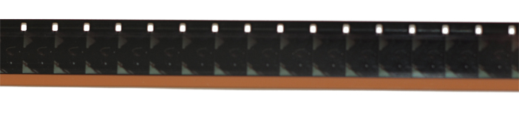
16mm
• 1923 (Magnetic stripe: 1973)
www.filmtransferexperts.com
Notes:
in 1923, 16mm (or about half of 35) was introduced as the first amateur filmmaking format: it was cheaper and made of the new acetate film stock, which was safer than its predecessor nitrate.

Slide 6
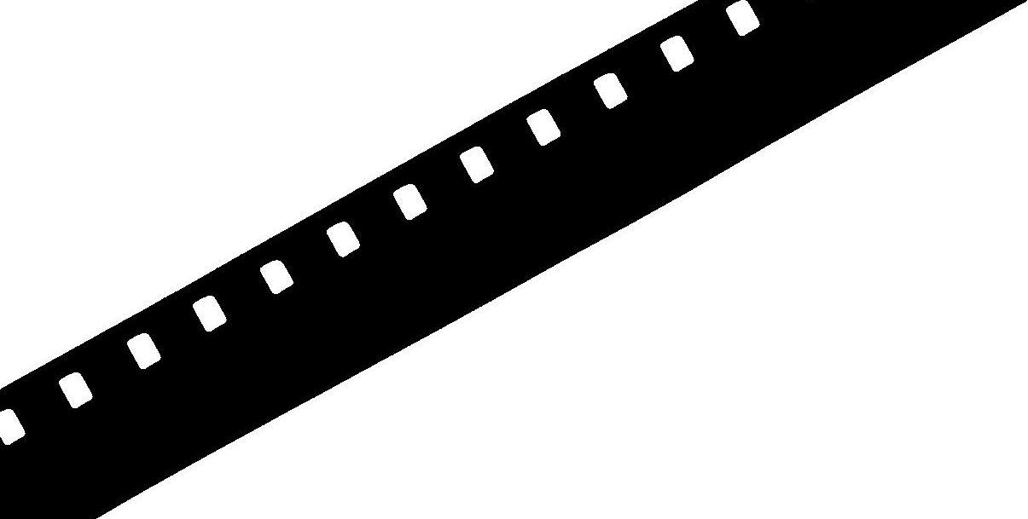
8mm
• 1935
www.homemoviedepot.com
Notes:
in 1935 8mm was introduced (or half of 16)

Slide 7
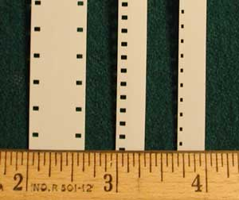
S-8mm
• 1965 (Magnetic stripe: 1973)
www.movies-2-dvd.com
Notes:
and then in 1965 Super8mm was introduced (which decreased the size of the sprocket holes in order to have more space for picture and therefore higher picture quality.

Slide 8
Poll # 2
Notes:
Now I would like you all to take Poll #2!
What types of film do you have in your collection?
8mm
S-8mm
16mm
Other

Slide 9
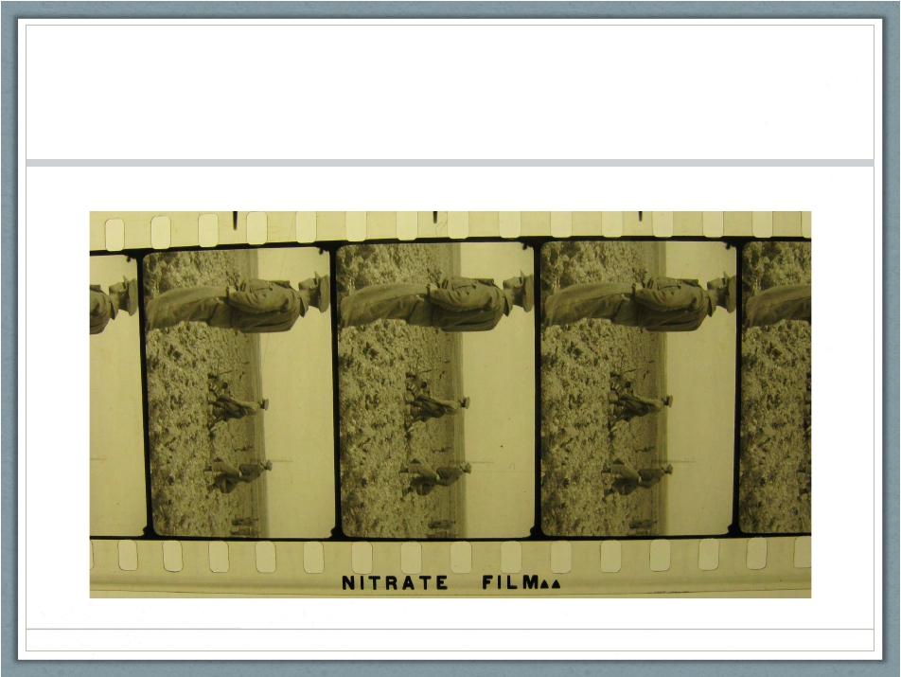
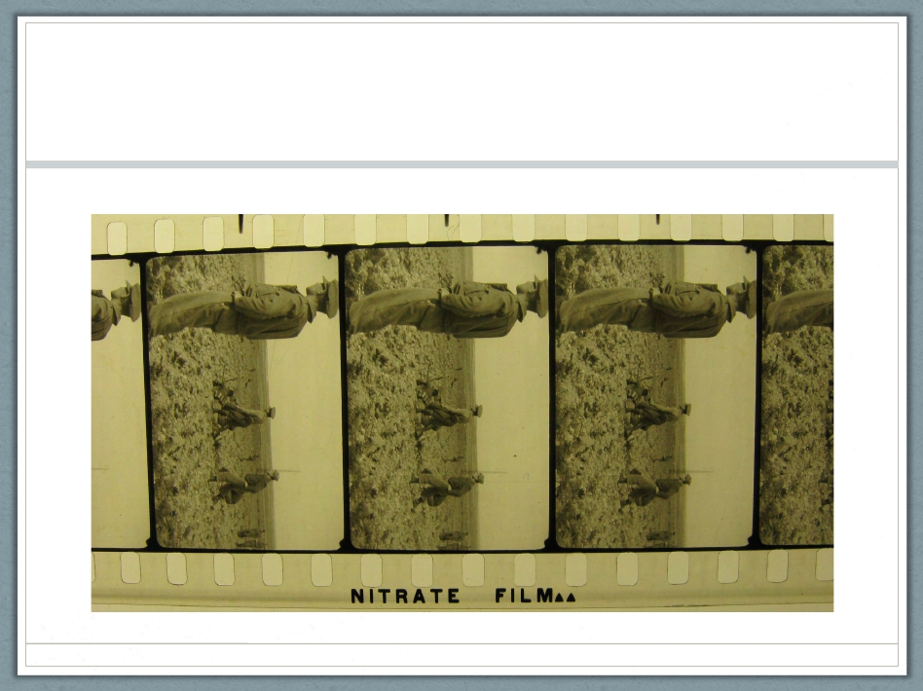
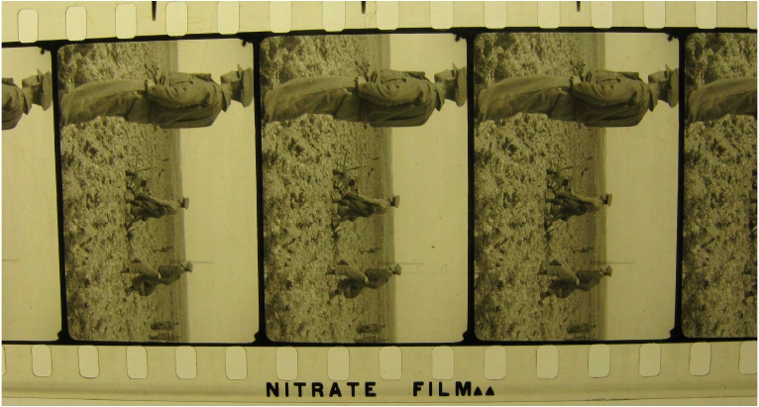
Nitrate
Photo: George Eastman House
Notes:
Preservation problems
-99% sure based on history of amateur filmmaking technology that you do not have nitrate film base, so you are good there

Slide 10
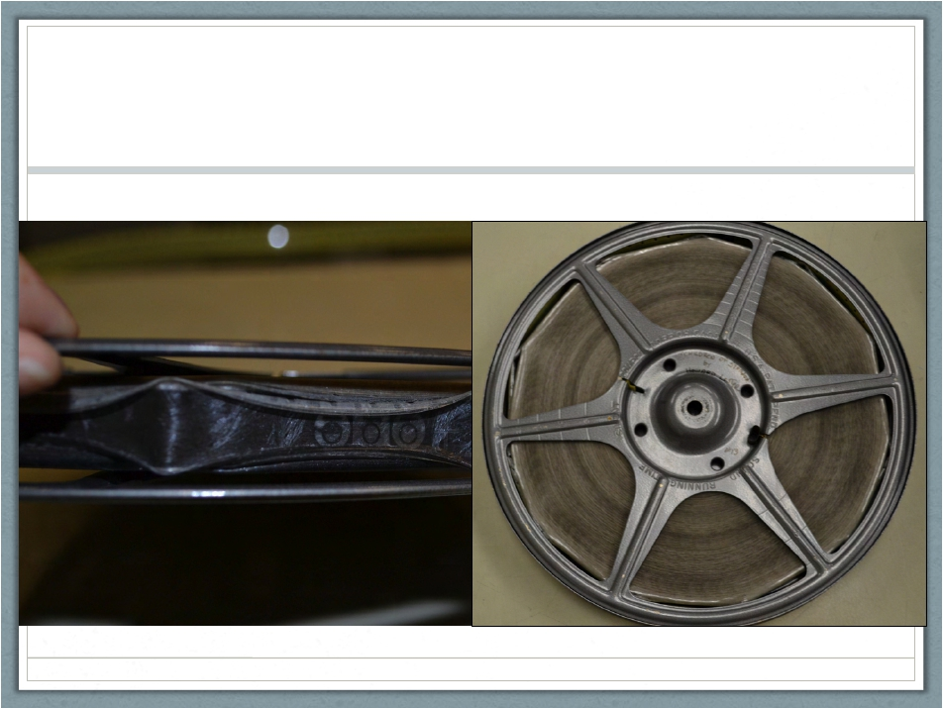

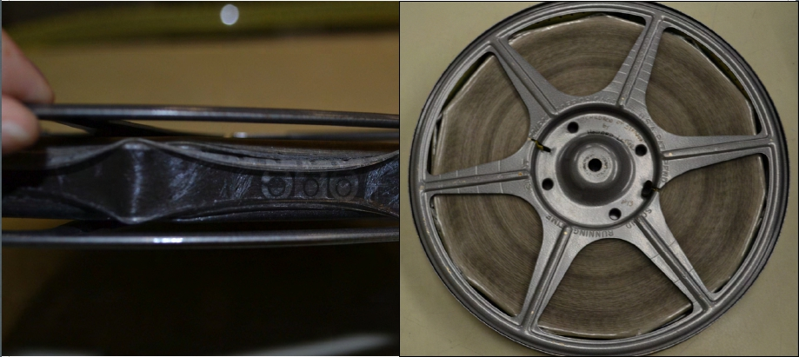
Vinegar syndrome
Notes:
But you will probably have: acetate film based problems: Vinegar syndrome
Magnetic stripes make this worse and need playback equipment to be read to these are a higher priority.

Slide 11
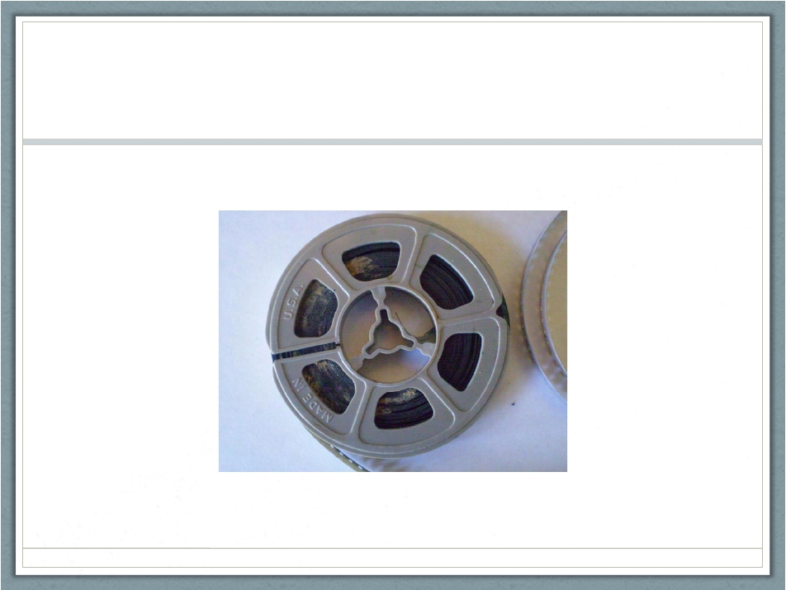
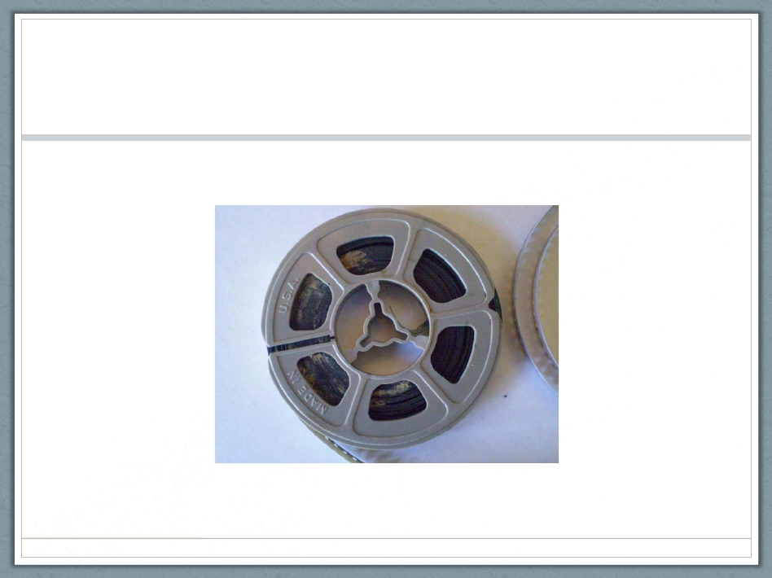
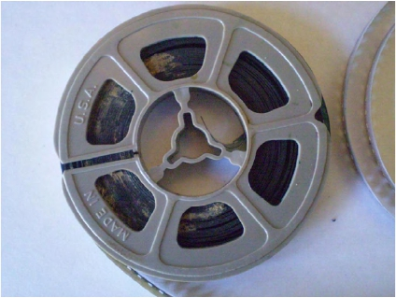
Mold
Photo: AZ Digital Transfers
Notes:
Mold is always a problem! Film does not like water, and mold loves film emulsion

Slide 12
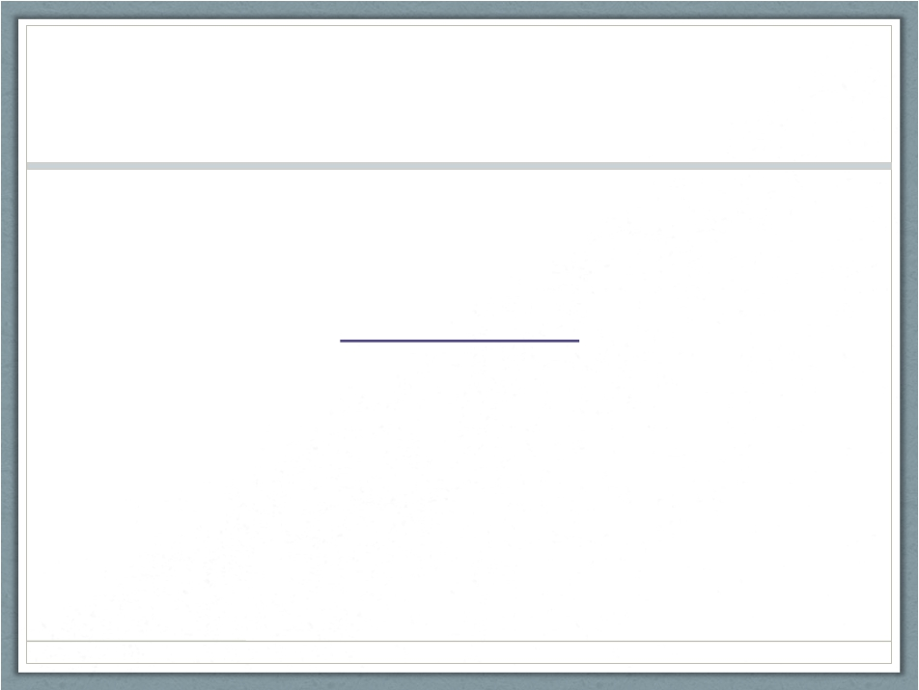
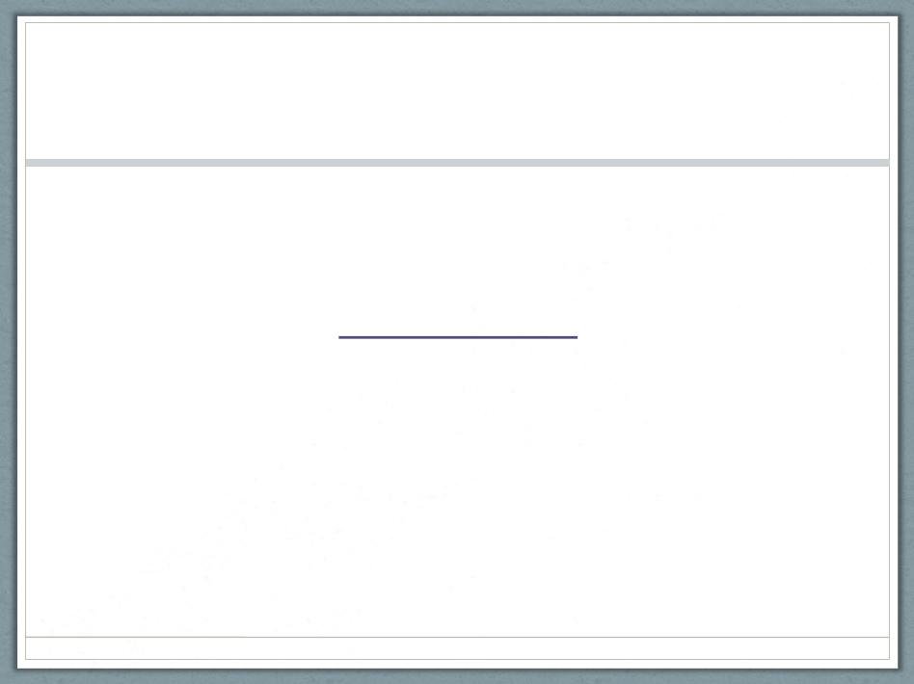
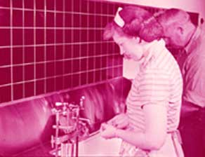
Color Film
Photo: filmforever.org
Notes:
Color film fades—some types more than others (1930s Kodachrome)

Slide 13
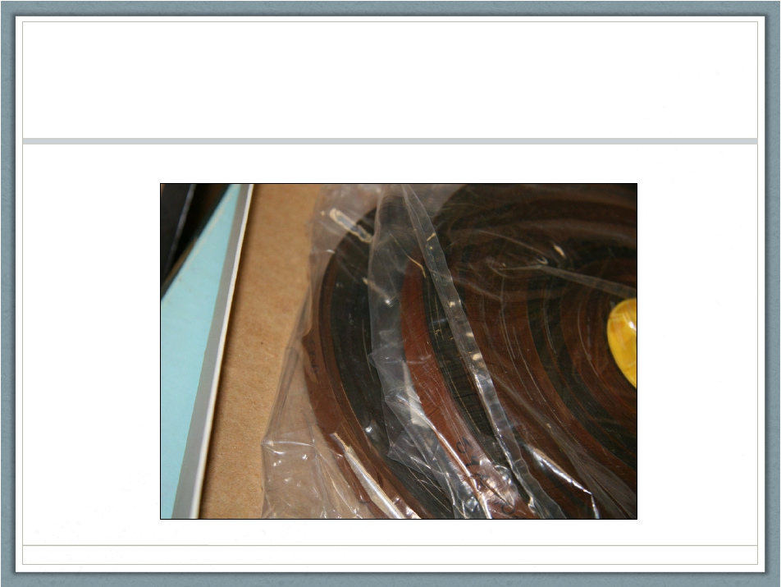

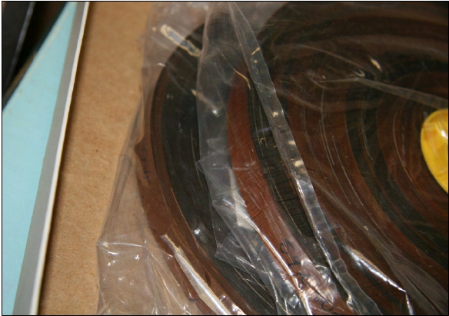
Poor Housing
✗
Notes:
let's talk about how and where to store
This is an example of poor storage: film wants to breathe!

Slide 14
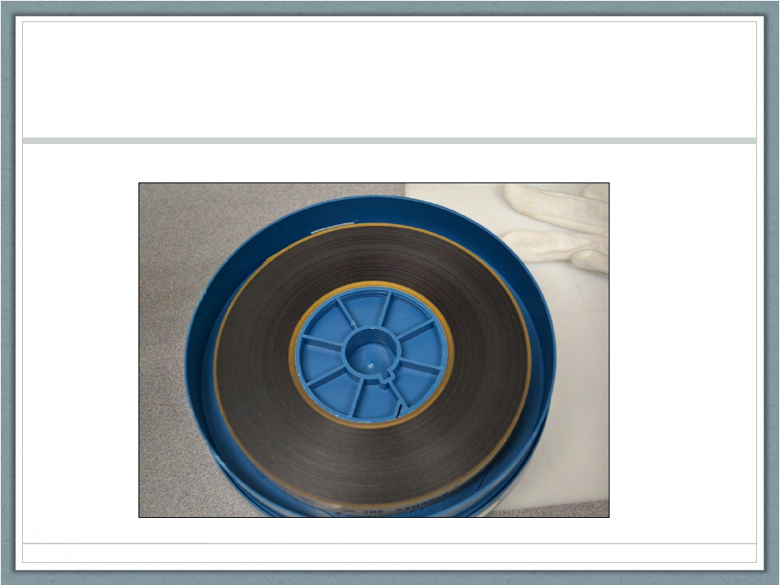

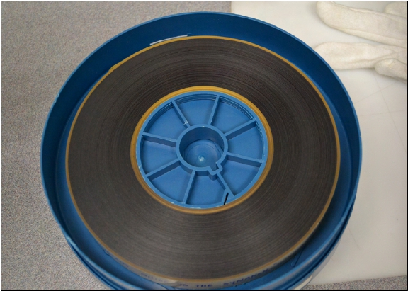
Preservation Re-housing
✔
Notes:
Here is how film wants to be in its ideal state--realistically you can try and get a happy medium between the two.

Slide 15
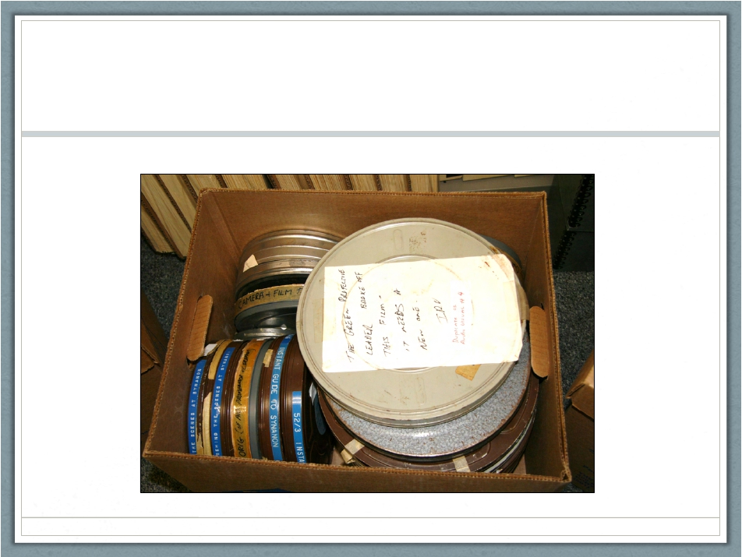

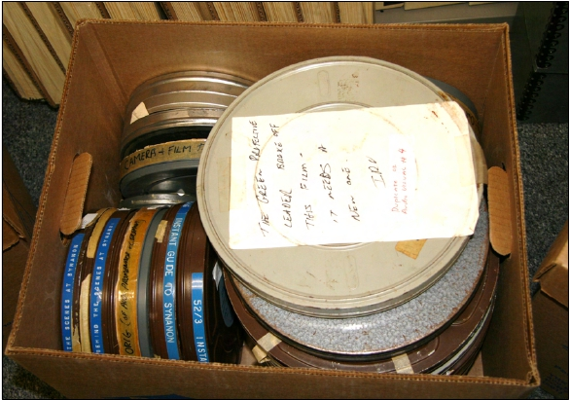
Poor Storage
✗
Notes:
This is an example of more poor storage in a different way

Slide 16
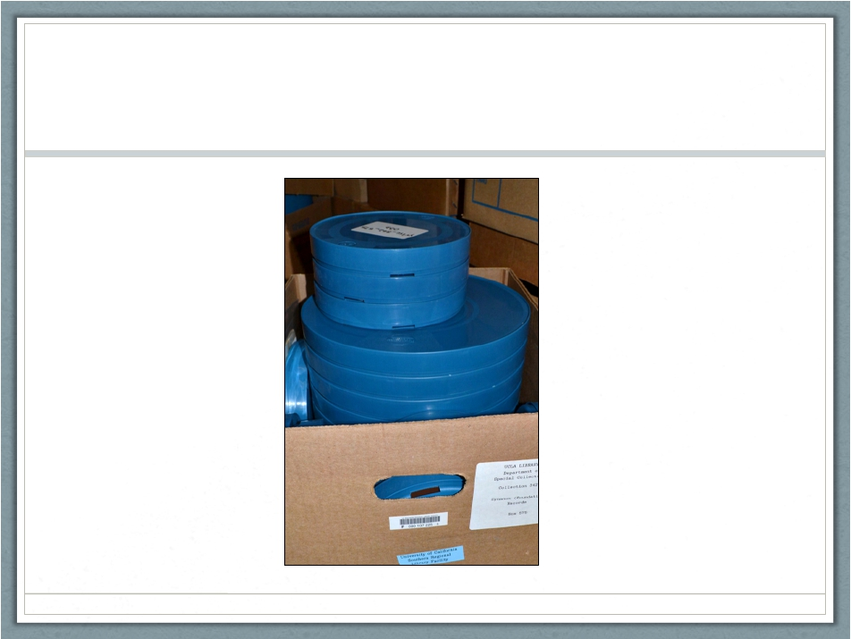

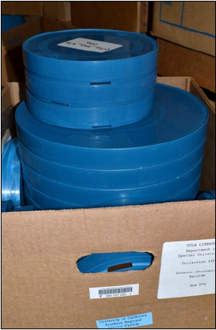
Preservation Re-housing…
• Film
• Flat
✔
Notes:
Film wants to be stored flat!

Slide 17
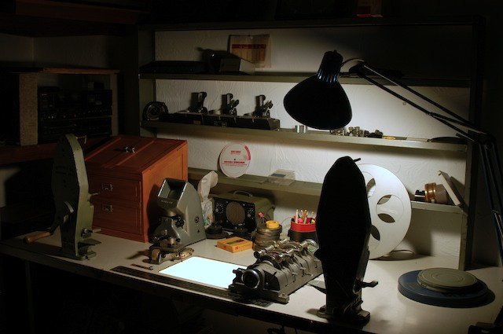
Film Best Practices
Keep the originals!
Find an experienced projectionist, otherwise don’t project
Photo:www.phinkproductions.com
Notes:
Some other practices to consider with film:
Even if you digitize, always keep the originals: digitize for access and store the originals.
Do not project the originals unless it is by an experienced projection archivist

Slide 18
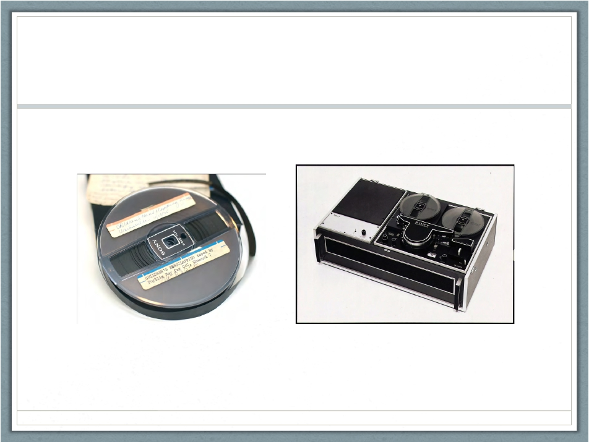

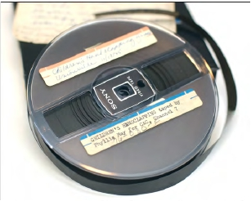
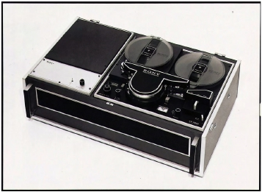
½ inch Open Reel Video
Photo: Sony.net
Photo: Indiana University - Bloomington
Notes:
1/2" open reel 1965

Slide 19
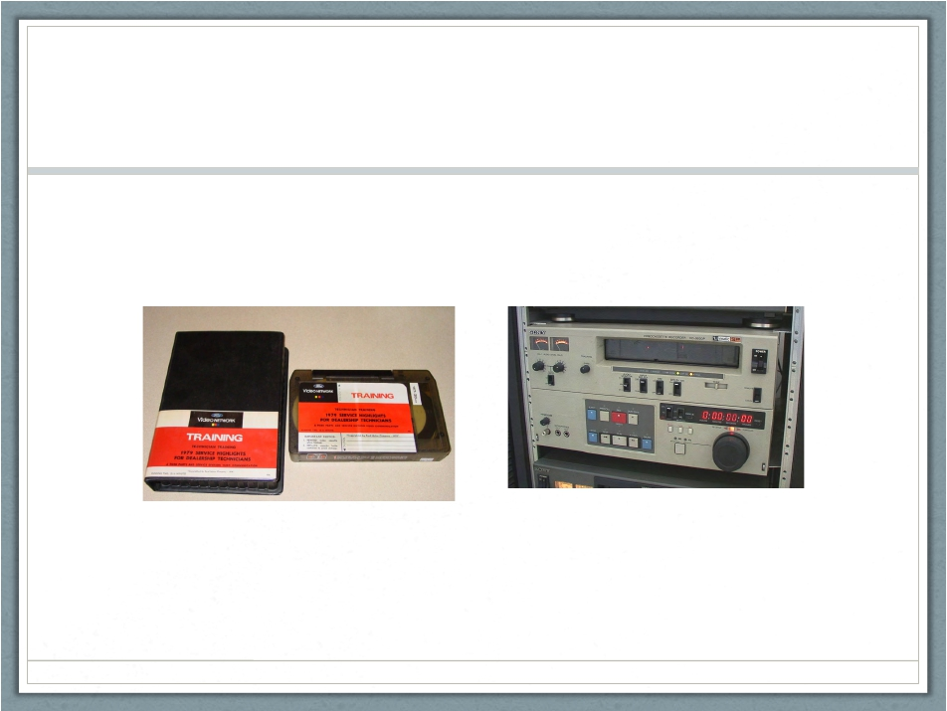

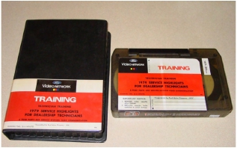
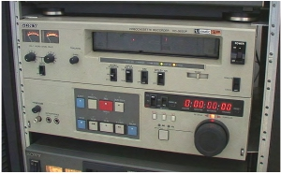
¾ inch U-Matic (SP)
Photos: Preservingvideo.blogspot.com
Photo: Ebay
Notes:
Maybe Umatic: 1971

Slide 20
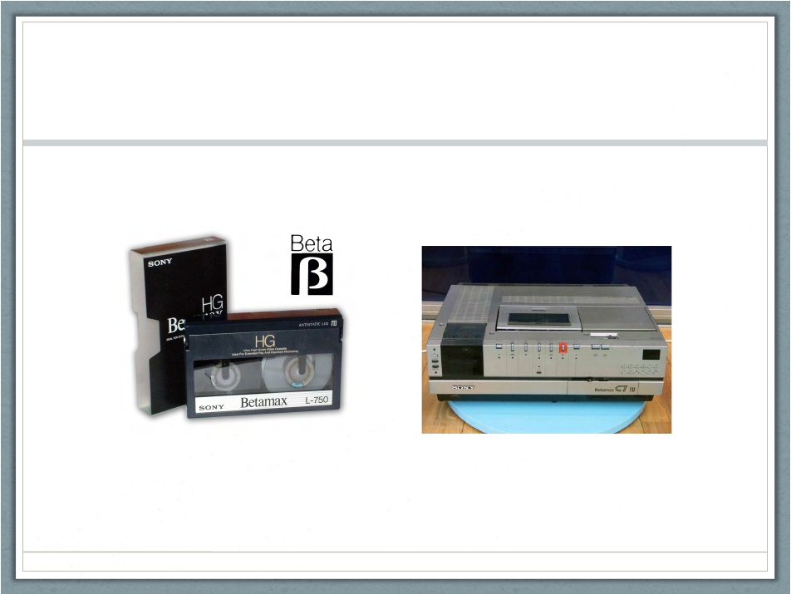

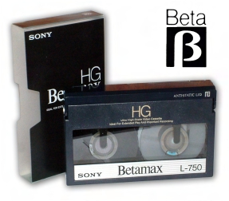
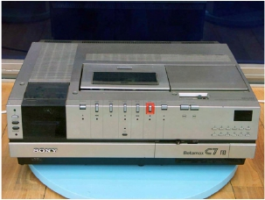
Betamax
Photo: Simplydv.biz
Photo: Ibenimagaes.com
Notes:
Betamax 1975

Slide 21
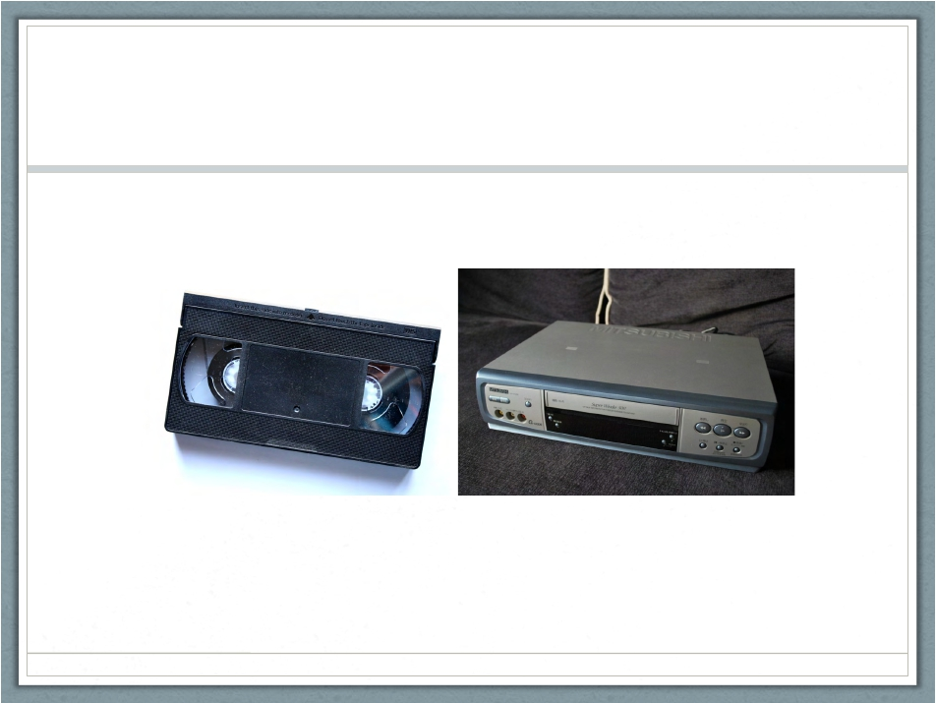

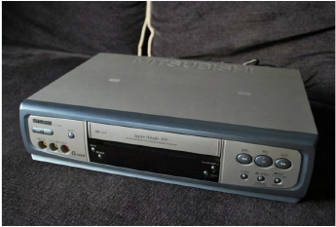
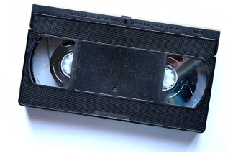
VHS
Photo: Photos-public-domain.com
Photo: Themovethemove.wordpress.com
Notes:
VHS, VHS-C: 1976

Slide 22
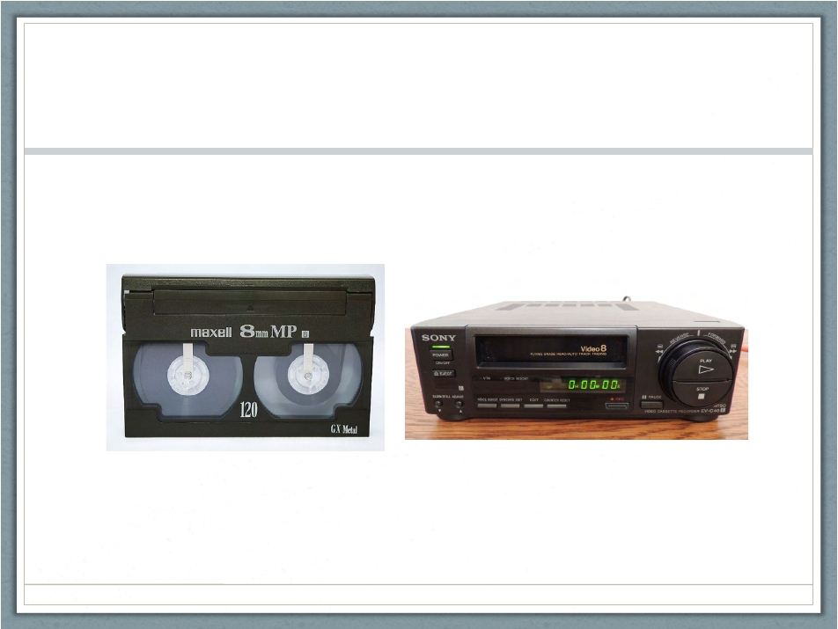

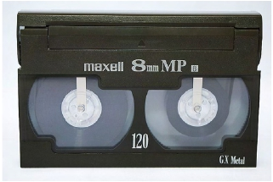
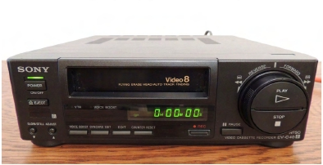
Video8
Photo: Wikipedia
Photo: Ebay
Notes:
8mm video family 1984

Slide 23
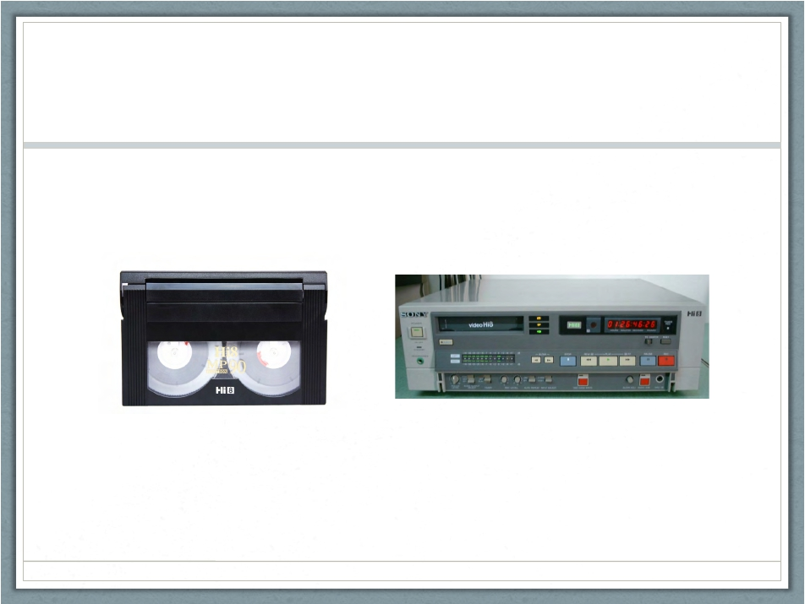

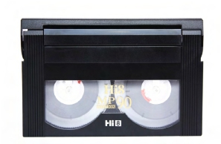
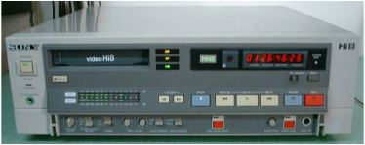
Hi8
Photo: Amazon.com
Photo: Ebay
Notes:
8mm video family 1984

Slide 24
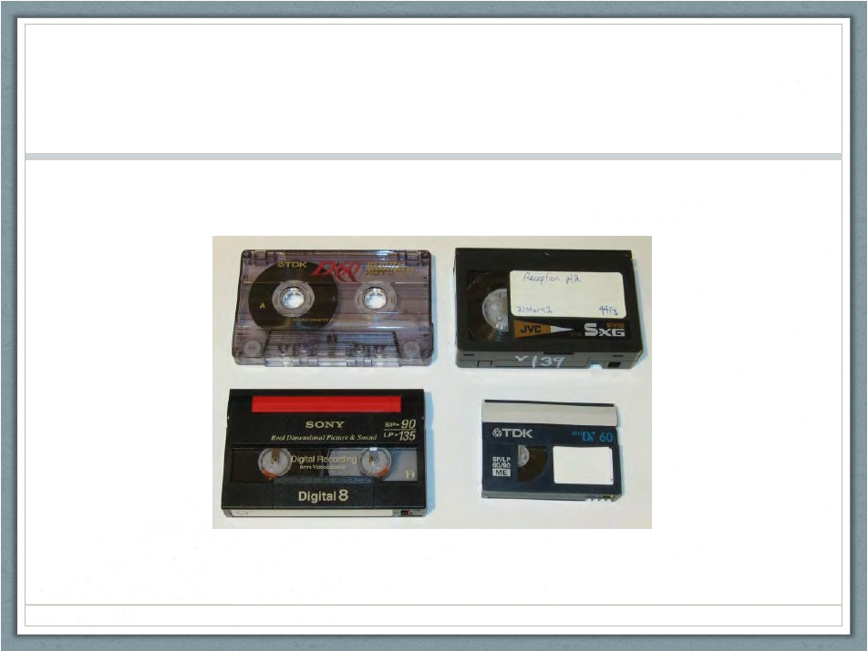

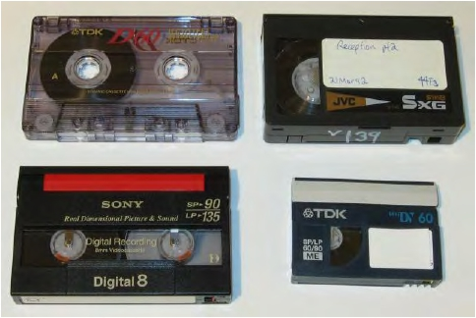
Digital8
Photo: Cameratim.com
Notes:
1990s

Slide 25
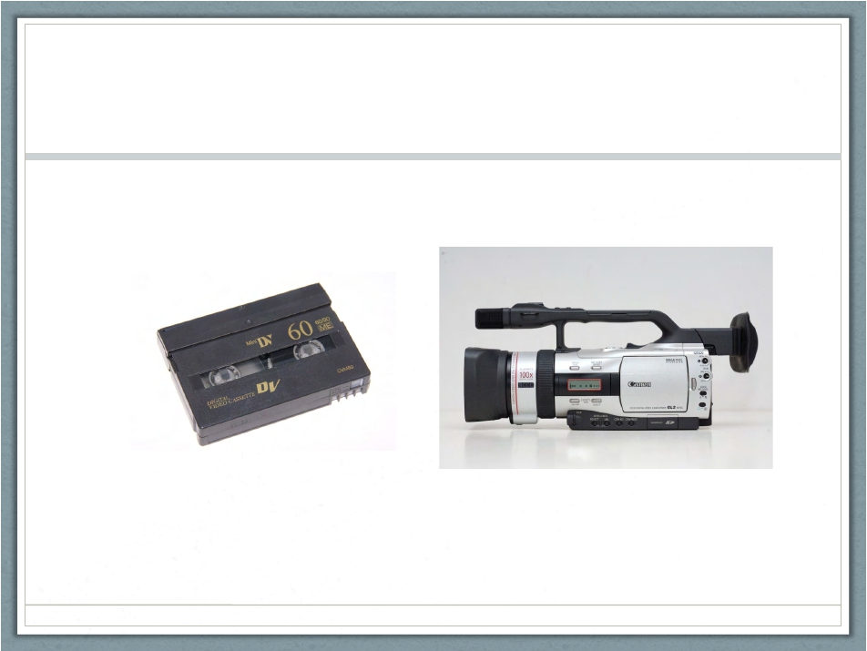
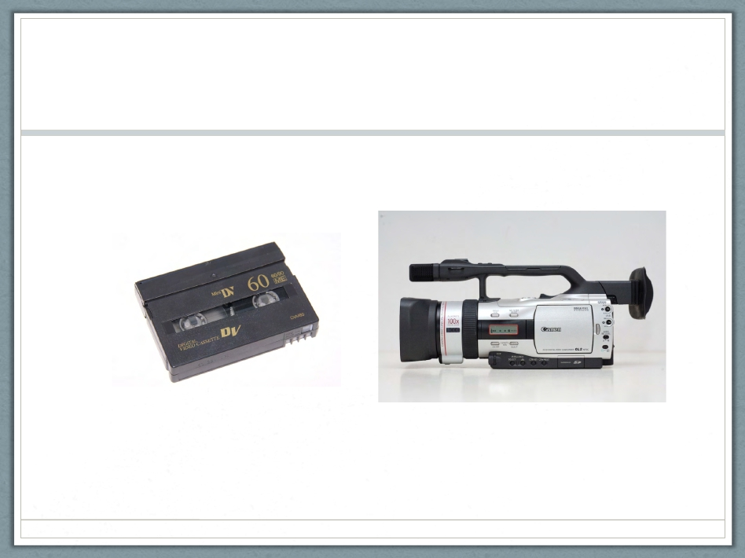
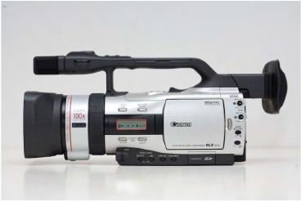
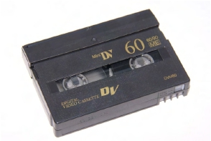
MiniDV
Photo: dvdyourmemories.com
Photo: Bladeforums.com
Notes:
MiniDV 1995

Slide 26
Poll # 3
Notes:
What types of video do you have in your collections?
list

Slide 27



Mold
Photo: Video Recovery & Restoration
Notes:
So video has many problems. Mold can be one of them.

Slide 28

Sticky Shed Syndrome
Photo: www.thegreatbear.net
Notes:
Sticky Shed can be one: binder hydolysis; water in the air changes the magnetic particles to become sticky and/or flakey dramatically seen above (most times much less obvious than that)

Slide 29

Video Best Practices
Digitize!
Problems=obsolescence + degradation (degralescence)
Digital Preservation!
Store Vertically for Video
Photo: www.governmentnews.com
Notes:
But the bigger ones are
To preserve video, you must digitize and then preserve the digital files, which we will talk more about later.
Video problems: obsolescence, degradation, longevity problems
How to store (but digitize them soon): vertically
As archivists we always recommend keeping the originals, but in a few years those tapes might not even be playable so use your judgement.

Slide 30

Born-Digital
Photo: www.shutterstock.com
Notes:
Born Digital
Mostly thinking about those cell phone videos! Not going to get into any depth here.
Make sure you take them off your cell phones: these are lower resolution so you can migrate them if they aren’t already a popular file like MOV and have two versions.

Slide 31
Poll # 4
Notes:
POLL: wHow do you have born-digital video?
Cell phones
Consumer camcorder
DSLR
Other
I do not have any born-digital videos in my collection

Slide 32
Further Thoughts
Labels
Write down what the labels say!
Video accompaniments
Video or audio oral histories of subjects
Notes:
Metadata
Always remember to write or type down what the labels say on the original physical objects (perhaps in a text document or spreadsheet that you keep with the files on the external hard drive). You could also video or audio record family members watching the content with them verbally identifying people, places, events, dates, etc. and then preserve that as a separate file.

Slide 33
Further Resources
April 30 Preservation Week Webinar
“Digital Preservation for Individuals and Small Groups”
Personal Digital Archiving
http://digitalpreservation.gov/personalarchiving/
The Center for Home Movies
http://www.centerforhomemovies.org/
Notes:
Digital Preservation of your digitized or born-digital video files requires a lot, including having multiple copies in multiple geographic locations. LOCKSS: Lots of copies keeps stuff safe! Perhaps team up with family members: one house has a solid state external hard drive stored in their closet, one in Seattle, one in California, one in Maine. There are other aspects to digital preservation that are very important and I recommend that you attend another ALCTS webinar happening April 30 entitled, “Digital Preservation for Individuals and Small Groups”.
Further resources: Personal Digital Archiving and the Center for Home Movies

Slide 34
Thank you!
Siobhan C. Hagan
shagan@ubalt.edu
@AV_DiscoTech
Notes:
Thank you all for attending, and thank you to ALCTS and the sponsors of this webinar. Happy Preservation Week!

