Slide 1
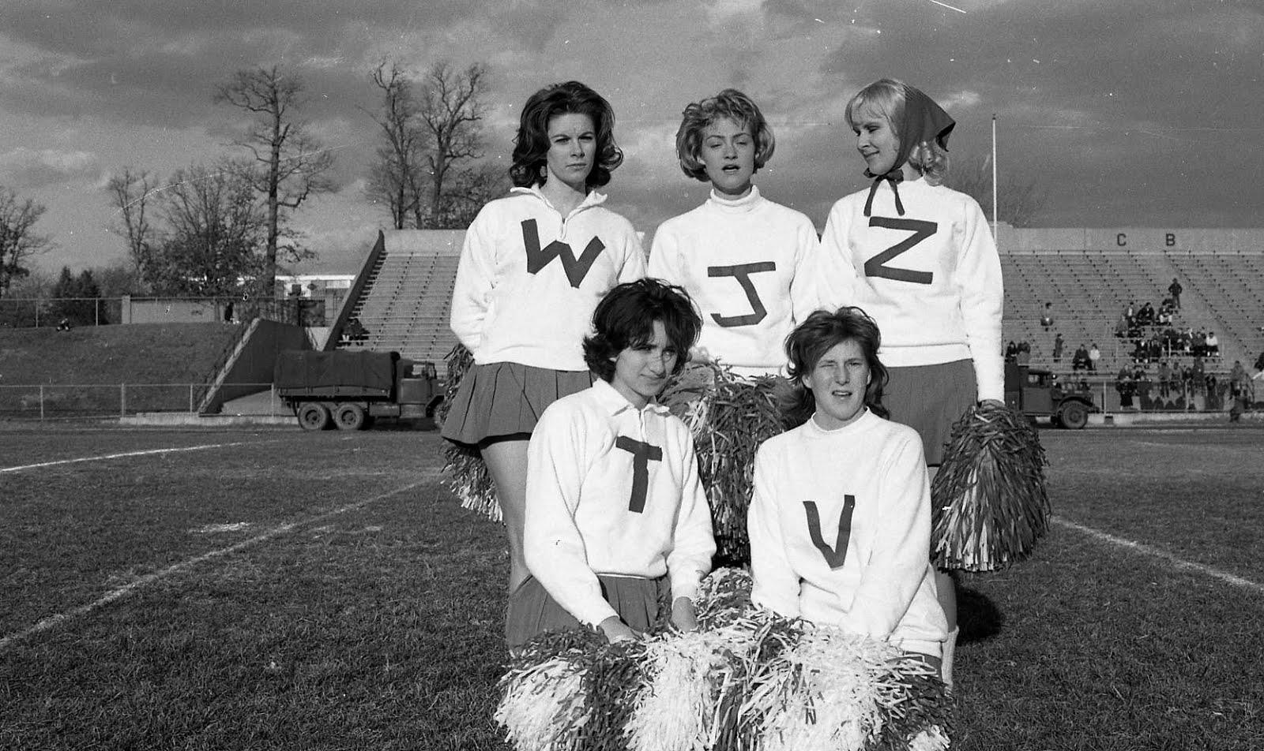
D-I-G-I-T-I-Z-E!
What does
that spell?
Siobhan Hagan
Audiovisual Archivist
#Ubalt Audiovisual Preservation Workflows in University Libraries
ACCESS?

Slide 2
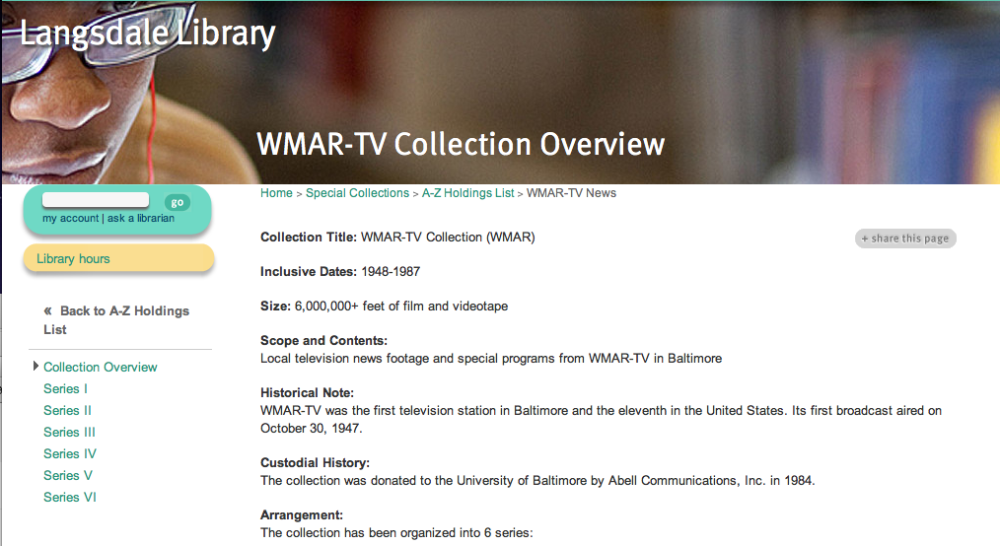
Notes:
4,000+reels of 16mm, 2” Quad, Umatics; the first TV station in Baltimore 1948-1980s; donated in 1983

Slide 3
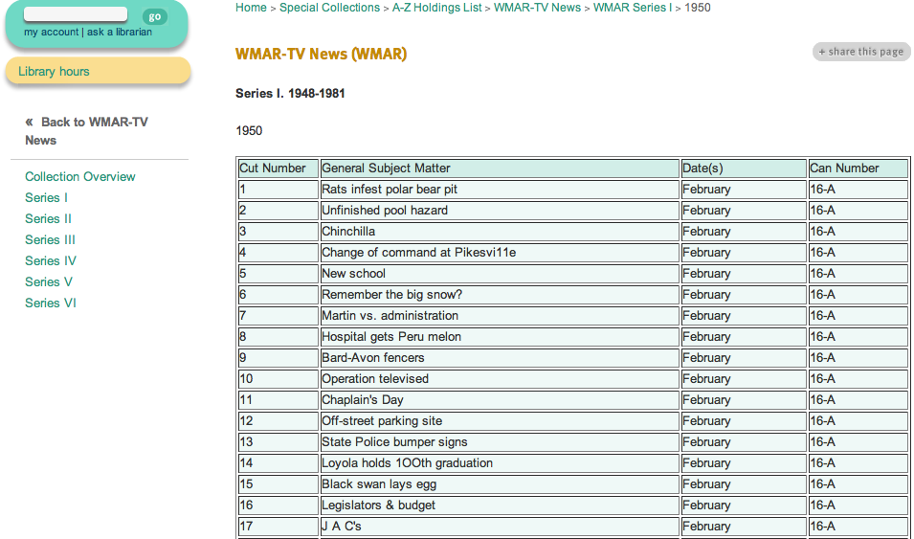

Slide 4
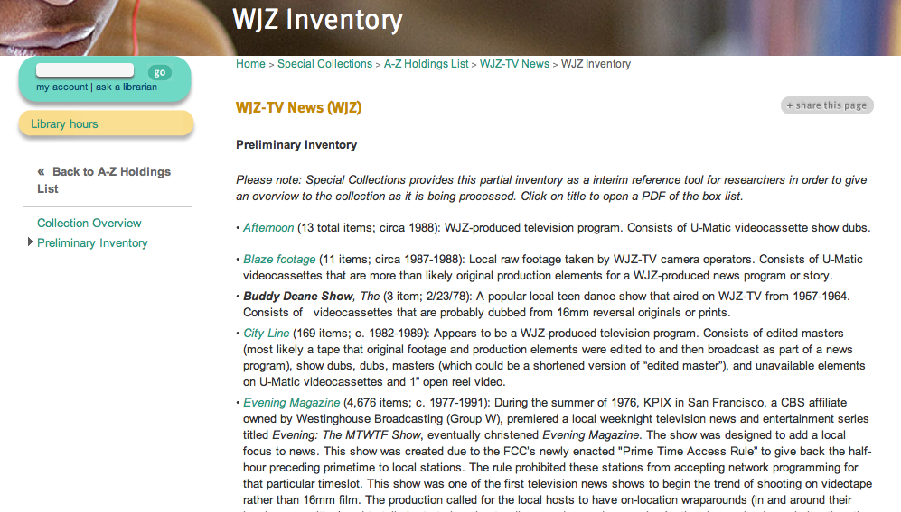
Notes:
20,000+ AV items: donated in 2007. Organized differently. c. 1960s-2000

Slide 5
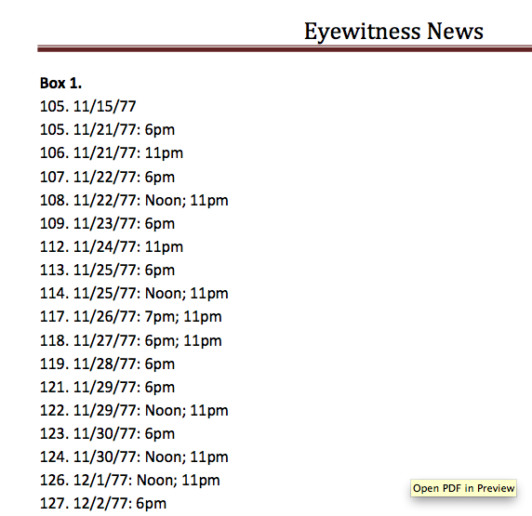

Slide 6
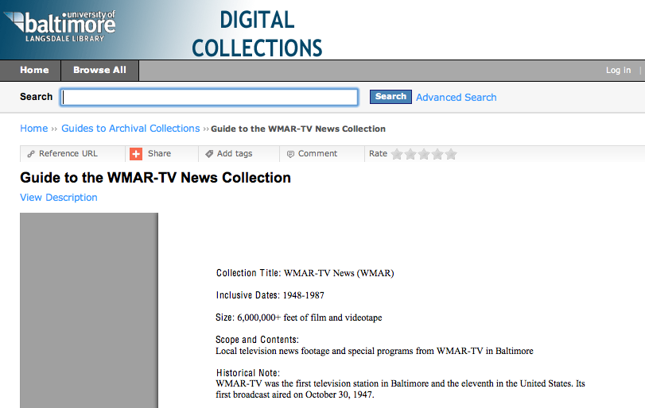
Notes:
ContentDM>PDF guides

Slide 7
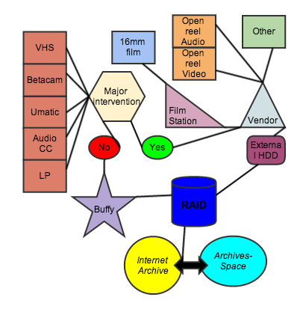
What Format Do You Have?

Slide 9
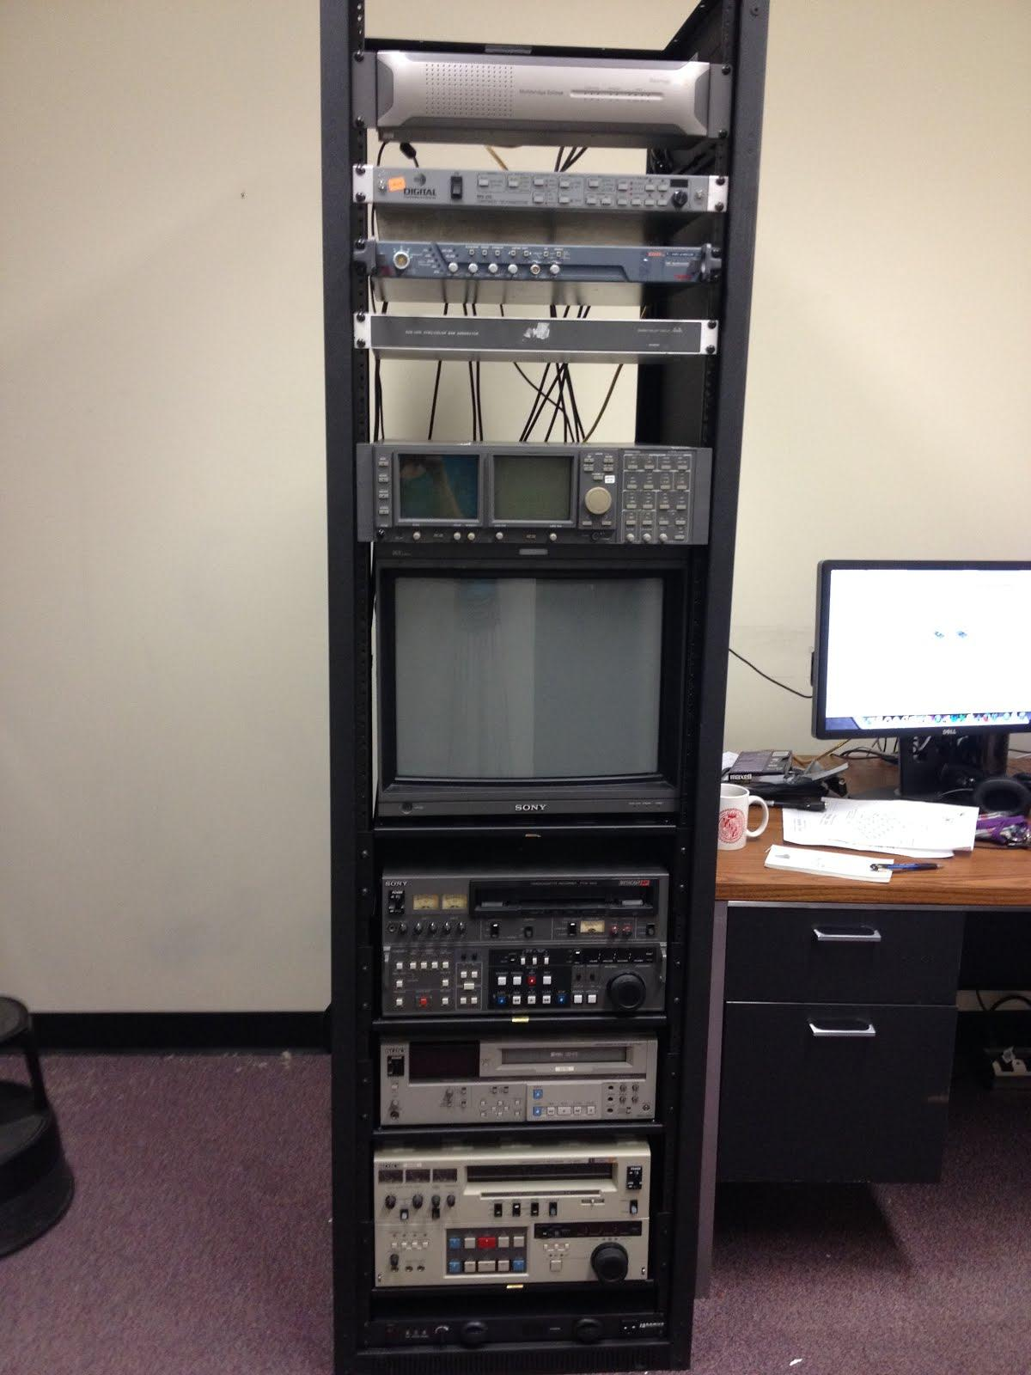
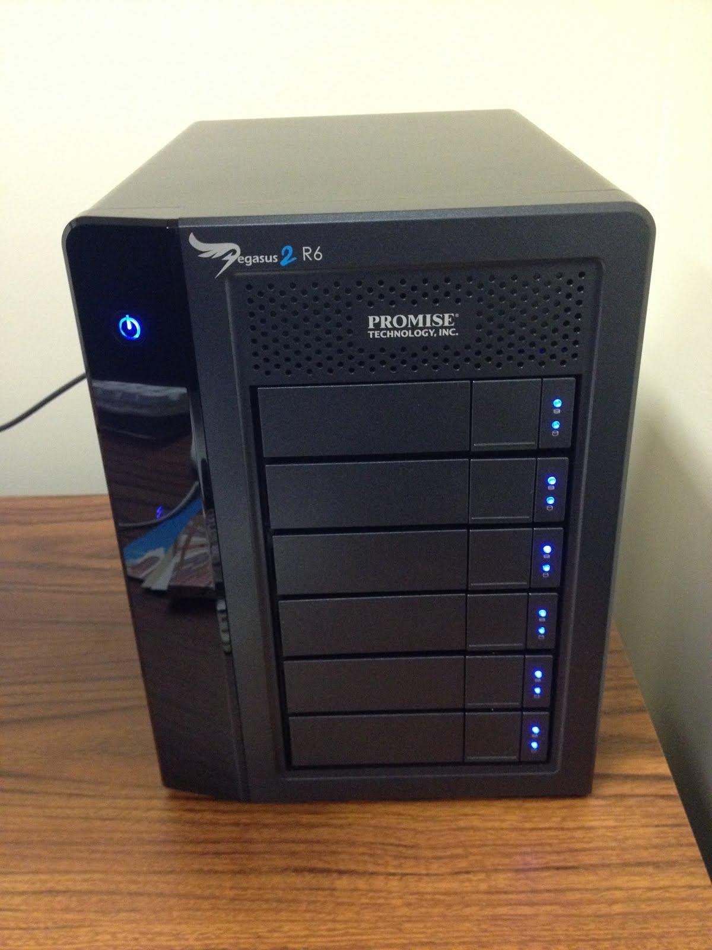

Slide 10
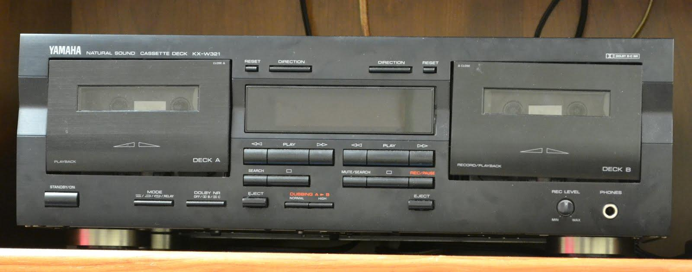
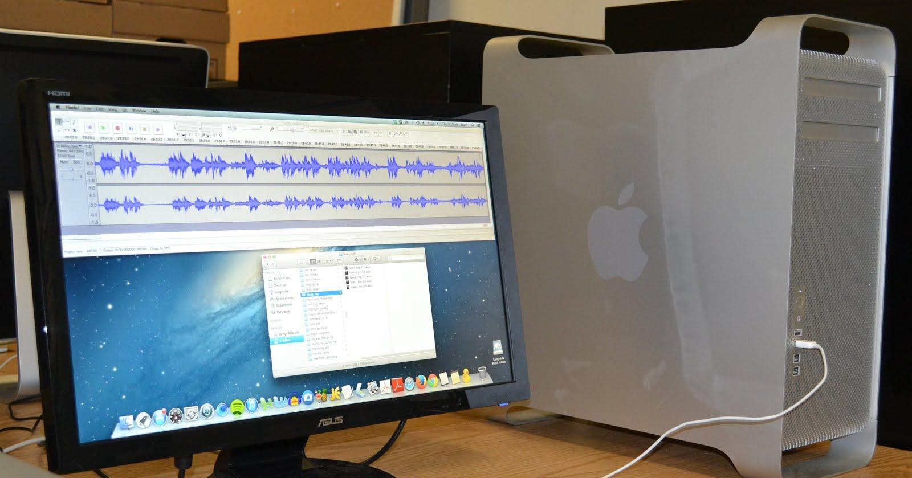
Notes:
Compact Cassettes+regular LPs

Slide 12
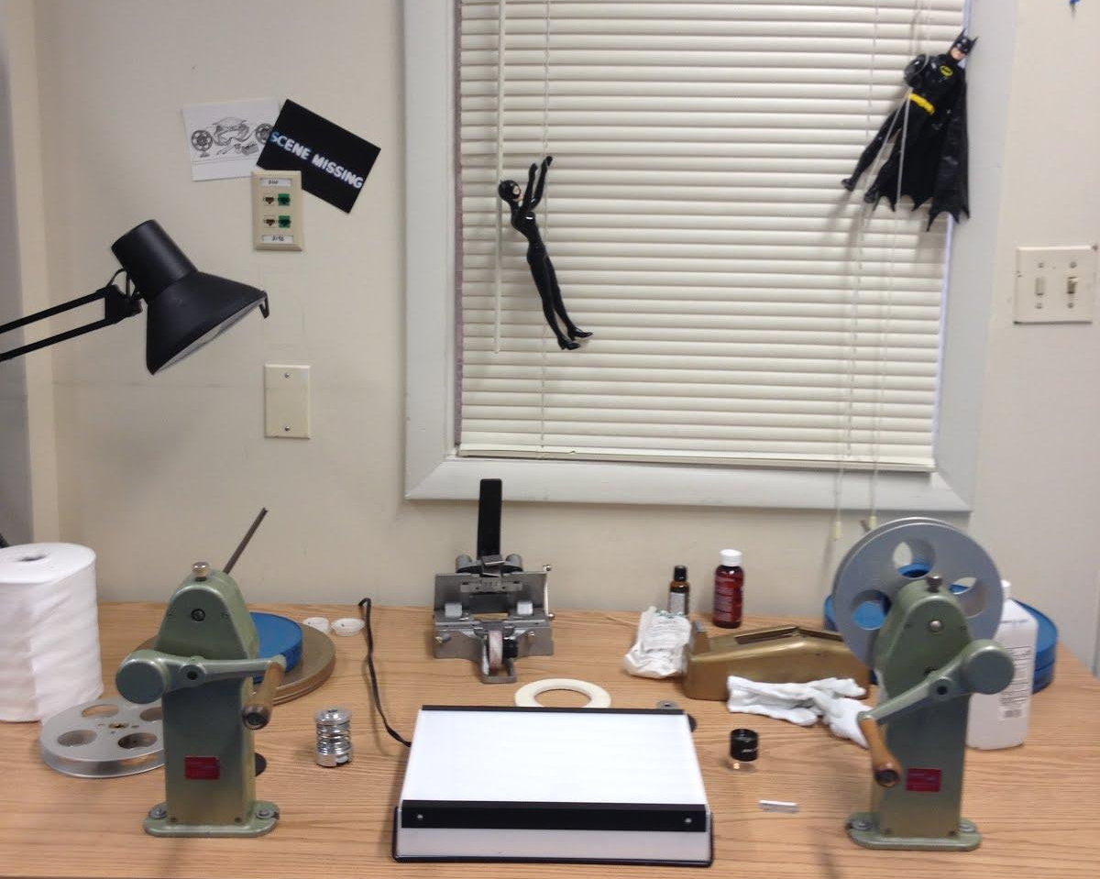

Slide 14
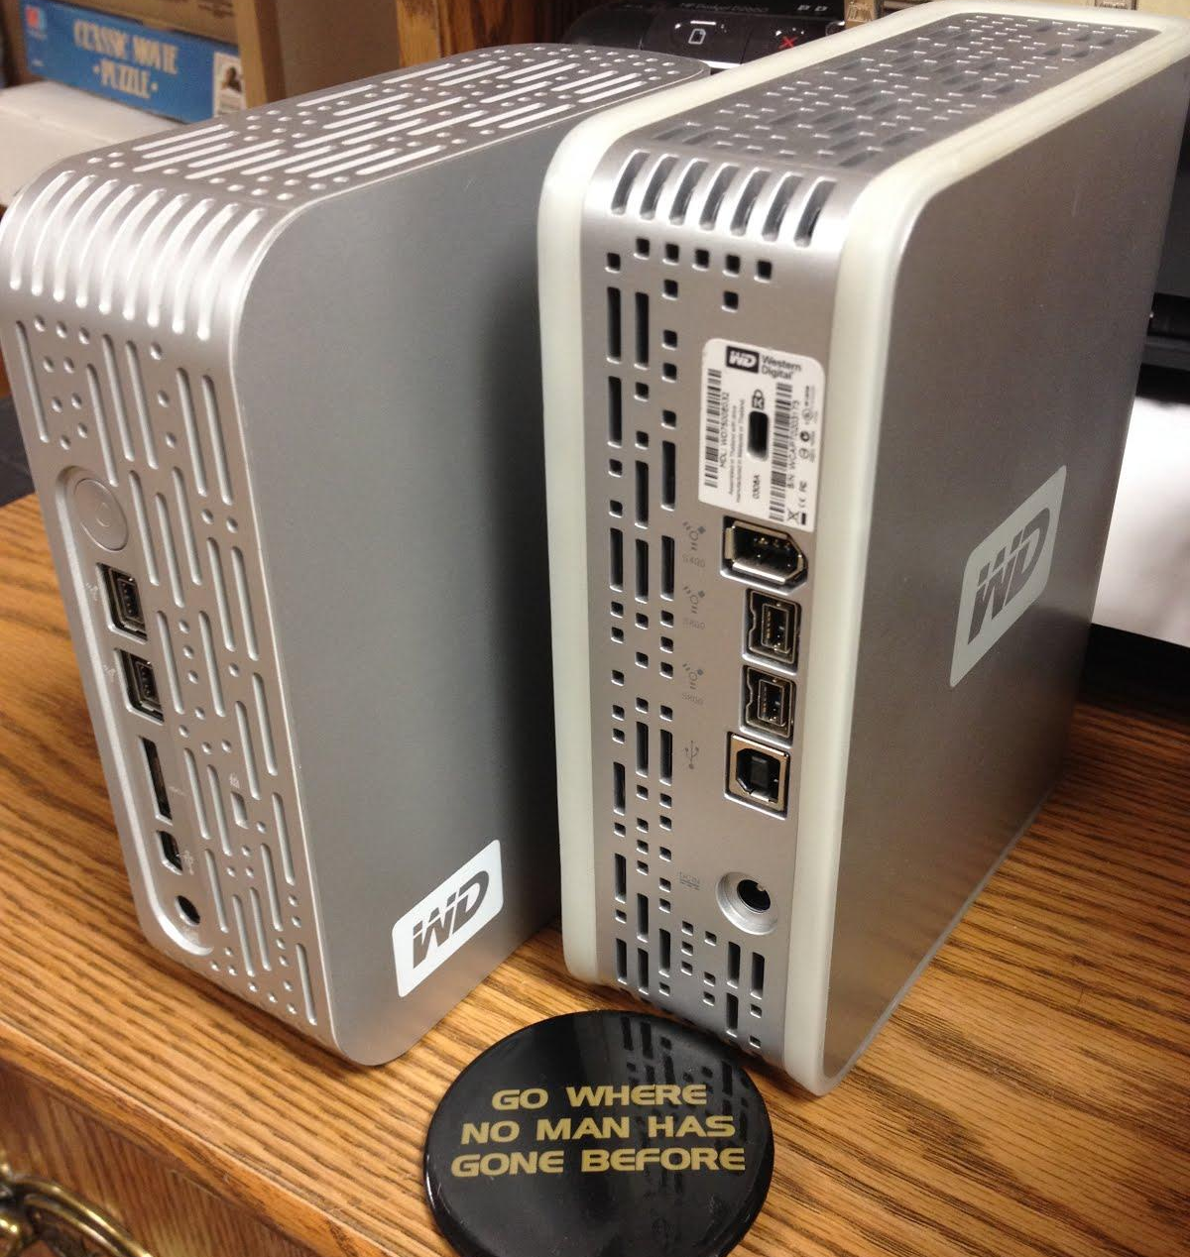
Vendor
Notes:
Vendor>external hard drive>RAID

Slide 16
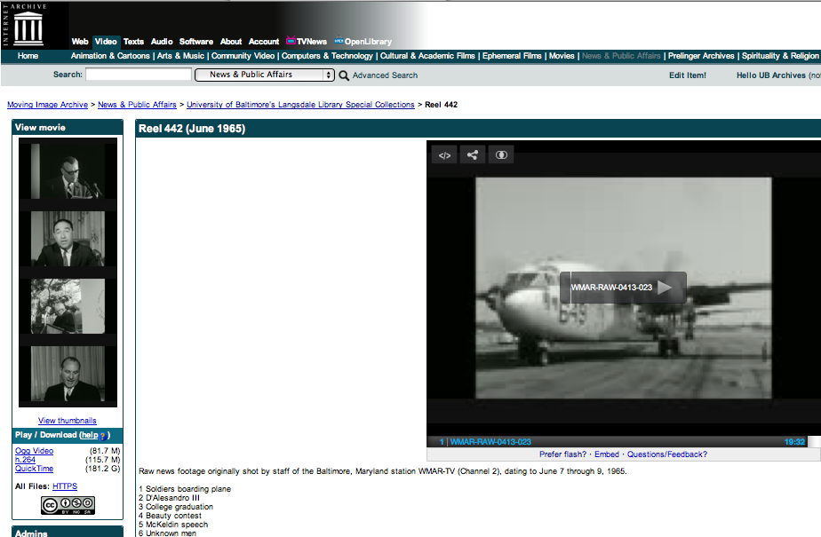
Notes:
RAID>Internet Archive

Slide 18
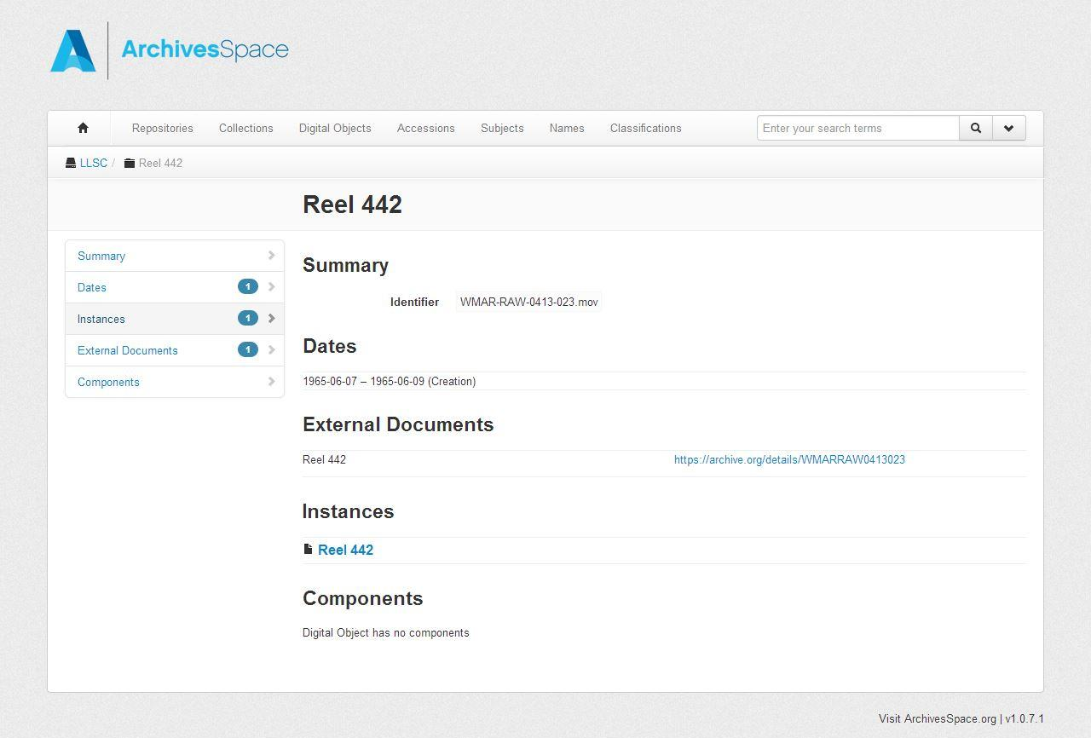
Notes:
Link Internet Archive to Archives Space; eventually phasing out inventories on website and CONTENTdm>ArchivesSpace only

Slide 19
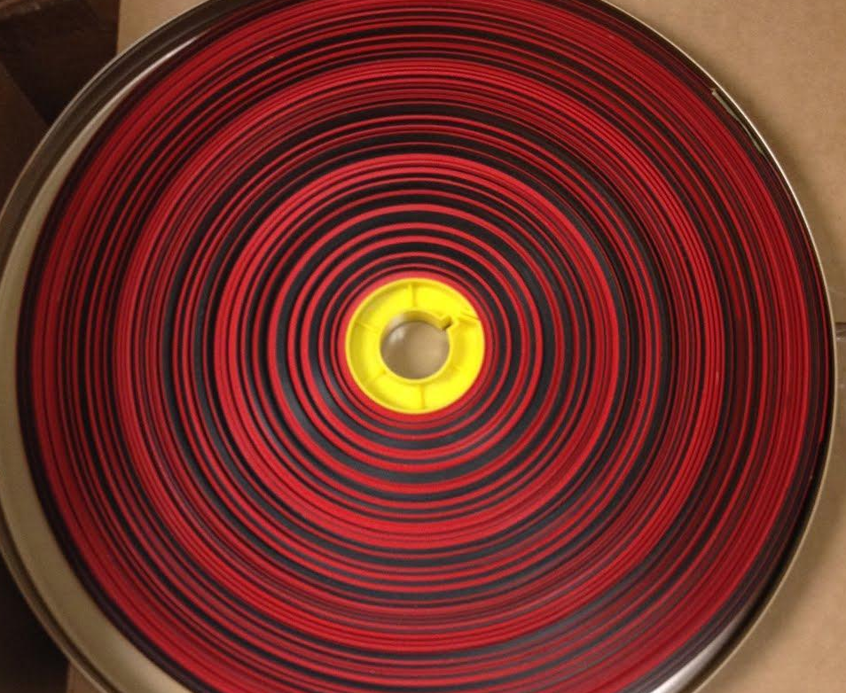
Thank you!
shagan@ubalt.edu
@AV_DiscoTech

