Slide 1
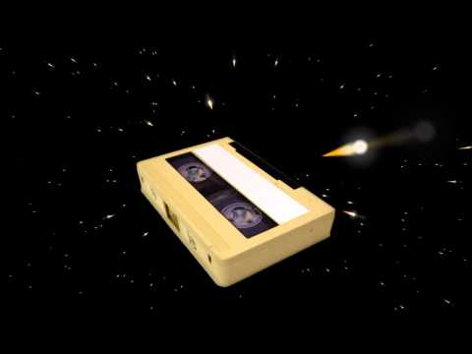
¾ inch: videotape U-matic
<<Siobhan Hagan << AV Archivist << U. of Baltimore, Langsdale Library <<October 9, 2015>>
Notes:
Photo from i.ytimg.com

Slide 2
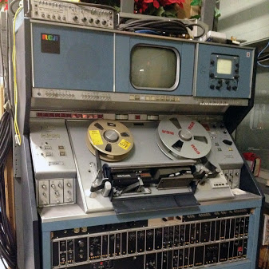
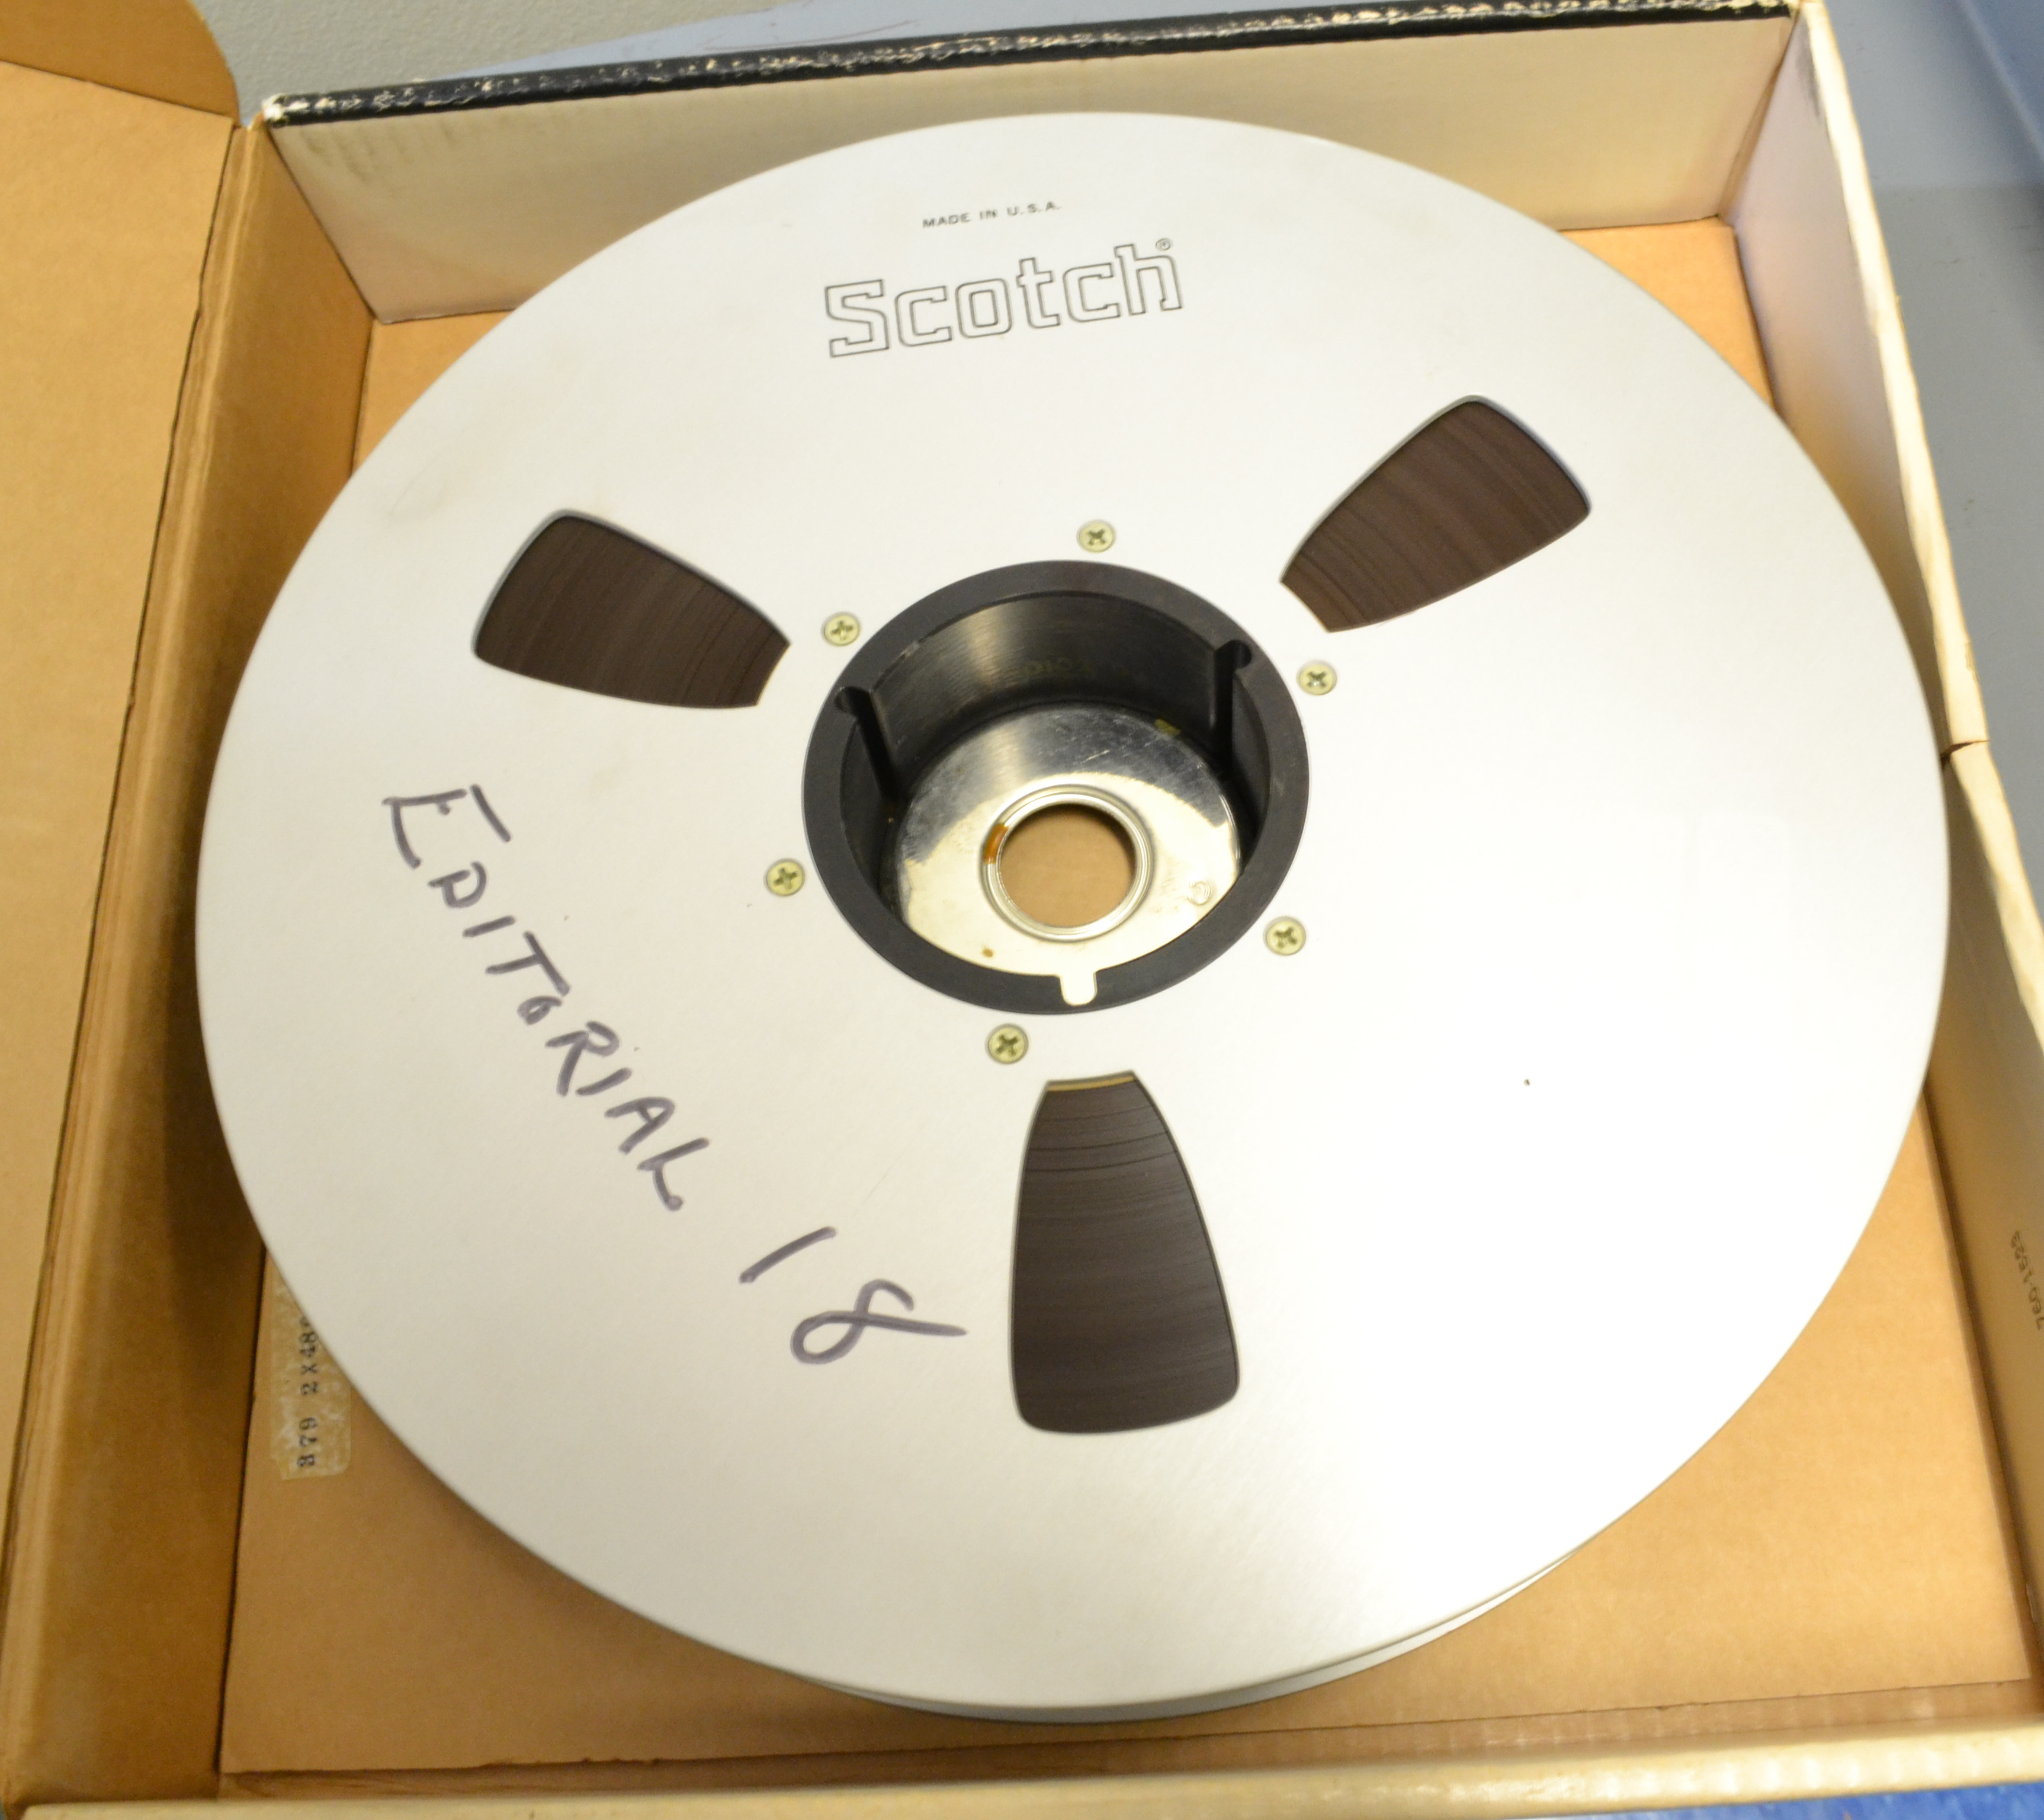

Open reel video: 1956-
Vermont PBS

Slide 3
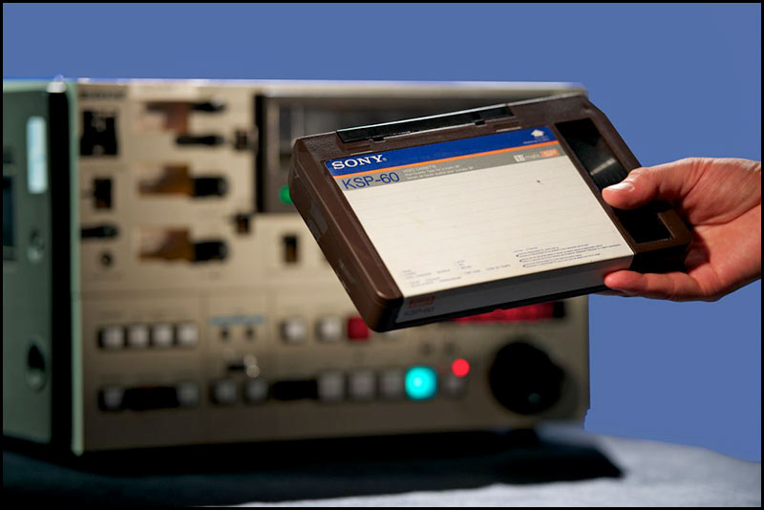
1971!
hdwarrior.co.uk

Slide 4
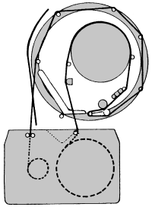
Tape Path
umatic.palsite.com
Notes:
Need link for photo

Slide 5
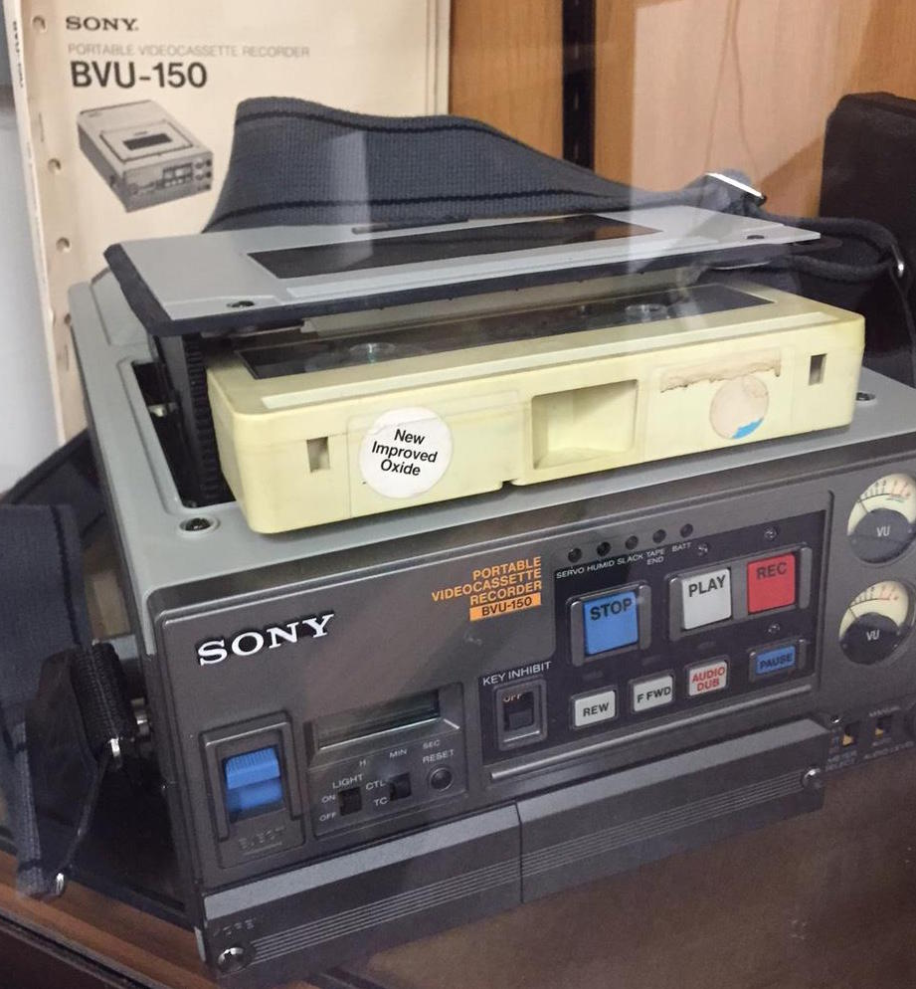
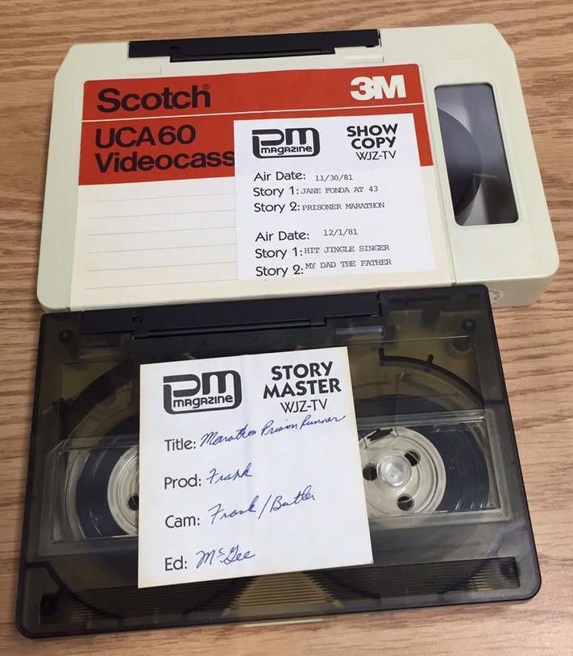
Cassette Sizes

Slide 6
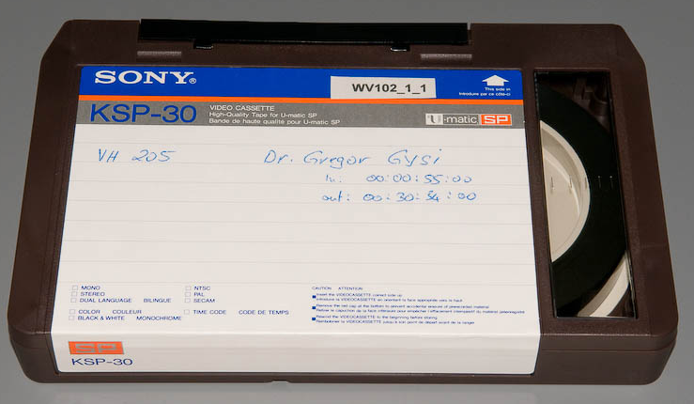
SP
http://krg.htw-berlin.de/
Notes:
Need link for photo

Slide 7
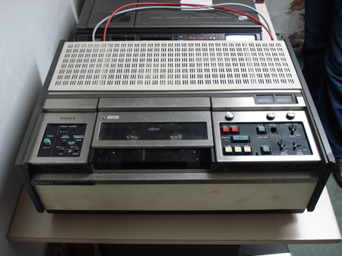
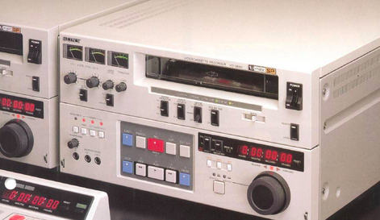
Playback Machines
Scart.be.com

Slide 8
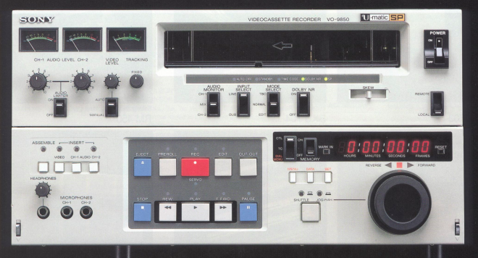
Playback Machines

Slide 9
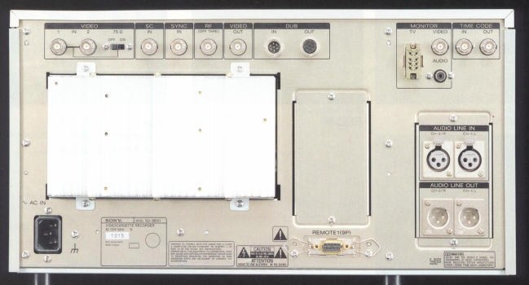
Input/Output
Goldpt.com

Slide 10
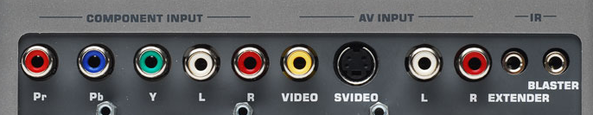
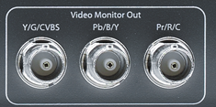
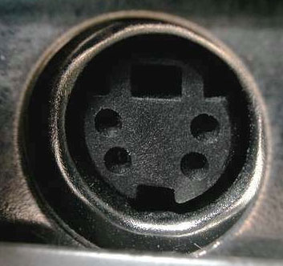
Input/Output
Gefen.com
aja.com
blog.outletpc.com
Notes:
S-video, composite and component video illustrations

Slide 11
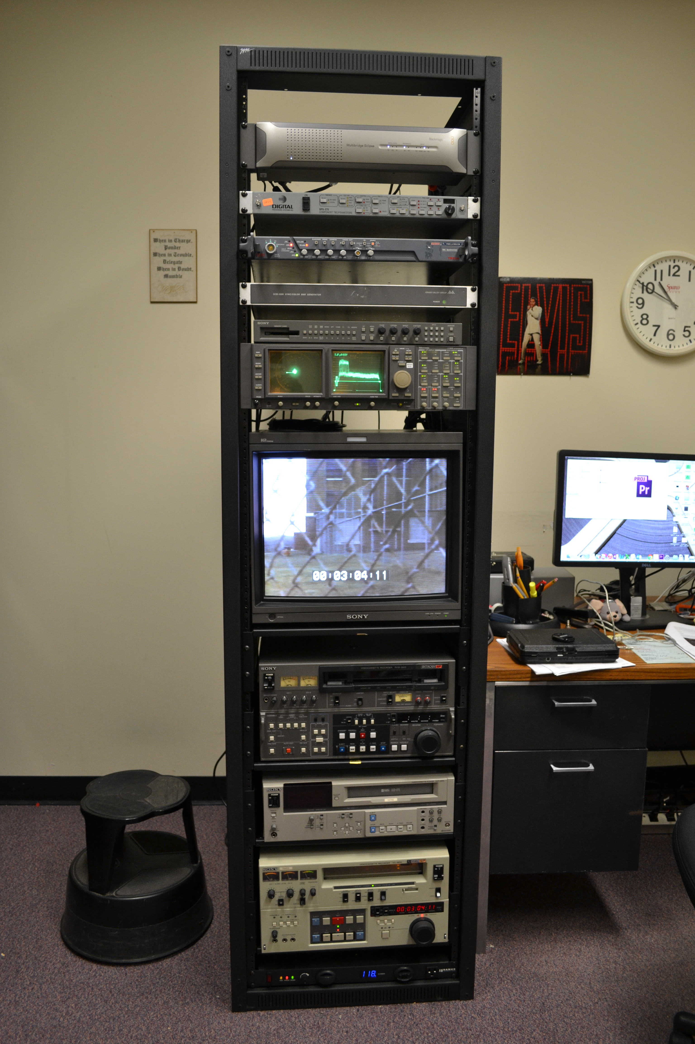
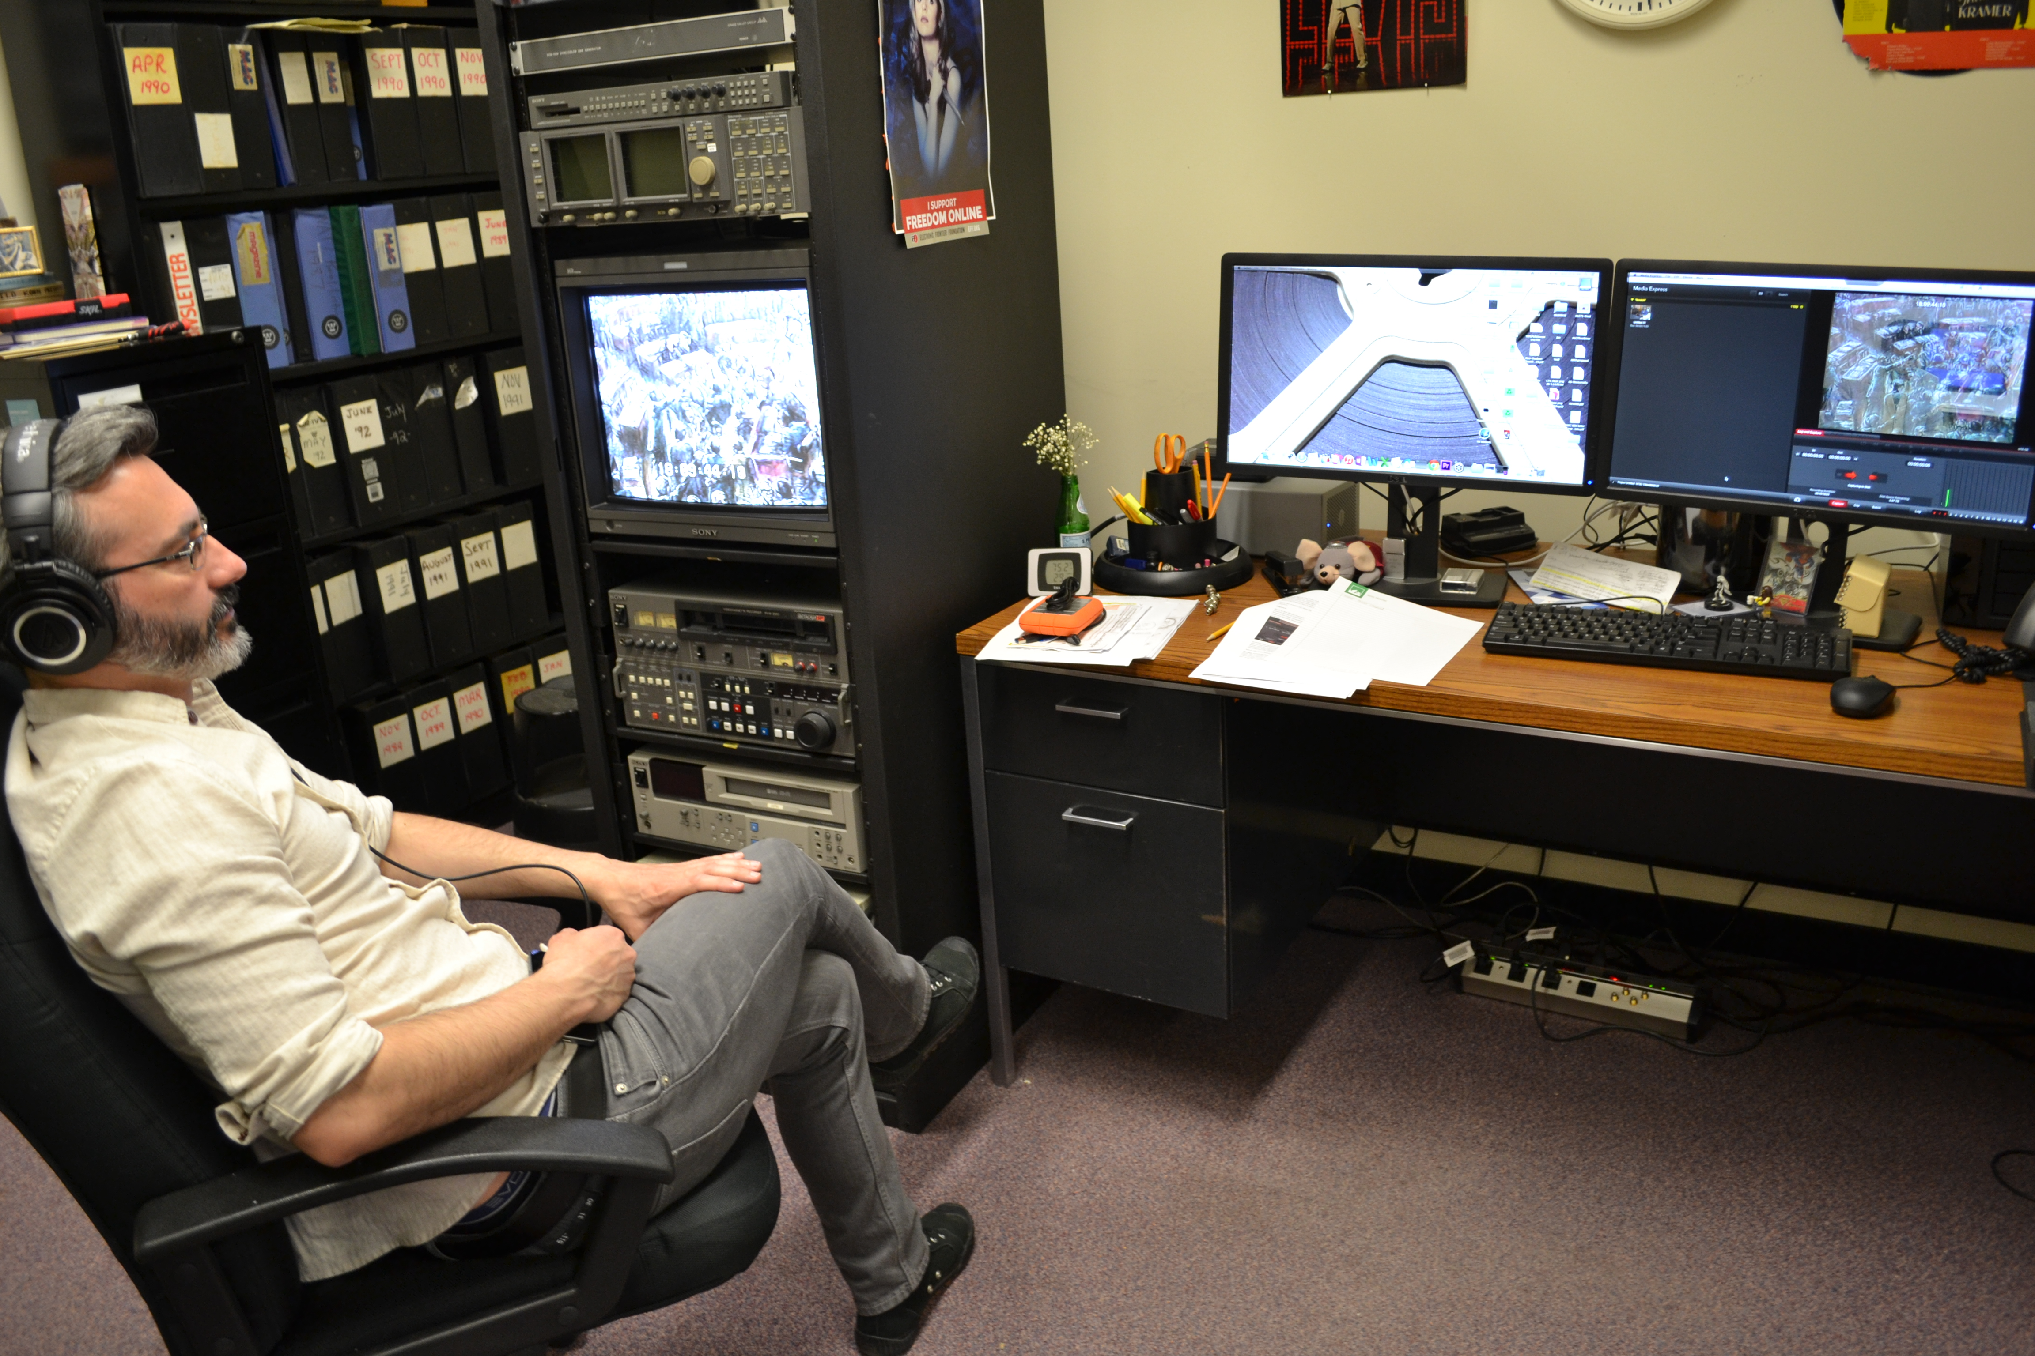
Digitization

Slide 12
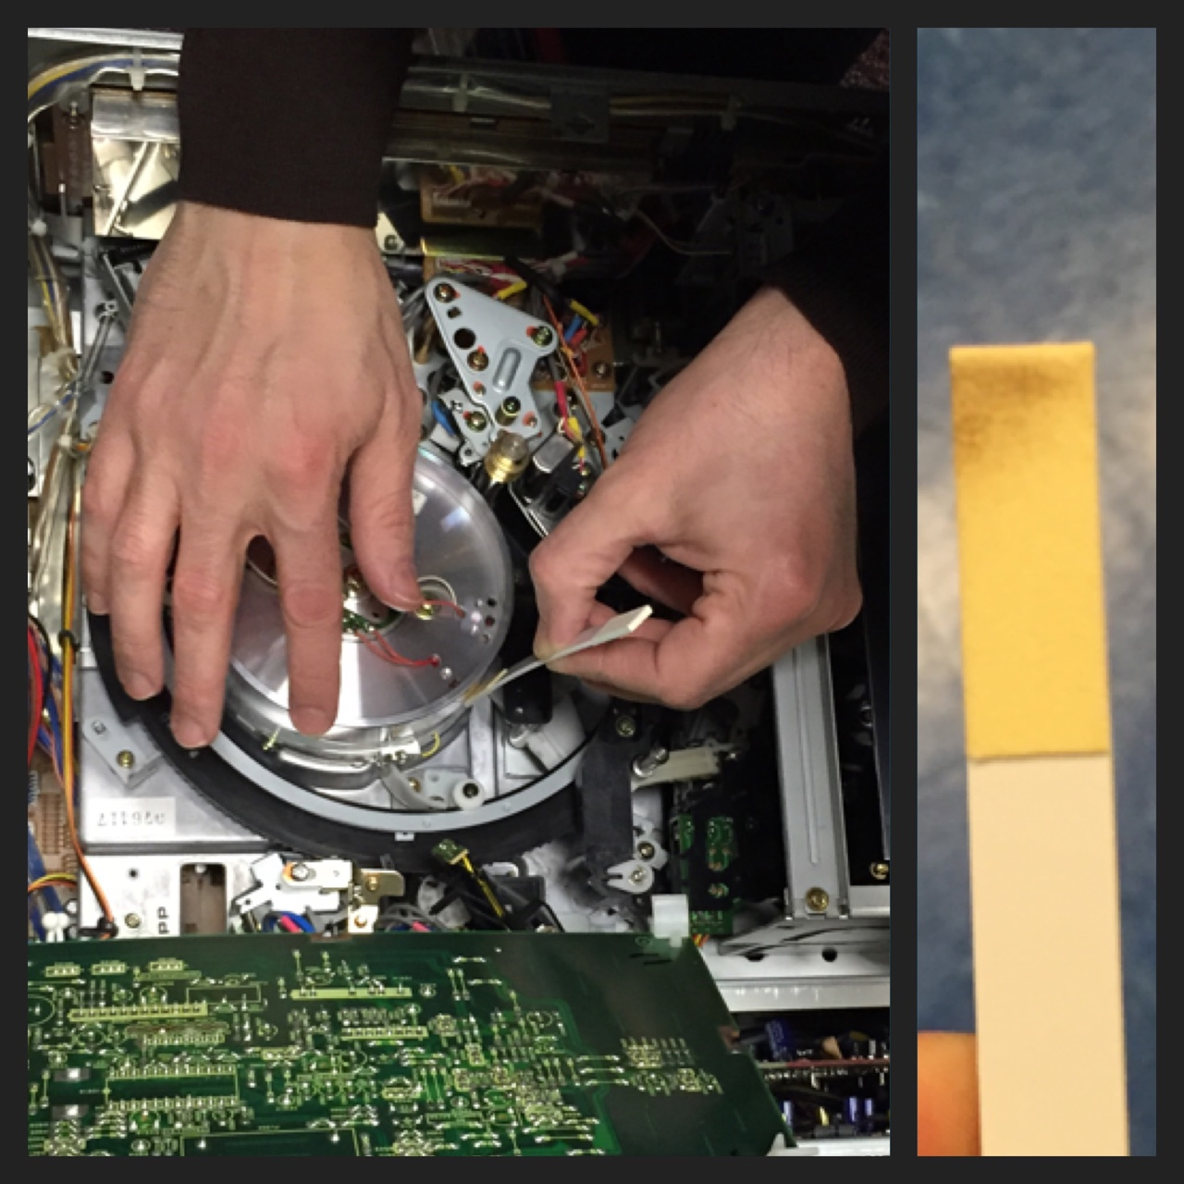
Care and Maintenance

Slide 13
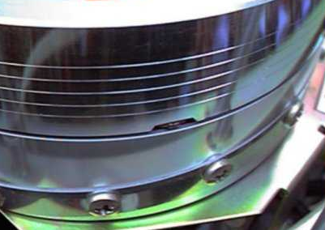
Playback Heads
labguysworld.com

Slide 14
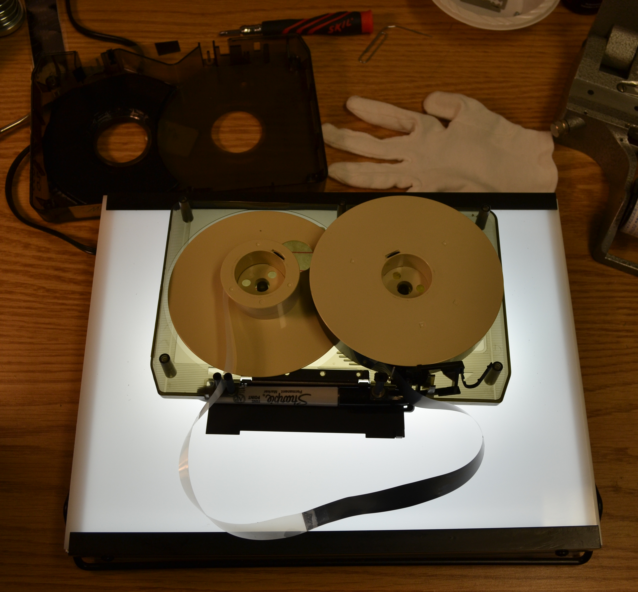
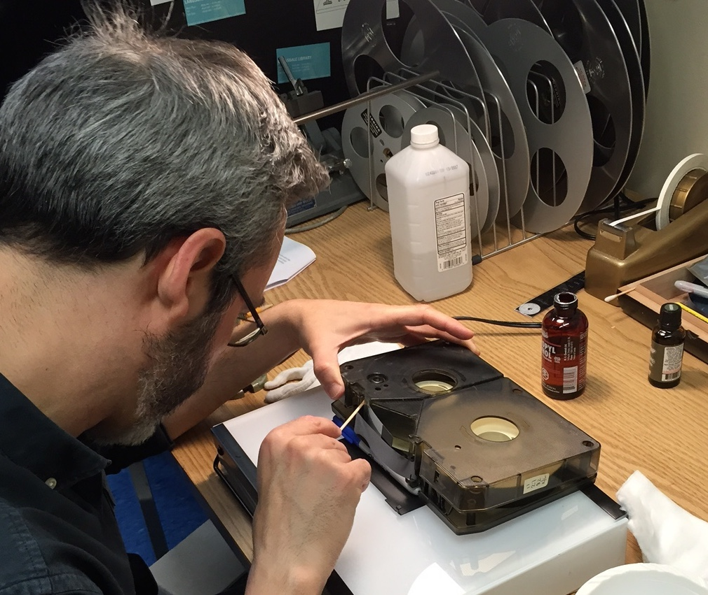
Issue & Solution:
Leader tape breakage & Surgery

Slide 15
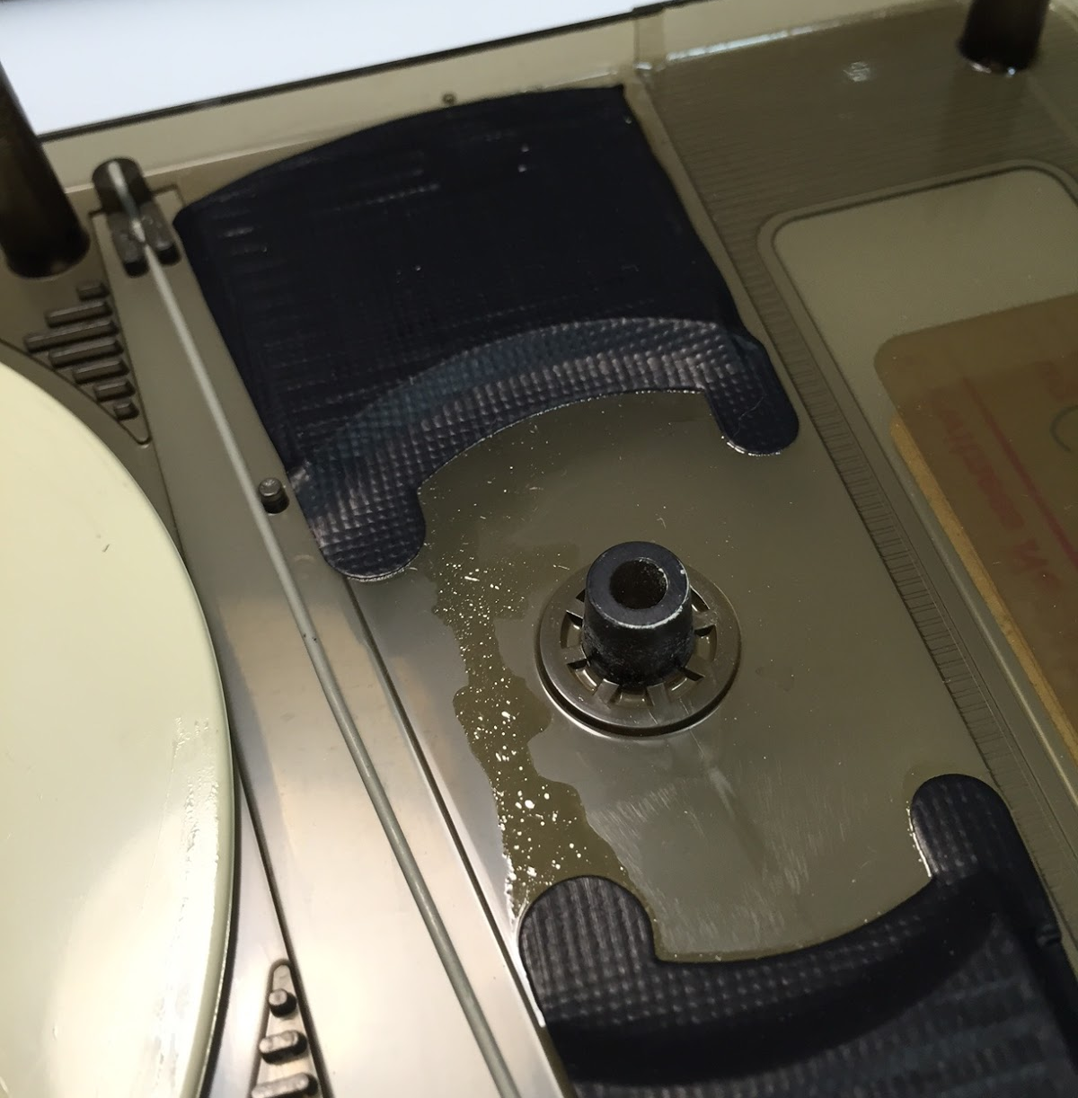
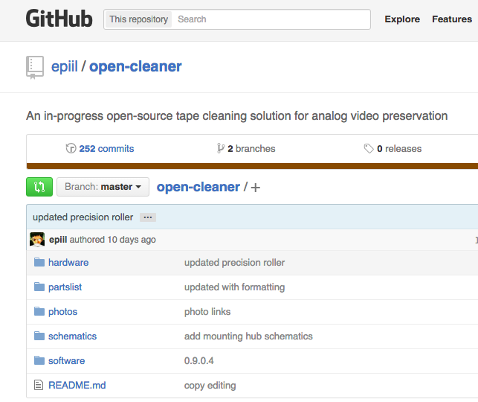
Issue & Solution:
Glue Seeping & Cleaning
github.com/epiil/open-cleaner
Notes:
Need photo from Langsdale and of Erik’s cleaner

Slide 16
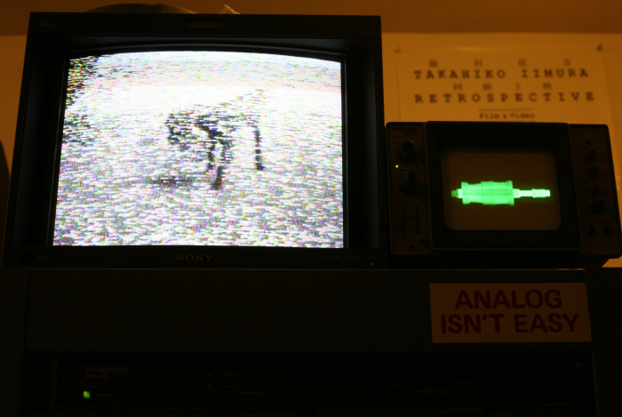
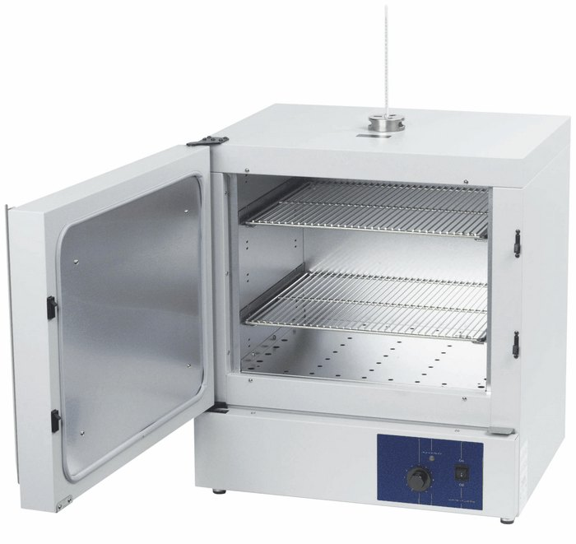
Issue and Solution:
Sticky Shed Syndrome & Baking
http://erikpiil.com/
coleparmer.com
Notes:
Need photo of convection oven lab grade

Slide 17
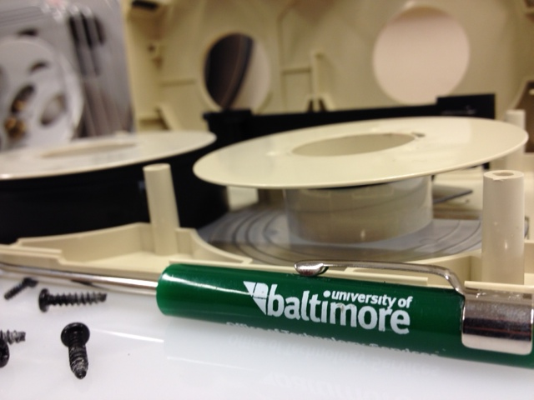
Thank you!
shagan@ubalt.edu
@AV_DiscoTech
Notes:
Thank you!

