Slide 1
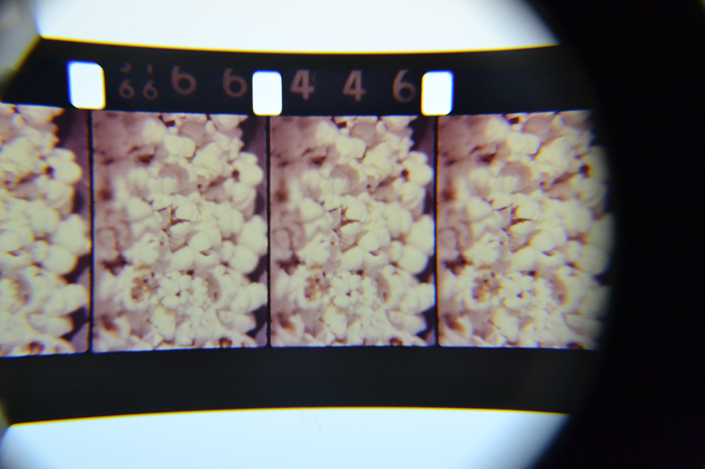
CUE
CHARM CITY!
Siobhan Hagan, University of Baltimore
James Stimpert, Johns Hopkins University
Joe Tropea, Maryland Historical Society
Notes:
Welcome and thank you for coming to our session, “Cue Charm City”. Our speakers today will be sharing different types of audiovisual materials found in various Baltimore City Special Collections: myself, Siobhan Hagan, from the University of Baltimore Langsdale Library, James Stimpert of the Sheridan Libraries at Johns Hopkins, and Joe Tropea from the H. Furlong Baldwin Library at the Maryland Historical Society. Hopefully you can learn from our successes and our failures to apply to your archive, or at the very least enjoy some fantastic regional movies!

Slide 2
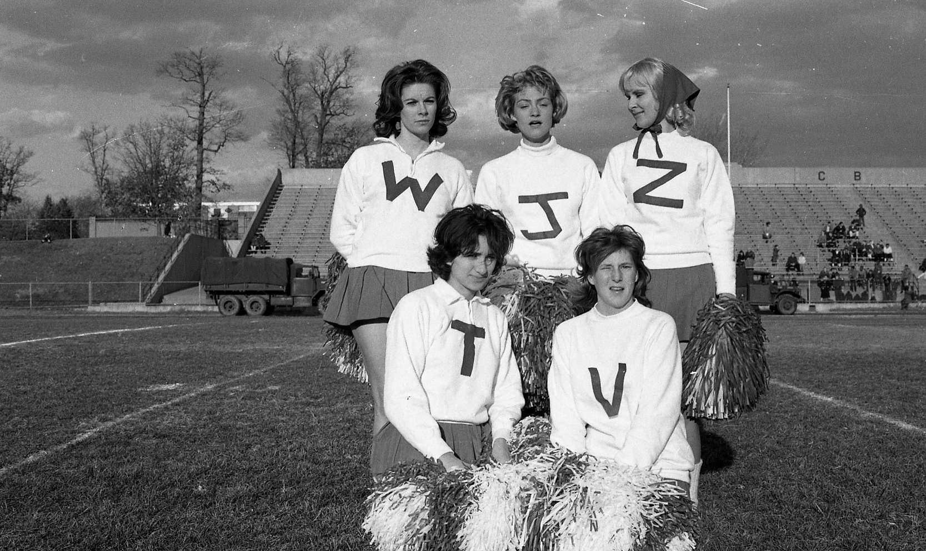
WJZ-TV+
WMAR-TV
Collections
@UBalt
Notes:
I started in January of this year as the first Audiovisual Archivist at the University of Baltimore’s Langsdale Library Special Collections Department. The University of Baltimore is one of twelve institutions in the University of Maryland System and is located in Baltimore City right next to Pennsylvania Station. The majority of our AV materials lies in the collections of two Baltimore-area television stations: WMAR-TV and WJZ-TV.

Slide 3
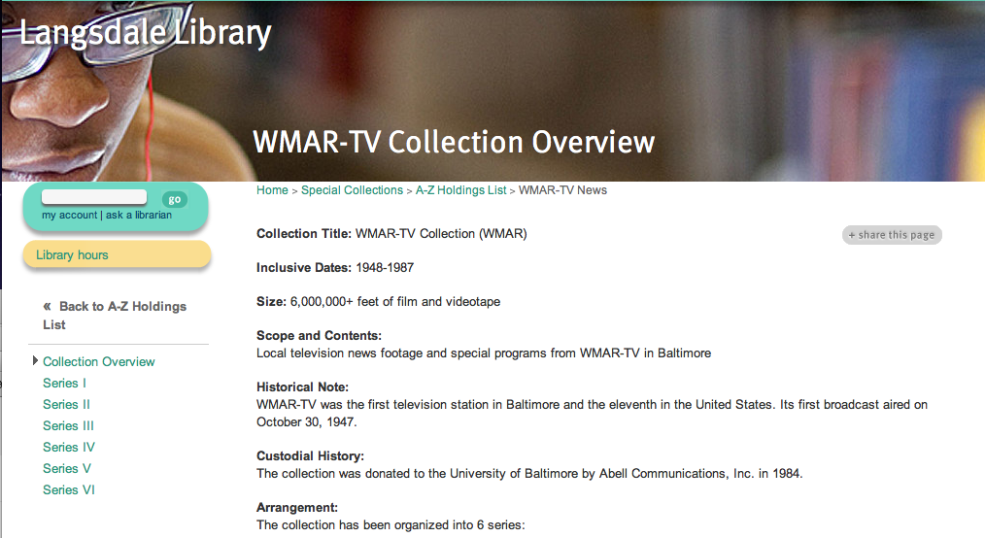
DISCOVERY: WMAR
Notes:
The WMAR-TV Collection was donated in 1983 to Ubalt, consists of 4,000+reels of 16mm, ~250 reels of 2” Quad, and a few hundred videocassettes on Umatic, VHS and Betacam formats. WMAR was the first TV station in Baltimore broadcasting in October of 1947. The WMAR-TV Collection at UBalt spans the time period of approximately 1948-the late 1980s.

Slide 4
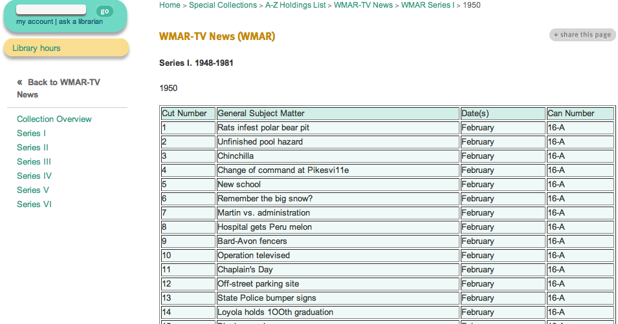
DISCOVERY: WMAR
Notes:
Google searchable description of reels in HTML tables which are no where near perfect: these are transcribed from old logbooks from the station: not everything is described; lots of “unknowns” or errors like “Pikesvi11e”; no standardized vocabulary. The best way to search is through specific places, events, dates and people: but make sure you try multiple types of spellings and knicknames!

Slide 5
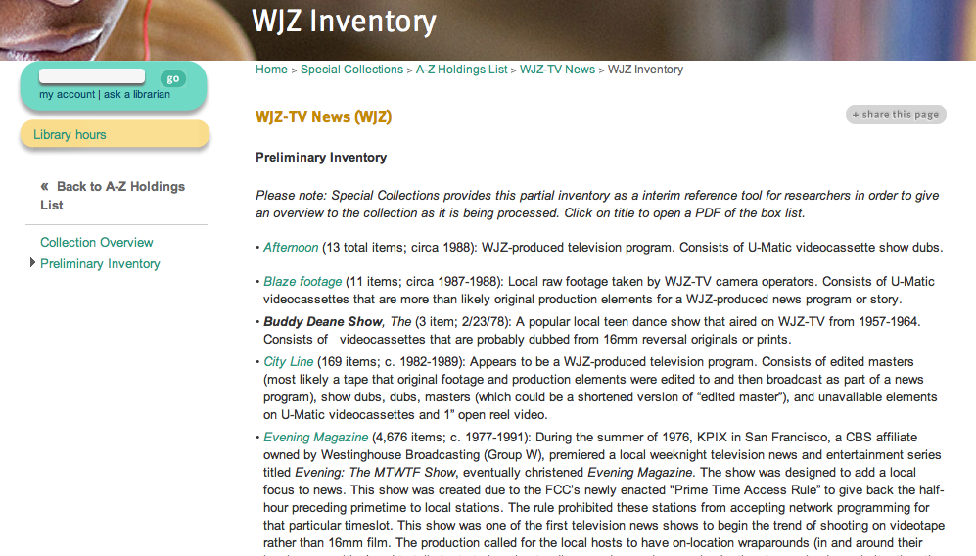
DISCOVERY: WJZ
Notes:
The WJZ-TV Collection consists of 20,000+ AV items (mostly Umatic and VHS) and was donated to UBalt in 2007. The station began operation in 1948 as “WAAM” and was Baltimore’s 3rd TV station. In 1957 the station was sold and the call sign changed to WJZ. The date of coverage of the collection at UB spans from the 1960s-2000. Discoverability is different than WMAR-TV as it is organized by series with PDF inventories whose tape labels are keyword searchable.

Slide 6
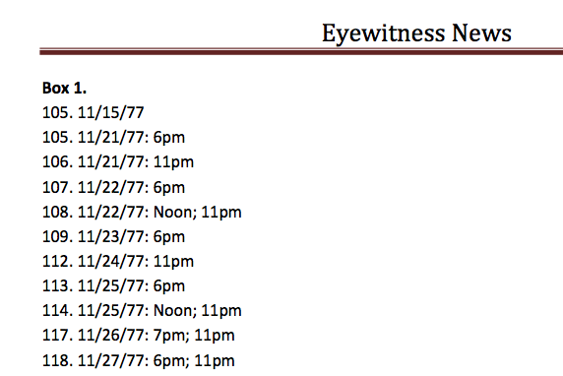
DISCOVERY: WJZ
Notes:
Here is an example of one of WJZ-TV’s biggest series, “Eyewitness News”. The only information that we get from the labels of the tapes is the tape and time of the broadcast that is on the tape (while limited, I do still feel extremely lucky that I have at least this).

Slide 7
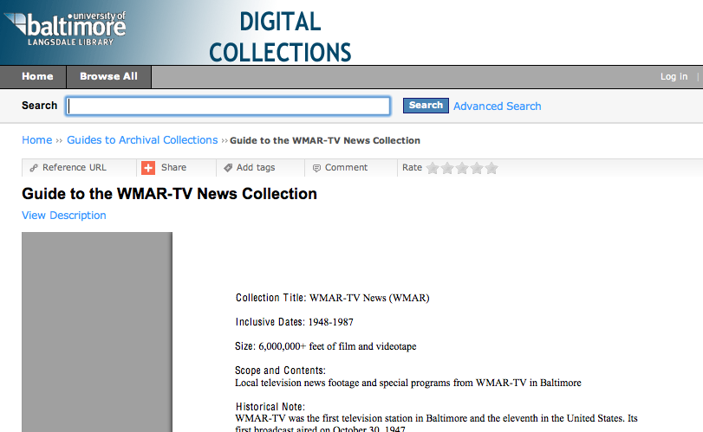
Notes:
We also have series-level Finding Aids in CONTENTdm; PDF word searchable but not as detailed as the inventories on the library website.

Slide 8
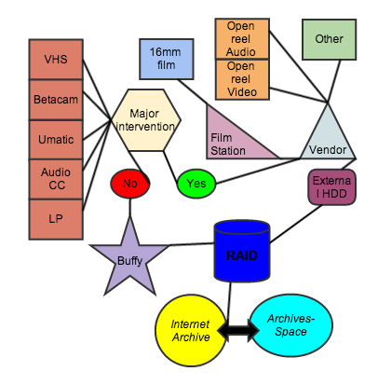
WHAT’S YOUR FORMAT?
Notes:
Once you have found an item that you want to have access to from our website/inventories, then our workflow is informed by the following question: What format do you have?

Slide 9
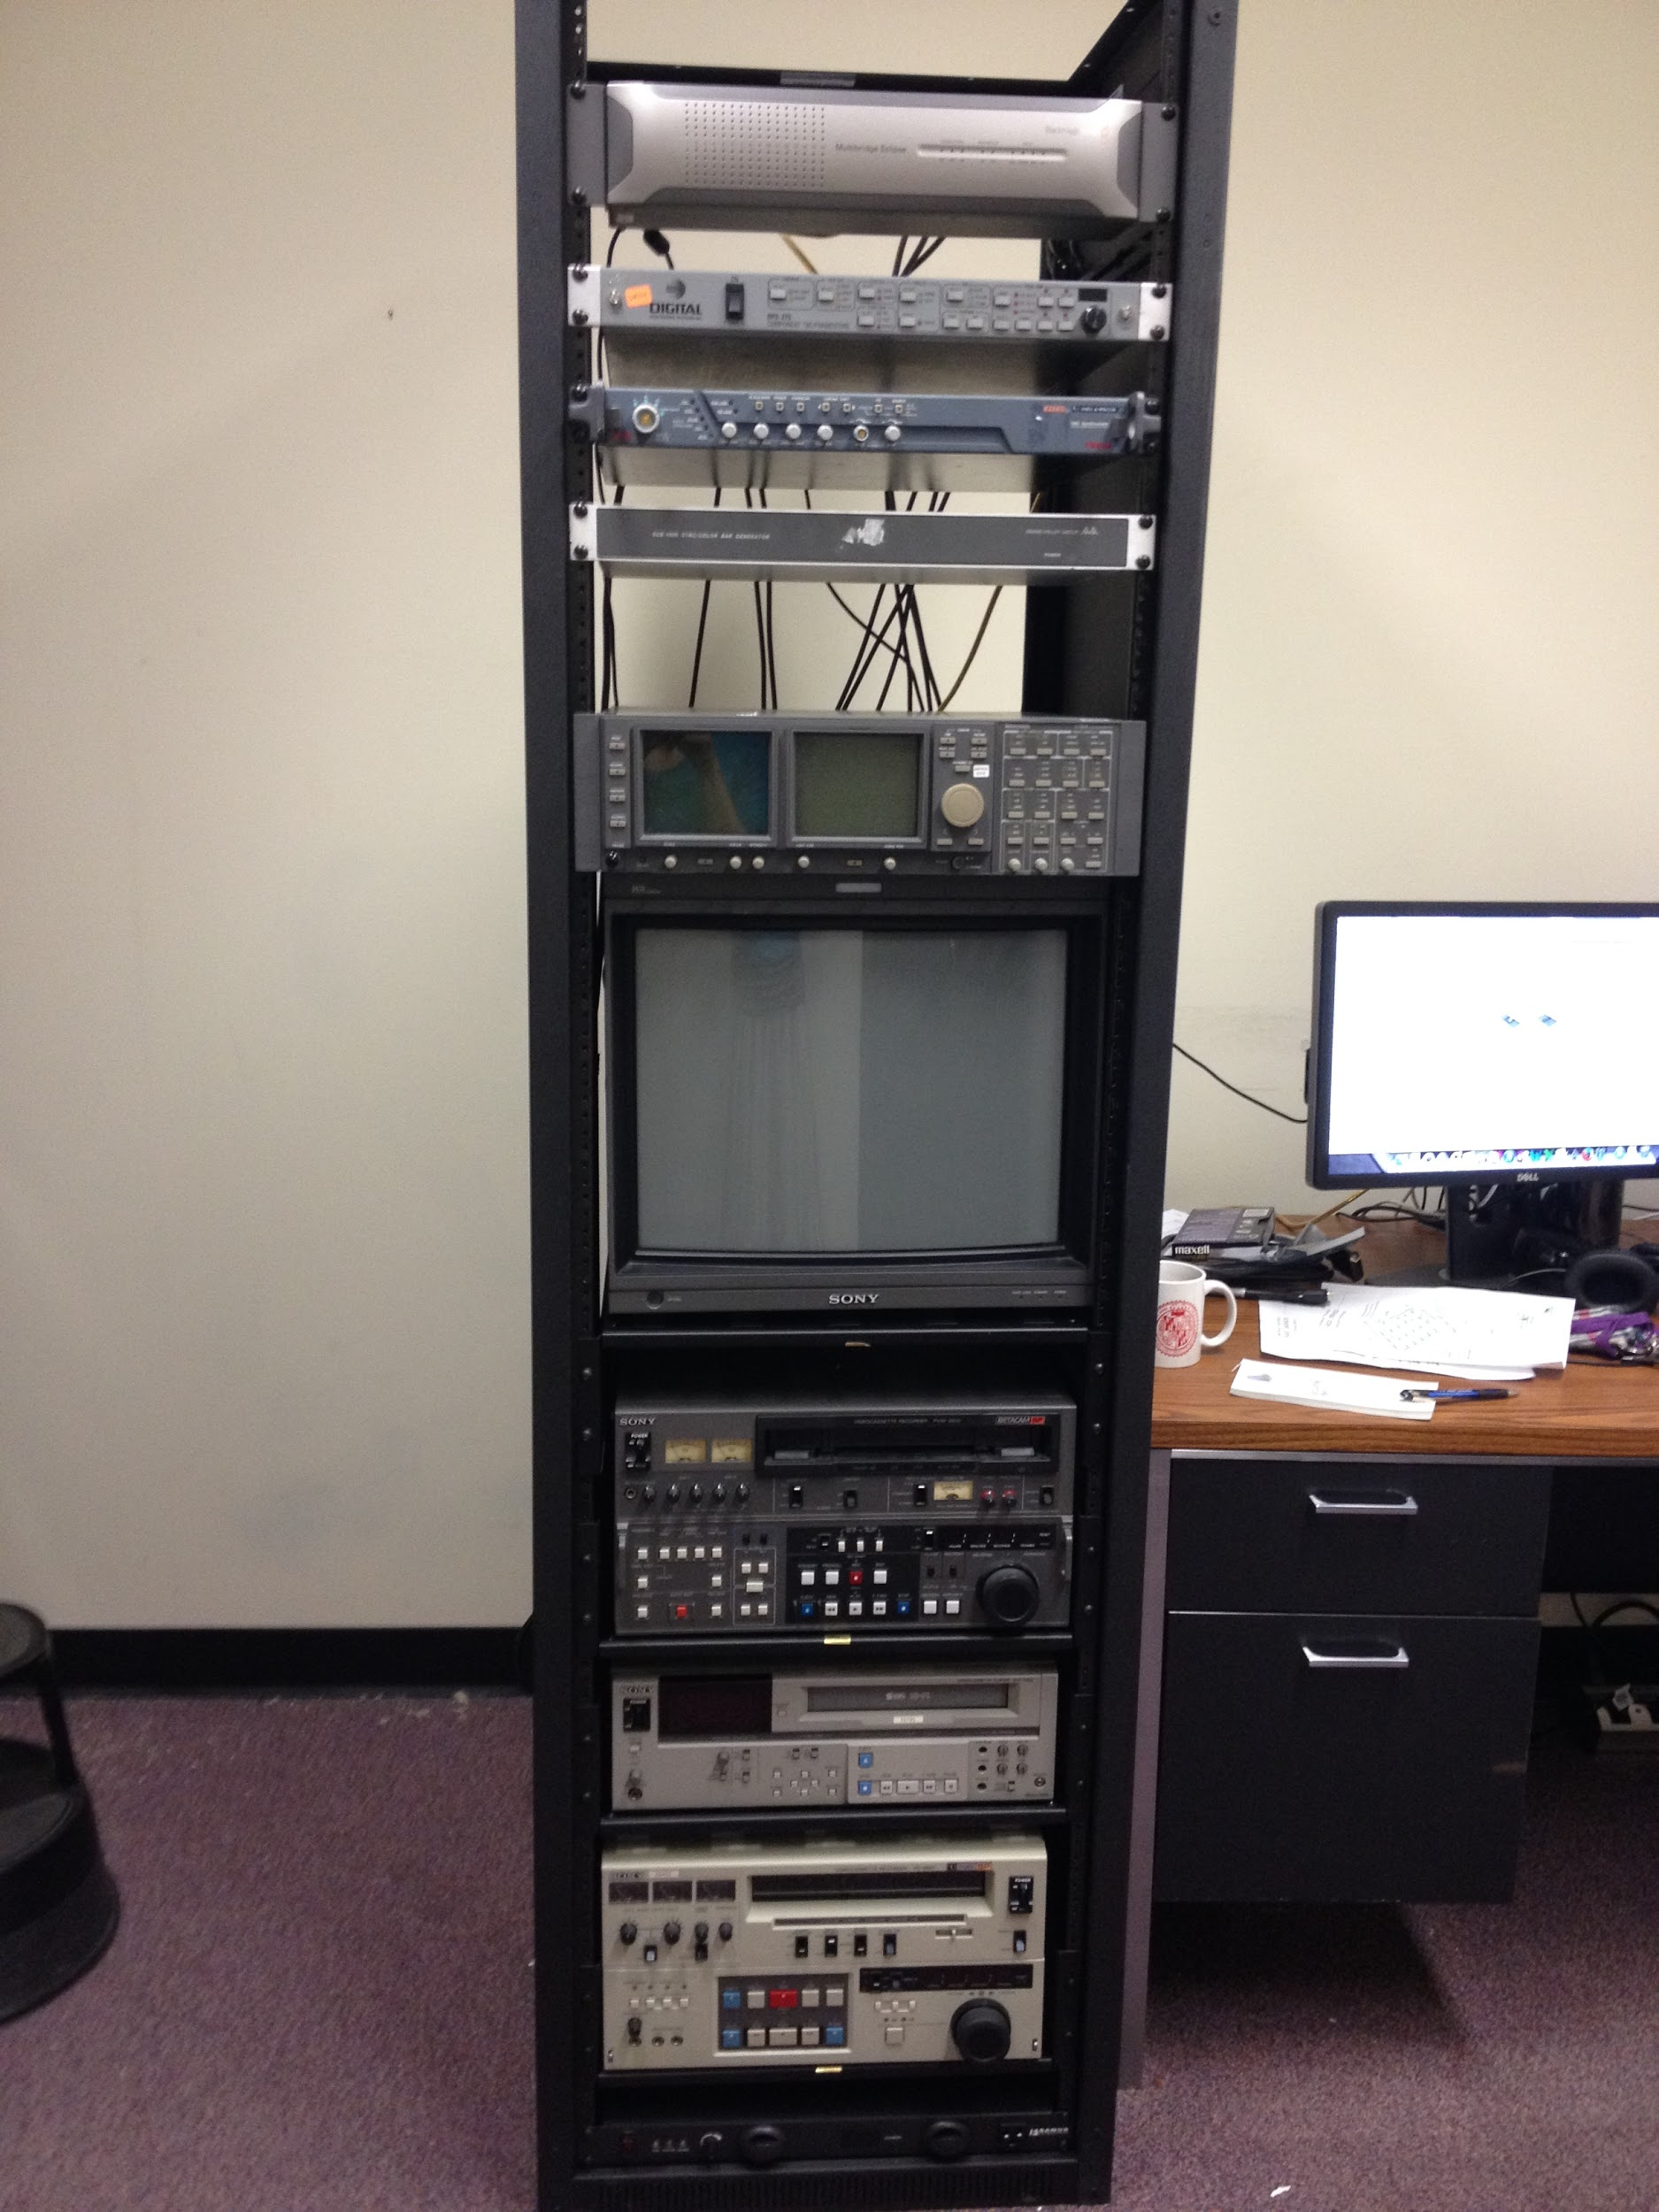
DIGITIZATION
Buffy
the Video Slayer
Notes:
Betacam, SVHS, Umatic goes to the our video rack, Buffy: The Video Slayer! Which gets captured to our 18TB RAID, configured at RAID 5: which basically means you have quick reliable access to your data (backed up across multiple discs in case of failure the data ban be recovered). Baking needs to be outsourced. I can do basic repair/surgery on cassettes. Currently access copies only: $30 charge to patron for work (this pays more for my time-reformatting, troubleshooting, QCing the end files-- and maintaining equipment and supplies to clean each video deck). So I built this video rack for UB, and you can too! If you find yourself with a few thousands dollars AND a few thousand videocassettes, email me and I can help you out.

Slide 10
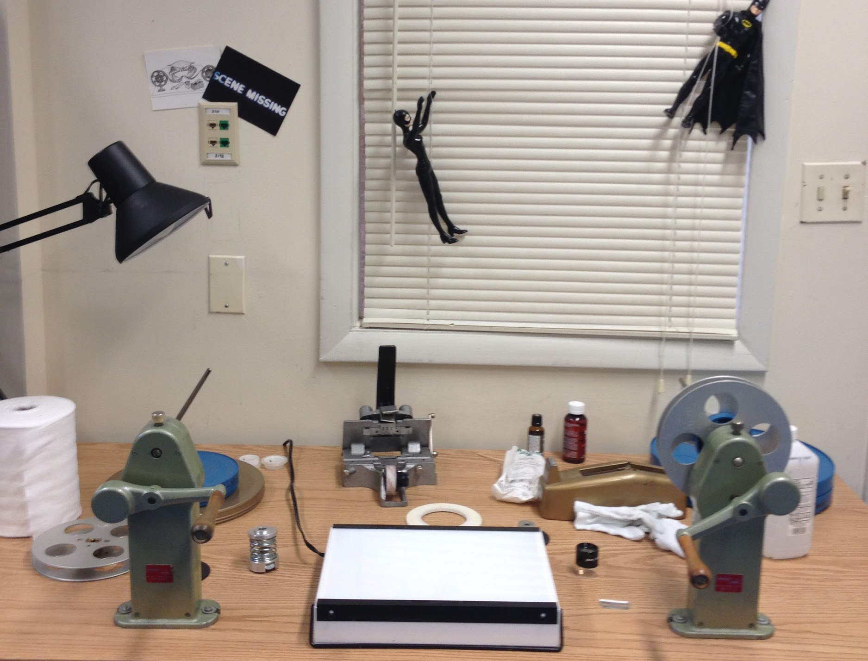
FILM INSPECTION
Notes:
If the format requested is 16mm it is here at the Film Station where I can inspect, repair, and clean in-house (which can save me up to $75/hour). This is also an easy and relatively inexpensive in-house AV capability many archives can and should have.

Slide 11
WHAT’S YOUR FORMAT?
Notes:
Whether the item is digitized in-house or externally, eventually it ends up on our RAID and is uploaded to the Internet Archive.

Slide 12
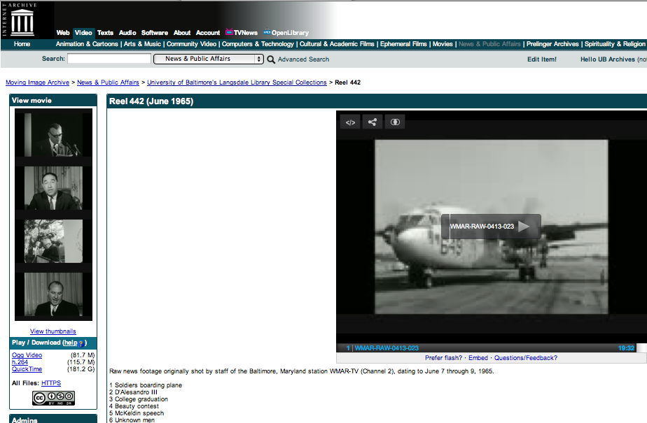
Internet Archive=
Storage and Access
Notes:
The files get uploaded to the Internet Archive using their their S3-like API, IAS3 Bulk Uploader: to upload batches of content alongside per-item metadata in an automated fashion . Once it is uploaded and backed up to IA, data is deleted from RAID: backed up, working storage. If you are willing to have a more copyleft interpretation of Section 108 of Copyright law and Fair Use, then the Internet Archive is a great place to store your digital files (we currently are looking into a separate option so we can have two backed up copies, geographically separate).

Slide 13
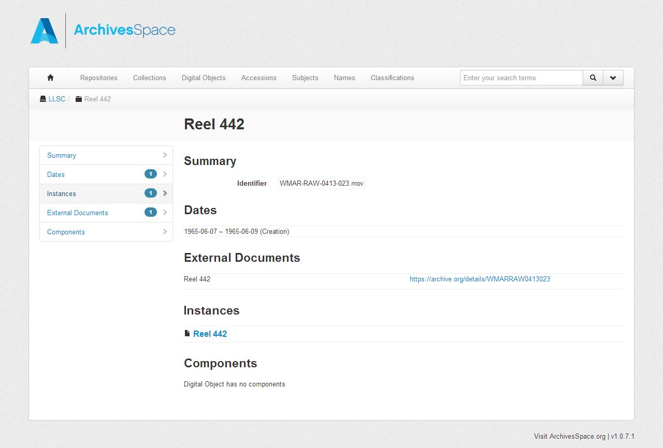
Notes:
Then we link the Internet Archive item record to one in ArchivesSpace (this has NOT gone live yet on the public interface yet but is what we plan for in the near future). Here is an example of an item-record in AS that links to IA. We are planning to eventually phase out inventories on website and CONTENTdm and use ArchivesSpace only for discovery.

Slide 14
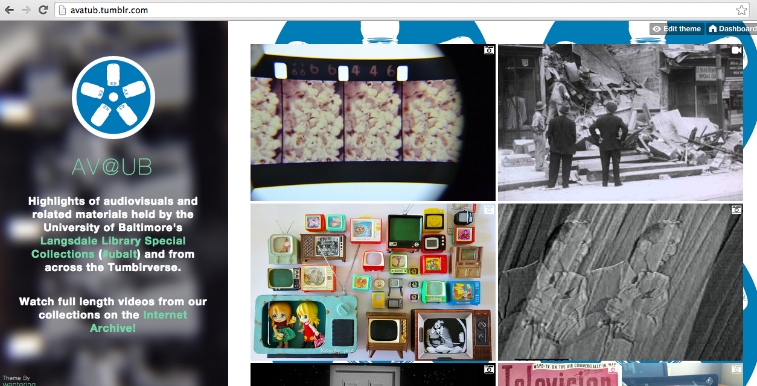
OUTREACH
www.AVatUB.tumblr.com
Notes:
We also have a Tumblr, avatub.tumblr.com, to help showcase certain clips and to reach other types of audiences.

Slide 15
THANK YOU &
ENJOY THE SHOW!
shagan@ubalt.edu
@AV_DiscoTech
Notes:
Now let’s take a look at examples of AV from our collections.

