Slide 1
“Predatory” Publishers and How to Avoid Them
CAS Scholarship Day
March 4, 2014
Betty Landesman
Head of Technical Services
and Content Management
Langsdale Library

Slide 2
Jeffrey Beall – librarian at University of Colorado Denver
“Predatory” scholarly open access publishers exploit OA model of article processing charges – the more articles they publish, the more $$ they make
To be put on “Beall’s List”publisher must engage in deceptive practices and/or show lack of transparency

Slide 3
Scholarly Open Access: Critical Analysis of Scholarly Open-Access Publishing
http://scholarlyoa.com/
List of publishers
List of standalone journals

Slide 4
Criteria (Selected):
Publisher’s owner identified as editor of all journals; no one identified as editor; no credentials provided for editor; no editorial board; same editorial board for multiple journals
Name does not match mission; name does not reflect origin; false claims of impact factor, abstracting/indexing; SPAM requests for peer reviews
Claim to be “leading” publisher when only startup company
Minimal or no copy editing
Insufficient contact information
Title too broad (e.g., “Journal of Education”)
Poorly maintained web site
Include words like “Institute or “Center” in name

Slide 5
ISSN Network
Assigning ISSN to journal used to be a simple matter of publisher requesting one
Now ISSN Network is being inundated with requests – single publishing requesting dozens or even hundreds of new ISSN’s at a time
Developing guidelines for requesting ISSN; no longer issuing in bulk, pre-publication
ROAD – Directory of Open Access Scholarly Resources (http://road.issn.org/
http://road.issn.org/) – launched by ISSN International Centre and UNESCO at end of 2013

Slide 6
Principles of Transparency and Best Practice in Scholarly Publishing (http://oaspa.org/principles-of-transparency-and-best-practice-in-scholarly-publishing/)
Committee on Publication Ethics, Directory of Open Access Journals, Open Access Scholarly Publishers Association, World Association of Medical Editors
Principles of transparency:
Peer review process
Ownership and management
Name of journal
Etc.

Slide 7
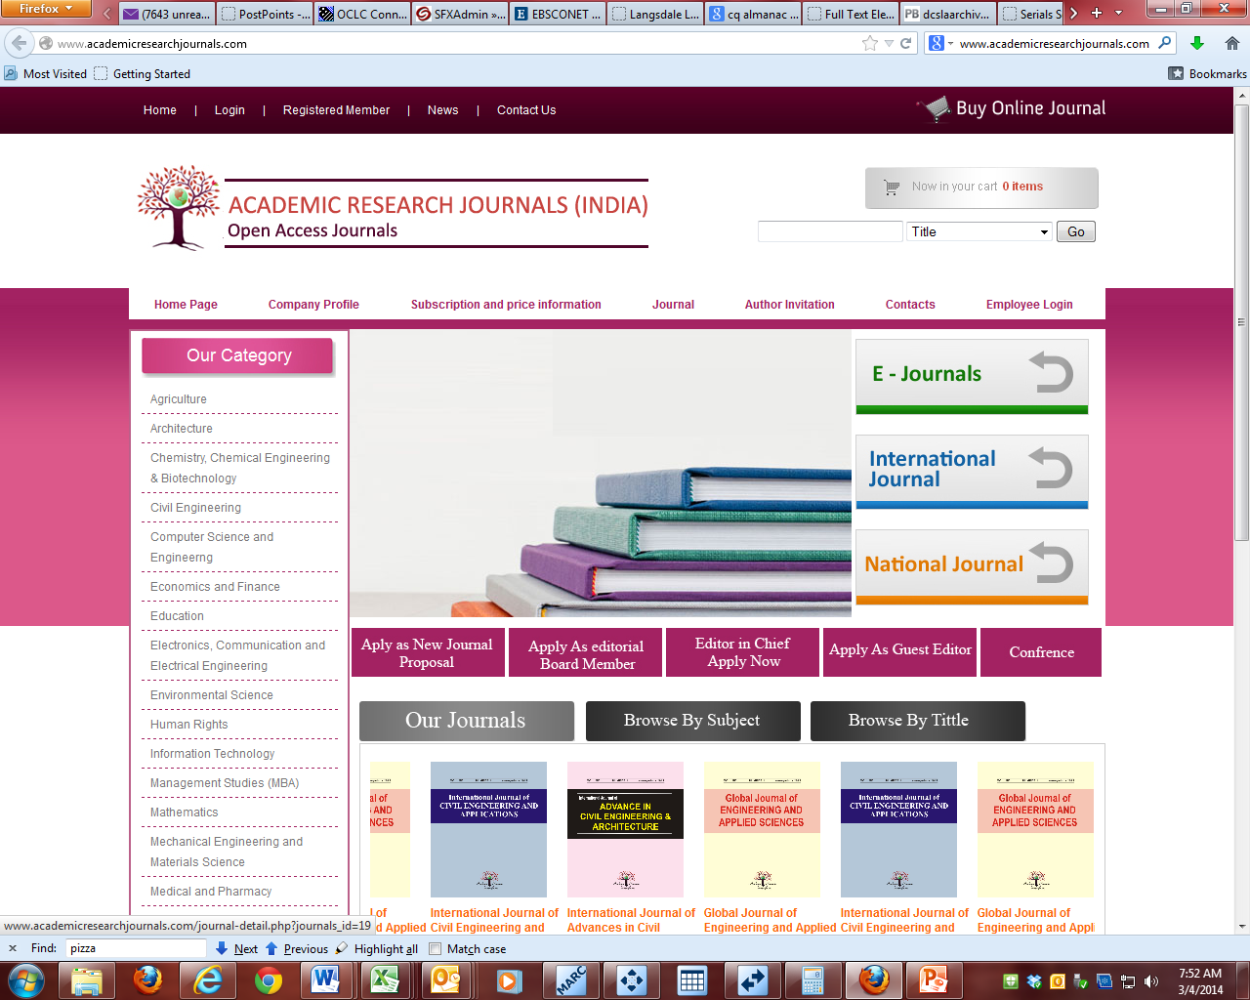

Slide 8
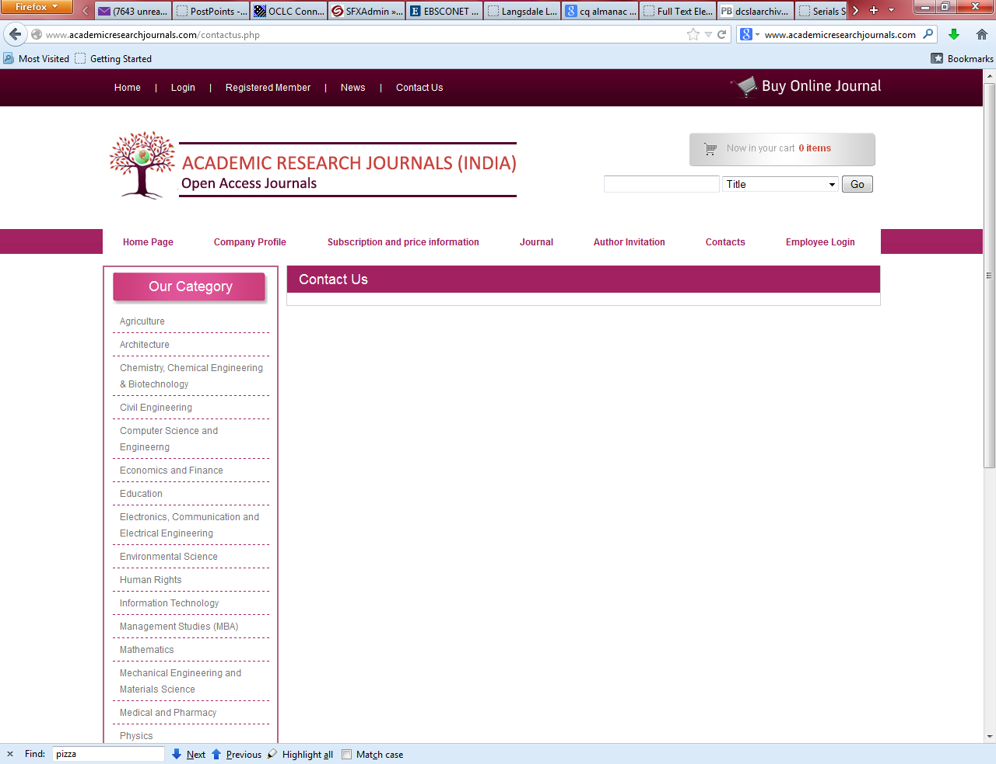

Slide 9
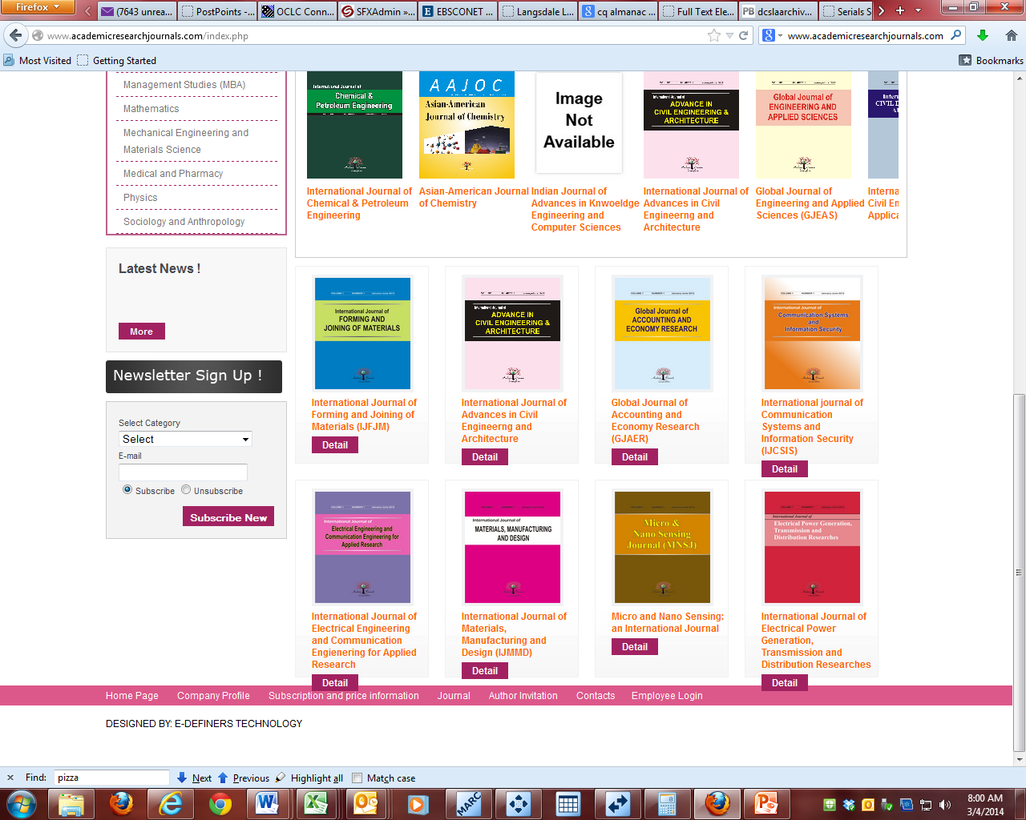

Slide 10
