Slide 1

Piloting pda with ebrary
Initiation, Cataloging, and Acquisition
(Or, Serving E-Books “Buffet Style”…)
USMAI Fall Forum
October 29, 2013
Mary Gilbert, Rick Davis, and Whitney Blake
Albert S. Cook Library, Towson University
Image credit: Luca Tettoni / Robert Harding World Imagery / Universal Images Group.
Source: Britannica Image Quest.

Slide 2
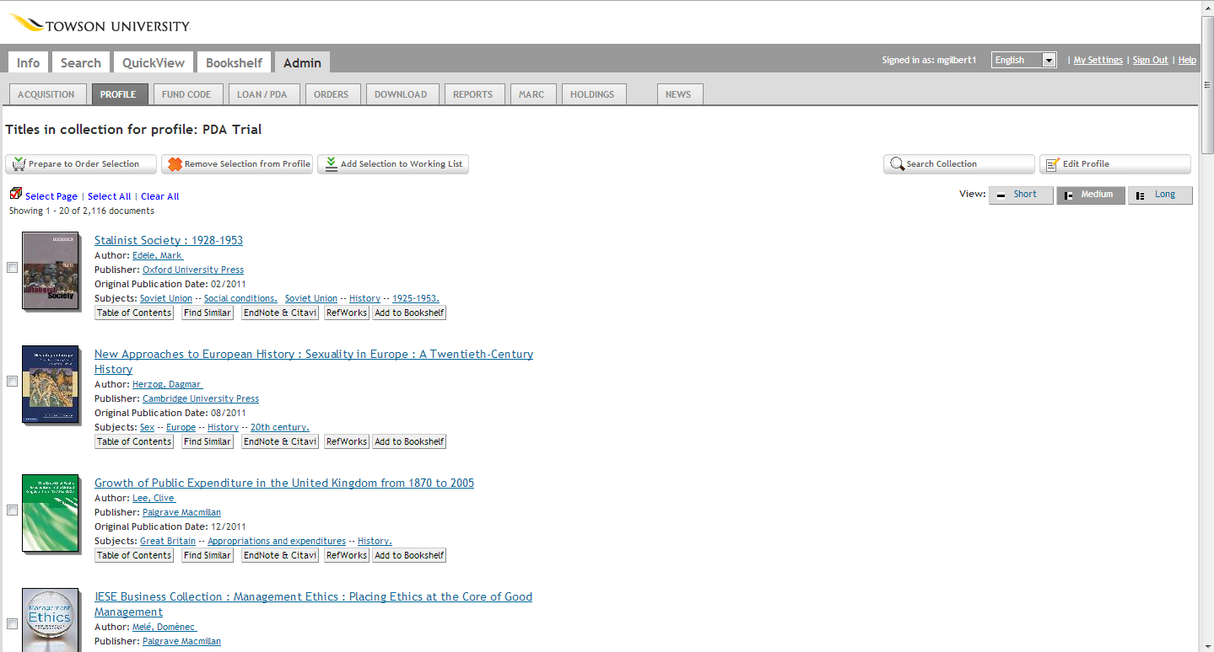
Initiation: Selecting Titles and Maintaining
Collection Profile

Slide 3
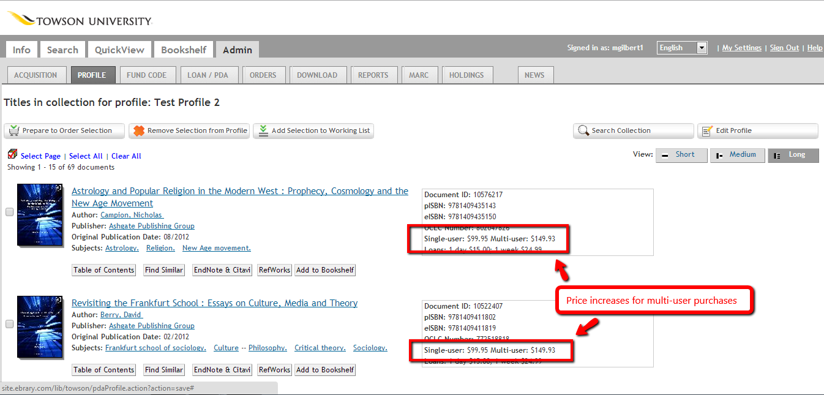
Initiation: Remember Price Multiplier for Multi-User Licenses When Creating Your Profile!

Slide 4
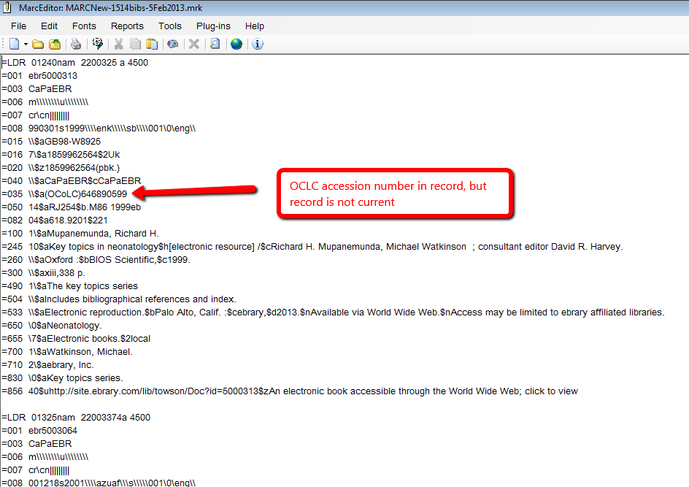
Cataloging: Sample bib provided by ebrary

Slide 5
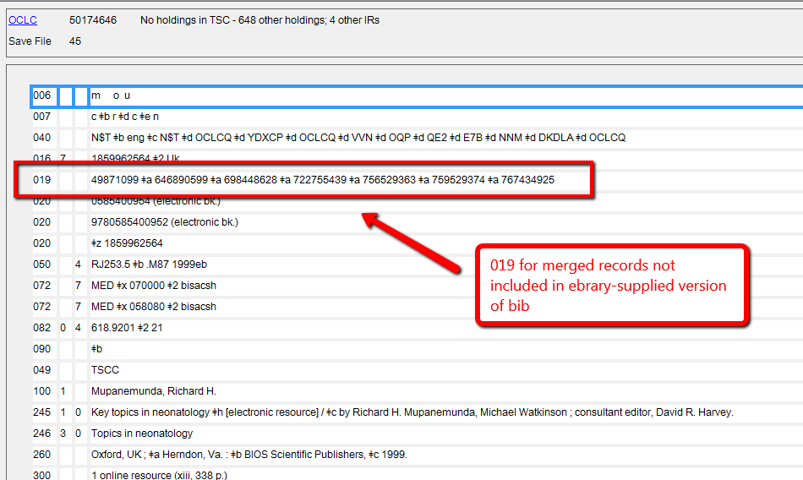
Cataloging: Same bib downloaded from OCLC

Slide 6
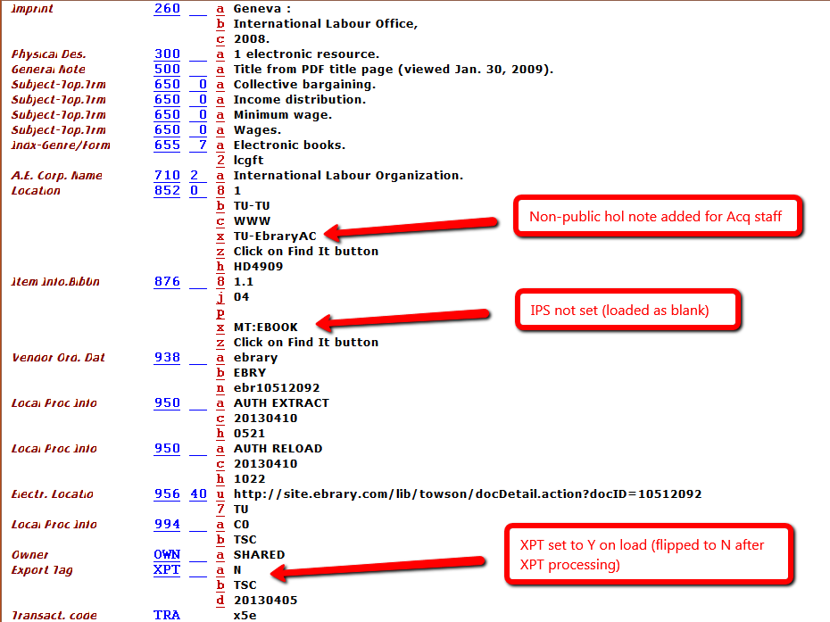
Cataloging: Distinguishing ebrary PDA from AC titles
AC bib example

Slide 7
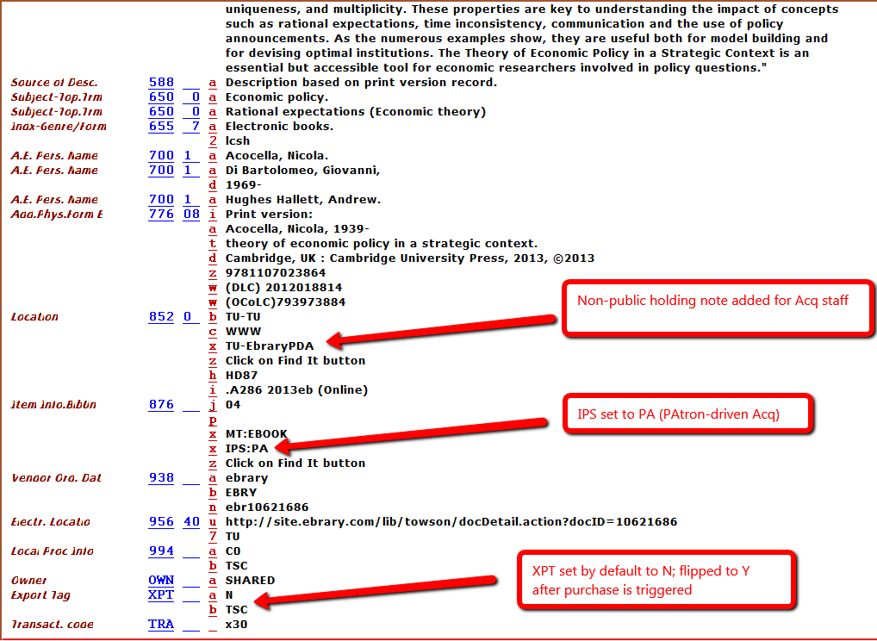
Cataloging: Distinguishing ebrary PDA from AC titles
PDA bib example

Slide 8
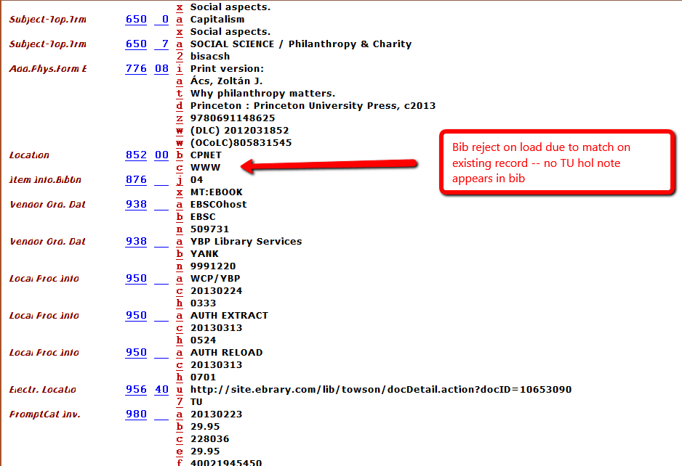
Cataloging: Distinguishing ebrary PDA from AC titles
Rejected PDA bib example

Slide 9
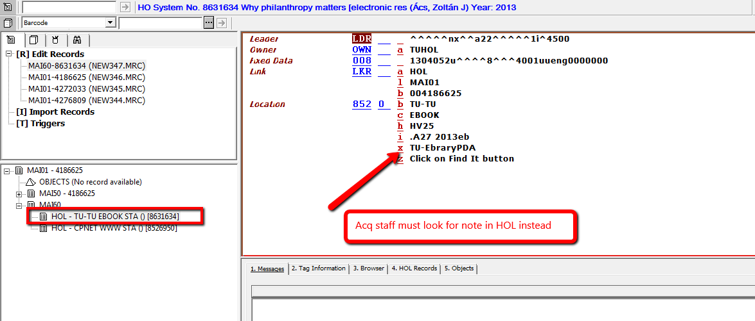
Cataloging: Distinguishing ebrary PDA from AC titles
Rejected PDA bib example: HOL record

Slide 10
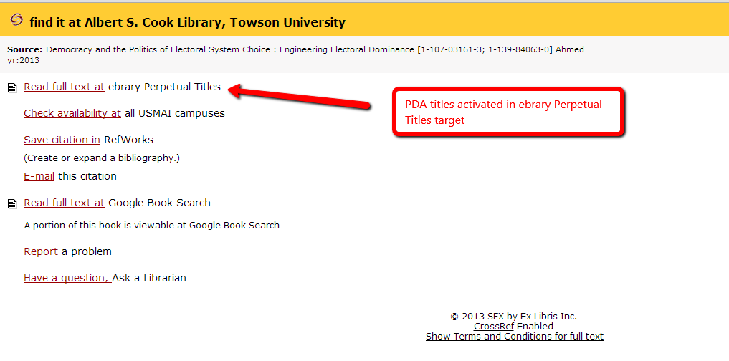
SFX/Find It display: PDA example

Slide 11
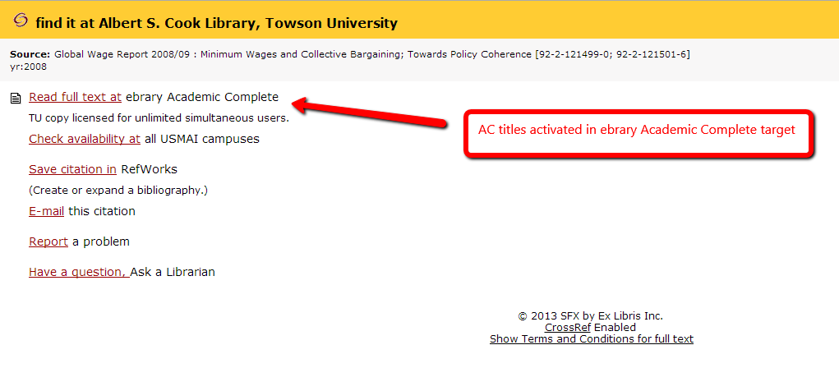
SFX/Find It display: AC example

Slide 12
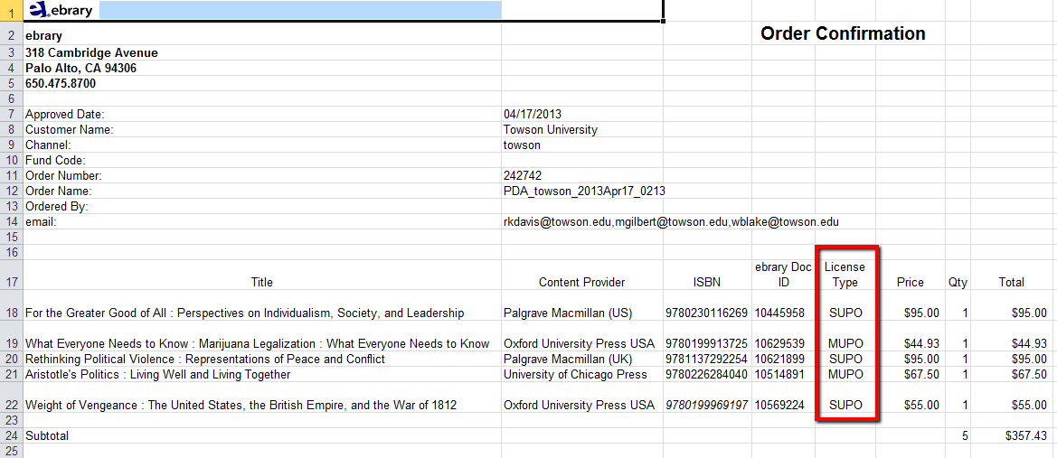
Acquisition: Sample Order Confirmation for Triggered Purchases

Slide 13
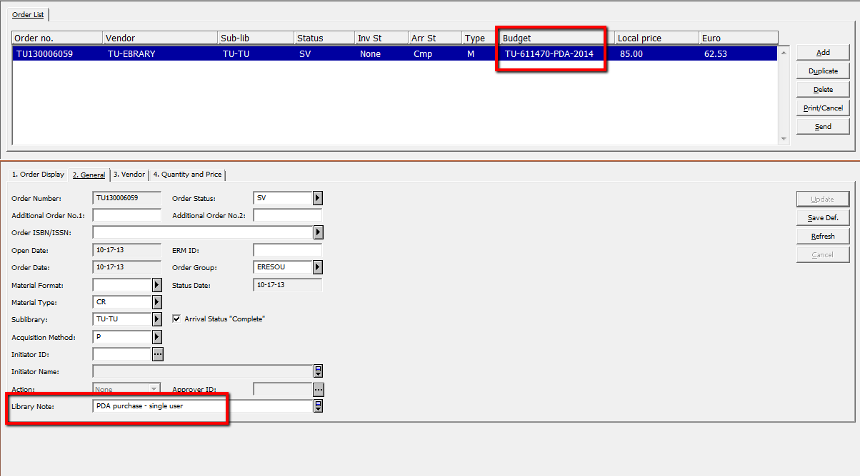
Acquisition: Order Created in Aleph for Purchased
PDA Title

Slide 14
PDA Trial Results
Initial funds for PDA were exhausted quickly, so there was clearly evidence of patron demand for this as an alternative acquisitions method.
Titles triggered for purchase were current and of high-quality (thanks in large part to our profile parameters).
Communication with the vendor was sometimes difficult, especially in light of ebrary/EBL merger.
Ebrary did not provide OCLC-sourced bib records, complicating the batch cataloging process.
Temporarily suppressing PDA bibs in Aleph and deactivating them in SFX when initial funds were spent was fairly straightforward, but timing is important!

Slide 15
Additional Considerations…
Staying up-to-date with cataloging as new titles are added to your profile or as you change your profile parameters is an ongoing challenge.
Identifying overlap with other e-book packages or PDA/DDA profiles—as well as your print collection—is also difficult.
How will you handle requests for titles included in your PDA profile—trigger purchase or send link to bib record and allow requester to trigger purchase?
Should you include non-purchased PDA/DDA titles in your yearly collection statistics? What about consortium PDA/DDA titles?

Slide 16
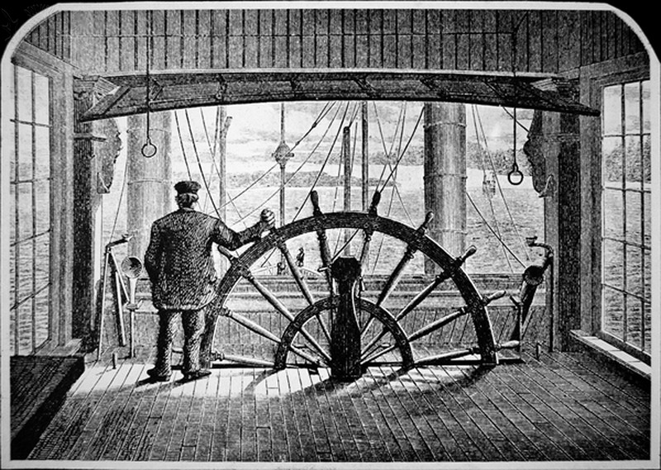
Thanks for listening!
Mary Gilbert / mgilbert@towson.edu
Rick Davis / rkdavis@towson.edu
Whitney Blake / wblake@towson.edu
Image credit: Bridgeman Art Library / Universal Images Group. Source: Britannica Image Quest.

