Slide 1
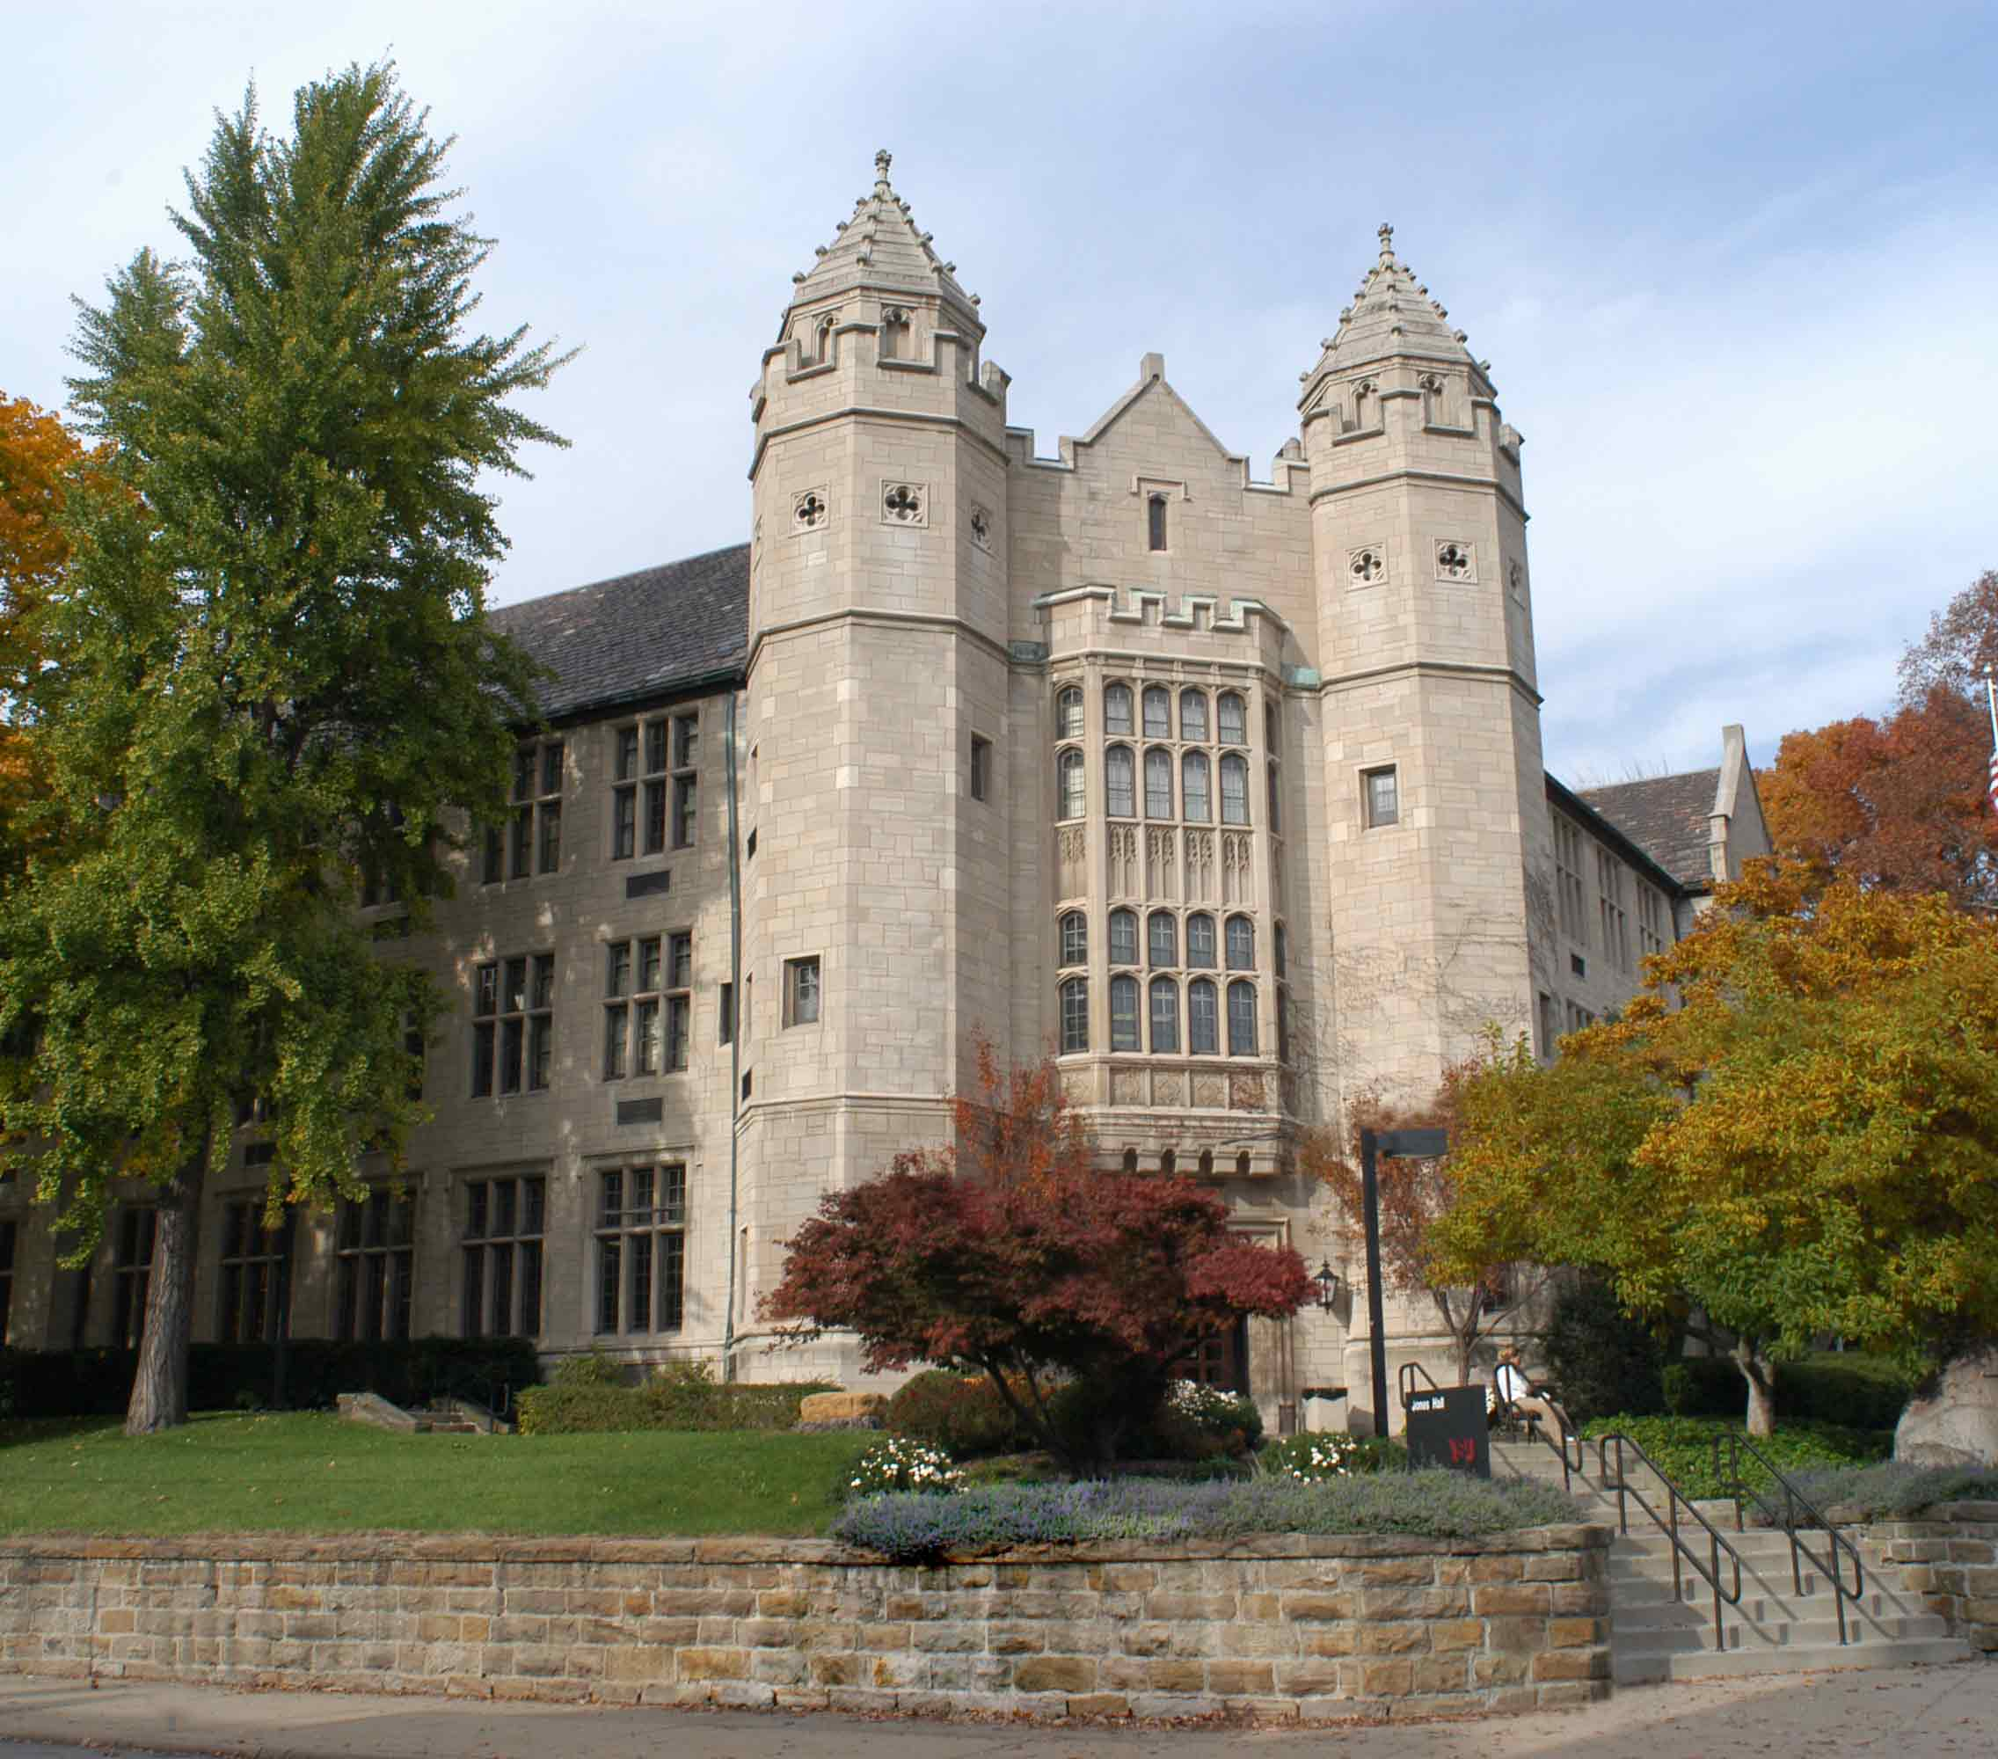
Archives:
From the National Archives to Your Family Papers
Jones Hall

Slide 2
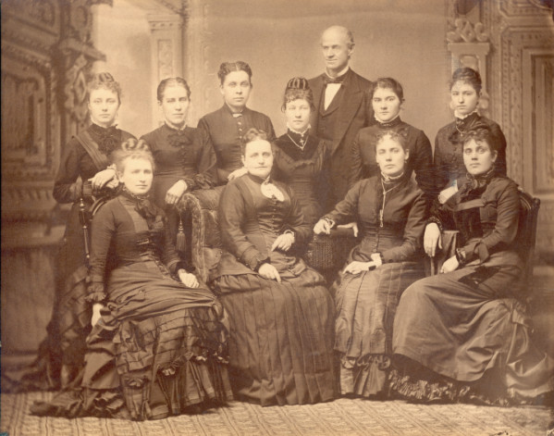
Today’s Presentation
Introduction to archives
a. Definition
b. Types
c. Examples
d. Activities
2. Tour of YHCIL Archives
3. How do I create an archives?
a. What to save
b. How to organize
c. Containers to use
d. Location to store
e. Scanning
f. Creating a website
Youngstown Wood Street School Teachers, 1870s
Ohio Memory Collection

Slide 3
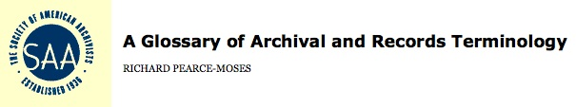
What is an Archives?
Materials created or received by a person, family, or organization and preserved because of their enduring value, or as evidence of the functions and responsibilities of their creator; permanent papers or records.
http://www.archivists.org/glossary/

Slide 4
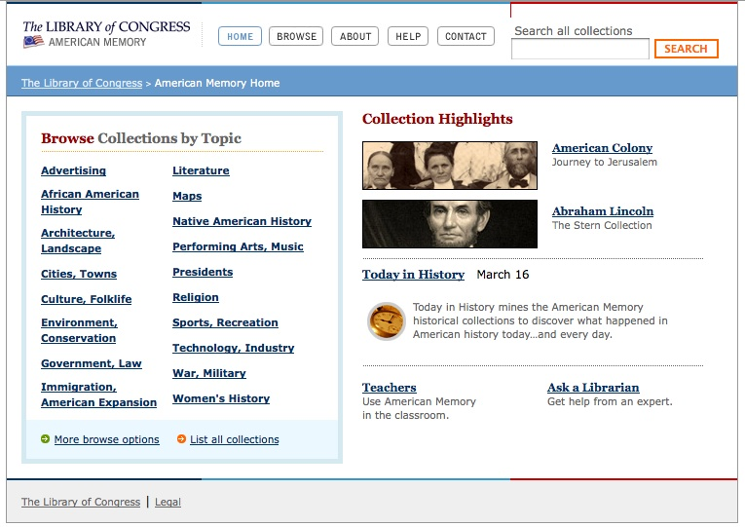
Types of Archives
International
National
State
Local
Organizations
Subjects
Family
Personal
http://memory.loc.gov/ammem/index.html

Slide 5
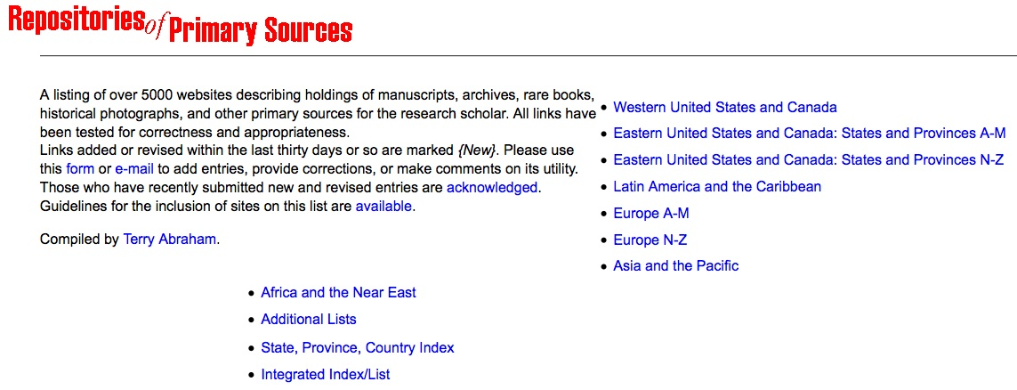
Directory of Archives
Terry Abraham, archivist at the University of Idaho maintains an extensive list of archives around the world
http://www.uiweb.uidaho.edu/special-collections/Other.Repositories.html

Slide 6
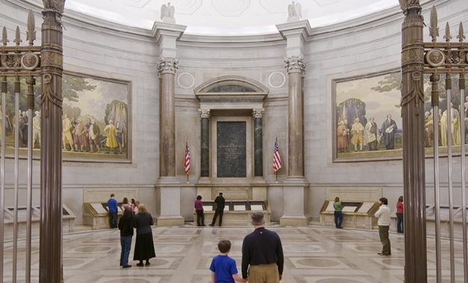
United States National Archives and Records Administration
Largest archives in the United States, federal government records.
Original 1935 building in downtown Washington, DC, has Declaration of Independence, Constitution and Bill of Rights on display (Archives I).
Modern research facility in College Park, MD (Archives II)
Good vacation destination.
http://www.archives.gov/nae/

Slide 7
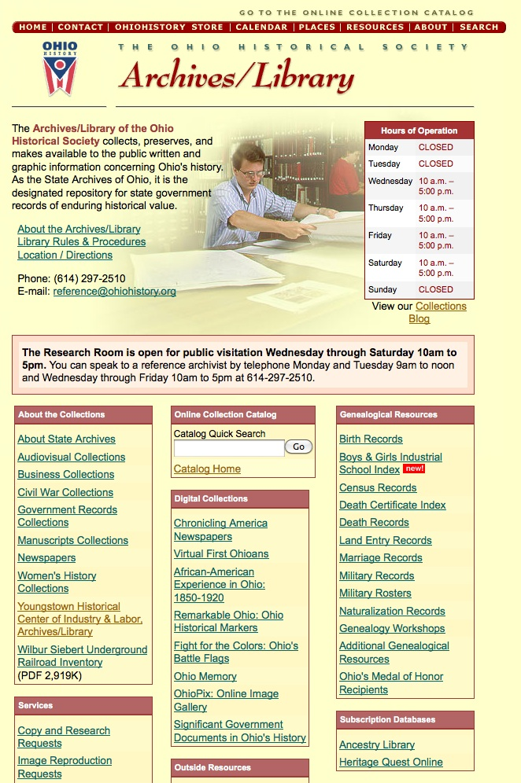
Ohio Historical Society
Ohio government records and much more, a wide variety of records of organizations and major figures in the state’s history.
Ohio Memory online digital archives:
http://www.ohiomemory.org/
Network of sites, including with archives, around the state.
Search the catalog, Ohio Memory and website, then make an appointment.

http://www.ohiohistory.org/resource/archlib/index.html

Slide 8
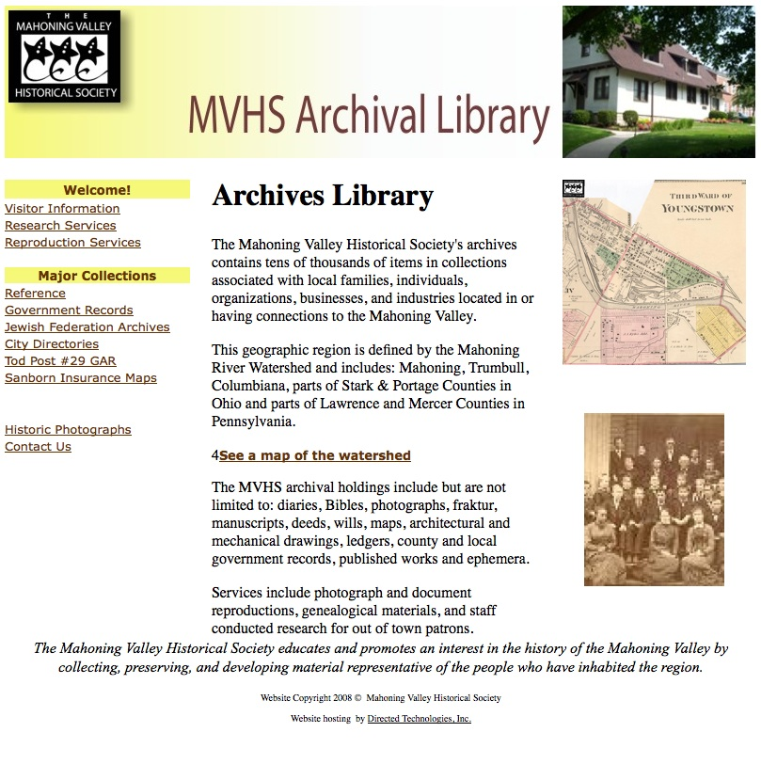
Mahoning Valley Historical Society
First stop for local history research.
Holds a broad range of local government and organization records and the papers of important figures in the valley’s history.
Review the website then call for a research appointment.
http://www.mahoninghistory.org/archhome.htm

Slide 9
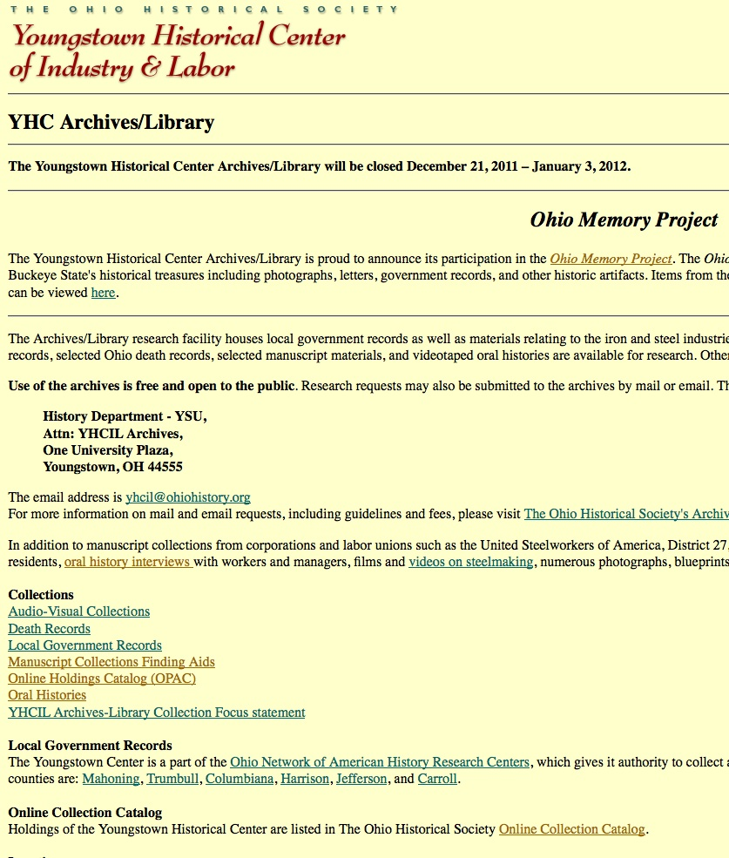
Youngstown Historical Center of Industry and Labor
Second major stop for local history research after the MVHS. First stop if you are interested in local labor and industrial history.
Like MVHS holds a wide variety of government, organizational and personal collections related to the Mahoning Valley’s history.
Review the website, search the OHS catalog, and then call for a research appointment.

http://www.ohiohistory.org/youngst/arch_lib.html

Slide 10
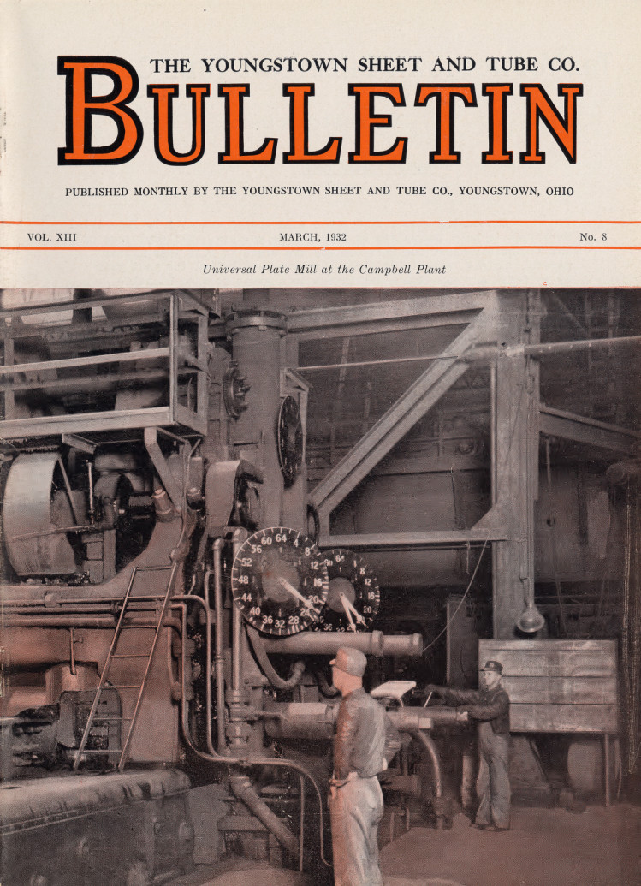
What happens in an archives?
Contacting potential donors.
Appraising possible donations.
Accessioning new collections.
Collection processing.
Digitizing collections.
Uploading collection content to the web.
Reference work.
Source: Ohio Memory

Slide 11
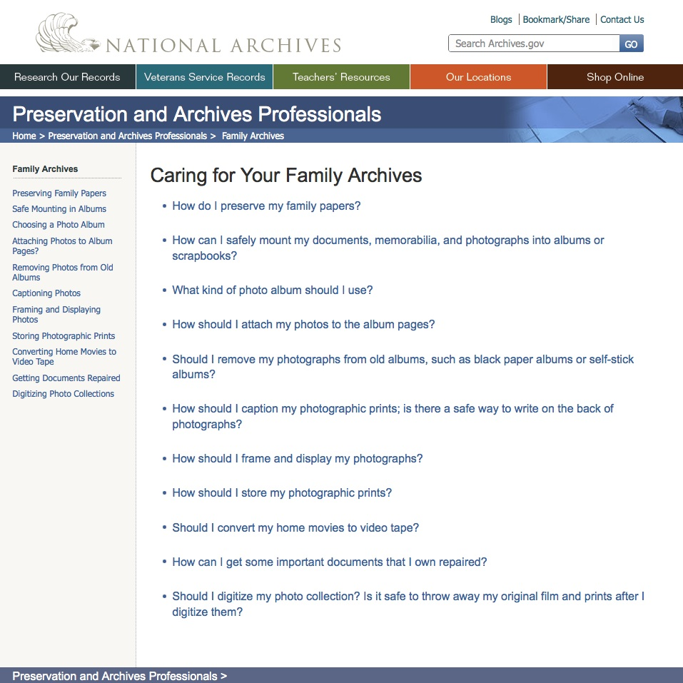
How do I create a family or personal archives?
What to save?
How should I organize my archives?
What type of containers should be used?
Where should I put my archives?
What should I digitize?
How can I put my archives on web?
Donate to an archives?
http://www.archives.gov/preservation/family-archives/

Slide 12
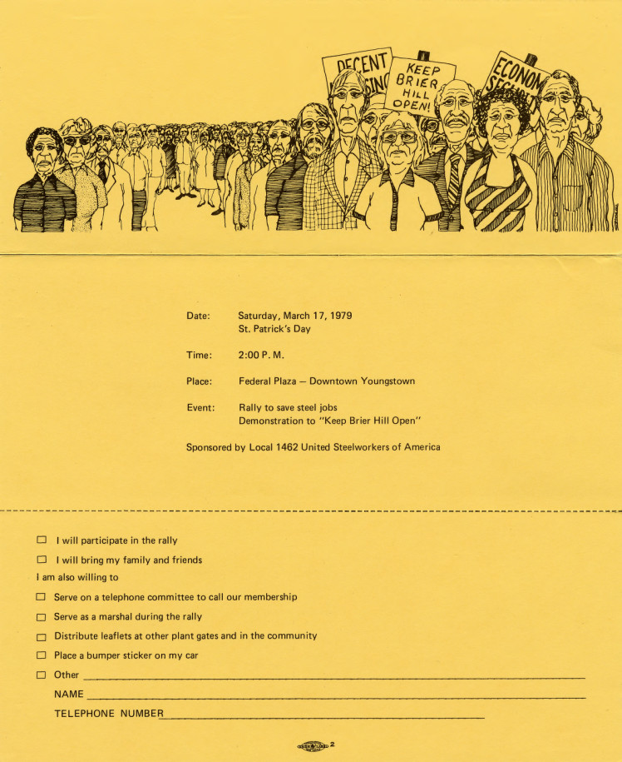
What to save?
letters
memoirs/reminiscences
diaries
scrapbooks/photo albums
professional papers
genealogical information
speeches/lectures
business records
subject files
legal documents
minutes/reports
brochures and flyers
photographs (labeled)
films/videos/audio tapes (labeled)
Gerald Dickey Collection
Youngstown Historical Center of Industry and Labor

Slide 13
How should I organize my archives?
Group by format of the material and then content
Examples of paper document group or series titles (labeled folders):
memoirs/reminiscences/diaries (by person)
correspondence (by date)
educational/professional documents (by school or organization)
genealogical/family information (by person)
general speeches/lectures (by topic)
business/organizational records (by organization name)
general subject/research files (by topic)
legal documents (by case)
Audio/visual material organized by format (individual item labels):
photographs
scrapbooks/photo albums
motion picture films
video tapes/discs
audio tapes

Slide 14
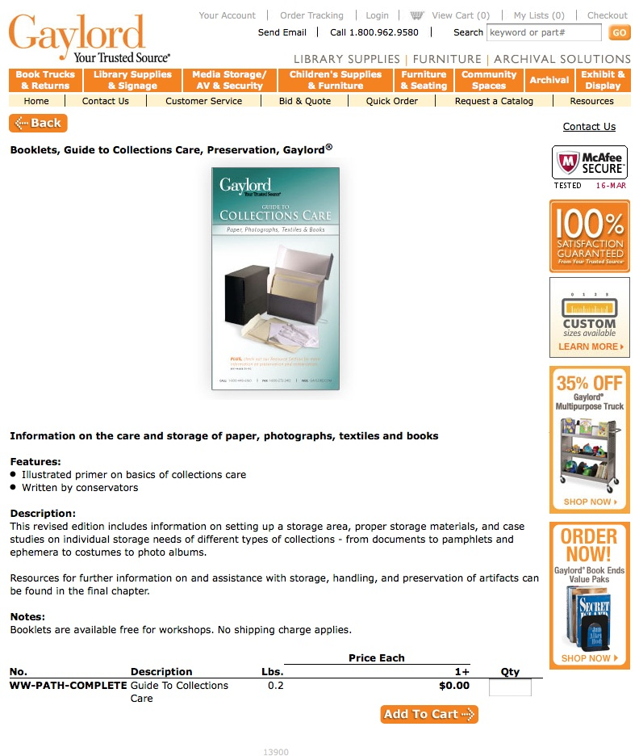
What type of containers should I use?
Get the Gaylord “Guide to Collections Care”
Archival containers and supplies from these three companies are of the best quality:
Gaylord Brothers, Inc.
http://www.gaylord.com/lobby_gaylordmart.asp
1-800-272-3412
Hollinger Metal Edge, Inc.
http://www.hollingermetaledge.com
1-800-634-0491
University Products, Inc.
http://www.universityproducts.com
1-800-628-1912

http://www.gaylord.com/lobby_gaylordmart.asp?

Slide 15
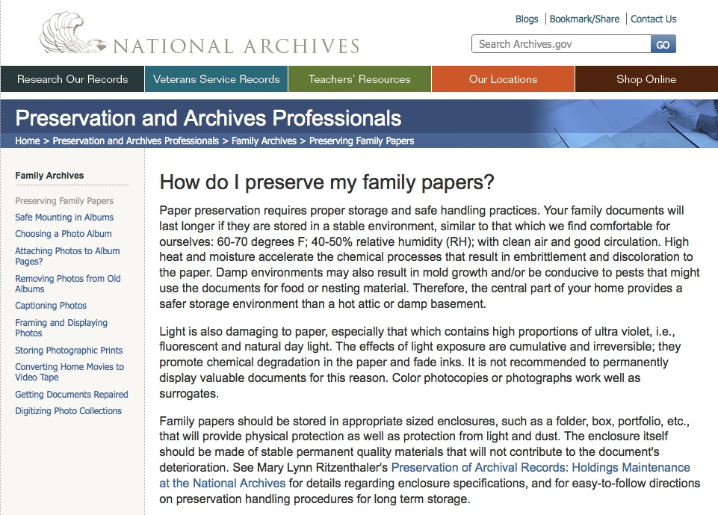
Where should I put my archives?
In a closet or home office space, not in your attic, basement or garage.
http://www.archives.gov/preservation/family-archives/preserving-family-papers.html

Slide 16
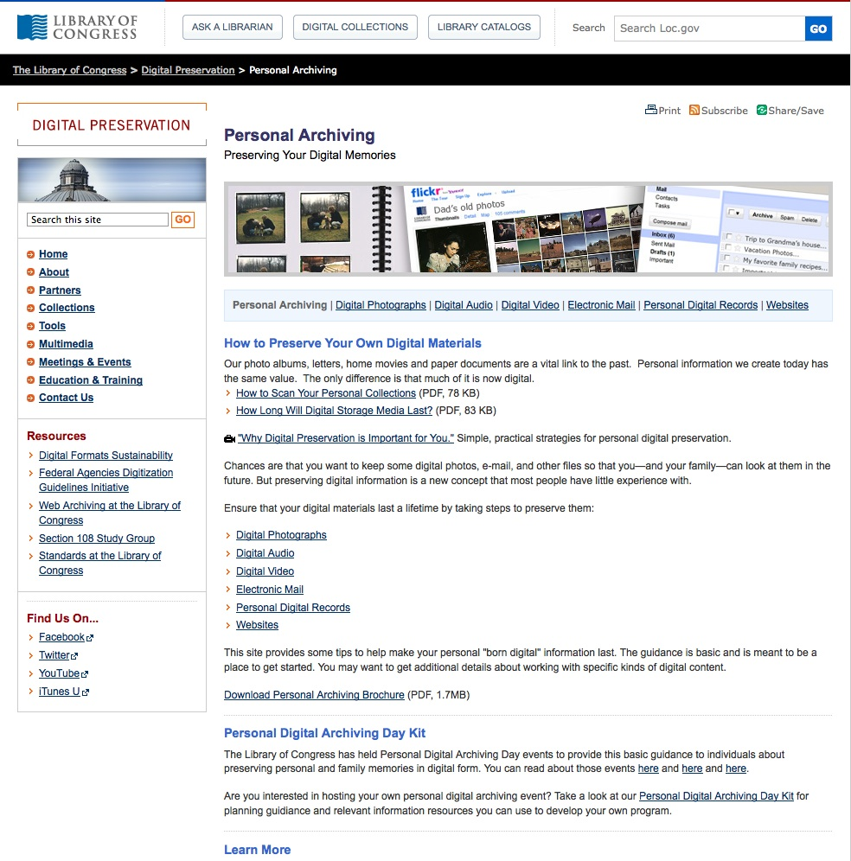
What should I digitize?
Be selective.
Paper and photographs relatively easy, audio visual materials more challenging, may need a professional.
Save in multiple places: PC hard drive, flash drive, internet storage.
Best file formats:
Paper documents: PDF files.
Photographs: TIFF.
Audio: WAV.
Video: MPEG4.
http://www.digitalpreservation.gov/personalarchiving/

Slide 17
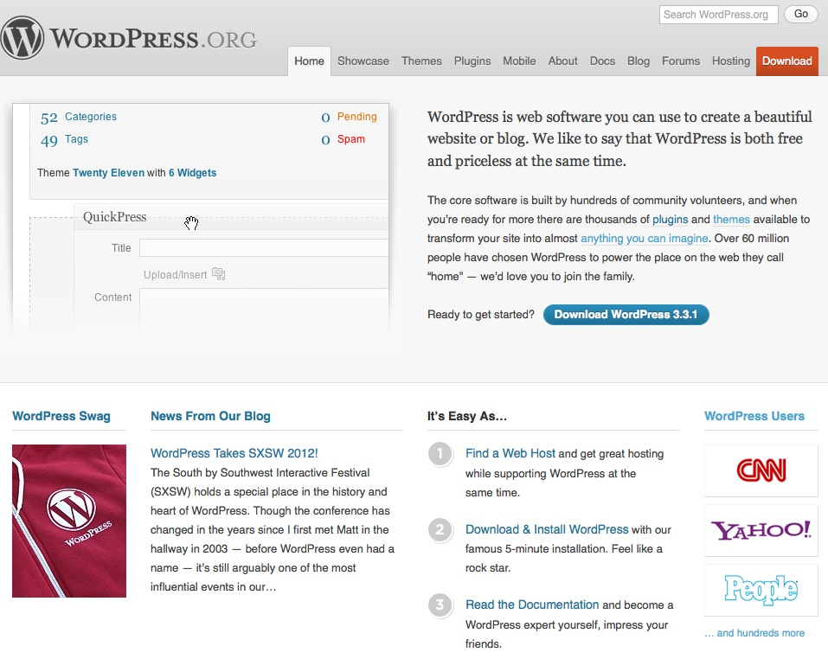
How can I put my archives on web?
WordPress, or a similar system, is probably your best option.
http://wordpress.org/

Slide 18
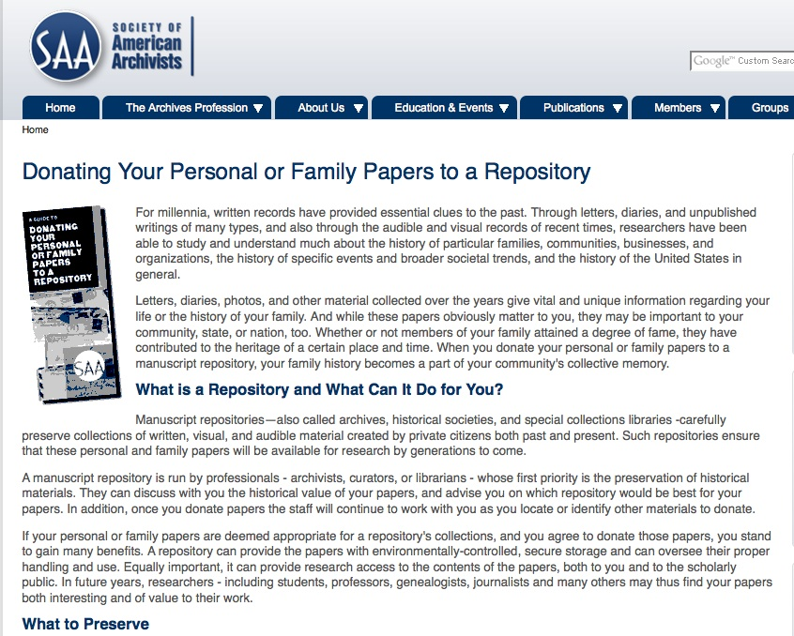
Donating to an archives?
letters
memoirs/reminiscences
diaries
scrapbooks/photo albums
professional papers
genealogical information
speeches/lectures
business records
subject files
legal documents
minutes/reports
brochures and flyers
photographs (labeled)
films/videos/audio tapes (labeled)
http://www2.archivists.org/publications/brochures/
donating-familyrecs

Slide 19
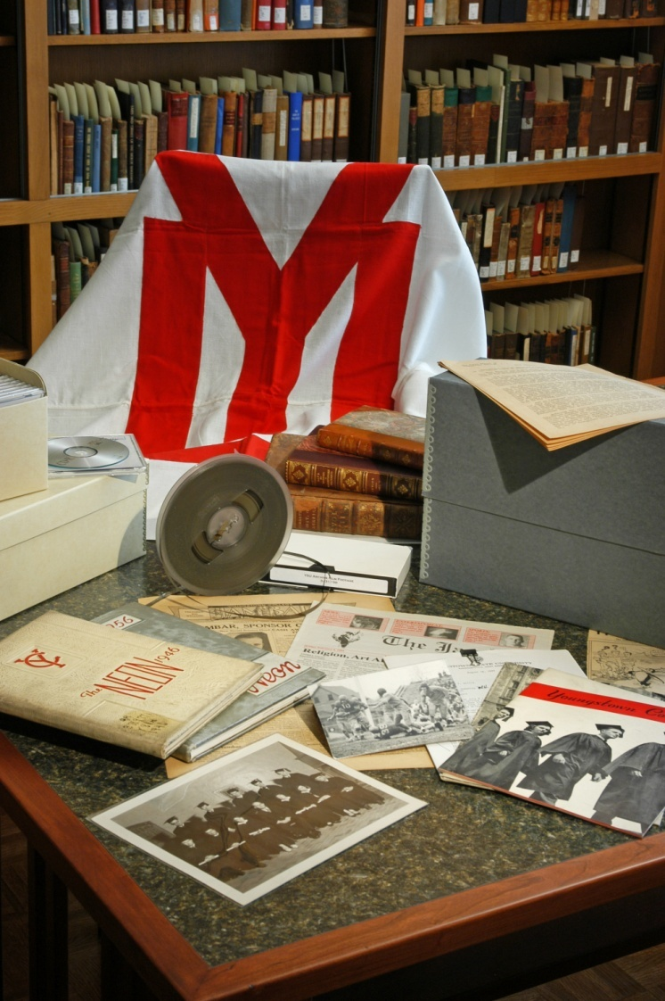
Questions?
Ben Blake
University Archivist
Archives and Special Collections
Maag Library
Youngstown State University
330-941-3788
bsblake@ysu.edu
http://www.maag.ysu.edu/archives/index.html

