Slide 1

Can Fanfiction be considered good storytelling?
By: Julianna Head

Slide 2
What makes a story good?
Common Criteria:
  overall affect of the story has some emotional and/or psychological authenticity
  the characters have to be dynamic and must be relatable on some level
  the plot and any subplots have to be entertaining and compelling
  the writing must be clean and polished
  Components of a ‘good’ story are subjective.
  The mode in which the story is presented can effect the order of the Common Criteria.

Slide 3
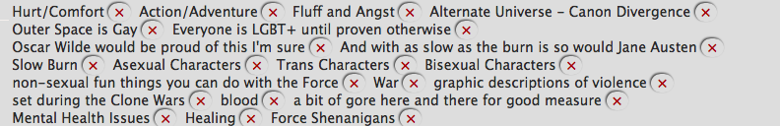
Fanfiction (aka: fanfic)
Author assumes the reader knows the story and has connected with the characters.
Characterization is more important than plot or other Common Criteria.
Fanfiction is highly subjective – some prefer fluffy fics, others prefer angsty fics.
If you can imagine it, there’s a fic of it.

Slide 4

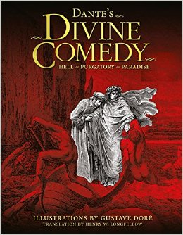
Not Original? Not good.
Because fanfiction isn’t original, it’s almost always deemed as bad.
What about the classics though?
Photos: Amazon.com

Slide 5
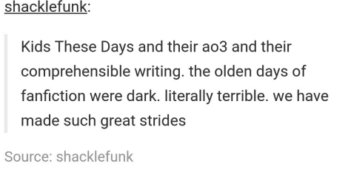
Fanfiction = laziness
Another common argument is that fanfic is lazy.
People usually begin writing fanfic when they’re 13/14 years old.
Fanfiction is a gateway and helps kids learn how to write.

Slide 6
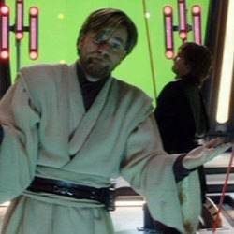
Sometimes you branch out, sometimes you don’t

Slide 7
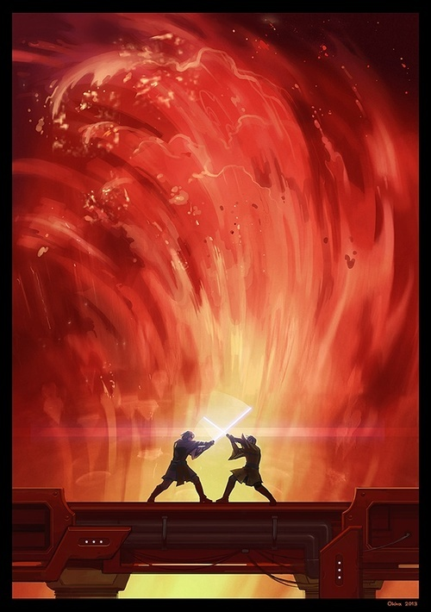
AU Canon Divergence of Star Wars: Episode III, Revenge of the Sith
The prequels may have been bad, but this scene? A masterpiece.

Slide 8





