Slide 1
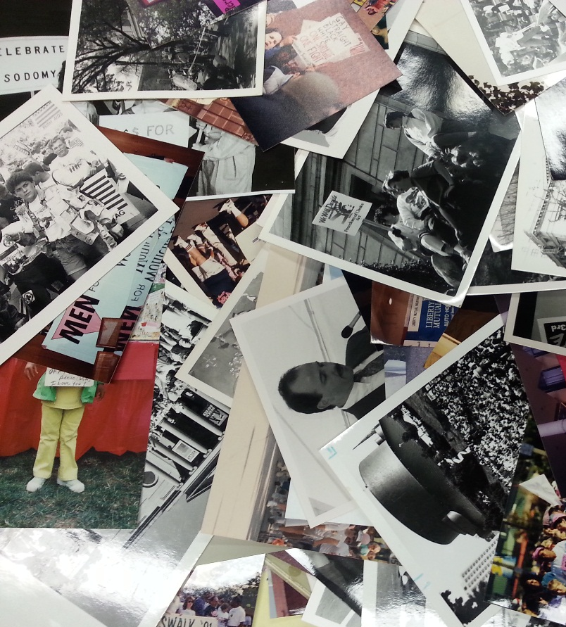
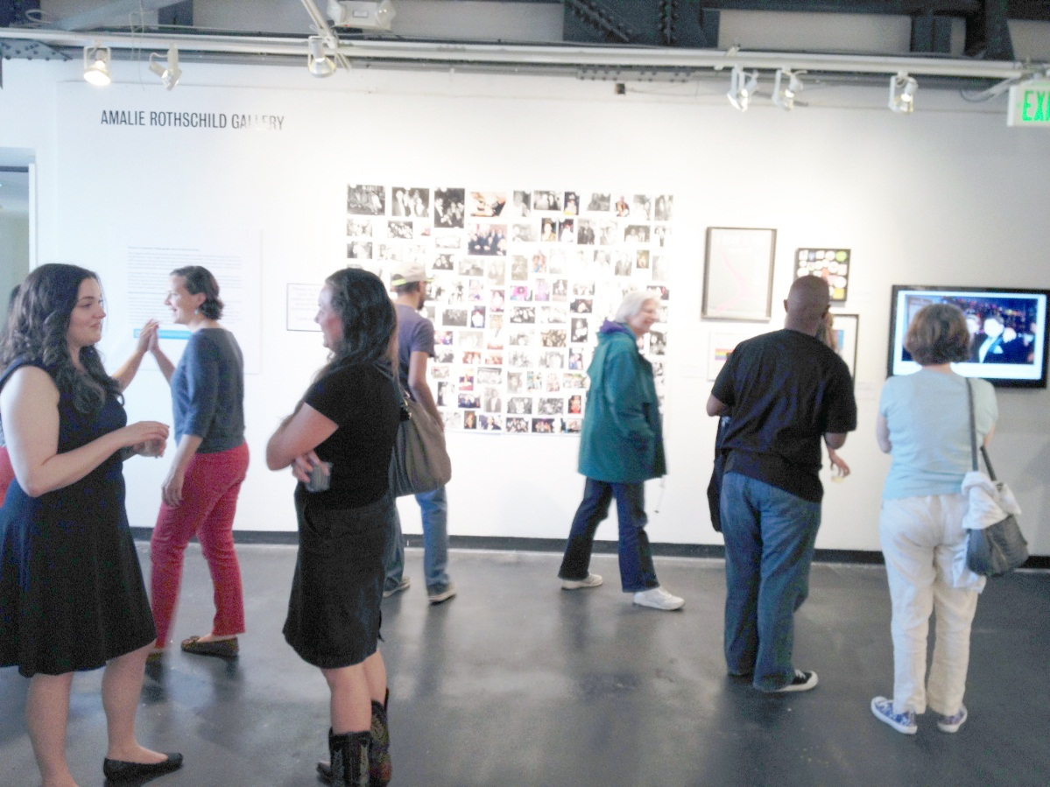
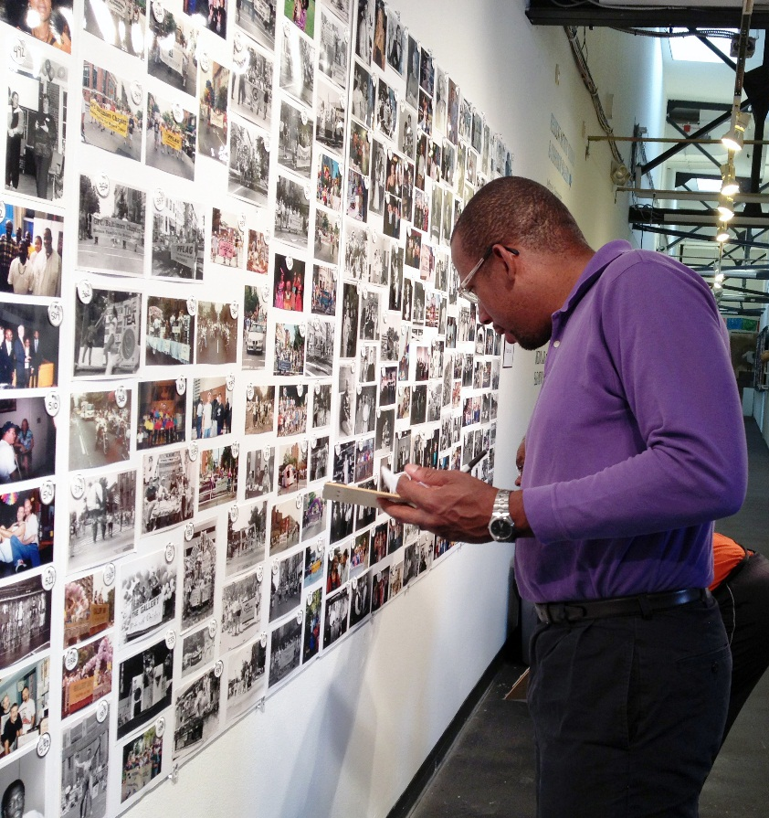

Crowd Sourcing Metadata for Photographs of the LGBT Baltimore Community:
An Interactive, Inexpensive and Low Tech Approach
Ben Blake
University of Baltimore
MARAC Fall Conference
October 10, 2015

Slide 2
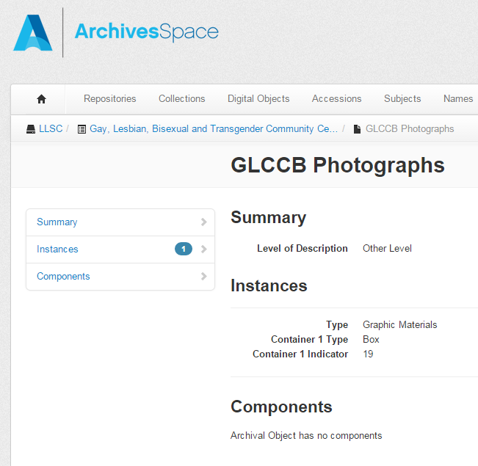
Why crowd source?
Thousands of unidentified photographs
Energetic volunteers
Opportunity to engage veteran LGBT activists
Raise awareness
Encourage community engagement
Build future support for the
LGBT Baltimore archives project

Slide 3
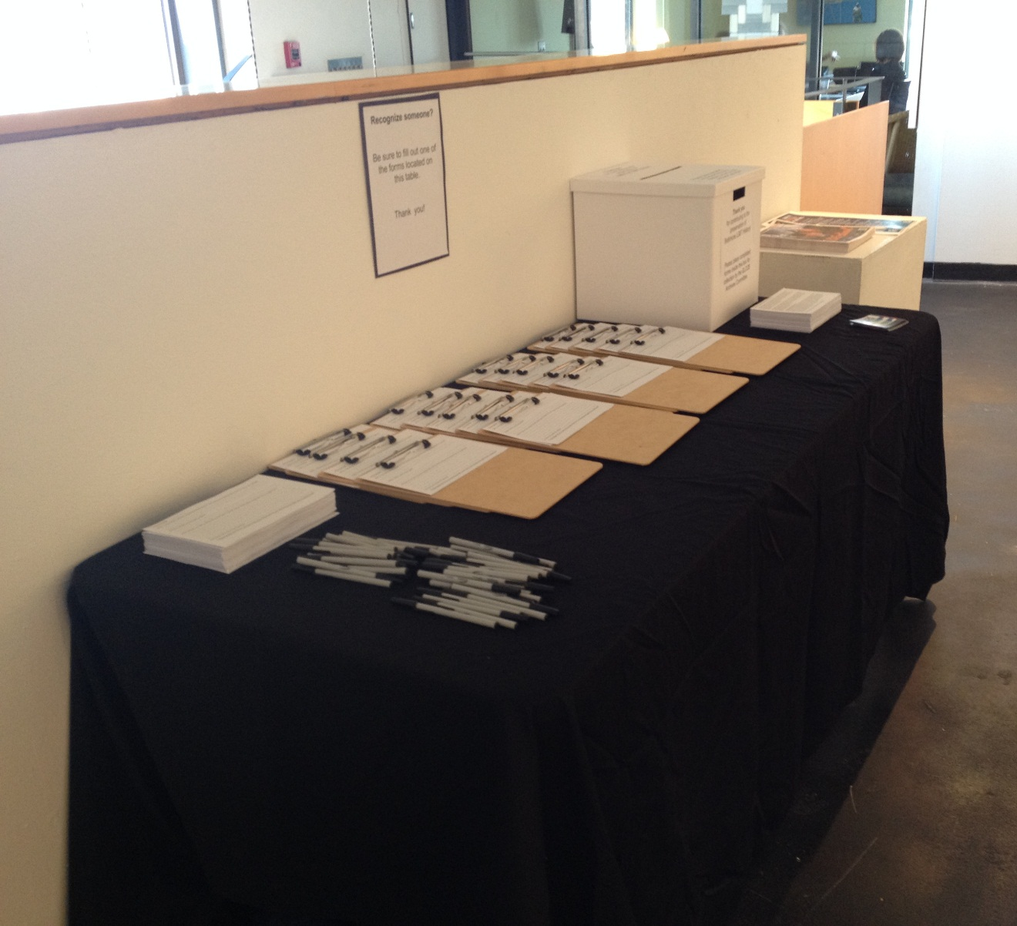
Our approach:
Why Low Tech?
$0.00 budget
Plentiful volunteer labor supply
Interested community members
Limited tech resources
Start now, build a foundation
for the future

Slide 4
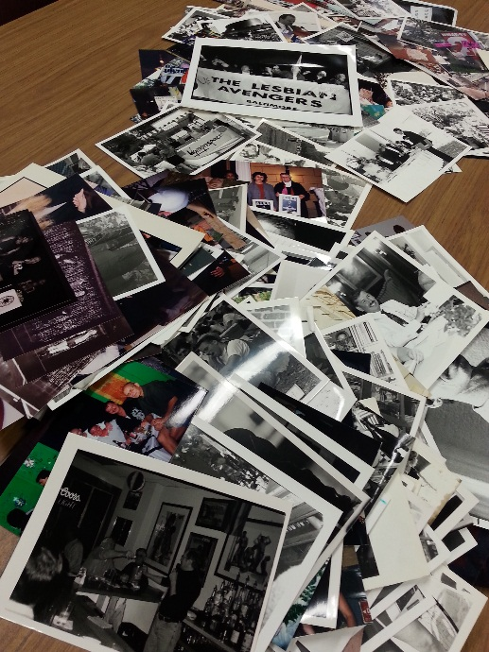
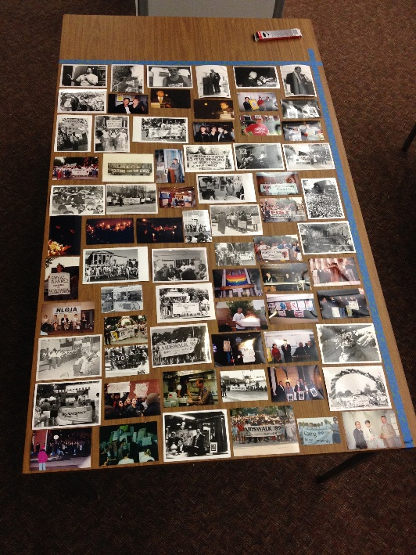
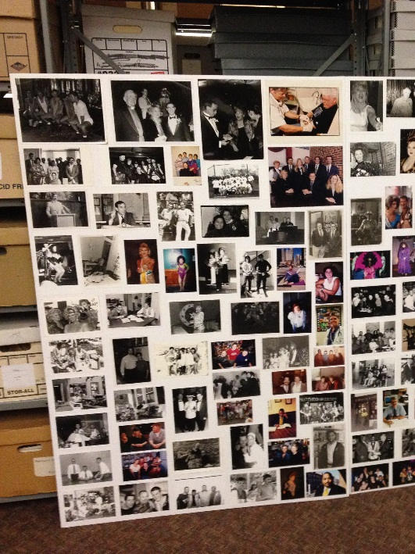
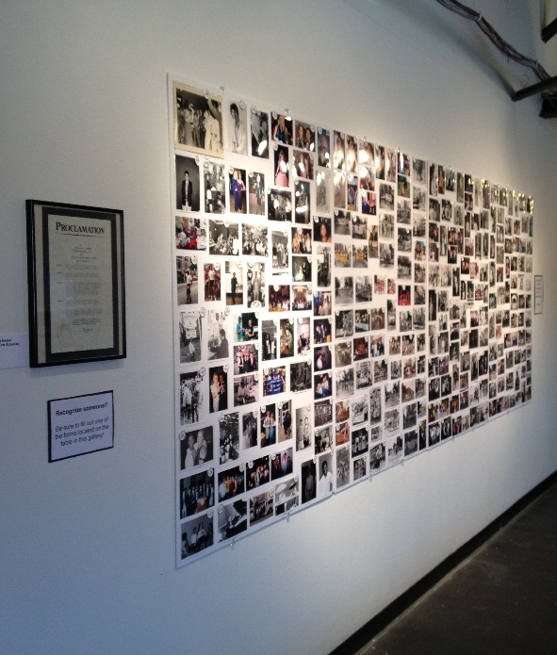
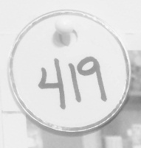
Creating the Exhibit: Cheap, Fast and Easy
Selection of a representative set of images
Layout on a table space
40” x 60”
Mount images on foam board with identifying numbers
Mount foam boards in exhibit space

Slide 5
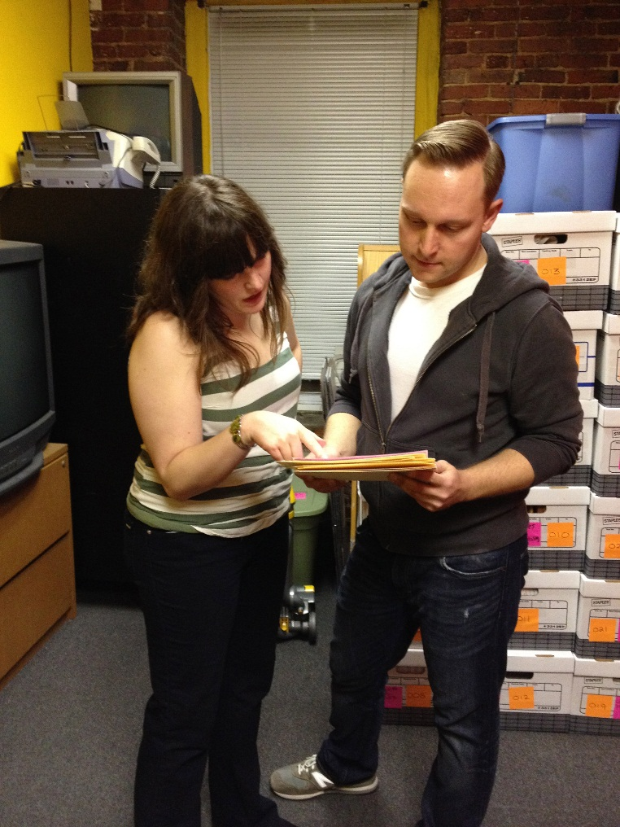
Results from the Two Week Exhibit:
158 identification forms were turned in with information on 110 images (21% of the grand total of 532 images)
Of the 158 forms turned in: 59% had information
in “who” field, 20% also had “when, where”
information and 21% also had additional information
Information for all three fields were provided
for 4% of the grand total of 532 images
95 forms or 60% were turned in anonymously
20 people who identified images also provided their contact information (17% of all 158 forms turned in)

Slide 6
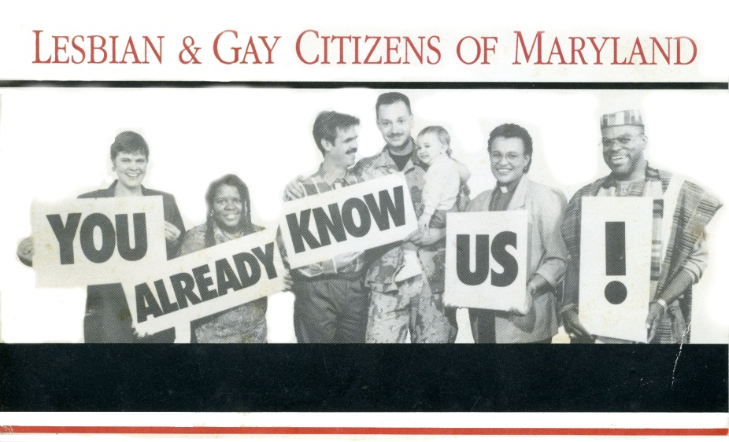
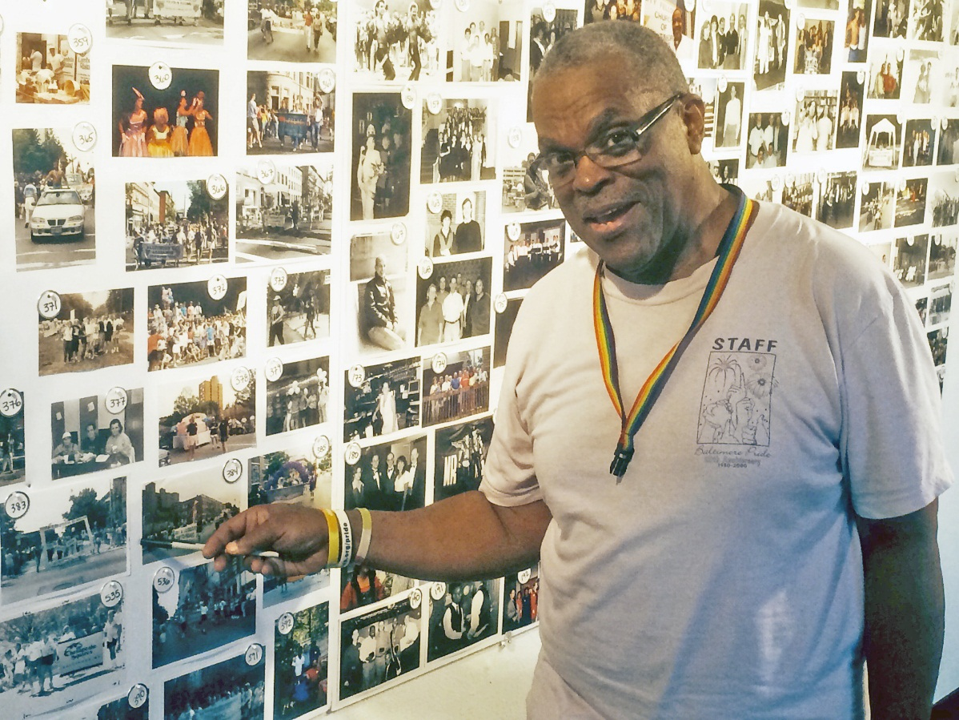
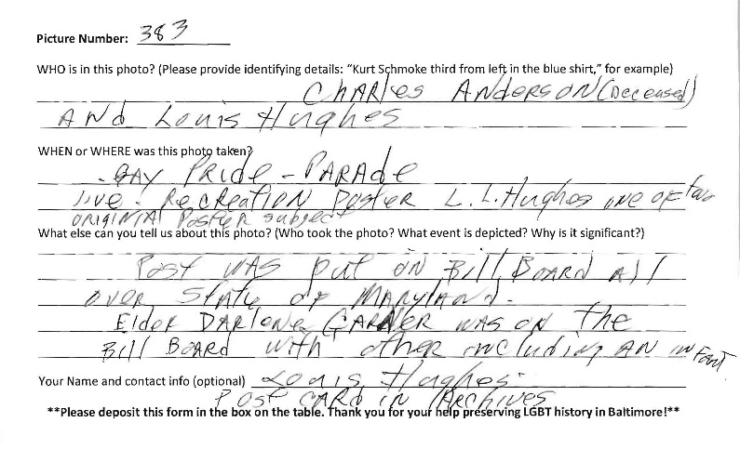
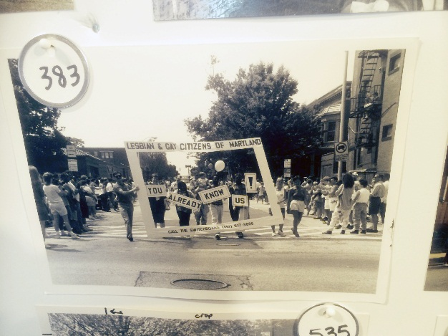
The Process of Linking Images and Information:
Postcard in Motion, The Baltimore Justice Campaign, 1992

Slide 7
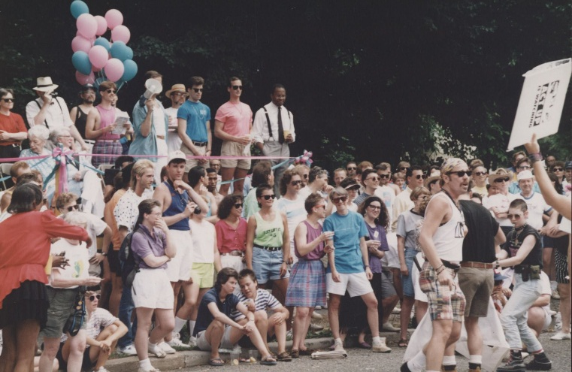
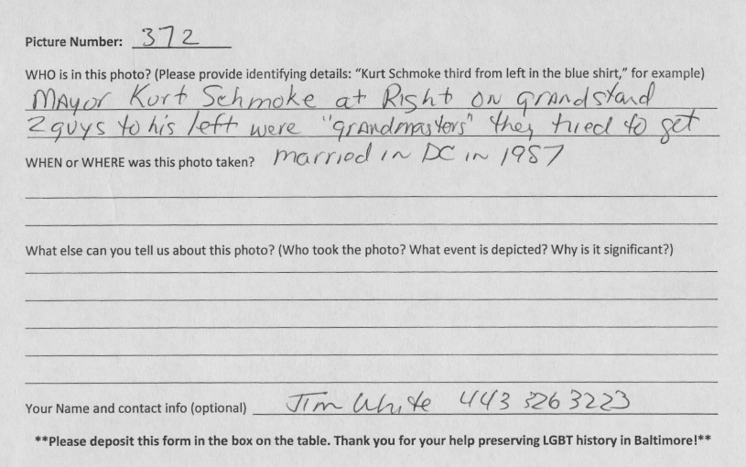
Unidentified parade crowd becomes:
Baltimore Mayor Kurt Schmoke and Grandmaster couple reviewing the Pride Parade, 1992

Slide 8
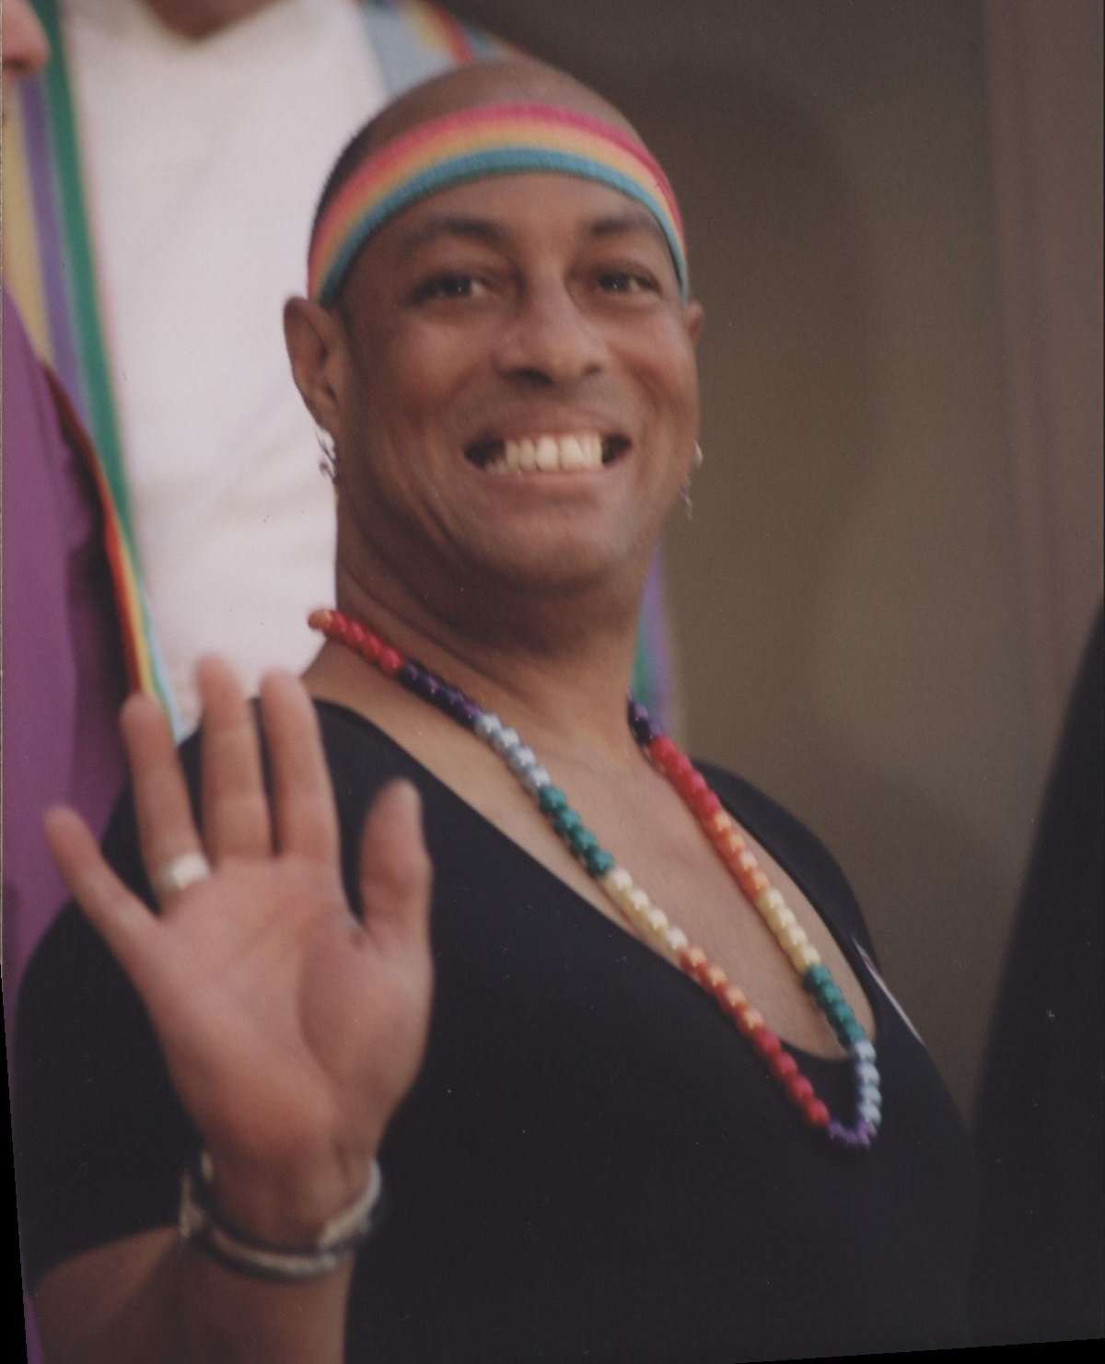
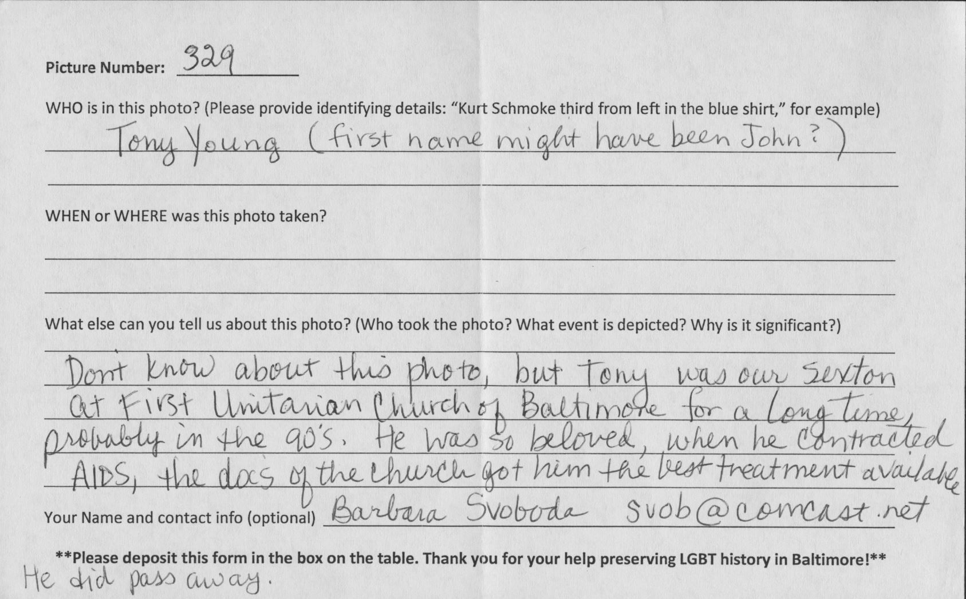
Anonymous portrait becomes:
Tony Young, beloved Sexton of the First Unitarian Church, who died of AIDS in the early 1990s

Slide 9
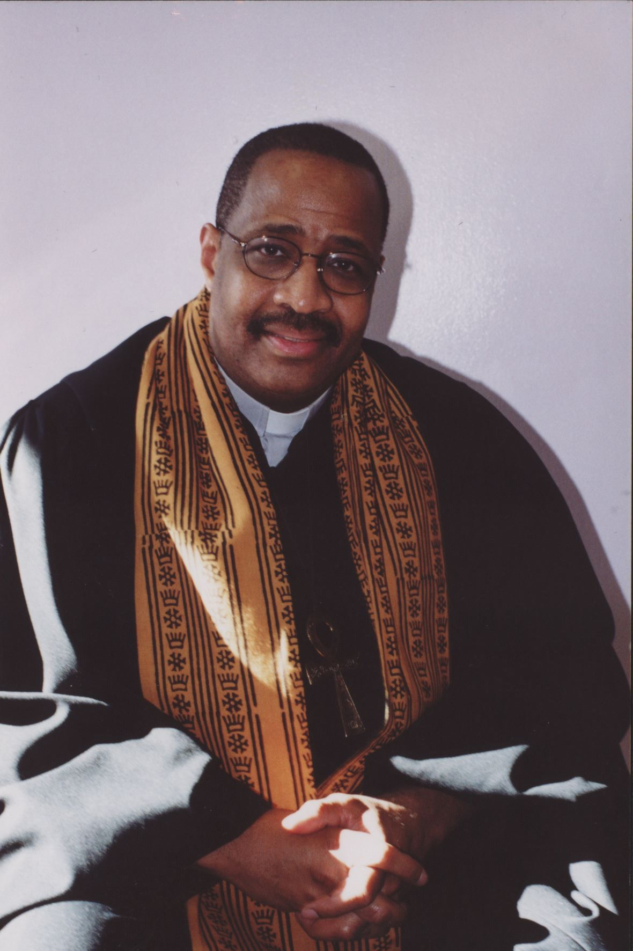
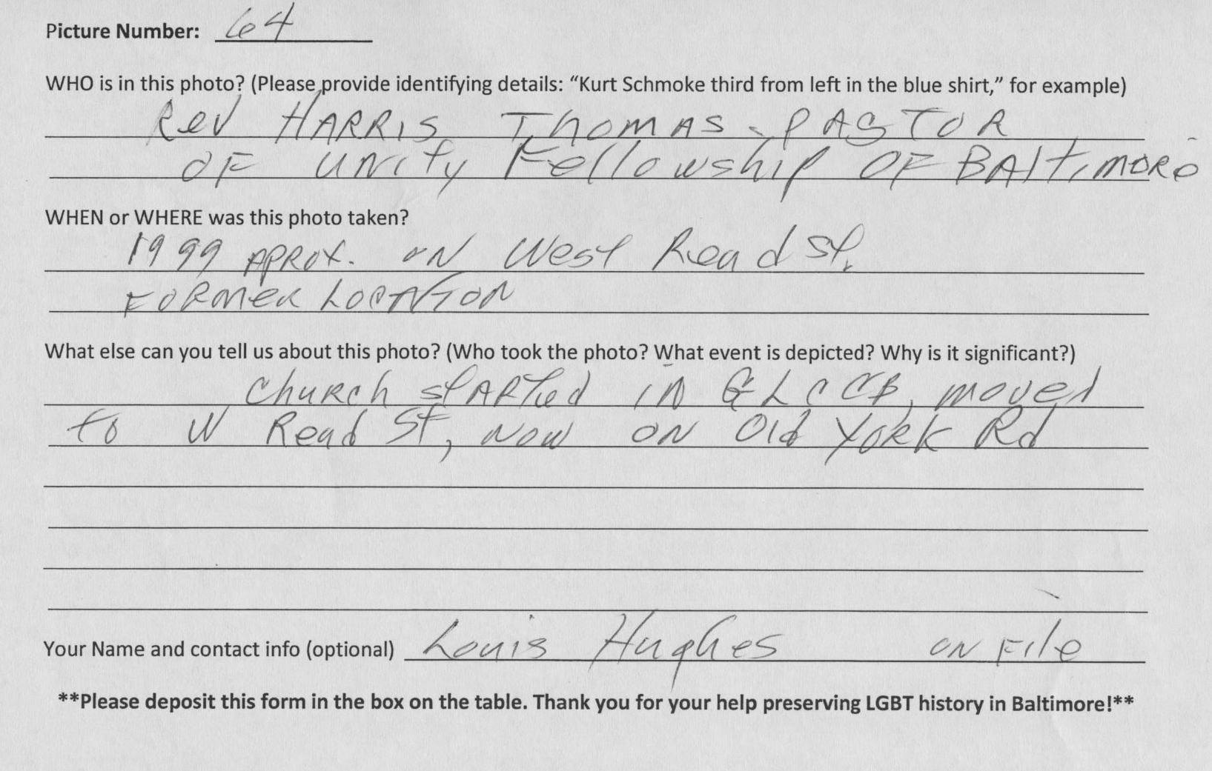
Unidentified minister becomes:
Reverend Harris Thomas, Pastor of Unity Fellowship, which was founded in the GLCCB building,1999

Slide 10
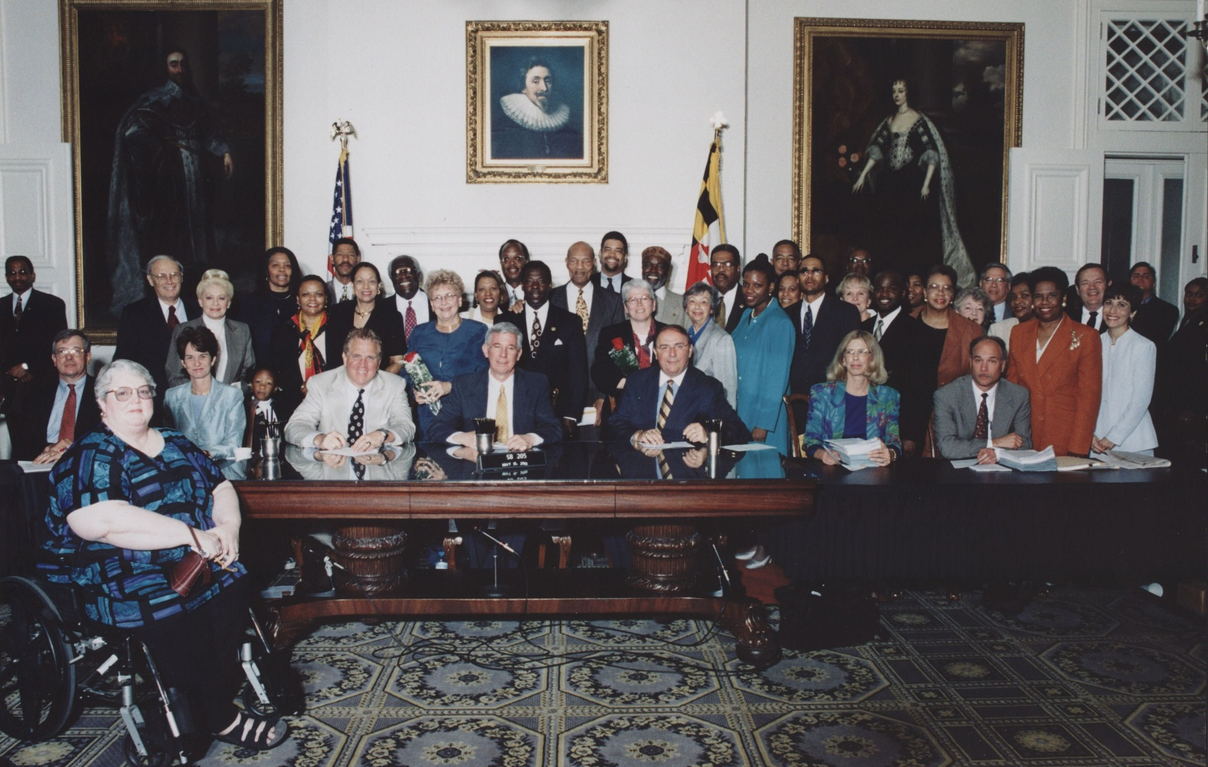
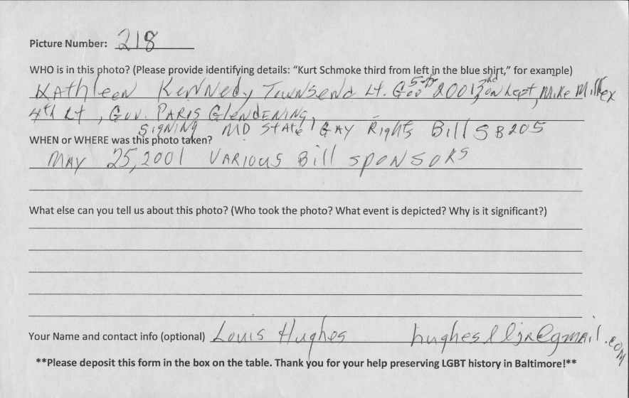
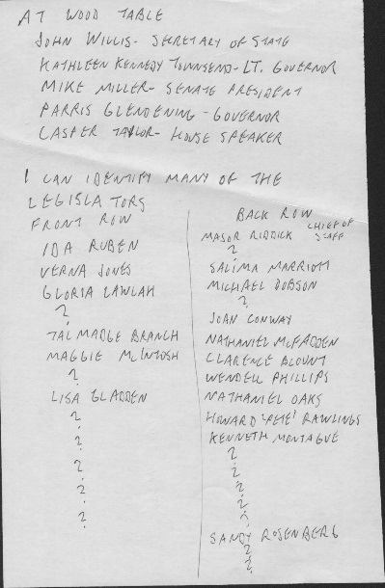
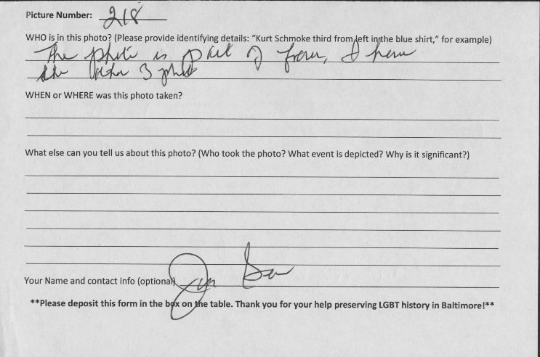
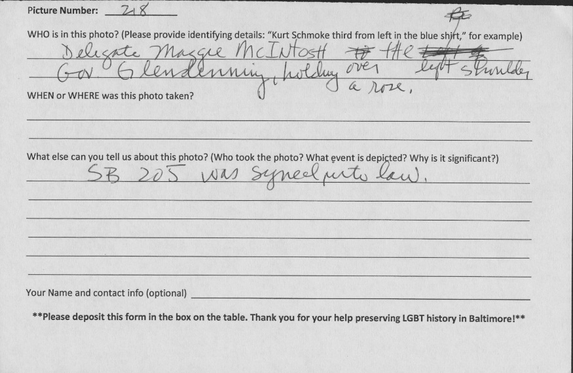
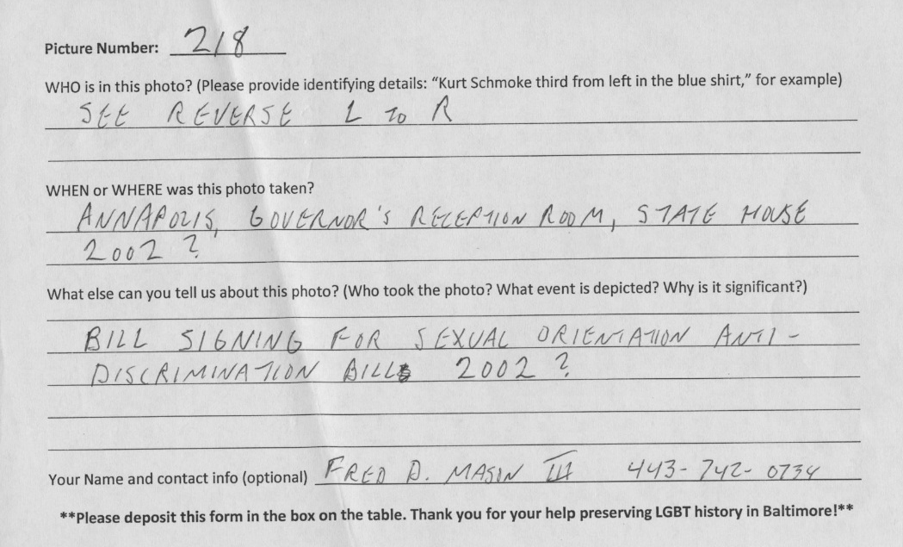
Crowd of unidentified officials becomes:
Maryland Governor Paris Glendening signing the Sexual Orientation Anti-Discrimination Bill, SB250, May 25, 2001 (1 of 4 different group portraits)

Slide 11
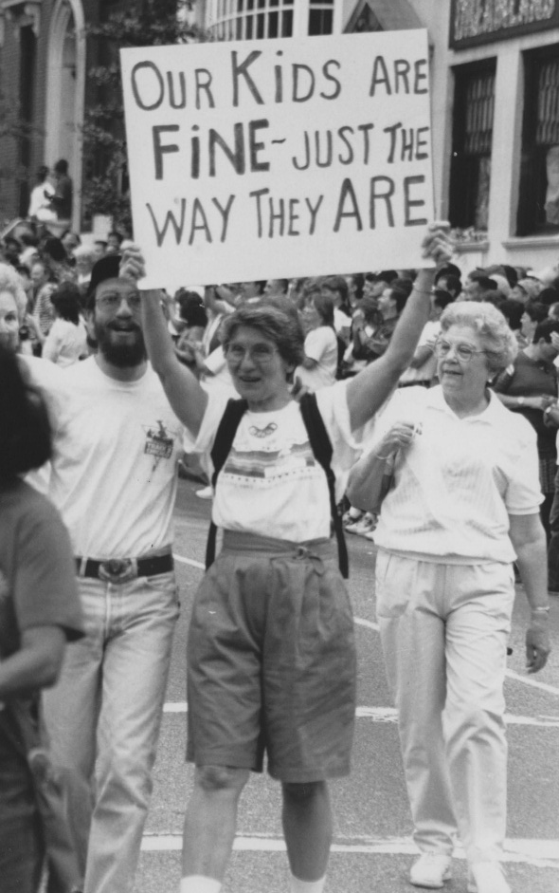
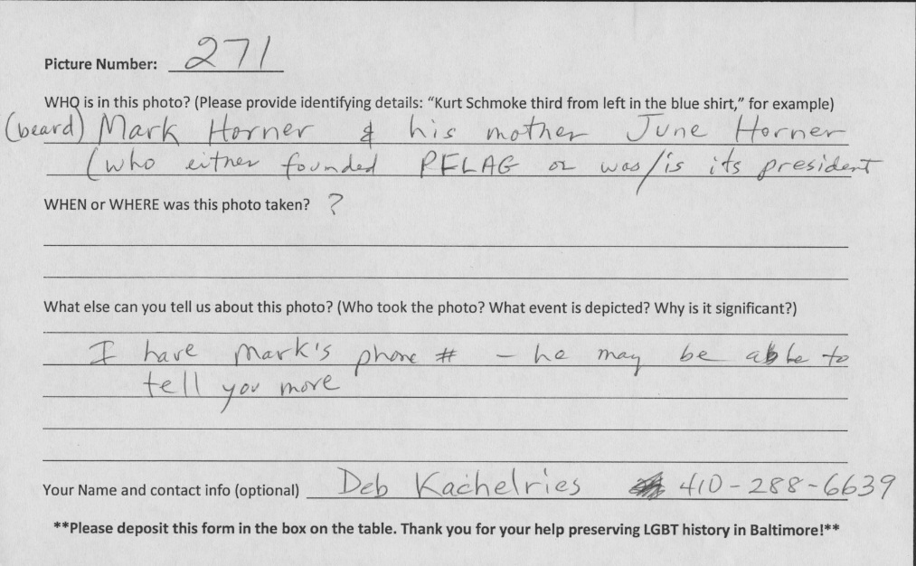
Protestor with sign becomes:
Mark Horner’s mother, June, founder of Parents For Lesbians and Gays

Slide 12
Lessons Learned
High exhibit participation + requires active curation
New contacts + time commitment for follow up
Original photo prints + little risk of theft or damage
Zero digital infrastructure + no web presence
$0.00 budget + limits project expansion, follow up
Volunteer driven + more supervision

Slide 13
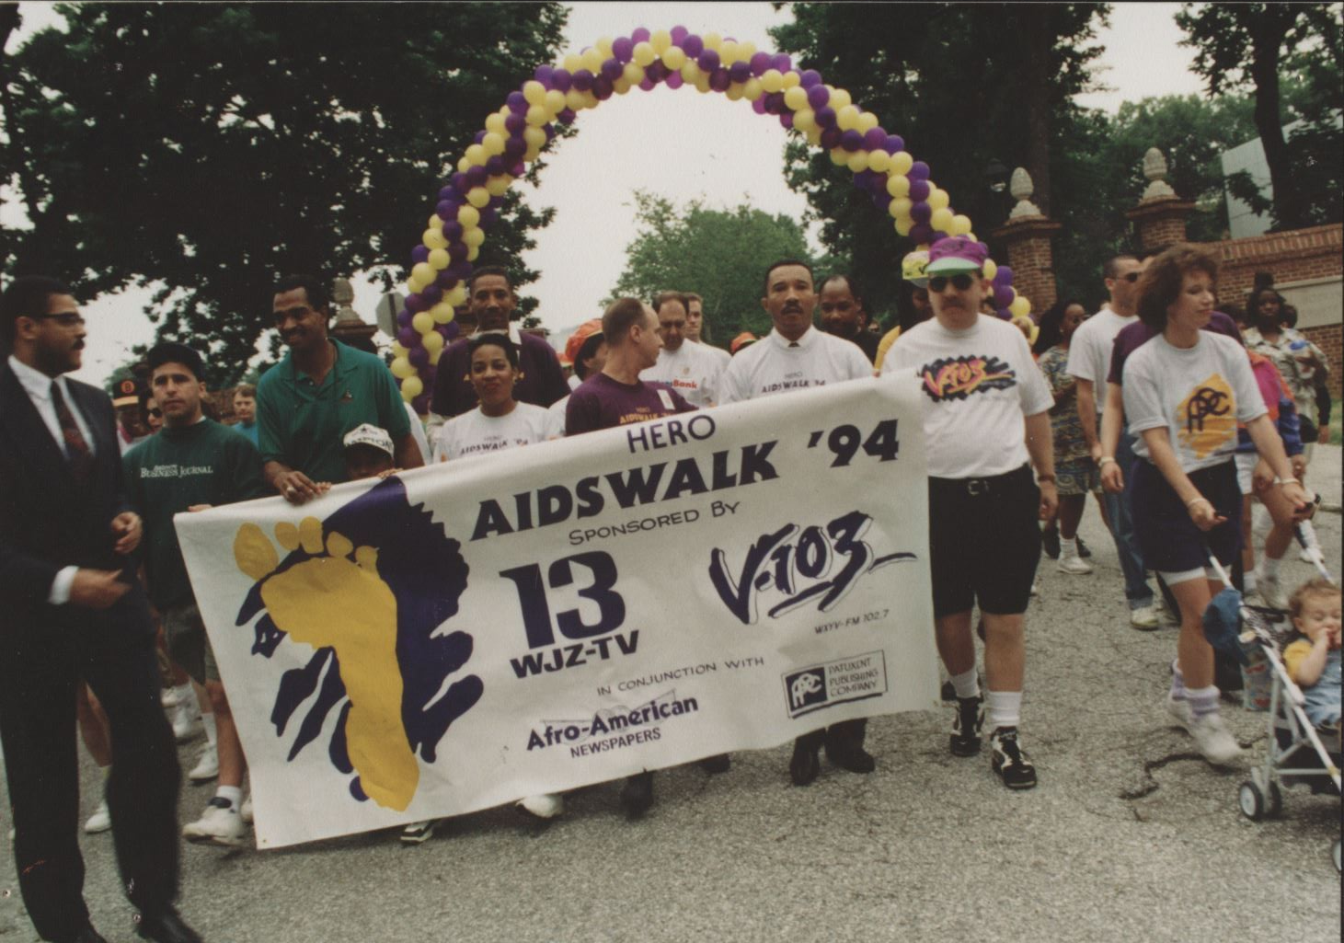
Thank you!
Ben Blake
University Archivist
Special Collections
Langsdale Library
University of Baltimore
bblake@ubalt.edu
410.837.5047

