Slide 1
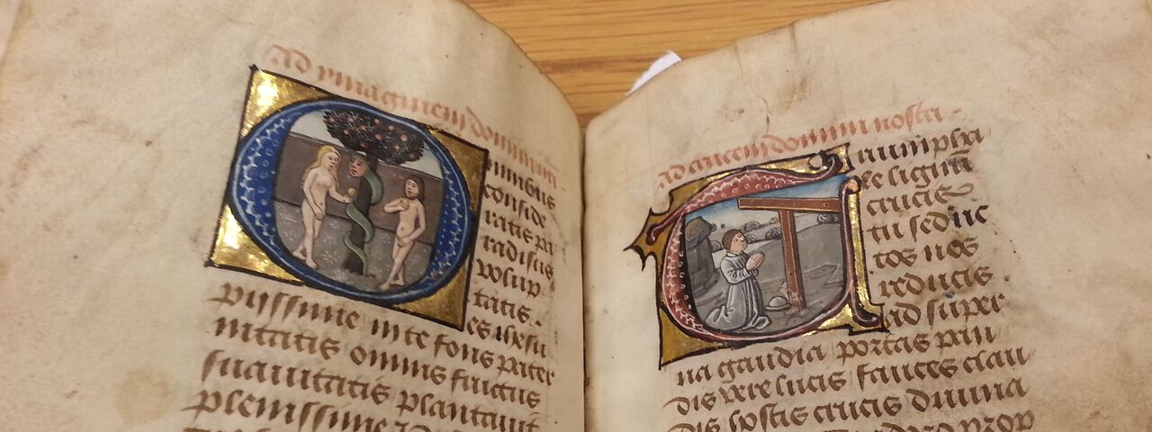
The Berners Hours
A 237-leaf Fifteenth-Century Illuminated Manuscript Prayer-Book (Horae)

Slide 2
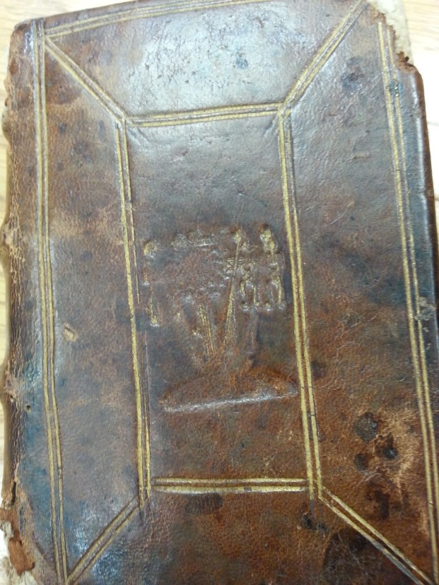
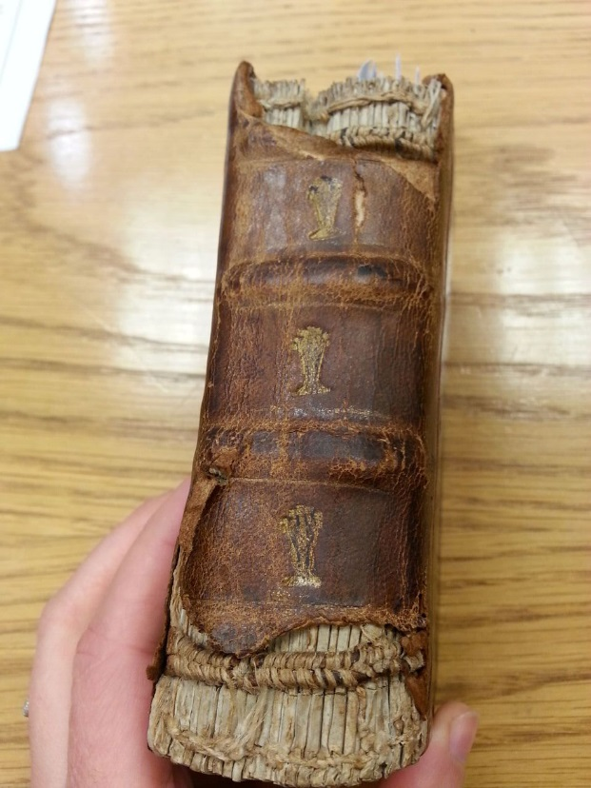
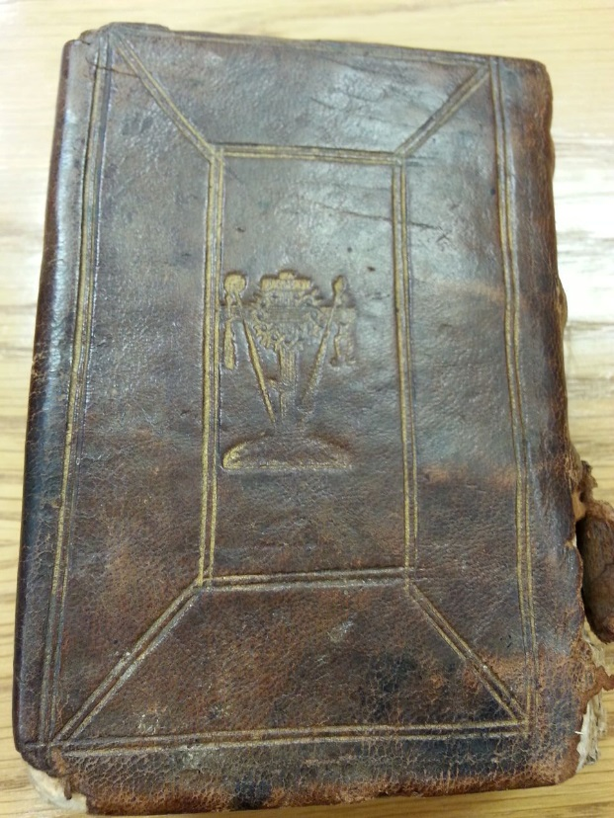

“Book of Hours, Use of Sarum, in Latin. Illuminated manuscript on parchment. Bruges [Belgium]: [the Vrelant atelier], c. 1470.”
The “Berners Hours,” named for its earliest known owner, is 237 leaves of parchment, written in gothic batârde script. It is small, 12 x 8.5 cm (5 x 3 ½ inches), about the size of an iPhone6, but thicker (4 cm. / 1 ½ inches), fitting the palm of one’s hand. It contains eight full-page illuminated miniatures and twenty-one historiated (pictorial) initials commenting on the texts. Made in the 1470s, it lost its binding between the then and the 1700s. Rebound in brown calf, gold stamped with the “Instruments of the Passion” leaning on the Cross, it appears to have been in near constant use until the late 18th or early 19th century. Even great manuscript collections like the Morgan Library or the Walters Art Museum do not have an horae like the Berners; their founders cared mainly for beautiful, unused books. This book reveals the reading and worship behaviors of its readers through the damage it suffered during perhaps 300 years of passionate devotion.

Slide 3
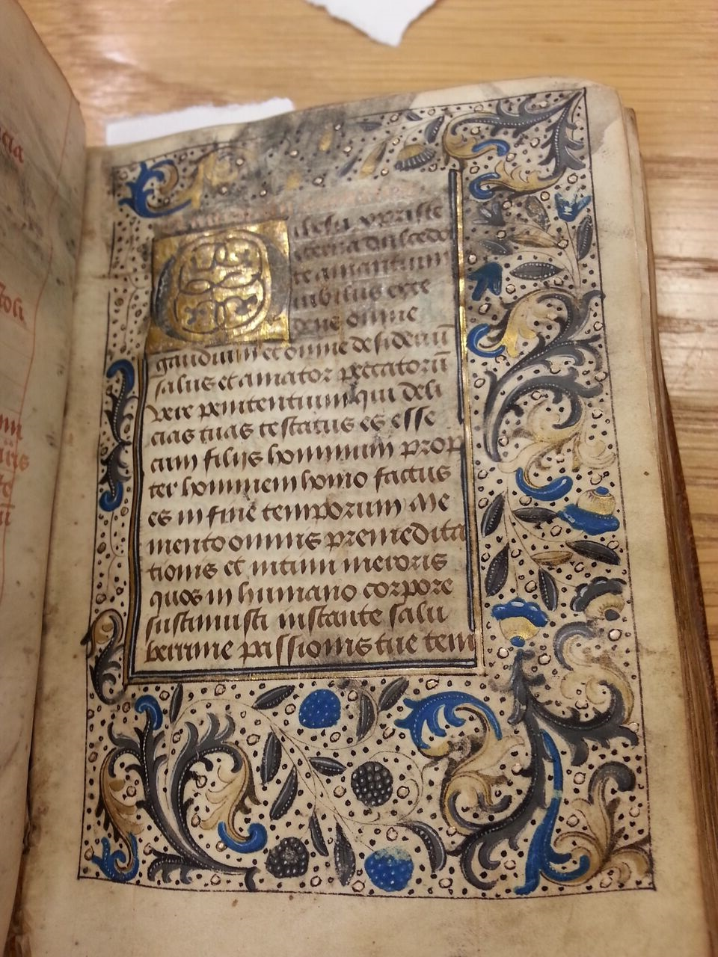
What is a “book of hours” and how did their owners use them?
From about 1300 to the late 1500s, Medieval Christians increasingly wished to own sacred books to help them worship privately, passionately, and physically. A “book of hours” collected psalms, hymns, and biblical passages, with beautiful images guiding worshipers’ prayers at all the canonical hours into which the Church divided the day: Matins (midnight), Lauds (3 AM), Prime (6 AM), Terce (9 AM), Sext (noon), Nones (3 PM), Vespers (6 PM), and Compline (9 PM). Added devotional sequences, such as the “Fifteen Os” of Saint Brigit of Sweden, and “suffrages,” petioning prayers to specific saints, asked for sacred aid of against sudden death, plague, and pains of childbirth.

Slide 4
Who made the Berners Hours?: Probably female apprentices trained by and working with William and Marie Vrelant
In the 1470s, twenty years after Gutenberg printed the first book with moveable type, manuscript (hand-written) books were still created and cherished as the best way to display and preserve important texts. Just as deluxe printed books were made on parchment rather than paper, the best manuscripts were made on smoothly polished parchment, as thin as rice paper and strong as leather. The scribes who wrote these texts and illuminators who painted the pages were secular craft guild members working in collaborative networks. The Berners Hours came from the “atelier” or work-group of William de Vrelant (ca.1420?-1481), a master illuminator whose collaborators produced hundreds of manuscripts in Bruges, then in the duchy of Burgundy, now in the Netherlands. All but one of Vrelant’s apprentices appear to have been women, apparently beginning with his wife, Marie.
Marie de Vrelant, active 1460-1491, full member Guild of St. John Evangelist and master of the atelier after her husband’s death, 1481-1491. Possibly “Master of the Polemical Texts” (Van Buren 25).
Anonymous female apprentice (based on 3-groat fee to Guild of St. John Evangelist, 1461-1462.
“Matkin” [Matilda], 1464-1465.
“daughter of Lodovic Brayels,” 1467-1469.
Anonymous female apprentice, 1469-1471.
Adriaen de Raedt, the only known male: apprenticed 1474-1475.
“Betkin” [Beatrice] Scepens, 1476-1478, full member Guild of St. John Evangelist, 1478-1489.

Slide 5
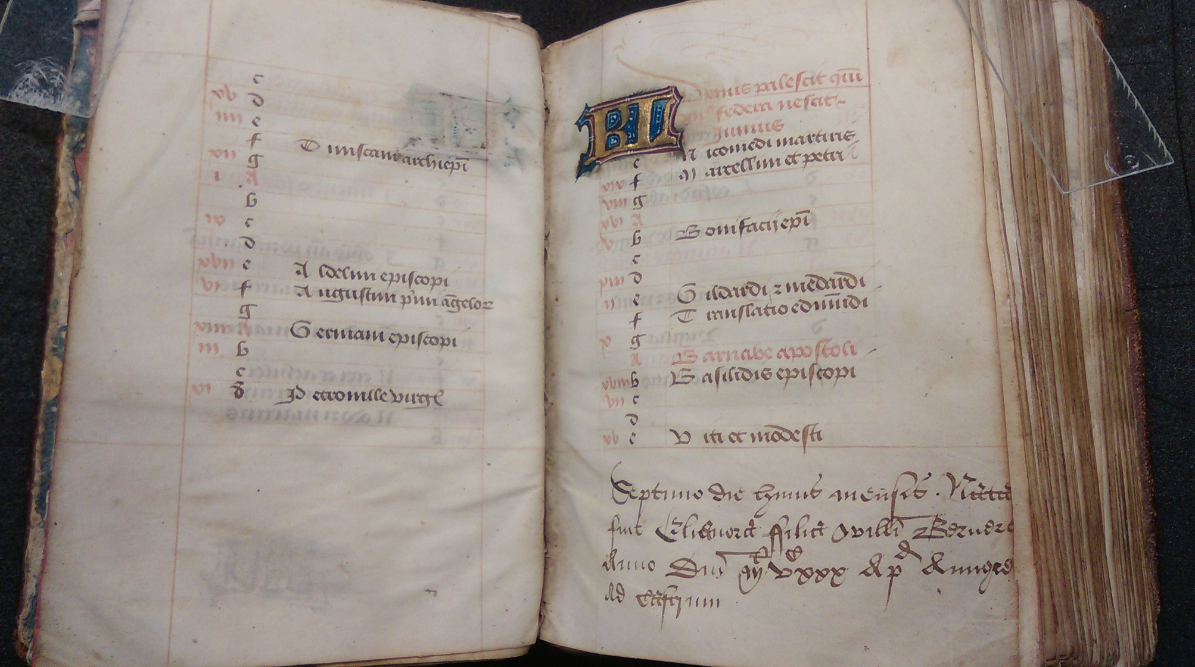
Berners Hours. Part I: folios 1r-12v, The Calendar
The Vrelant atelier customized books for potential buyers’ locations, because Christian religious services’ prayers varied by the “use” or rule of local bishops. The Berners Hours follows the “Use of Sarum,” based on services at Salisbury Cathedral in England, suggesting its first owners were English. The manuscript also includes prayers to English saints: Thomas a Becket, Guthlac, Ethelwalde, Edmund, and Ethelrede. The first owners (ca. 1470-1525) are not known, but they may have been ancestors of William Berners (fl. 1527-1531), who annotates the Calendar. The beginning Calendar of saints’ feast days, one or two pages per month, was annotated by William Berners at Aungre [Ongar] ad Castrum, near Epping (England) with the birth dates of his children: Eleanora Berners’ birth is noted on the right below.

Slide 6
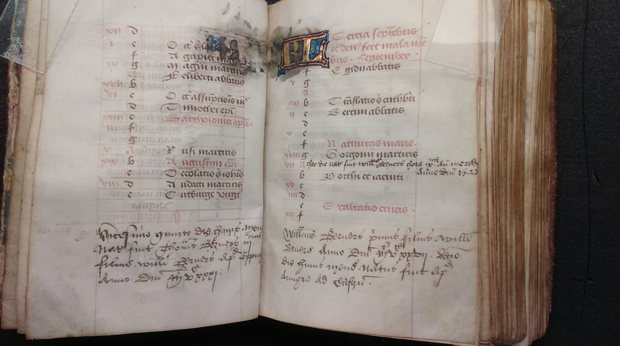
How and why did medieval owners add to their books?
Medieval book owners often used the few books they owned to store precious family records. Birth, marriage, and death dates were commonly written on blank front or end leaves, or on calendars of books of hours, a tradition still continued by owners of many modern family Bibles. On the right page below, on 10 September 1527, William Berners proudly recorded his first son (“primus filius”) William Berners’ birth twice, in the middle of the list of saints’ feast days and at the foot of the page. On the left facing page, is birth record of Thomas Berners (25 August 1531), who may have been his last child.

Slide 7
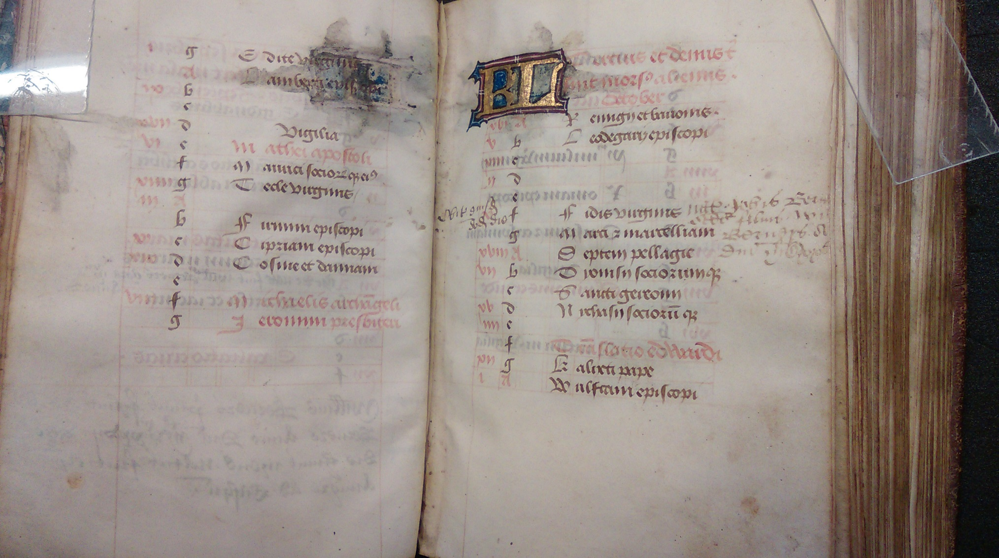
Why were births, marriages and deaths so important to record?
A book of hours was the collective memory of an owner, family, or community, helping them pray to the appropriate saints on the right feast days, and for salvation of the souls of living and dead relatives. William’s second son, John, who died on the day he was born, would have been of intense concern for him. See the beginning “Obit” in the left margin opposite the birth record in the right page’s margin.

Slide 8
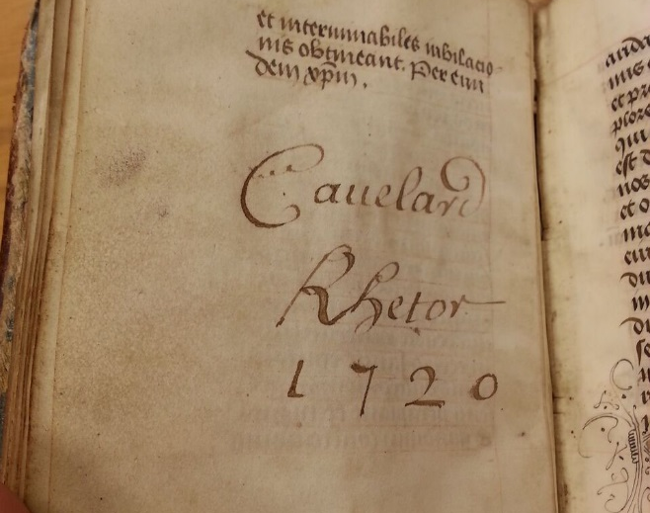
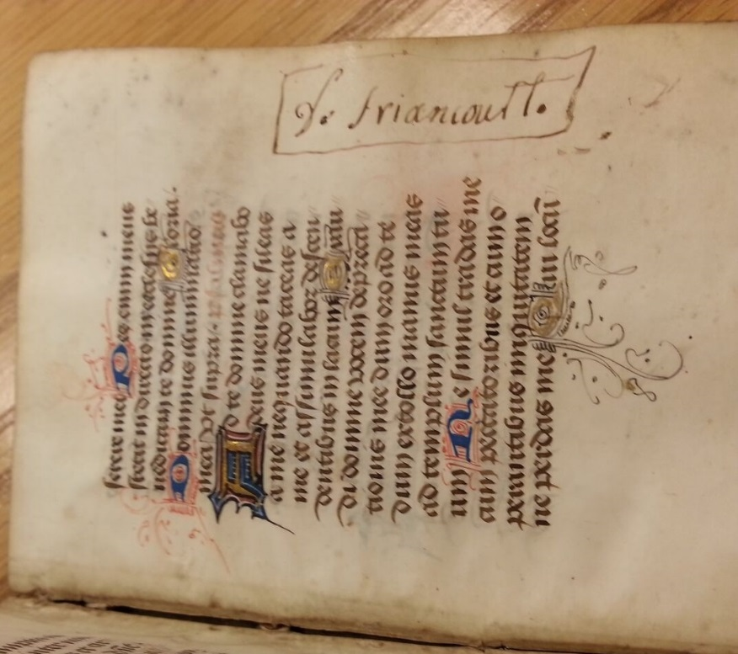
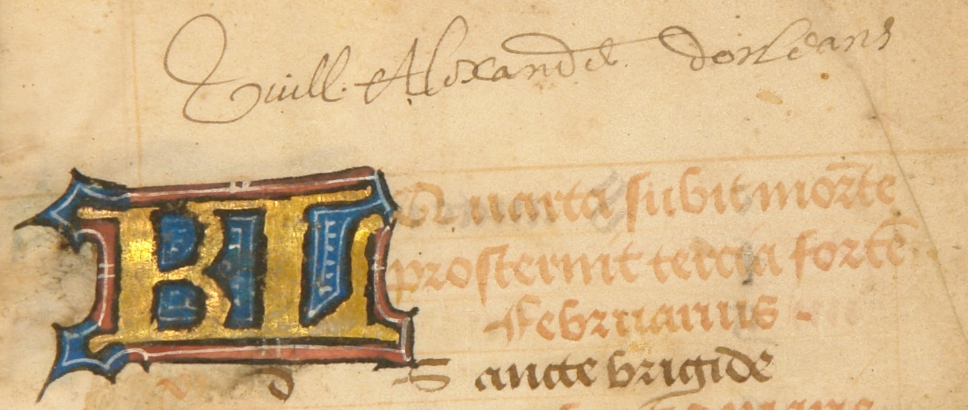
Who owned the Berners Hours in the modern era?
A later owner, or perhaps a French censor, signed folio 38v “Cauelard Rhetor 1720.” Someone in Picardy inscribed folio 207r “de Friancourt.” Another reader, twice wrote his name in the Calendar: “Guill[aume] Alexandre Dorleans” (f. 2r and 7r), possibly a father or his son from Normandy, fl. 1694-1740 or fl. 1744-81.

Slide 9
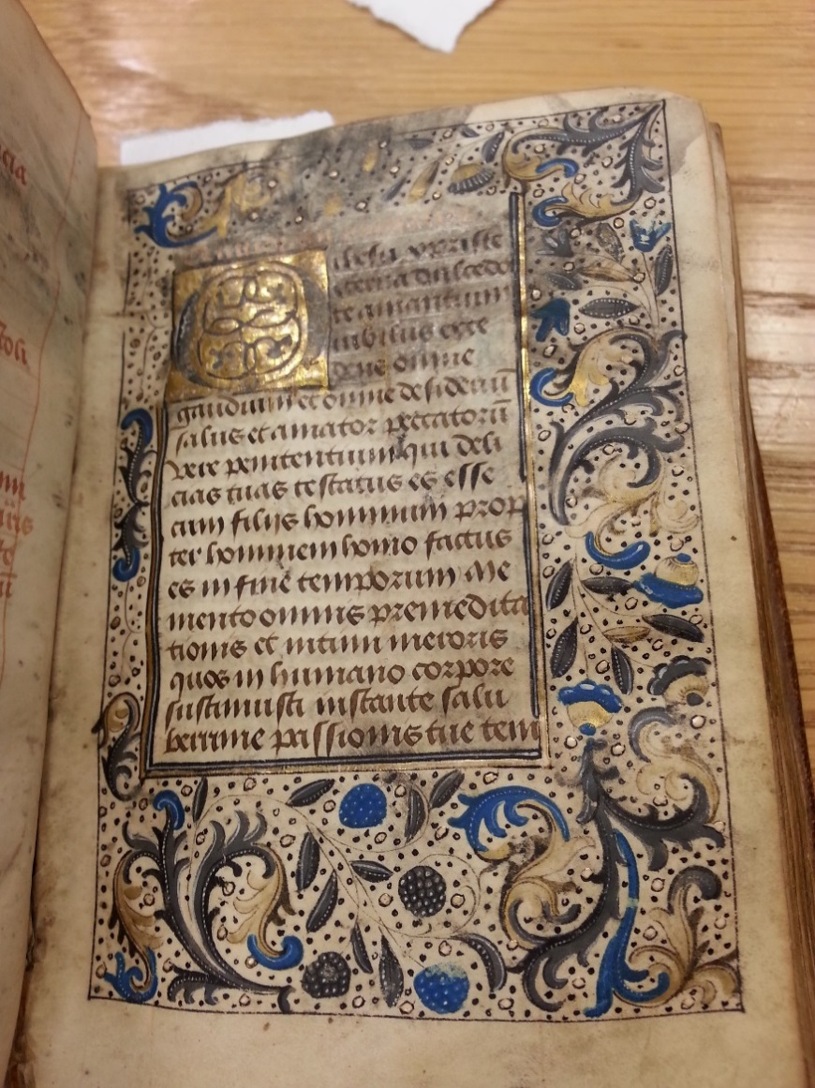
Berners Hours Part II: folios 13r-23r “The Fifteen Os”
This sequence of fifteen prayers, each beginning with the exclamation “O” and attributed to Saint Brigit of Sweden, promised forgiveness of sins if prayed every day of the year. This is the first prayer, beginning “O IESU CHRISTE, aeterna dulcedo te amantium” (“O JESUS CHRIST! Eternal Sweetness to those who love Thee”). The gold initial “O” has often been kissed in worship.

Slide 10
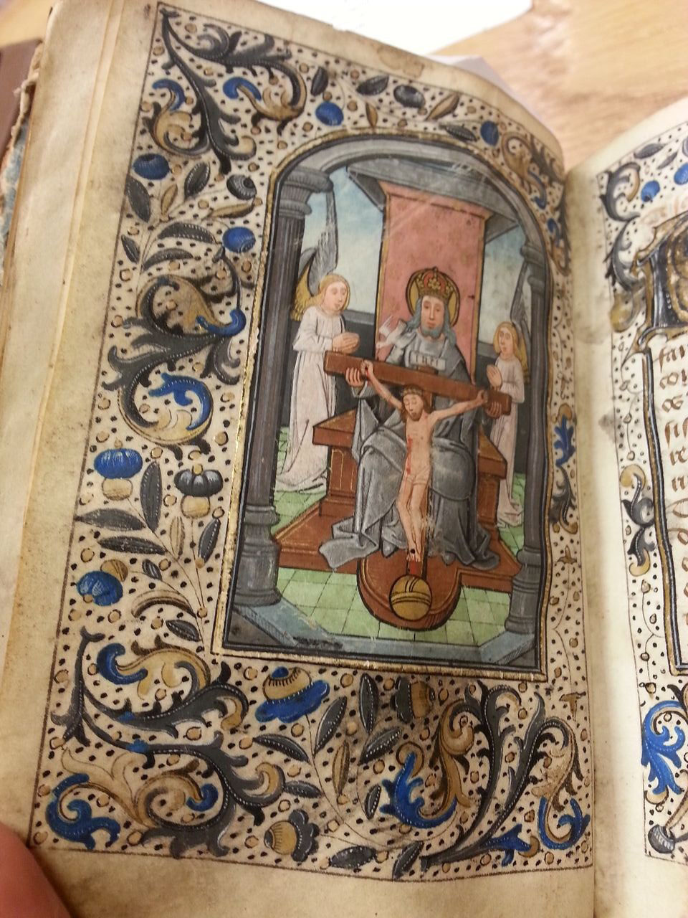
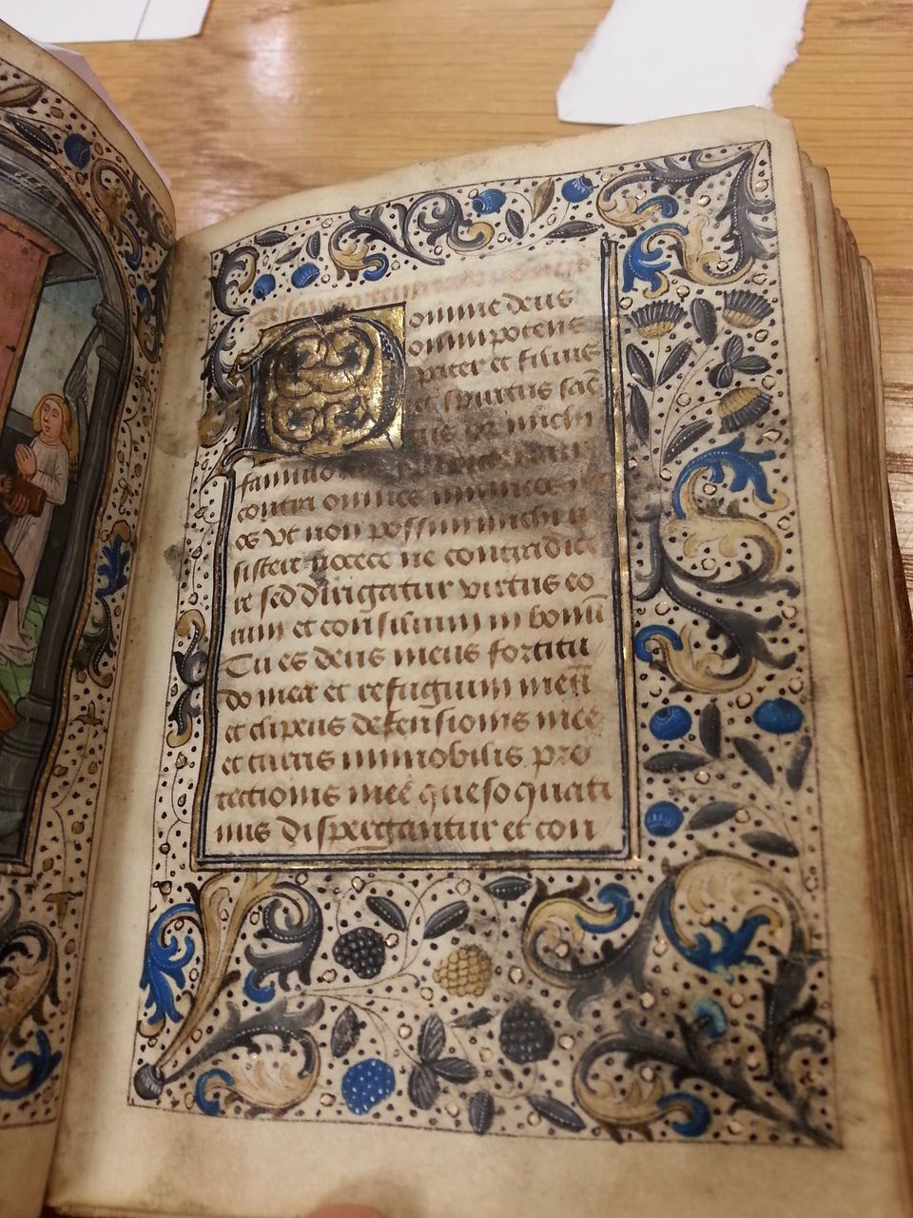
Berners Hours Part III: folios 23v-26r, Suffrage to the Trinity
Suffrages, or prayers asking divine aid and protection, were specialized text-image combinations that focused worshipers’ eyes and ears and minds upon the agent of the prayer. Many Berners Hours suffrages lack their miniatures, which may have been removed as private devotional aids. The “Trinity” miniature is strikingly intact, though the gold initial “D” of “Domine deus” on the facing page has frequently been kissed in worship.

Slide 11
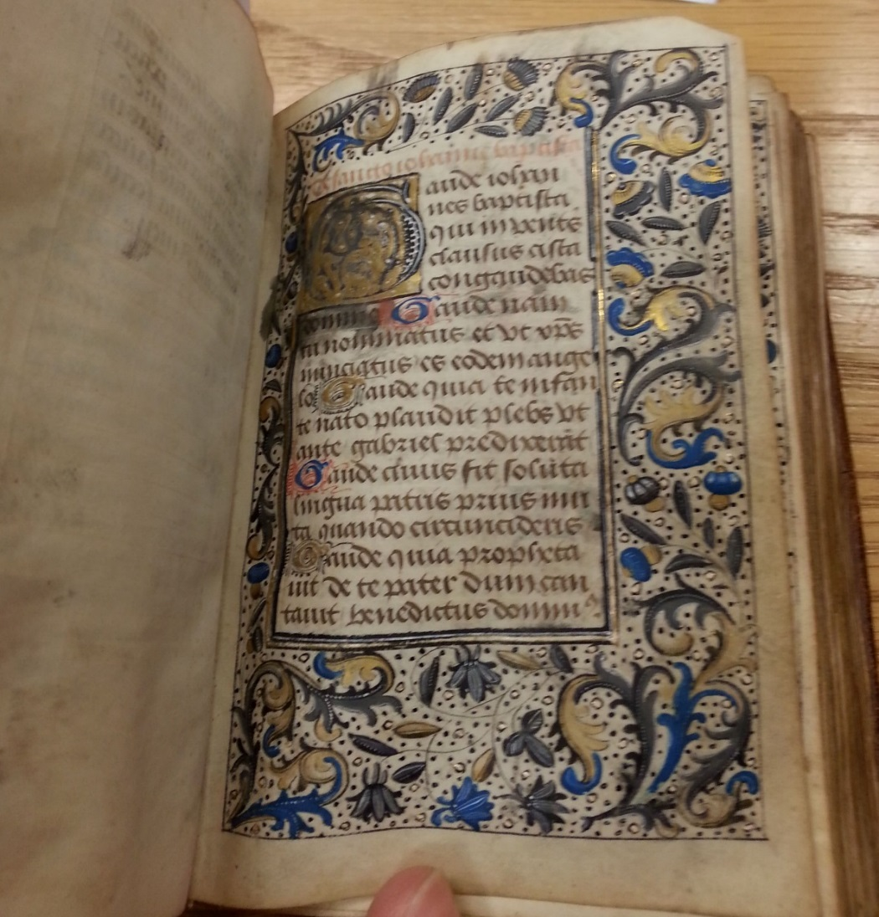
Berners Hours Part IV: folios 27r-v, Suffrage to St. John the Baptist
John the Baptist (vs. “the Evangelist,” author of Revelations), foretold Jesus’ coming and baptized him in the Jordan River. This suffrage’s miniature has been removed, possibly to aid private devotion. The gold initial “G” of “Gaude iohannes baptisti” (“Rejoice John Baptist”) has been lightly kissed.

Slide 12
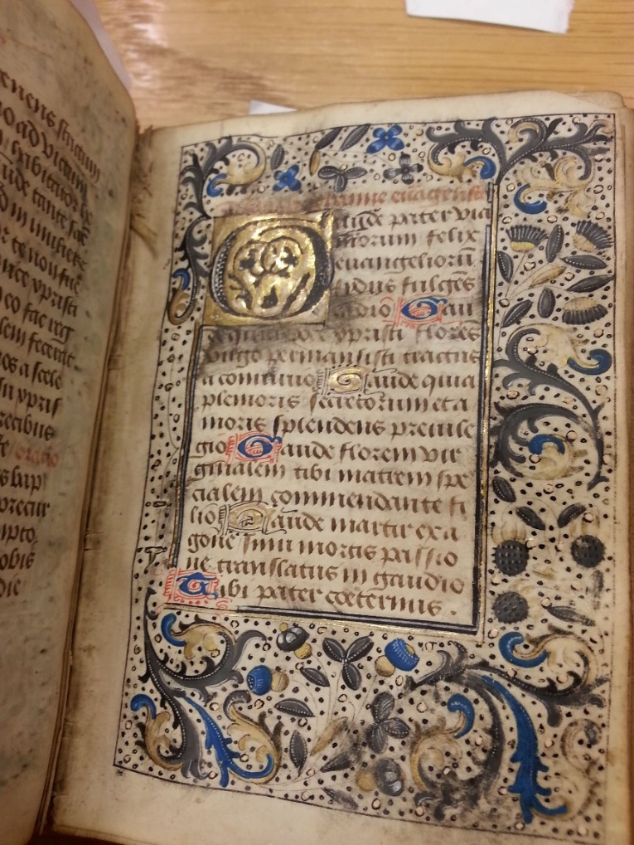
Berners Hours Part V: folios 28r-v Suffrage to St. John Evangelist
John, the author of Revelations (the “Apocalypse”), was revered by medieval Christians for giving them a map of time to come, and a powerful narrative of how God will unmake and remake the world at the end of time. Since the salvation of souls of the dead would occur at the Apocalypse, it was anticipated with joy by some Christians. John’s miniature has been removed, and his suffrage’s gold capital “G” of “Gaude pater via morum felix” (“Rejoice father of the happy way”) has been persistently kissed.

Slide 13
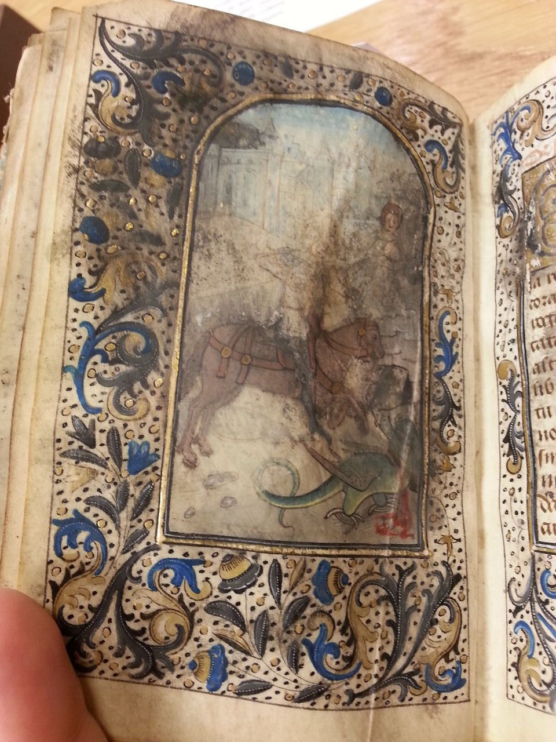
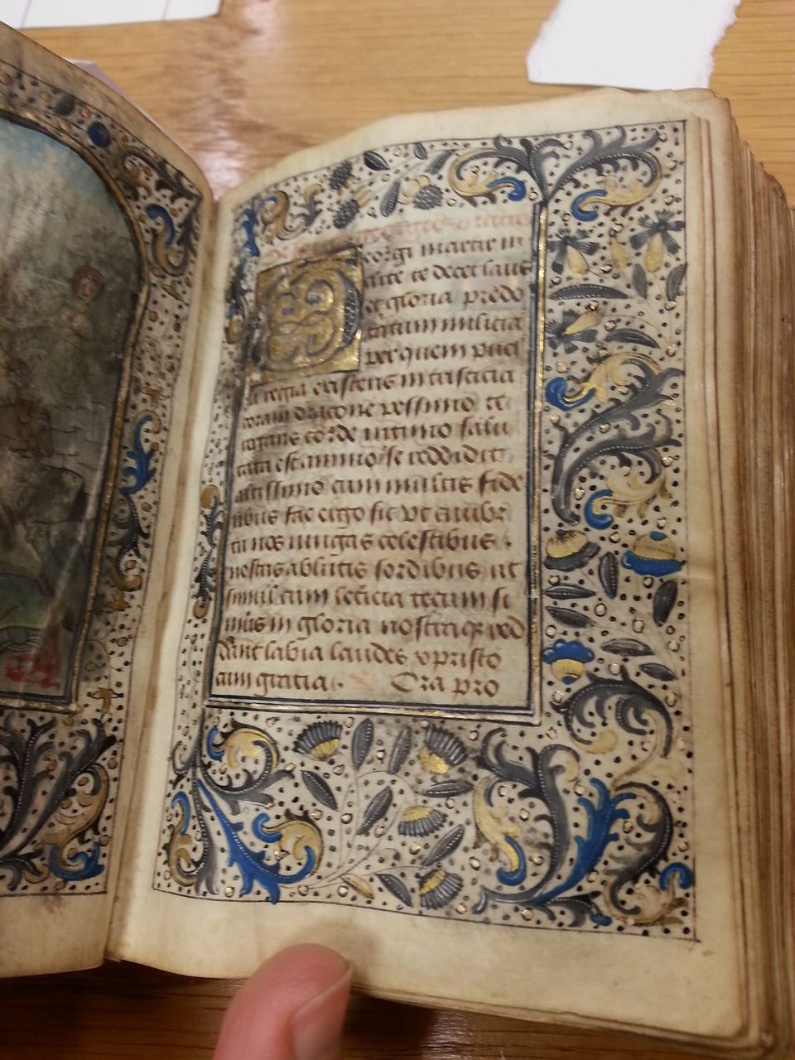
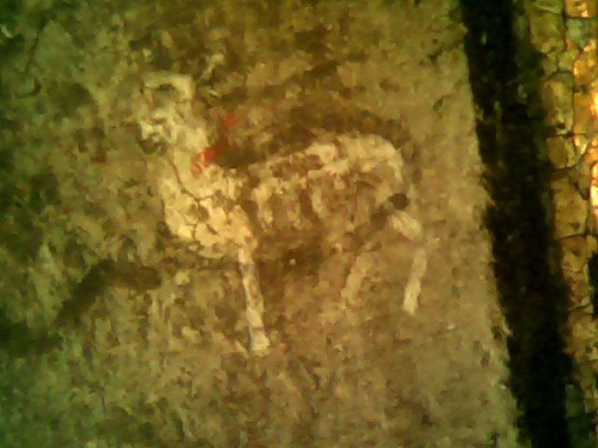
Berners Hours Part VI: folios 30r-v: Suffrage to St. George
St. George’s battle with the dragon (lower right corner of the miniature on the left) entered the saint’s legend in the first millennium and made his devotion important for soldiers and those seeking protection against diseases of the skin, including leprosy and plague. The saint’s body has nearly been kissed away, but his horse, the towers in the background and the dragon’s red blood remain. Worshipers’ attention to the image suggests its importance as a portal to sacred power. A tiny, 4 mm. lamb was discovered by photomicroscopy just above and to the right of the horse’s head. In Bulgaria, where George’s legend acquired the dragon fight, George is patron saint of shepherds.

Slide 14
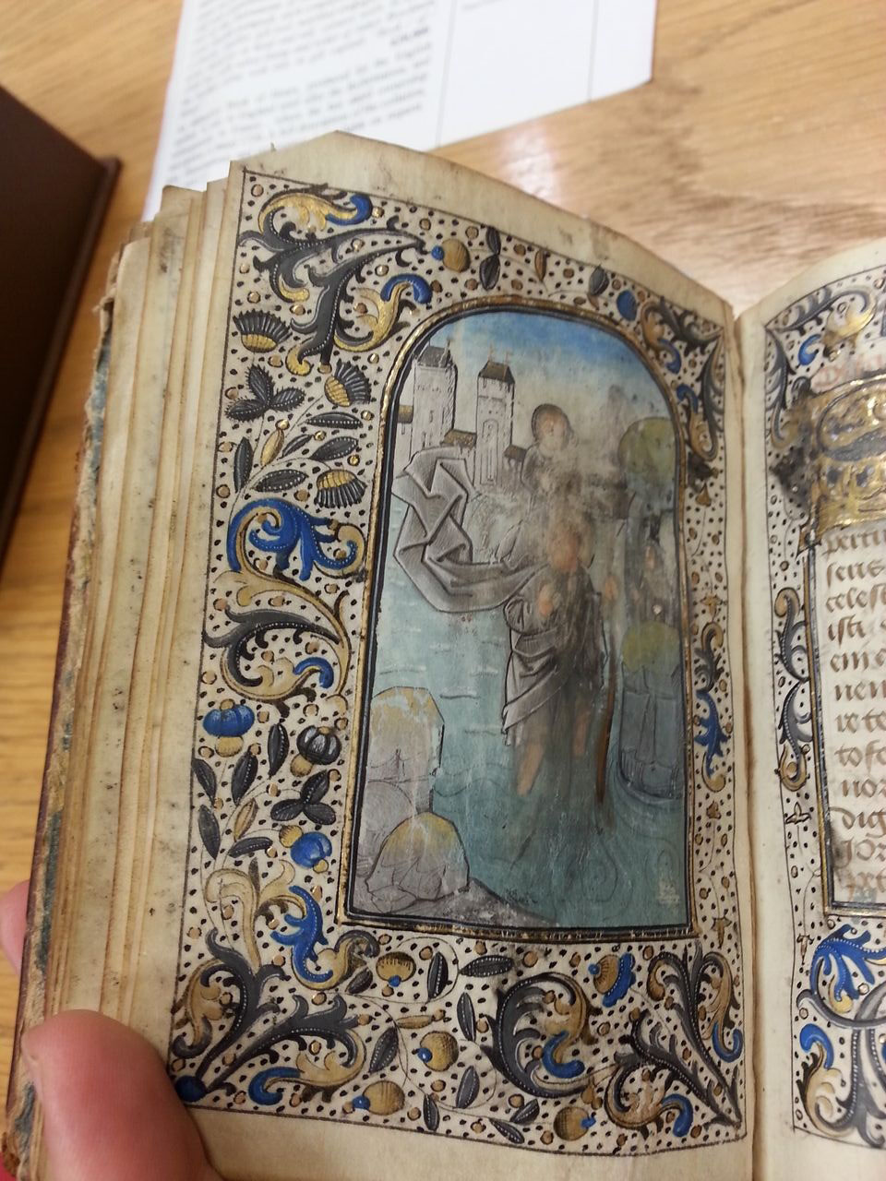
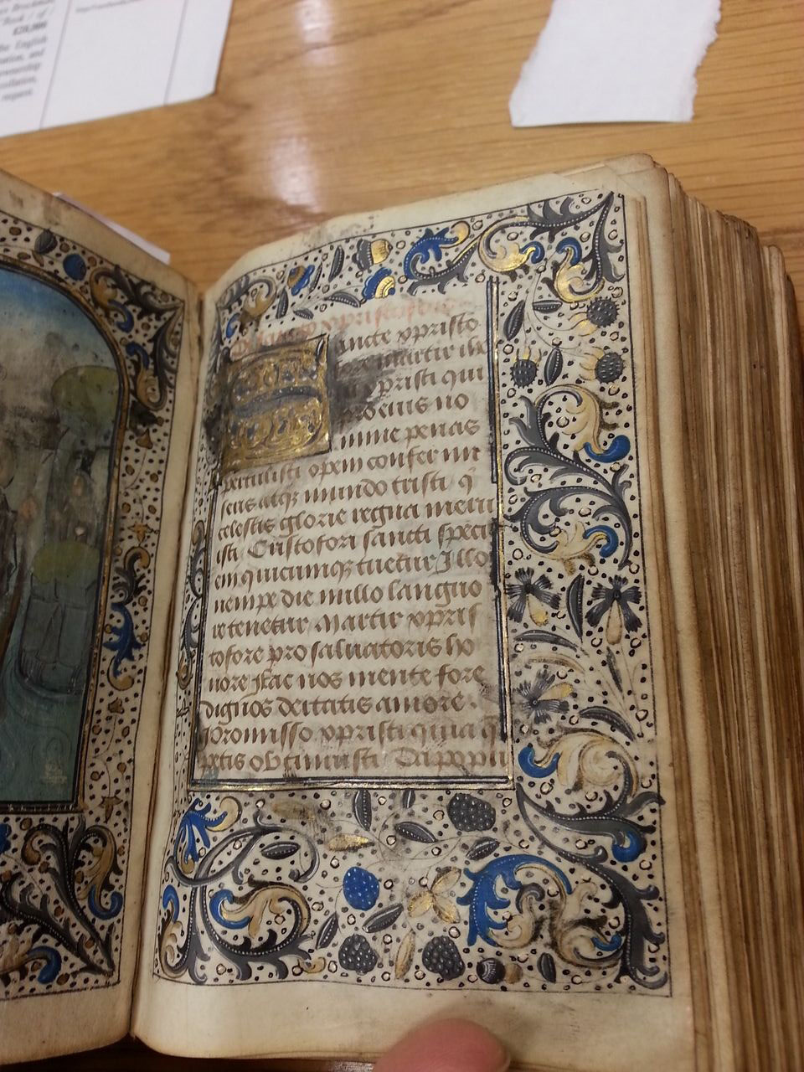
Berners Hours Part VII: folios 32r-33r Suffrage to St. Christopher
Christopher’s legendary carriage of the infant Jesus across a river became attached to his legend at the end of the first millennium. As a willing bearer of the divine, he acquired the intercessory role of protector of travelers from the danger of dying far from home and unconfessed. His medals are still seen today. The miniature’s saint and Jesus’ body were the target of kisses, preserving surrounding towers, river, and riverbank. The suffrage’s initial “G” of “Sancte xristophoro” has been kiss-damaged.

Slide 15
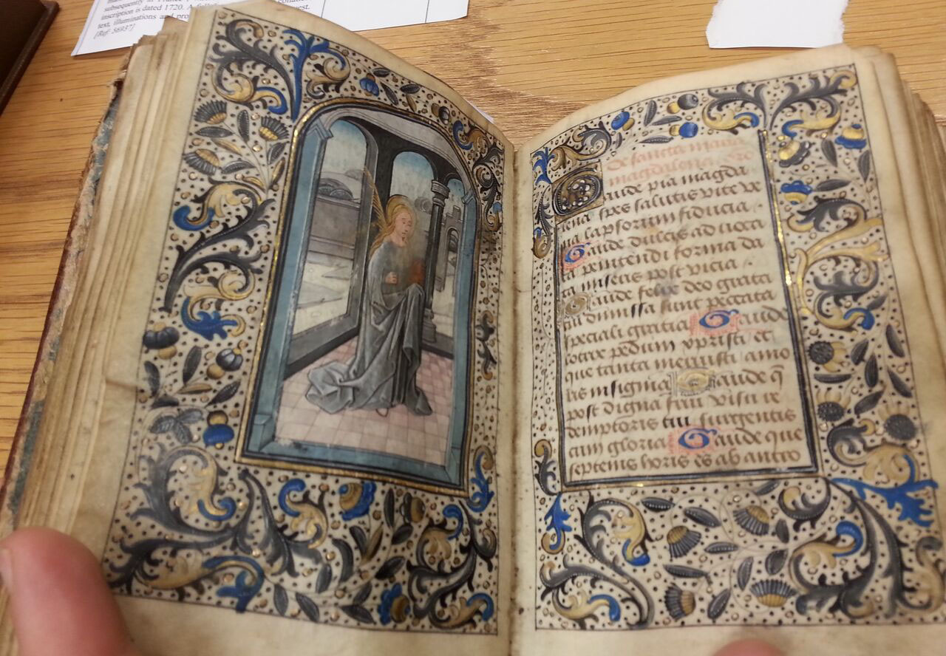
Berners Hours Part VIII: folios 34r-35r, Suffrage to Mary Magdalene
Mary Magdalene’s legend grew complex in medieval times, perhaps because she offered an example other than Mary of a woman who volunteered to serve Jesus, and one who did so without being “called” as Mary was by the Annunciation. Her pilgrim’s palm may refer to her being considered the protector of pilgrims.

Slide 16
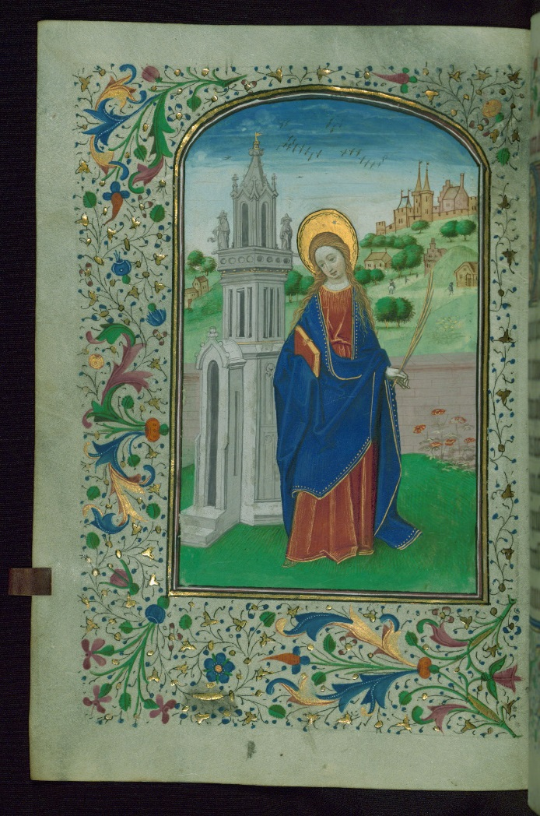
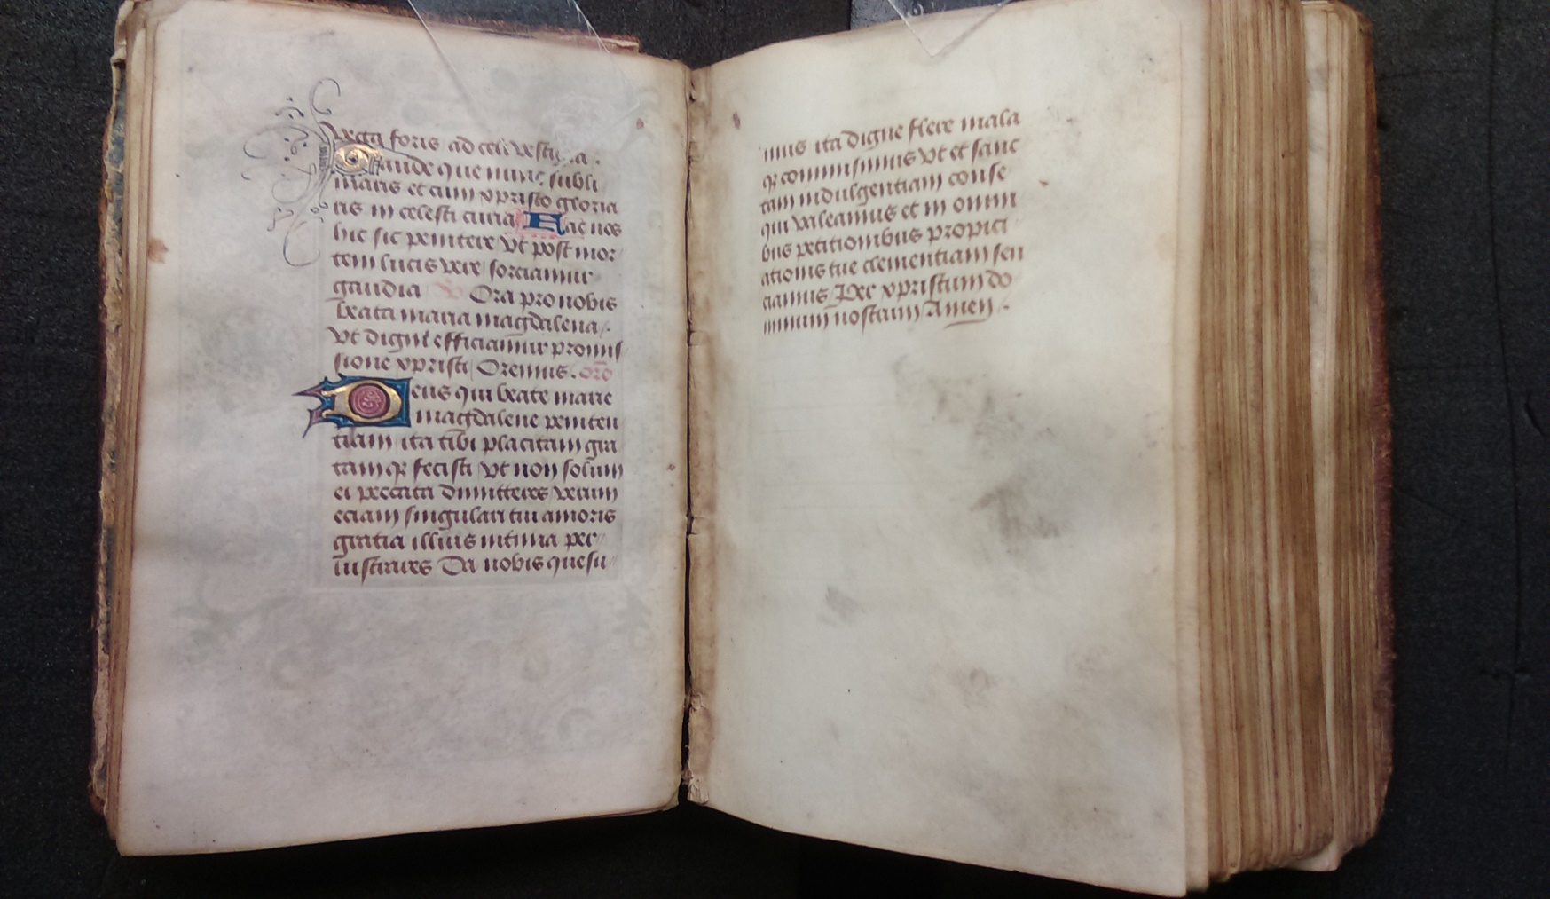
Berners Hours Part IX: folio 36r, Suffrage to St. Barbara
St. Barbara, patroness of architects, armorers, engineers, miners, and those suffering from fevers, was usually depicted with the tower whose construction she modified, telling builders to give it three windows to honor the Trinity. Her pagan father beheaded her, and was stuck by lightning. This vivid narrative made her image and suffrage so attractive that both were removed, leaving only the final suffrage passage on the right (recto) side of this opening in the image on the left. Barbara’s miniature in the Berners Hours would have resembled the one on the right from the Walters Art Museum Vrelant horae W.197.

Slide 17
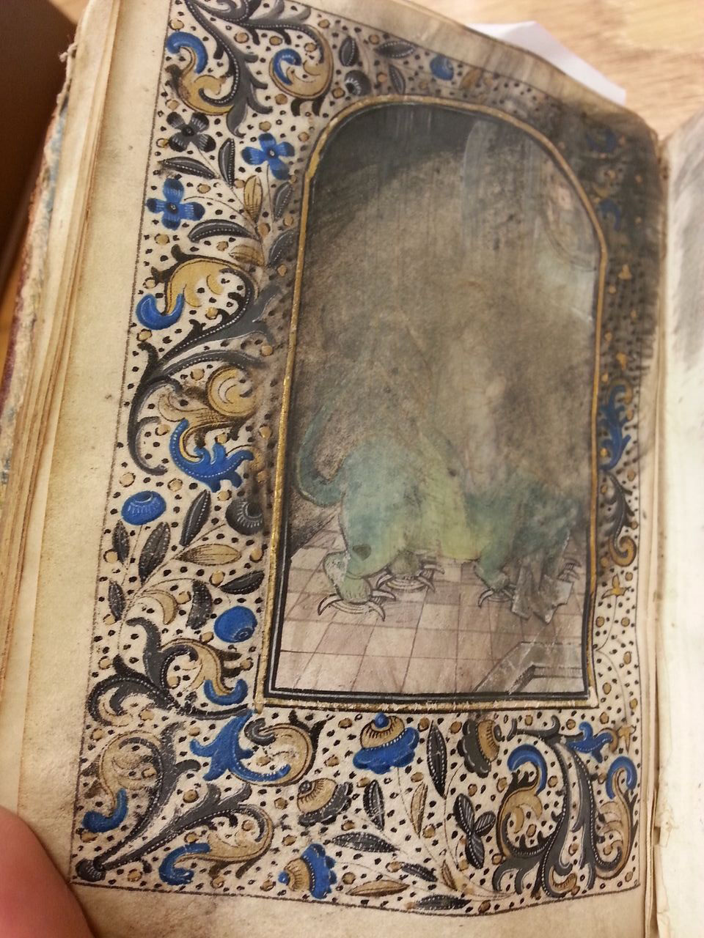
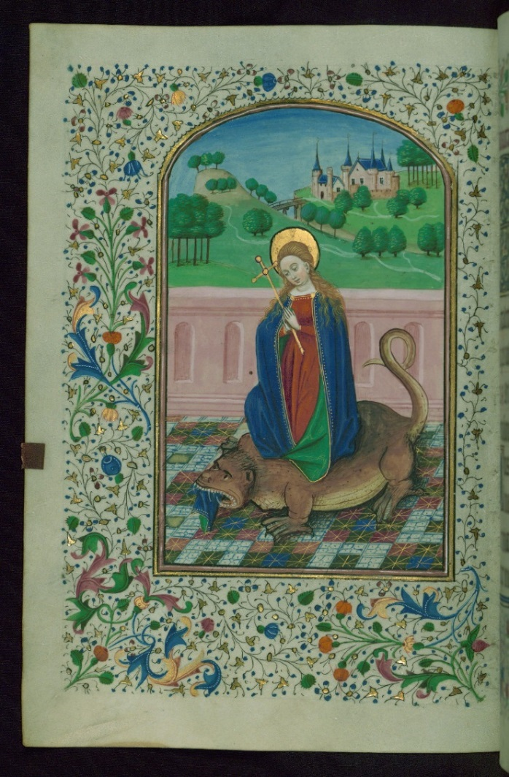
Berners Hours Part X: folios 37r-v, Suffrage to St. Margaret
Margaret, like Barbara, was one of the “virgin martyrs” whose suffrages typically end books of hours. She may have this more important location because her escape from the belly of a demonic dragon was made possible by the Cross she carried. By this logic, her image, like her cross, would have had apotropaic (harm-avoiding) power. She is shown bursting upward through the dragon’s back, which is still choking down the remains of her robe. Worshipers sought her aid to staunch bleeding and for difficult childbirth. This miniature’s damage suggests avid, open-mouthed kissing, perhaps by generations of women in pain. The suffrage has been removed, perhaps as a medical talisman to be worn by sufferers. Compare Margaret’s miniature from Walters W.197.

Slide 18
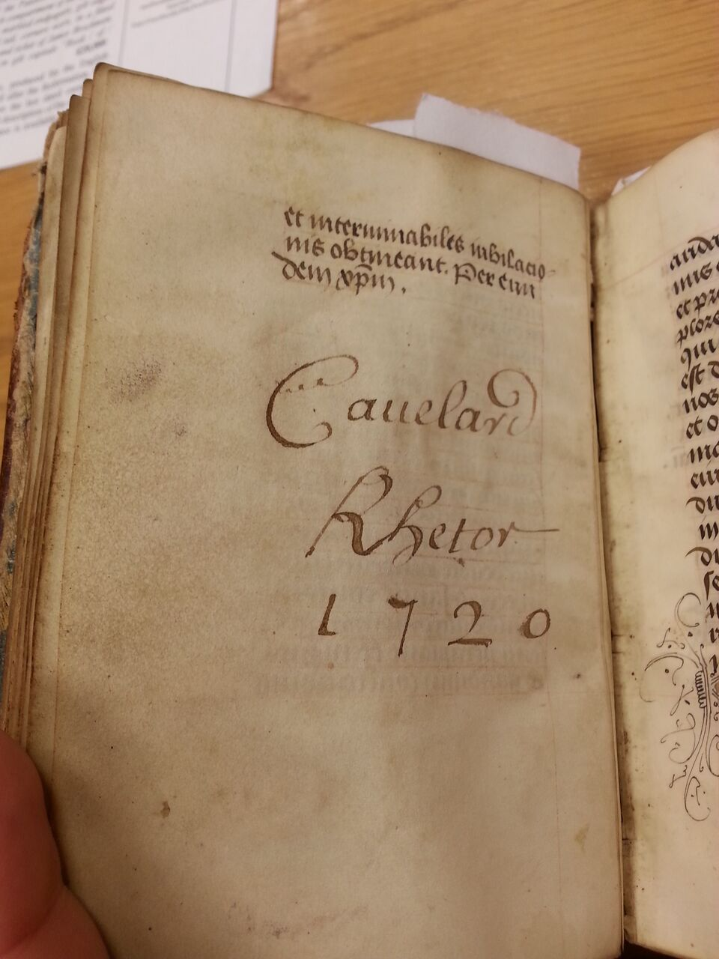
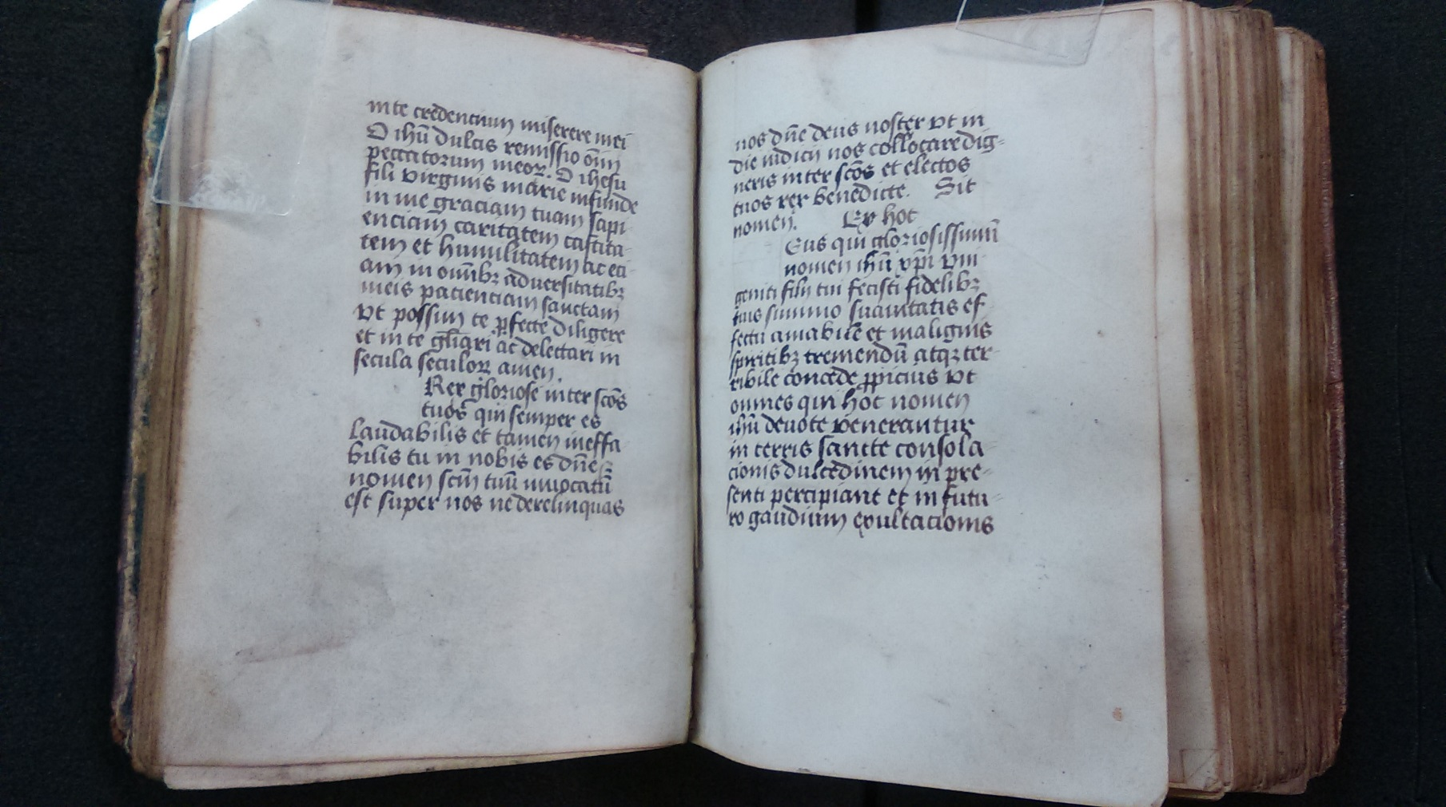
Berners Hours Part XI: folios 37r-38v Three additional “Sacred Name” prayers
  The first of these “Sacred Name” prayers, ‘O bone Ihesu,’ attributed to St Bernardino, is missing its first leaf. It was set to this 4-part motet, either by Loyset Compère or Francisco de Peñalosa, around 1519. This setting of the text might have been heard at Castle Angers William Berners. The other two prayers are “[O] rex gloriose inter sanctos”. “[D]eus qui gloriosissimum nomen Ihesu Christi.” Each of these prayers repeats a sacred name with variations to increase its salvific or apotropaic power. Production of this gathering was rushed because the capitals are missing on the inner opening of the gathering, folios 37v-38r (left). The scribe who would have painted the capitals in blue and gold would have followed the faint “guide letters” in the upper right of the blanks. “Cauelard Rhetor” signed below the last prayer in 1720, perhaps signifying that the texts were not heretical.

Slide 19
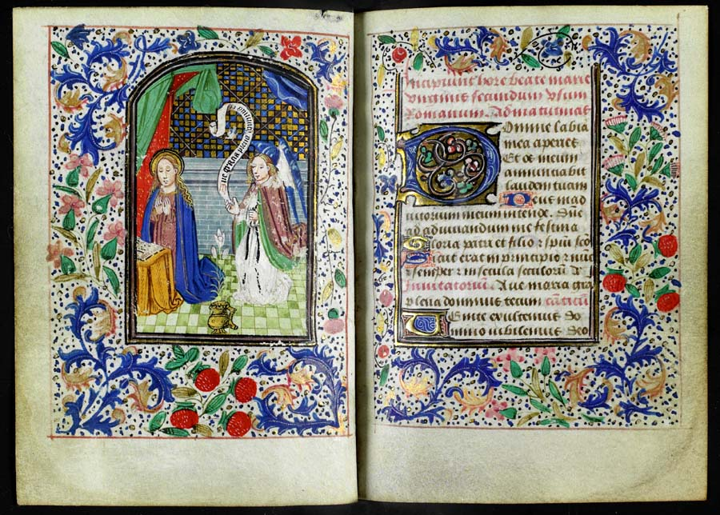
Berners Hours Part XII: folios 39r-89r Hours of the Virgin intermixed with Hours of the Cross
The Hours of the Virgin and Hours of the Cross regulate the book of hours’ function as a daily, hourly prayer guide. These prayers would have guided a worshiper to focus affective and meditative attention upon specific moments in Mary’s and Jesus’ life, and upon saints whose lives required daily ritual remembrance. The hours began with Matins (midnight), whose first leaves are missing, starting at “aridam fundaverunt manus eius” (“His hands founded the dry land”). Typically, Matins would face a miniature of the Annunciation, similar to this opening from University of Glasgow Special Collections MS Euing 3 (Flanders ca. 1460), also in the style of William Vrelant’s atelier.

Slide 20
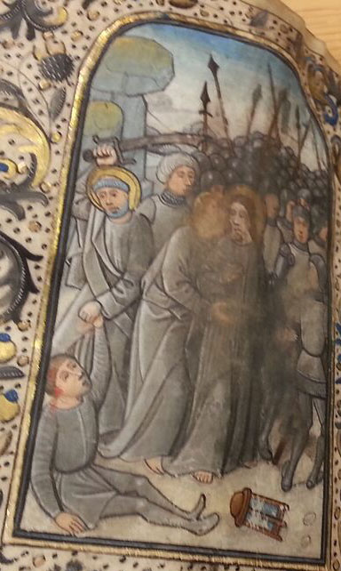
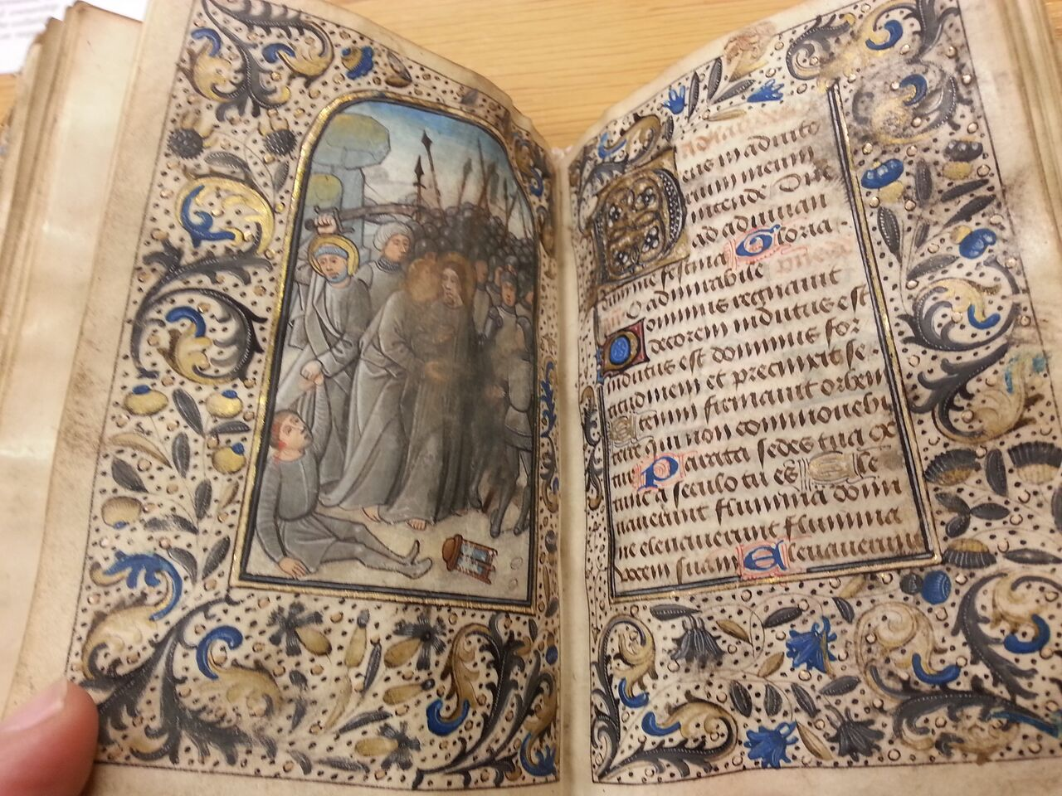
Berners Hours Part XI continued: folio 48v, Hours of the Cross, Lauds (3 AM), the “Betrayal”
The prayer for Lauds (Psalm 70, “O Lord, make haste to help me”) faces a miniature of soldiers arresting Jesus (center), who has just been kissed by Judas (left). At the far lower left, a disciple (often Simon Peter) has just cut off the ear of Malchus, servant of the high priest, before Jesus can signal to the disciple to spare him. The kiss of the Betrayal (see right image) has been worshiped with kisses until the two faces are nearly invisible.

Slide 21
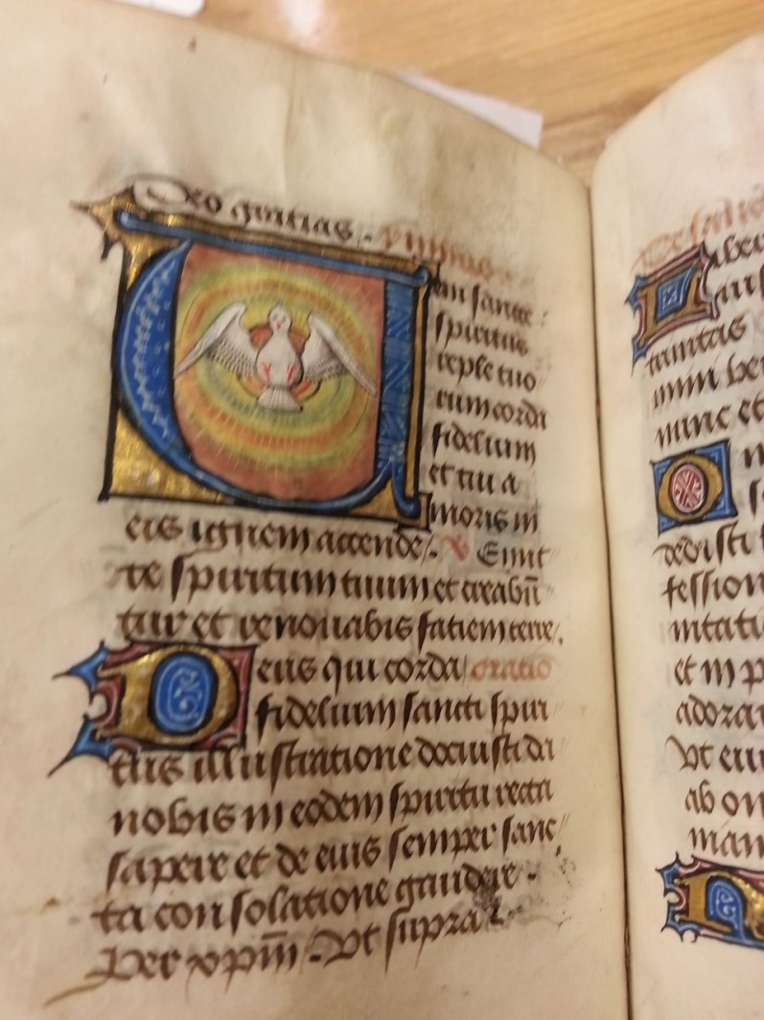
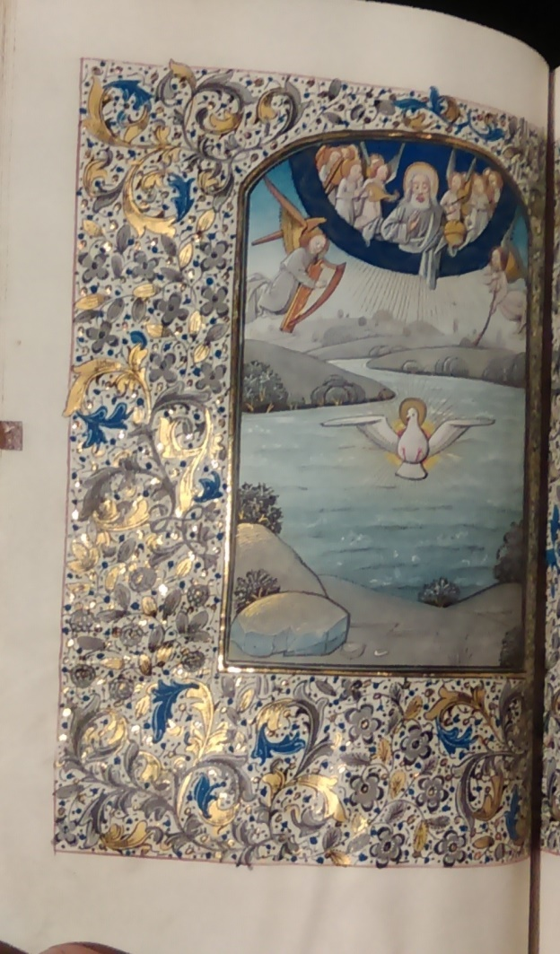
Berners Hours Part XI continued: folio 58v, Hours of the Cross, Suffrage to the Holy Spirit
In the Berners Hours, the hymn “Veni, Sancte Spiritus, reple tuorum corda fidelium” (“Come Holy Spirit, fill the hearts of thy faithful”) begins with a striking historiated “V” (left) filled with concentric rainbow circles of fire out of which the dove flies, wings spread and feet-first, toward the worshiper. Compare the dove in the “Hours of the Holy Spirit, Terce” miniature in Walters W.196.

Slide 22
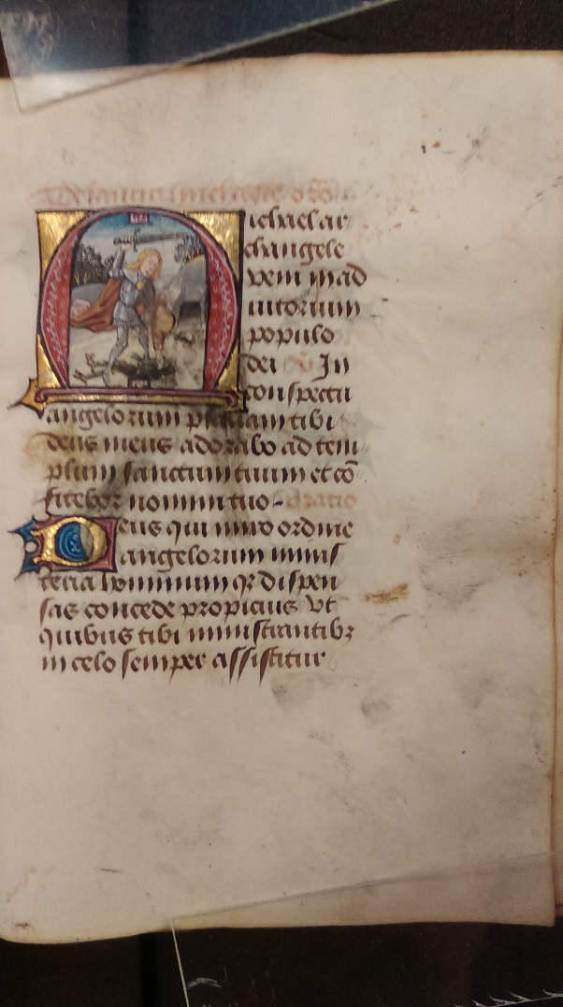
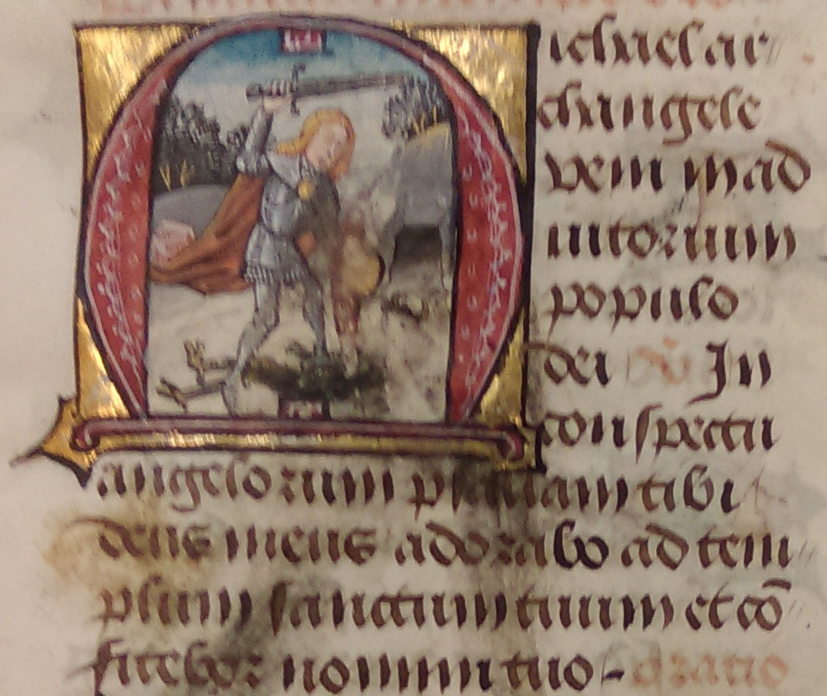
Berners Hours Part XI continued: folio 60r, Hours of the Holy Cross, Suffrage to St. Michael
St. Michael’s battle with Satan in the Apocalpyse here begins the prayer for his aid, “Michael archangele veni in adjutorium populo Dei” (Archangel Michael make haste to help God’s people).

Slide 23
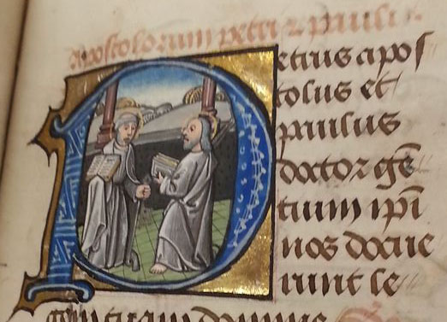
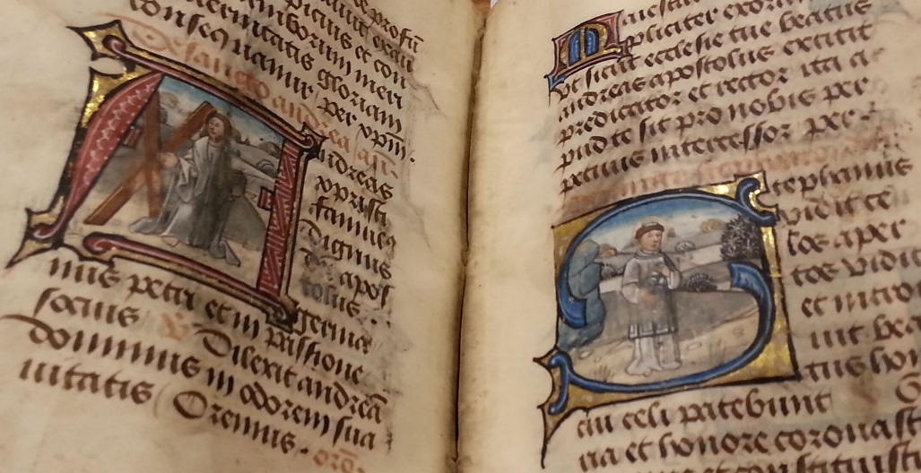
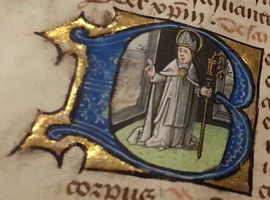
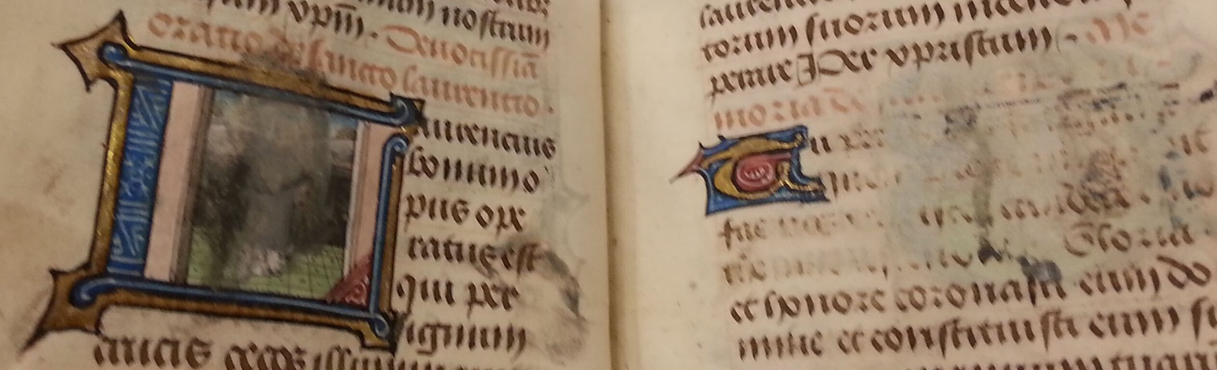
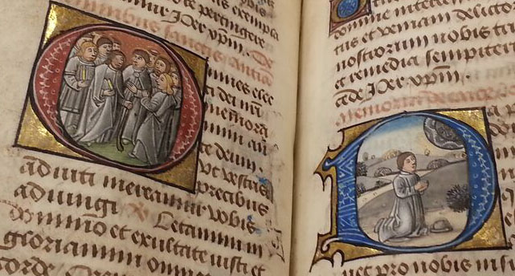
Berners Hours Part XI continued: folios61r- 66r, Suffrages to Peter and Paul, Andrew, Stephen, Nicholas, Laurence, Thomas, All Saints, and Prayer for Peace
Many of these individual prayers’ historiated initials survive, though in the lower left image, Laurence’s mocking martyrdom on a gridiron (“turn me over; I’m done on this side”) has been obliterated by kissing. We know the manuscript was still in England in 1538 because the facing page prayer to St. Thomas a Becket was scraped away in obedience to Henry VIII’s decree of that year. The individual suffrages end with universalized prayers to All Saints and a Prayer for Peace (lower right).

Slide 24
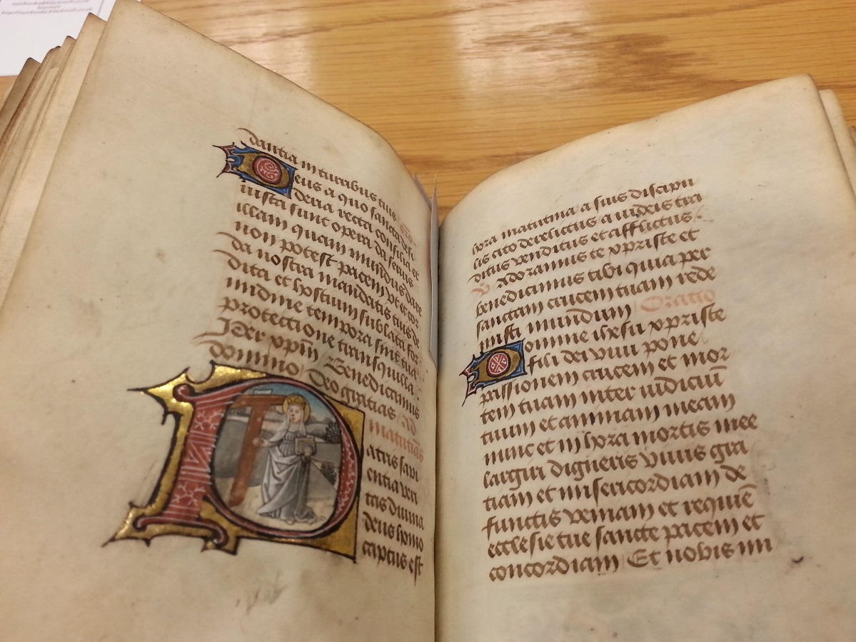
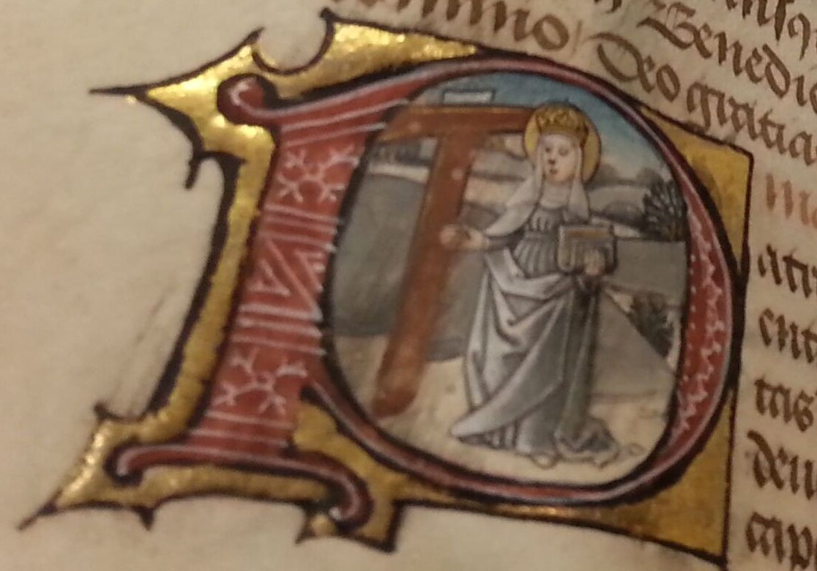
Berners Hours Part XI cont., Hours of the Cross: folio 66v, St. Helen and the True Cross
St. Helen, mother of the first Christian Roman Emperor, Constantine, performs a crucial role in the empire’s religious “translatio empirii,” changing the official religion from pagan to Christian faith, by finding Christianity’s most sacred relic, the Cross on which Jesus died. By the fourth century C.E., her discovery of the cross had become widely believed. This initial begins the Suffrage of the Holy Cross, “Patris sapientia, veritas divina” (“Father of wisdom and divine truth”).

Slide 25
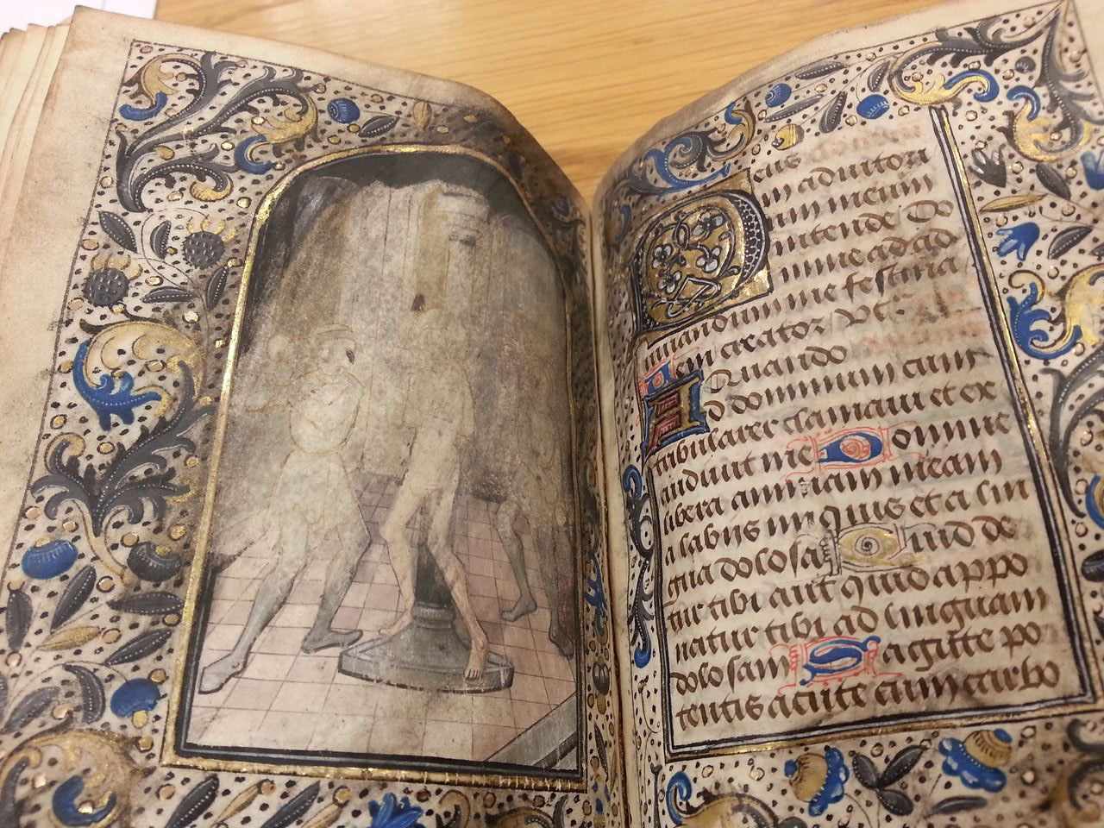
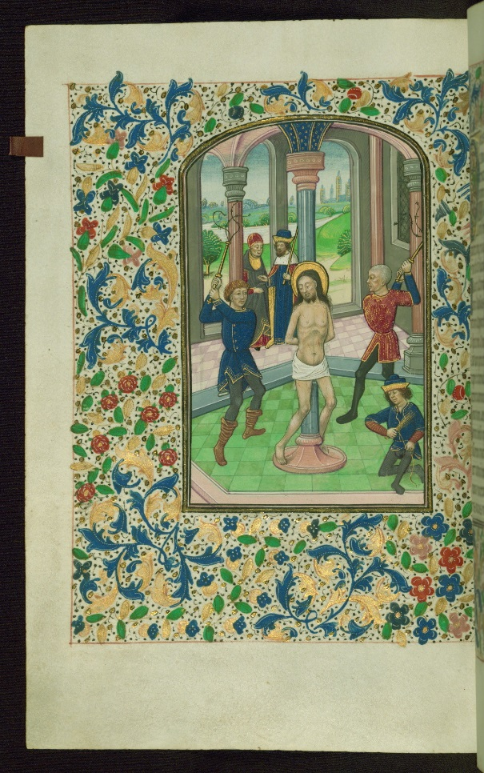
Berners Hours Part XI continued: folio 73v, Hours of the Cross, Terce (9 AM), “The Flagellation”
The Hours of the Cross conclude with this second surviving miniature in the typical sequence: Agony in the Garden (Matins), Betrayal (Lauds), Christ before Pilate (Prime), Flagellation (Terce), Christ Carrying the Cross (Sext), Crucifixion (None), Deposition (Vespers), and Entombment (Compline). This miniature’s central figures have nearly been obliterated by kissing. Compare the construction of the Walters W.196 “Flagellation” miniature.

Slide 26
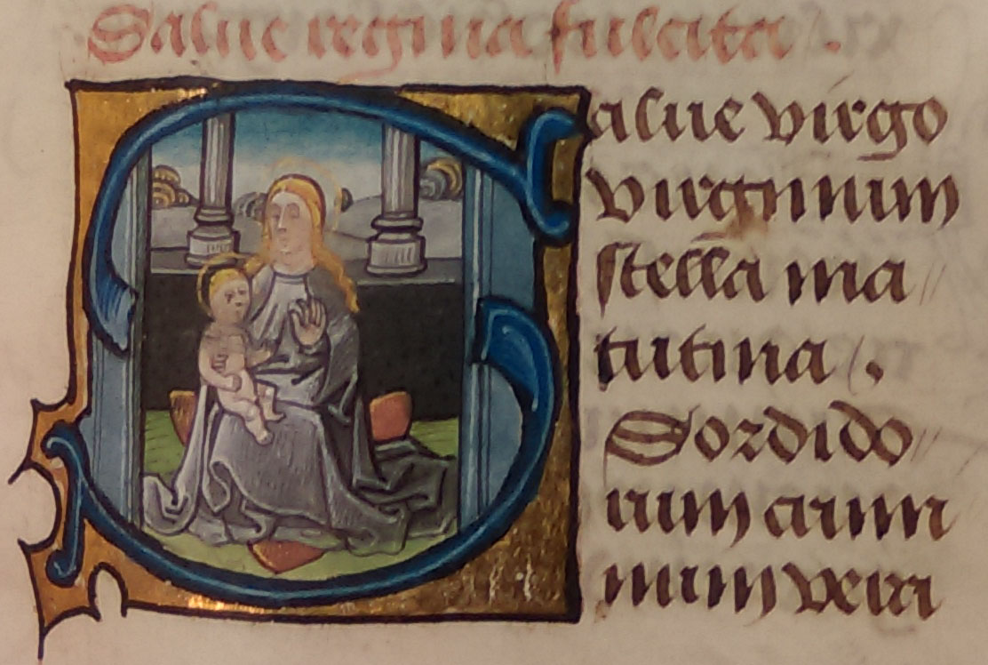
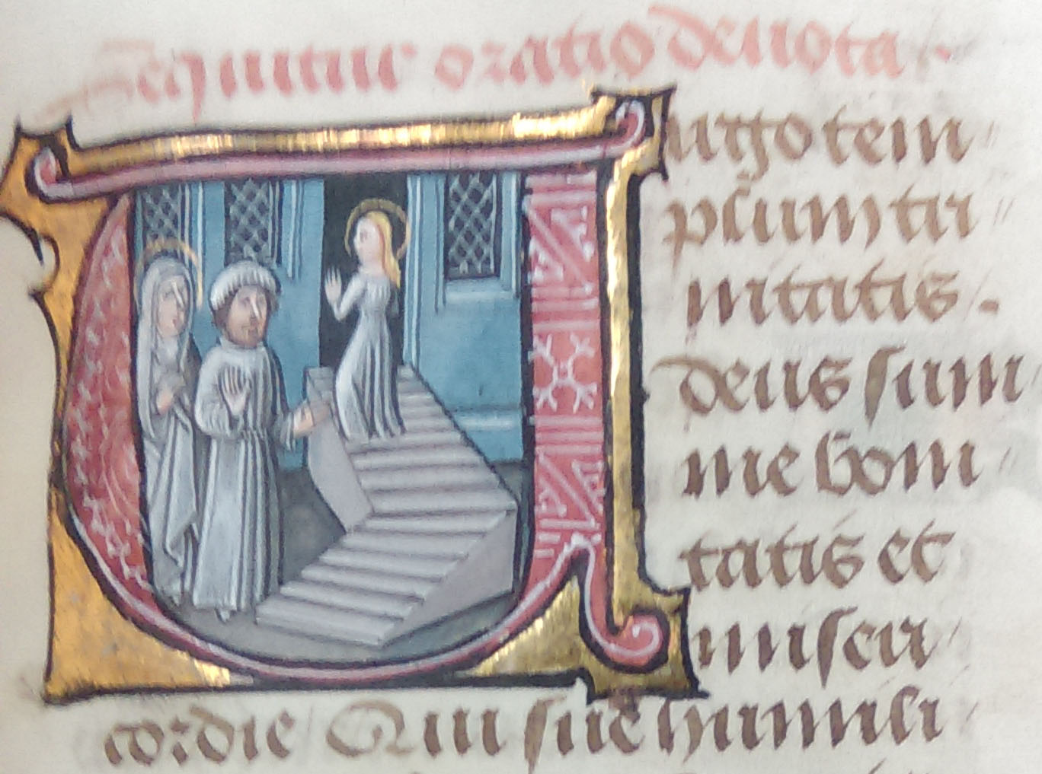
Berners Hours Part XII (fols.89r–112r) Prayers to the Virgin: 7 Joys of the Virgin: including “Gaude virgo mater Christi,” “Salve regina,” “O intemerata … orbis terrarum inclina mater,” “Obsecro te,” “Ave mundi spes Maria,” “Salve virgo virginum stella matutina,” “Virgo templum trinitatis,”
“Salve virgo virginum stella matutina” begins with a historiated “S.” In close-up view, the faces of Virgin and Child appear lightly kiss-eroded. The historiated “V” of “Virgo templum trinitate” emphasizes the sacred irony of the entrance into the Temple of a woman whose body would become a temple of the Incarnation.

Slide 27

Berners Hours Part XIII (fols.112v-116v) Seven Joys of the Virgin
Paradoxically, the “Seven Joys of the Virgin” begin with an initial depicting Eve’s Temptation opposite an initial showing a worshiper in prayer before the Cross. Some medieval sources asserted that the Cross was made from the wood of Eden’s Tree of Good and Evil, but more obvious is the opposition of Eve’s Fall by the instrument of Mary’s Son’s victory over Death. The Greek “tau” cross (Т) echoes the gold and red “T” beginning the prayer “Triumpha de ligum crusis” (“Triumph of the True Cross”).

Slide 28
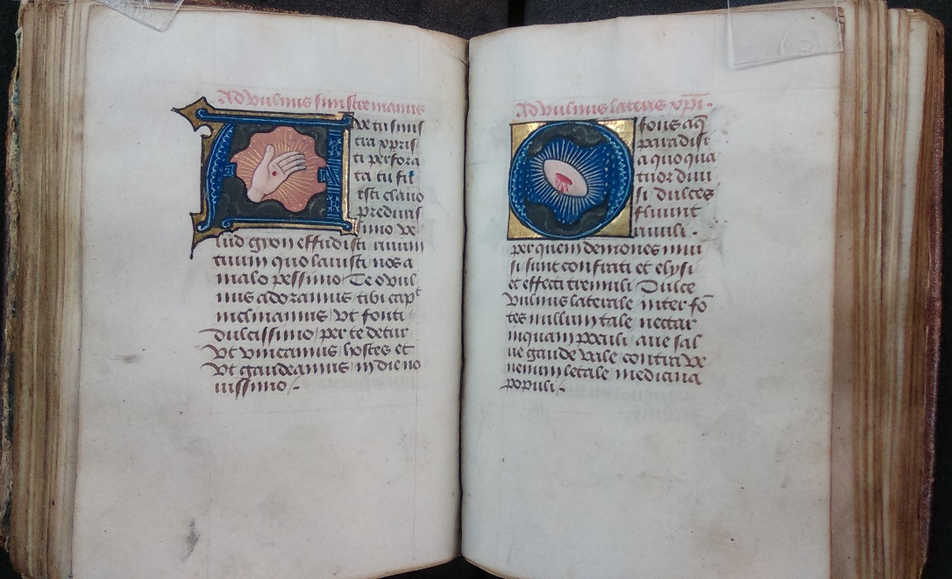
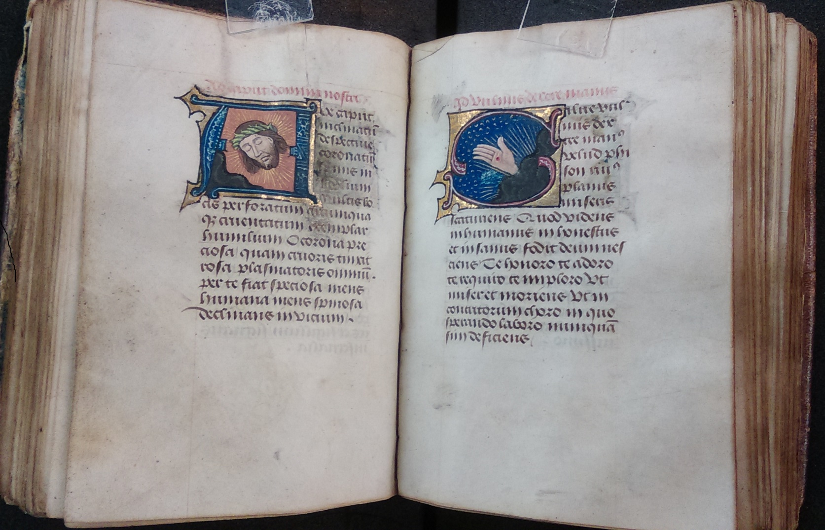
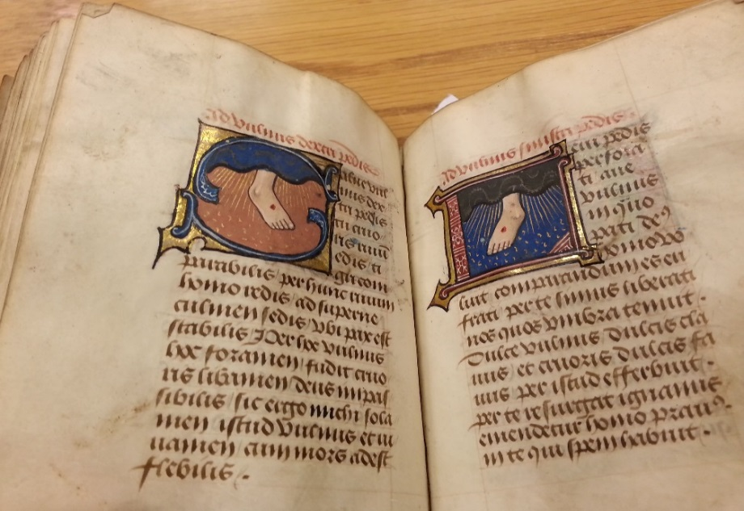
Berners Hours Part XIII (fols.113v-116v) Seven Joys of the Virgin cont., Wounds of the Passion
Meditative and affective worship of the Wounds of the Passion (Crown of Thorns, hands, side, and feet) encouraged late medieval Christians to imaginatively identify with Jesus’ suffering and to experience the transfiguring triumph of spirit over flesh.

Slide 29
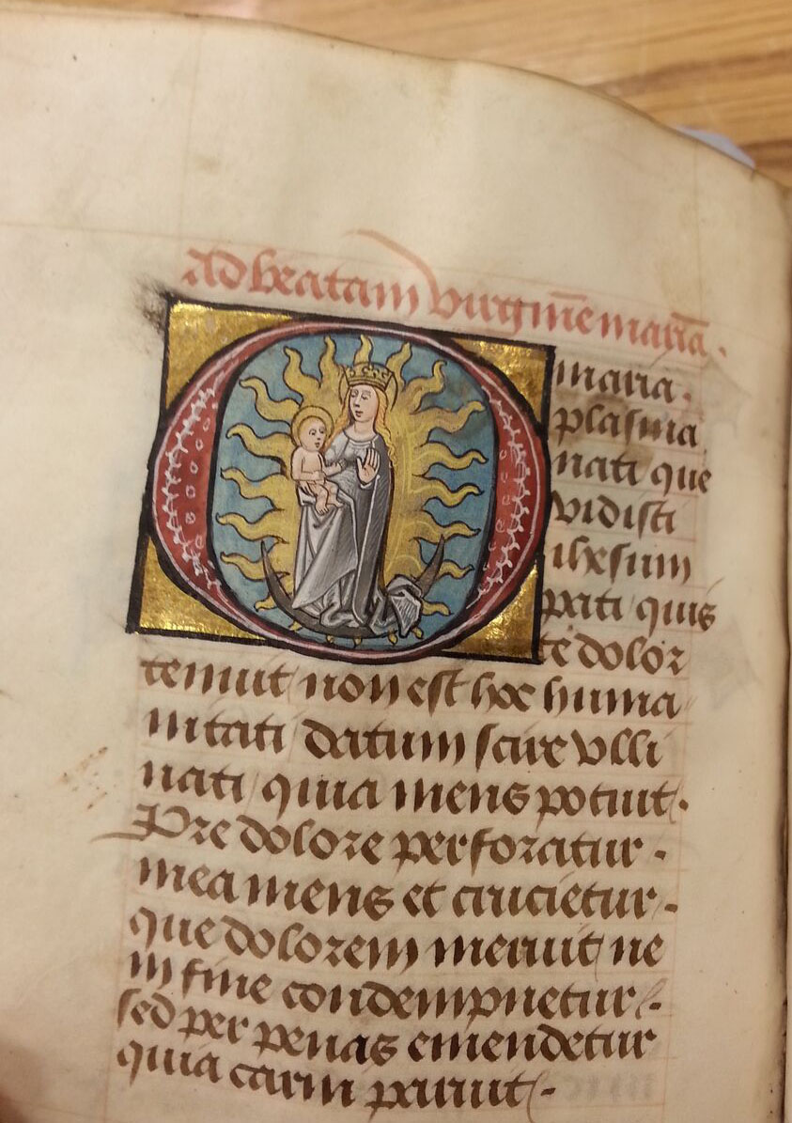

Berners Hours Part XIII cont. (fols.113v-116v)
The Marian prayer “O Maria plasma nati” ends the “Wounds of the Passion” sequence with an initial “O” containing Mary’s image as the “Virgin of the Apocalypse,” "a woman clothed with the sun, with the moon under her feet, and on her head a crown of twelve stars" (Revelation 12:1). This marks Mary’s triumph through her Son.

Slide 30


Berners Hours Part XIV, Prayers to Christ (fols.125v-126r)
The Berners Hours “Last Judgment” miniature has been so devastated by worshipful kissing that a later owner has attempted to redraw the images above their ghostly palimpsests. The Walters W.197 “Last Judgment” is probably similar to the layout of the damaged Berners miniature.

Slide 31

Berners Hours Part XV (fols.185r-201v), Commendations of Souls
Following the Office of the Dead (fols. 151r-183v) in the Use of Sarum (Salisbury Cathedral), worshipers pray for the souls of the dead, an act whose ideal outcome is represented in this miniature. During the Resurrection, believed to follow the Last Judgment, the souls of the Saved will be carried by angels to Heaven.

Slide 32

Berners Hours Part XVI (fols.227r-233r), Additional Music Settings of “In festis duplicibus”
In the eighteenth century, someone added a series of musical settings of “In festis duplicibus,” beginning at the end of the Psalter of St. Jerome on the last quire of the original manuscript and continuing onto an additional four-leaf quire of much heavier, later parchment. On “Double Feast” days, the same text was sung at many canonical hours to differing tunes.

Slide 33


Berners HoursPart XVII, Rear Pastedown, hidden French C18 manuscript
Thanks to the sharp eyes of Abigail Quandt, the Walters Art Museum Manuscript Conservator, we have discovered a final part of the Berners Hours that perhaps only one of its former owners knew about: a single handmade paper leaf, written in cursive French in an eighteenth-century hand and hidden between the rear pastedown and the back board, probably in the early to mid-1700s.

