Slide 1
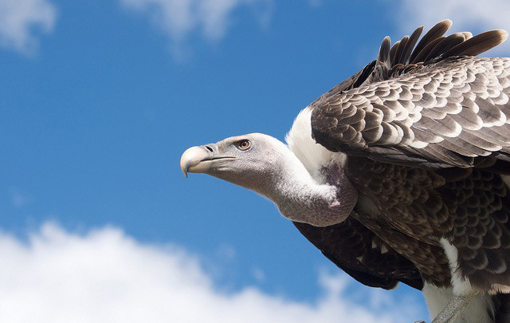
Predatory publishing
How to avoid falling prey to predatory publishers
Victoria Martin, Scholarly Communications Librarian, Salisbury University April 12, 2018

Slide 2
Part 1
Predatory publishing: An overview
Part II
Predatory publishers and other scholarly “predators”
Part III
How to avoid getting scammed

Slide 3
Part 1
Predatory publishing: An overview
Predatory publishing as a complex phenomenon
Definition
Origins of the term
Predatory publishing model
Some interesting findings

Slide 4

predatory publishing as a complex phenomenon
Long history
Few studies on the topic
Not limited to journal publishing
Multiple definitions
Multiple names

Slide 5

Defining predatory publishing
Predatory publishing: an unethical business practice that exploits the “author pays” publishing model to earn revenue.

Slide 6

Origins of the term “predatory publishing”
Coined by Jeffrey Beall who said,
“The reason I call certain pub­lishers predatory is because they prey on people. They try to trick honest researchers, and sometimes they are successful.”
By definition, implies deliberate intent to deceive
However, not all predatory publishers are deliberately deceitful
Jeffrey Beall

Slide 7
predatory publishing model
Pretend to operate as legitimate open access journals
Spam academics with requests for submissions
Charge authors to publish their work

Slide 8
Some Interesting findings
Number of predatory publishers
996 publishers, approximately 8,000 journals, 67% active
Number of published articles
420,000 articles in 2014 (compared to 53,000 in 2010)
Publisher’s location
27 % publishing in India
Authorship
¾ of authors come from Asia and Africa
Source: Cenyu, S. & Bo-Christer, B. (2015).‘Predatory’ open access: A longitudinal study of article volumes and market characteristics. BMC Medicine 13 (1).

Slide 9
Some Interesting findings (cont’d)
Subject matter
“General” or multidisciplinary
Engineering
Biomedical sciences
Publishing speed
3 months on average
Fees
$178 on average
Source: Cenyu, S. & Bo-Christer, B. (2015).‘Predatory’ open access: A longitudinal study of article volumes and market characteristics. BMC Medicine 13 (1).

Slide 10
Why Is predatory publishing harmful?
Threatens the integrity of published research
Results in loss of knowledge
Corrupts the open access publishing model
Encourages unethical behavior of some authors
Hurts researcher's academic credibility and career advancement

Slide 11
Part II
Predatory publishers and other scholarly “predators”
Legitimate versus predatory journals
Common “predatory” tactics
Who are typically targeted?
Other scholarly “predators”

Slide 12
Legitimate vs predatory journals
Legitimate
Predatory
Affiliated with a well-known publisher or professional society
Rigorous peer review
Authoritative editorial board
Professional journal website design
Hosted by a credible publisher or technology partner
Run by a small publisher, a group or people, or a single person
Superficial or non-existent peer review
Untrustworthy editorial board
Amateur journal website design
Hosted by an unknown source or free platform

Slide 13
Legitimate vs predatory journals (cont’d)
Legitimate
Predatory
Authentic ISSN number and DOIs
Legitimate metrics and indexing information
Thorough and accurate contact information
Listed in reputable journal directories
Acceptance depends on quality of research
Fake or missing ISSN; no DOIs
False/bogus metrics and indexing claims
Fake or misleading contact information
Not listed in reputable directories
Acceptance depends on author payment

Slide 14

TOP 10 TACTICS OF PREDATORY PUBLISHERS
Spam emails sent to .edu addresses
Promise of expedited peer review and/or speedy publication
Low article processing charges (APCs)
False impact factor and indexing claims
Imitating the names of established journals
Linking to logos of established scholarly organizations and publishers
Using fake editor names or using real names without permission
Providing misleading information about their headquarters locations
Refusing to retract submitted articles without payment
Refusing to waive APCs

Slide 15
Who are typically targeted?
Early-career researchers
Researchers who are under pressure to publish :
to meet grant funding requirements
to meet deadlines for tenure or promotion
Authors who have already published in predatory journals

Slide 16
TOP RED FLAGS OF PUBLISHING FRAUD
(easily detected in an email invitation)
Unsolicited and poorly written email invitations
Extremely broad journal scope
Promise of expedited peer review and/or speedy publication
Suspiciously low article processing charges
Missing credentials and not credible addresses (e.g., PO Box)

Slide 17
Dear Researcher,
Call for paper
Fast Review Process
Indexed in Reputed Databases
Low Article Processing Charges (30 US $ only)
Indexed in Reputed Database (http://jsaer.com/indexed): Open J Gate, Worldcat, , ZB Med,
indianscience.in, SCIENTFIC JOURNALS, EZB etc.
Website: www.jsaer.com
With this regard we request you to send original research papers relevant to your work for publication in the journal. The manuscript may be submitted along with filled scanned copy right
by e-mail at submit@jsaer.com or through our SUBMIT MANUSCRIPT link at our website.
Please refer:
Author’s guidelines: http://jsaer.com/download/pdf/Instructions-to-Authors.pdf
Regards
Editor
Journal of Scientific and Engineering Research

Slide 18
TOP RED FLAGS OF PUBLISHING FRAUD
(easily detected in the journal’s website)
Spelling and grammar errors
Missing or fake ISSN
False impact factor and indexing claims
Invented metrics
Newness and high quantity of articles per issue
Contradictions and inconsistencies
Publishers are also editors w/o academic credentials

Slide 19
Other types of scholarly “PREDATORS”
Predatory conference organizers
Solicit submissions and charge registration fees for poorly organized or non-existent conferences
Predatory monograph publishers Often target new thesis and dissertation authors to publish their work as books
Journal hijackers Create a duplicate website for an established scholarly journal and then solicit article submissions for the authentic journal on the hijacked website

Slide 20
Part III
How to avoid getting scammed
Journal blacklists and whitelists
Journal and conference checklists
Tips and strategies
Getting help

Slide 21
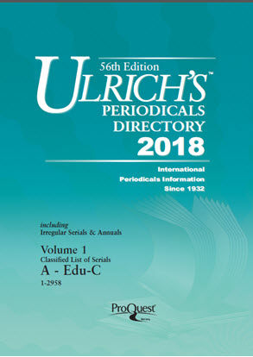

Journal whitelists

Slide 22
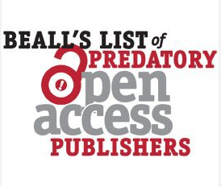
Journal blacklists
BLACKLIST

Slide 23

Journal evaluation checklist
https://thinkchecksubmit.org/

Slide 24

Conference evaluation checklist
https://thinkcheckattend.org/

Slide 25
Tips and strategies
Avoid any association with predatory publishers
Keep yourself well informed about the tactics of predatory publishers
Use journal and conference evaluation tools http://libraryguides.salisbury.edu/PredatoryPublishing

Slide 26
Help with evaluating journals and conferences
Contact Scholarly Communications Librarian
Victoria Martin, vmmartin@salisbury.edu

Slide 27
RESOURCES
Predatory publishing research guide http://libraryguides.salisbury.edu/PredatoryPublishing
Directory of Open Access Journals (DOAJ) https://doaj.org/
Ulrich’s Periodicals Directory
http://salisbury.worldcat.org/oclc/1641260 Beall’s List https://beallslist.weebly.com/

Slide 28
credits
Publications
Shen, C., & Björk, B. C. (2015). ‘Predatory’ open access: A longitudinal study of article volumes and market characteristics. BMC Medicine, 13(1). [online].
Vence, T. (2017). Identifying Predatory Publishers. The Scientist. [online].
Illustrations
“Vulture” by Stefan van Bremen
“Dark era of publishing” by Marta D’Asaro
“Predatory publishing” by Dušan Petričić
“Editor” by Richard Wilkinson

