Slide 1
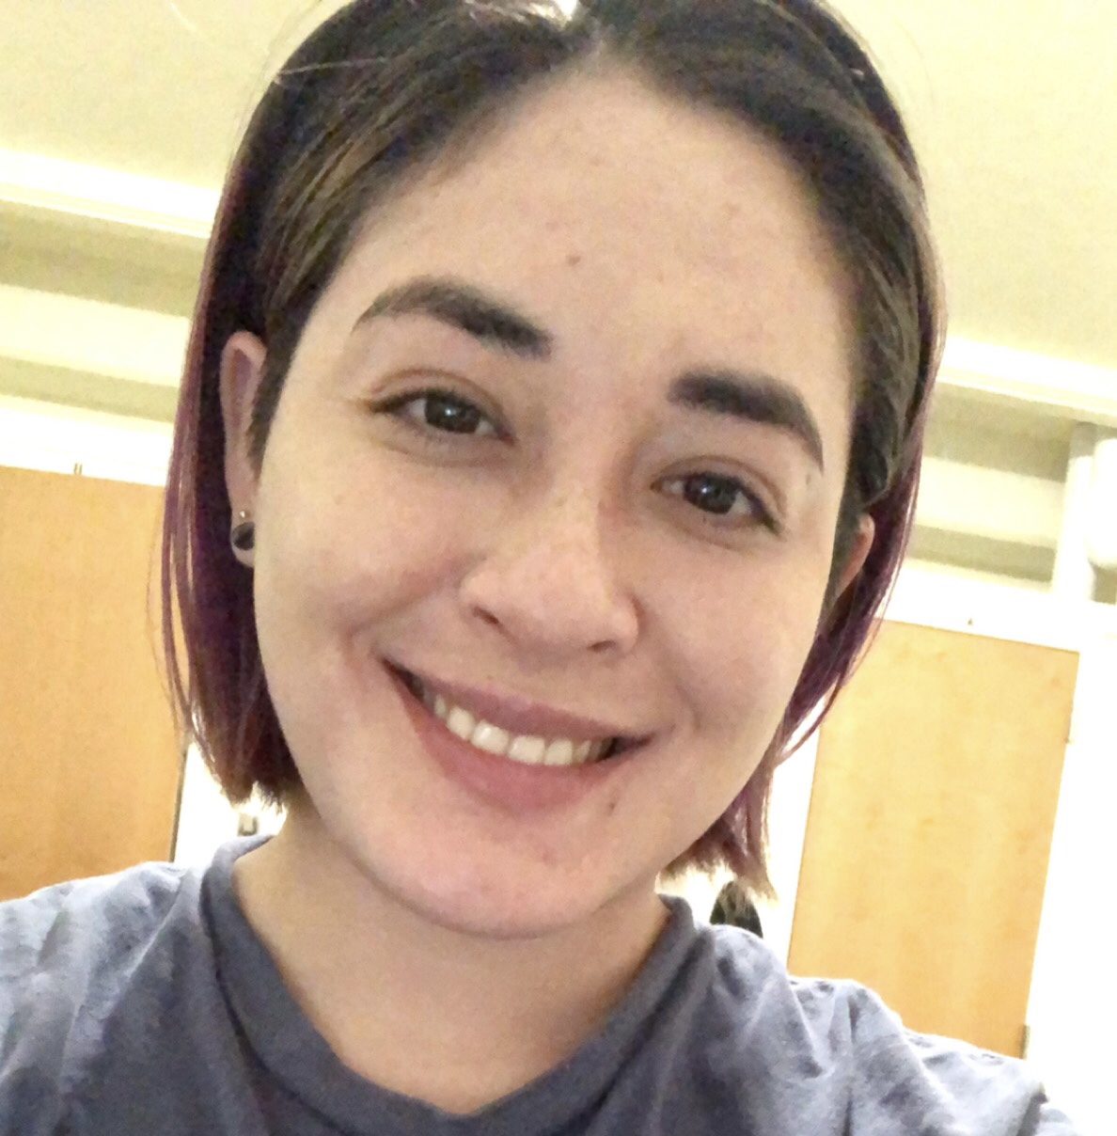

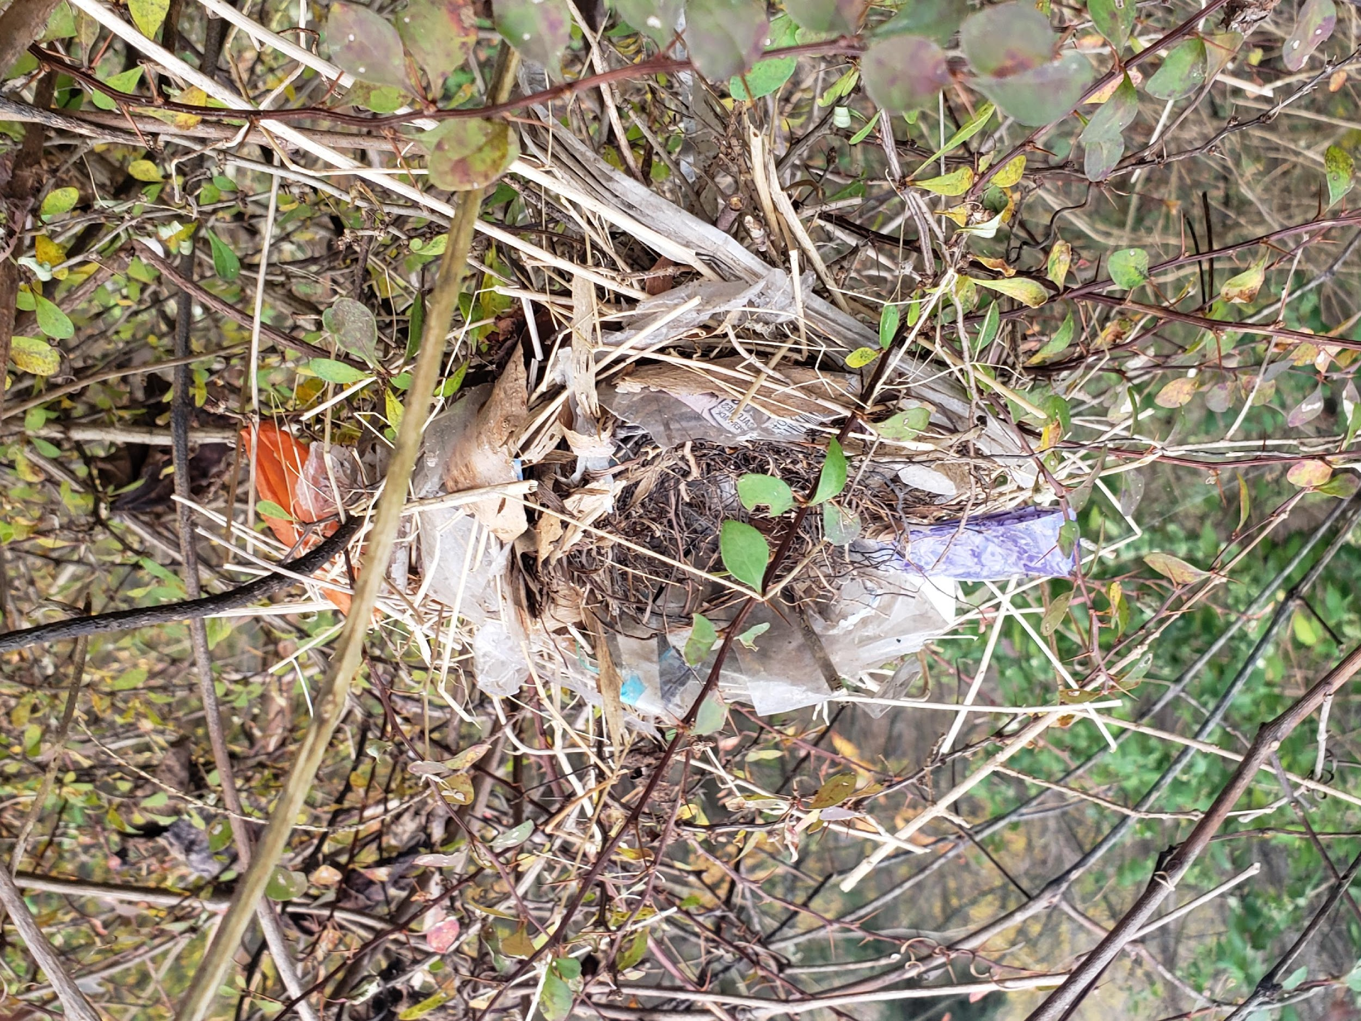
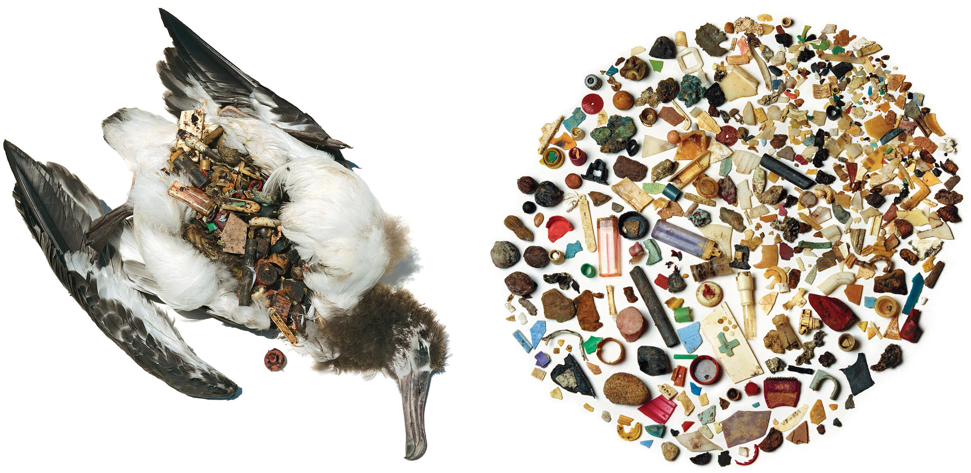
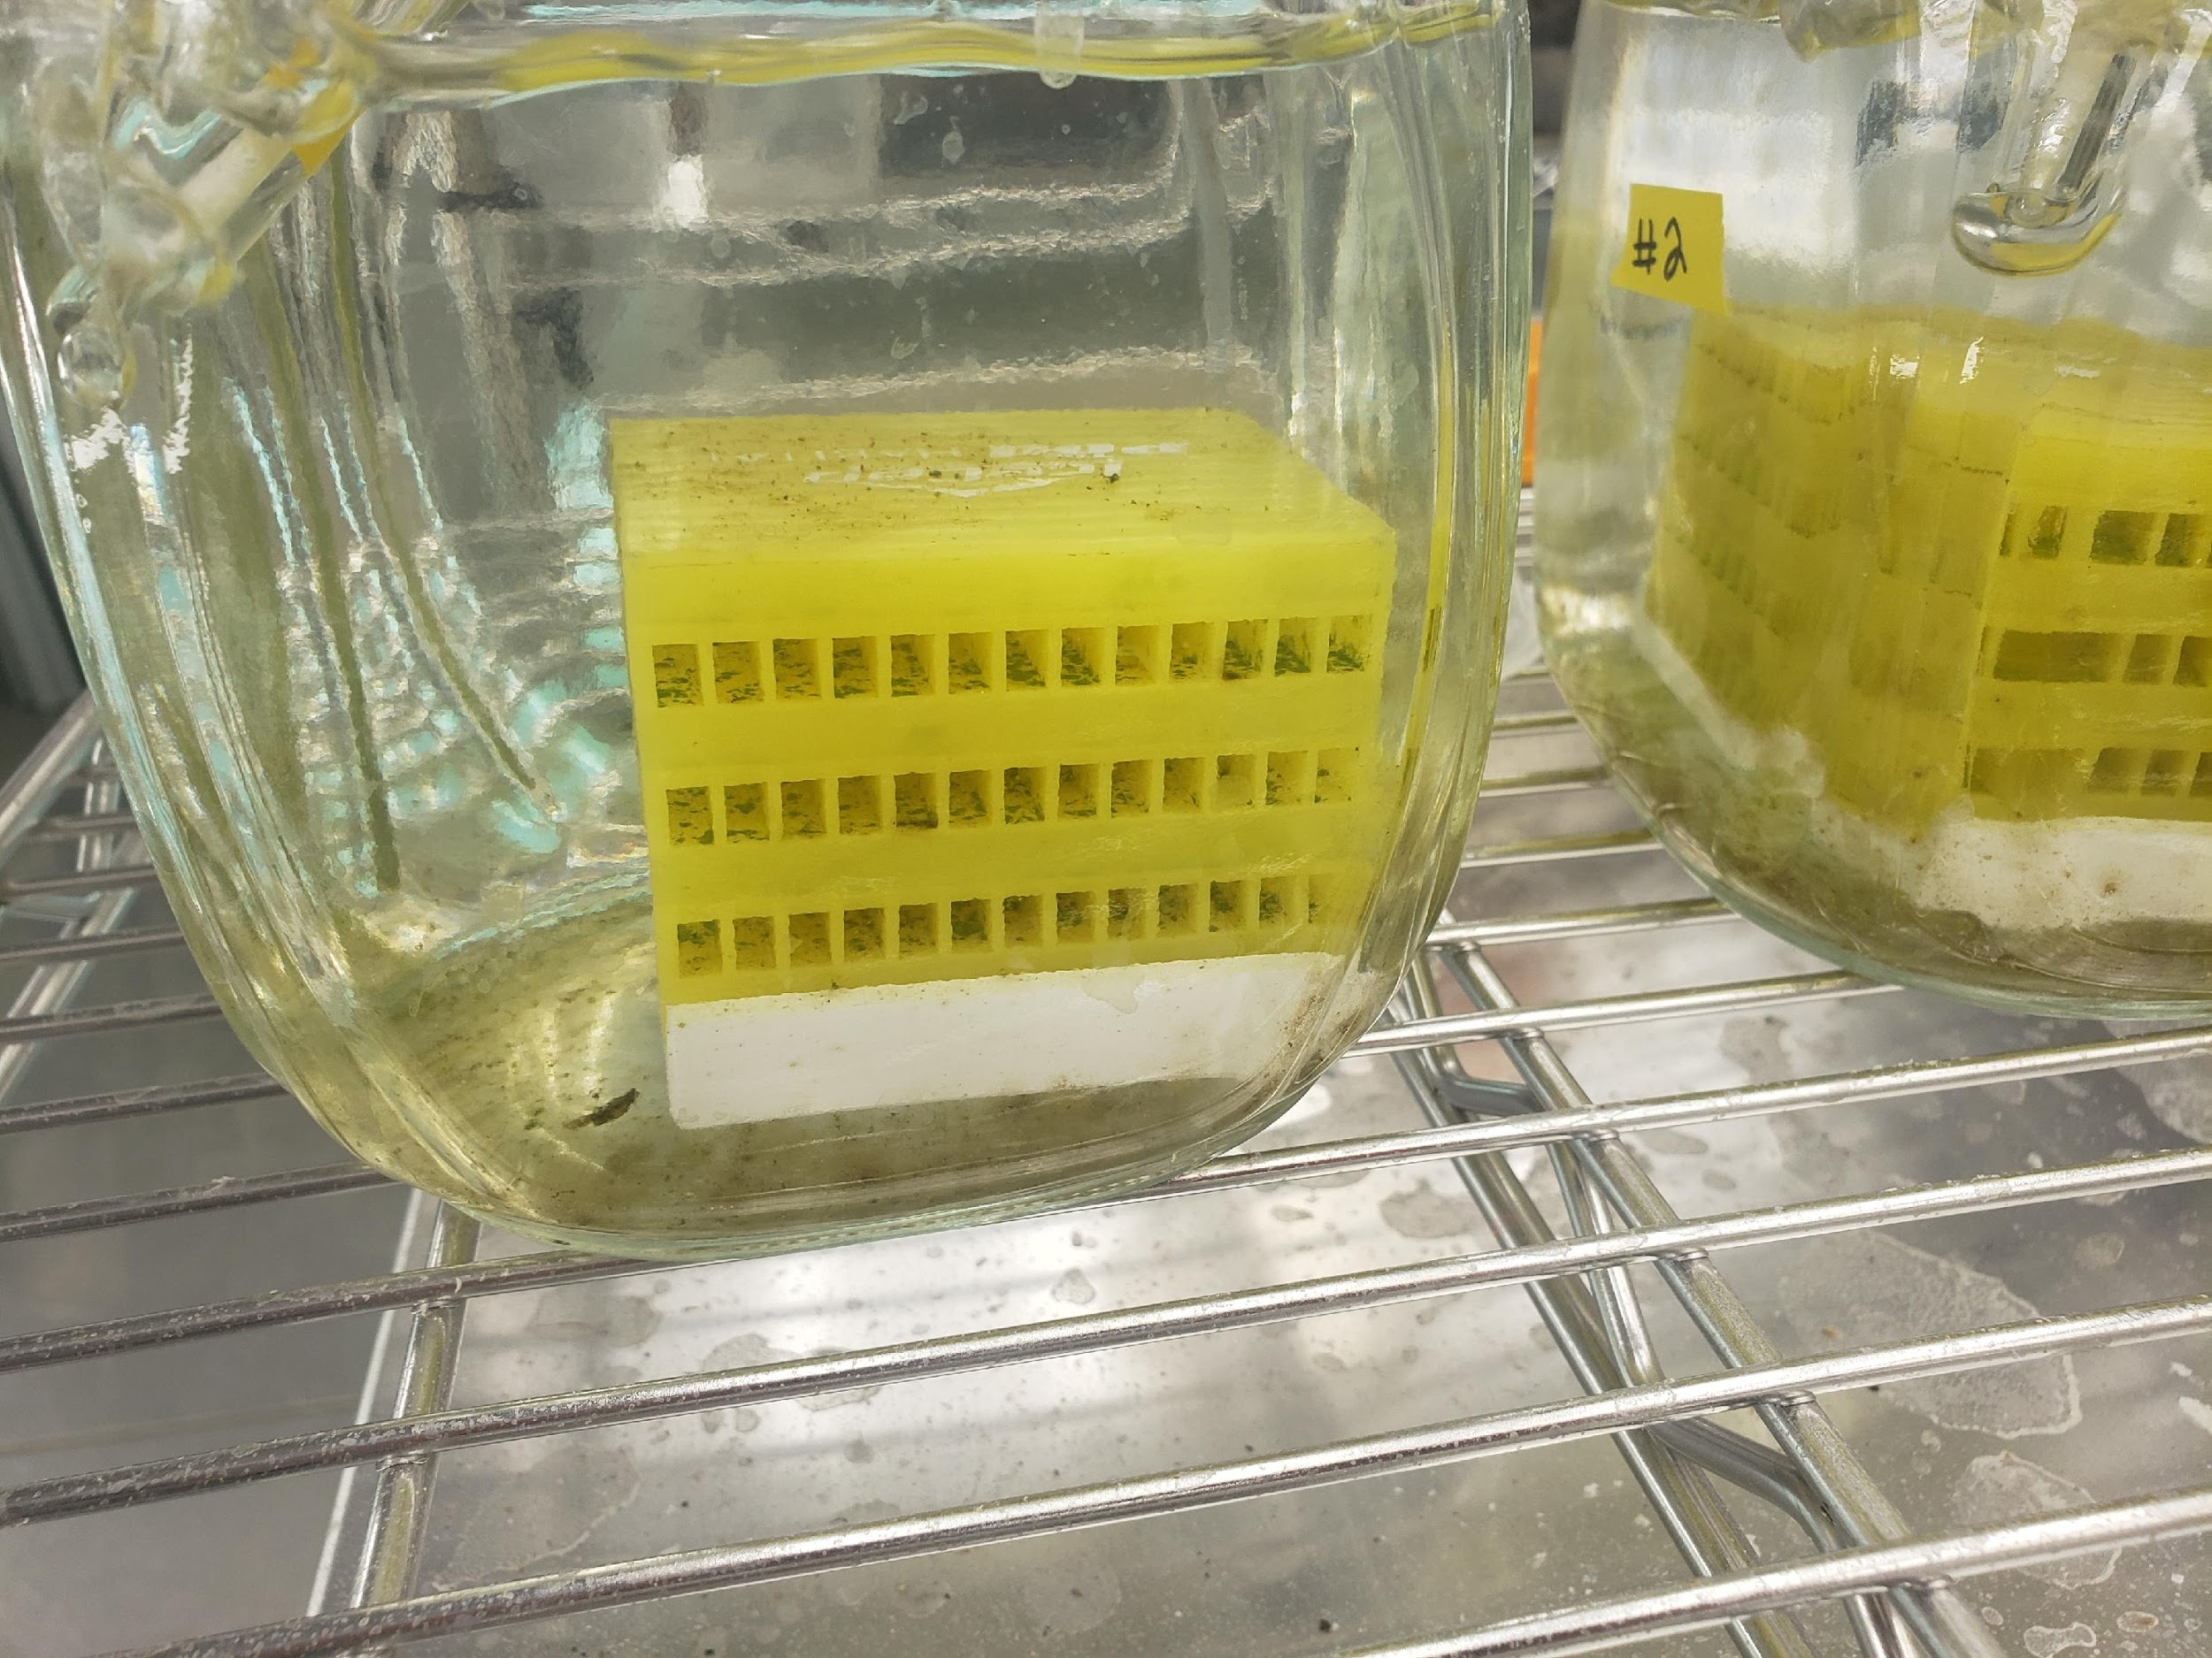
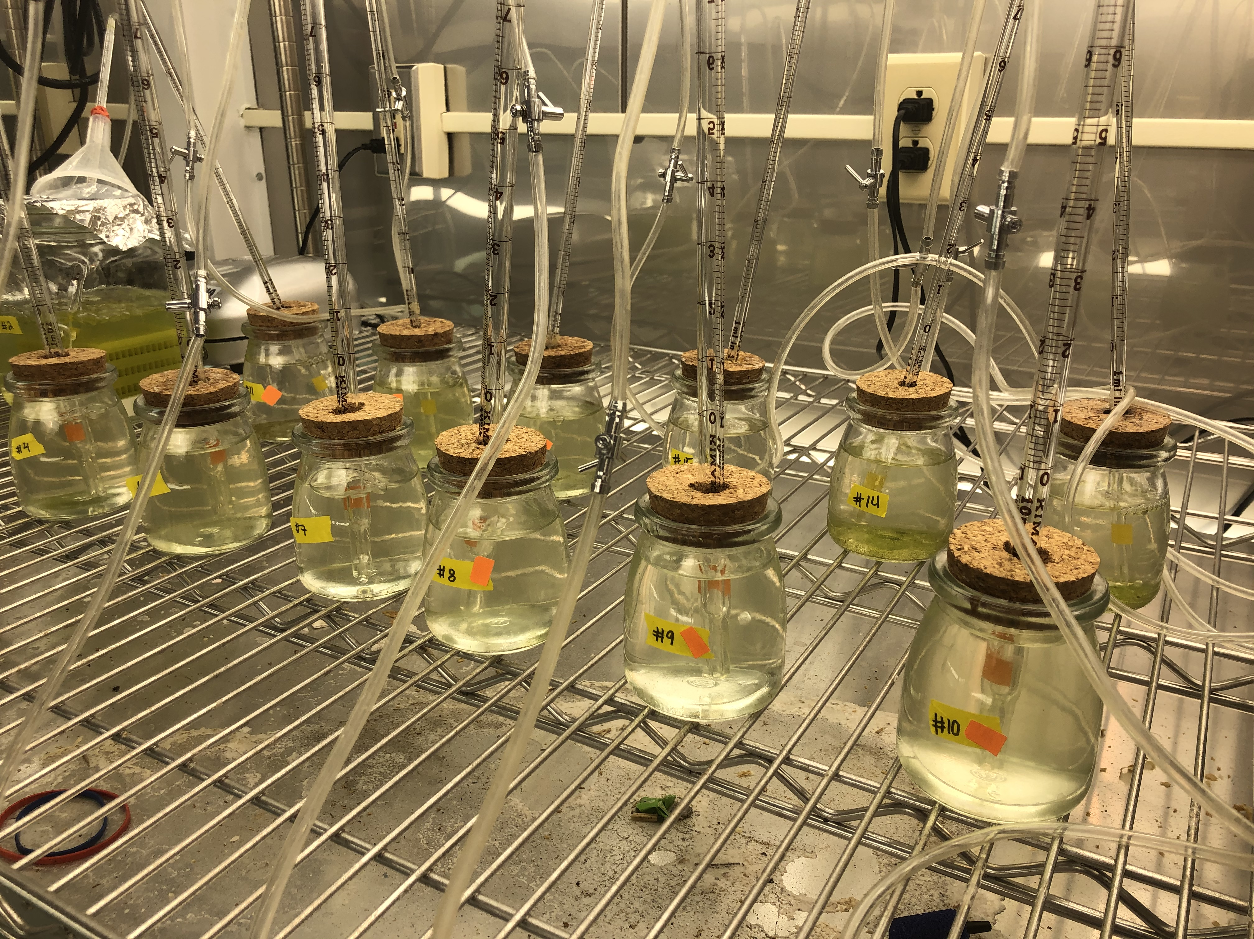
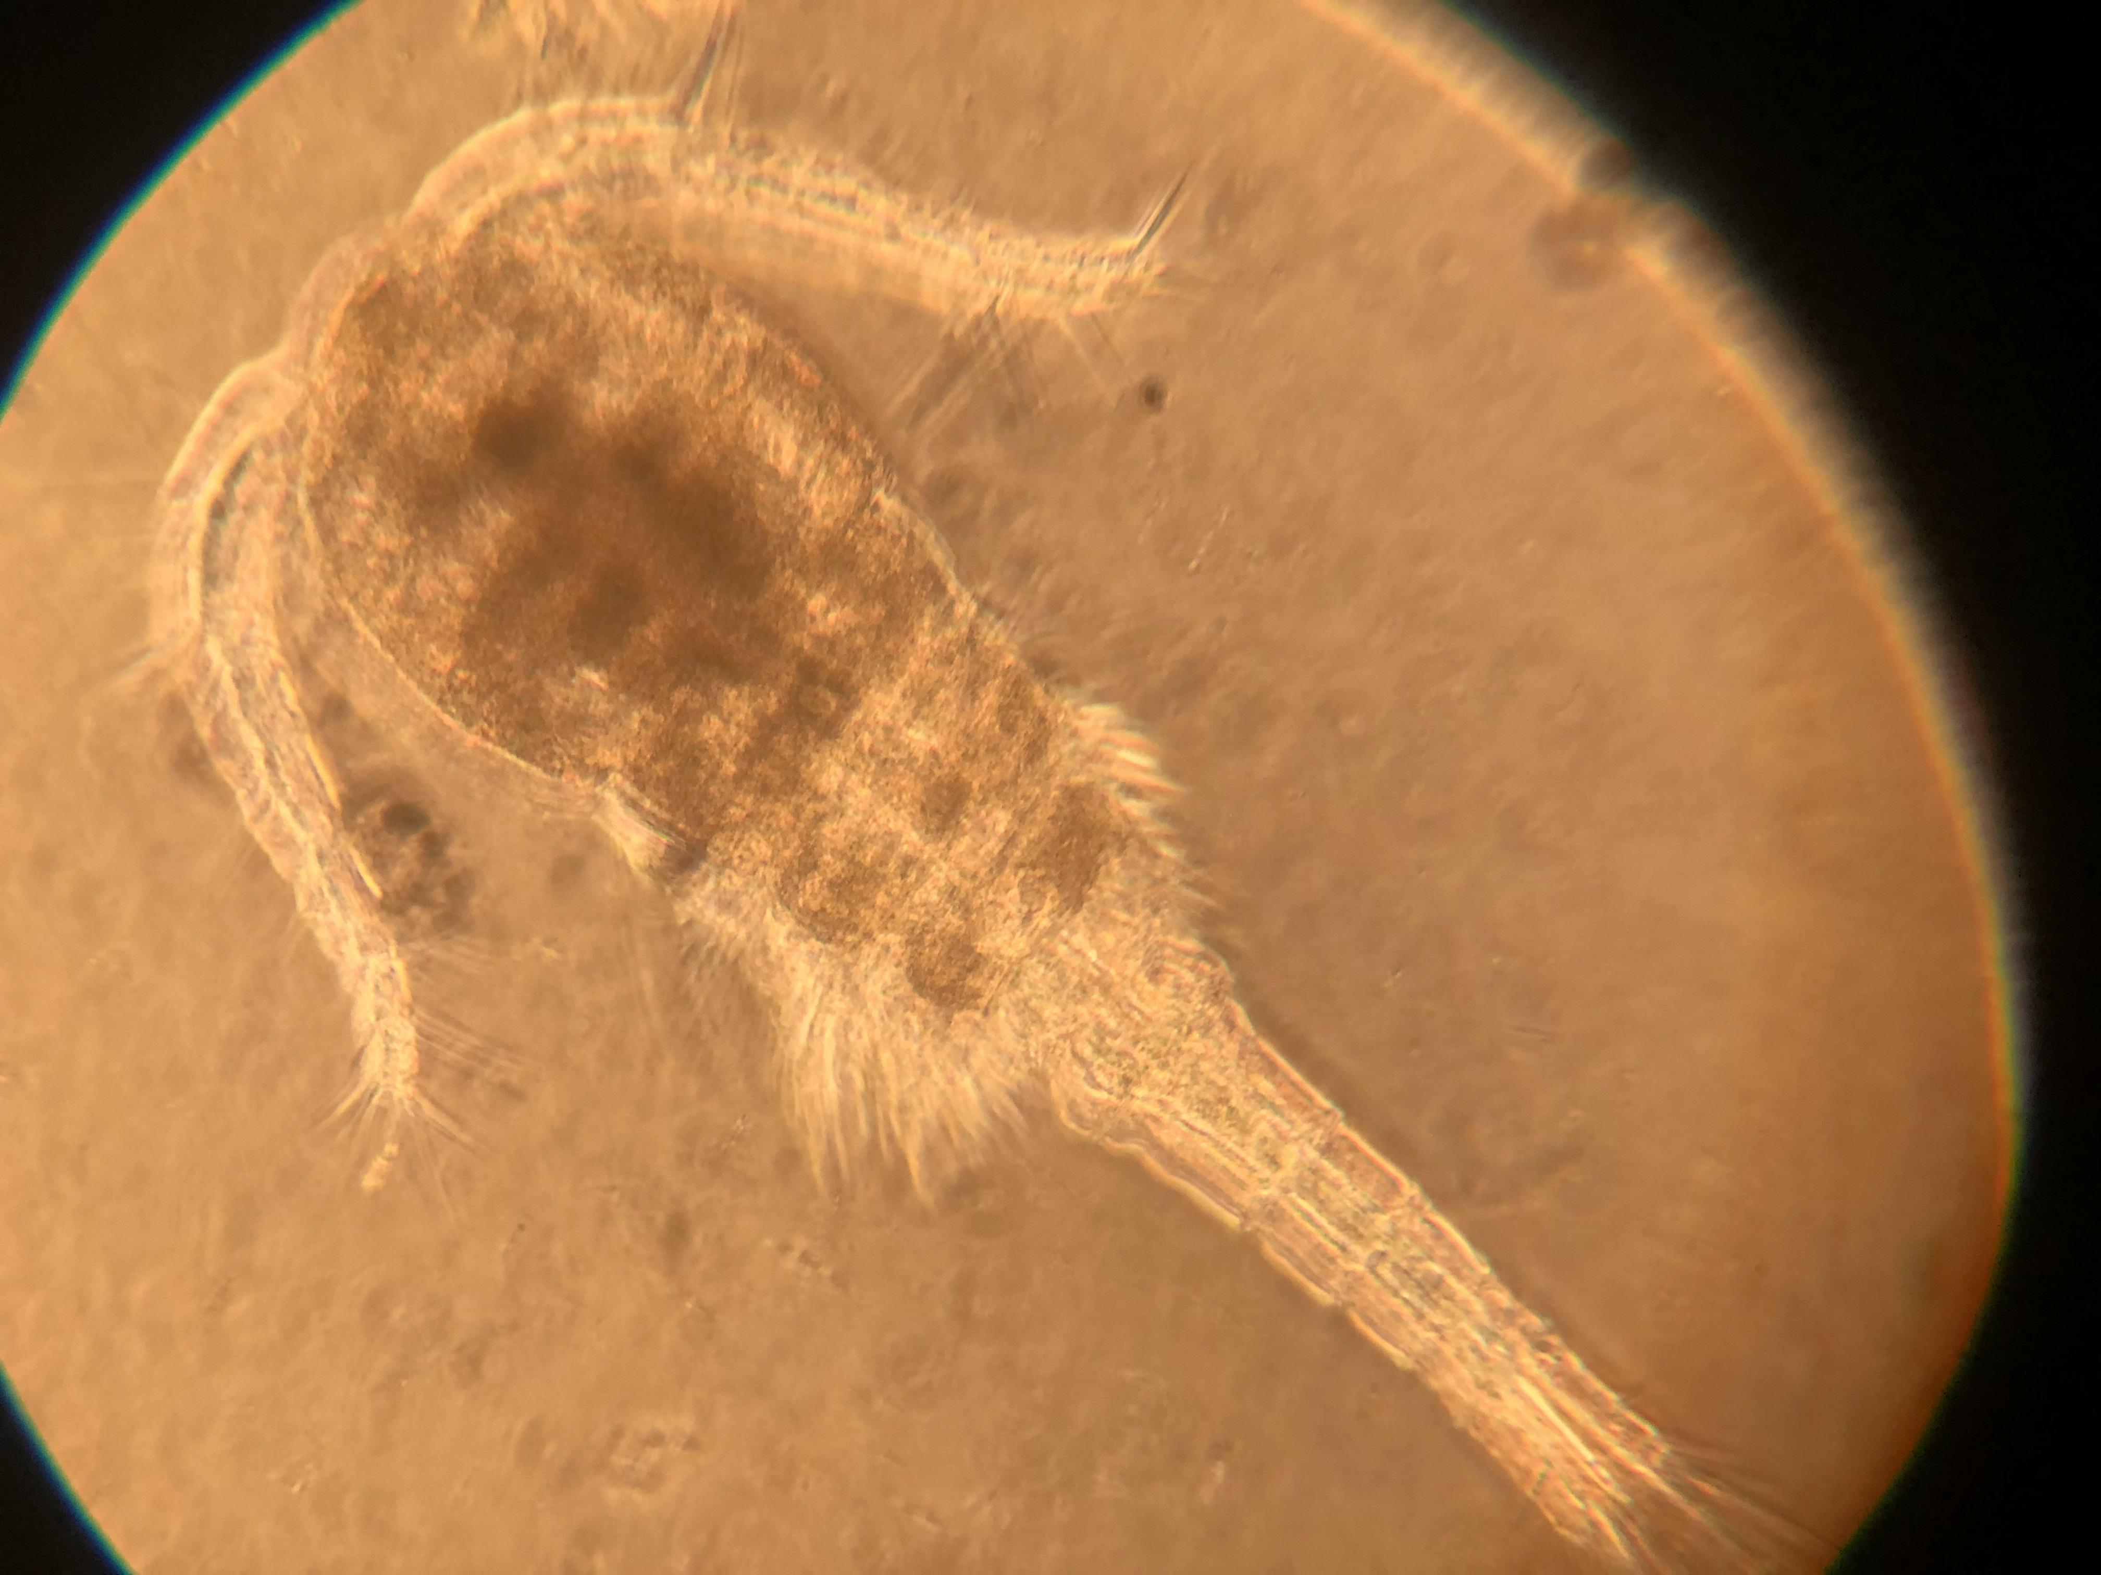
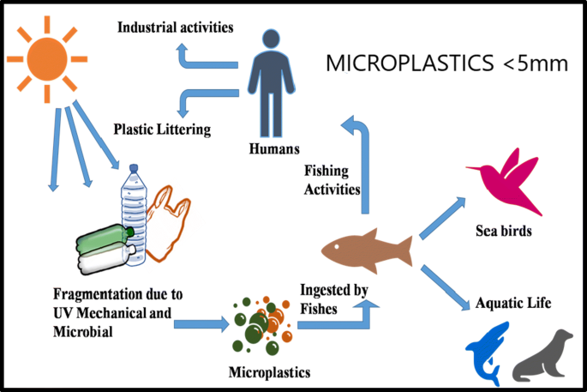
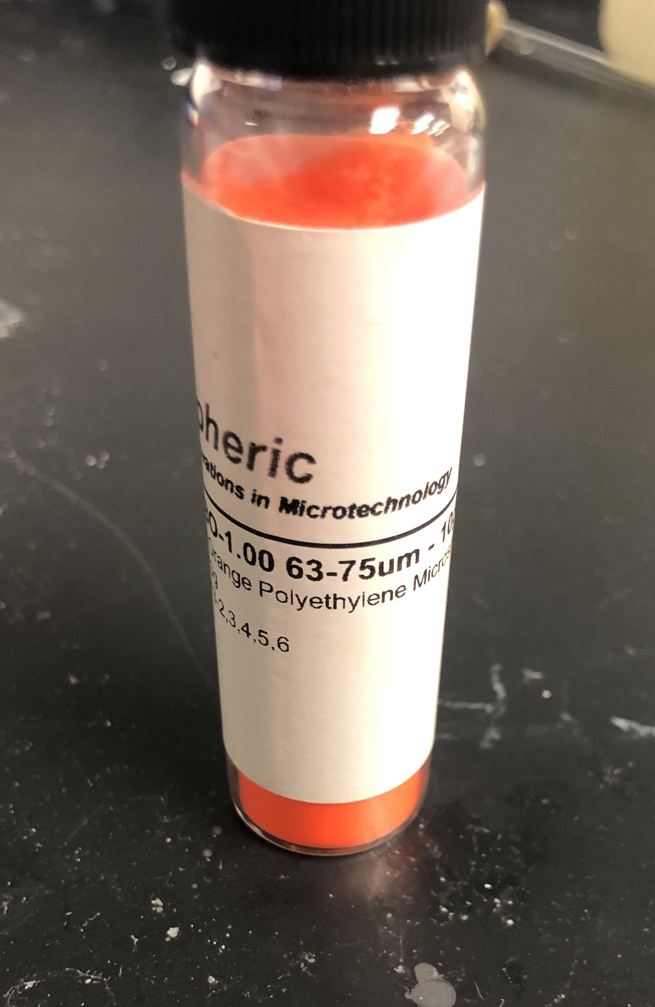
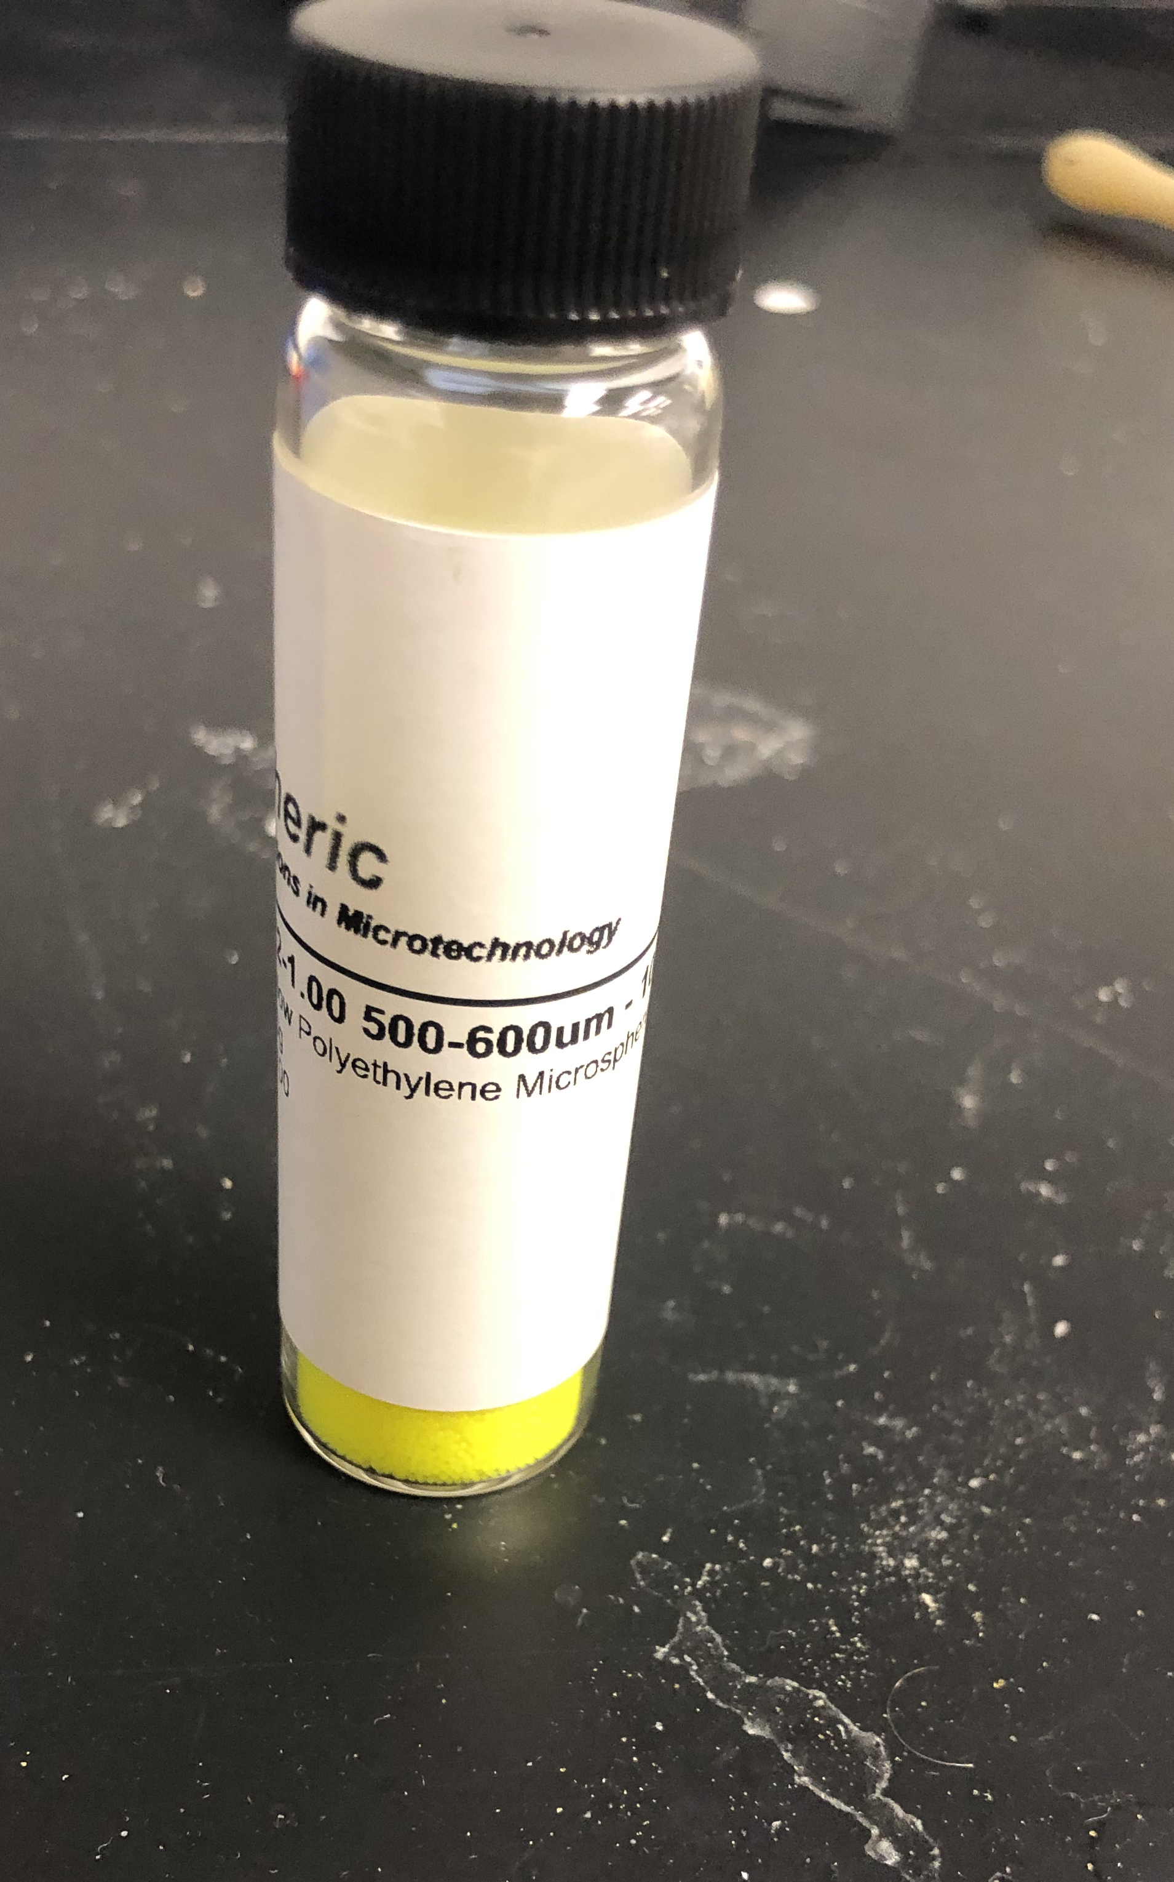
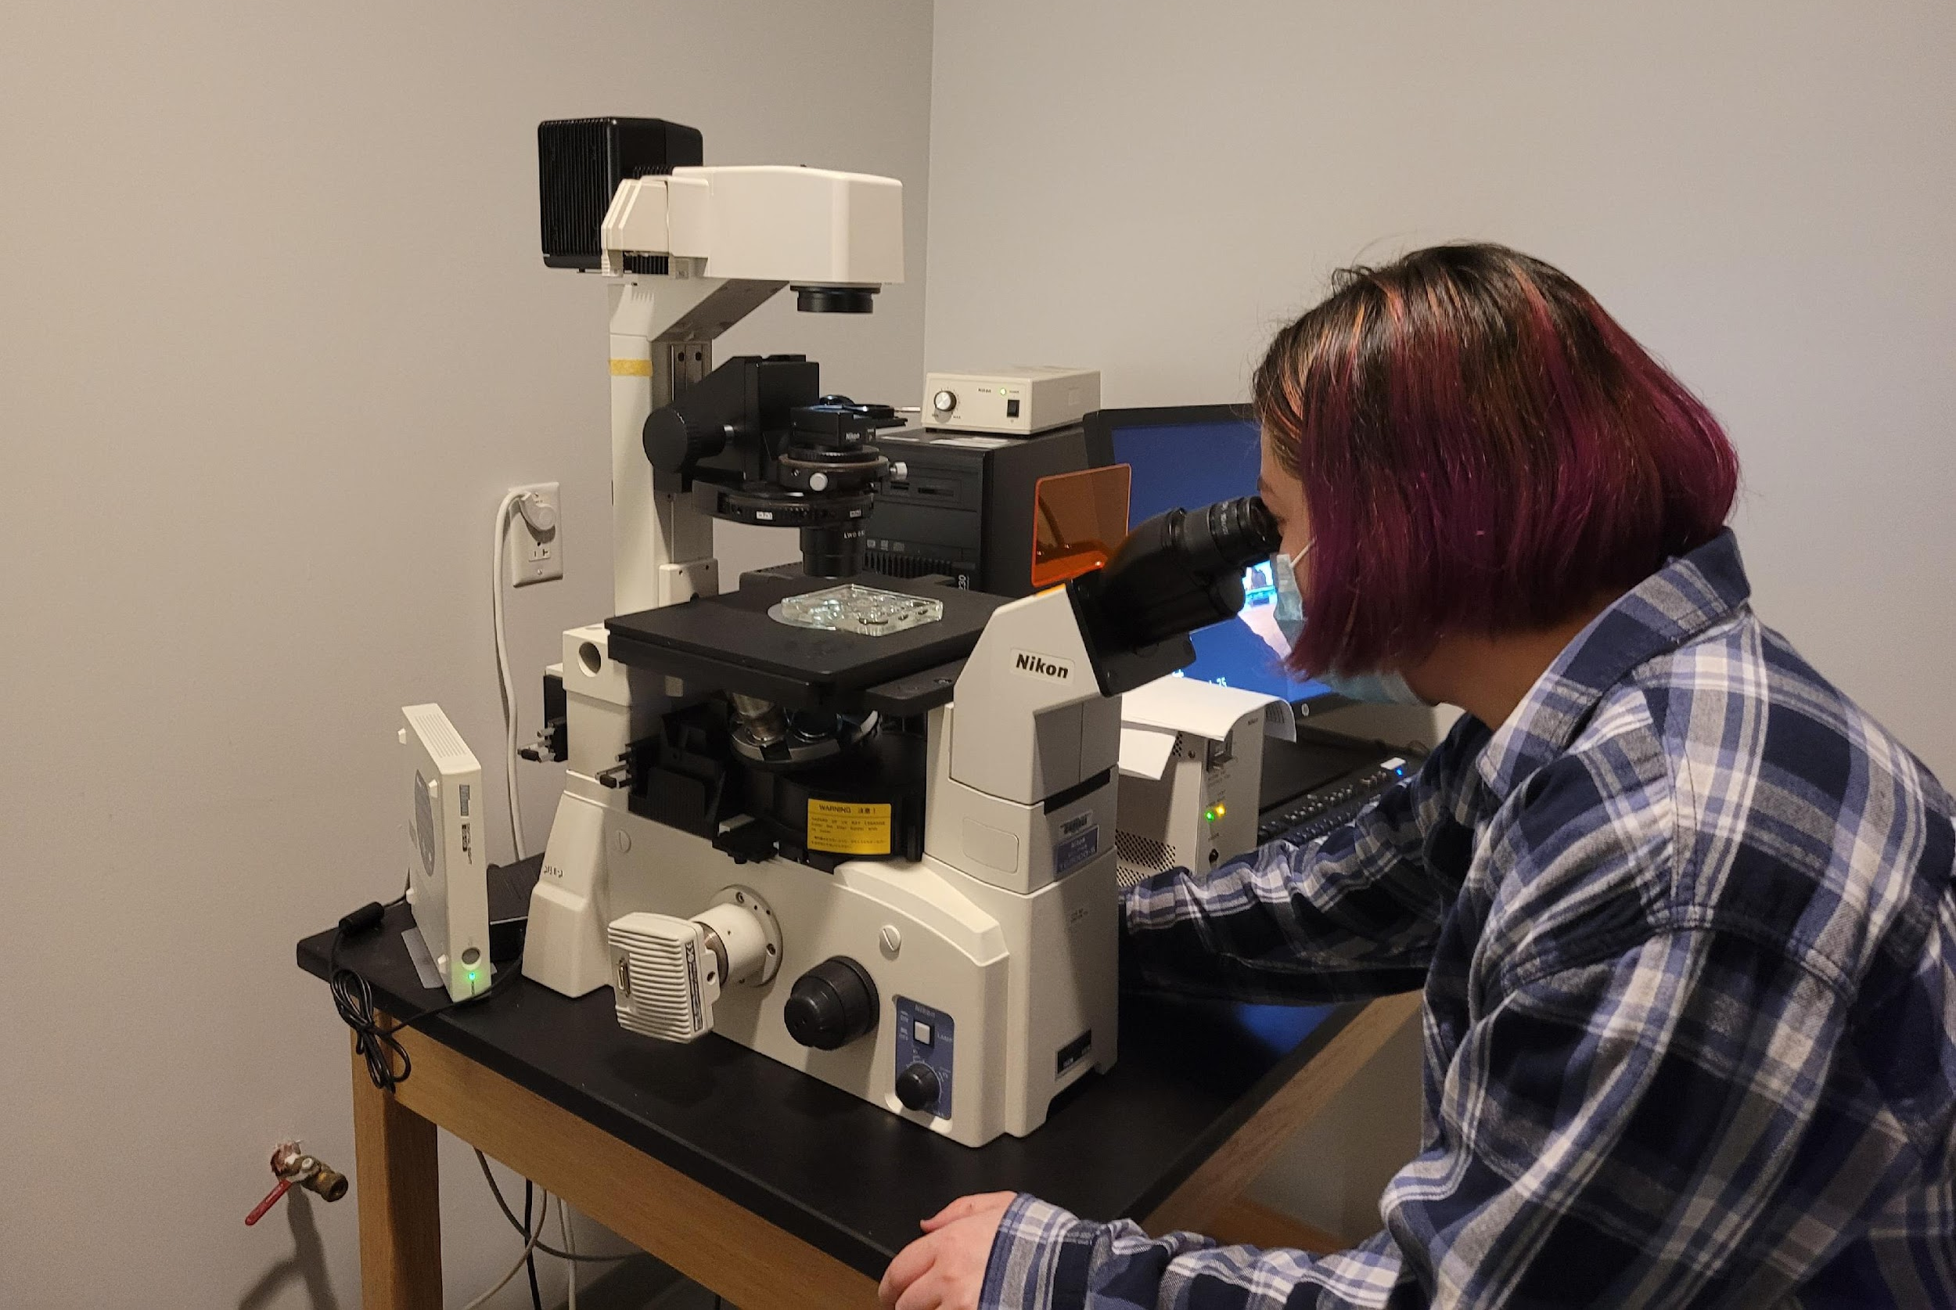
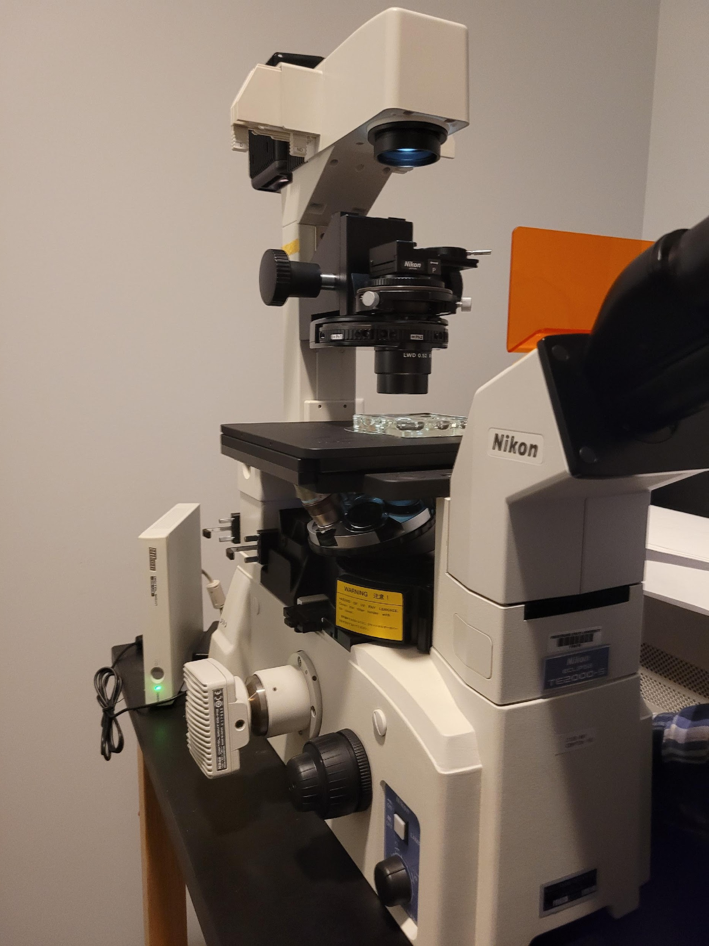
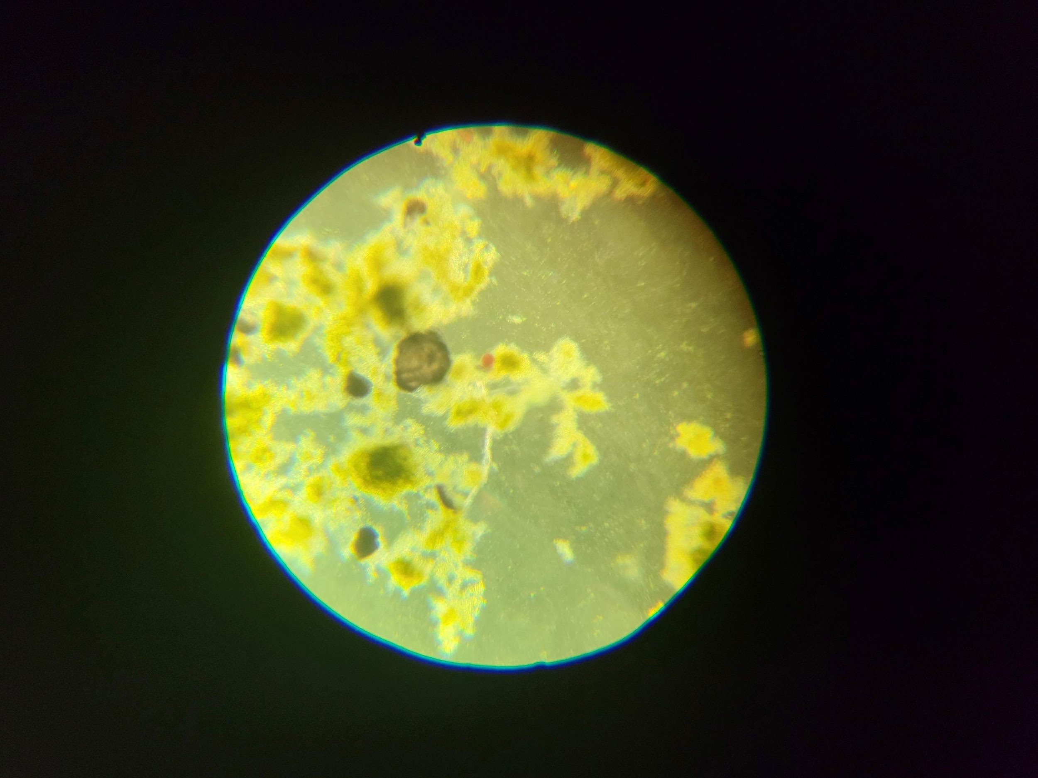
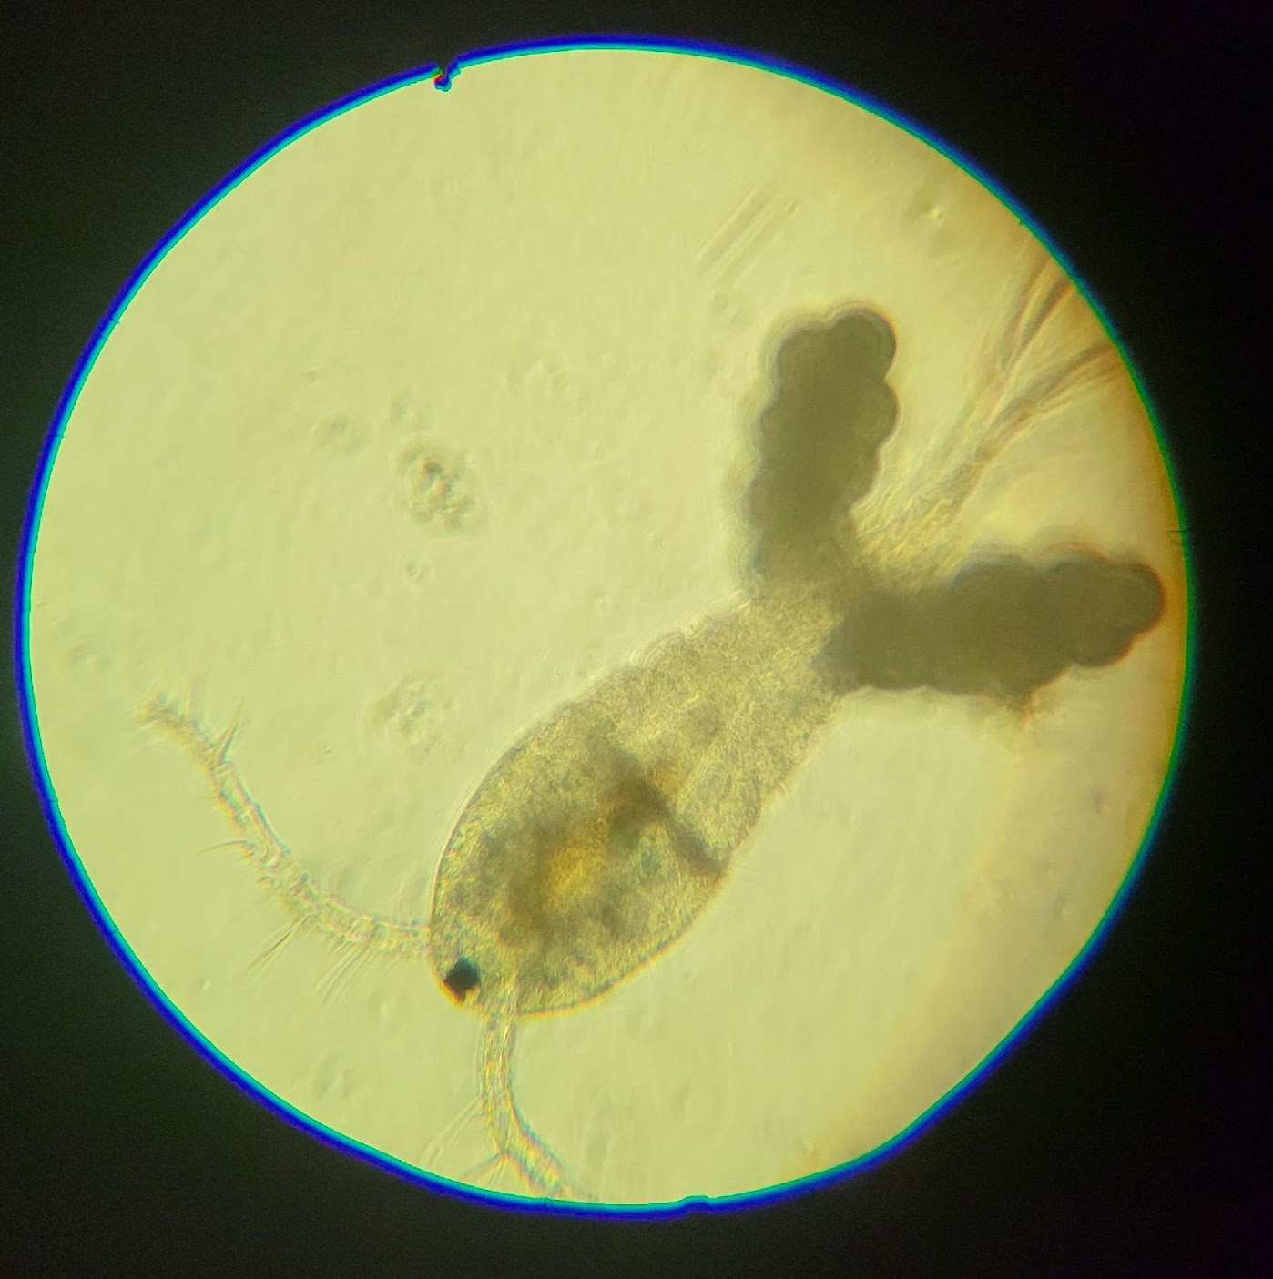
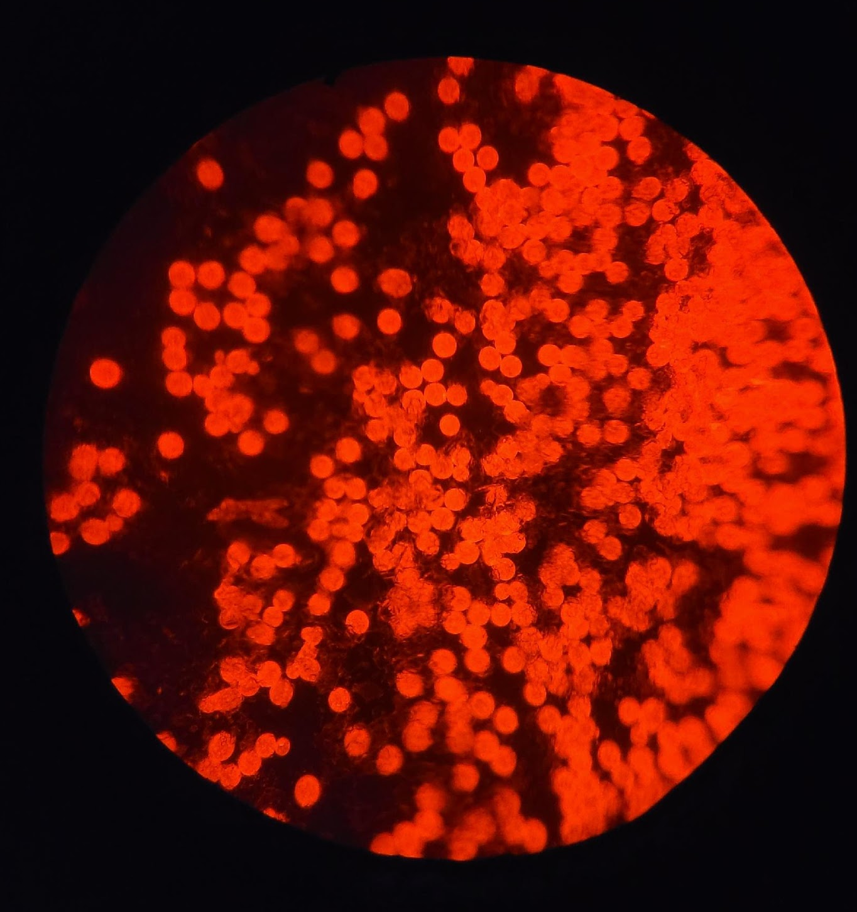
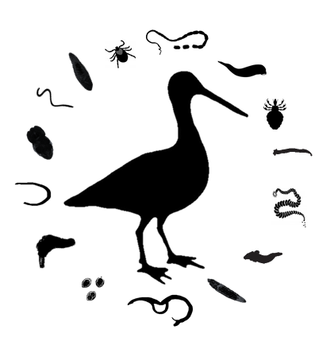
Investigations into the Roles of Organisms on Environmental Plastic Pollution
Zophia Galvan Lam & Kate Lyn Sheehan
Frostburg State University, Frostburg, MD
INTRODUCTION
  Establishing cultures in the laboratory
  Environmental Chambers
  25⁰C & 16-hour progressive light cycle
    Algae – living phytoplankton by Ocean Magic ©
    Apocyclops panamensis copepods from Algae Barn ©
    Copepod maintenance
    Regular survival and reproduction rate assessments on replicated organismal containers
    Weekly 25% water changes and monthly 50% water changes to all stocks in order to maintain water quality and reduce algal overgrowth
    Using fluorescence microscopy on cultures exposed to plastic
    If the algae breaks up plastic microbeads it will glow
    If the copepods eat the plastic parts of their bodies will glow
RESULTS
MATERIALS & METHODS
  Wildlife interact with plastic pollution
      Entanglement
      Nesting materials
      Feeding activities
      Impacts on wildlife populations
      Not well understood
      Injuries, blockages & death
      Toxic compounds in plastics
      Weathering facilitates fragmentation & degradation
      Breaking into small pieces
      Breakdown of compounds
A
Culturing of copepods
Using glass bubblers set at lowest levels
Too much agitation causes populations to crash
Too much algal growth reduces reproduction rates
Removing reproductive & placing into stock culture
Maintaining ~20 copepods per 100mL jar
Fluorescent beads
2 different sizes exposed to algae & copepods
63-75um & 500-600um
No fluorescence detected with either beads: no consumption
No fluorescence detected with algae/biofilm: no biofilm growth
Successfully maintained Apocyclops panamensis in the lab
Future experiments will infect them with a parasitic tapeworm
Interested in adding a larger-bodied copepod to our cultures
No evidence of plastic consumption in copepods
Are they not eating the plastic, or are we not capturing it?
Watching live interactions of copepods and plastic spheres
We need to grow a biofilm on the beads
Not enough time for a biofilm to develop? Too much agitation in bubbling water?
We will also look at the morphology of the plastics to see if it changes after being exposed to algae & copepods
B
Audubon.org
Figure 1. A bird’s nest lined with plastic wrappers (a) in Frostburg, MD. An albatross deceased from starvation due to intestinal blockage from consuming plastic waste in the ocean (b).
A
B
A
B
C
Issac & Kandasubramanian 2021
Figure 3. The laboratory set-up for culturing algae and copepods included two main copepod stocks (a) that were used to house copepods prior to use in the replicated organismal containers (a), and when container populations got large, to thin numbers.
Figure 5. Copepods and algae were exposed to 2 sizes of fluorescent micro-spheres. Orange fluorescently-labelled spheres (a) of 63-75um, and yellow fluorescently-labelled spheres (b) of 500-600um from Cospheric ©, Santa Barbara, CA. Copepod observations (c), showed no evidence of microplastic ingestion.
CONCLUSIONS & FUTURE DIRECTIONS
A
B
STUDY QUESTIONS
Q₁:What is the role of primary producers in the degradation of plastic pollution?
Is there evidence that biofilm (algae) could break down microplastic particles?
How can we detect this if it is happening?
Q₂: Do plastics degrade when consumed by planktonic invertebrates?
Do planktonic copepods consume microplastics?
How can we detect this if it is happening?
A
B
C
Figure 2. Images taken at 40x total magnification of (a) algae, and (b) copepods that had been exposed to microplastics.
ACKNOWLEDGEMENTS: This research is funded by Frostburg State University to assist with pilot research under the Grand Proposal Development Fund. Facilities that we have used for this work to date have included environmental chambers in Gunter Hall and the Microscopy Suite in the Compton Science Center. While this is preliminary in nature, the opportunity to develop these methods has been a great experience. Thank you to all who contributed!
Figure 4. Visualization of fluorescently-labelled microplastic spheres (c) requires the use of a microscope (a & b) that emits light over longer wavelengths and is filtered to detect fluorescence.
Sheehan Parasite & Plastics Lab

