Slide 1
TRANSCENDING BOUNDARIES
Reflections on transdisciplinary librarianship
Victoria Martin
February 10, 2018

Slide 2
PART 1
Transdisciplinarity in a nutshell
(What? Why? Who?)
PART 2
Cross-disciplinary research models
(multidisciplinarity, interdisciplinarity, transdisciplinarity)
PART 3
Implications of transdisciplinarity for libraries

Slide 3
PART 1
Transdisciplinarity in a nutshell
(What? Why? Who?)
PART 2
Cross-disciplinary research models
(multidisciplinarity, interdisciplinarity, transdisciplinarity)
PART 3
Implications of transdisciplinarity for libraries

Slide 4
“Crossing boundaries is a defining characteristic of our age.”
─Julie Klein, 1996

Slide 5
Part 1
WHAT, WHY, WHO
The challenge of defining TransDisciplinarity (TD)
    Definitions vary among scholars
    Not yet defined in dictionaries
    Often (mis)used interchangeably with
    interdisciplinarity
    Sometimes defined metaphorically

Slide 6

Part 1
WHAT, WHY, WHO
A web is a common metaphor for transdisciplinarity

Slide 7
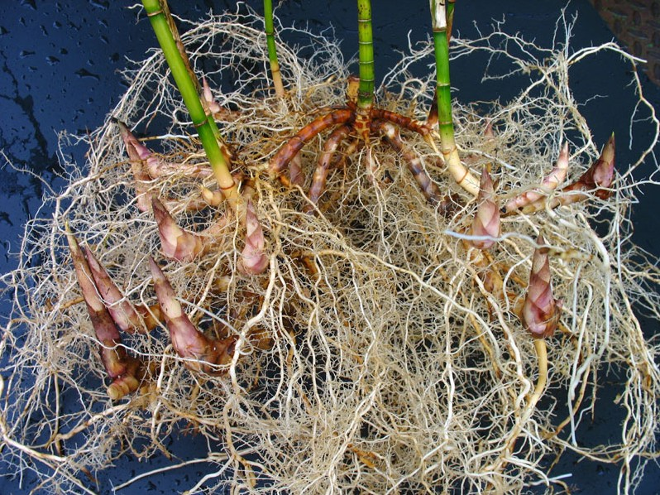
Part 1
WHAT, WHY, WHO
A rhizome is another common metaphor for transdisciplinarity

Slide 8
WHAT, WHY, WHO
Part 1
“Trans -”
(across, beyond, through, to the other side)
+
“discipline”
(1. an organized field of knowledge; 2. a set of rules)

Slide 9
Part 1
WHAT, WHY, WHO
Key characteristics of the TD research model
Problem-driven
Action-oriented
Highly collaborative
Integrative
Socially relevant

Slide 10

Part 1
WHAT, WHY, WHO
Transdisciplinarity is a new way of conducting research,
in which multiple contributors and stakeholders, both
from within and from outside academia, are working together on identifying specific real-world problems and
on finding solutions to these problems.

Slide 11
WHAT, WHY, WHO
Part 1
The need for TD arises in response to four major concerns:
A growing concern about a host of urgent complex real world problems
The need to seek solutions to these problems
A realization that contemporary science can neither properly understand nor address these urgent problems
The need for a more democratic governance of knowledge production

Slide 12
Part 1
WHAT, WHY, WHO
Examples of complex urgent real world problems
that TD aims to address:
Environmental pollution
Human rights violation
Spread of antibiotic resistance
Nuclear insecurity
Unsustainable use of resources
Health risks from new technologies

Slide 13
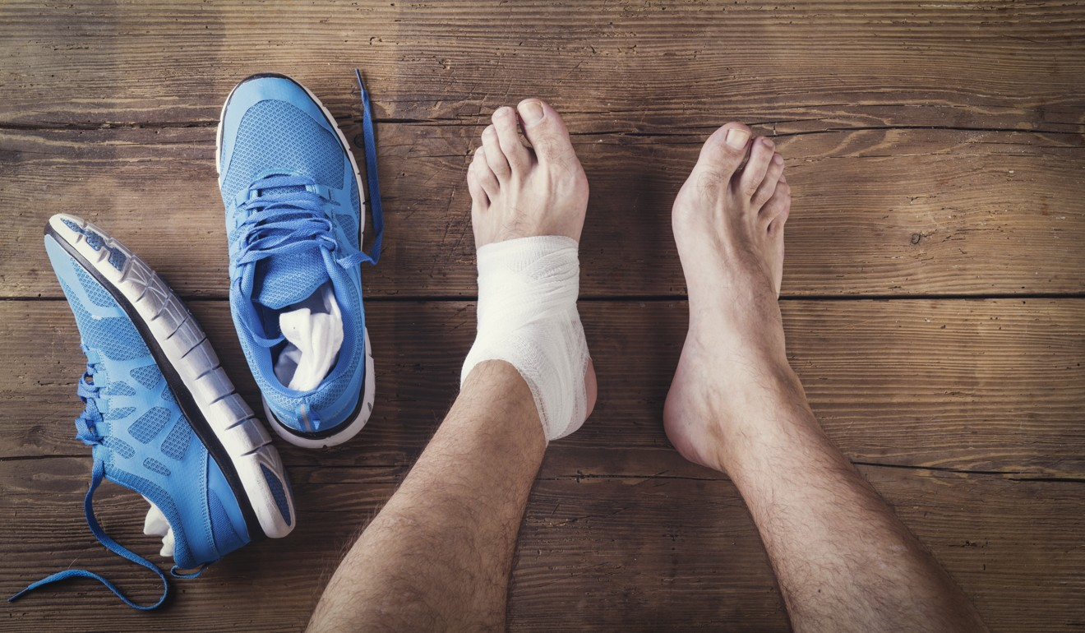
Part 1
WHAT, WHO, WHY
“The man who wears the shoe knows best that it pinches and where it pinches, even if the expert shoemaker is the best judge of how the trouble is to be remedied.”
─ John Dewey, 1927

Slide 14
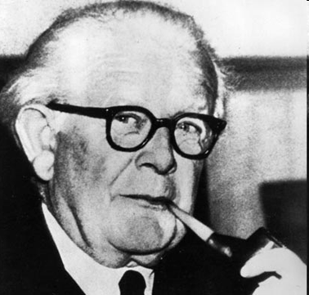
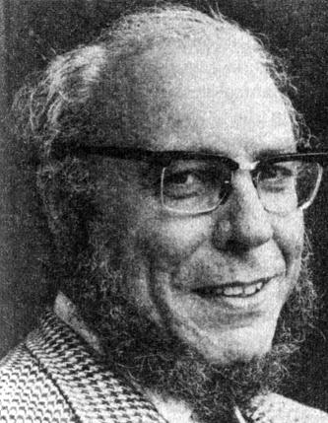
WHAT, WHY, WHO
Part 1
Jean Piaget
Erich Jantsch

Slide 15
Part 1
WHAT, WHY, WHO
The Zurich School’s
transdisciplinarity
Nicolescuian transdisciplinarity
  Approach
Multiple levels of reality and the Hidden Third
The logic of the included middle
Complexity
Key proponents
Basarab Nicolescu
Edgar Morin
Approach
Based upon Mode-2 knowledge production
Key proponents
Gertrude Hirsch Hadorn
Christian Pohl

Slide 16
PART 1
Transdisciplinarity in a nutshell
(What? Why? Who?)
PART 2
Cross-disciplinary research models
(multidisciplinarity, interdisciplinarity, transdisciplinarity)
PART 3
Implications of transdisciplinarity for libraries

Slide 17
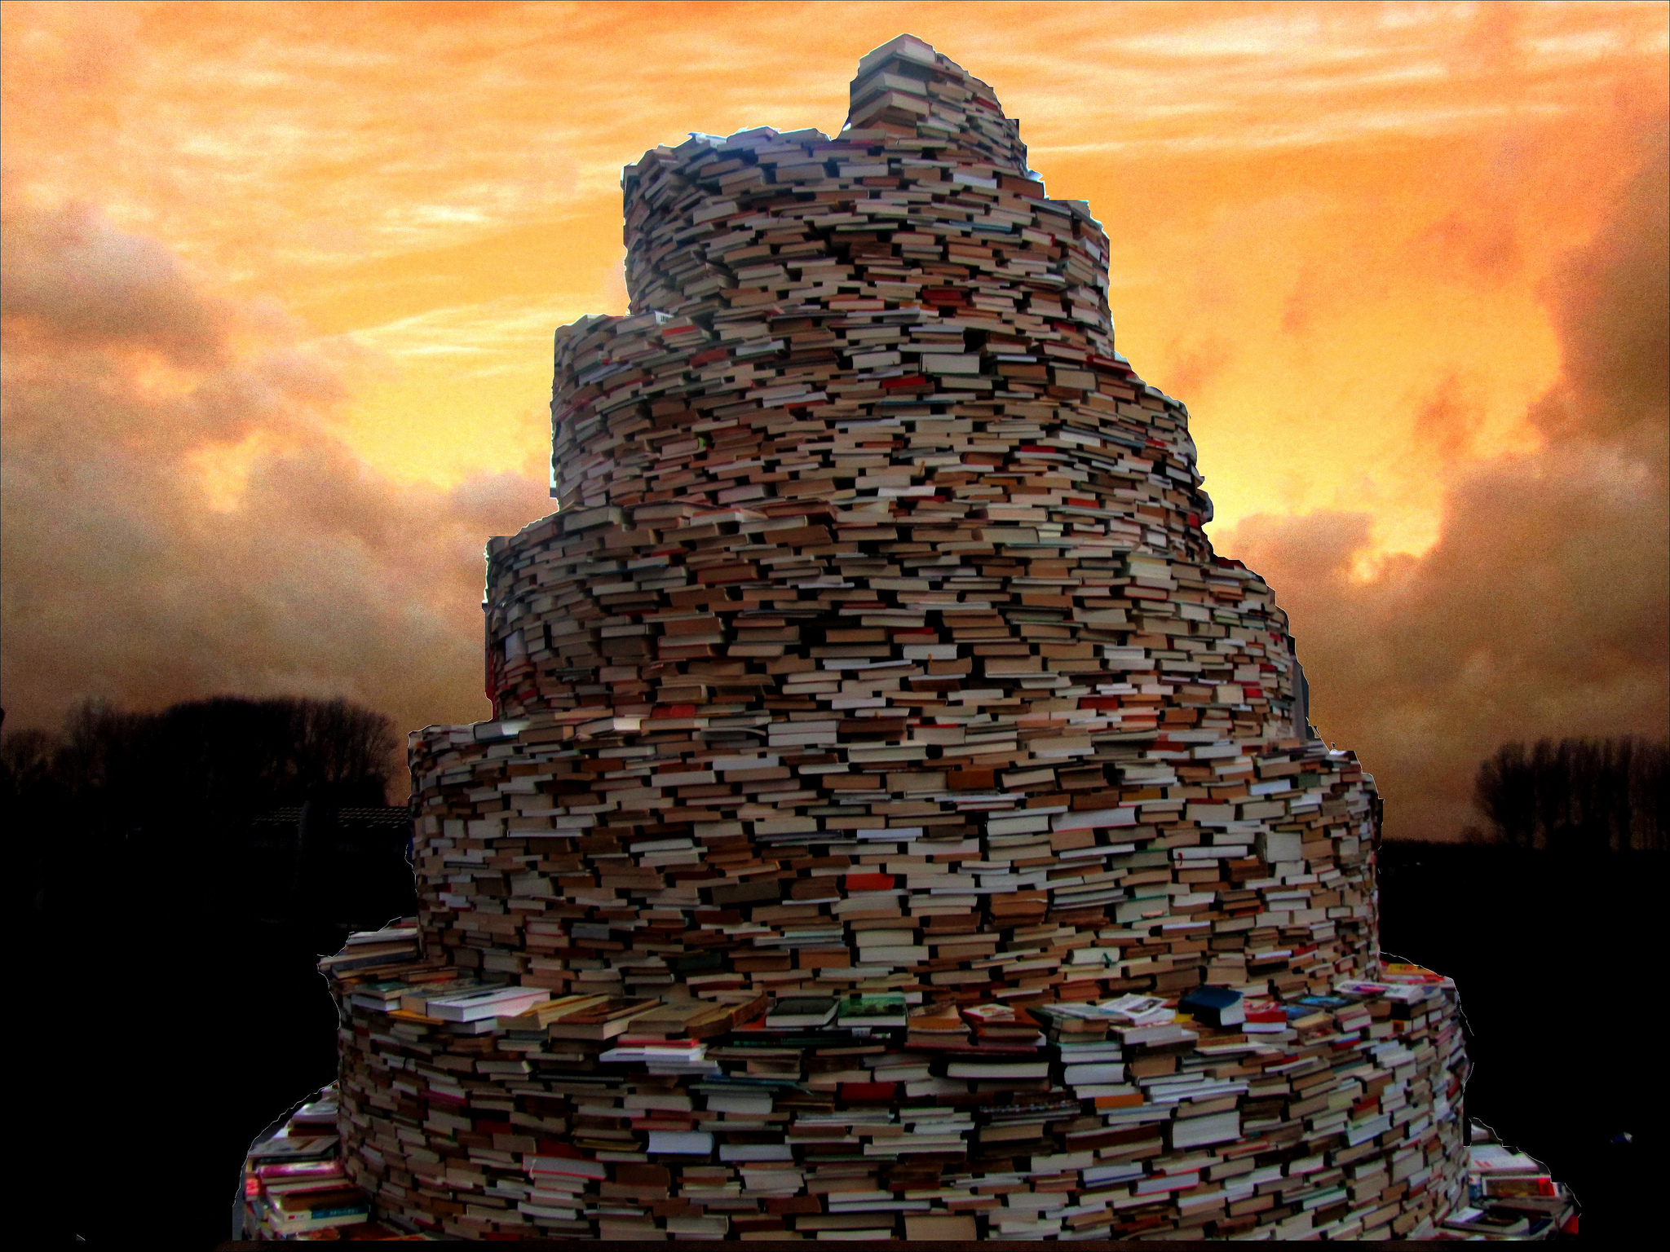
Part 2
“How can a theoretical particle physicist truly hold a dialogue with a neurophysiologist, a mathematician with a poet, a biologist with an economist, a politician with a computer programmer, beyond mouthing more or less banal generalities? Yet, a true decision maker must be able to have a dialogue with all of them at once.”
─ Basarab Nicolescu, 2002

Slide 18
Part 2
DISCIPLINARITY
MULTIDISCIPLINARITY INTERDISCIPLINARITY TRANSDISCIPLINARITY
Discipline A
Discipline B
Discipline C

Slide 19
Part 2
DISCIPLINARITY
MULTIDISCIPLINARITY INTERDISCIPLINARITY TRANSDISCIPLINARITY
Discipline A
Discipline D
Discipline B
Theme
Discipline C

Slide 20
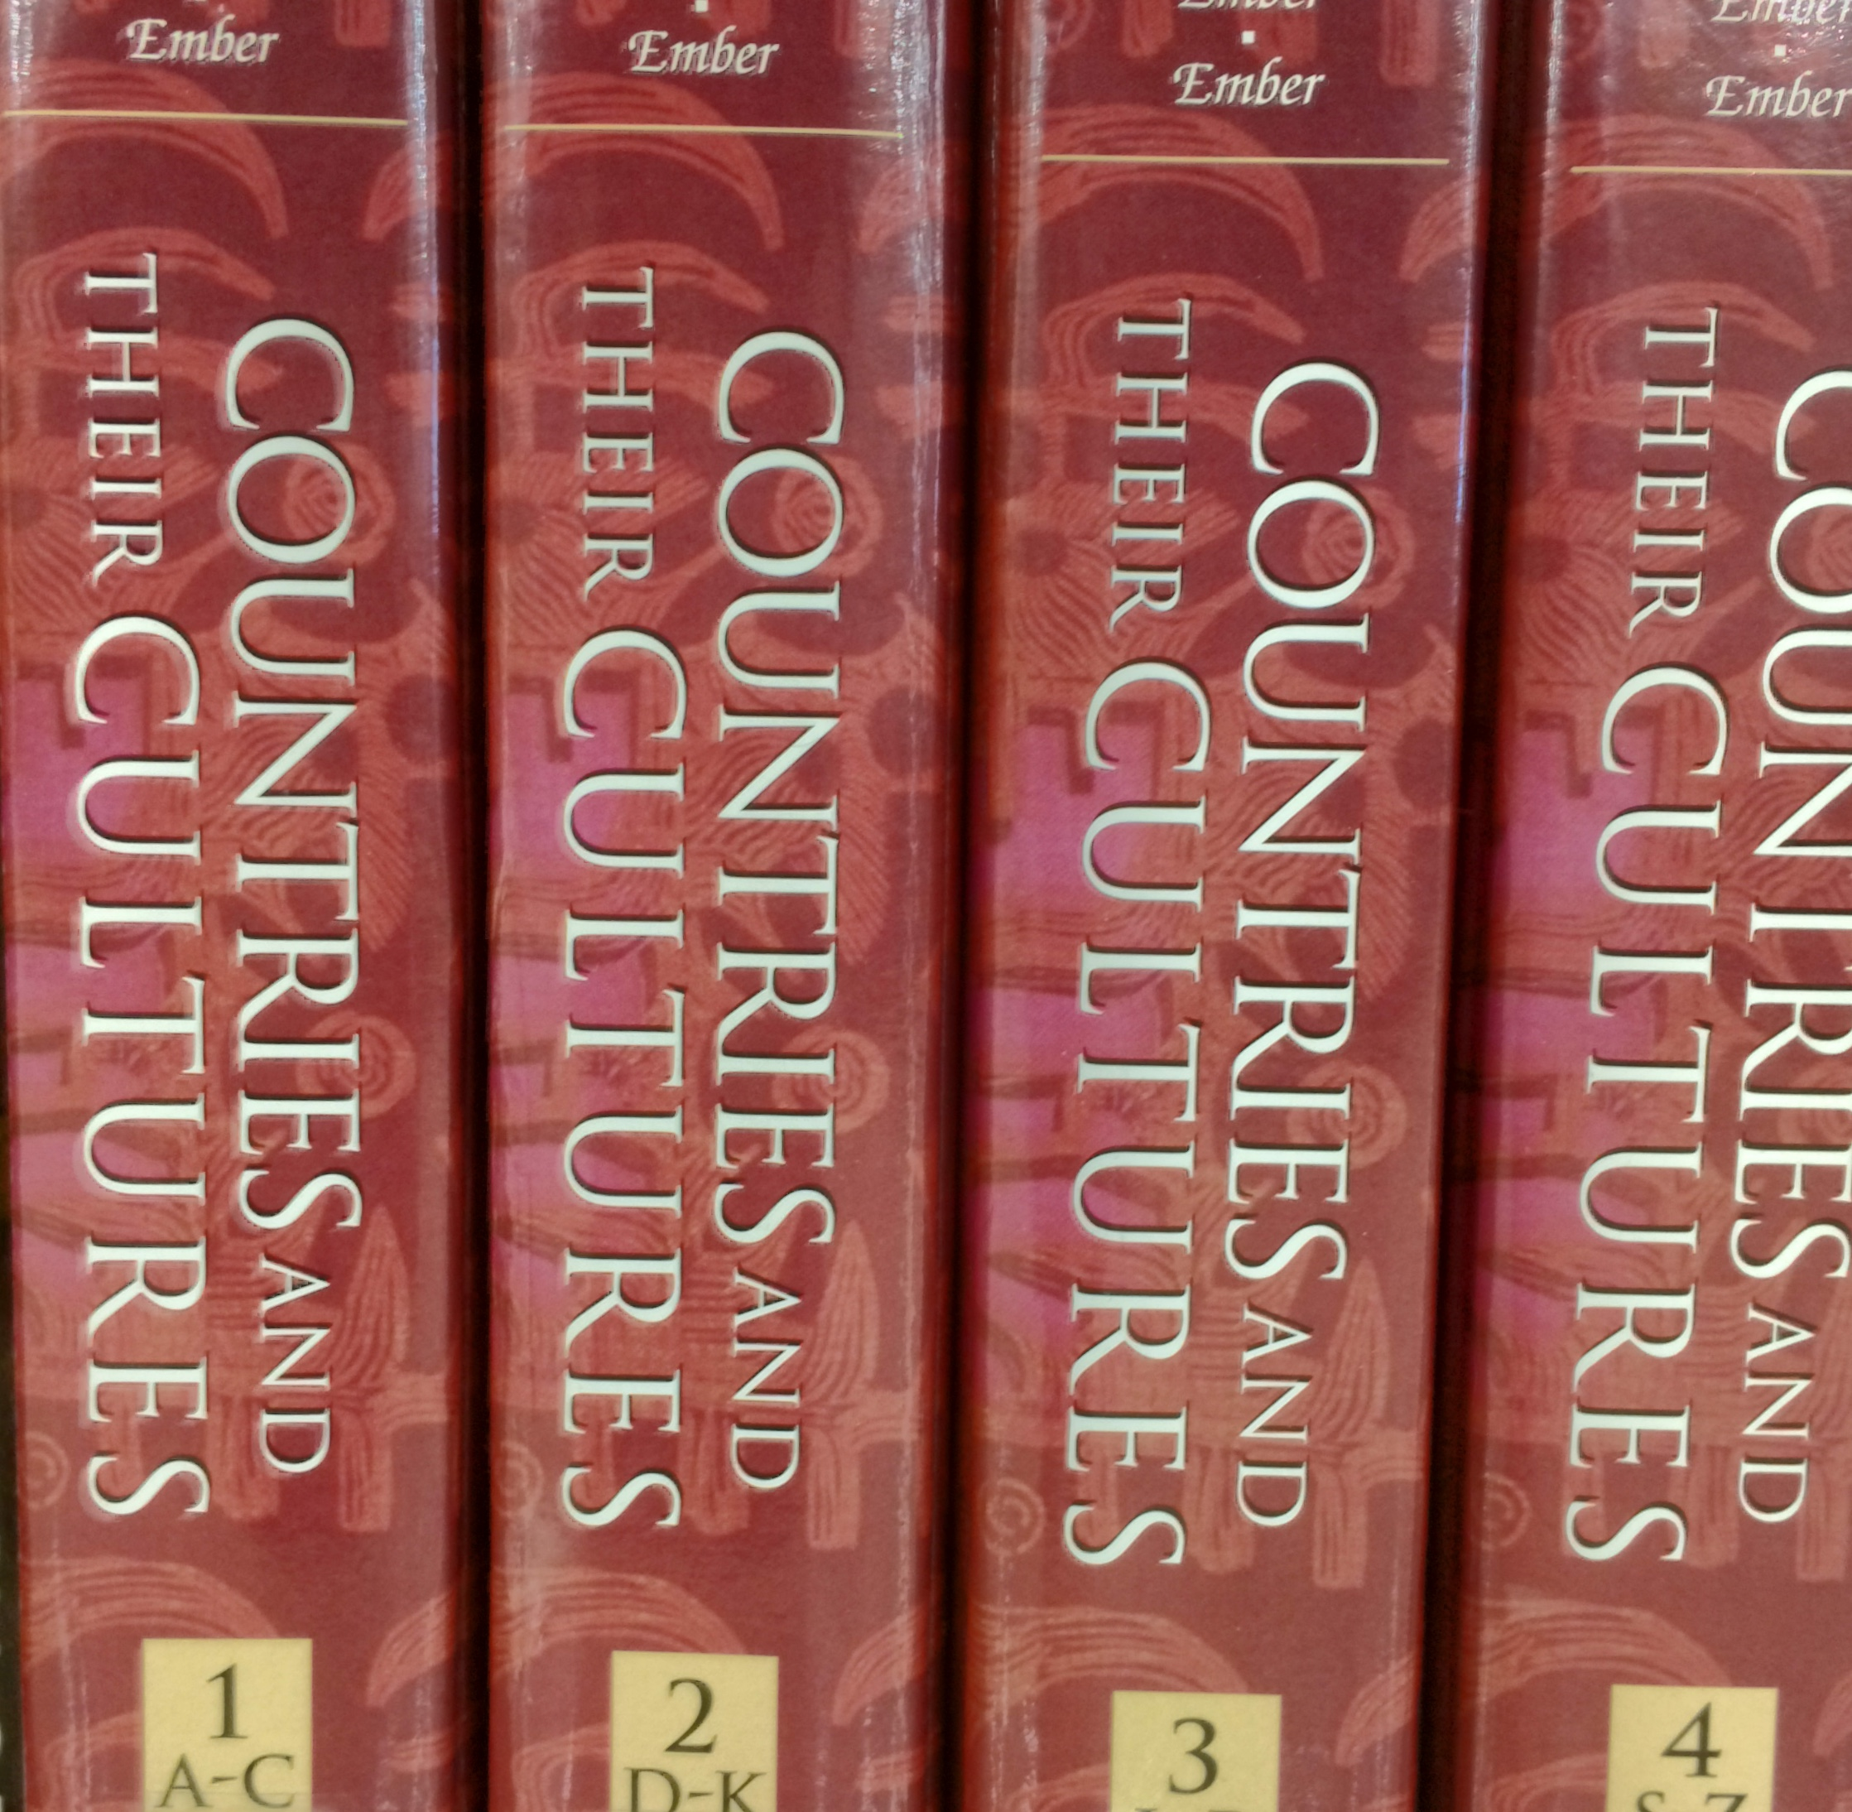
An example of a multidisciplinary project
A multi-volume encyclopedia “Countries and their cultures”

Slide 21
Part 2
DISCIPLINARITY
MULTIDISCIPLINARITY INTERDISCIPLINARITY TRANSDISCIPLINARITY
Research question
Discipline A
Discipline C
Discipline B

Slide 22

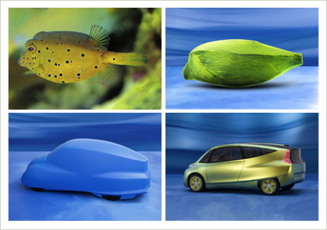
Part 2
Examples of interdisciplinary fields
Paleontology
Biomimicry

Slide 23
Part 2
DISCIPLINARITY
MULTIDISCIPLINARITY INTERDISCIPLINARITY TRANSDISCIPLINARITY
Discipline A
Discipline B
Discipline C
Real-world problem
Nonacademic participants
Academic knowledge
Nonacademic knowledge
Integrated knowledge
Solution

Slide 24
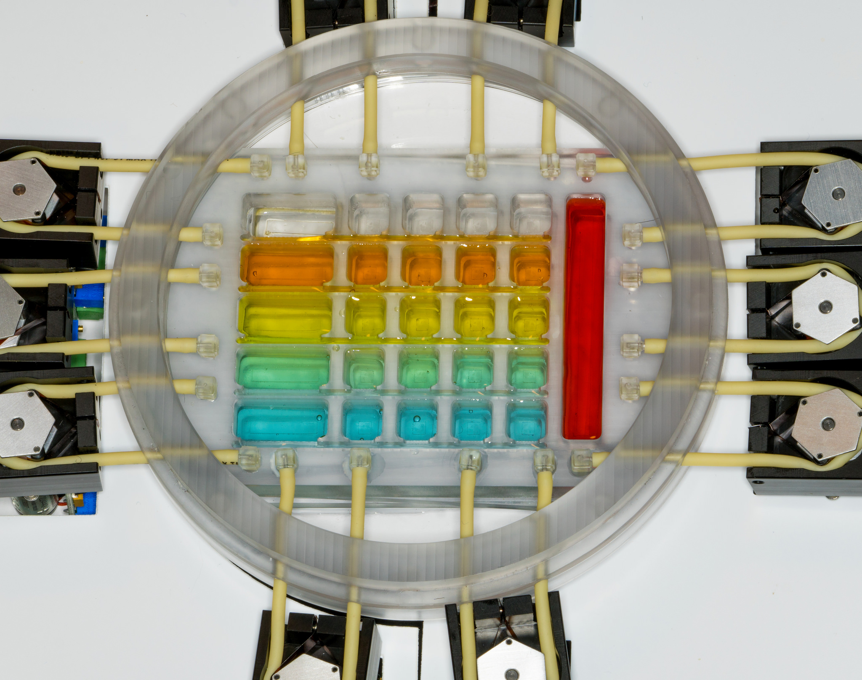
Part 2
An example of a transdisciplinary project
Problem-driven
Addresses the problem of drug failure in clinical trials
Action-oriented
Develops 3-D human tissue chips to predict drug safety in humans
Highly collaborative
Collaboration between NIH, DARPA, and FDA
Integrative
  Academic knowledge: tissue engineering, chemistry, biology, physiology, microfluidics, regulatory science
  Nonacademic knowledge: community organizations and patient groups
Socially relevant
Translates scientific discoveries into the real world
The Tissue Chip for Drug Screening project

Slide 25
Key Challenges for TD researchers
Part 2
Disciplinary acculturation
Information overload
Communication challenges
Inadequate institutional support
Funding challenges
New information needs

Slide 26
PART 1
Transdisciplinarity in a nutshell
(What? Why? Who?)
PART 2
Cross-disciplinary research models
(multidisciplinarity, interdisciplinarity, transdisciplinarity)
PART 3
Implications of transdisciplinarity for libraries

Slide 27
Part 3
“Of the many concepts and areas
of librarianship …, the one consistent thread is change.”
─Jeffrey Knapp, 2012

Slide 28
Impact of transdisciplinarity on libraries
Part 3
Transdisciplinarity:
  challenges the traditional organization of knowledge
  generates new user needs
  creates new mindset expectations for librarians

Slide 29
Key information needs of TD researchers
Part 3
Find highly scattered information
Search by a phenomenon being studied
Discover “undiscovered public knowledge”
Learn about transdisciplinary methodologies

Slide 30
library functions likely to be impacted by transdisciplinarity
Part 3
Cataloging and indexing
Collection development
Reference and research help services
Information literacy instruction

Slide 31
Librarians’ KEY strengths
Part 3
Transdisciplinary nature of librarianship
Strong core competencies
Ability to conduct research in unfamiliar fields
Librarians’ traditional role as “connectors”

Slide 32
KEY challenges
(and opportunities)
Part 3
Create more flexible classification schemes
Fill collection gaps
Develop more holistic approaches to research inquiries
Become “transdisciplinary literate”
Cultivate “transdisciplinary attitude”

Slide 33
“Transdisciplinary attitude”
Part 3
Open-mindedness
Intellectual flexibility
Combinatorial creativity
Capacity for dialog and collaboration
Intellectual humility

Slide 34
conclusion
Part 3
“Transdisciplinarity is not a single form
of knowledge but a dialogue of forms.”
─ Kate Maguire, 2015

Slide 35
WORKS CITED
Dewey, John. The Public and Its Problems: An Essay in Political Inquiry. University Park, PA: Pennsylvania State University Press, 2012.
Klein, Julie Thompson. Crossing Boundaries: Knowledge, Disciplinarities, and Interdisciplinarities. Charlottesville, VA: University of Virginia Press, 1996.
Knapp, Jeffrey. “Plugging the ‘Whole’: Librarians as Interdisciplinary Facilitators.”
Library Review 61, no. 3 (2012): 199-214.
Maguire, Kate. “Transdisciplinarity as Translation.” In Transdisciplinary Professional Learning and Practice, edited by Paul Gbbs, 165-177. Cham, Switzerland: Springer, 2015.
Nicolescu, Basarab. Manifesto of Transdisciplinarity. Albany, NY: SUNY Press, 2002.

