Slide 1



Standards For Collection Management ALCTS Webinar – October 7, 2014
Nettie Lagace, Associate Director of Programs, NISO Betty Landesman, Head of Technical Services and Content Management, University of Baltimore

Slide 2

Can be used as alternative to license agreement
Statement that expresses commonly shared understandings between content provider and subscribing institution
Authorized users
Nature of content
Use of materials
Privacy and confidentiality
Online performance and service
Archiving and perpetual access
First adopted as NISO Recommended Practice (RP-7) in 2008, with focus on e-journal transactions between library and publisher
Updated in 2012 to include language that can be applied to a variety of e-resources such as e-books
Hosted by ALCTS, Association for Library Collections and Technical Services
Notes:
Shared Electronic Resource Understanding
Eliminates time and effort of negotiated license
Articulates standard business practices; no license required – copyright governs use (same as for print)

Slide 3
How Does SERU Work?
The SERU Document including “Statements of Common Understandings for Acquiring Electronic Resources” is available on the NISO web site at http://www.niso.org/publications/rp/RP-7-2012_SERU.pdf
If both library and publisher agree to use SERU in place of a license, the library sends a document (e-mail, purchase order) to the publisher stating this along with any terms or concerns not included in SERU
Hosted by ALCTS, Association for Library Collections and Technical Services

Slide 4
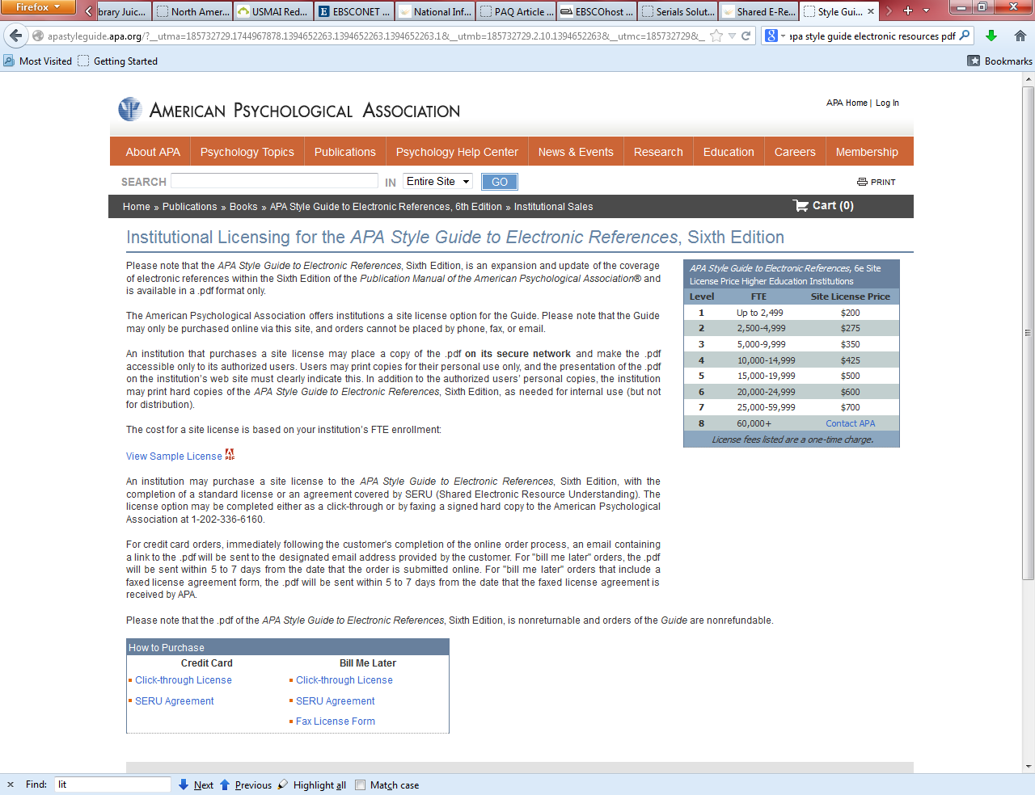
Deliverables
Vocabulary
NISO Recommended Practice
Data format and data transfer
Library rights to specific content
Level of indexing
Fair linking
Usage statistics
Mechanisms to evaluate conformance with recommended practice
Notes:
Publisher can offer option of using SERU when placing order

Slide 5
Sounds Great! Where Do I Start?
Consult the “SERU For Librarians” page, Getting Started with SERU – for Libraries, at http://www.niso.org/workrooms/seru/for_librarians/
Join the Registry (publishers wishing to use SERU with any of their products, libraries/consortia wishing to have SERU apply to any of their resources), available at http://www.niso.org/workrooms/seru/registry/
Hosted by ALCTS, Association for Library Collections and Technical Services
Notes:
“SERU For Librarians” meant to answer librarians’ questions
There is also a “SERU For Publishers” page - http://www.niso.org/workrooms/seru/for_publishers/

Slide 6
More Info?
SERU home page: http://www.niso.org/workrooms/seru/
See who’s on the standing committee charged with providing ongoing support and maintenance of the RP at http://www.niso.org/workrooms/seru/standingcte/
Join seruinfo listserv (for asking questions, sharing experiences, getting new information): http://www.niso.org/lists/seruinfo/
Hosted by ALCTS, Association for Library Collections and Technical Services

Slide 7

Transfer Code of Practice - set of voluntary best practice guidelines for publishers involved in the transfer of a journal between publishers
Includes:
Provision of ongoing access to online content
Exchange of subscriber lists
DOI and URL transfer
Perpetual access rights to journal content
UKSG Transfer Working Group released 1st version of the Code of Practice in 2006; version 2.0 September 2008; version 3.0 March 2014
http://www.uksg.org/transfer
Hosted by ALCTS, Association for Library Collections and Technical Services
Notes:
UKSG = United Kingdom Serials Group
Guidelines to help ensure continued accessibility to journal content when there is a transfer between parties

Slide 8
How Does Transfer Work?
The Transfer Code of Practice containing roles and responsibilities of transferring and receiving publishers is available on the UKSG web site at http://www.uksg.org/sites/uksg.org/files/TRANSFER_Code_of_Practice_3%200_FINAL.pdf
Supplementary information and glossary documents (not part of Code itself) are available at http://www.uksg.org/Transfer/Code
Hosted by ALCTS, Association for Library Collections and Technical Services
Notes:
Transferring publisher: digital content files, access to title, subscriber and non-subscriber access, other content and data types, journal URL, communication, identifier information
Receiving publisher: access to title, licensing terms, communication, subscription lists, identifier information

Slide 9
More Info
List of the publishers endorsing the code: http://www.uksg.org/transfer/transfer_publishers
Enhanced Transfer Alerting Service
Journal Transfer Notification Database - http://etas.jusp.mimas.ac.uk/
Journal Transfer Notification Form (for participating publishers) - http://etas.jusp.mimas.ac.uk/
Transfer Notification Blog - http://uksg-transfer.blogspot.com/
And for your up-to-date notification pleasure -
Join the Transfer Notification List to get e-mail alerts when a journal transfer is announced - https://www.jiscmail.ac.uk/cgi-bin/webadmin?A0=TRANSFER
Hosted by ALCTS, Association for Library Collections and Technical Services
Notes:
Enhanced Transfer Alerting Service – designed to facilitate communication of journal transfers
Database serves as archive of transfer information supplied by publishers using the service

Slide 10
Where Does NISO Fit In?
The Transfer Initiative is in the process of moving from UKSG to NISO
A NISO Standing Committee will provide ongoing support, education, and revisions of the Code of Practice
NISO Voting Members have approved this step; coordination efforts are under way to have the next meeting of the Transfer Committee take place as a NISO Standing Committee
NISO will republish Transfer as a NISO RP
Hosted by ALCTS, Association for Library Collections and Technical Services

Slide 11
Questions From Day 1?
Nettie Lagace, Associate Director of Programs, NISO Betty Landesman, Head of Technical Services and Content Management, University of Baltimore

