Slide 1
An Introduction to
Physics-based Animation
Adam Bargteil
University of Maryland,
Baltimore County
Tamar Shinar
University of California,
Riverside

Slide 2
I. A Simple Start:
Particle Dynamics

Slide 3
Let’s jump right in and consider the problem of
tracing a particle through a velocity field

Slide 4
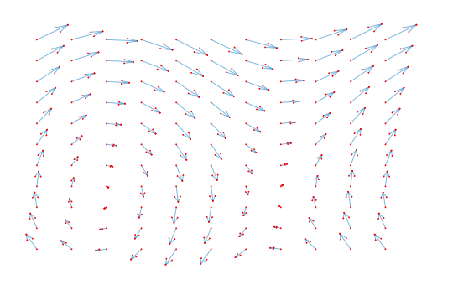


Slide 5


Initial Value Problem
Change
Difference
First-order
Ordinary
Differential Equation

Slide 6
Initial Value Problem
Simple
Powerful
Instructive

Slide 7
Euler’s Method

Slide 8




The Derivative

Slide 9


Euler’s Method
+

Slide 10
The Great Tradeoff
As
decreases
the approximation gets better
but
the computational cost increases

Slide 11
Let’s consider another problem

Slide 12

In the real world

Slide 13
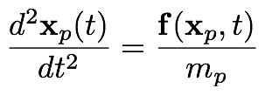
Another Initial Value Problem
Second-order Ordinary Differential Equation

Slide 14

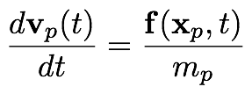
Another Initial Value Problem
Coupled First-order Ordinary Differential Equations

Slide 15
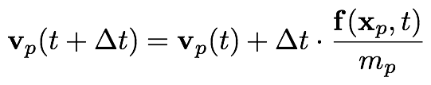
Euler’s Method (Again)
Symplectic Euler

Slide 16
struct Particle {
double mass;
Eigen::Vector3d pos, vel, frc;
};
foreach (p : particles) {
p.frc = 0.0;
}
foreach (f : forces) {
foreach (p : forces.affectedParticles) {
p.frc += f.computeForce(p);
}
}
foreach (p : particle) {
p.vel += dt * p.frc / p.mass;
p.pos += dt * p.vel;
}

Slide 17
Check our Karl Sim’s Particle Dreams

Slide 18
Let’s Add Springs!

Slide 19




Springs
`
non-zero rest length?

Slide 20
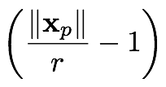
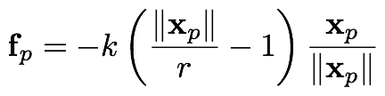
Springs
`
Strain

Slide 21
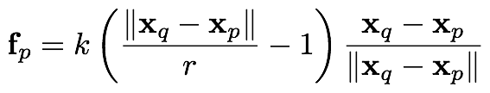

Springs
`
arbitrary connection?

Slide 22
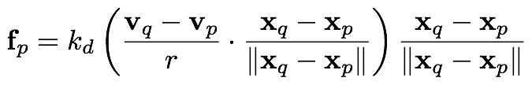
Damping
{
{
relative
velocity
spring
direction

Slide 23
foreach (p : particles) {
p.frc = 0.0;
}
foreach (s : springs) {
Eigen::Vector3d d = particles[s->j].pos - particles[s->i].pos;
double l = d.norm();
Eigen::Vector3d v = particles[s->j].vel - particles[s->i].vel;
Eigen::Vector3d frc = (params.k_s*((l / s->r) - 1.0) +
params.k_d*(v.dot(d)/(l*s->r))) * (d/l);
particles[s.i].frc += frc
particles[s.j].frc -= frc
}
foreach (p : particle) {
p.vel += dt * p.frc / p.mass;
p.pos += dt * p.vel;
}

Slide 24
Live Demo

Slide 25
II. Mathematical Models

Slide 26
Newton’s Laws

Slide 27
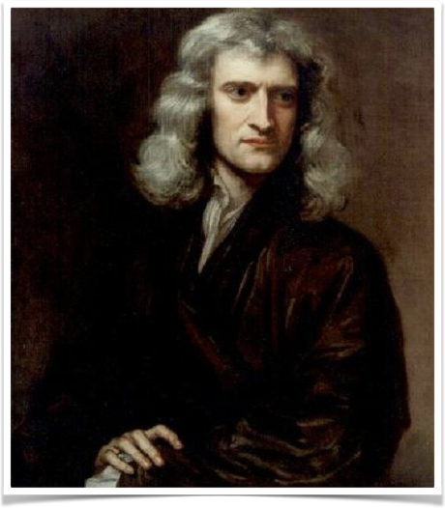
Newtonian Mechanics
Published in Principia, 1687
Includes three laws of motion:
  inertia
  f = ma
  action/reaction
Idealized particle or point mass
Notes:
inertia - remains at rest or moves with a constant velocity unless acted upon by a force

Slide 28
Newton’s First Law
A body persists at rest or in uniform motion in a straight line unless acted upon by a force
Law of Inertia
  Defines an inertial frame of reference
Notes:
Actually first published by Descartes 1644?
uniform motion:
body at rest stays at rest
body in motion stays in motion
change in view from Aristotle
thought heavier objects fall faster
thought force was necessary to keep something in motion
challenged by Copernicus and Galileo (16th century)
before people thought things would come to rest
defined an inertial frame
frame in which first and second laws are valid
another reference frame stationary or moving at constant velocity relative to first is also inertial

Slide 29

Newton’s Second Law (f = ma)
The rate of change of momentum of a body is directly proportional to the force applied to the body
The basis for evolving a system of interacting particles

Slide 30
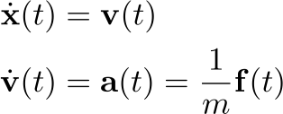

Newton’s Second Law (f = ma)
leads to a system of ODEs
`
Notes:
Free Body Diagram - illustrate all forces acting on a body

Slide 31
Newton’s Second Law (f = ma)
To model a system of particles,
  characterize all the forces on each particle
  Start with some initial conditions and apply f = ma to evolve in time
`

Slide 32
Newton’s Third Law (Action/Reaction)
For every action, there is an equal and opposite reaction
If body 1 applies force f to body 2, then body 2 applies force -f to body 1

Slide 33
Newton’s Third Law (Action/Reaction)
For every action, there is an equal and opposite reaction
If body 1 applies force f to body 2, then body 2 applies force -f to body 1
Example: Two particles connected by a spring force, equal/opposite pair of forces
`

Slide 34
Newton’s Third Law (Action/Reaction)
For every action, there is an equal and opposite reaction
If body 1 applies force f to body 2, then body 2 applies force -f to body 1
Example: In the collision of two particles, equal/opposite pair of forces prevents interpenetration

Slide 35
Newton’s Third Law (Action/Reaction)
For every action, there is an equal and opposite reaction
If body 1 applies force f to body 2, then body 2 applies force -f to body 1
Example: Particle resting on a surface, equal/opposite pair of forces prevents interpenetration

Slide 36
Newton’s Third Law (Action/Reaction)
For every action, there is an equal and opposite reaction
If body 1 applies force f to body 2, then body 2 applies force -f to body 1
Example: Particle resting on a surface, equal/opposite pair of forces prevents interpenetration

Slide 37
Alternative: Variational Mechanics
Newtonian Mechanics is one formulation of classical mechanics
  Based on vectors in Cartesian space
Another set of approaches is called “variational” and is based on a principle of least action
  variational approaches let you use any set of coordinates
Notes:
Newton’s approach is not the only one

Slide 38
Conservation Laws

Slide 39
Conserved Quantities
Cannot be created or destroyed!
Includes mass, linear momentum, angular momentum, and energy

Slide 40
Conservation Laws
Used in deriving evolution equations
Inform choice of discrete approximation to continuous equations
Implications for visual quality, numerical accuracy, and stability
Notes:
physical laws give us mathematical equations to solve - these are continuous equations
to solve these numerically, we must discretize them - conservation laws inform our choice of discretization - discretizations can themselves either conserve or not conserve these quantities. While nonconservative discretizations are still use, designing numerical schemes that are numerically conservative as well can have advantages - both in visual quality, stability and accuracy.

Slide 41
Conservation of Mass
Mass not created or destroyed (inexact)
Mass naturally conserved in particle-based methods
  Particles carry mass with them as they move
Grid-based methods sometimes have issues with proper mass conservation

Slide 42


Conservation of Momentum
By Newton’s second law, if there is no net force on a body, i.e.,
So the momentum of the particle is conserved
Similarly, if there is no net torque on a body, angular momentum is constant

Slide 43


Conservation of Momentum
Newton’s third law equal/opposite also implies conservation of linear and angular momentum
`

Slide 44
Conservation of Momentum
Newton’s third law equal/opposite also implies conservation of linear and angular momentum
`

Slide 45


Conservation of Momentum
Same holds for a collection of interacting particles!
`
`

Slide 46





Conservation of Energy
Initial energy (potential)
Conservation of energy
Speed when hits

Slide 47
Conservation of Energy
Initial energy (potential)
Conservation of energy
Speed when hits

Slide 48
Conservation of Energy
Different numerical schemes have different ent energy conservation properties
In many schemes, energy grows or decays nonphysically
  instability (blow up), or
  motion too damped

Slide 49

Conservation Laws for Continua
At large enough length scales, model matter as a continuum rather than set of discrete particles

Slide 50
Conservation Laws for Continua
To derive evolution equations for continua, consider arbitrary control volume

Slide 51


Conservation Laws for Continua
Conservation of Mass
Continuity Equation

Slide 52

Conservation Laws for Continua
Local conservation law
flux
Notes:
local conservation laws conserve things locally rather than globally - don’t want to lose mass in one part of the sim and add in another
can also include sources and sinks on rhs

Slide 53
Rigid Bodies

Slide 54
Rigid Body Idealization
If deformation is negligible, a rigid body approximation is more efficient than a soft body model
`
`
`
`
`
`
Notes:
instead of elastic forces between particles
TODO: replace with white RB

Slide 55
Rigid Body Idealization
Elastic forces are replaced with constraints that particles in the body remain a fixed distance apart
`
`
`
`
`
`
`
`
`
`
`
`

Slide 56

Rigid Body Idealization
3n DoF are replaced with 6 DoF! position and orientation
`
`
`
`
`
`

Slide 57
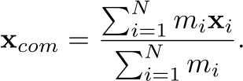
Rigid Body Kinematics
Center of mass
`
`
`
`
`
`
Notes:
helpful to think of rigid body as made of of particles

Slide 58



Rigid Body Coordinates
Object Space
World Space
Notes:
convenient to have an object space coordinate system in addition to the usual one (world space to distinguish)
Object space coordinates fixed - convenient to put origin at com
world space coordinates change - as body translates and rotates

Slide 59

Linear and Angular Velocity
Linear velocity

Slide 60

Linear and Angular Velocity
Angular velocity
Notes:
instantaneous rotation about axis through com

Slide 61
Linear and Angular Velocity
angular velocity

Slide 62

Rigid Body Coordinates
particle position
particle velocity

Slide 63
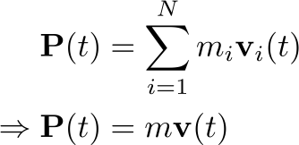
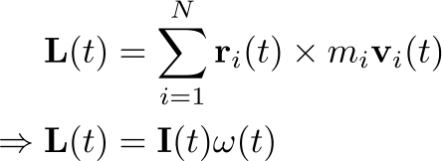

Linear and Angular Momentum
Linear Momentum
Angular Momentum
(c.o.m. origin)
(c.o.m. origin)
inertia tensor

Slide 64
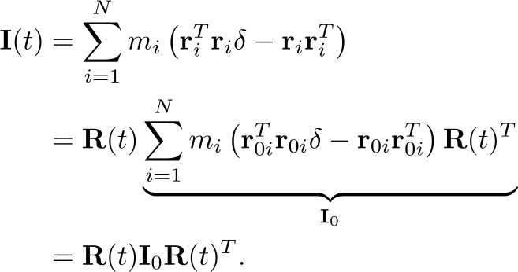
Rigid Body Inertia Tensor

Slide 65

Linear and Angular Momentum
No net force =>
  linear momentum and velocity constant
No net torque =>
  angular momentum constant
  angular velocity not necessarily constant
Notes:
Q. when might omega be constant or changing

Slide 66

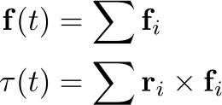
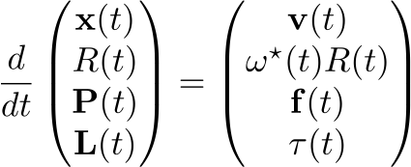
Newton’s Second Law for Rigid Bodies
Summary

Slide 67
Soft Bodies

Slide 68




Adding Elasticity and Damping
in terms of displacements

Slide 69

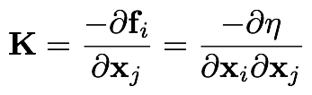
Generalization of spring stiffness, called stiffness matrix
Sparse, Symmetric, Diagonally Dominant, Row/Col sums 0
Positive semi-definite
Negative Jacobian of forces
Negative Hessian of energy

Slide 70
So how do we calculate elastic forces?

Slide 71
Elastic Forces Cookbook
Deformation Function (world pos, rest position)
Deformation Gradient (deformation function)
Strain (deformation gradient)
Stress (strain)
Energy (stress, strain)
Forces (energy)

Slide 72









Deformation and Its Gradient

Slide 73
Strain is
a measure of deformation
dimensionless (i.e. has no units)
a function of the deformation gradient

Slide 74




Strain Metrics
Green’s finite
Cauchy’s infinitesimal
Co-rotated
where

Slide 75
Stress
stress is a function of strain
stress has units of (Newton / meter^2)
models of stress-strain relationships can be highly complex, especially with organic materials

Slide 76


Linear Stress-strain Relationships
General, linear
isotropic material

Slide 77
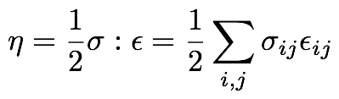

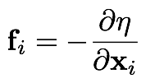
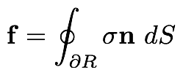
Elastic Potential, Traction, Force

Slide 78

Plasticity

Slide 79
Fluids

Slide 80
Fluids

Slide 81
Fluids
take shape
of container
can’t support
shear stress

Slide 82
Fluids
can support
normal stress

Slide 83
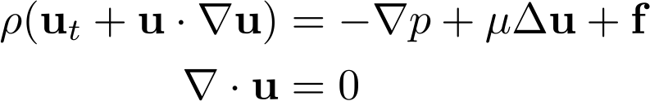





Navier-Stokes Equations

Slide 84
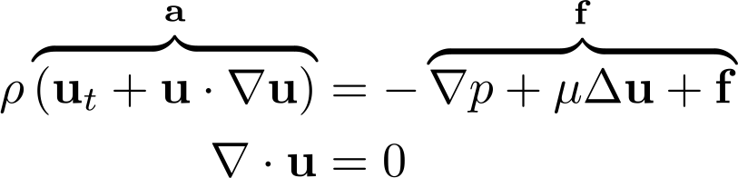
Navier-Stokes Equations
m

Slide 85
Navier-Stokes Equations
m

Slide 86
Navier-Stokes Equations
m

Slide 87
Navier-Stokes Equations
m

Slide 88
Navier-Stokes Equations
m

Slide 89
Navier-Stokes Equations
m

Slide 90
Material Derivative
m

Slide 91

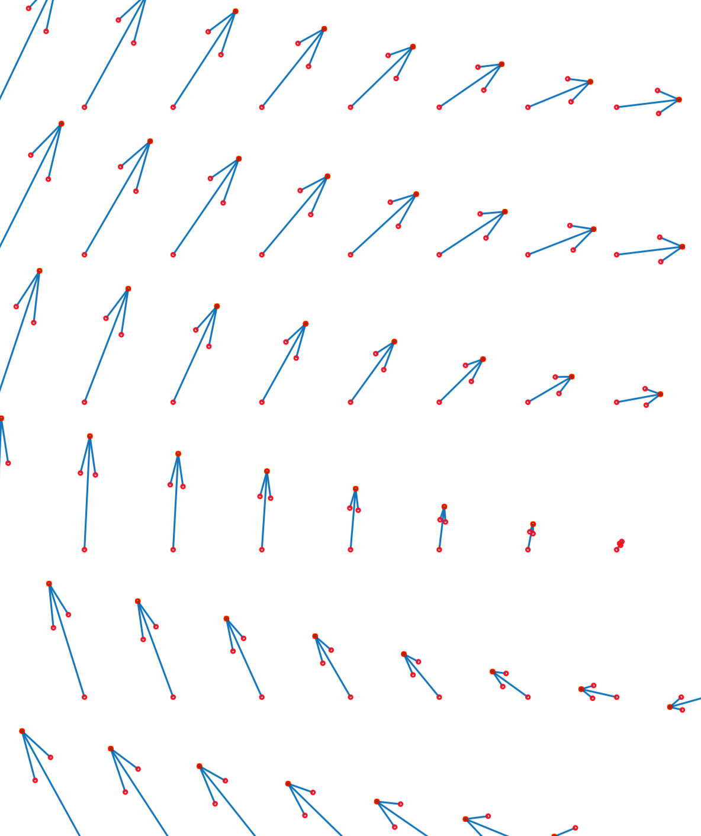
Material Derivative

Slide 92
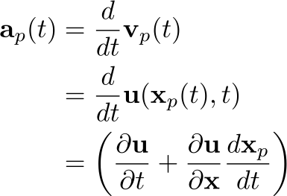

Material Derivative

Slide 93
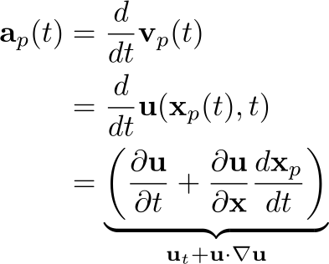

Material Derivative

Slide 94
Pressure Forces
m
maintains fluid volume, resisting compression/expansion
forces fluid from areas of high pressure to low pressure

Slide 95
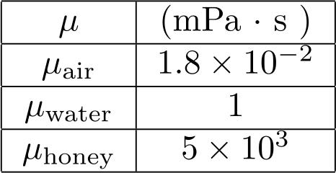
Viscous Forces
m
internal friction
Laplacian measures difference from neighbors

Slide 96
Viscous Forces: Solid Boundaries
m
no-slip boundary condition

Slide 97
External Forces
m
Gravity, surface tension, interaction forces, control forces, embedded structures

Slide 98

Incompressibility
m
Conservation of mass
Constant density

Slide 99

Incompressibility
m
Net flow through boundary must be zero
Notes:
net flow through boundary has to be zero

Slide 100
Incompressibility
m
Net flow through boundary must be zero
Notes:
net flow through boundary has to be zero

Slide 101
III. Spatial Discretization

Slide 102
Lagrangian vs. Eulerian

Slide 103
Reference Frames
An Eulerian reference frame is fixed.
A Lagrangian reference frame moves with the material.

Slide 104


Reference Frames
Eulerian
Lagrangian

Slide 105
Grids, Meshes, and Particles

Slide 106
Regular Grids
Advantages
Disadvantages
Simple
Fast operations (e.g. point location)
Can take advantage of structure for efficiency
Difficult to track shape over time
Difficult to handle non-grid-aligned boundaries

Slide 107







Staggered Grid

Slide 108
Meshes (Simplicial Complexes)
Advantages
Disadvantages
Easy to map to previous points in time
Can conform to boundaries
Difficult to generate meshes
Difficult to perform some operations (e.g. point location)

Slide 109
Particles
Advantages
Disadvantages
Simple
Easy to map to previous points in time
Difficult to perform integration because they don’t partition space

Slide 110
Hybrid Structures
Advantages
Disadvantages
Advantages of underlying structures
Complexity
Computational and accuracy costs from mapping between structures

Slide 112
Interpolation

Slide 113
Interpolation
Samples stored at discrete points on grid, mesh, or particles
Elsewhere, must be interpolated there

Slide 114
Interpolation
Example: semi-Lagrangian advection

Slide 115
Interpolation
Example: semi-Lagrangian advection

Slide 116
Interpolation
Example: semi-Lagrangian advection

Slide 117

Interpolation
Example: semi-Lagrangian advection

Slide 118




Linear Interpolation (1D)
weights sum to 1
weight is length opposite point

Slide 119
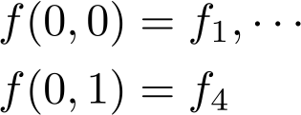

Bilinear Interpolation (2D)
weights sum to 1
weight is area opposite point

Slide 120
Bilinear Interpolation (2D)

Slide 121
Bilinear Interpolation (2D)

Slide 122
Bilinear Interpolation (2D)

Slide 123
Bilinear Interpolation (2D)

Slide 124


Bilinear Interpolation (2D)

Slide 125
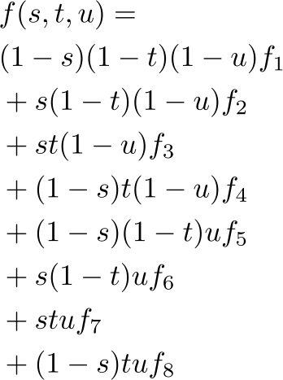
Trilinear Interpolation (3D)

Slide 126
Trilinear Interpolation (3D)

Slide 127
Trilinear Interpolation (3D)

Slide 128
Barycentric Coordinates

Slide 129
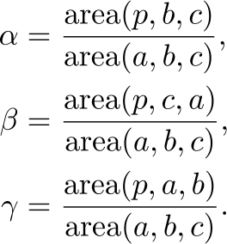
Barycentric Coordinates

Slide 130
Barycentric Coordinates

Slide 131
Barycentric Coordinates

Slide 132
Barycentric Coordinates

Slide 133
Barycentric Coordinates

Slide 134
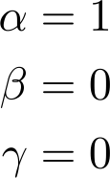
Barycentric Coordinates
Coordinates at a vertex

Slide 135
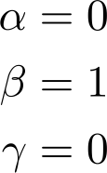
Barycentric Coordinates
Coordinates at a vertex

Slide 136
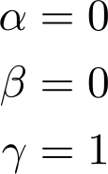
Barycentric Coordinates
Coordinates at a vertex

Slide 137
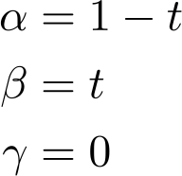

Barycentric Coordinates
Coordinates on edge

Slide 138
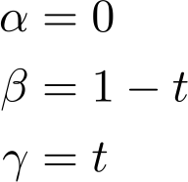
Barycentric Coordinates
Coordinates on edge

Slide 139
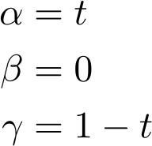
Barycentric Coordinates
Coordinates on edge

Slide 140

Barycentric Coordinates
Inside/outside test

Slide 141

Barycentric Coordinates
Inside/outside test

Slide 142
Barycentric Coordinates
Inside/outside test

Slide 143

Polynomial Interpolation

Slide 144

Polynomial Interpolation

Slide 145
Polynomial Interpolation
Lagrange interpolation
Newton interpolation
Same polynomial
Different cost of construction and evaluation
Notes:
Also Bezier curves, splines, don’t go through all points

Slide 146
Least Squares Approximation
Approximate noisy or overdetermined data
Notes:
Also Bezier curves, splines, don’t go through all points

Slide 147



Least Squares Approximation
Given m data points
Given basis
Find coefficients
Notes:
Also Bezier curves, splines, don’t go through all points

Slide 148

Least Squares Approximation
minimize sum of squared errors
Notes:
Also Bezier curves, splines, don’t go through all points

Slide 149


Least Squares Approximation
Normal equations
Notes:
Also Bezier curves, splines, don’t go through all points

Slide 150


Least Squares Approximation
Weighted least squares
Regularized least squares
Notes:
Also Bezier curves, splines, don’t go through all points

Slide 151
Other Methods
Bezier curves, splines
Harmonic coordinates, mean value coordinates, Green coordinates
Notes:
Also Bezier curves, splines, don’t go through all points
green coordinates: shape preserving deformations - 2d conformal - 3d quasi-conformal

Slide 152
Finite Differences

Slide 153
Finite Difference Methods
Used to discretize spatial derivatives

Slide 154



Finite Difference Methods
Recall derivative of function
Finite difference approximation
forward difference

Slide 155


Finite Difference Methods
Error decreases with decreasing h
Taylor series
Rearrange
Notes:
error in approximation
first order accurate

Slide 156

Finite Difference Methods
Error decreases with decreasing h
Taylor series
Rearrange
first order accurate
Notes:
error in approximation
first order accurate

Slide 157

Forward and Backward Difference
Forward difference
Backward difference
Notes:
error in approximation

Slide 158
Forward and Backward Difference
Forward difference
Backward difference
Notes:
error in approximation

Slide 159



Order of Accuracy
first order accurate
second order accurate

Slide 160

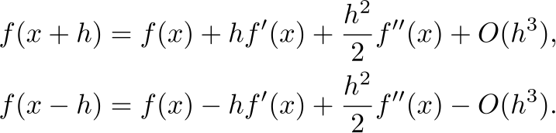

Central Difference Approximation
Taylor series
Combine, rearrange
second order accurate

Slide 161

Discretization Error
Forward difference
Central difference
Notes:
other considerations other than just order of accuracy
e.g., in discreizing pdes, first order introduces diffusive errors
central dispersive errors

Slide 162
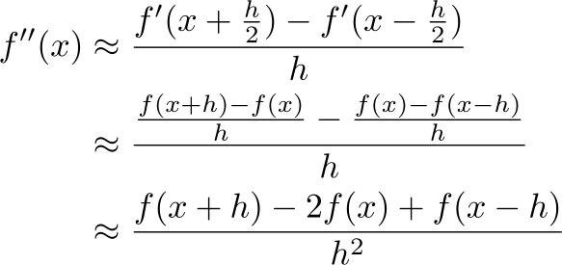
Higher Derivatives
Notes:
TODO: better drawing for estimating 2nd derivative

Slide 163
Higher Derivatives
Notes:
TODO: better drawing for estimating 2nd derivative

Slide 164
Higher Derivatives
3 - point stencil
Notes:
TODO: better drawing for estimating 2nd derivative

Slide 165

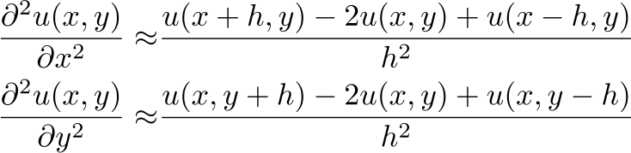
Laplacian Operator
In 2D

Slide 166

Laplacian Operator
5 - point stencil

Slide 167




Poisson Equation (1D)
At each interior node
Boundary nodes

Slide 168
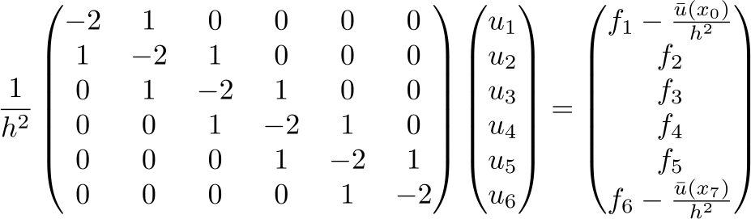
Poisson Equation (1D)
linear system

Slide 169
Finite Elements

Slide 170
Finite Elements
Discretize the space of representable functions, instead of discretizing derivatives
Method:
  Discretize space into a finite set of elements
  Choose a set of basis functions over the elements (e.g. piecewise linear)
  Galerkin projection onto these basis functions
  Solve the problem

Slide 171
Lets try an example:
Linear Finite Elements for Elasticity

Slide 172

Choose Element Type: Triangle

Slide 173
Choose Basis Functions: Piecewise Linear

Slide 174
Project Deformation Function onto the
Piecewise Linear Function Space

Slide 175

Solve the Problem
We know we can compute forces from
But, how do we compute ?
( in
)

Slide 176
Project Deformation Function onto the Piecewise Linear Function Space
But, how do we compute ?

Slide 177



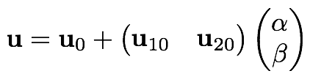


Slide 178




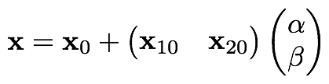



Slide 179

Rest/Material
World

Slide 180




Rest/Material
Canonical
World

Slide 181


Solve the Problem
where
where
are the normals of the opposite faces
in rest space

Slide 182
IV. Temporal Integration

Slide 183

Explicit Integration
Explicit formula for (t+1)
in terms of quantities known at time t
Note: everything on the right hand side
is evaluated at time t

Slide 184
Choose Your Integration Scheme Wisely

Slide 185
Trapezoidal Rule vs. Midpoint Method
Forward Euler
Trapezoidal Rule
Midpoint Method

Slide 186
Trapazoidal Rule

Slide 187
Average

Slide 188
Midpoint Method

Slide 190
Trapezoidal Rule vs. Midpoint Method
Both second-order Runge-Kutta methods (same accuracy)
Very different behavior
  Trapezoidal rule is smoother, more damped looking
  Midpoint Method keeps more energy, but can be noisy/aliased

Slide 191
Position Updates for

Slide 192


Three Position Updates

Slide 193





“Stiff” Problems
Consider the IVP:
After one time step:
If
the spring will be more extended then when we started

Slide 194
If We Want to Take Bigger Timesteps

Slide 195


Implicit Integration
Replace:
With:

Slide 196


Applied to Soft Bodies
Linearize
+
substitute into
re-arrange

Slide 197

Euler step of elastic
and external forces
Momentum
Linear System
Sparse, Symmetric

Slide 198
V. Constraints

Slide 199

Constraints
Geometric relationships that must be satisfied

Slide 200
Constraints
Constraint forces arises in response to other forces to maintain the constraint

Slide 201
Degrees of Freedom (DOF)
Number of independent parameters describing configuration

Slide 202
Degrees of Freedom (DOF)
number of independent parameters describing configuration

Slide 203


Unilateral/Bilateral Constraints

Slide 204

Unilateral/Bilateral Constraints

Slide 205
Soft vs. Hard Constraints
Soft constraint: force competes with other forces in the system
Hard constraint: force as strong as necessary to maintain constraint
`
Notes:
left: force competes with other forces in the system
right: force arbitrarily strong

Slide 206
Soft vs. Hard Constraints
Soft constraint: force competes with other forces in the system
Hard constraint: force as strong as necessary to maintain constraint
`
Notes:
left: force competes with other forces in the system
right: force arbitrarily strong

Slide 207
Constraints: Solution Methods
Maximal coordinates + auxiliary conditions
  Include forces to maintain constraint
Generalized coordinates (a.k.a., reduced coordinates, minimal coordinates)
  Parameterize true DOF, respecting constraints
`
`
`
`
`
`

Slide 208
Constraints: Solution Methods
Maximal coordinates + auxiliary conditions
  include forces to maintain constraint
Generalized coordinates (a.k.a., reduced coordinates, minimal coordinates)
  parameterize true DOF, respecting constraints

Slide 209


Penalty Methods
Restoring force that acts to drive system to valid state
constraint:
penalty force:
`

Slide 210
Penalty Methods
Simple to add to solver
Must tune parameters (k)
Introduce stiff forces -> smaller time step or implicit integration
Constraint violation, oscillations

Slide 211
Lagrange Multiplier Methods
Constraint force arises in response to other forces in the system
Add unknowns to equations that represent strength of constraint force
Add (differentiated) constraint equations

Slide 212



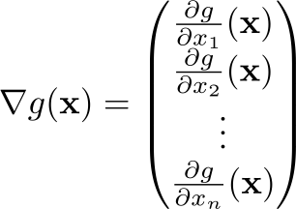


Constraint Implicit Surface
Gradient

Slide 213


Constraint Force
Constraint force
Workless
Lagrange multiplier

Slide 214
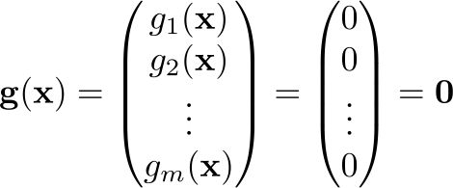
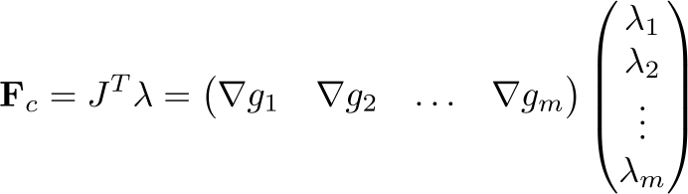
Equations of Motion
m constraints
Constraint force
Equations of motion

Slide 215




How to find
Constraint tells us valid positions
Differentiate to get valid velocities
Differentiate again to get valid accelerations

Slide 216

How to find
Equations of motion

Slide 217
How to find
Equations of motion
Plug into expression for valid a

Slide 218
How to find
Equations of motion
Plug into expression for valid a
Rearrange

Slide 219


How to find
Rearrange
KKT System

Slide 220
Generalized Coordinates
Instead of maximal coordinates along with auxiliary conditions and forces
Generalized coordinates with that take constraints into account

Slide 221

Generalized Coordinates
Example: rigid body
`
`
`
`
`
`
+ constraints

Slide 222
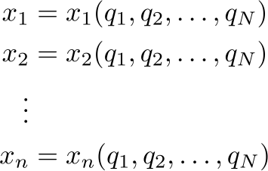


Transformation Equations
Relate maximal and generalized coordinates
Jacobian

Slide 223


Velocity and Kinetic Energy
Velocity
Kinetic energy

Slide 224




Generalized Forces
`
`
`
`
`
`
?

Slide 225
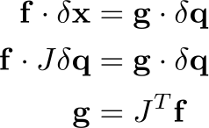
Generalized Forces
`
`
`
`
`
`
Two sets of forces are dynamically equivalent if they do the same “virtual work”

Slide 226
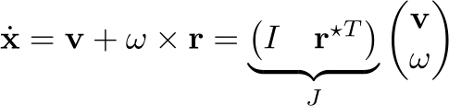

Generalized Forces: Rigid Body
`
`
`
`
`
`
Jacobian
generalized force

Slide 227



Equations of Motion
Lagrange equations of motion
Euler-Lagrange equations of motion, defining Lagrangian

Slide 228




Example: Pendulum
Transformation equations
Velocity
Equations of motion
Lagrangian

Slide 229
Constrained Rigid Body Systems
Types of constraints
  Articulation (joints)
  Collisions
  Resting and sliding contact
Notes:
may be with generalized coordinates
otherwise constraint forces w/ practical modifications

Slide 230
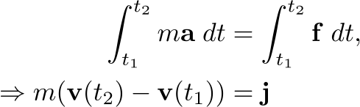
Impulse-Momentum Equations
Acceleration-level formulation doesn’t work well with discontinuous velocities, frictional contact
Instead, integrate f = ma to get impulse-momentum formulation
Notes:
acceleration level formulation earlier problems with discontinuous velocity
challenges with frictional contact

Slide 231

Impulse-Momentum Equations
Integrated, semi-discrete equations
Combine with velocity-level constraint equation JV = 0
Notes:
acceleration level formulation earlier problems with discontinuous velocity
challenges with frictional contact

Slide 232
Impulse-Momentum Equations
Instead of solving global, coupled system, common to split
update with non-constraint forces
add constraint impulses
Notes:
constraint impulses can be determined through global coupled solve, or pairwise iterative

Slide 233
Impulse-Momentum Equations
Instead of solving global, coupled system, common to split
update with non-constraint forces
add constraint impulses
Notes:
constraint impulses can be determined through global coupled solve, or pairwise iterative

Slide 234
Impulse-Momentum Equations
Instead of solving global, coupled system, common to split
update with non-constraint forces
add constraint impulses
global
impulse
solve
Notes:
constraint impulses can be determined through global coupled solve, or pairwise iterative

Slide 235
Impulse-Momentum Equations
Instead of solving global, coupled system, common to split
update with non-constraint forces
add constraint impulses
iterative
impulse
solve
Notes:
constraint impulses can be determined through global coupled solve, or pairwise iterative

Slide 236
Impulse-Momentum Equations
Instead of solving global, coupled system, common to split
update with non-constraint forces
add constraint impulses
iterative
impulse
solve
Notes:
constraint impulses can be determined through global coupled solve, or pairwise iterative

Slide 237
Impulse-Momentum Equations
Instead of solving global, coupled system, common to split
update with non-constraint forces
add constraint impulses
iterative
impulse
solve
Notes:
constraint impulses can be determined through global coupled solve, or pairwise iterative

Slide 238
Impulse-Momentum Equations
Instead of solving global, coupled system, common to split
update with non-constraint forces
add constraint impulses
iterative
impulse
solve
Notes:
constraint impulses can be determined through global coupled solve, or pairwise iterative

Slide 239
Impulse-Momentum Equations
Instead of solving global, coupled system, common to split
update with non-constraint forces
add constraint impulses
iterative
impulse
solve
Notes:
constraint impulses can be determined through global coupled solve, or pairwise iterative

Slide 240
Impulse-Momentum Equations
Instead of solving global, coupled system, common to split
update with non-constraint forces
add constraint impulses
iterative
impulse
solve
Notes:
constraint impulses can be determined through global coupled solve, or pairwise iterative

Slide 241
Impulse-Momentum Equations
Instead of solving global, coupled system, common to split
update with non-constraint forces
add constraint impulses
iterative
impulse
solve
Notes:
constraint impulses can be determined through global coupled solve, or pairwise iterative

Slide 242
Impulse-Momentum Equations
Instead of solving global, coupled system, common to split
update with non-constraint forces
add constraint impulses
iterative
impulse
solve
Notes:
constraint impulses can be determined through global coupled solve, or pairwise iterative

Slide 243
Impulse-Momentum Equations
Instead of solving global, coupled system, common to split
update with non-constraint forces
add constraint impulses
iterative
impulse
solve
repeat fixed number of times or until tolerance met
Notes:
constraint impulses can be determined through global coupled solve, or pairwise iterative

Slide 244
Global vs. Iterative Solve
Global
  need to solve larger linear system
  LCP for inequality constraints
Iterative
  may be slow to converge
  simple to do inequality constraints

Slide 245

Handling Drift With Stabilization
Approach was based on velocity-level constraints lead to drift in positions
Correct drift with stabilization
  E.g., Baumgarte stabilization
  Modify positions and velocities so they satisfy constraints

Slide 246

Softening Constraints
Also common to soften constraints
Stabilizes constraints
Regularizes system
  Better numerical properties
  Handle redundant constraints
Adds some compliance to constraint

Slide 247
Collisions and Contact
Notes:
Large part of overall computational cost
Two distinct tasks
Collision detection
Collision response

Slide 248
Collisions and Contact
Large part of overall computational cost
Two distinct tasks
  Collision detection
  Collision response

Slide 250
Collision Detection
Polygonal geometry
non-convex
convex
Separating axis theorem
Convex decomposition

Slide 251



Collision Detection
Signed distance field
Zero level set
Fast inside/outside tests
Penetration depth
Normals

Slide 252
Accelerating Collision Detection
Bounding volumes
Hierarchical bounding volumes
Spatial partitions
AABB
Notes:
TODO: illustrate concepts

Slide 253
Discrete vs. Continuous Collision Detection

Slide 254



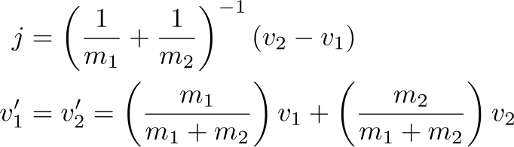
Collision Response: Inelastic
Newton’s third law (action/reaction)
Assume inelastic (sticking)
Solve:
Notes:
resulting velocity is mass-weighted average of incoming velocities

Slide 255

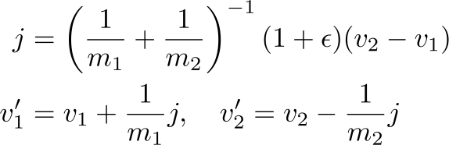
Collision Response:Elastic
Newton’s third law (action/reaction)
Assume elastic (bouncing)
coefficient of
restitution
Solve:
Notes:
resulting velocity is mass-weighted average of incoming velocities

Slide 256


Deformable Object Collisions
Body compresses, stores energy and bounces
Inelastic collision between particles and ground
Notes:
compresses - stores energy - releases - rebound

Slide 257
Rigid Body Collisions
Physically, similar to deformable body collisions
But rigid idealization precludes storing energy
Instead, algebraic collision laws for before/after collision
Cases:
  Inelastic (sticking)
  Elastic: frictionless, with friction
Notes:
TODO: simple animation

Slide 258



Rigid Body Inelastic Collision
Linear momentum
Angular momentum
15 equations/unknowns
Sticking

Slide 259

Rigid Body Frictionless Collision
Linear momentum
Angular momentum
13 equations/unknowns
Elastic

Slide 260






Rigid Body Frictional Collision
Coulomb friction model
coefficient of friction
Static
Sliding
friction cone

Slide 261

Rigid Body Frictional Collision
Example [Guendelman et al. 2003]
Elastic in normal direction
Assume sticking (+2 equations)
If not admissible, assume sliding (-2 unknowns)

Slide 262
Thanks!
For notes, slides, and source code visit:
https://cal.cs.umbc.edu/Courses/PhysicsBasedAnimation
      adamb@umbc.edu shinar@cs.ucr.edu

