Slide 1
Wrangle those (e)-Dogies!
Community-Driven Standards and Best Practices for Librarians and Vendors
COUNTER/SUSHI
SERU
Betty Landesman
ER&L Conference
March 17, 2014

Slide 2
COUNTER
Counting Online Usage of Networked Electronic Resources
“an international initiative serving librarians, publishers and intermediaries by setting standards that facilitate the recording and reporting of online usage statistics in a consistent, credible and compatible way”

Slide 3
COUNTER (2)
Launched March 2002
First COUNTER Code of Practice (online journals and databases) published 2003
Code of Practice for online books and reference works March 2006
Journals and databases (Release 3) August 2008
E-Resources (Release 4) April 2012

Slide 4
COUNTER (3)
COUNTER web site: http://www.projectcounter.org/
Register of compliant vendors: http://www.projectcounter.org/compliantvendors.html

Slide 5
SUSHI
Standardized Usage Statistics Harvesting Initiative
NISO Z39.93-2013
Standard protocol to automate transport of COUNTER formatted usage statistics
http://www.niso.org/workrooms/sushi/
Work group being formed to explore adapting SUSHI for retrieving snippets of usage (“SUSHI Lite”)

Slide 6
SERU
Shared Electronic Resource Understanding
NISO RP-7-2012
Publishers and libraries join registry; agree to use SERU instead of negotiating and signing license
Based on standard business practices and copyright law

Slide 7
SERU (2)
SERU home page: http://www.niso.org/workrooms/seru/
RP-7-2012: http://www.niso.org/publications/rp/RP-7-2012_SERU.pdf
Registry: http://www.niso.org/workrooms/seru/registry/

Slide 8
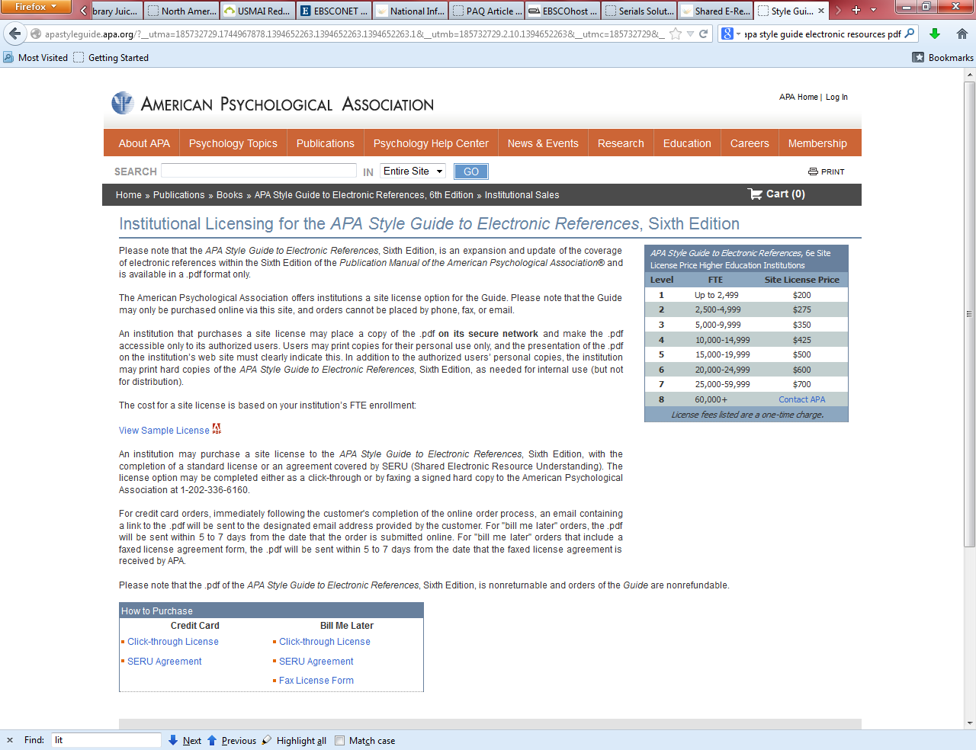

Slide 9
Betty Landesman
blandesman@ubalt.edu

