Slide 1
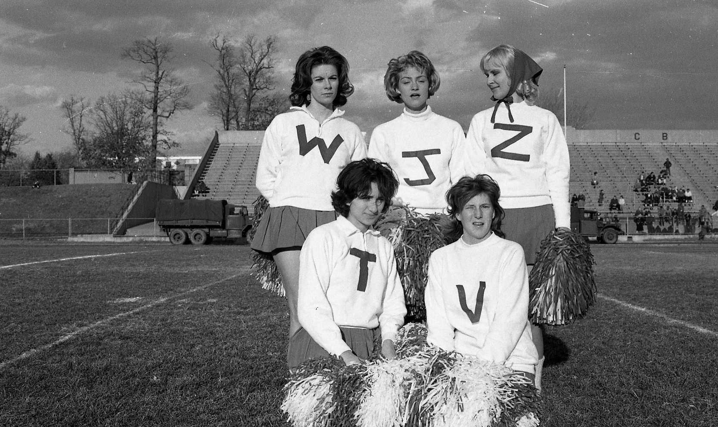
Siobhan Hagan
AV Archivist
#UBalt

Slide 2
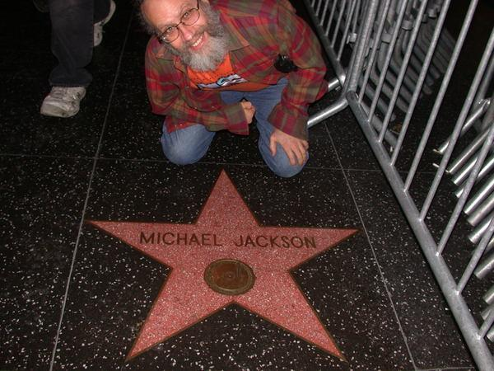
Notes:
Howard Besser was brought in as a consultant to evaluate UCLA’s ‘Performance Capture” and AV preservation capacity. (NOT the UCLA Film and TV Archive)

Slide 3
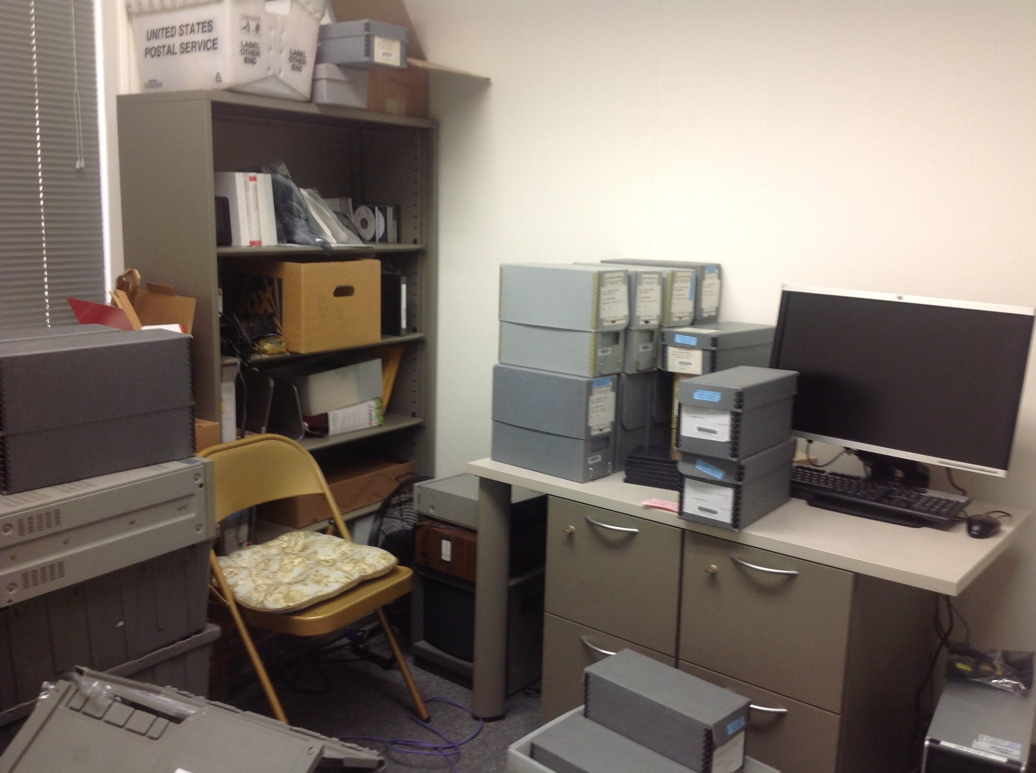
Notes:
Through generous funding from the Arcadia Fund, I was hired on a contractual basis July 2011.

Slide 4
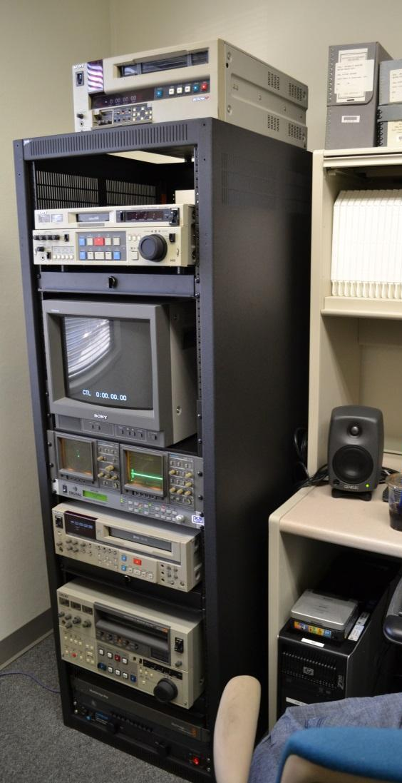
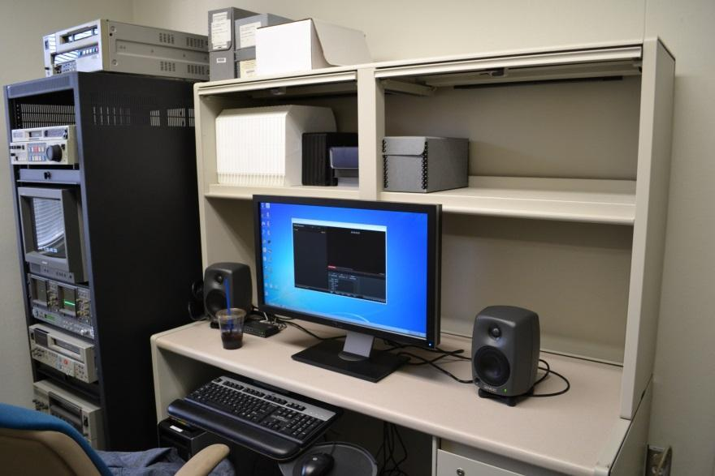
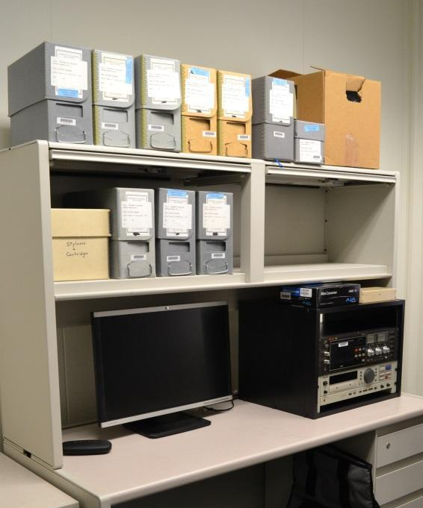
Notes:
I built this! In-house capacity as well as large-scale outsourcing projects.

Slide 5
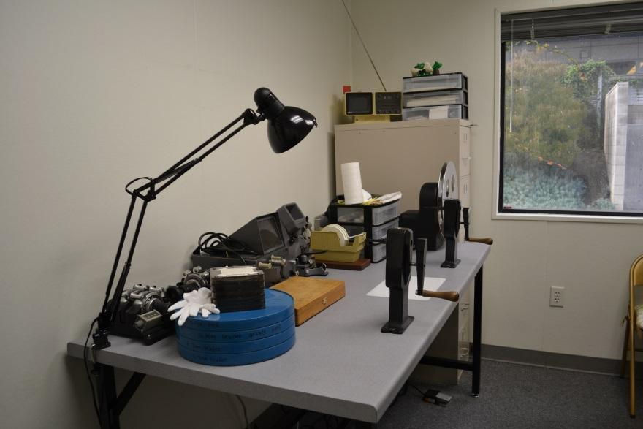
Notes:
And this!

Slide 6
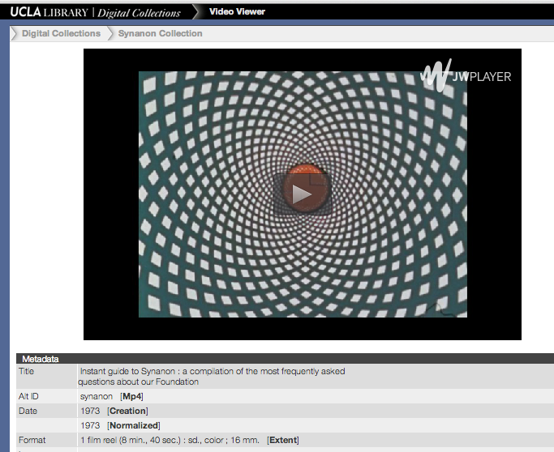
Notes:
UCLA Digital Library: access

Slide 7
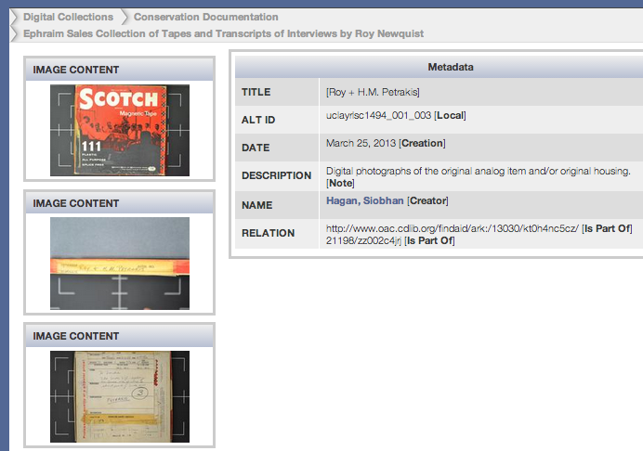
Notes:
Conservation Documentation collection

Slide 8
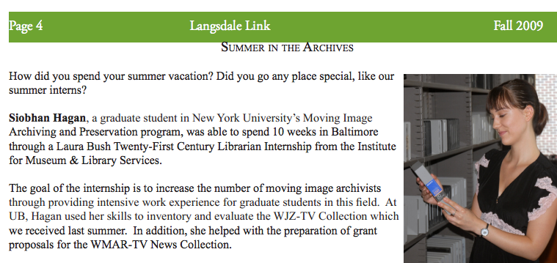
Notes:
IMLS-funded internship in the summer of 2009 while a grad student at NYU; created an inventory of the WJZ collection and a collection assessment with preservation priorities.

Slide 9
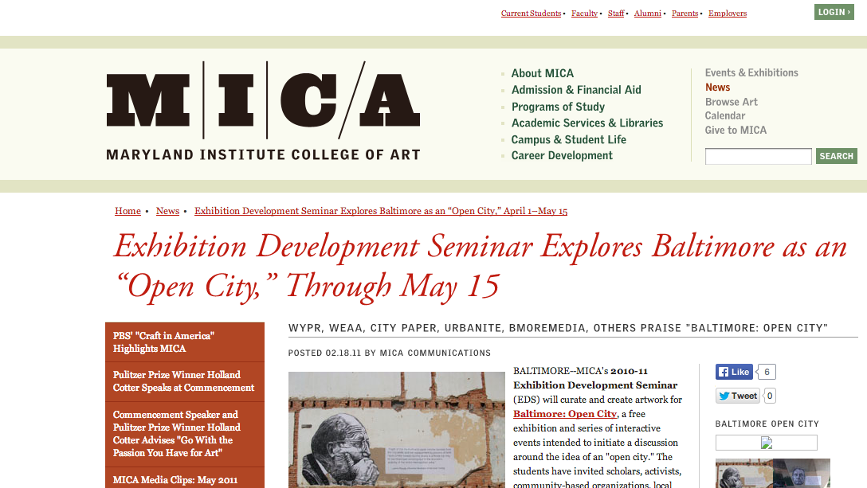
Notes:
2011 footage reformatted to be used in classroom-created exhibition with another local school, Maryland Institute College of Art. Received small amount of funding from local foundations.

Slide 10
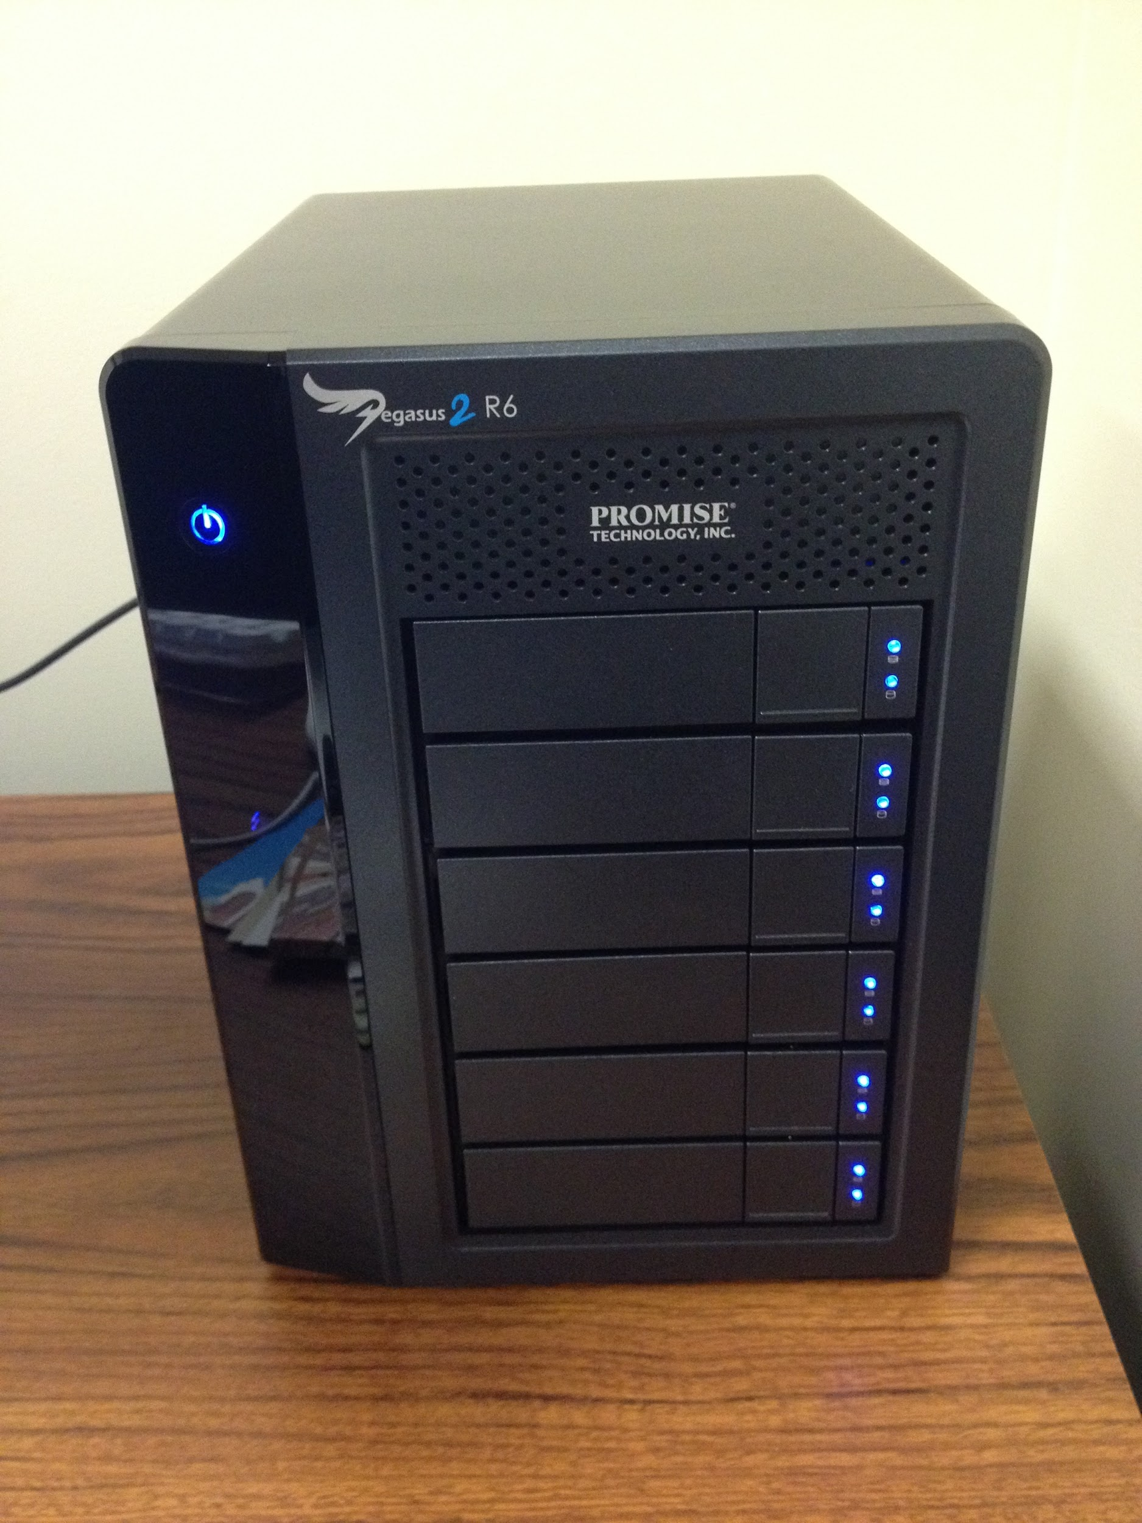
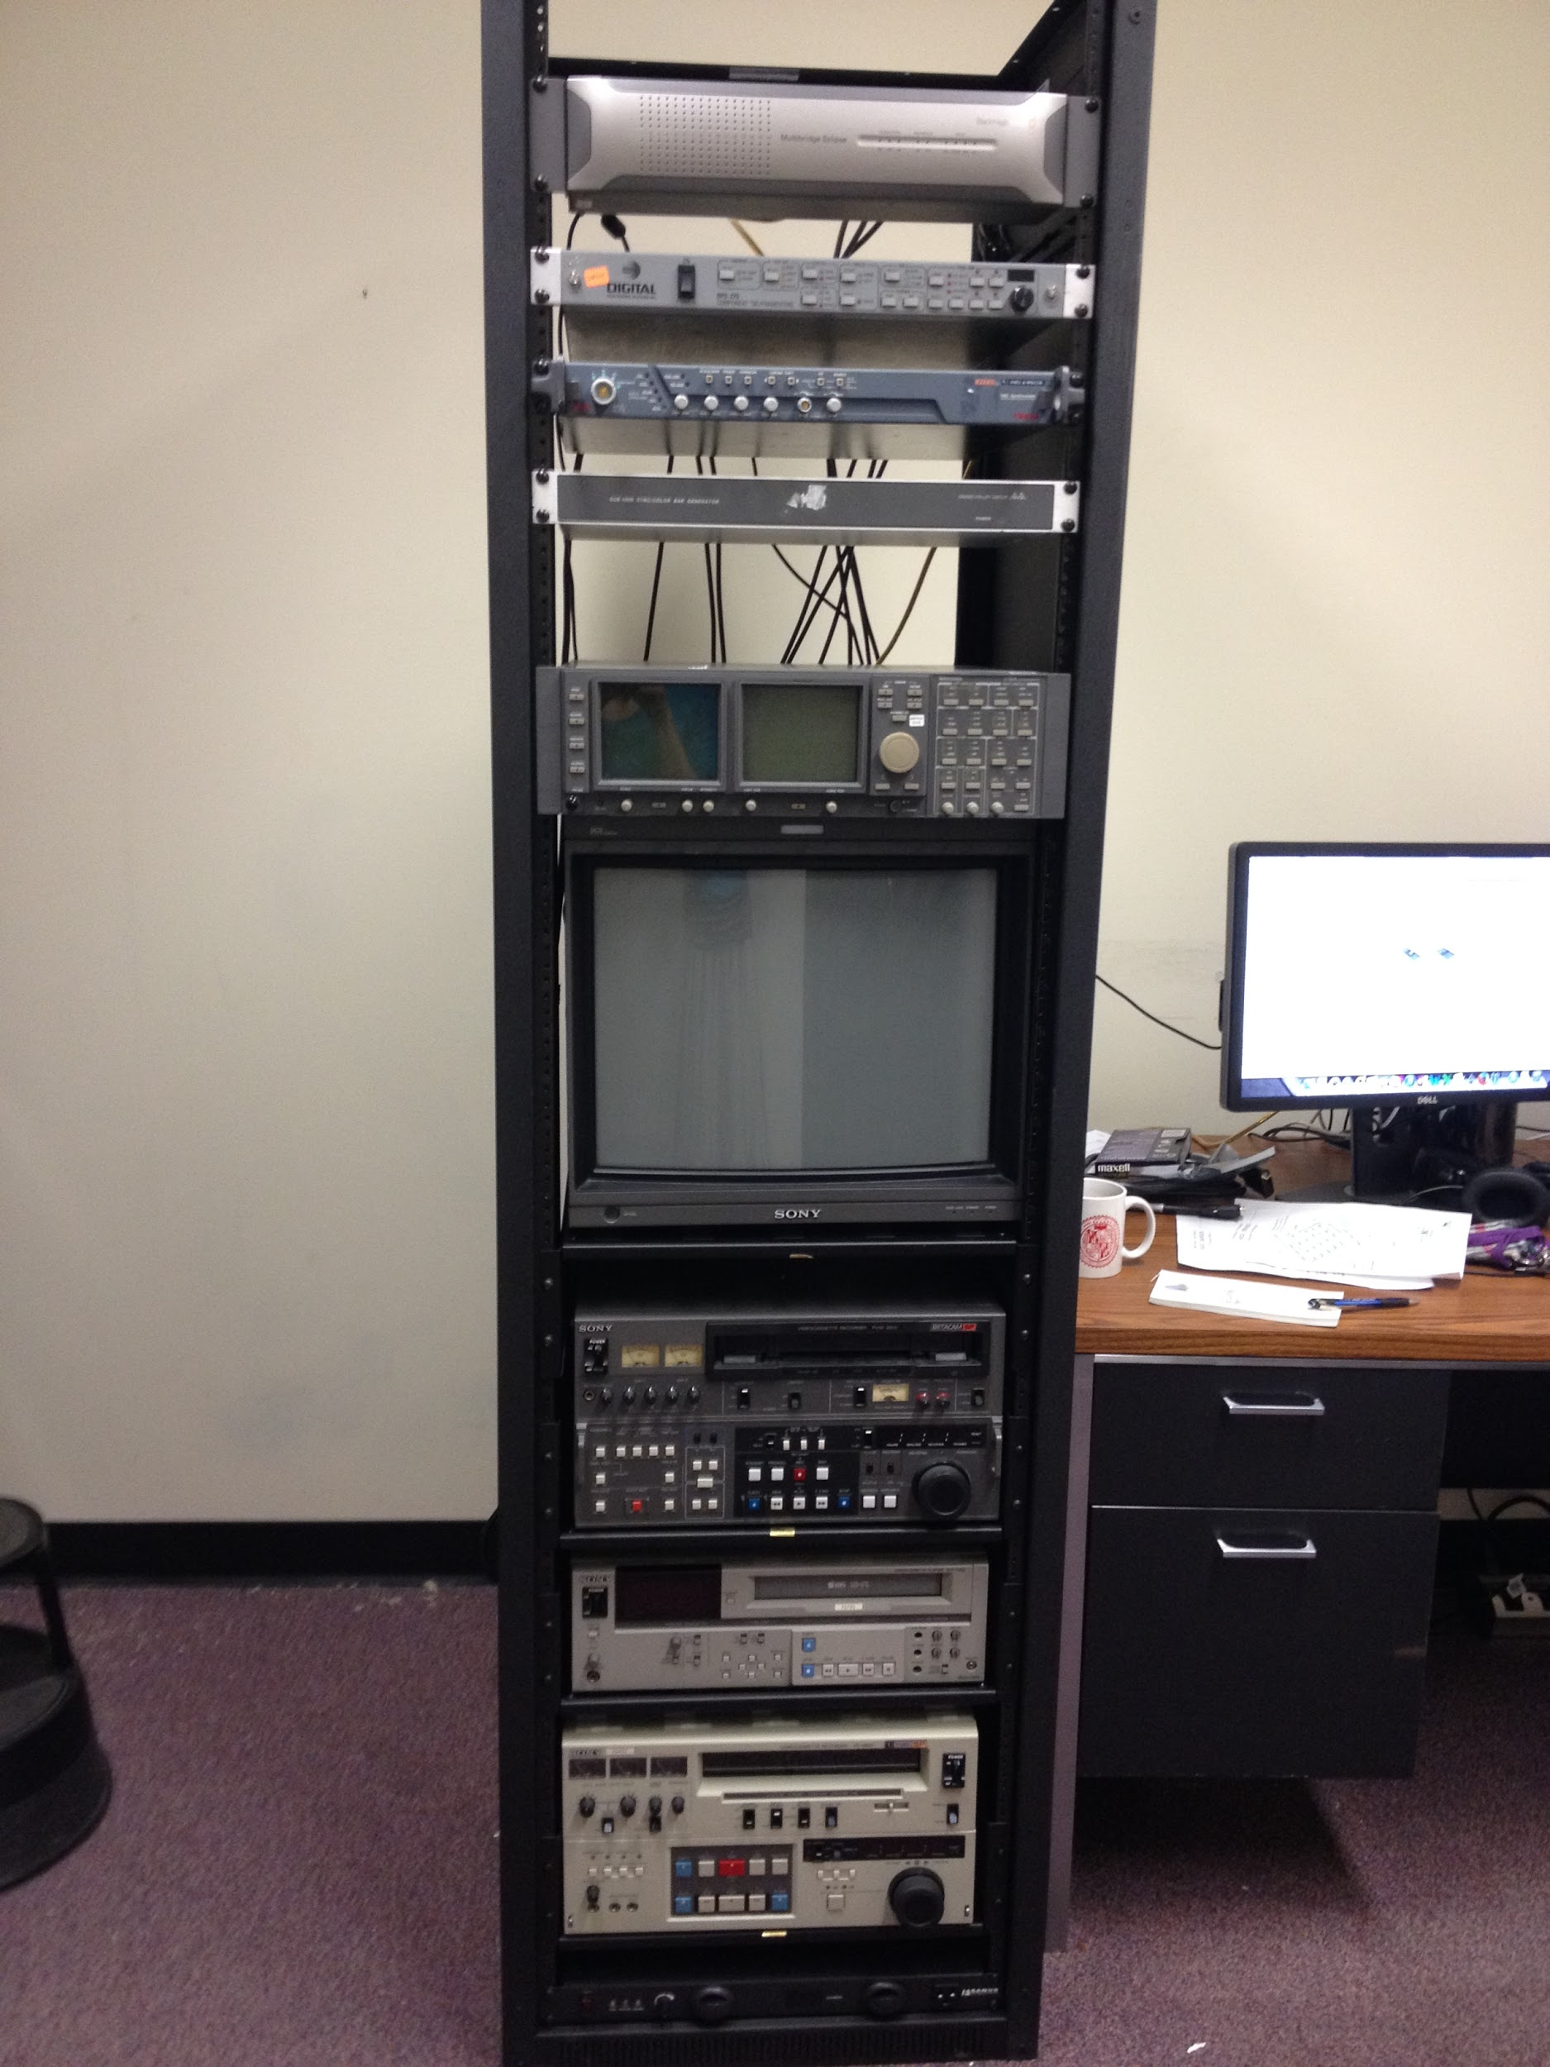
Notes:
With a retirement and resignation in 2013, the Special Collections department was able to restructure itself to have an AV Archivist. In January of 2014 I started working at UBalt. I just finished installing this video preservation reformatting rack.

Slide 11
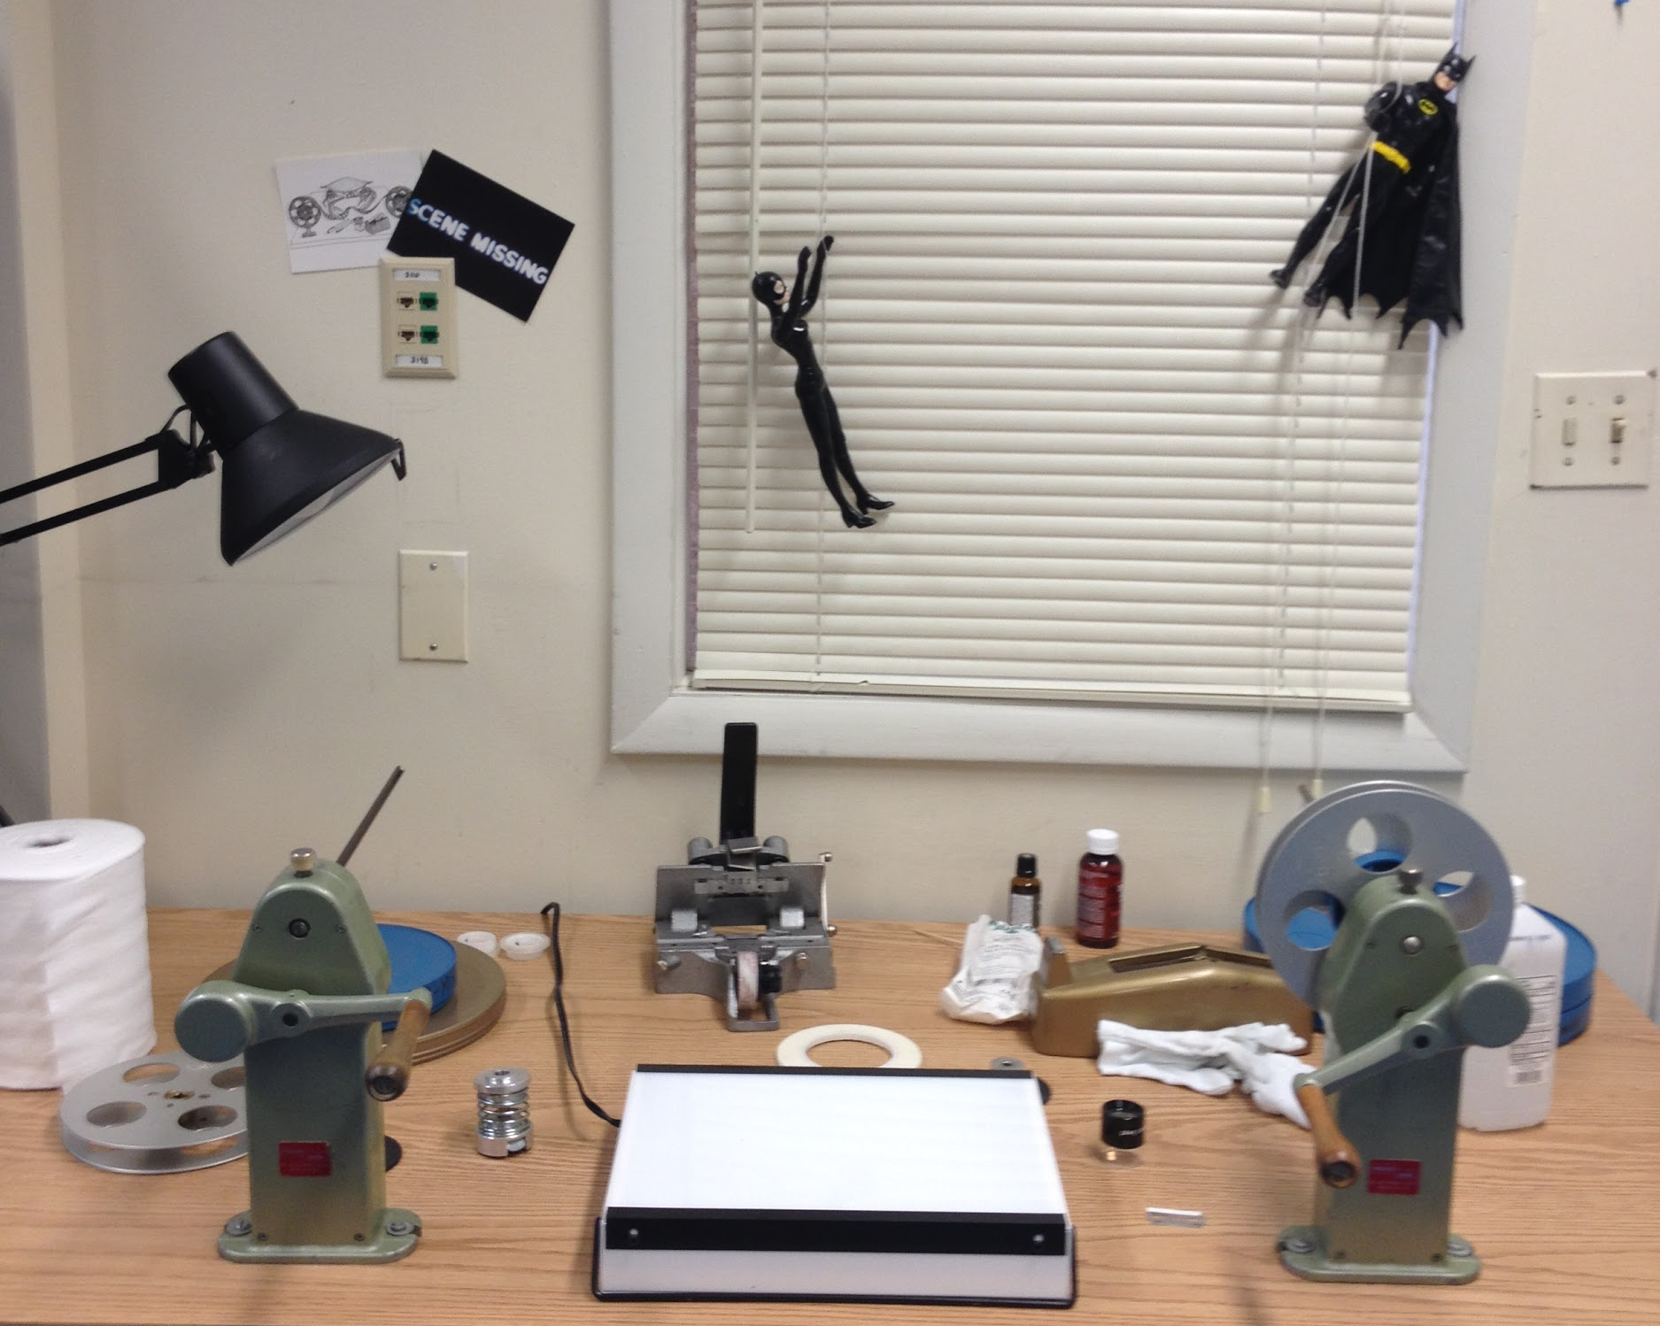
Notes:
And I was also able to create a safe place to inspect and repair 16mm film (the bulk of the WMAR collection).

Slide 12
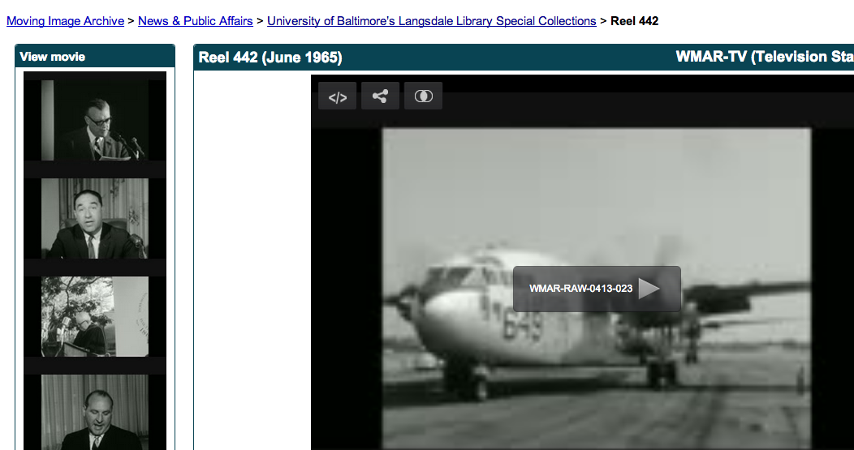
Notes:
Internet Archive for access and storage

Slide 13
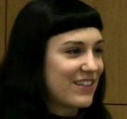
UCLA Library
Preservation Unit
Model
Consultant/Report-->Grant->Temporary-->Career
$$$$
∞

Slide 14


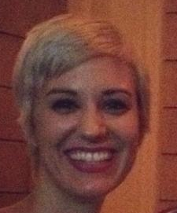
UBalt Langsdale Library
Special Collections Dept
Model
Intern/report-->Grants/collaboration-->Increased interest-->Restructuring-->Career
$
!!!

Slide 15
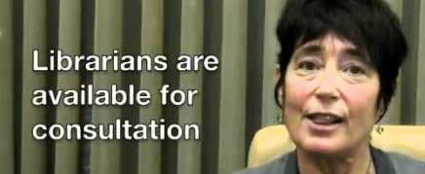
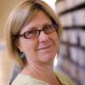
Administrative Support
Sharon Farb
UCLA Library
Lucy Holman
Langsdale Library
&
Notes:
Sharon Farb is Associate University Librarian at UCLA Library and Lucy Holman is the Library Director of Langsdale.

Slide 16
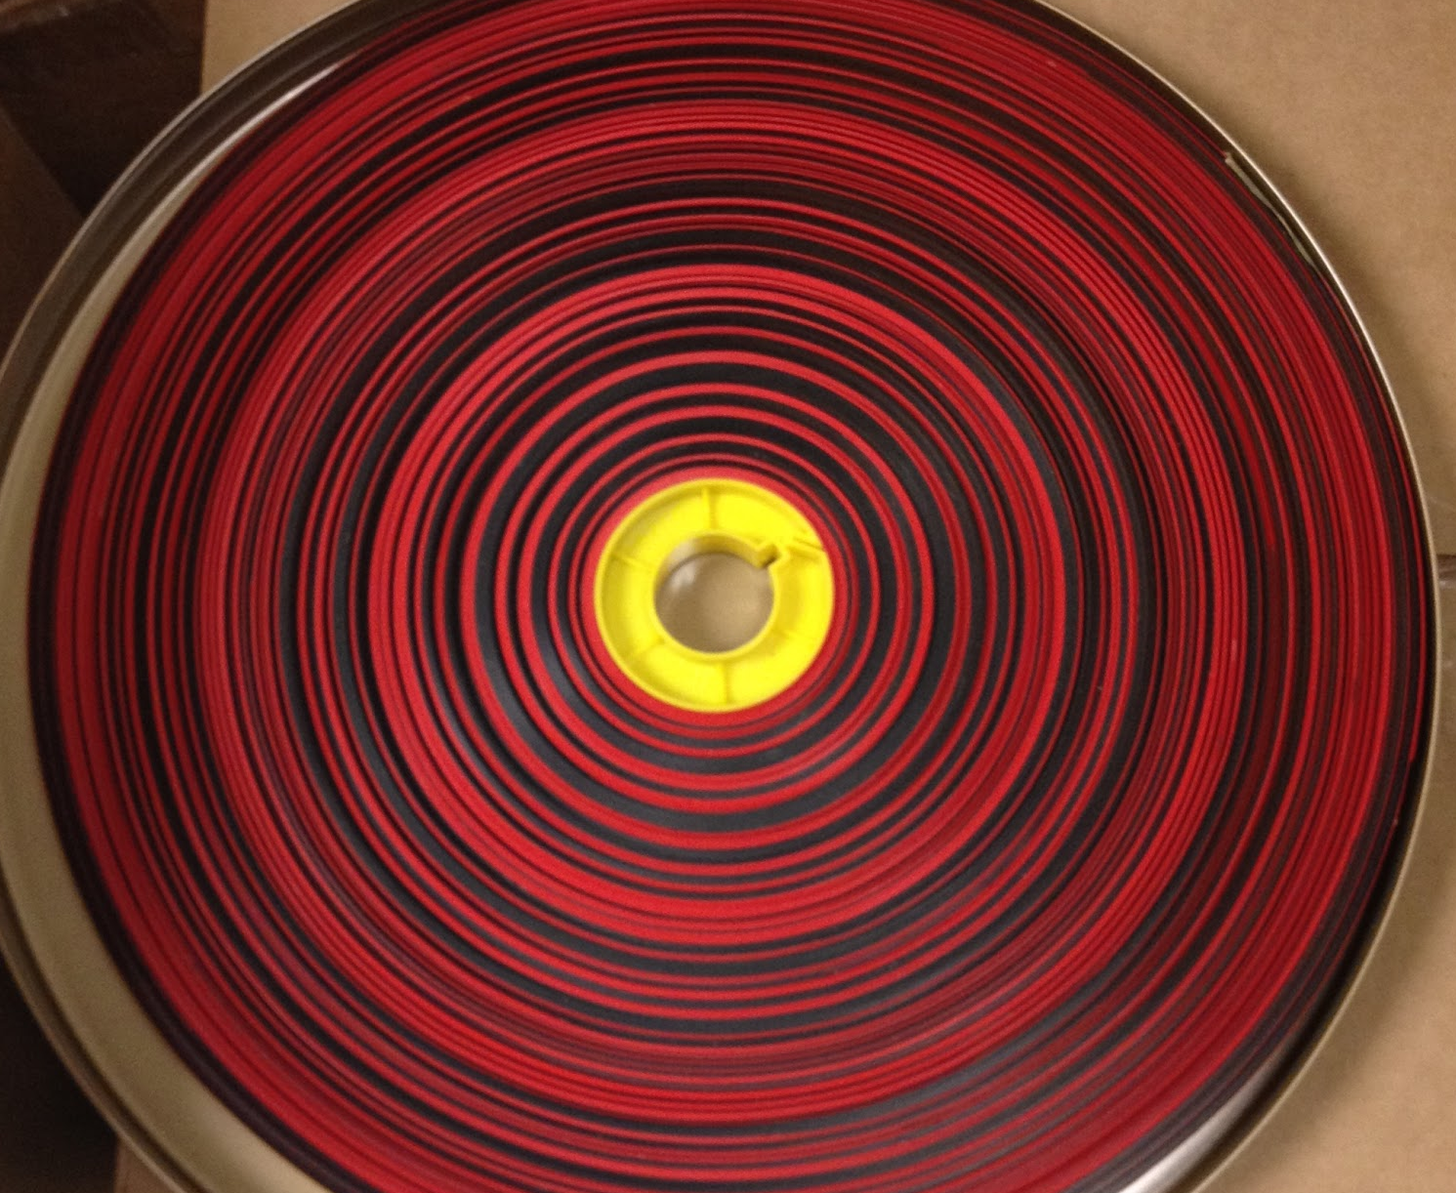
Thank you!
shagan@ubalt.edu
@AV_DiscoTech

