Slide 1

Planning for Diversity and Inclusion
Bea Hardy, Amy Jones, and Angeline Prichard
Salisbury University

Slide 2
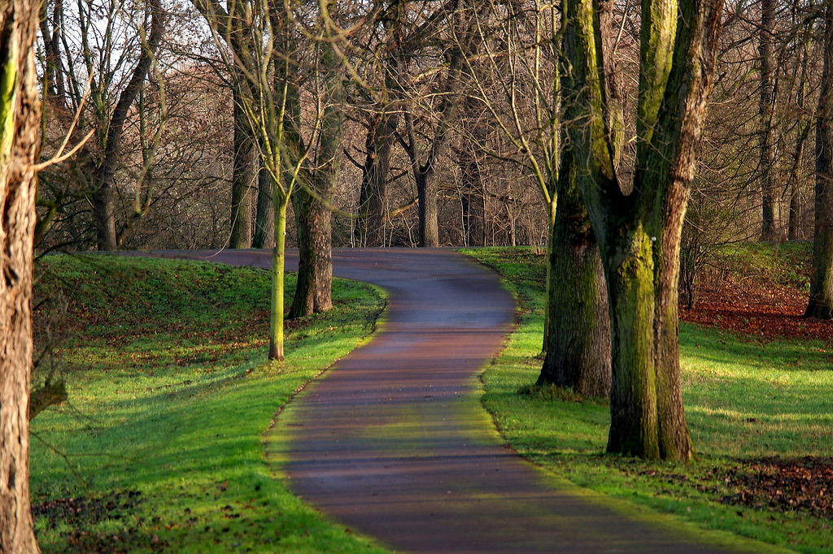
Agenda
Defining diversity
Soliciting feedback
Creating a plan
Issues to consider
Notes:
https://www.flickr.com/photos/147382244@N06/34916502566/

Slide 3
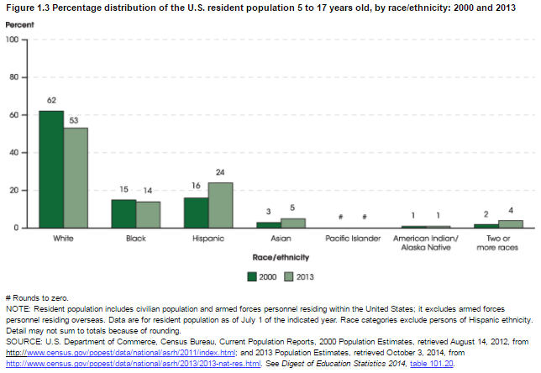
Why a diversity and inclusion plan?
Notes:
The population we serve is getting more diverse, as can be seen from the growth in numbers of Hispanic, Asian, and mixed race/ethnicity and decline in white.

Slide 4

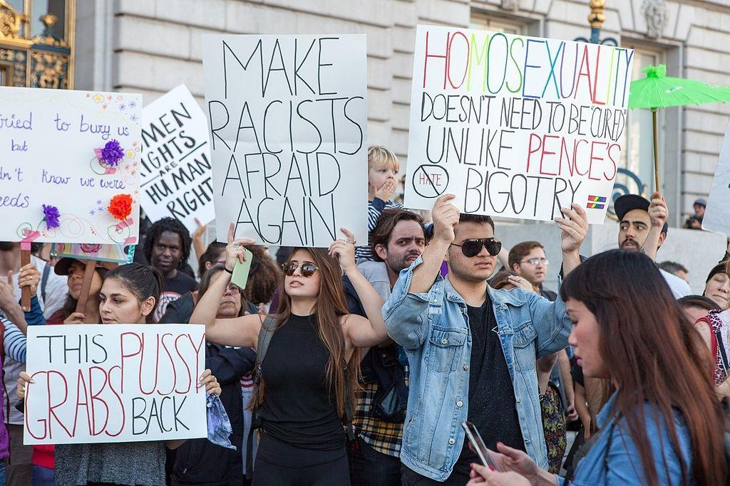
Why a diversity and inclusion plan?
Notes:
Growing controversies over diversity issues, especially in 2016 campaign.

Slide 5
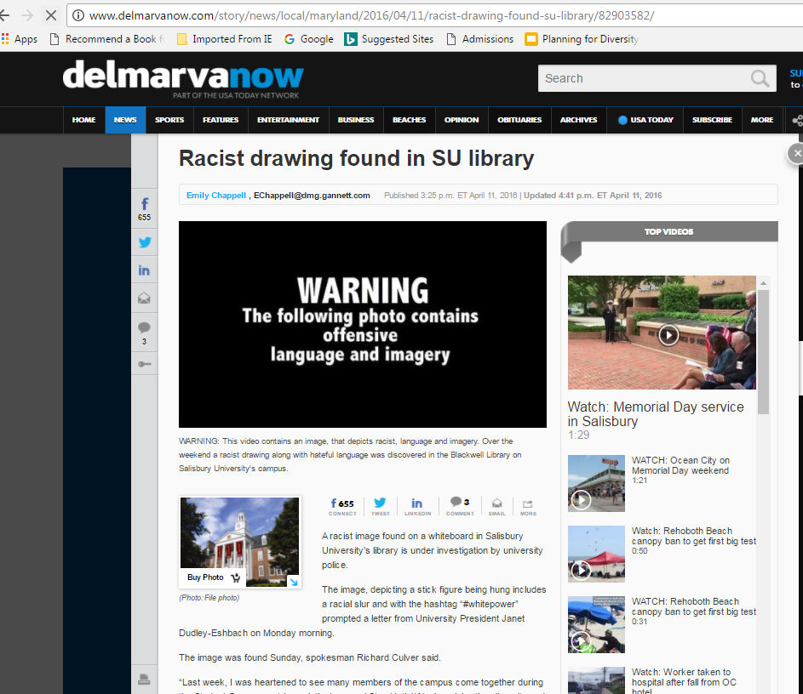
Why a diversity and inclusion plan?
Notes:
In April 2016, a racist drawing was found on a whiteboard in our library. It turned out, eventually, that it was the work of a student of color, but it raised awareness of race-related concerns on campus.

Slide 6
Logistics: Who should come up with a plan?
Issues to consider:
Organizational: top-down or bottom-up?
Permanent or ad hoc?
Size: big or small?
Membership: diversity in demographics and library units
Notes:
SU: selective; members include person of color, HIspanic, LGBTQIA, non-Hispanic white, diverse ages; all units

Slide 7

Logistics: Charge
SU Libraries:
By March 31, 2017, develop a definition for what diversity at the Salisbury University Libraries means and develop a plan to promote that diversity. This can include collections, services, programs/events, staff training, recommendations for ways of recruiting and retaining a diverse staff, etc.
Key points: due date, specific tasks
Notes:
Don’t read the charge out loud! Charge should be clear, have a due date, and ask for specific tasks or results. Note: we later changed the task force to be the “Diversity and Inclusion Task Force.”

Slide 8

Logistics: Budget
Notes:
The task force or committee ideally will be assigned a budget, especially for use during information-gathering and feedback stages. Not a problem for SU since dean chaired the task force.

Slide 9
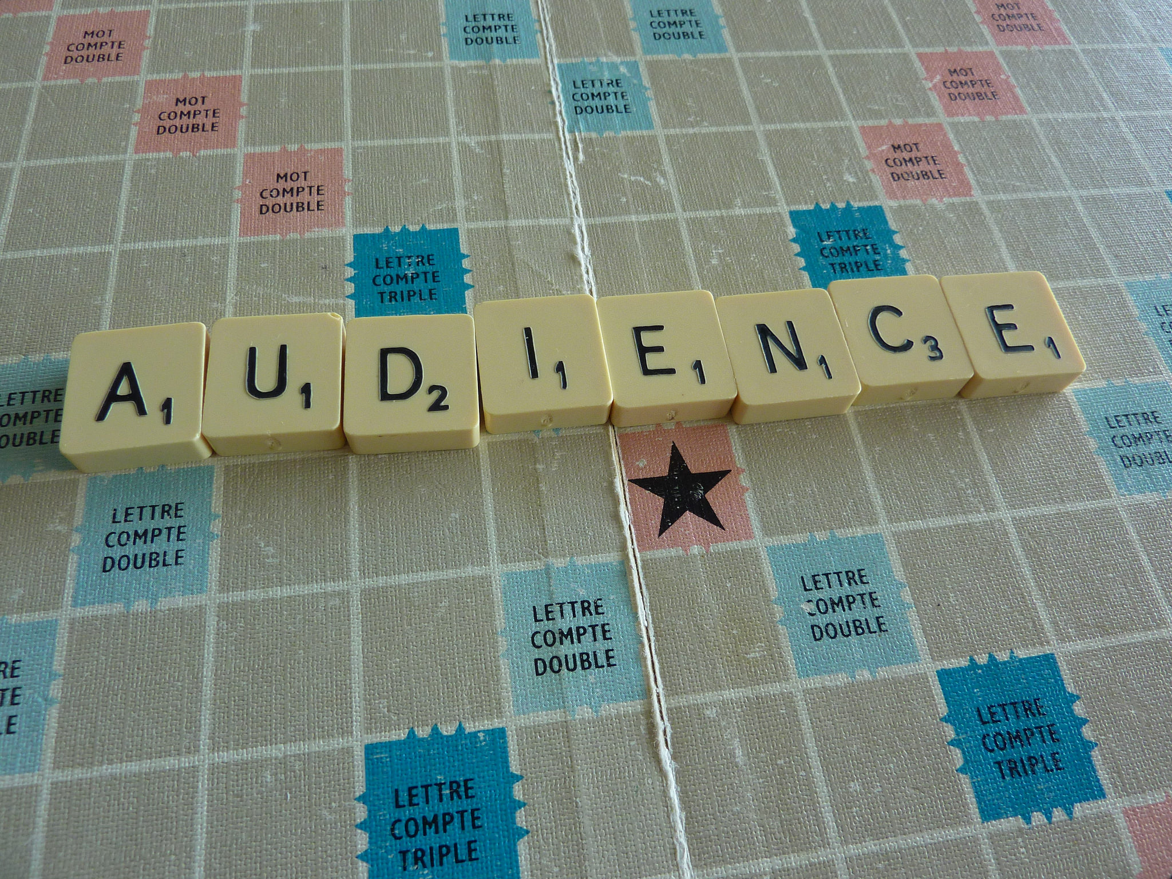
Defining Diversity: Audience participation
What does diversity mean to you?

Slide 10
Defining Diversity
Looked at:
ALA/ACRL/SAA
Our own university website
Other libraries and archives
Professional literature

Slide 11
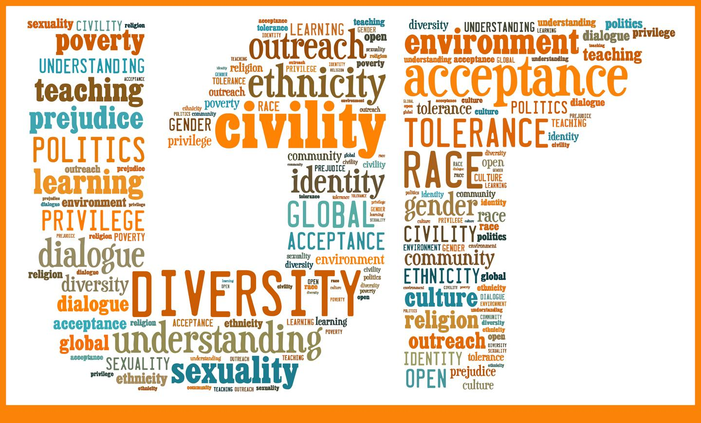
Defining Diversity
Notes:
What we found was that diversity definitions tend to be long lists.

Slide 12
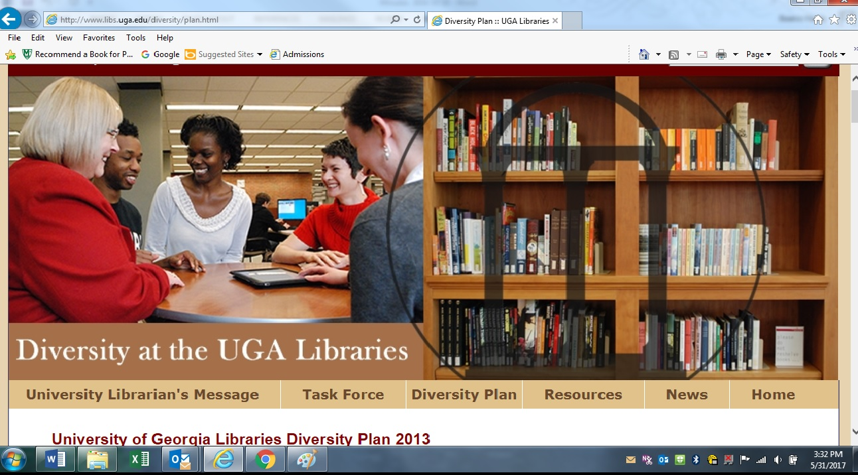
“Every person is a complex individual with multiple overlapping identities rather than an easily categorized member of monolithic majority or minority groups.”
Notes:
One of our task force members particularly liked the inclusion of intersectionality in the University of Georgia’s definition.

Slide 13
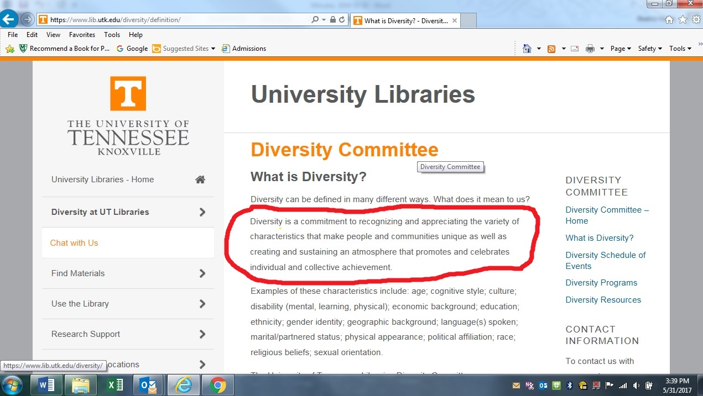
Notes:
What our task force liked about this was the second paragraph that is highlighted, specifically abotu sustaining an atmosphere that promotes and celebrates individual and collective achievement.

Slide 14
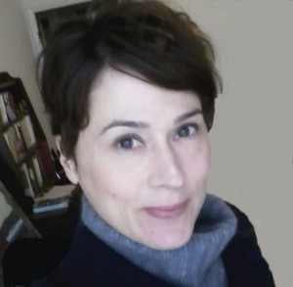
Defining Diversity
Anne Switzer, Oakland University:
Redefine diversity to include “‘nontraditional’ users--that is, any student who differs from the typical college student with regard to abilities, age, gender/sexuality, nationality or ethnicity, and locale.”
“Redefining Diversity: Creating an Inclusive Academic Library through Diversity Initiatives,” College & Undergraduate Libraries 15 (2008): 281.
Notes:
We liked the broad range covered by just seeing diversity as different from typical--but how do you define typical?

Slide 15
Defining Diversity: The SU Definition
Did not list specific diverse groups
Ended up with other lists
Included intersectionality w/o calling it that
Also included what unites us
Notes:
The staff of the Salisbury University Libraries welcomes, supports, and appreciates all SU students, faculty, staff, and visitors. We recognize and celebrate the differences in background, abilities, experiences, characteristics, identity, and thought that make each person unique and that enrich our campus, community, and nation. At the same time, we acknowledge that which unites us: our basic humanity and the search for knowledge that is central to Salisbury University’s mission. We are committed to providing services, collections, and programs that promote affirmation, respect, inclusion, and understanding.

Slide 16

Inventory: How are we supporting diversity now?
Events
Exhibits
Social Media
Collections
Building
Policies
Staff
Are staff members aware of the ways we support diversity?
Notes:
Image source: https://pixabay.com/en/phone-old-year-built-1955-bakelite-1742833/

Slide 17











How do our peer institutions support diversity?

Slide 18
Inventory: Audience Participation
What are some things your library is doing to promote diversity?

Slide 19

Soliciting Feedback
Faculty/Staff
University Diversity & Inclusion Committee
All-Staff Library Meeting
Students
Focus Groups
Notes:
Focus group for faculty fell through, senate committee not as helpful as hoped
https://www.flickr.com/photos/nowhere77/3347881990/

Slide 20

All-Staff Meeting
Update on what we are already doing
Brainstorming in 4 sections
Events and Activities
Human Resources
Collaborations and Partnerships
Collections
Ranking priorities
Notes:
Part of an all-staff meeting, where the majority of the focus was on diversity and inclusion related issues.
Credit: https://www.flickr.com/photos/andymangold/4455910733/

Slide 21
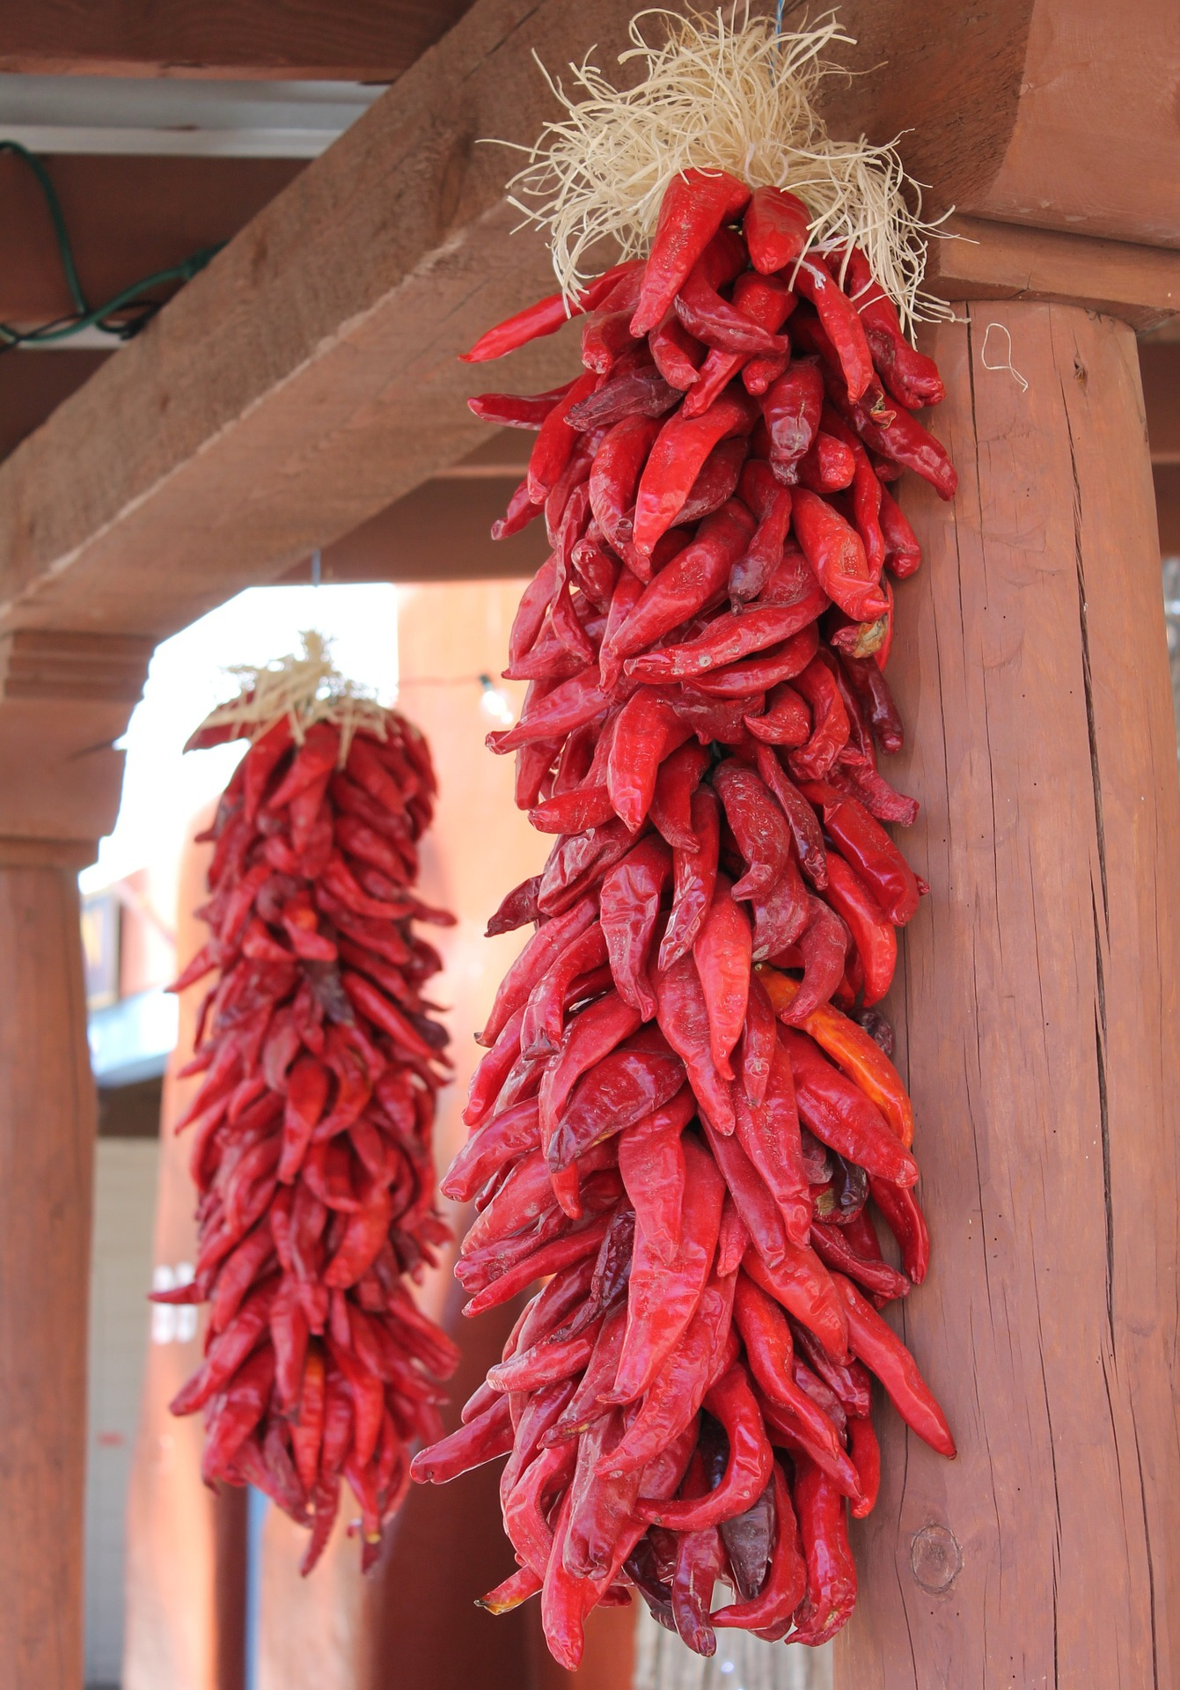
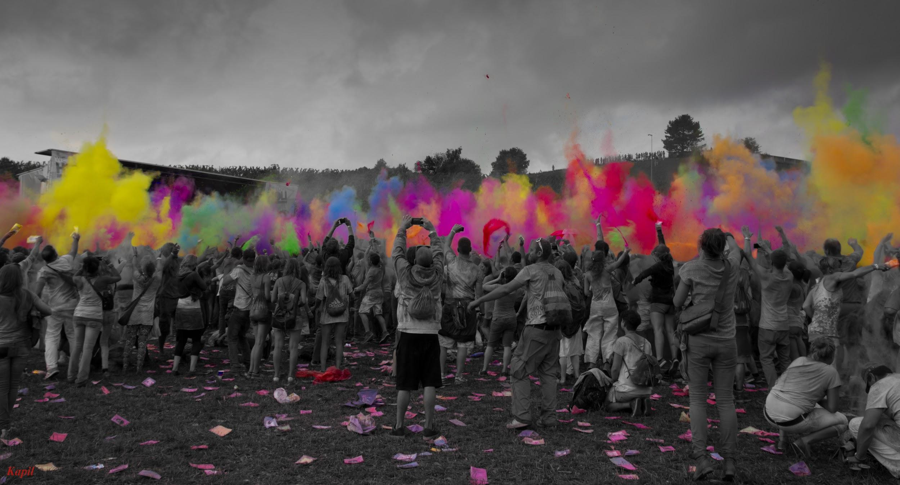
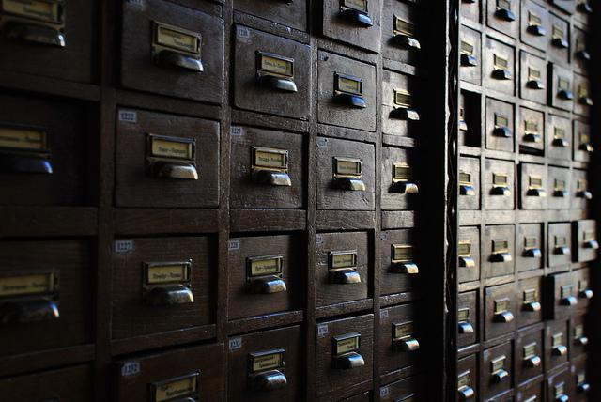


All-Staff Ideas
Notes:
Events and Activities: Festival of Colors, Book Club, cooking demonstrations, Accessibility Room training, wikipedia edit-a-thons
Human Resources: Encourage staff to include diversity efforts in professional development (Safe Spaces), regular workshops, job description, diversity orientation for new hires, dress code
Collaborations: Office of Student Disability Support Services, Student organizations (LGBTQ, Multicultural Student Alliance, Greek Life), , promote events through our social media
Collections: Nabb Center/oral histories of local community, highlight diversity of collection, books in braille, large print, cookbooks of various ethnic groups, assessment of general stacks?, ELI, ASL films
Photo of peppers: https://pixabay.com/en/new-mexico-albuquerque-tourism-1010508/
https://www.flickr.com/photos/kapildevsingh/10953867756/in/photostream/
https://www.flickr.com/photos/67372428@N06/32986366181/
https://www.flickr.com/photos/129657698@N02/16159019626/

Slide 22
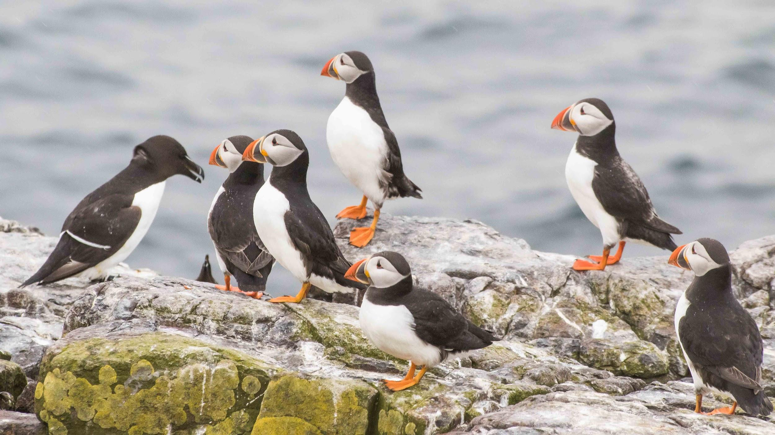
Focus Groups
Collaboration with the department of Conflict Analysis and Dispute Resolution
Neutrality
2 focus groups
1 hour in length
White board, projector, audio recorder
Notes:
Alexandra Martin, faculty; Sarah Cukier, graduate student. 6 students each. Students were members of minority organizations at Salisbury University were contacted to recruit by Bea, but got few responses. The rest were generally recruited by circ. Discuss ideal size of 12, gift cards as incentive, necessary neutrality (not run by nor held in library).
https://www.flickr.com/photos/ian-s/34819871231/

Slide 23

Focus Group Questions
What does diversity and inclusion mean to you?
How do you think your definition of diversity and inclusion could DIFFER from the faculty and/or the staff’s definition?
Notes:
https://commons.wikimedia.org/wiki/Category:Diversity#/media/File:Diversity_baum.png

Slide 24
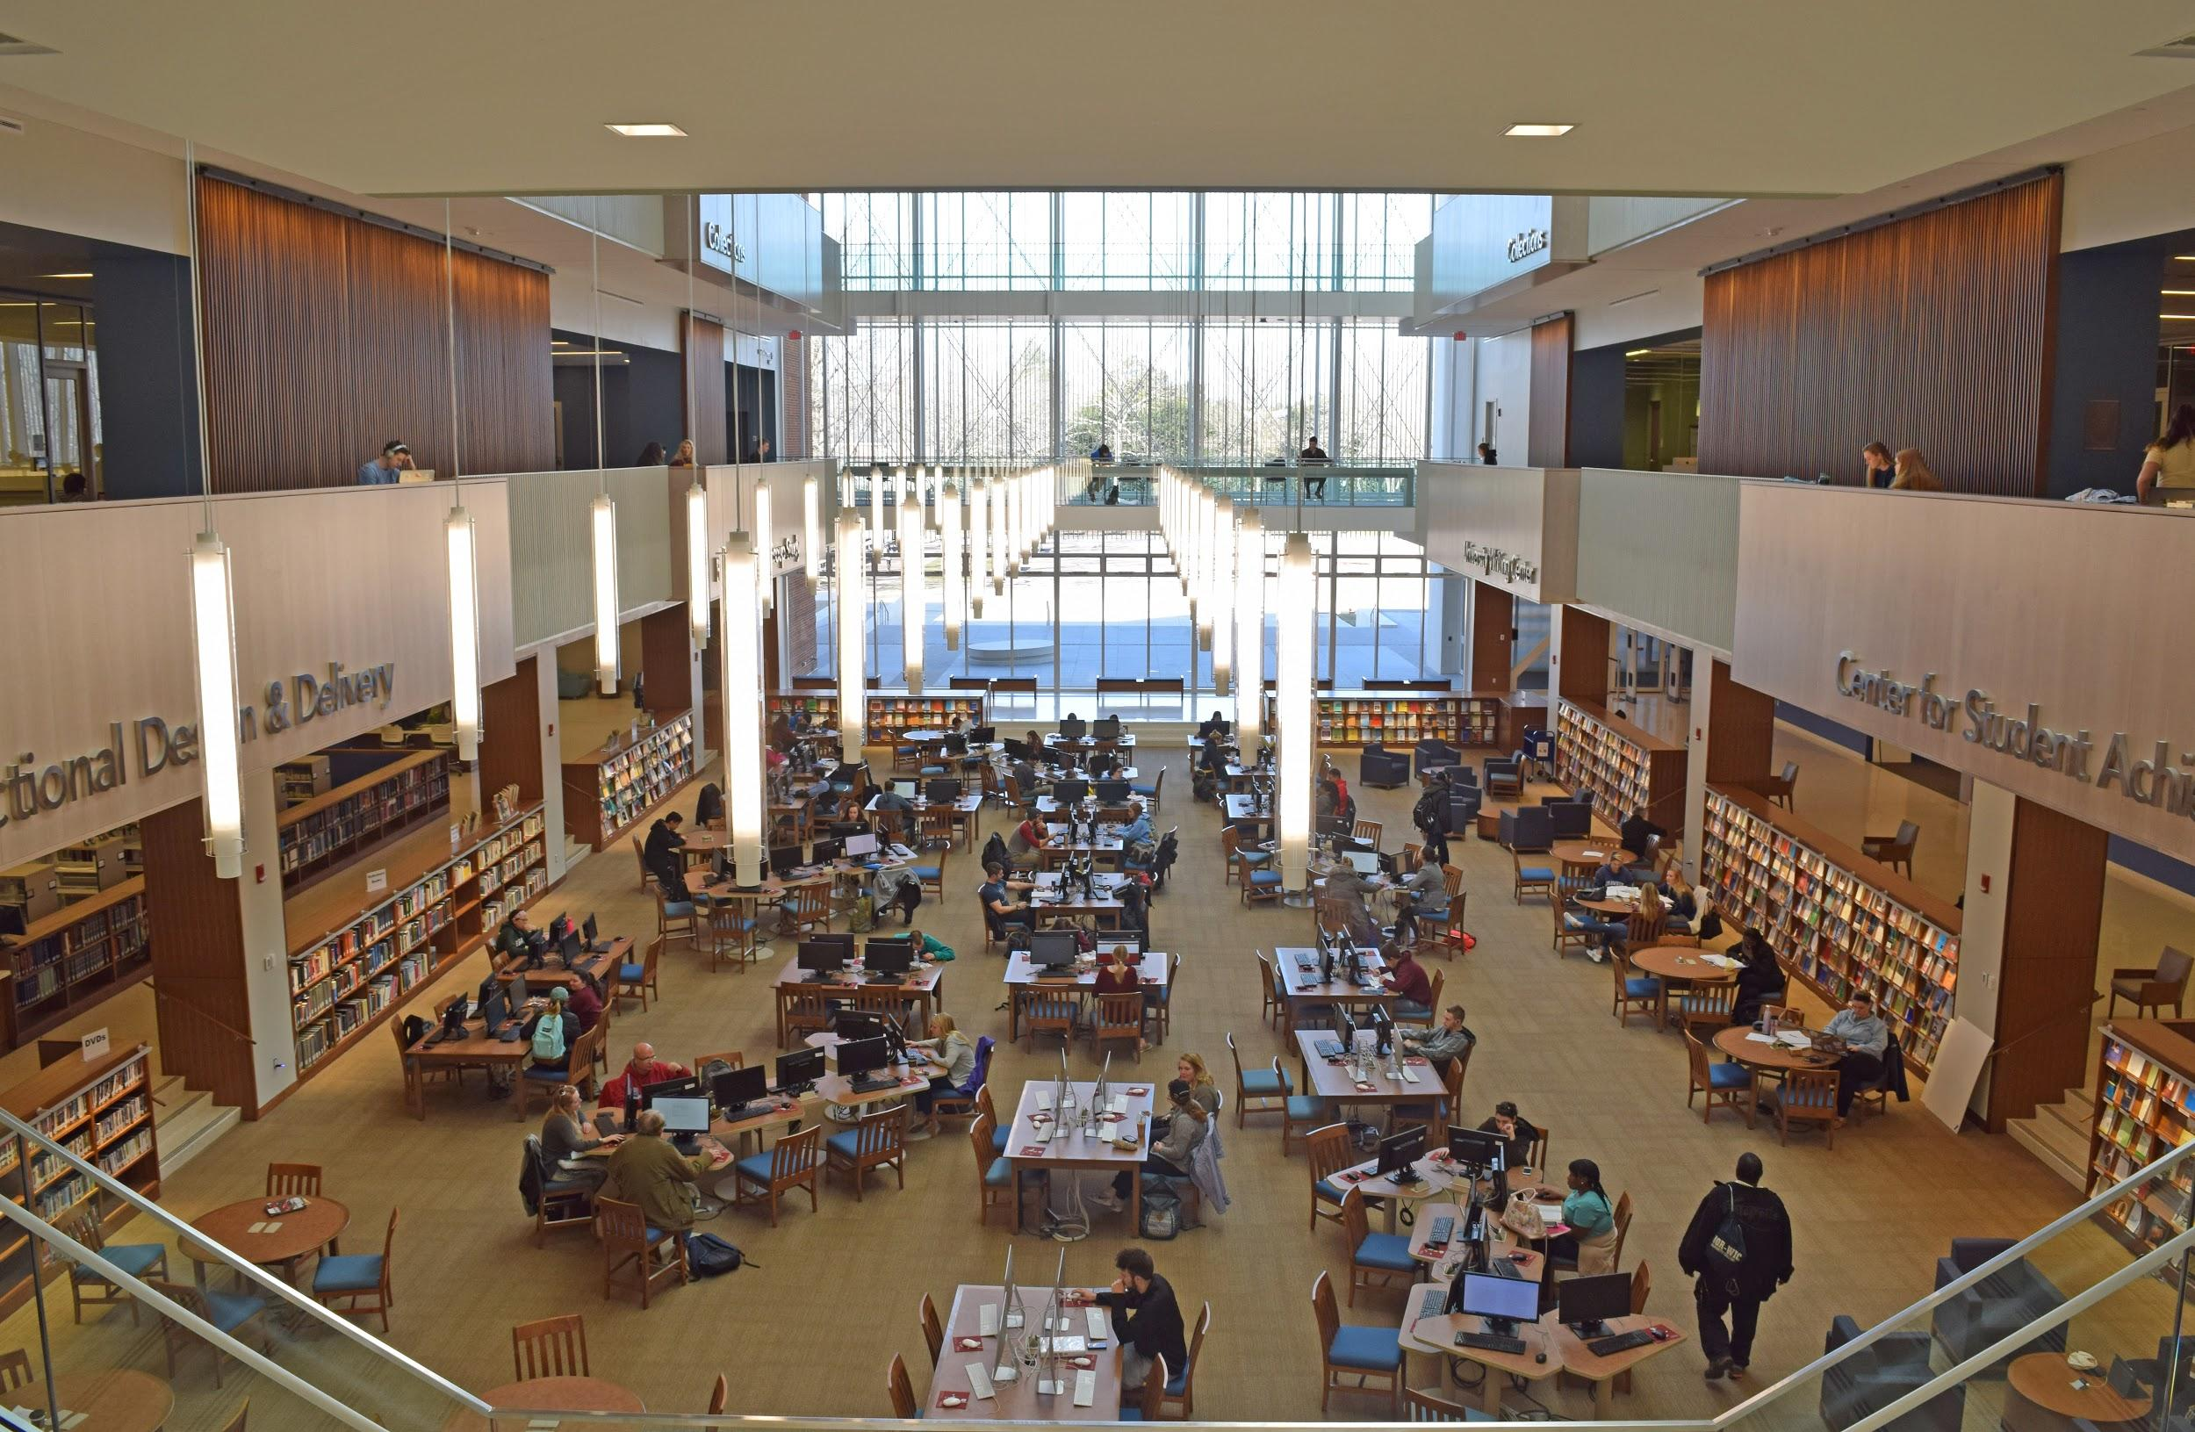
Focus Group Questions
Was there a time when you personally experienced, witnessed or heard about an oversight at the library due to race/sex/sexual orientation/ religion etc.? Have you noticed the libraries taking a proactive role in promoting diversity and inclusion? This can be positive or negative.
Notes:
Photo: Kathy Pusey

Slide 25
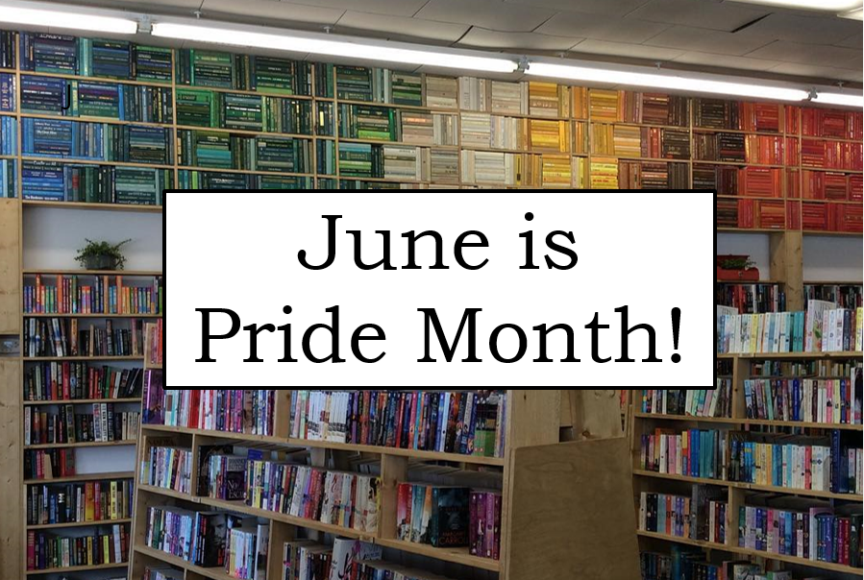
Focus Group Questions
Let’s have some creative ideas for how to encourage more diversity/inclusion in the libraries collections, spaces, or interactions…?
Are you aware of any diversity/inclusion groups on campus that the library could support?
Notes:
Exchange student partnering, book club, professor involvement in library diversity efforts, rotating awareness weeks, library presence at campus events, increase advertisement, night at the library a la Night at the Museum, international collection, interactive screen, highlight collections
Picture: https://www.flickr.com/photos/epist/33961134000/ , flyer by SU libraries

Slide 26
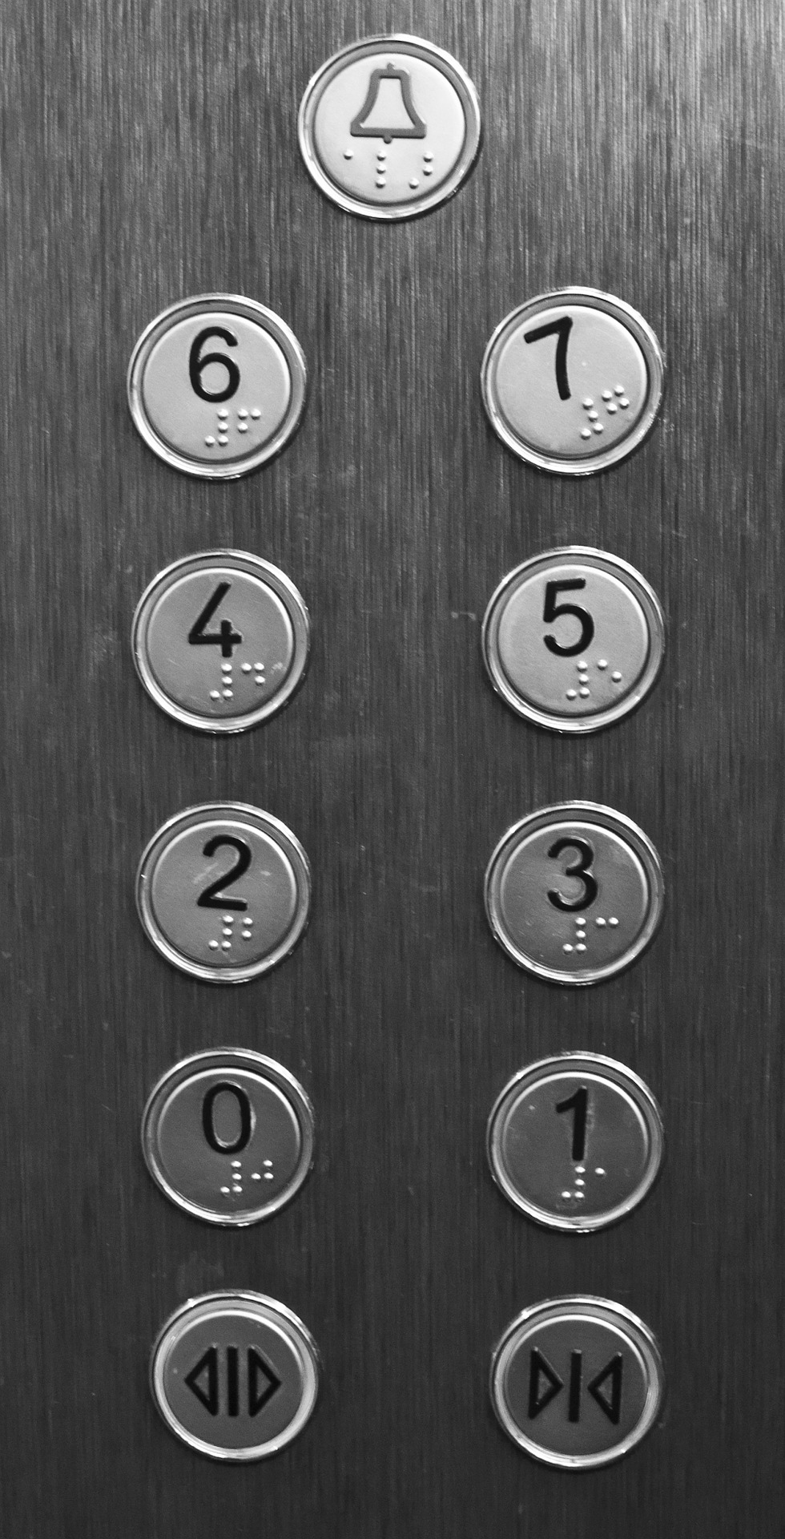
Focus Group Questions
We have provided a list of inclusion specific events, collections, policies, etc. that the library has already done. Please rate them from best to your least favorite idea.
Notes:
Image source: https://pixabay.com/en/elevator-button-building-push-lift-1207812/

Slide 27
Coming Up with a Plan: Task Force Subgroups
3-year plans:
Collections
Human resources
Events and activities
Collaborations and partnerships
Notes:
Even before getting the student feedback, we subdivided the task force into four subgroups to develop 3-year plans. The subgroups were based on the categories used at the all-staff meeting. Plans were to include action items, timeline, responsibility, and (when possible) cost.

Slide 28
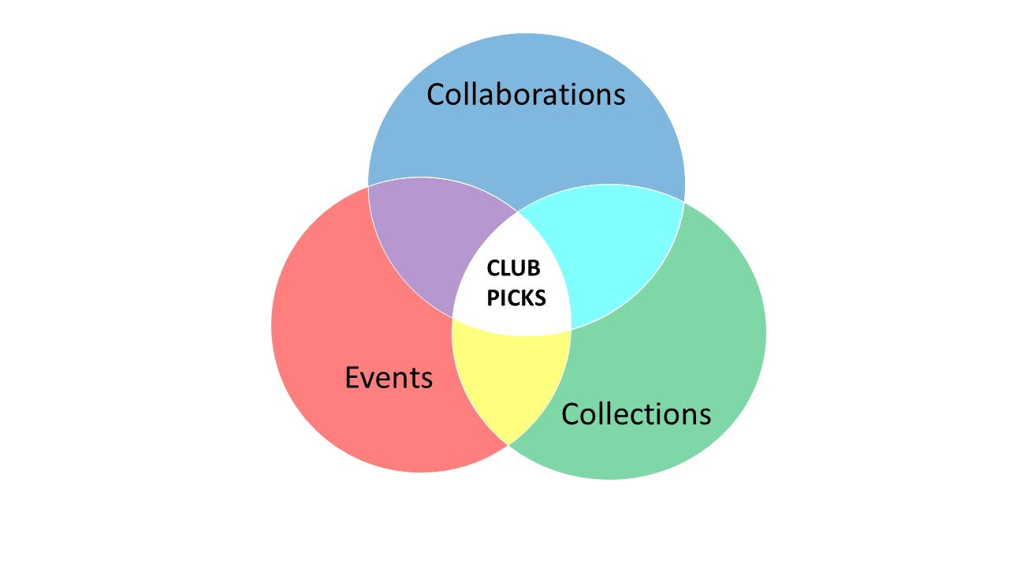
Coming Up with a Plan: Overlap
Notes:
There was a lot of overlap in the subgroup plans. Should “Club Picks”--having student organizations pick diversity-related books or DVDs and promoting them--come under collections, events/activities, or collaborations?

Slide 29
Coming Up with a Plan: Integration into Goals
Goals in final plan:
Promote awareness of and expand diversity-related collections
Improve support for diverse students, faculty, and staff
Promote and support diversity and inclusion among SU Libraries staff members
Notes:
The task force chair took the subgroup plans and integrated them into three goals, shown on the slide.

Slide 30

Coming Up with a Plan: Approvals
SU: Task force and staff feedback solicited, Department Heads approval, informed others
Your campus: Dean/Director? Provost? Who controls resources?
Notes:
We sent the draft plan to the task force and to all staff for feedback before submitting it to the Department Heads group for approval. Before you even write your plan, think about who needs to buy in and who needs to formally approve the plan.

Slide 31
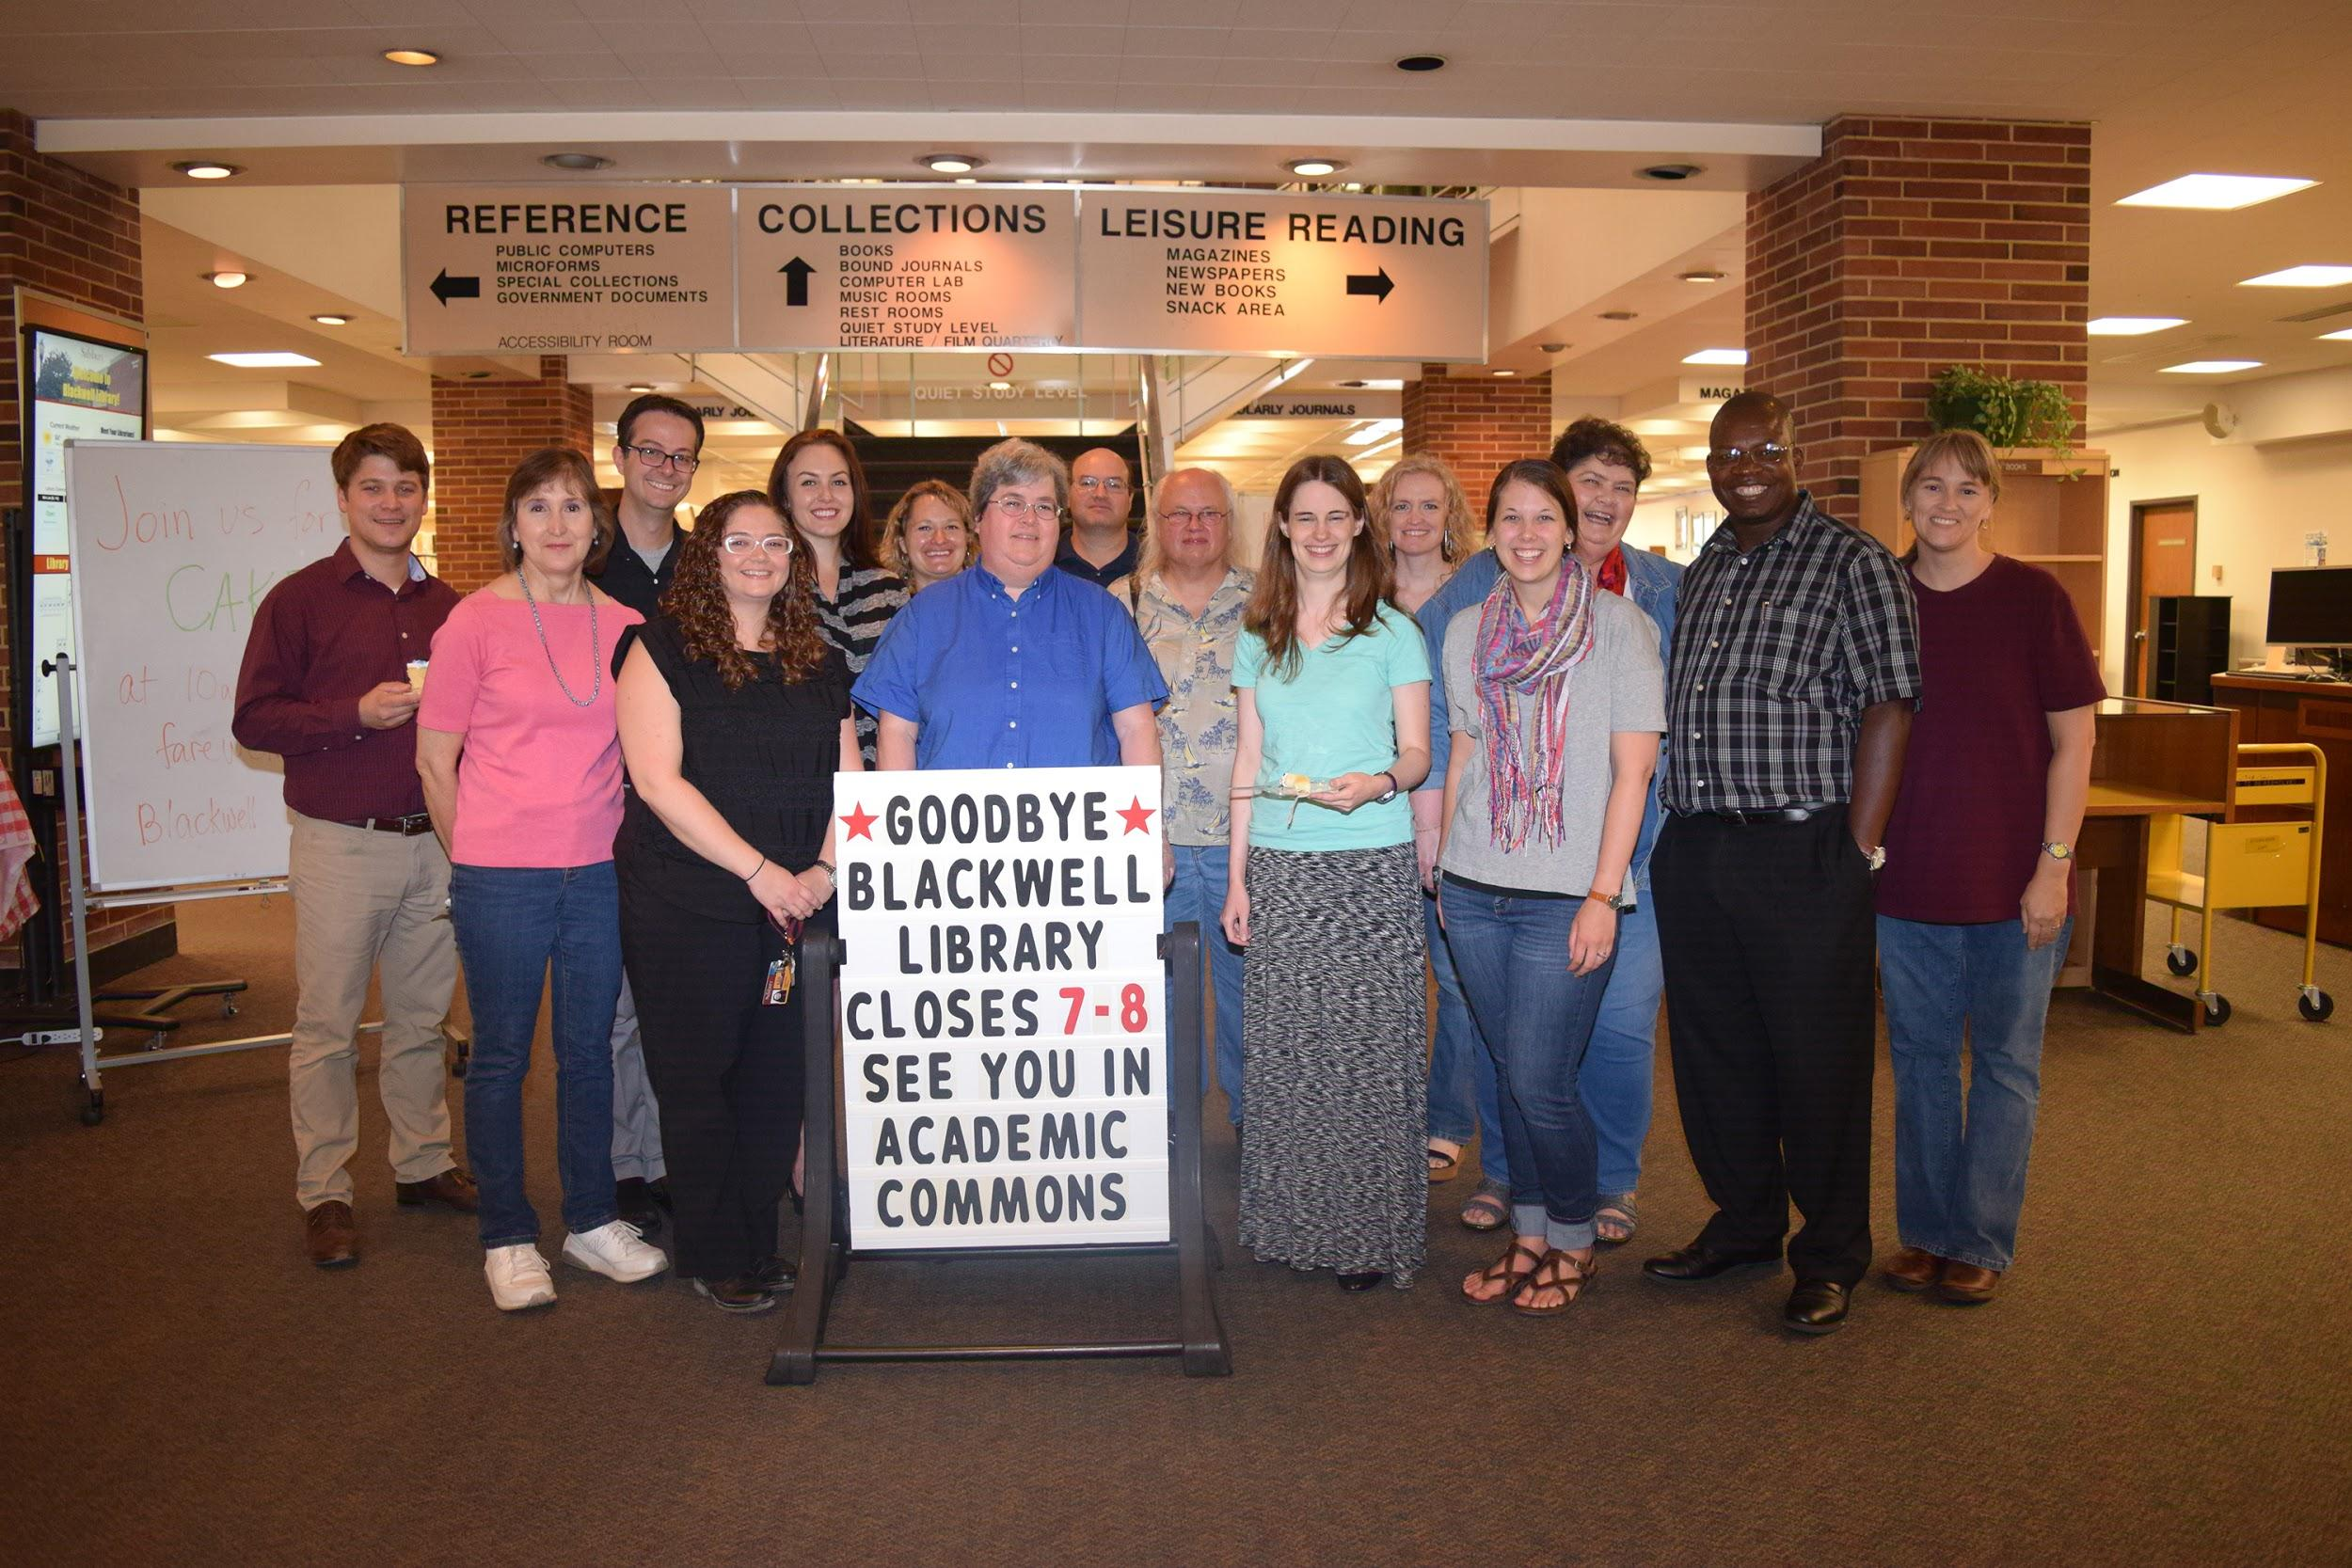
Issues to consider: Personnel
Notes:
Who carries out the plan? It shouldn’t just be minority staff. One or (preferably) a combination:
Full-time staff person devoted to diversity
Staff person with diversity as part of job
Committee (volunteer or assigned)
Numerous people as part of job duties (liaisons with collection development, for example)

Slide 32
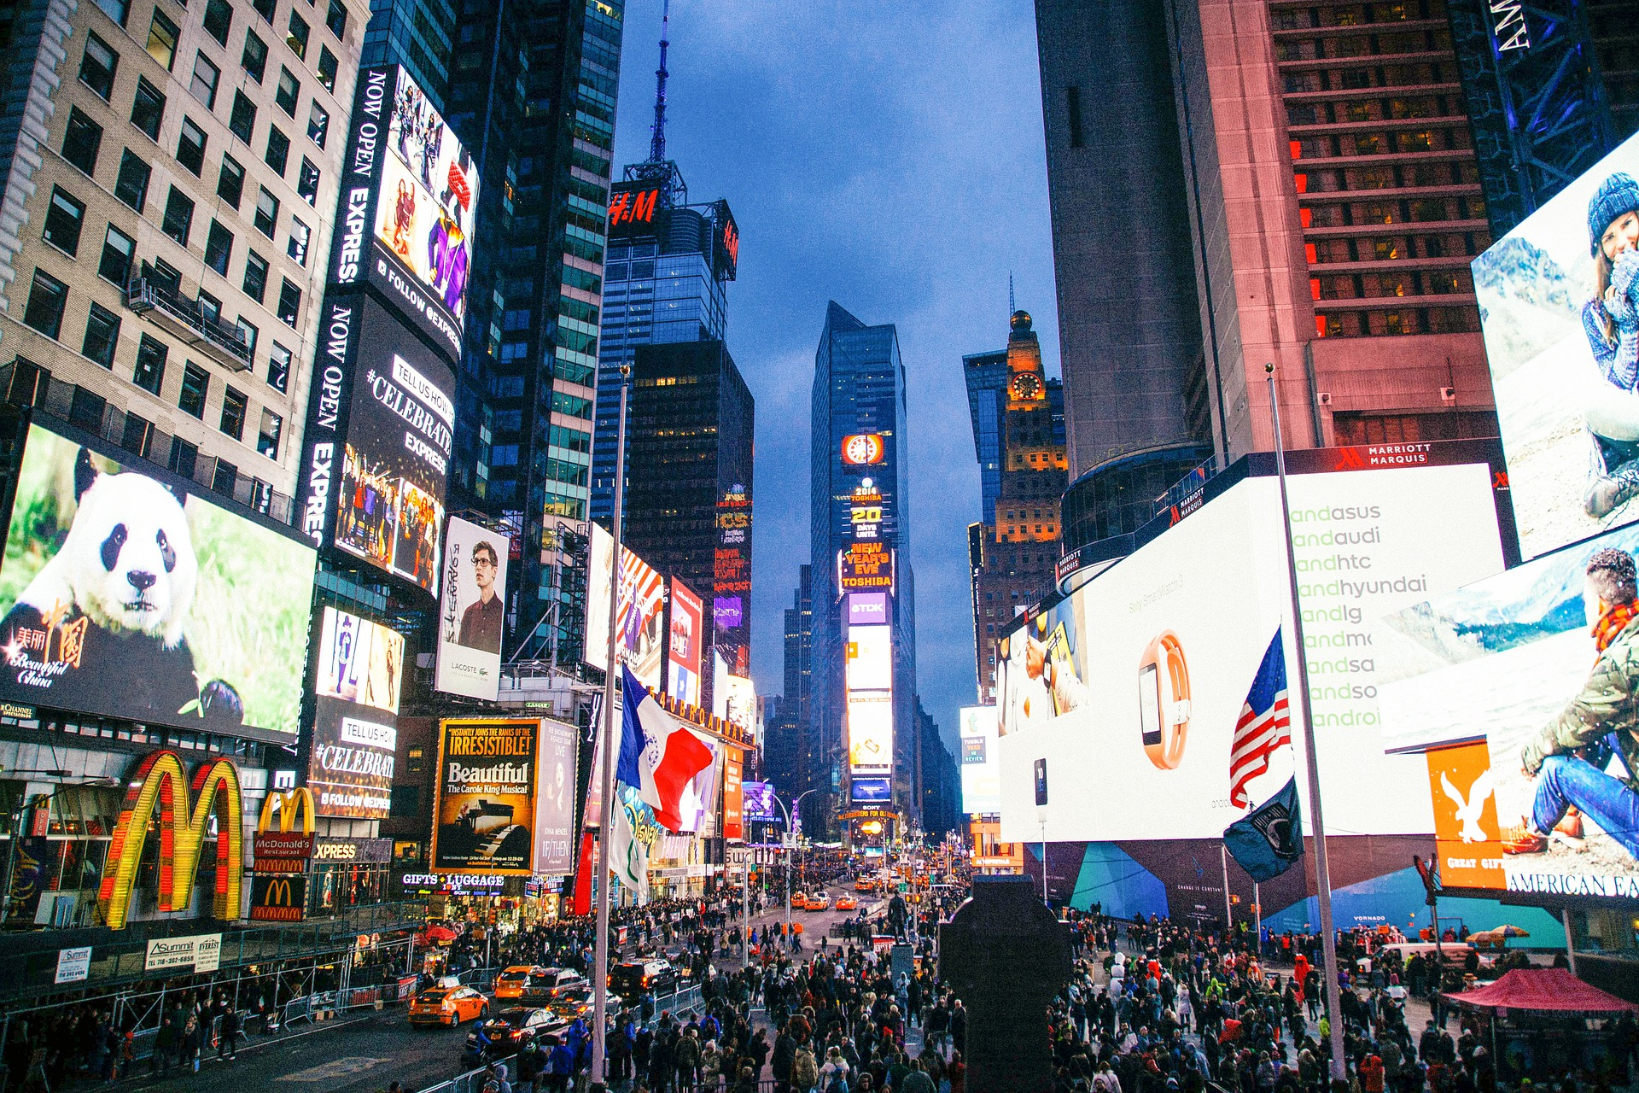
Issues to Consider: Marketing
Notes:
As we found in our focus groups and our all-staff meeting, one of the main ways we need to improve is in marketing/raising awareness. Think about how you are going to publicize what you are doing, raise awareness, etc.

Slide 33

Issues to Consider: Assessment
Notes:
Need to plan ahead of time for assessing new programs and efforts. Informal assessing: books being picked up off display shelf, feedback from student group meeting. Formal assessing: circulation records, surveys. Either way, plan early!
https://www.flickr.com/photos/pollyann/3242575196/

Slide 34

Issues to consider:
Notes:
Keep in mind that you are developing a LIBRARY diversity and inclusion plan. Keep your focus on diversity in the library. Make sure events such as speakers have a library tie, such as building or highlighting collections. Our student focus groups had some suggestions that were more in keeping with student affairs or would more appropriately take place at the student union than at the library--awareness weeks with clubs having food tables, a diversity day with musicians/bands.

Slide 35
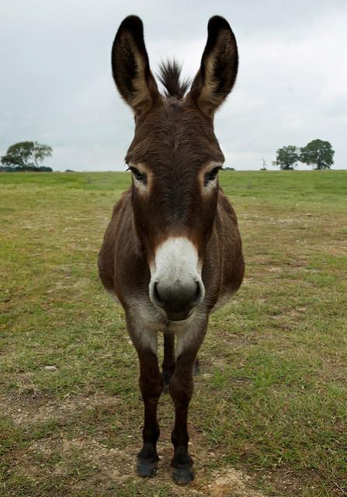
Issues to Consider: Don’t Assume You Know
Notes:
Jackass Image source: https://www.flickr.com/photos/66816094@N00/3076575004/in/photolist-5FSfyC-oN1n5-5vxfC-ULy7Ap-TVzrpE-SxYT4r-8LQuWm-askuK-64iiTe-5Q7AQ4-6gTb8e-SahEER-9g8goV-gCcQA-bcTNr-5PV8VX-5g6nwq-nzovW8-4qD9qG-6gXgtS-x86ob-tM3hi-hdvfo-4sX84e-6gTa6R-nz6oQK-AV9Md-bhFzf-nhTJWp-nz9c31-6gSVcV-6gT32B-4kZzb-9Uix6M-8TVxCy-2fJh6H-34JExE-4vVpmz-bLYzuM-4tXb2d-a2CCJg-5zEQKM-4m8VD8-4Sij4k-nxkGU9-4x1MT9-6gSNF4-9hC7zk-7zNeer-nzoqCc
Reach out to your audience; understand and listen to their needs. Be sensitive to cultural and religious norms.
Don’t assume they want what you think they want. Ask! Be open to learning from them and changing plans accordingly.

Slide 36
Issues to Consider: Audience Participation
What obstacles do people with varying abilities and backgrounds face in using your own libraries?
Notes:
https://www.flickr.com/photos/christophebenoit/21864092831/

Slide 37
Sources
Slide 3: https://nces.ed.gov/programs/raceindicators/indicator_raa.asp, accessed 5/31/2017
Slide 4: Colin Hattersley and Friends of the Earth Scotland, CC-BY-SA 2.0; Pax Ahimsa Gethen, CC-BY-SA 4.0
Slide 7: https://en.wikipedia.org/wiki/Charging_station#/media/File:Free_EV_charge_station_sign_evinfra.svg
Slide 8: Credit: Uncopyrightable logo of You Need a Budget Company,
https://commons.wikimedia.org/wiki/File:You_Need_A_Budget_Logo.png
Slide 9: https://www.flickr.com/photos/christophebenoit/21864092831/
Slide 11: University of Tennessee diversity word cloud, used by permission, https://www.lib.utk.edu/diversity/
Slide 14: “Redefining Diversity: Creating an Inclusive Academic Library through Diversity Initiatives,” College &
Undergraduate Libraries 15 (2008): 281. Photo: https://library.oakland.edu/people/bios/index.php?bio=Switzer.
Slide 16: https://pixabay.com/en/phone-old-year-built-1955-bakelite-1742833/
Slide 18: https://www.flickr.com/photos/christophebenoit/21864092831/
Slide 19: https://www.flickr.com/photos/nowhere77/3347881990/
Slide 20: https://www.flickr.com/photos/andymangold/4455910733/
Slide 21: https://pixabay.com/en/new-mexico-albuquerque-tourism-1010508/;
https://www.flickr.com/photos/kapildevsingh/10953867756/in/photostream/; https://www.flickr.com/photos/67372428@N06/32986366181/; https://www.flickr.com/photos/129657698@N02/16159019626/

Slide 38
Sources
Slide 22: https://www.flickr.com/photos/ian-s/34819871231/
Slide 23: https://commons.wikimedia.org/wiki/Category:Diversity#/media/File:Diversity_baum.png
Slide 24: Kathy Pusey, Salisbury University
Slide 25: Picture by https://www.flickr.com/photos/epist/33961134000/ , flyer by SU libraries
Slide 26: https://pixabay.com/en/elevator-button-building-push-lift-1207812/
Slide 30: http://maxpixel.freegreatpicture.com/static/photo/1x/Pattern-Form-Psychedelic-Retro-Like-Thumb-1638752.png, CC0
Slide 31: Kathy Pusey, Salisbury, University
Slide 32: https://pixabay.com/en/city-time-square-nyc-buildings-869064/
Slide 33: https://www.flickr.com/photos/pollyann/3242575196/
Slide 34: Credit: Brooke Bida CC-BY-2.0
Slide 35: https://www.flickr.com/photos/66816094@N00/3076575004/
Slide 36: https://www.flickr.com/photos/christophebenoit/21864092831/

