Slide 1


Modeling Social Justice Through Innovative, Low-Cost Textbook Options for Social Work Students
Becky Anthony & Victoria Venable
School of Social Work
(ANIMATED SLIDE)

Slide 2


What do we know?
Between 2001 and 2017 the cost of textbooks rose over 140% (U.S. Bureau of Labor Statistics, 2017)
Studies suggested over 66% (n = 22,000) of students did not purchase a required textbook (Florida Virtual Campus, 2016)
Students most effected by textbook costs are students who utilize student loan programs and those who report working more hours in a week (Jhangiani & Jhangiani, 2017).
Notes:
Students reported spending anywhere from $600 (Association of American Publishers, 2016) to $1,000 U.S. dollars per year on textbooks (Martin, Belikov, Hilton, Wiley, & Fischer, 2017).

Slide 3

Social Justice Issue
Textbook costs are an economic injustice due to the issues of access and accessibility
Notes:
Blessinger and Bliss (2016), identified education as a “fundamental human right”. they provide information about five global major movements that shaped formal education and helped to ensure it is more accessible. The fourth movement is the acknowledgement that education is a human right in which all in society should have access (Blessinger, 2015). They also suggested that the fifth movement is the open education movement, including Open/Alternative Educational Resources (Blessinger & Bliss, 2016).
Students, like those participants in the surveys referenced above, have limited access to educational opportunities based on their financial status. Professors have little ability to control the course tuition or room and board costs; however, they do have control over the required readings assigned in their courses (Martin, et al., 2017).

Slide 4

What can we do?
Professors have little ability to control the course tuition or room and board costs; however, they do have control over the required readings assigned in their courses (Martin, et al., 2017).
Notes:
It has been found that the usage of alternative textbooks is often more cost effective for students and provides a greater degree of diversity in the readings and resources that can be incorporated into the course (Lindshield and Adhikari, 2013).
Create OAER and/or OER for students!

Slide 5
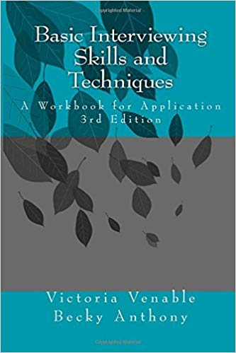
Non-Traditional Textbook Option
Course specific and focused material
Supplemented by videos and assignments
  located in the course LMS
Createspace.com as Tool
  Utilizing a web-based software program, Createspace, we were able to develop our own workbook and have it self-published.
  Global distribution
  Inexpensive and not dependent on bookstore
Notes:
Another challenge with textbooks is that the content within the books themselves is so abundant, and it can come off as general reference knowledge as opposed to being information needed for their course. Our first step to addressing the problem of high-cost textbooks was to explore creating a cheaper textbook option for students in our class. We found a variety of social work textbooks, however, many covered topics that were more far reaching than the focus of our course and cost more than $50 per book. We also examined open source or open educational resources available on the web such as (can you give some examples here?). However, we were unable to find specifically what we needed for our seven-week Basic Interviewing Skills course.
Our next step was to see how other faculty across our campus were handling the textbook issue. The cost of textbooks not only effects social work students, it effects all students across campus. We researched and met with faculty from other disciplines to hear from others about what faculty can do to decrease textbook prices. We learned that faculty are choosing to rely more on course packets and open source materials. As our knowledge increased, so did our desire to create something unique and personalized for our course. Due to the practice nature of this course, we wanted students to be able to engage with the written material, mostly in table format or in short paragraphs, and have learning activities to help them apply the knowledge learned. We decided to create a customized, self-published workbook for the course Can you add a comment or two about what other faculty on your campus were doing?
Does this work?
In the interest of social change, we decided to use these royalties to fund social work student research projects and social work faculty professional travel, as both areas are currently underfunded within our university system.

Slide 6

The Study
The focus
  Evaluating the impact of a non-traditional text option on the learning experience of students enrolled in an undergraduate social work course
Methods
  Participants completed an online survey over the course of two academic years (2016 and 2017)
      Both multiple choice and open ended questions
    N=36 (2016)
    N=46 (2017)
    Total of 82 participants
Notes:
Salisbury University students enrolled in social work 310: Basic Interviewing Skills or instructors teaching the course. These students are typically classified as sophomores or juniors

Slide 7
Who Participated
 | Fall 2016 n=36 Total | Fall 2017 n=46 Total
Gender Male Female | 1 (2.8%) 35 (97.2%) | 2 (4.3%) 44(95.7%)
Age Under 21 21-30 31-40 41 and over | 14 (38.9%) 14 (38.9%) 5 (13.9%) 3 (8.3%) | 20 (43.5%) 10 (21.7%) 8 (17.4%) 8 (17.4%)
Location Salisbury Campus Satellite UMUC | 30 (83.3%) 5(13.9%) 1 (2.8%) | 32 (69.6%) 11 (23.9%) 0
Notes:
Total of 82

Slide 8
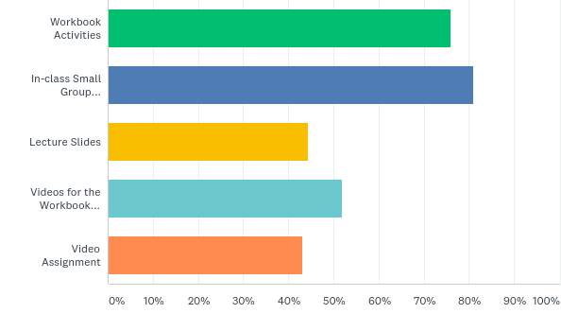
Initial Findings: Year One and Year Two
What specific components were the most beneficial to your learning experience in this course?
60% (p=.000) of participants indicated that they felt the workbook was beneficial to their learning in the course.
In addition, 42% (p=.000) of participants felt that both the workbook activities coupled with in-class activities and the supplemental videos were beneficial to their learning in the course.
Notes:
Need to run chi squre analysis for each of these tables

Slide 9
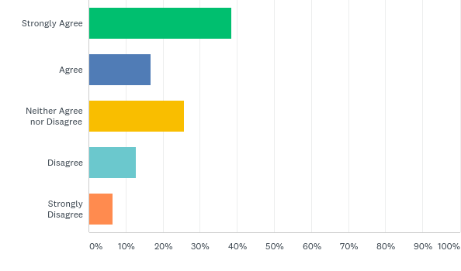
Initial Findings
The cost of textbooks is often the major reason why I do not purchase them for my classes
Over 40% (p=.000) of participants strongly agreed and agreed that the price of their textbooks is a major factor when considering whether or not to buy books for classes

Slide 10
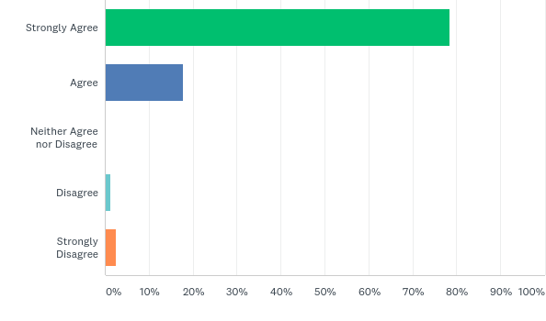
Initial Findings
Compared to other courses that utilize traditional textbooks, I am more likely to read a workbook like the Basic Skills workbook.
Over 70% (p=.000) of participants strongly agreed or agreed that they were more likely to read and use a workbook like the one we created for our course

Slide 11
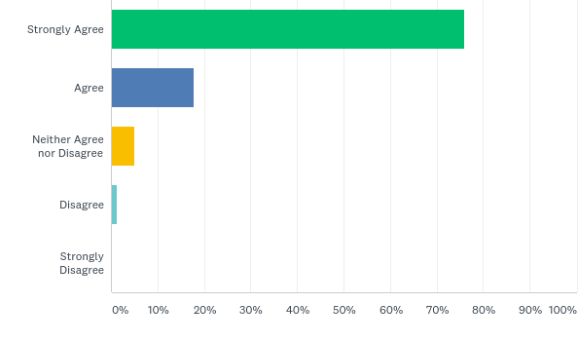
Initial Findings
I found the language and organization of the Basic Skills workbook easier for me to understand and use than what is in some of my traditional textbooks
Over 70% (p=.000) of participants strongly agreed or agreed that the non-traditional text option was easier to use and understand compared to their traditional textbooks

Slide 12

Overview of the Findings
Students liked the workbook more than a traditional textbook
Students found the workbook to be convenient and affordable
Students liked that the workbook was straight to the point and short, but wanted more in depth information about the subjects covered
  Add more information but keep the workbook smaller and more concise than a traditional textbook
  Add vocab words and definitions
Students liked having examples and supplementary material
  Add more examples in the book and try to improve the existing ones
  Put links in the book for videos

Slide 13

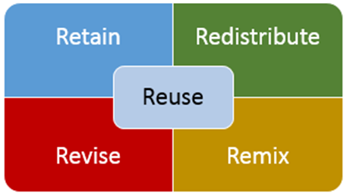
Next Steps
Continue:
Moving Forward:
Utilizing workbook
Surveying students
Updating
workbook every
year
Adapting workbook based on
feedback
Create updated videos (funding
is needed!)
Potential for true OER
Notes:
Open license that permits no cost access, user adaptation, and redistribution by others with no or limited restrictions
OER 5 Rs
Retain Make and own copies
Reuse Use in a wide range of ways
Revise Adapt, modify, and improve
Remix Combine two or more
Redistribute Share with others

Slide 14

Questions?
Becky Anthony
rsanthony@Salisbury.edu
@becky_anthony
(ANIMATED SLIDE)

Slide 15
References
Florida Virtual Campus. (2016). 2016 Florida student textbook and course materials survey.
Retrieved from https://florida.theorangegrove.org/og/file/3a65c507-2510-42d7-814c-
Jhangiani, R. & Jhangiani, S. (2017). Investigating the perceptions, use, and impact of open
textbooks: A survey of post-secondary students in British Columbia. International Review of Research in Open and Distributed Learning, 18(4), 172-192.
Martin, M. T., Belikov, O. M., Hilton, J., Wiley, D. & Fischer, L. (2017). Analysis of student and faculty
perceptions of textbook costs in higher education. Open Praxis, 9(1), 79-91.
U.S. Bureau of Labor Statistics. (2017, August 13). Consumer price index – All urban consumers: College
textbooks. Retrieved from http://www.bls.gov/data

