Slide 1


Student Curators and Exhibit “Labs” in Libraries
Beatriz Hardy, Salisbury University
Jennie Davy, College of William & Mary
Re-Think It: Libraries for a New Age • August 11, 2015
Notes:
This presentation will focus on student curators and the creation of exhibits labs in libraries at Salisbury University and the College of William & Mary. Bea Hardy is Dean of Libraries at Salisbury University, and Jennie Davy is the Burger Archives Specialist at William & Mary’s Swem Library.

Slide 2
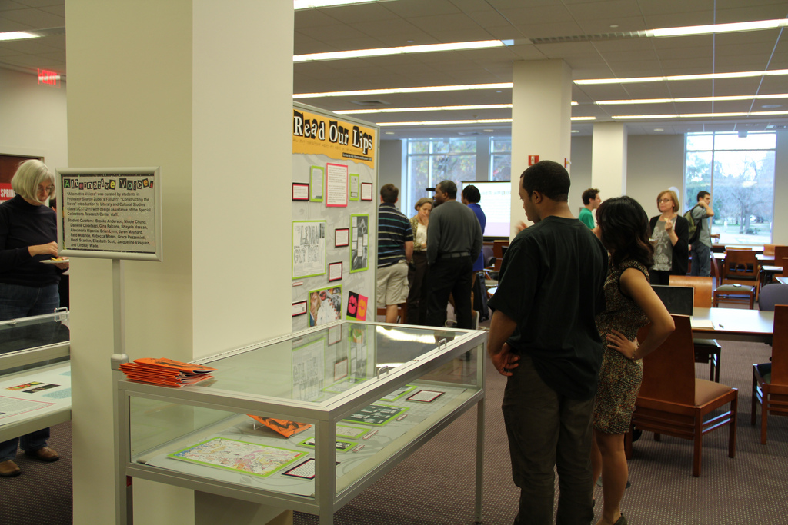
Student Curators at Work
Notes:
Beginning in 2010, Swem Library’s Special Collections added a program of student-curated exhibitions to its outreach agenda, having to date collaborated with faculty and classes to create six exhibitions within the library.

Slide 3
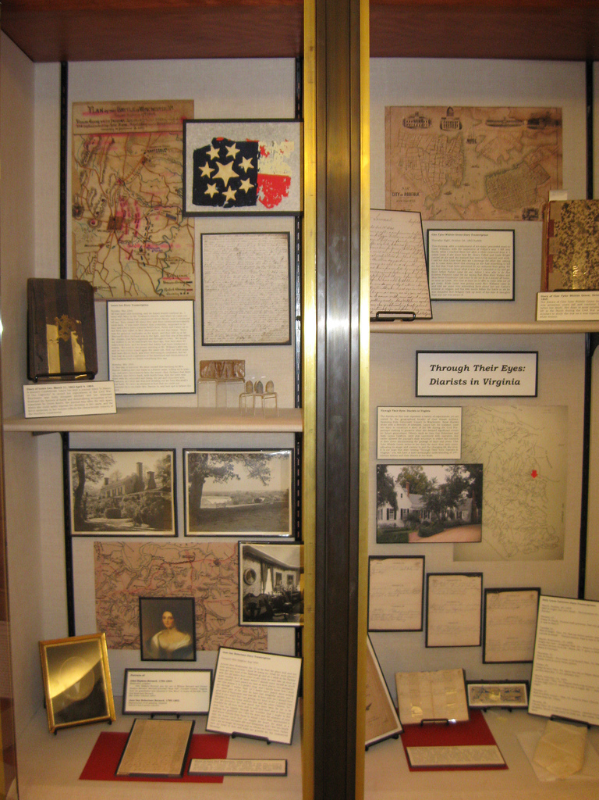
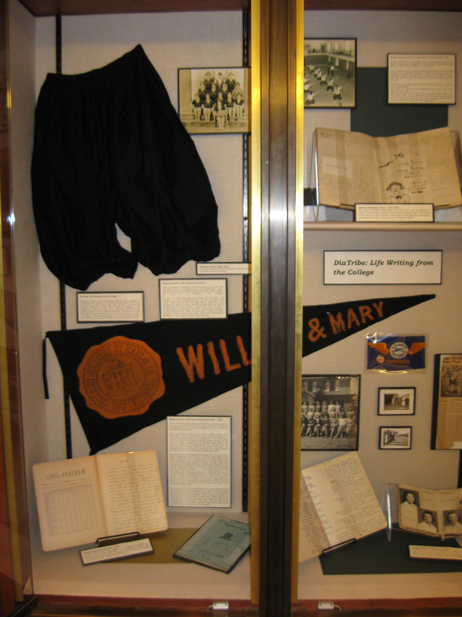
Student Curators at Work
Notes:
Since the program’s inception, students have curated exhibits on topics including the material culture of tobacco, William & Mary student publications, nineteenth- and twentieth-century diaries, and William & Mary during the era of Jim Crow.

Slide 4
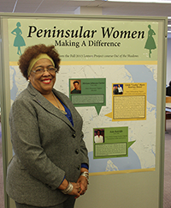
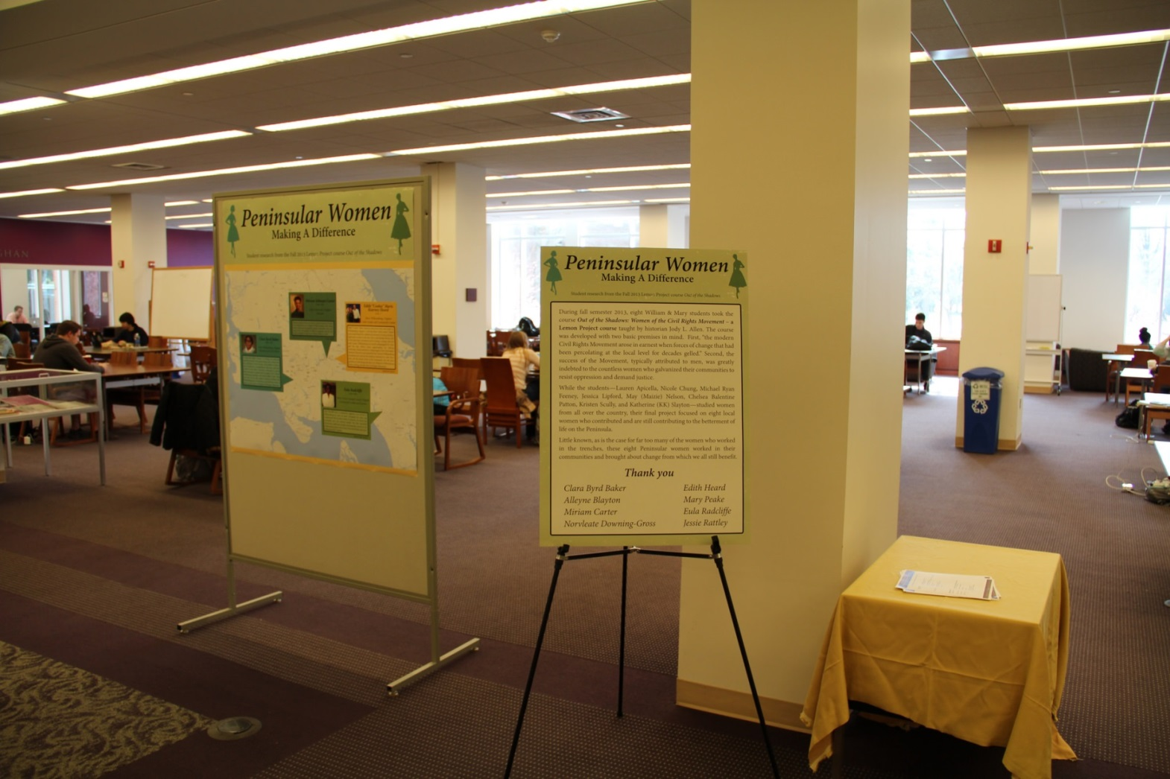
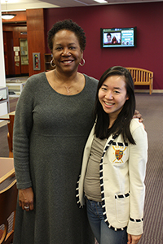
Student Curators at Work
Notes:
Student curation at the College of William & Mary allows us opportunities to showcase and integrate our materials into coursework, come up with new exhibit ideas, fill our expanded spaces, and provide students with a class project based on the real-world work of public historians, archivists, and museum professionals.

Slide 5
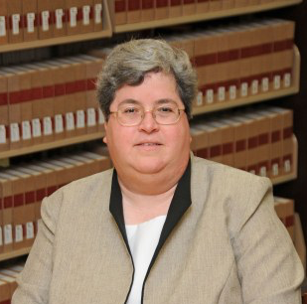
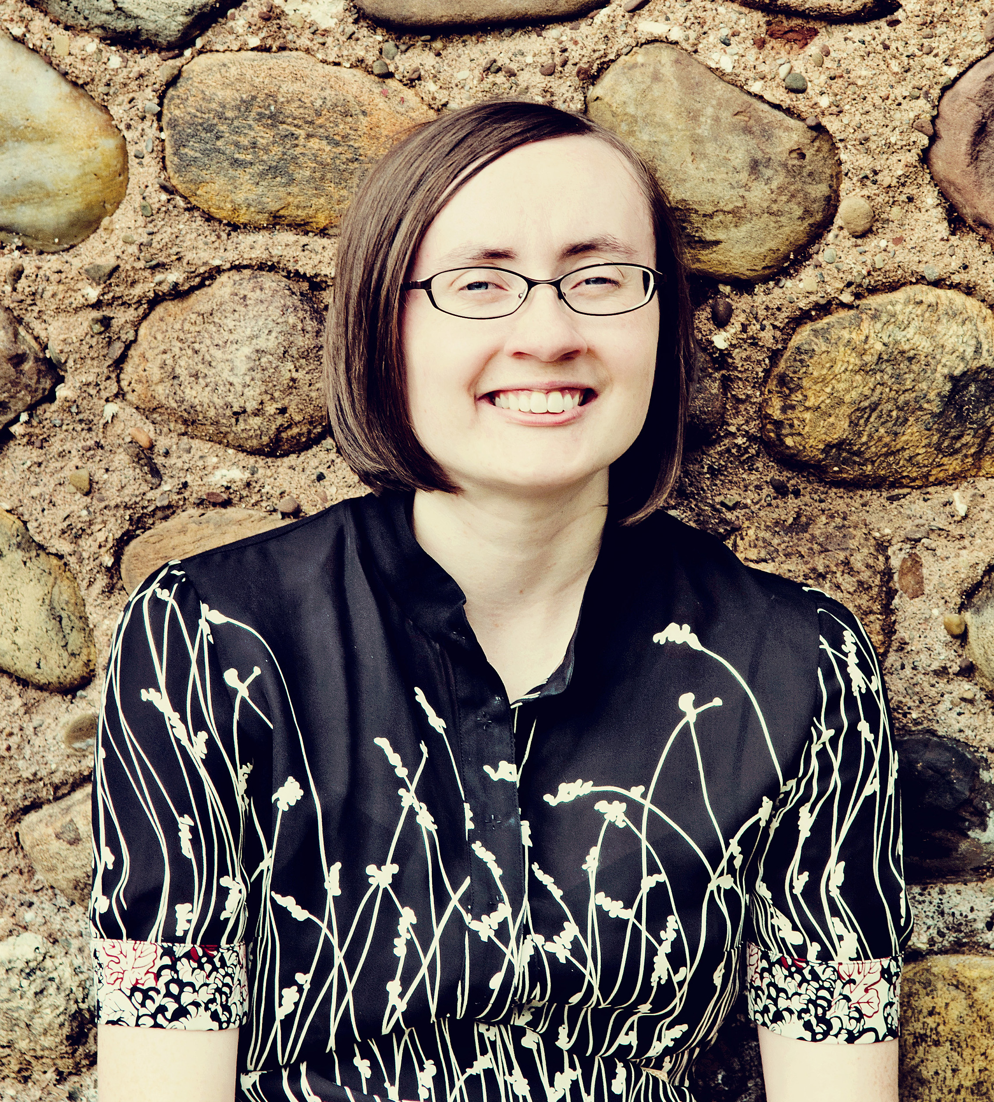
Our backgrounds
Bea Hardy
PhD in history, MLS
Employment History
Maryland Historical Society
William & Mary
Salisbury University
Jennie Davy
MA, Museum Studies
Employment History
Palmer Historical Society
Orleans County Cornell Cooperative Extension
William & Mary
Notes:
Bea Hardy earned both her PhD and MLS from the University of Maryland at College Park. She was a history professor before becoming library director at the Maryland Historical Society. She served as director of the Special Collections Research Center at W&M before occupying her current position as Dean of Libraries at Salisbury University in 2012.
Jennie Davy earned my Masters Degree in History Museum Studies from the Cooperstown Graduate Program in Upstate NY, during which she completed an internship as the Colony House Intern at the Palmer Historical Society in Palmer Alaska. She also worked as a finance and archives assistant at the Orleans County Cornell Cooperative Extension before becoming the Burger Archives Specialist at Swem Library in 2011.

Slide 6
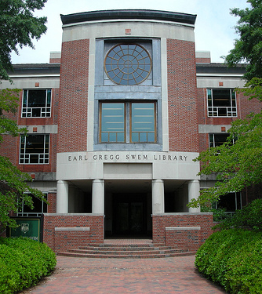
William & Mary
Founded 1693
8,000 FTE students
Library 1966, 2006
35 librarians, 84 total staff
>2 million books, journals, etc.
SCRC—excellent Virginia, political, business collections, also University Archives
Notes:
The College of William & Mary is a public research university located in Williamsburg, Virginia. We have a long history as the college was chartered on February 8, 1693 by King William III and Queen Mary II as the second institution of higher learning in the American colonies. We have a strong commitment to undergraduate education with graduate programs in History, American Studies, Anthropology, Physics, Business, Education, and Law. Swem Library was completed in 1966 with a renovation adding a Special Collections wing in 2006. The Special Collections department has collections related to Virginia history, several 20th century politicians papers, the University Archives, as well as the Chapin Horowitz Collection, which is the second largest collection of books on dogs in the country.

Slide 7
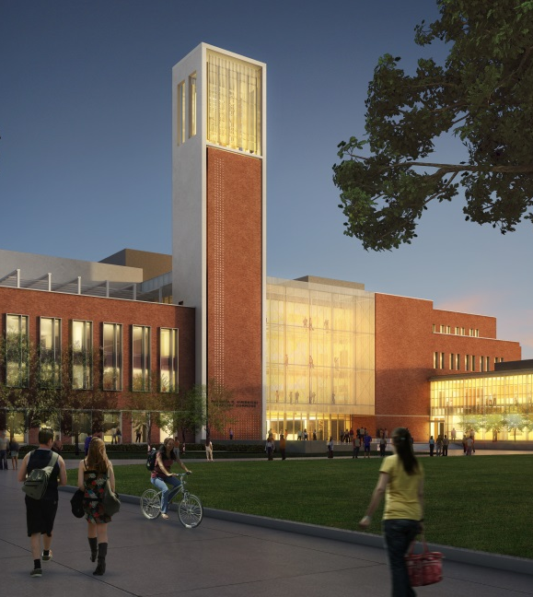
Salisbury University
Founded 1925
8,000 FTE students
Library 1957, 1975
16 librarians, 27 total staff
216,000 books, journals, etc.
Nabb—excellent Delmarva collections, also University Archives
Notes:
Not quite so old as W&M! Salisbury University was established as a teachers’ college in 1925 and is now a regional comprehensive university with strong programs in health sciences, social work, business, and teaching. Nursing is, in fact, the biggest major. SU’s current library was built in 1957 and renovated in 1975., The new library, pictured above on the campus quad side, is set to open in 2016 and will triple the size of the current library space. The staff and collections are obviously considerably smaller than W&M’s. The Nabb Research Center for Delmarva History and Culture was established in 1987 and has an active program of exhibits, lectures, etc., as well as archives.

Slide 8
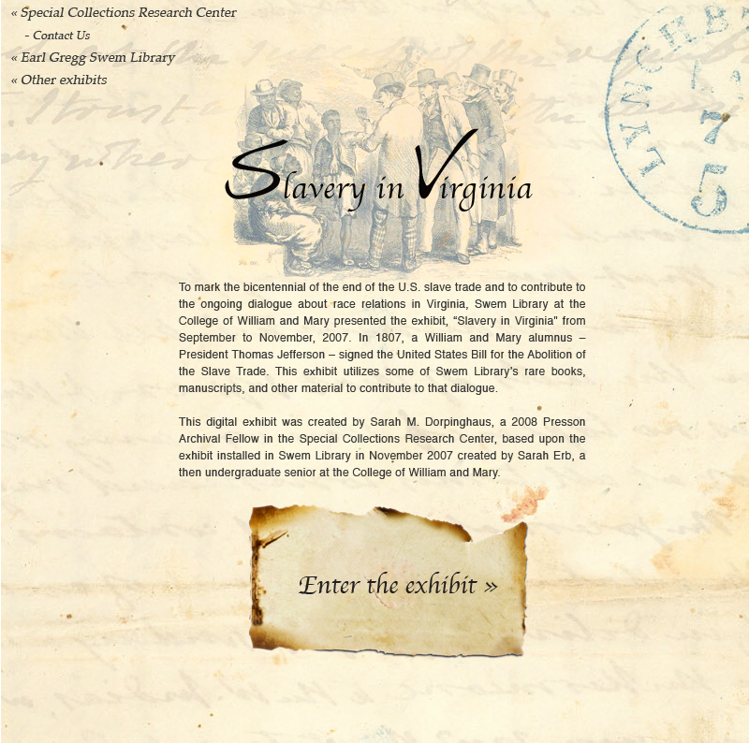
History of W&M Exhibit Lab Student intern summer project 2007
Notes:
The then-dean of libraries at W&M, Connie McCarthy, wanted to show support for the undergraduate summer research program at W&M and came up with the idea of sponsoring a student to create an exhibit. We had a competition, and Sarah Erb’s proposal to do an exhibit on slavery in Virginia won. She spent the summer working with Chandi Singer, former Burger Archives Specialist, and Bea Hardy to create the exhibit. A later Presson Archival Fellow created the online exhibit, based on Sarah’s exhibit. Working with a student in this intensive fashion turned out to be even more work than if we’d just done the exhibit ourselves, but seeing what an intellectual workout it was for Sarah and how much she got out of it inspired us to think about having classes create exhibits.

Slide 9
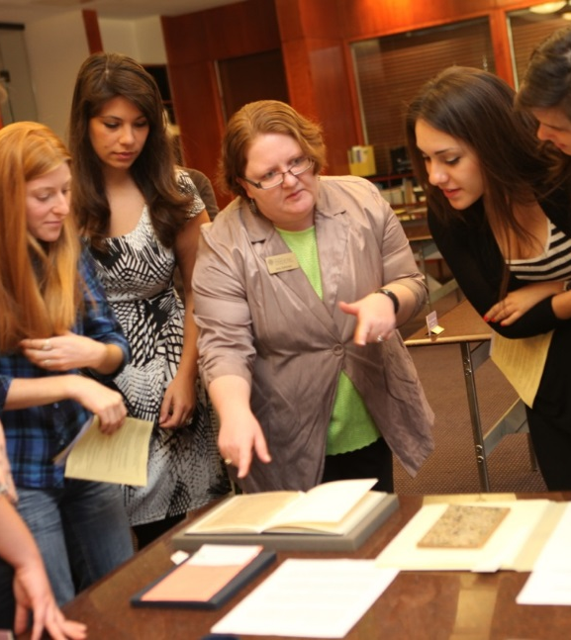
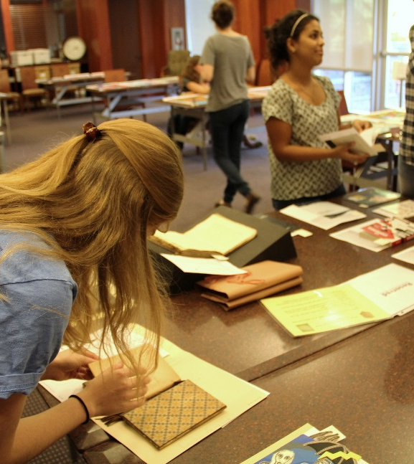
Push to increase use of SCRC
Notes:
Meanwhile, we were pushing to greatly increase the number of students and faculty taking advantage of the SCRC. Initially, many of the classes just came for a “show and tell” session, but we wanted to get people to do assignments using our collections. Pushing exhibits was a natural outgrowth of that.

Slide 10
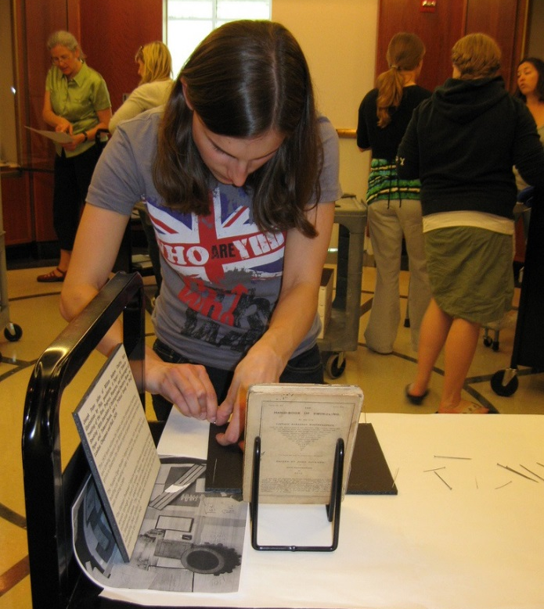
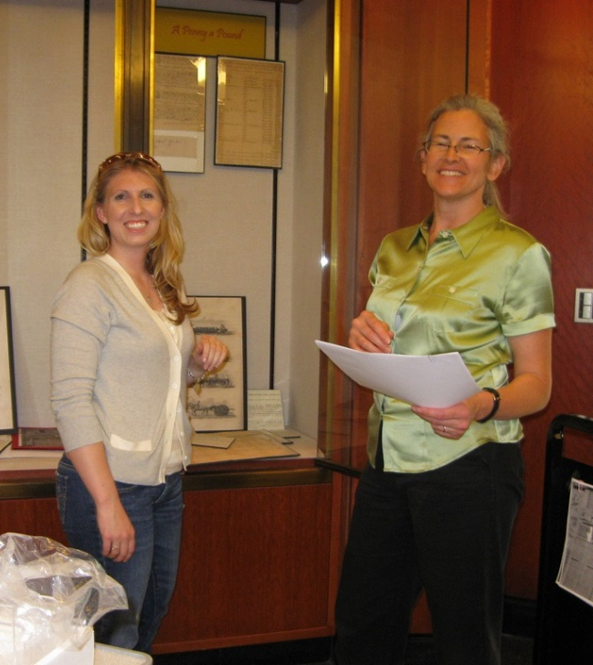
First class-curated exhibit A Large and Curious History: Tobacco at the College of W&M, 2010
Notes:
This was the first exhibit done by a class—Susan Kern’s NIAHD Field School in Material Culture class (HIST 491/591) in spring 2010. That’s Susan on the right. The class worked with former University Archivist Amy Schindler and Chandi Singer and installed the exhibit themselves.

Slide 11
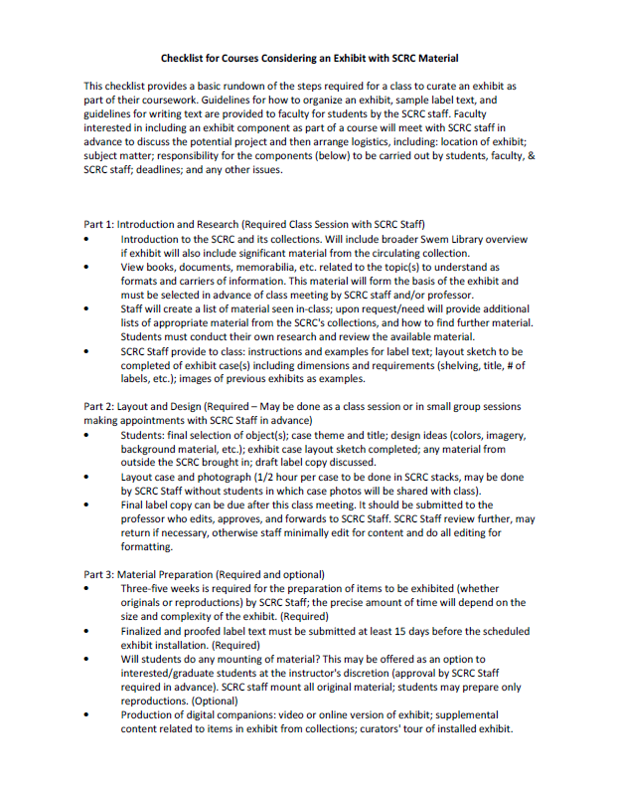
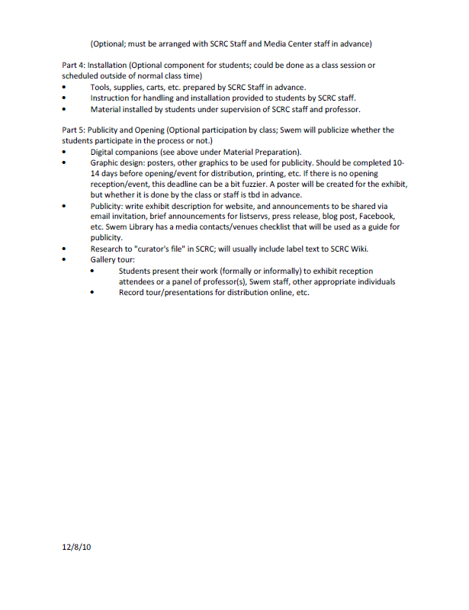
Planning
Notes:
Planning for a class-curated exhibit must start months before the class begins. For many professors, including an exhibit project requires a major reworking of their syllabus for existing courses. We typically meet with an interested professor the semester before and develop a checklist of who will be responsible for what portions of the exhibit, a timeline for when components will be completed, and course readings on exhibits and interpretation for students. Special Collections staff, in consultation with the professor, develop a list of related materials from our collections to help get students started with selected items for the exhibit.

Slide 12
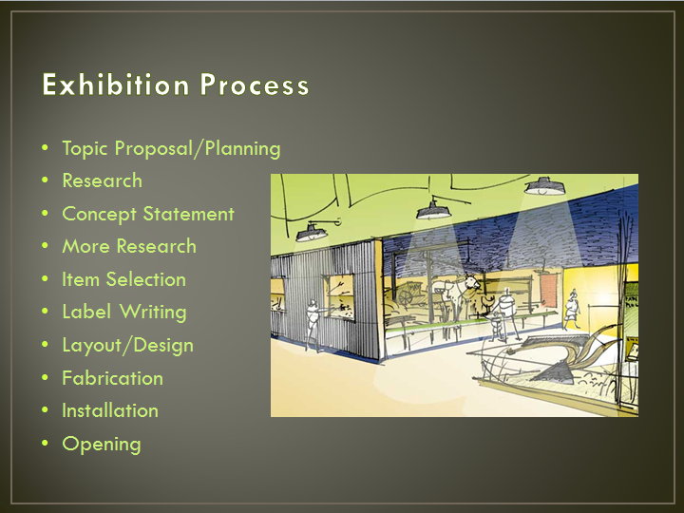
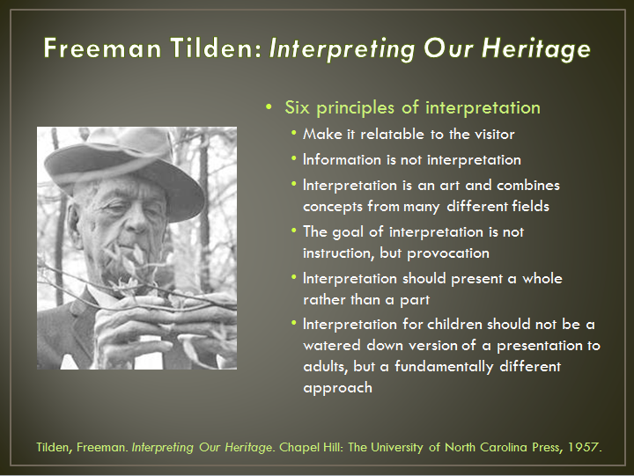
Introductory Session
Notes:
For each class, the first session in Special Collections is used to introduce our department and archival research to students as well as discuss exhibit development. Prior to this class session, we have students read selected portions of Beverly Serrell’s Exhibit Labels and Freeman Tilden’s Interpreting Our Heritage. Students take part in a primary source analysis activity using archival materials related to the course topic, which could be potentially used in the exhibit. If time allows, we have the students critique one of our current exhibits.

Slide 13
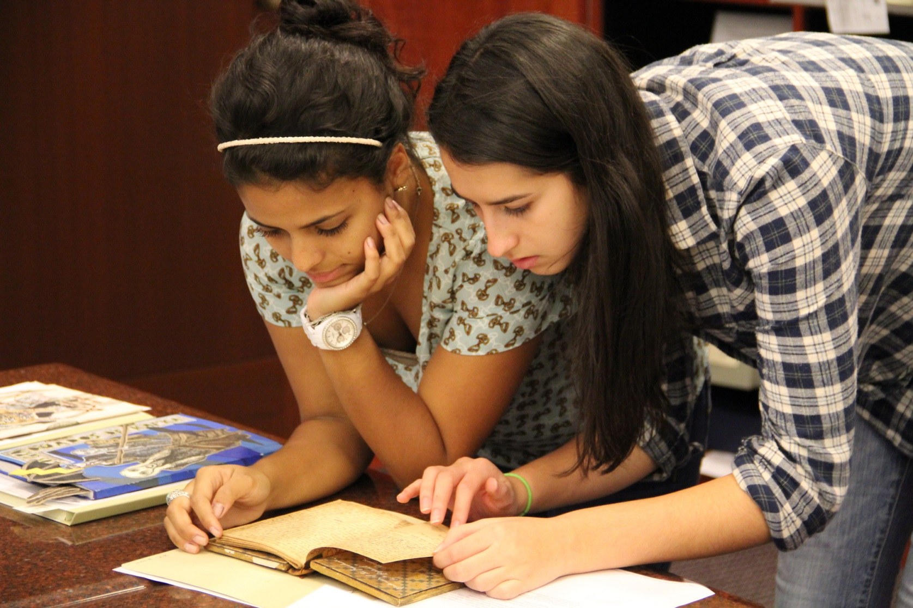
Class work sessions
Notes:
We suggest that professors schedule workdays in the archives to ensure students have time to meet with their groups during the operating hours of the archives. We suggest that students should provide written summaries of their research experiences in the archives to the professor and us to ensure they are on track with their research and are actually putting in adequate time early in the semester. Requiring smaller scaffolded assignments helps students learn to manage their time and projects effective.

Slide 14
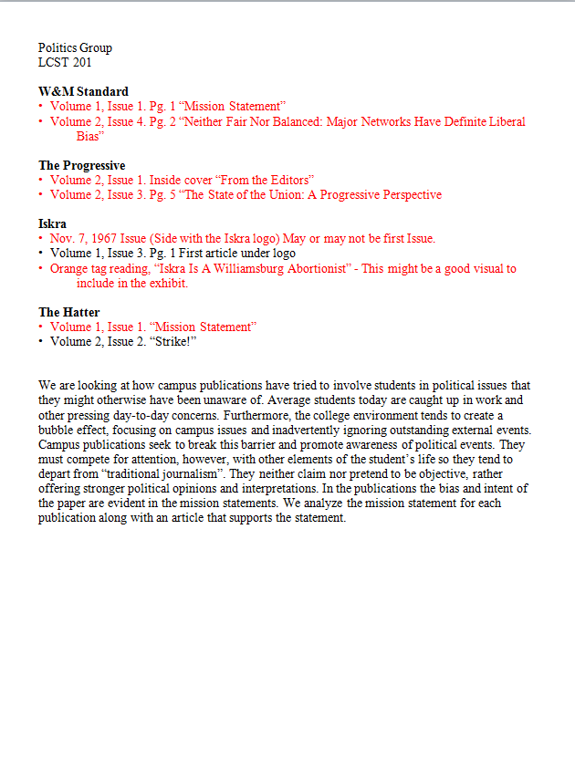
Group Proposals and Item Selection
Notes:
Individual student group meetings are scheduled with staff and faculty for the students to present and solicit feedback on potential themes in their section of the exhibit, items to be included, and suggestions for design elements. We require the object list to be submitted earlier in the semester so staff can have adequate time to prepare original materials or make reproductions.

Slide 15
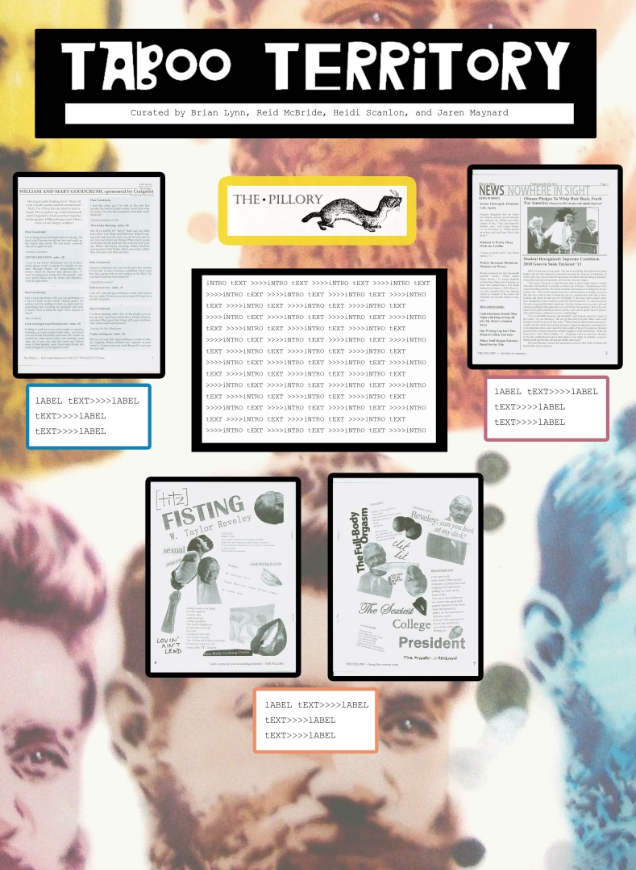
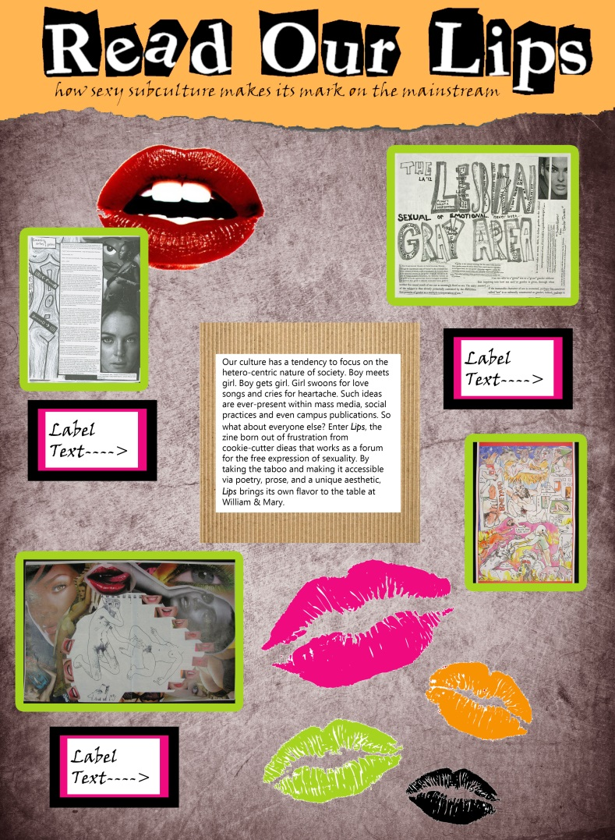
Design Drafts
Notes:
After the first class-curated exhibit, the exhibits have been designed and installed by library staff. Prior to Jennie Davy’s arrival, the graphic elements were designed by a library graphic designer who had not worked with the class. Since then, Jennie has taken over the design of exhibits, and by working directly with the class, she try to create visuals that better match the themes and visions of the student curators. Once students have submitted their proposals and item selections, Jennie works on developing design drafts for each section of the exhibit to be shared with the student curators for feedback and suggestions.

Slide 16
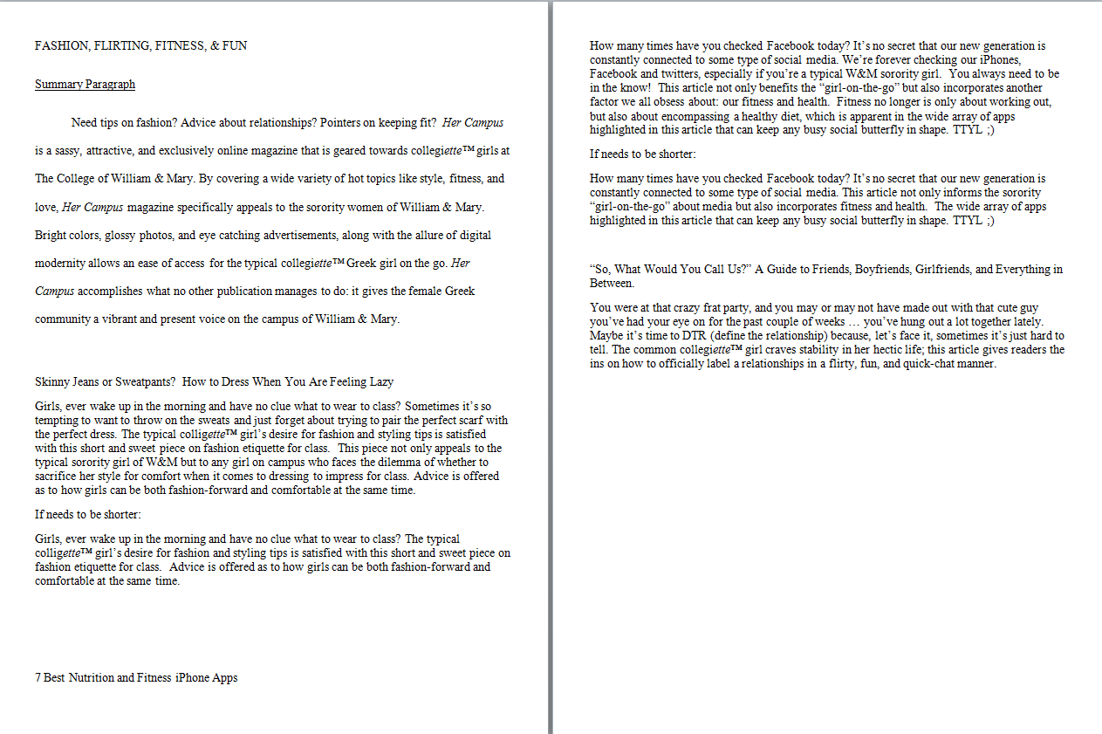
Labels
Notes:
In working with students, we find that label writing is one of the hardest aspects of exhibit development for student curators. In earlier class curated exhibits, we simply provided examples of past exhibit labels, but found that students did not follow the example formats provided and we spend a good deal of time editing and reformatting the labels. We have started providing more in-depth instruction with label writing and adapted our label writing guidelines. We suggest that professors require label writing and editing exercises to help students gain confidence in their writing for a public audience. Students should first write out all of the important ideas and aspects they want to cover related to an object or topic without consideration for word count. They then write several iterative drafts working to cutout superfluous words and ideas until they create a concise, meaningful label that fits the suggested word count and reading level guidelines. Labels are submitted to the professor, who approves them and submits them to us. One staff member proofs the labels for grammatical errors, but otherwise leaves the labels untouched for content and interpretation. We label all student-curated exhibits with the names of the students and class to indicate to the public that the interpretation is that of students and not of the library itself.

Slide 17
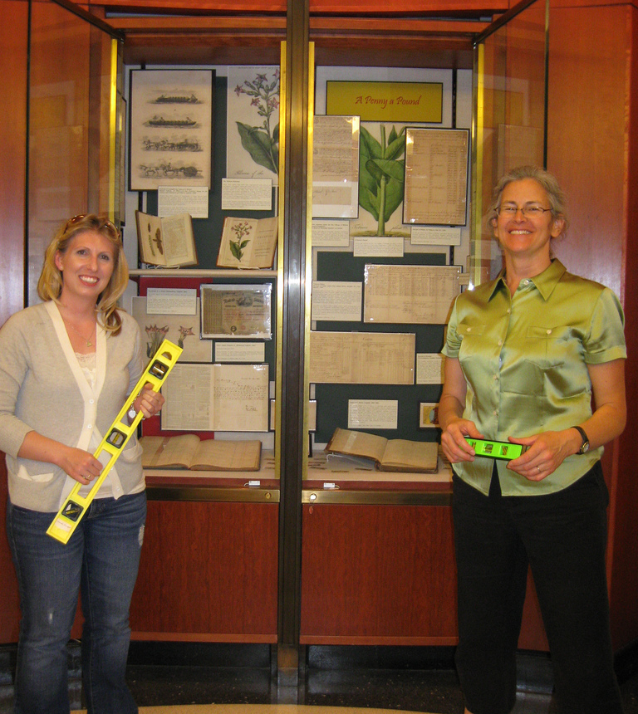
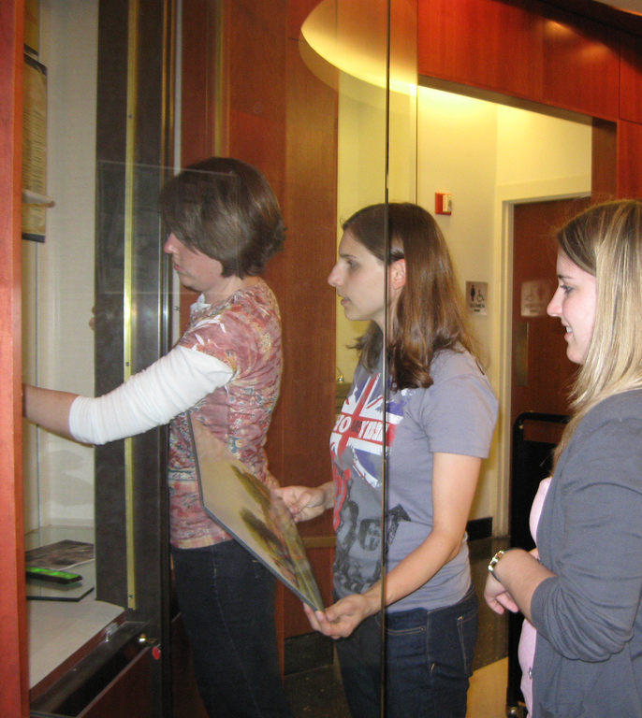
Fabrication and Installation
Notes:
As previously mentioned, the first class-curated exhibit was the only exhibit in which students assisted with the fabrication and installation. Professor Kern’s students each mounted one reproduction, while all original materials were prepared by library staff. 2 staff members and one graduate assistant were on hand during the final class session to guide students in installation.

Slide 18
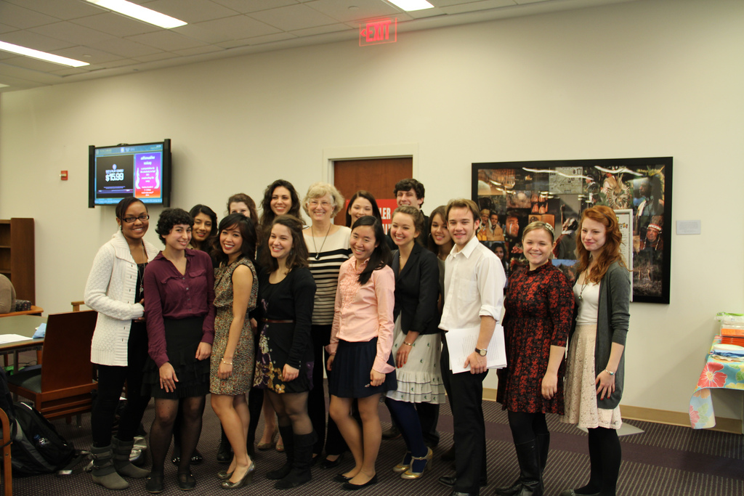
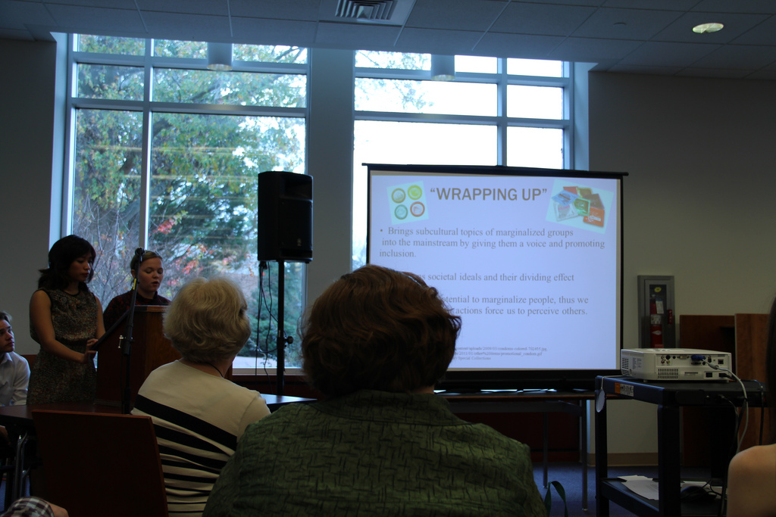
Presentations and Opening Receptions
Notes:
Student curators typically present or do a gallery talk in an opening reception at the end of the semester. This provides a great opportunity to showcase the students’ research and learning to the greater campus community and our library colleagues.

Slide 19
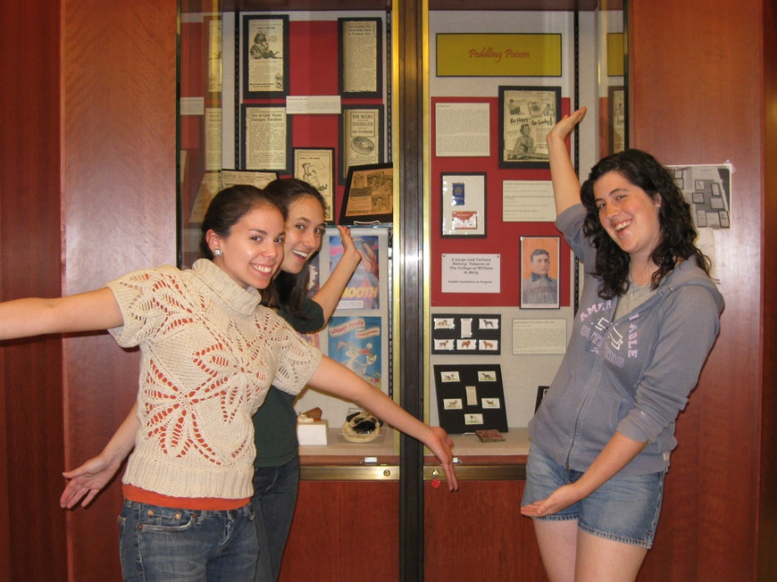
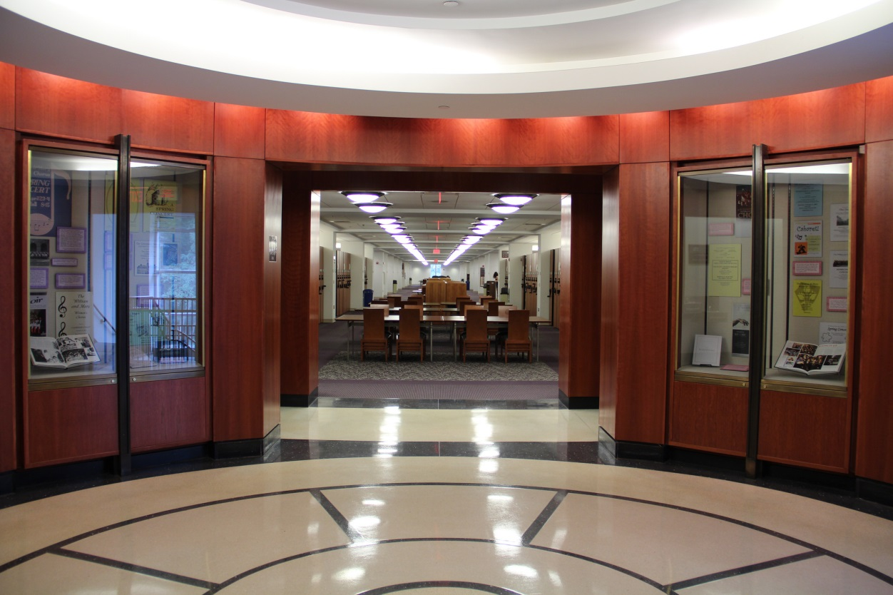
W&M Exhibit Spaces
Rotunda Galleries
Notes:
Swem Library has three floors of build-in exhibit cases at the entrance to the Special Collections wing from the rest of the library. These exhibit cases are also used for staff-curated exhibits of Special Collections material and a rotating exhibit of faculty publications.

Slide 20
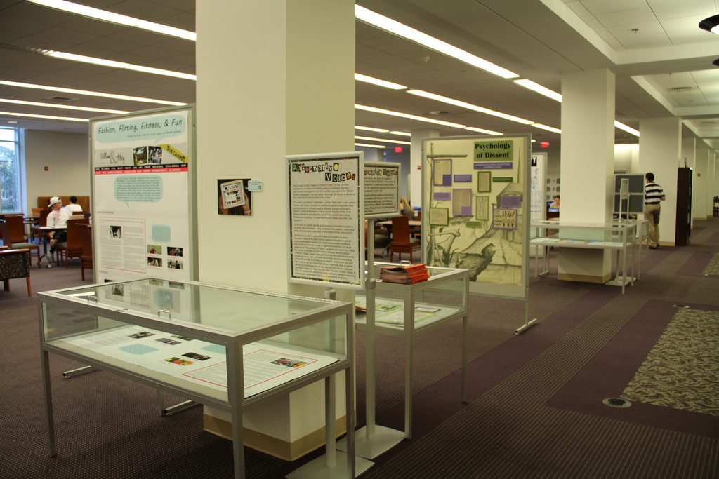
W&M Exhibit Spaces
Margaret Baxter Vaughan Read & Relax Area
Notes:
The Read & Relax area, which is a large open space with tables and chairs on our first floor, is one of the most popular spaces for group work and socializing in the library. We use the space for temporary exhibits using movable upright panels, which accept straight pins and velcro, and flat table-base cases.

Slide 21
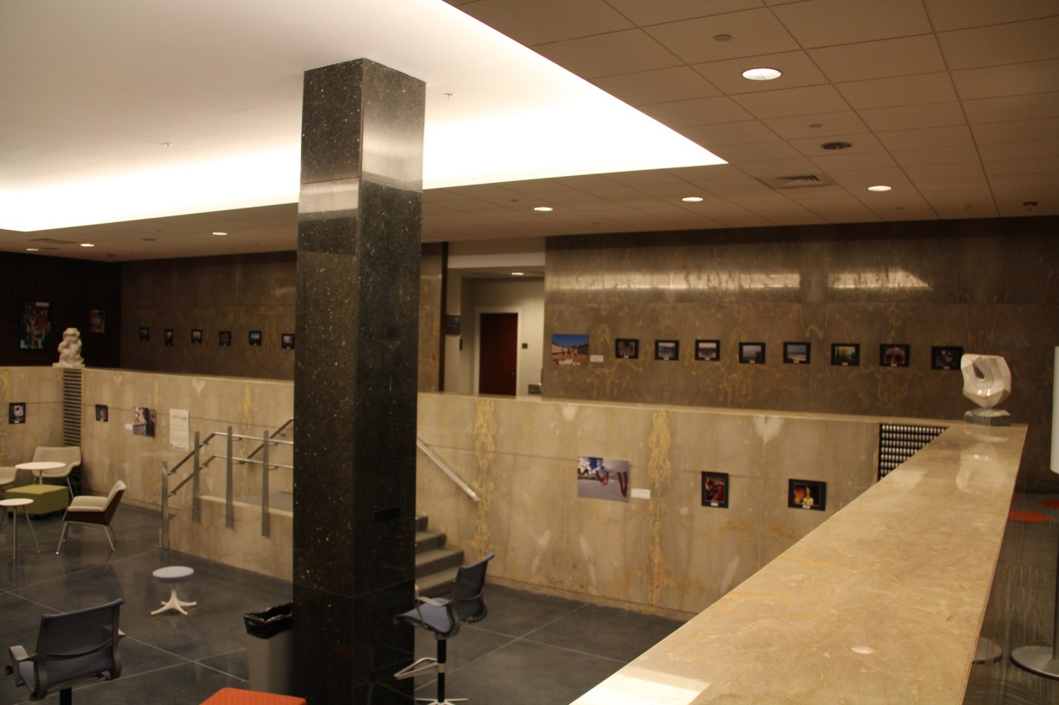
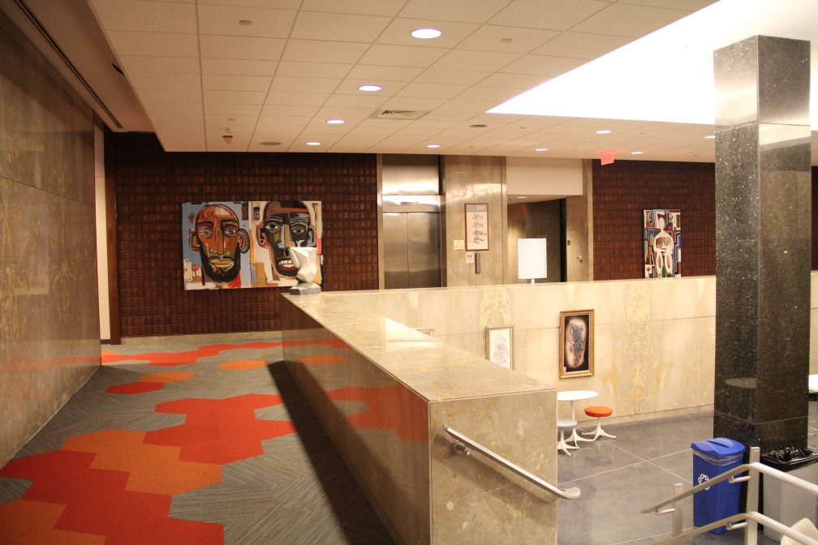
W&M Exhibit Spaces
Botetourt Gallery
Notes:
The Botetourt Gallery is located in our ground floor adjacent to our newly renovated Reeder Media Center. Prior to the renovation, the upper portion of the gallery featured a permanent display of portraits from the university’s art collection, but since the renovation, we have used the space as a rotating gallery for university and community exhibits.

Slide 22
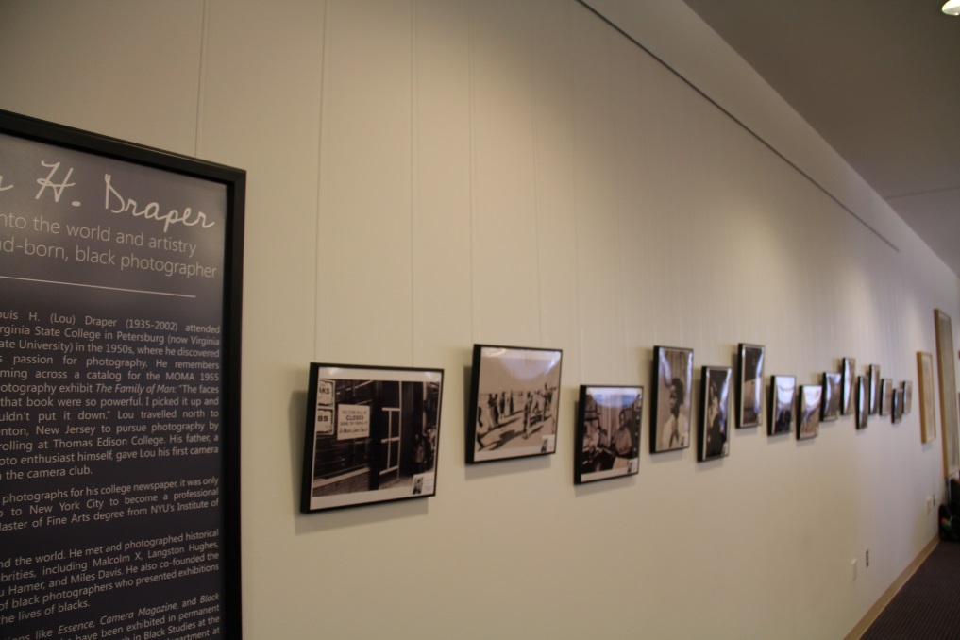
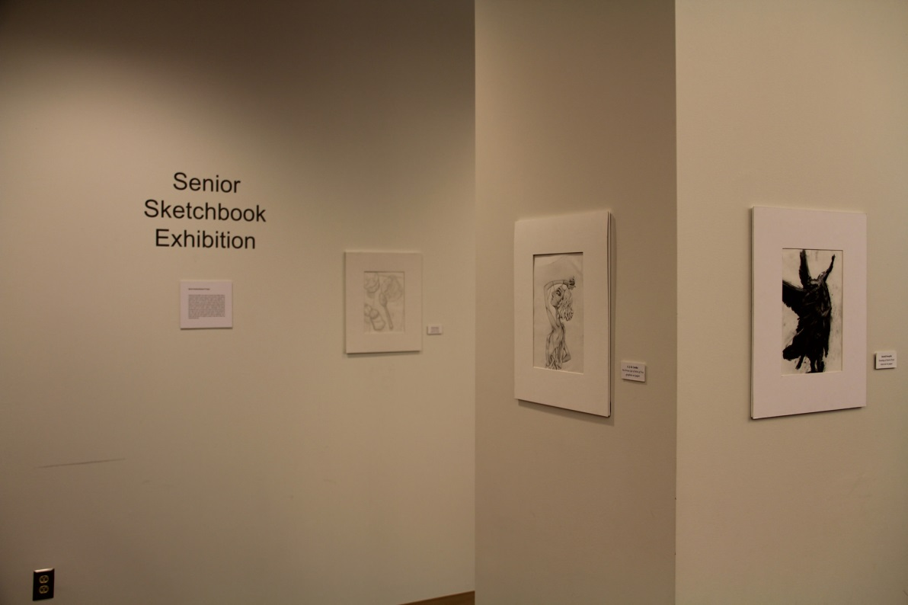
W&M Exhibit Spaces
Swem Library Lobby
Notes:
To the side of Swem Library’s entrance, our newest exhibit space uses a discrete hanging system from Absolute Museum and Gallery Products for the display of two dimensional pieces of artwork without damage to our walls.

Slide 23
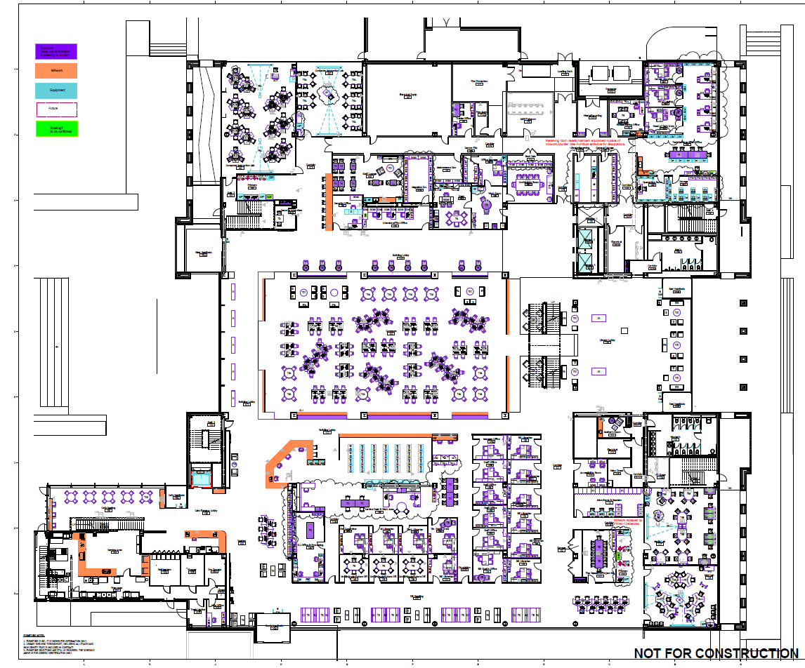
Salisbury University Planned First Floor Exhibit Area
Street and parking lot side
Campus Quad side
Large lobby area meant for rotating exhibits—open area is ca 900 sq. ft., not counting walkways from entrances
Entrance
Entrance
Notes:
The Academic Commons (aka the new library) at SU has several large exhibit spaces. On the first floor, by the main public entrance to the building, there is a large open area (right side of the floor plan). Because the area may be used for events such as receptions, it will be easily reconfigurable. There will be no built-in cases in this space but are purchasing various exhibit cases and modular display panels that can be used here. We are not likely to have many originals on display here, because there is no light control. This will be a heavily trafficked area and very visible and is meant to be used much the way the Read-and-Relax area is at W&M.

Slide 24
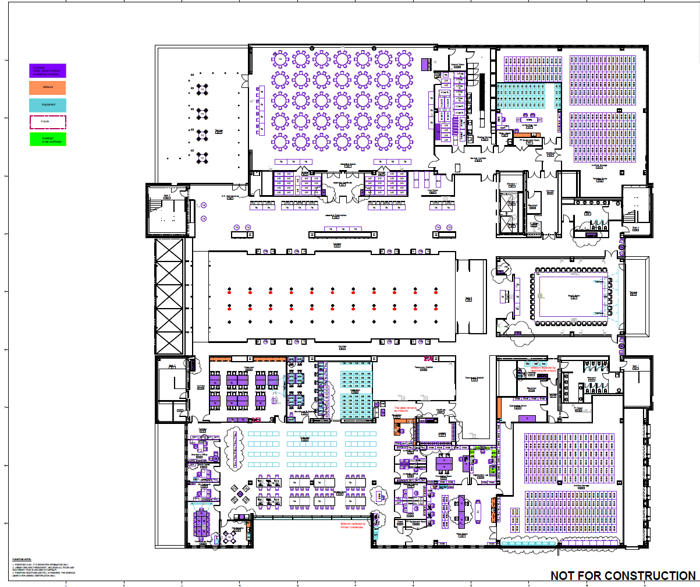
SU Fourth Floor Exhibit Areas
Assembly Space
Semi-permanent exhibit
Temporary exhibits
Board Room
Entrance to Nabb Center
Notes:
There are two major exhibit spaces on the fourth floor, both intended primarily for use of the Nabb Center for Delmarva History and Culture (which will include University Archives and Special Collections). These spaces are just outside the entrance to the Nabb Center. There are two major public meeting rooms on this floor—the Assembly Space which can seat 350 at round tables and more auditorium-style and the Board Room. Both will be used for campus and public events. We put the exhibits outside the Nabb Center so that they would be available to people attending events on the 4th floor, whether or not the Nabb Center itself is open.

Slide 25
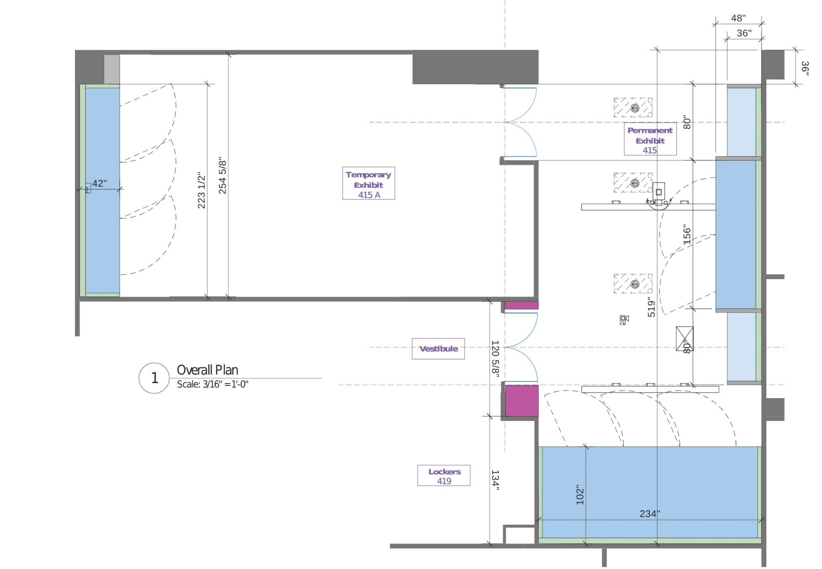
SU Fourth Floor Exhibit Areas with Entrance Route to Nabb Center marked
Temporary Exhibit Ca 800 sq ft
Semi-permanent
Exhibit Ca 650 sq ft
Nabb Entrance
Notes:
This is a more detailed view of the spaces. The main entrance route to the Nabb Center runs through the semi-permanent exhibit space. This exhibit is intended to highlight the different subject areas of the Nabb Center’s collections. On the wall on the right, there will be two horizontal cases flanking a floor-to-ceiling built-in case. At the bottom of the space will be a very deep (five feet) case extending the width of the exhibit area where we will display the types of possessions listed in a typical mid-19th century inventory for our local area. This area does have proper exhibit lighting which will be motion-activated. The temporary exhibit space is quite large but only has a built-in floor-to-ceiling case on the left wall. Otherwise, like the first-floor exhibit space, it is meant to be very flexible and is intended to host student-created exhibits.

Slide 26

Making SU exhibit space student-friendly
Very flexible spaces
Variety of cases and modular panels
4th floor space can be closed off for installation, ceiling hanging, power/network
http://www.mbawalls.com/mila_panel3c4.jpg
Notes:
We are purchasing a variety of vertical and horizontal cases to move around the building as needed. In addition, we are buying modular panels that can stand on their own or are quickly linked. These will be used in either the 1st floor space or the 4th floor temporary exhibit area. The temporary exhibit area can be closed off easily while exhibits are being installed or taken down, to avoid annoying library users with the noise as sometimes happens at W&M. The ceiling in the temporary exhibit area is designed to have banners or other items hanging from it, to allow maximum flexibility for student creativity in designing the exhibits. And there is plenty of power if we need electricity, we have monitors in the exhibit spaces that can be used to display videos on the walls, and we have both wired and wireless access if we want to provide interactive electronic displays.

Slide 27
Impact
Student Feedback
“I really enjoyed participating in the creation of the exhibits for Swem. I thought it was really neat that we were working as a class to create something would be showcased in the library at the end of the semester.”
Notes:
Feedback from students show that many of them were previously unaware of special collections, its holdings, and availability for undergraduate researchers. Students had generally positive responses to the exhibit project in their evaluation.

Slide 28
Impact
Faculty Feedback
“The exhibits were an excellent way to reinforce classroom learning and give students a real-life opportunity to showcase their work.”
Notes:
Feedback from faculty members about their experiences has also been overwhelmingly positive, with word-of-mouth being the most effective way of recruiting new faculty members for class-curated exhibits.

Slide 29
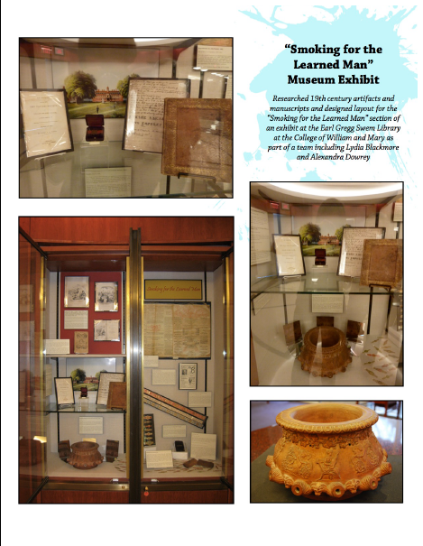
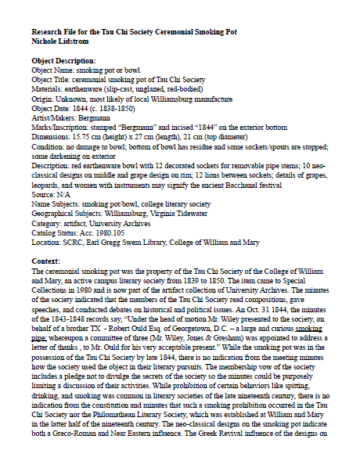
Impact on Student Learning and Careers
Notes:
Bea found these pages documenting an alumna’s work on the tobacco exhibit in her online portfolio on Weebly. She participated in the first class-curated exhibit and is now a writer partnering with organizations such as museums.

Slide 30
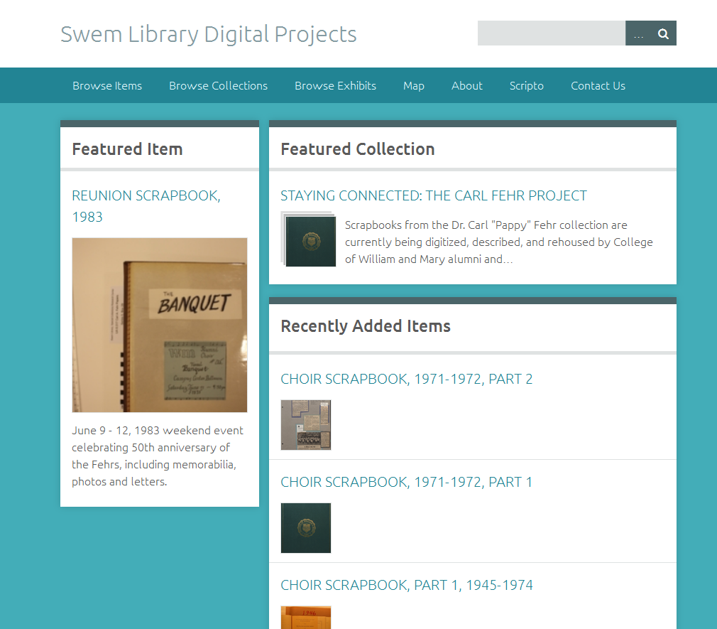
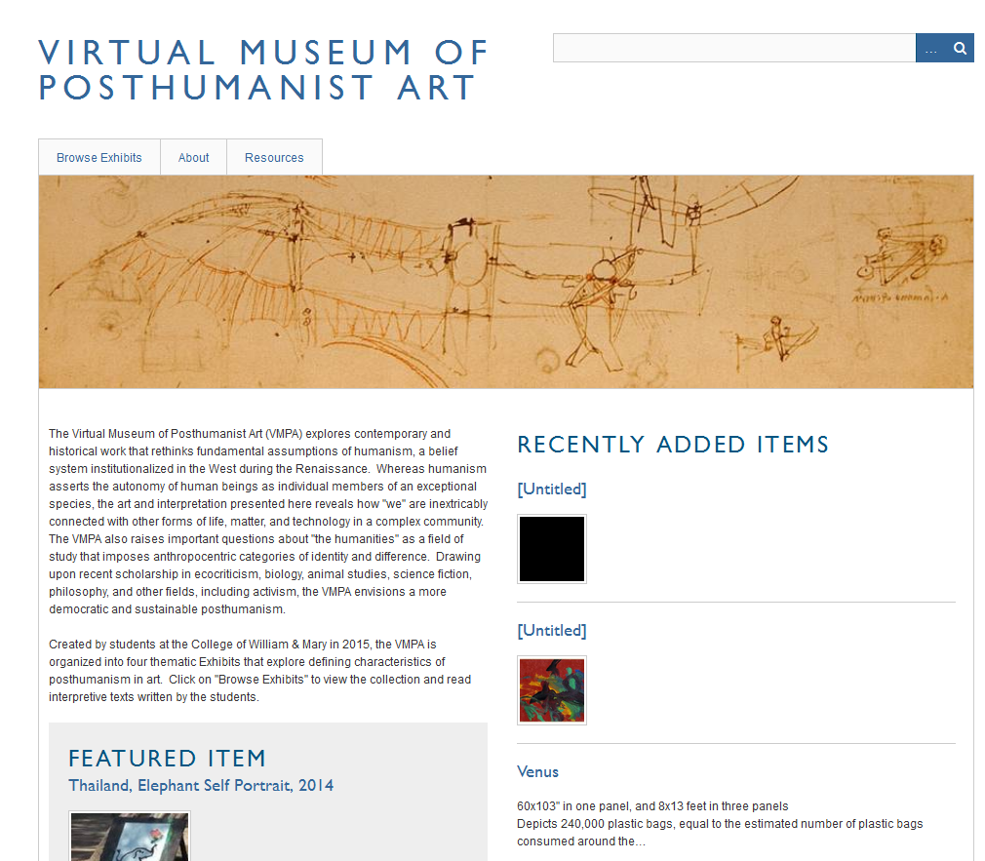

Next Steps
Notes:
In the future, we would like to work more with classes to develop online exhibits of our materials using Omeka. Our current installation of Omeka has been used for a Civil War transcription project and a volunteer project documenting the W&M choir. In the Spring semester, W&M Arts Librarian Kathleen DeLaurenti worked with Art History Professor Alan Braddock and his class to create a virtual museum of posthumanist art using a hosted Omeka site. Kathleen used the class exhibit as an opportunity to teach about copyright and permissions.

Slide 31
Contact Us
Bea Hardy
Salisbury University
Dean of Libraries
bbhardy@salisbury.edu
410-543-6133
Jennie Davy
William & Mary
Burger Archives Specialist
jadavy@wm.edu
757-221-3062
Images, except where noted, are from a variety of William & Mary and Salisbury University
social media and other institutional sources.
This work is licensed under a Creative Commons Attribution-ShareAlike 3.0 United States License.

