Slide 1

Accessibility Training Module for Web Editors
Notes:
(Title Slide)
This training will address web accessibility for web editors and content creators.

Slide 2
1.3 Billion People worldwide have a disability
Notes:
(#1 – Gaining Attention)
According to the World Health Organization approximately 1.3 billion people worldwide have a significant disability. That is approximately 17% of the population.

Slide 3
1 in 2 people over the age of 65 have some sort of disability
Notes:
(#1 – Gaining Attention)
As people age, the likelihood that they develop a disability increases. For people 65 and over, half of the population has some form of disability.

Slide 4
Accessibility Overview:
What is Accessibility
Why Accessibility is Important
Role of the Web Editor and/or Content Creator
Notes:
(#2 – Goals)
The training will begin with a brief overview. We will discuss accessibility, why it is important, and your role in creating accessible web content.

Slide 5
Training Objectives:
Headings and the H1 tag
Alt Text and Images
Link Text
Lists
Video captions, Transcripts, and Alt Text
Accessibility Best Practices
Notes:
(#2 – Goals)
By the end of this training, you should understand the importance of and know how to implement headings, the H1 tag, alt text, images, link text, lists, video captions, and transcripts. You should also understand accessibility best practices.

Slide 6
Accessibility – What is it?
Notes:
(#3 Recall - Section Header)
Let’s dive in, what is accessibility?

Slide 7
What is Accessibility?
Accessibility means that everyone regardless of ability can have an equivalent experience.
Accessibility is about removing barriers. It is about creating opportunities for everyone.
Notes:
(#3 – Recall)
So, what is accessibility?
Accessibility means that everyone regardless of ability can have an equivalent experience.
Accessibility is about removing barriers. It is about creating opportunities for everyone.

Slide 8
Accessibility is about turning “I can’t” moments
Into “I can” moments.
Notes:
(#3 – Recall) Think about this sentence. Accessibility is about turning “I can’t” moments into I can” moments.
When people struggle with and become frustrated by a website, they leave the site. As a web editor, you need to turn the “I can’t” moments into “I can” moments. If people are successful on your website, they will return to the site.

Slide 9
Why is accessibility important?
Notes:
(#3 - Recall)
Why is accessibility important?

Slide 10
Recall information on accessibility
When a website is accessible, everyone can use the website.
Following accessibility principles while building web pages, opens the web up to people who use assistive or adaptive technology.
Assistive or adaptive technology allow people with disabilities that affect seeing, hearing, motor skills, or cognitive abilities to use the web.
Notes:
(#3 - Recall)
When a website is accessible, everyone can use the website.
Following accessibility principles while building web pages, opens the web up to people who use assistive or adaptive technology.
Assistive or adaptive technology allow people with disabilities that affect seeing, hearing, motor skills, or cognitive abilities to use the web.

Slide 11






Disabilities can be, temporary, situational, or permanent
Notes:
(#3 - Recall)
Disabilities can be, temporary, situational, or permanent
A person caring for a child, using a cellular device in bright sunshine, or being in a very loud environment would be examples of situational disabilities. Someone with a broken arm or an eye infection would be an example of a temporary disability. A person with complete blindness, dyslexia, or Parkinsons disease would be examples of permanent disabilities.

Slide 12
Examples of permanent disabilities that rely on assistive or adaptive technology:
  Vision
  Completely or partially blind
  Color blind – red/green, blue/yellow, complete
  Auditory
  Deaf
  Cognitive Issues
  Dyslexic, Reading Disabilities
  ADHD
  Traumatic Brain Injury
  Learning Disabilities
  Memory Impairments
  Motor
  Quadriplegic
  Parkinsons
  Stroke victims
  Essential Tremor
Notes:
(#3 - Recall)
As a web editor, the accessible content that you create will allow people who rely on assistive or adaptive technology to use your website. Examples of permanent disabilities include complete or partial blindness, deafness, ADHD, and essential tremor.

Slide 13
Examples of assistive and adaptive technology:
  screen readers
  screen magnification
  captions
  transcripts
  mouth wands
  Text to braille conversion
  Speech-to-text
  Text-to-speech
Notes:
(#3 - Recall)
Assistive and adaptive technology allow people with disabilities to access the web in various ways. Examples of assistive and adaptive technology include screen readers, screen magnification, captions, transcripts, mouth wands, text to braille conversion, speech-to-text, and text-to-speech.

Slide 14
Accessibility and the Law:
Accessibility is the law.
The Americans with Disabilities Act (ADA) applies to websites.
Additionally, website accessibility is a priority for the Department of Justice. In April 2024, the DOJ released new guidance for website accessibility, and they reference both Section 508 of the Rehabilitation Act of 1973 and the Website Content Accessibility Guideline (WCAG) as references for accessibility best practices.
Notes:
(#3 - Recall)
One final reason to ensure an accessible website is that accessibility is the law. The Americans with Disabilities Act applies to websites. The curb cuts on sidewalks and the ramps on businesses are equivalent to alt text and semantic code on a website. In April of 2024, the Department of Justice released new guidance for website accessibility and referenced both section 508 of the Rehabilitation Act of 1973 and the Website Content Accessibility Guidelines as a reference for accessibility best practices.

Slide 15
What can you do?
The role of a content creator or website editor in accessibility differs from that of the website developer and the designer. It is the responsibility of the content creator or website editor to ensure that all the content added to the website is accessible.
Notes:
(#3 - Recall)
What can you do?
Accessibility is the responsibility of everyone who works on a website. As a content creator or website editor you need to ensure that all the content that you add to a website is accessible.

Slide 16
Website Accessibility Training
Notes:
(#3 Recall - Section Header)

Slide 17
How do you make a website accessible?
WCAG 2 introduced four user focused principles for achieving website accessibility. These principles are Perceivable, Operable, Understandable, and Robust which spell out the acronym POUR. By understanding and implementing the POUR principles, website editors can remove barriers to website use for people with disabilities.
Notes:
(#3 - Recall)
WCAG 2 introduced four user focused principles for achieving website accessibility. These principles are Perceivable, Operable, Understandable, and Robust which spell out the acronym POUR. By understanding and implementing the POUR principles, website editors can remove barriers to website use for people with disabilities.

Slide 18
The POUR Principles
Perceivable – Content can be accessed by anyone. Content is presented in more than one way.
Operable – Content can be accessed with different technologies.
Understandable – Content can be understood by anyone.
Robust – Information is accessible across devices and web browsers.
Notes:
(#3 - Recall)
We will look at each of the POUR principles and the requirements. Then we will ask questions relative to the content.
Perceivable – Content can be accessed by anyone. Content is presented in more than one way. Have I included captions? Do I have alt text? Are there transcripts?
Operable – Content can be accessed with different technologies. Can someone using a screen reader understand this webpage? Do the links make sense?
Understandable – Content can be understood by anyone. Is this written at a 6th to 8th grade reading level? Is the content well organized? Have I used the proper code for each element on the page?
Robust – Information is accessible across devices and web browsers. Will this content present equally on a phone, tablet, or desktop computer?

Slide 19
Headings and the H1 Tag
Notes:
(#4 – Content)
Let’s move into the training and learn about headings and the H1 tag.

Slide 20
Headings and the H1 Tag
Headings are necessary to bring order to a web page.
Heading levels range from H1 (the page title) to H6.
Heading tags need to follow in order, H1, H2, H3, H4, H5, and H6. Although not all tags need to be used on all pages.
Notes:
(#4 – Content)
Headings bring order to a web page.
You can think of a webpage like a newspaper. There are titles and subtitles or headings and subheadings.
Heading levels range from H1 (the page title) to H6.
Heading tags need to follow in order, H1, H2, H3, H4, H5, and H6.
Not all tags will be used on all pages.

Slide 21
The Page Title - H1 Tag
The page title uses the H1 tag
All pages need an H1 tag, and they should be unique. Multiple pages with the title “About Us” will cause confusion for people using a screen reader to access the website.
Notes:
(#4 – Content)
The page title is the H1 heading. Every page needs a title, an H1 tag. Titles need to be unique. If you have multiple pages with the same title, it will be confusing to a person using a screen reader.

Slide 22
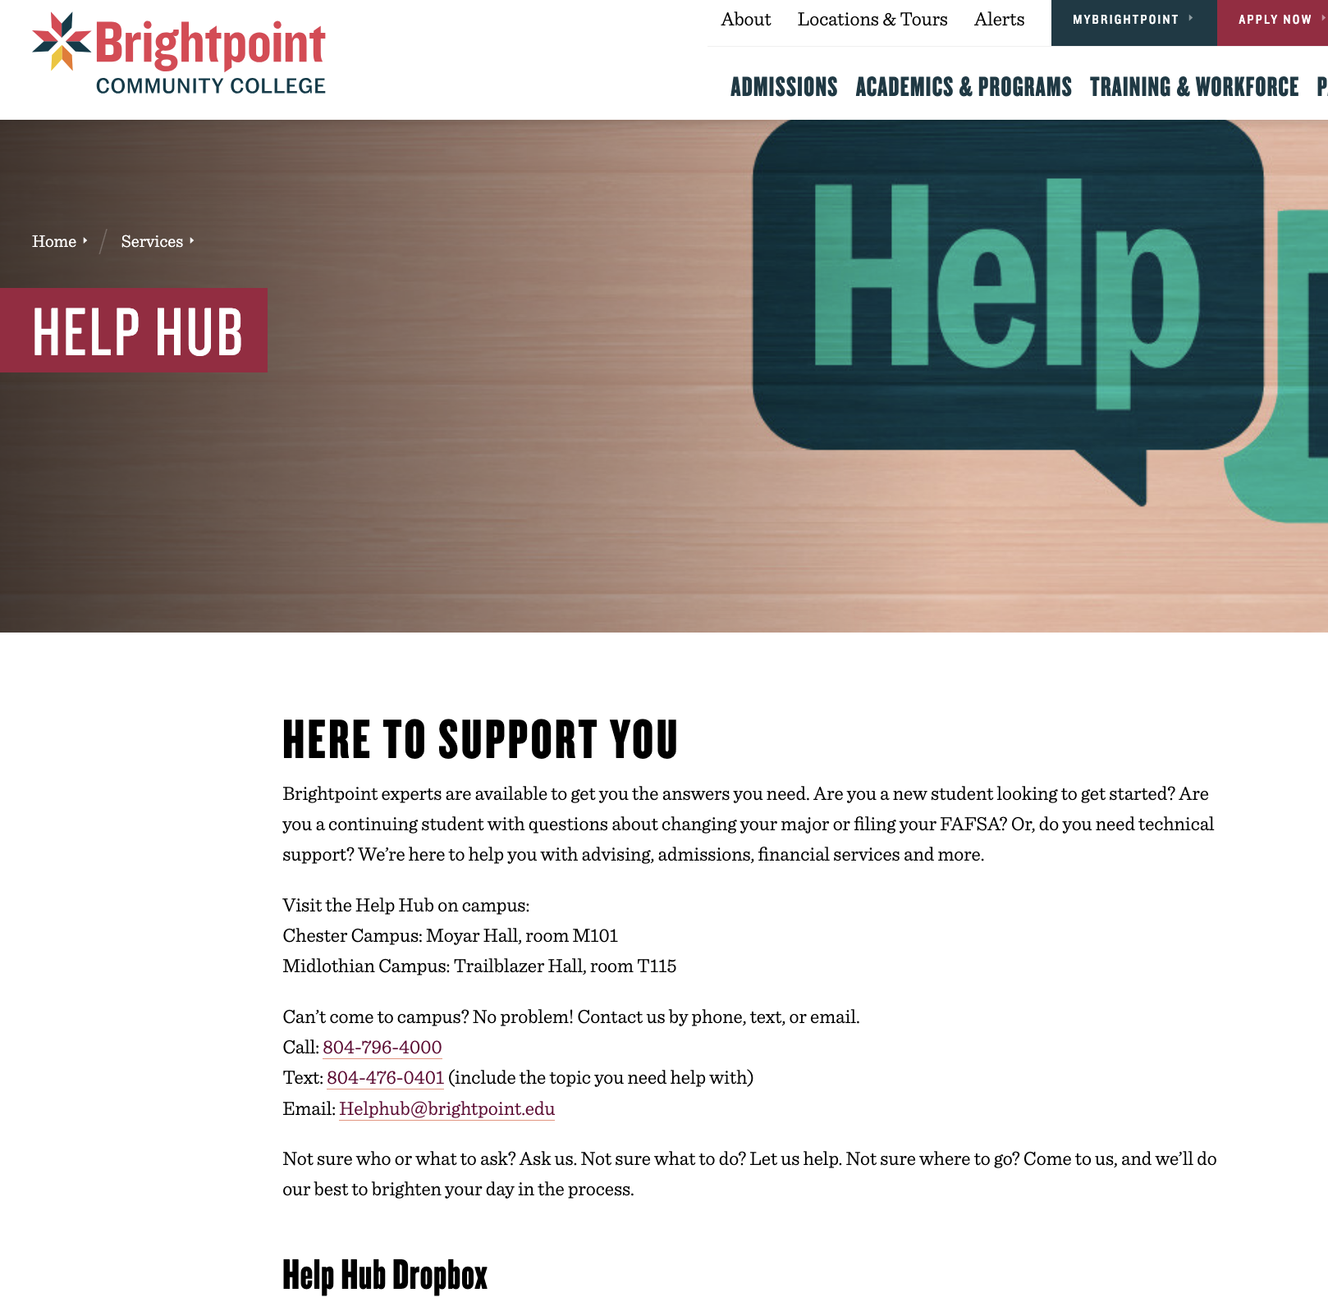
Headings on a Webpage
H1
H2
H3
Notes:
(#5 – Learning Guidance)
(The blue boxes with H1, H2, and H3 appear dynamically after a few seconds.)
For this webpage, let’s decide which headings are needed for this content.
The page title, the H1 tag, is Help Hub.
Heading level 2, the H2, would be the Here to Support You.
Heading Level 3, the H3, is Help Hub Dropbox.

Slide 23
Building a webpage with proper Headings
H1
Primates
H2
New World Monkeys
New World Monkeys are found in Mexico, Central America, and South America.
  Grey-legged Night Monkey
  Grey-legged Night Monkey can live 15-20 years. It eats fruit, nectar, insects, and leaves.
  Colombian Red Howler
  Colombian Red Howler has a lifespan of 15-25 years. It eats fruit, leaves, and flowers.
Old World Monkeys
Old World Monkeys are native to Africa and Asia.
  Allen’s Swamp Monkey
  Allen’s Swamp Monkey has a lifespan of approximately 23 years. It eats fruit, leaves, beetles, and worms.
H3
H3
H2
H3
Notes:
(#6 – Practice)
Now we will build a webpage using proper headings. Look at the content for this webpage. The page is about Primates. It discusses both Old and New World monkeys. It also discusses individual monkeys within these categories.
Which headings do you think are needed on this page? (The boxes with H1, H2, and H3 appear dynamically after 20+ seconds.)
Primates is the page title, the H1.
New World Monkeys and Old-World Monkeys are second level headings, the H2.
Finally, Grey-legged Night Monkey, Columbian Red Howler, and Allen’s Swamp Monkey are all H3s.

Slide 24
Coding a Heading Tag
The code for a heading tag is written using opening and closing angle brackets with the heading designation, <h1>Page Title</h1>.
<h1>Page Title</h1>
<h2>Heading Level 2</h2>
<h3> Heading Level 3</h3>
<h4> Heading Level 4</h4>
<h5> Heading Level 5</h5>
<h6> Heading Level 6</h6>
Notes:
(#4 – Content)
The HTML code for a heading tag uses the opening and closing angle brackets and the heading designation. Between the opening and closing heading tags you write the title.
A web developer will use CSS (cascading style sheets) to differentiate the importance of each tag. They will assign the individual headings various font weights, sizes, and sometimes colors to create the different heading level styles.

Slide 25
Best Practices for Headings
Headings are one way to navigate a page using a screen reader. It is important that the headings are structured properly. As screen readers read aloud the headings on the page, proper order of headings limits confusion.
Web page style is created using CSS (cascading style sheets) so headings should not be used to affect page design. (Don’t skip from H2 to H4 or H5 for aesthetic reasons.)
Notes:
(#4 – Content)
Web page style is created using CSS so headings should not be used to affect page design. (Don’t skip from H2 to H4 or H5 for aesthetic reasons.)
Headings are one way to navigate a page using a screen reader. It is important that the headings are structured properly. As screen readers read aloud the headings on the page, proper order of headings limits confusion.

Slide 26
Alt Text and Images
Notes:
(#4 – Content)
Alt text and Images

Slide 27
Alt Text and Images - Content
Alternative text (alt text) is used by screen readers.
Alt text is also displayed if images are not available.
Images that are decorative only should have null alt text.
Images that convey meaning need descriptive alt text.
Notes:
(#4 – Content)
Alternative text (alt text) is used by screen readers.
Alt text is also displayed if images are not available.
Images that are decorative only should have null alt text.
Images that convey meaning need descriptive alt text.

Slide 28
Descriptive Alt Text
Alt text (alternative text) should accurately describe the image or the information contained within the image.
Alt text should be clear and concise.
To determine the alt text, look at the image and ask questions, who, what, where, why, and how.
Then decide which answers provide critical information.
The alt text for complex graphs, maps, and diagrams will require greater detail.
Notes:
(#5 – Learning Guidance)
What is descriptive alt text?
Alt text (alternative text) should accurately describe the image or the information contained within the image.
Alt text should be clear and concise.
To determine the alt text, look at the image and ask questions, who, what, where, why, and how.
Then decide which answers provide critical information.
The alt text for complex graphs, maps, and diagrams will require greater detail.

Slide 29
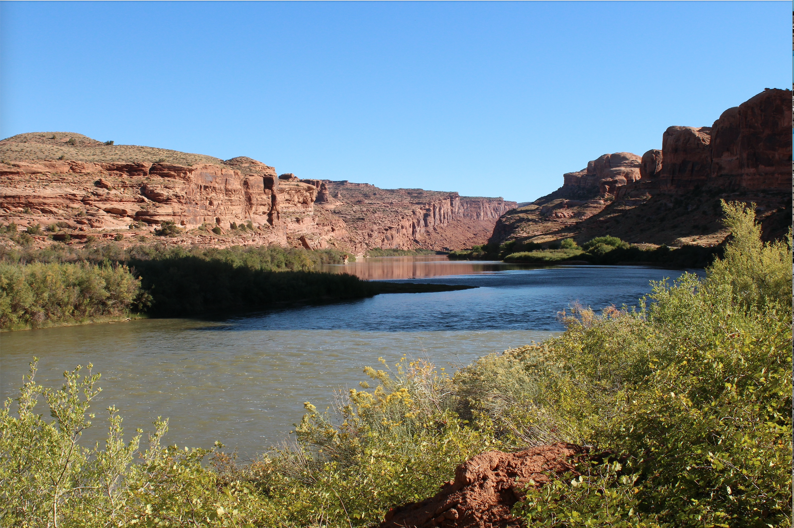
Writing Descriptive Alt Text
Start by asking questions:
What is this?
A river
What river?
The Colorado River
Where is it?
In Moab, Utah
The Colorado River in Moab, Utah would work as descriptive alt text for this image.
Notes:
(#6 – Practice)
(This page is dynamic. Each question followed by the answer appears in order. The final sentence appears last)
How do you write descriptive alt text?
You begin by asking questions.
(Q) What is this? (A) A river
(Q) What river? T(A) The Colorado Rover
(Q) Where is it? (A) In Moab, Utah
(A) The Colorado River in Moab, Utah would work as descriptive alt text for this image.

Slide 30
Coding for Images and Alt Text
<img src=”file name" alt=”Descriptive Text" width="500" height="600">
Examples
Null Alt Text – Assistive technology will skip this image, alt=“”
<img src=”Shenandoah_sunrise.jpg" alt=”" width="500" height="600">
Descriptive Alt Text – Assistive technology will read the alt text
<img src=”President_Schmoke.jpg" alt=”President Schmoke greeting students" width="500" height="600">
Notes:
(#4 – Content)
To code an image, you use the img tag. Which is a self closing tag. The parameters needed for the tag are the src – image file name, alt – the alt text, and width and height.
Null alt text has alt followed by the equals sign and empty quotation marks.
Descriptive alt text has alt followed by the equals sign and a description within the quotation marks.

Slide 31
Best Practices for Images and alt Text
Alt text should not contain the words “image of’, “picture of”, or “photograph of”. The screen reader alerts the user that an image is being described. If the phrase “image of” is used in the alt text, the screen reader will say “Image of, Image of …..”
Ideally, images will not have any words embedded in the image file.
If words are part of the image, all the words must be included in the alt text.
Images should have human readable file names. If alt text is missing, a screen reader will default to the image file name.
Notes:
(#4 – Content)
Alt text should not contain the words “image of’, “picture of”, or “photograph of”. The screen reader alerts the user that an image is being described. If the phrase “image of” is used in the alt text, the screen reader will say “Image of, Image of …..”
Ideally, images will not have any words embedded in the image file.
If words are part of the image, all the words must be included in the alt text.
Images should have human readable file names. If alt text is missing, a screen reader will default to the image fille name.

Slide 32
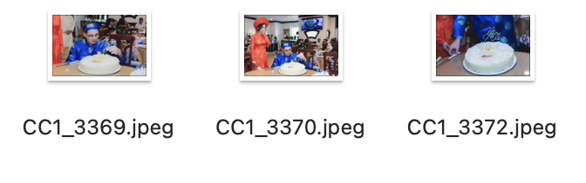
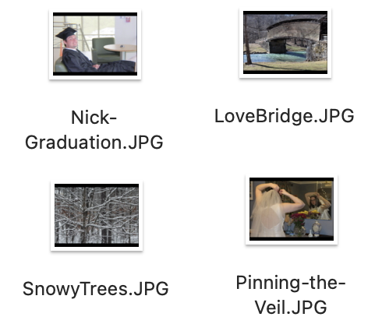
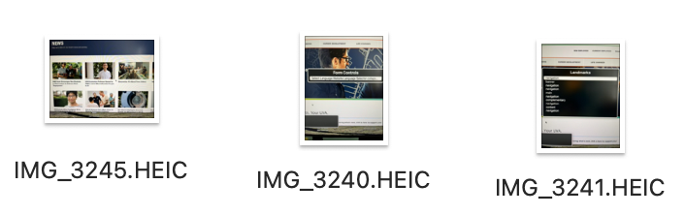
Examples of Image File Names
Camera Generated
Image File names
Human Readable
Image File names
Notes:
(#4 – Content)
What is a human readable file name?
The images on the left all have computer and I-phone generated file names. If these names were read aloud by a screen reader, the person hearing the file name would not know what the image contained.
The images on the right side of the screen have human readable file names. If a screen reader read “Snowy Trees” aloud, the person using the screen reader would understand the image.

Slide 33
Link Text
Notes:
(#4 - Content)
Let’s discuss Link Text

Slide 34
Link Text (Hyperlinks)
Link text is the text you click to move to another page, website, or to open a document.
Link text needs to be descriptive and have meaning.
For someone using a screen reader, quality link text is important as it lets the user know where each link leads. If all the links on the page are “click here”, a person using a screen reader will hear “Click Here, Click Here, Click Here, …” as they listen to the links on the page and they will not understand where any of the links lead.
Notes:
(#4 - Content)
Link Text also know as Hyperlinks
Link text is the text you click to move to another webpage, website, or to open a document.
Link text needs to be descriptive and have meaning.
For someone using a screen reader, quality link text is important as it lets the user know where each link leads. If all the links on the page are “click here”, a person using a screen reader will hear “Click Here, Click Here, Click Here, …” as they listen to the links on the page and they will not understand where any of the links lead.

Slide 35
Choosing Link Text (Hyperlinks)
Link text could be the title for an article or a sentence from a paragraph.
It is important to read through your sentences and choose the best text to include within the link.
Notes:
(#5 – Learning Guidance)
Choosing Link Text
Link text could be the title for an article or a sentence from a paragraph.
It is important to read through your sentences and choose the best text to include within the link.

Slide 36
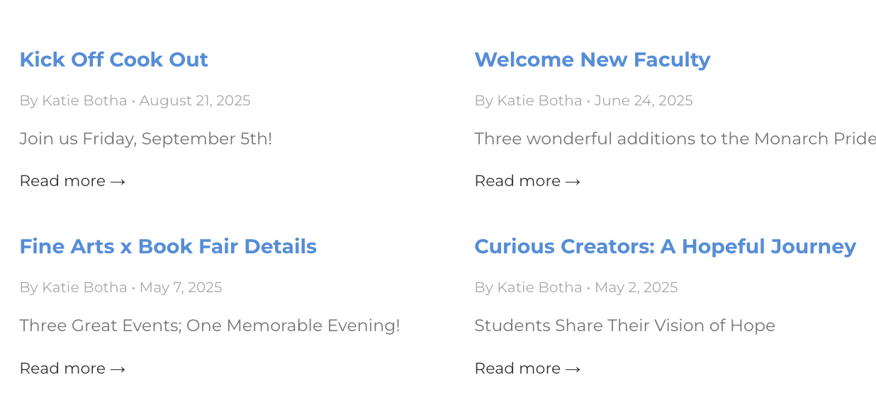
Examples of Link Text
Notes:
(#5 – Learning Guidance)
Let’s examine some link text examples
Kick Off Cook Out, Welcome New Faculty, Fine Arts x Book Fair Details, and Curious Creators: A Hopeful Journey are all article titles and are examples of good link text.
Read More, Read More, Read More, and Read More are examples of poor link text.

Slide 37
Determining Link Text
In the following paragraph, what text would make good link text?
Endangered animals can be listed as critically endangered, endangered, or vulnerable. The World Wildlife Fund maintains a species directory for endangered animals. Learn more.
Endangered animals?
The World Wildlife Fund?
Species directory for endangered animals?
Learn More?
Notes:
(#6 – Practice) (This page is dynamic. The four choices at the bottom and the green arrow appear after the text is read)
Read the following paragraph, what text do you think would make good link text?
Endangered animals can be listed as critically endangered, endangered, or vulnerable. The World Wildlife Fund maintains a species directory for endangered animals.
Endangered Animals?
The World Wildlife Fund?
Species directory for endangered animals?
Learn more?
Species directory for endangered animals makes the best link text for this content

Slide 38
Lists
Notes:
(#4 – Content)
What can we say about lists?

Slide 39
All About Lists
  Lists provide structure and order to content.
  A screen reader will announce the list and the number of items in the list.
  Lists need to use the list tag, and the list item tag.
  Avoid using numbers and dashes to make the content look like a list.
  Lists can be ordered, unordered, or description lists.
<ol></ol>
<ul></ul>
<dl></dl>
Ordered list tag
Unordered list tag
Description list tag
Notes:
(#4 – Content)
Lists
Lists provide structure and order to content.
A screen reader will announce the list and the number of items in the list.
Lists need to use the list tag, and the list item tag.
Avoid using numbers and dashes to make the content look like a list.
Lists can be ordered, unordered, or description lists.

Slide 40
Ordered Lists
    An ordered list has a defined sequence of steps.
    Code for an ordered list:
Washing Clothes List
Sort Laundry
Add Clothes to Washer
Add Soap
Choose Setting
Start Washer
<ol>
  <li></li>
  <li></li>
</ol>
Opening Ordered list tag
List Item Tags
Closing Ordered list tag
Notes:
(#5 – Learning Guidance)
An ordered list has a defined sequence of steps.
When doing a load of laundry, you need to sort your clothes before adding them to the washer.
(Discuss the code)

Slide 41
Unordered Lists
  An unordered list has no specific order.
  Code for an unordered list:
Shopping List
Eggs
Milk
Flour
Chocolate Chips
Sugar
Vanilla
<ul>
  <li></li>
  <li></li>
</ul>
Opening Unordered list tag
List Item Tags
Closing Unordered list tag
Notes:
(#5 – Learning Guidance)
An unordered list has no specific order.
When creating a shopping list, there isn’t any defined order. Shopping might be easier if the list follows the layout of the store, but it isn’t necessary.
(Discuss the code)

Slide 42
Description Lists
    A description list provides a list of terms with a description of the terms.
    Code for a description list:
Description List
Dog
Animal that barks
Cat
Animal that meows
Cow
Animal that moos
<dl>
  <dt></dt>
  <dd></dd>
  <dt></dt>
  <dd></dd>
</dl>
Opening Description list tag
Term Name Tags
Term Descriptor Tags
Term Name Tags
Term Descriptor Tags
Closing Description list tag
Notes:
(#5 – Learning Guidance)
A description list provides a list of terms with a description of the terms.
(Discuss the list and code)

Slide 43
Building a List
Let’s build a list.
This looks like Saturday Chores. An unordered list will do?
Content:
Vacuum the house
Wash the car
Make dinner
Rake the leaves
Which list type is best suited for this content?
<ul>
  <li>Vacuum the house</li>
  <li>Wash the Car</li>
  <li>Make Dinner</li>
  <li>Rake the leaves</li>
</ul>
Notes:
(#6 - Practice) (This is a dynamic page everything to the right of the bar appears after a short time.)
Let’s build a list.
The content for the list includes vacuum the house, wash the car, make dinner, and rake the leaves.
Which list type is best suited for this content?
This looks like Saturday Chores. An unordered list will do?
Using the <ul></ul> unordered list opening and closing tags and the <li></li> list item tag, let’s build the list.

Slide 44
Videos
Captions, Transcripts, and Title Attribute
Notes:
(#4 – Content)
Videos - Captions, Transcripts, and Title Attribute

Slide 45
Videos – Captions and Transcripts
Adding transcripts and captions to videos allows deaf people to understand the audio content in a video.
Captions also help people with cognitive disabilities follow along with the audio output.
Notes:
(#4 – Content)

Slide 46
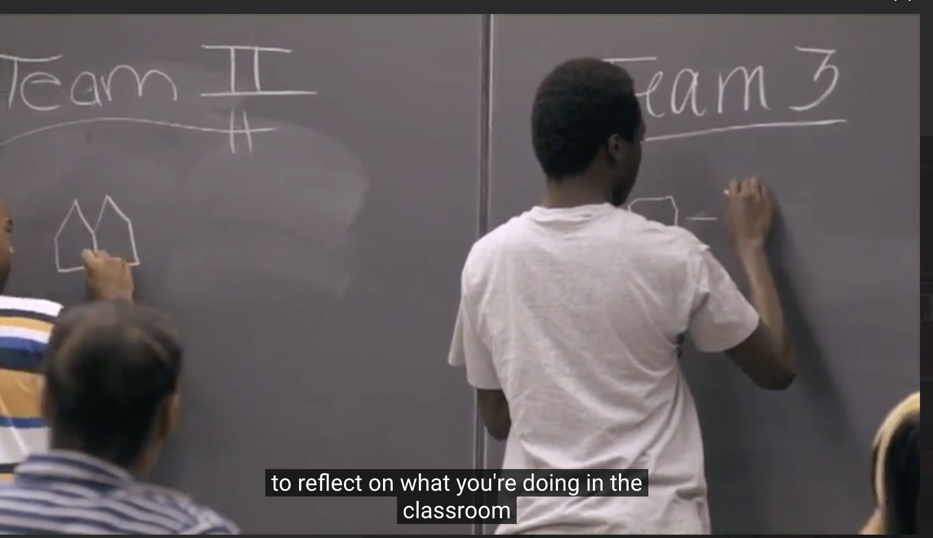
Captions
Notes:
(#5 – Learning guidance)
This video has captions overlaid on the video.
Captions need to be accurate to the audio content. If captions are auto generated, you will need to edit the captions for accuracy.

Slide 47
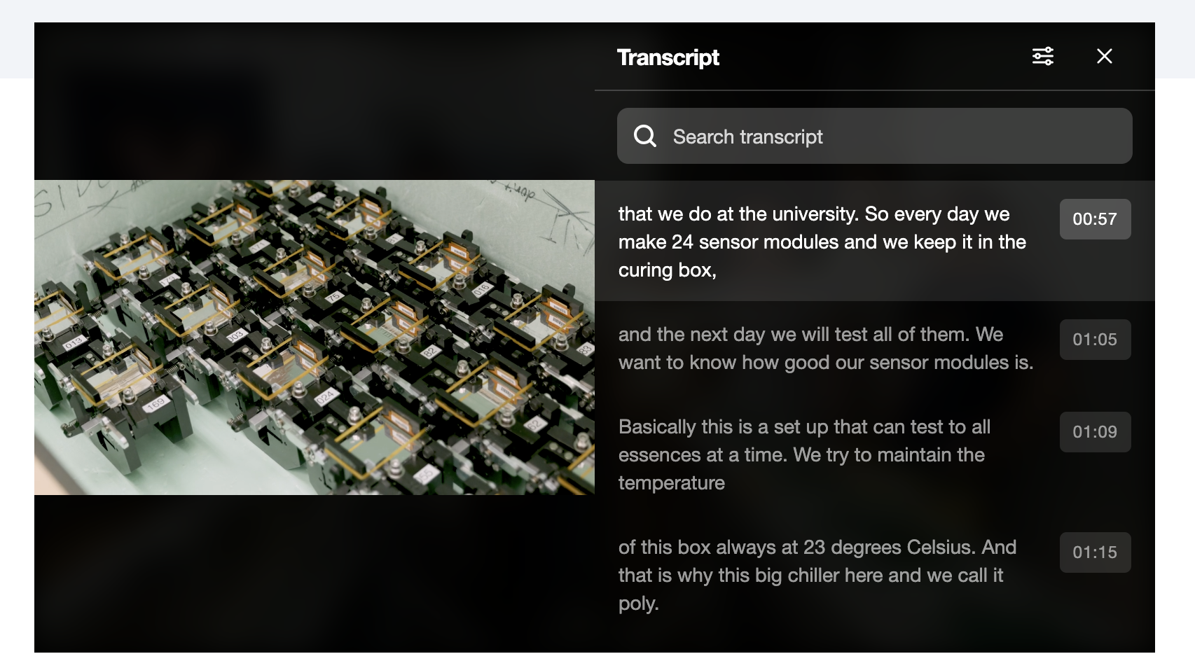
Transcripts
Notes:
(#5 – Learning guidance)
This video has a transcript playing beside the video content.
Transcripts need to be accurate to the actual verbal content.

Slide 48
Videos – Title Attribute
If pulling the embed code from YouTube, change the Title Attribute to be more descriptive of the video.
Embed Code
<iframe width="560" height="315" src="https://www.youtube.com/embed/ABCQR?S" title="YouTube video player" frameborder="0" allow="accelerometer; autoplay; clipboard-write; encrypted-media; gyroscope; picture-in-picture; web-share" referrerpolicy="strict-origin-when-cross-origin" allowfullscreen></iframe>
Notes:
(#4 – Content)
If pulling the embed code from YouTube, change the Title Attribute to be more descriptive of the video.
YouTube will add ”YouTube video player” as the title for all videos. If there are multiple videos on a page, each video should have a unique title.

Slide 49
Accessibility Best Practices
Notes:
(#4 – Content)
Now on to Accessibility Best Practices

Slide 50
Accessibility Best Practices
Visual cues are important - Graphs and tables should use more than color to display differences. Various pattern fills can be used to differentiate between data points. Also, the use of data labels and headers will make graphs and tables more accessible.
Content should be clear, concise, and understandable. It is advisable to aim for a 6th to 8th grade reading level for website content.
All PDFs, Docs, PPTs added to the site must be accessible.
To maintain visual contrast, allow the CSS to dictate font and background colors. Avoid adding special colors to the webpage.
When adding content to a webpage always use proper HTML tags, known as Semantic HTML.
Notes:
(#4 – Content)
A couple accessibility Best Practices
Many people are colorblind (1 in 12 males and 1 in 200 females). To aid people with color blindness or color deficiencies, use visual cues on graphs and tables to better display the data. Various pattern fills can be used to differentiate between data points. Also, the use of data labels and headers will make graphs and tables more accessible.
Content should be clear, concise, and understandable. It is advisable to aim for a 6th to 8th grade reading level for website content.
All PDFs, Docs, PPTs added to the site must be accessible.
To maintain visual contrast, allow the CSS to dictate font and background colors. Avoid adding special colors to the webpage.
When adding content to a webpage always use proper HTML tags, known as Semantic HTML.

Slide 51
Accessibility Best Practices for Copied Content
Content that has been copied from a Word document may have deprecated tags when it is pasted into the editor field of a CMS (Content Management System).
Check the source code to ensure that bold text uses the <strong></strong> tag and not the <b></b> tag. Also ensure that italicized text uses the <em></em> tag and not the <i></i> tag.
To draw attention to the content, it is preferable to use either the <strong> or the <em> tag. Using all capital letters can be confusing to someone with a cognitive disability. Also, underlining the text may cause people to click where there isn’t a link.
Notes:
(#4 – Content)
A couple accessibility Best Practices
Content that has been copied from a Word document may have deprecated tags when it is pasted into the editor field of a CMS (Content Management System).
Check the source code to ensure that bold text uses the <strong></strong> tag and not the <b></b> tag. Also ensure that italicized text uses the <em></em> tag and not the <i></i> tag.
To draw attention to the content, it is preferable to use either the <strong> or the <em> tag. Using all capital letters can be confusing to someone with a cognitive disability. Also, underlining the text may cause people to click where there isn’t a link.

