Slide 1
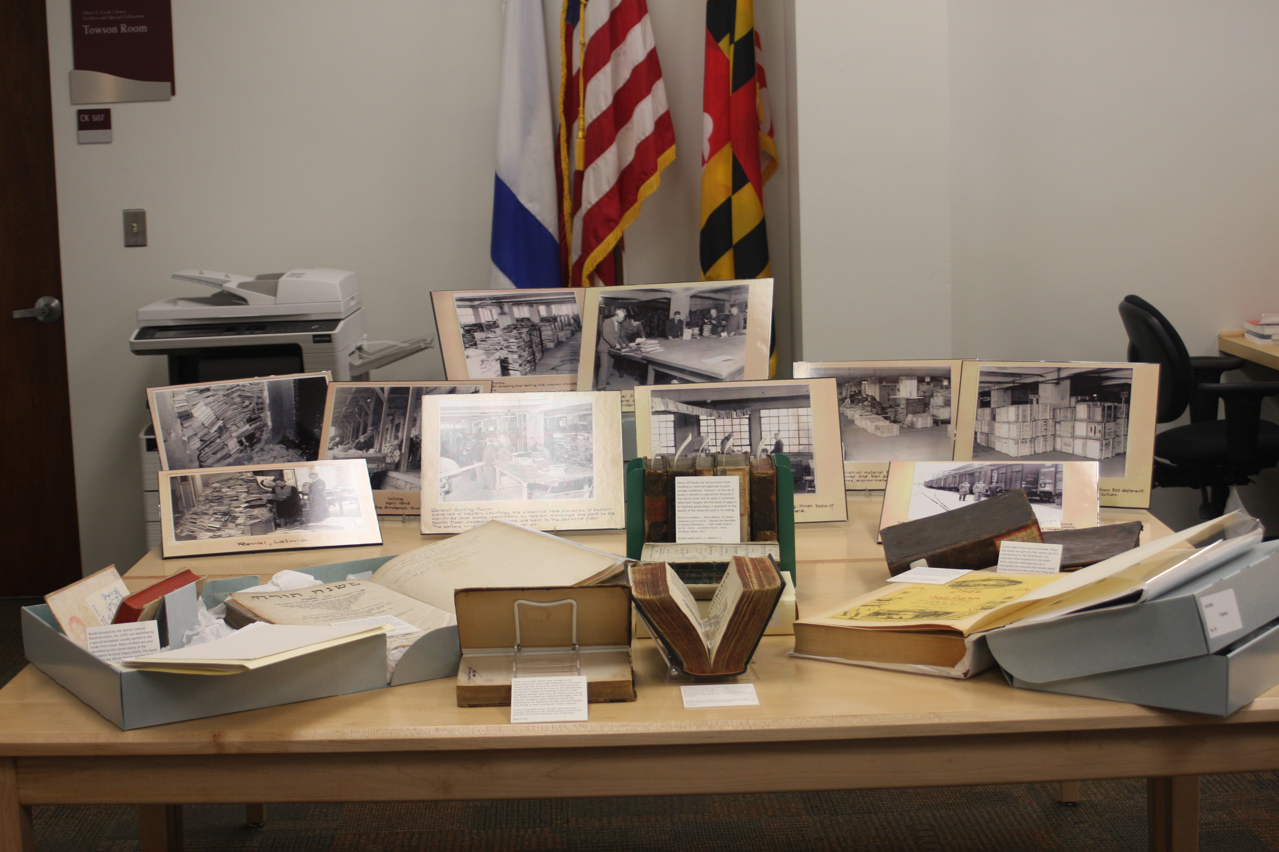
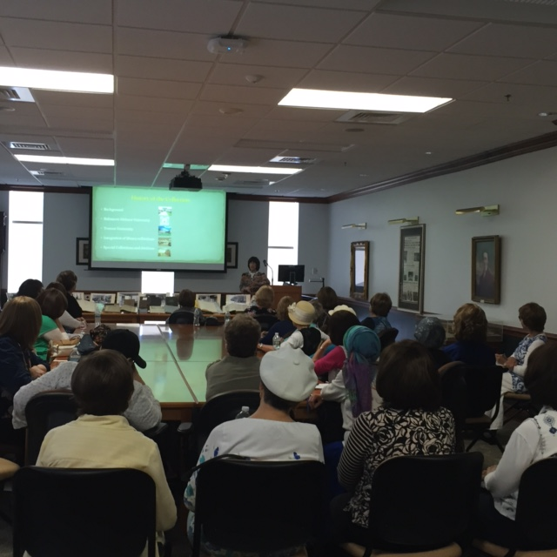
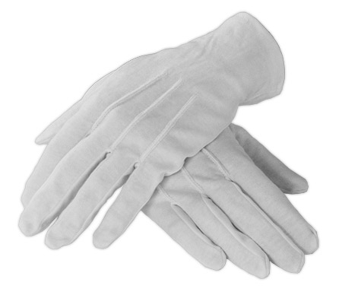

Putting History in their Hands:
White Gloves Sessions as a User Outreach Tool
Elaine Mael • Towson University
History
White Gloves Sessions Concept
Goals
Adaptations
TWO LIBRARIES BECOME ONE
2009: Integration of Towson University and Baltimore Hebrew University
HIDDEN COLLECTIONS
Specialized Collection of unusual materials unknown and under-utilized
SEARCH FOR DISCOVERABILITY
Accessibility concerns for the new Baltimore Hebrew Institute Collection
WHITE GLOVES EVENTS
Community outreach opportunity across a variety of populations intended to bring the collection to the public
Raise awareness of collection
Marketing tool for library
Novel approach to special collections
Promote concept of books as artifacts
Engender potential patronage for collection
Expose collection to the public
Increase awareness of books as cultural objects
Appreciation of librarians as curators
Generate sponsorship for preservation of items
Plant seeds for future donation of materials
History of an institution
Local history artifacts
Donor collections
Examples from Towson University:
Lives of TU enlisted alumni during WWII
Race relations on campus during
the 1960’s
Components
Methodology
Resources
Engaging story
Thematic artifacts
Presentation
Hands-on experience
Q & A opportunity
Handouts
Identify core theme
Gather supporting documentation
Select target audience
Select venue
Publicity
Logistics
Bahde, Anne, Smedberg, Heather, and Taormina, Mattie, eds. Using primary sources: hands-on instructional exercises. (Santa Barbara, California: Libraries Unlimited, 2014.
Nasr, Nadia. “White gloves sessions: Towson University raises awareness about unique collection.” Archival Outlook (March/April 2013): 10-24.
Wall, Kay, and Eric C. Shoaf. "Orange Glove events Clemson University Library’s special collections roadshow." College & Research Libraries News 74, no. 6 (2013): 312-314.
LOC:
http://www.loc.gov/teachers/usingprimarysources/
ALARUSA:
http://www.ala.org/rusa/sections/history/resources/pubs/usingprimarysources
Teaching History / National History Education Clearinghouse:
http://teachinghistory.org/best-practices/using-primary-sources
NARA: http://www.archives.gov/education/research/
Printed by the
Office of Academic Innovation

