Slide 1

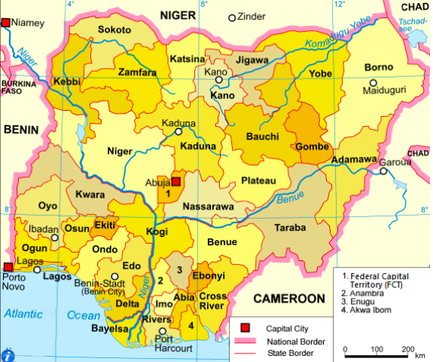
Application of an SEIRD model to track the spread of COVID-19 in Nigeria
Presenting Author: Maya Mueller
Co-authors: Ashok Krishnamurthy, PhD, Bedřich Sousedík, PhD,
Agatha Ojimelukwe, PhD, Loren Cobb, PhD and Jocelyn Boegelsack
Introduction:
The global coronavirus pandemic of 2019 (COVID-19) reached Lagos, Nigeria on February 27, 2020. Since then, the Nigeria Center for Disease Control (NCDC) is reporting a steady increase in the number of confirmed cases.
Research Stages:
Stage I
Use the compartmental SEIRD model to produce a forecast of COVID-19 in Nigeria that simulates the epidemic’s spatio-temporal dynamics
Stage II
Tracking the COVID-19 spread with the integration of the Bayesian data assimilation technique, Optimal Interpolation (OI)
Motivations:
Study the transmission dynamics of the COVID-19 epidemic spread across a 2-dimensional space.
Contribute to mathematical ideas on forecasting highly nonlinear epidemic outbreaks.
Figure 1: Map of Nigeria with state divisions and capitals. Nigeria is
divided into 36 states and a Federal Capital Territory (FCT). (Wikipedia)

Slide 2
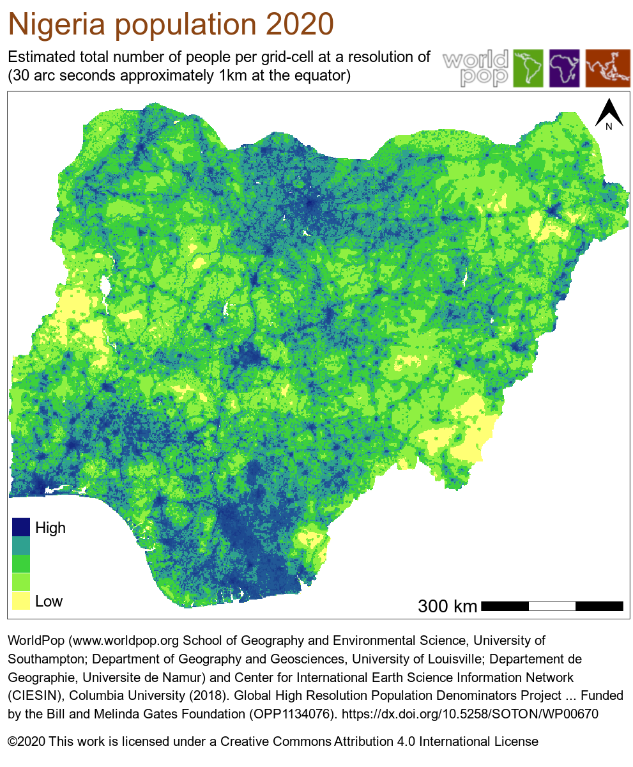

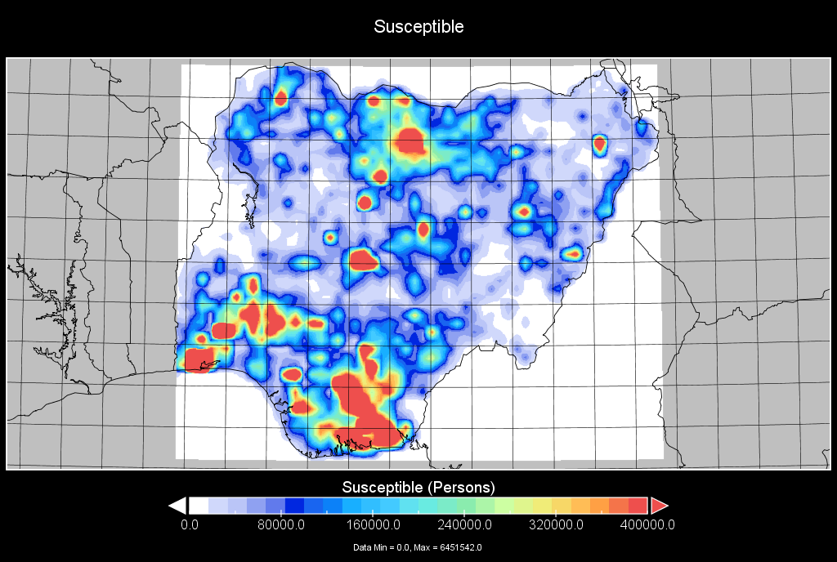


Setting up the Simulation Environment
Figure 3: Panoply visualization of netCDF file for distribution of Susceptible population in Nigeria
Figure 2: WorldPop 2020 UN-Adjusted gridded population count data of Nigeria as GeoTIFF image
Population becomes initial spatial domain of Susceptibles (47 rows × 58 columns = 2726 cells) with each cell 25×25 km²

Slide 3
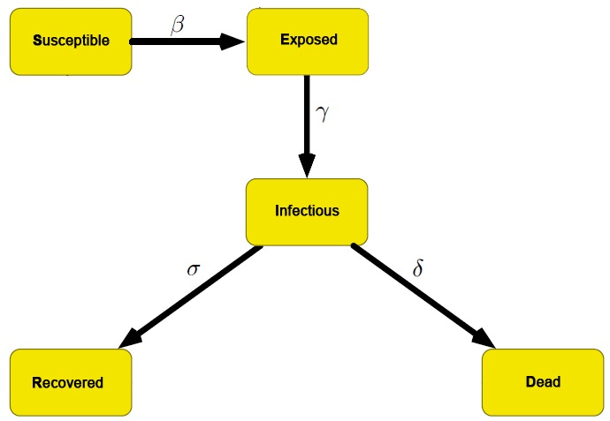
Stage I: The SEIRD Model
We used a five-compartment SEIRD model (Susceptible-Exposed-Infected-Removed-Dead) such that each 25×25 km² cell in the grid contains each epidemic state (47 × 58 = 2726 cells).
Each cell can transmit disease to its neighbors, with probabilities that decline exponentially with Euclidean distance.
The function for each SEIRD variable describes the density of the population for each compartment at spatial coordinate (x,y) and time t.
For every time-step, a portion of the population flows through the proceeding compartment as represented in the diagram.
Figure 4: A graph representing the five epidemic states (S, E, I, R, D) and movement between compartments. The rate of flow between compartments is represented by the (β, γ, σ, δ) parameters along each arrow.

Slide 4

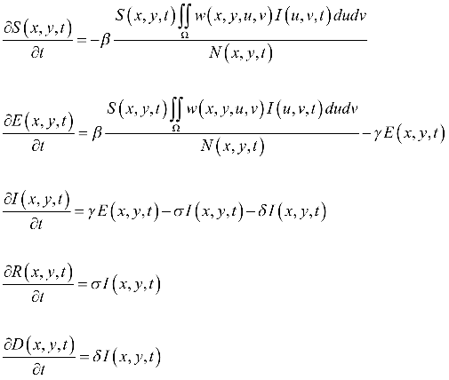
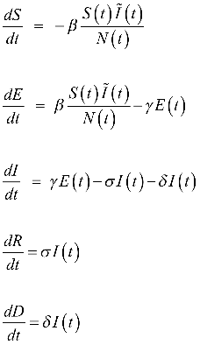
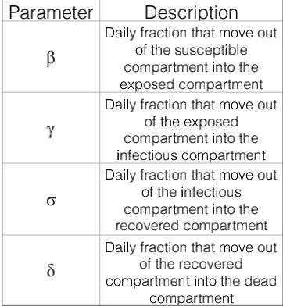
Equations for the SEIRD Model
We can decompose the system into
five ODEs under the assumption
that the population is continuously
distributed across the grid.
The dynamics of the SEIRD model in continuous time
can be represented as a system of five PDEs.
Weight function expresses the
idea that influence of nearby infectives
on susceptibles drops off as an
exponential function of Euclidean
distance.
Partial Differential Equations (PDEs):
Ordinary Differential Equations (ODEs):

Slide 5
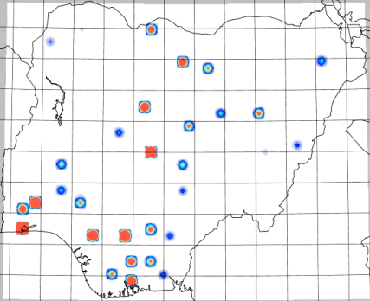
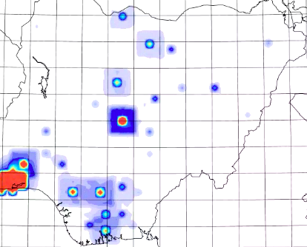
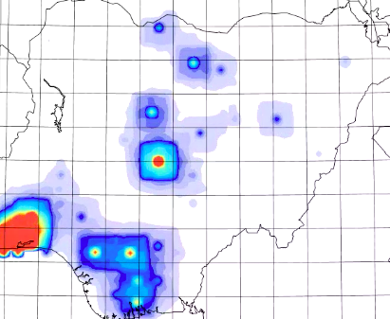
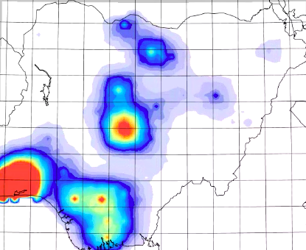
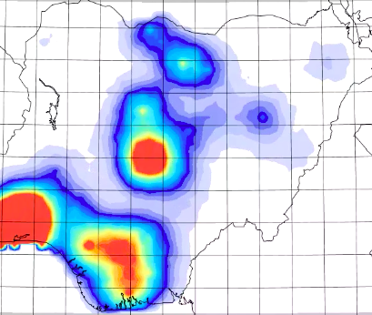

Spatio-temporal maps of the Infected Variable
Day 1
Day 50
Day 100
Our maps demonstrate the evolution of COVID-19 in Nigeria for 180 days according to the density of the Infected variable for each (x,y) cell in the grid.
Seed cases were placed in each of the 36 states and 1 FCT territory
Model parameters were set according to COVID-19 epidemic characteristics, and are representative of a worst-case scenario with no social distancing measures.
Day 150
Day 180
Figure 5: Stills from our MP4 video of the spread of COVID-19 in Nigeria
for various time steps between June 28, 2020 to December 28, 2020
(total 180 days) at a 12.5 arc-minute resolution.

Slide 6


Stage II: Bayesian Data Assimilation
Optimal Interpolation (OI)
Bayesian Update Algorithm:
COVID-19 spatial dynamics are highly nonlinear and thereby initial observation error may cause the SEIRD model to increasingly deviate from the true state over time.
We use the Bayesian data assimilation technique, Optimal Interpolation (OI), to produce a more accurate epidemic forecast.
OI estimates of the true state of the system given the background field x^{b}, incoming observations y⁰, and the error covariance matrices of the background Q and observations Y_{t}.
The analysis problem for the next state in the system is now integrated with weighted linear combinations of observations as the observable data arrives in real time.
OI assumes the inherent variability in scalar field of interest, and that the covariances decrease exponentially with distance.
where
x_{t} : epidemic state vector
y_{t} : observed data vector
Ψ_{t} : measurement error covariance matrix
H : linear interpolation operator
Q : constant model error covariance matrix
Bayesian Update Process:
Background or First Guess
Observation
Innovation (Observation - Background)
Analysis and Correction
Repeat

