Slide 1



MPLP & AV
More Product, Less Process & Audiovisuals
Siobhan C. Hagan
Audiovisual Archivist
University of Baltimore>Langsdale Library>Special Collections

Slide 2


Audio. Video. Disco.
• Wavelengths with varying frequencies
• Wavelengths as signals
• Analog: info is recorded as analogous to the original
• Digital: info is recorded as 1’s and 0’s
• Record onto lots of different types of physical media

Slide 3
AV Processing Problems
• Sparse information
• Incorrect identification of formats
• Poor housing and storage
• Adding/subtracting boxes
• Inefficiently enhancing finding aids

Slide 4
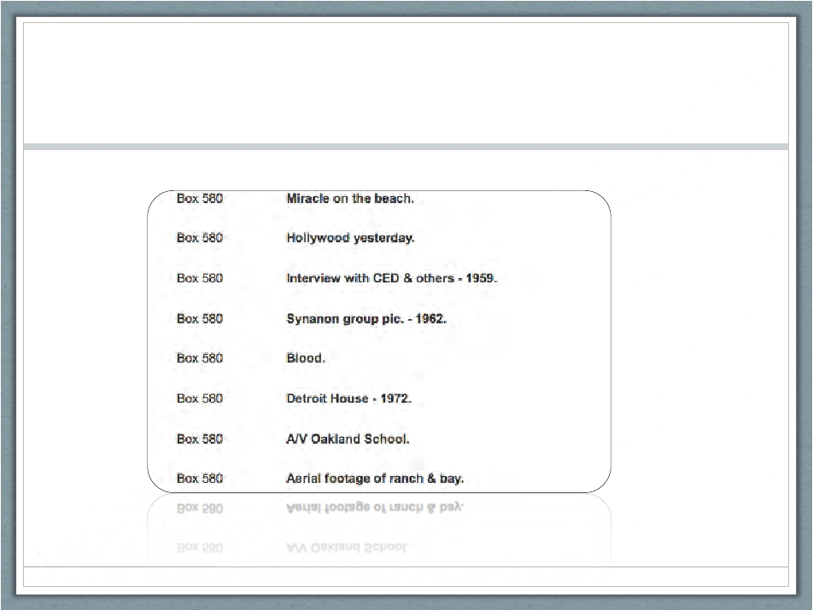
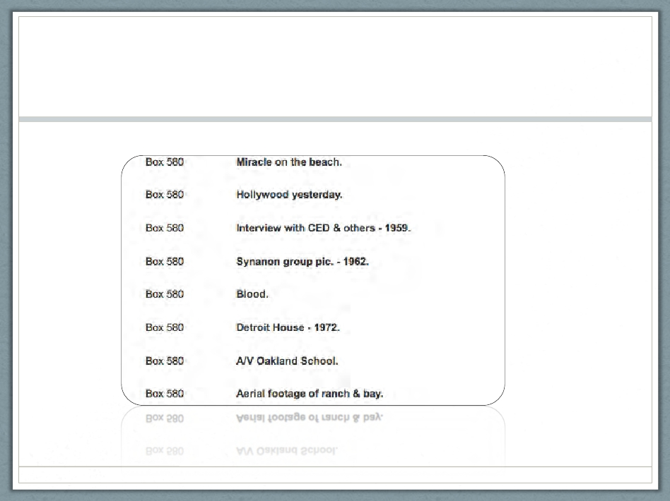
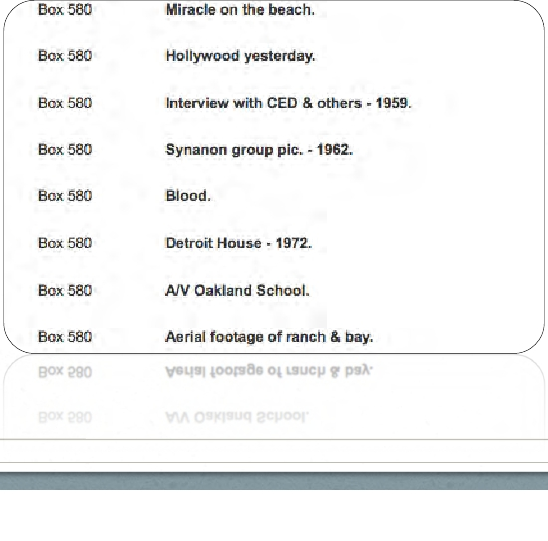
Sparse Finding Aid

Slide 5
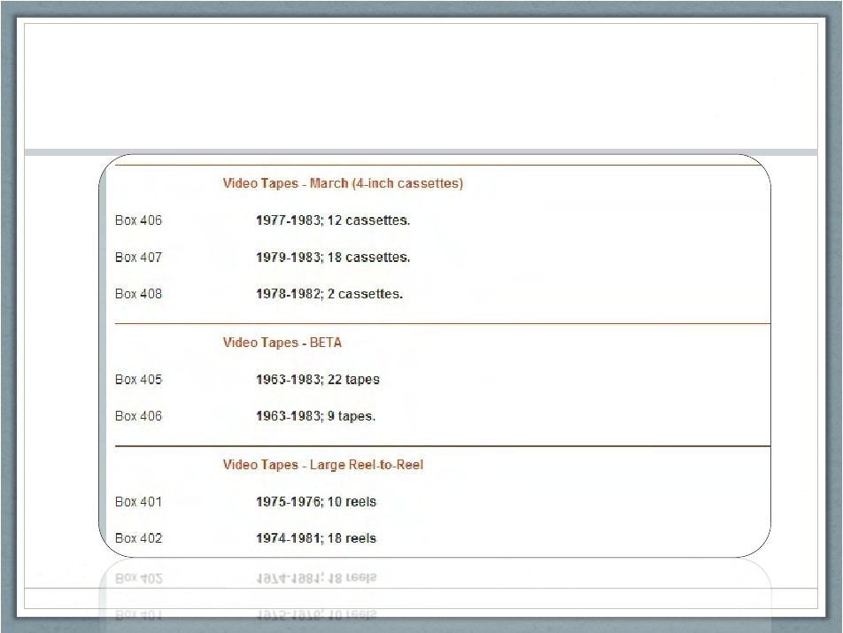
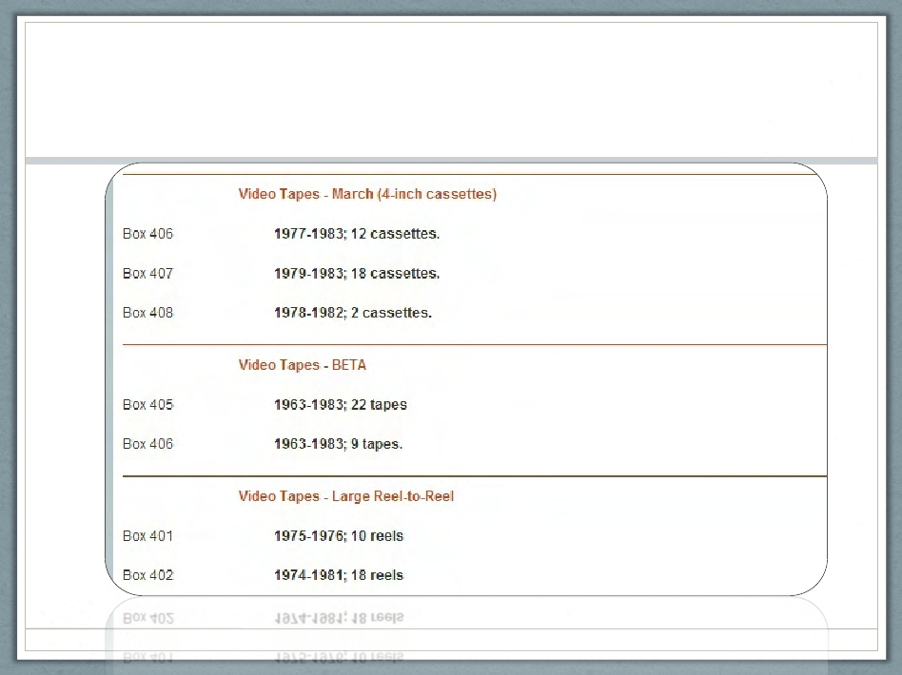
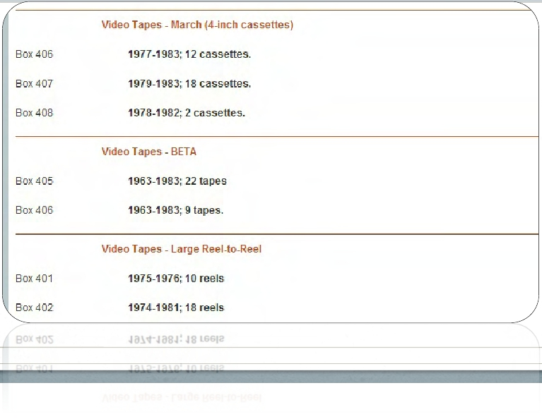
Sparse Finding Aid

Slide 6
MPLP
• Box/Shelf?
• Absolute minimum: impossible?
• Access vs. preservation
• Reinventing wheel
• Waste of time

Slide 7
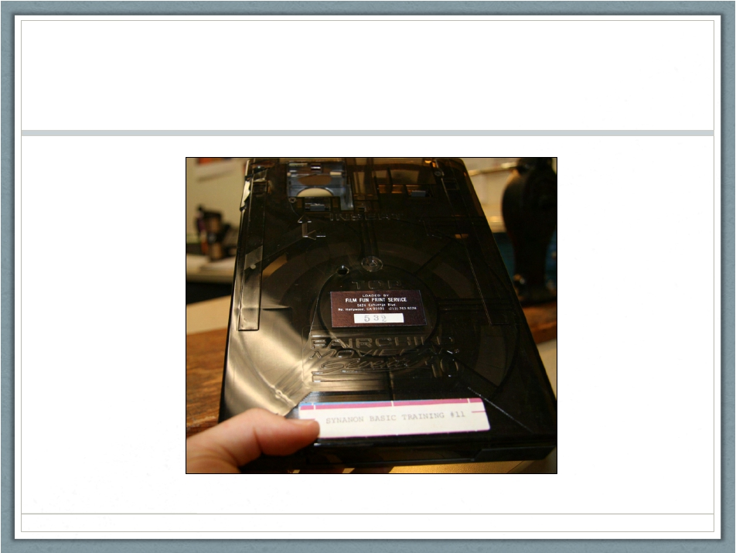
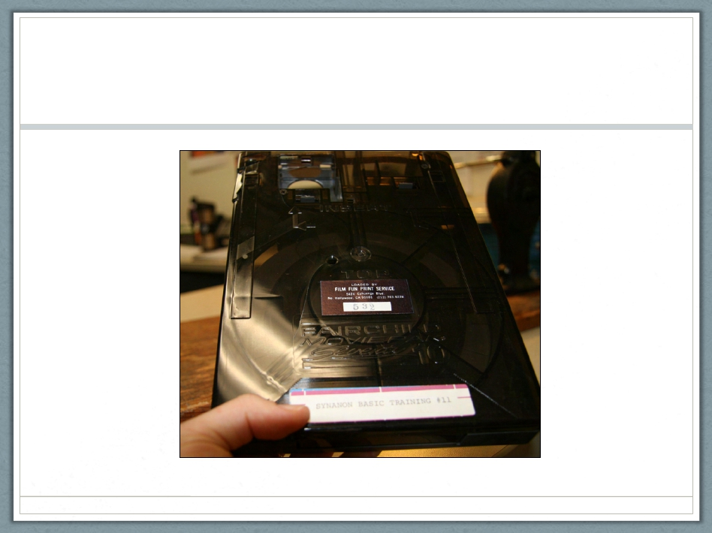
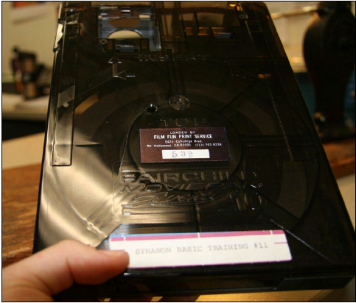
Incorrect Identification

Slide 8
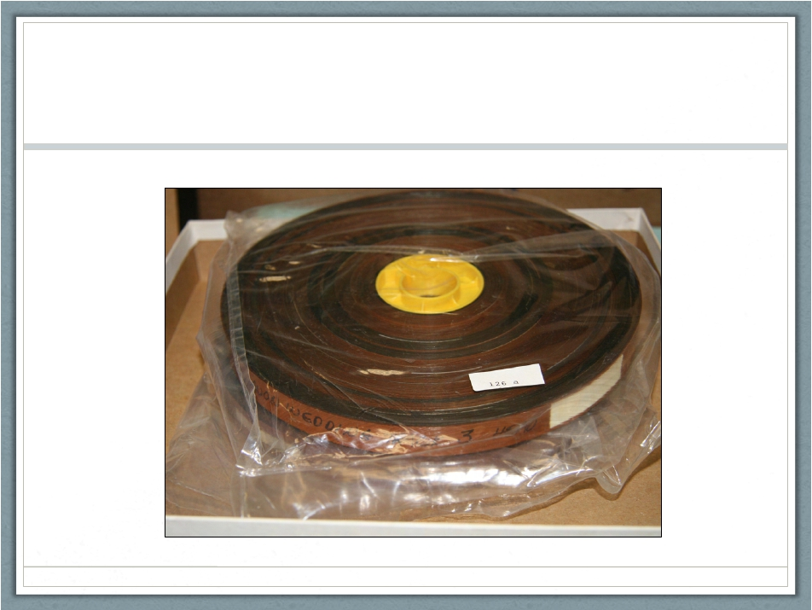
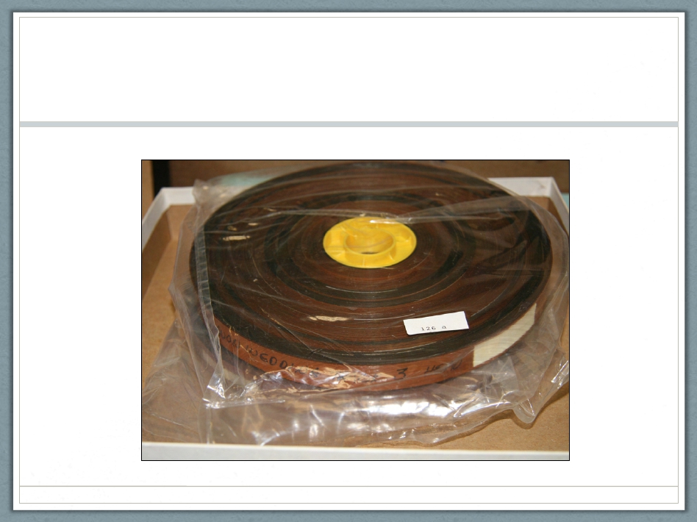
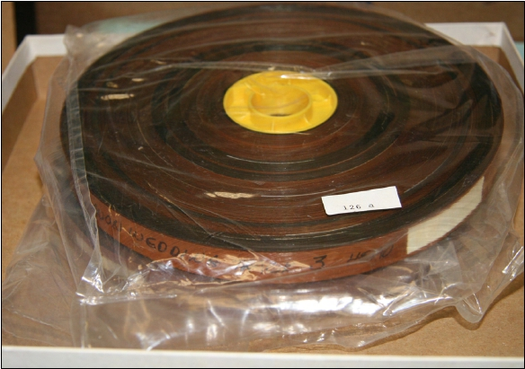
Incorrect Identification

Slide 9
Training to ID
• Media Type
• Format
• Size
• Speed
• Generation
❖ Red flags!
• Mold
• Degradation
• Etc.

Slide 10
MediaType
• Film
• Video
• Audio
• Optical

Slide 11
Format
• Film
• 8mm
• Super8mm
• Regular 8mm
• 16mm
• Full coat magnetic soundtrack
• 35mm
• Full coat magnetic soundtrack
• 70mm

Slide 12
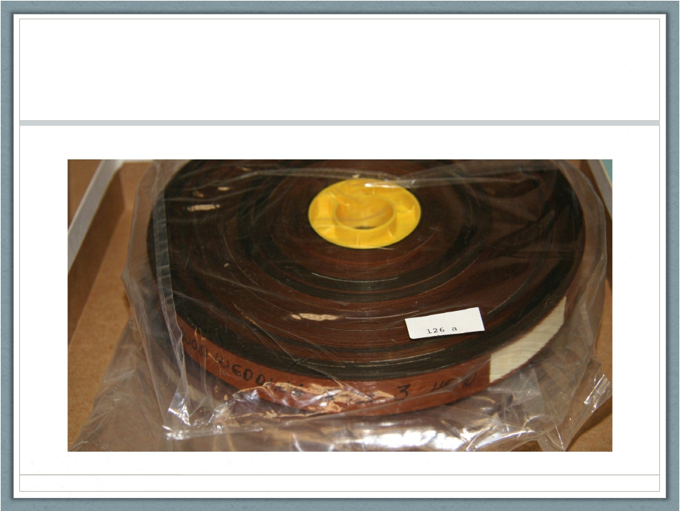
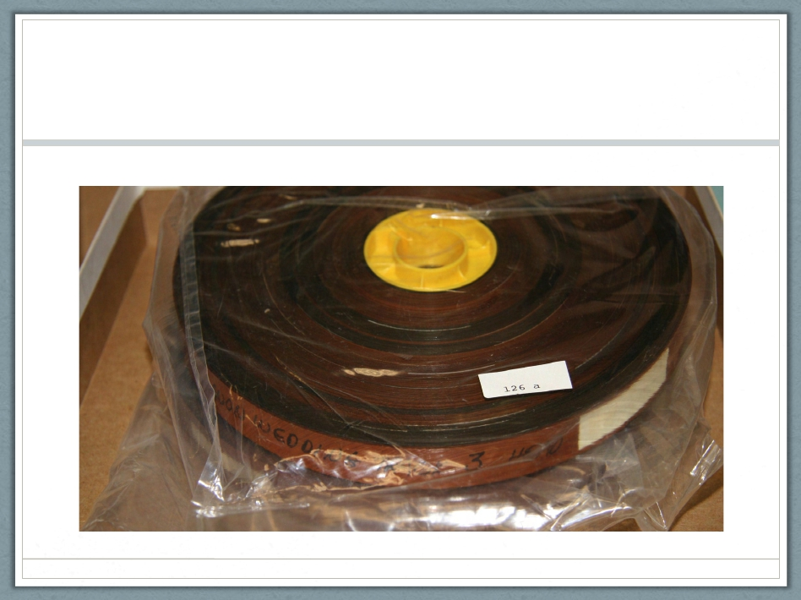
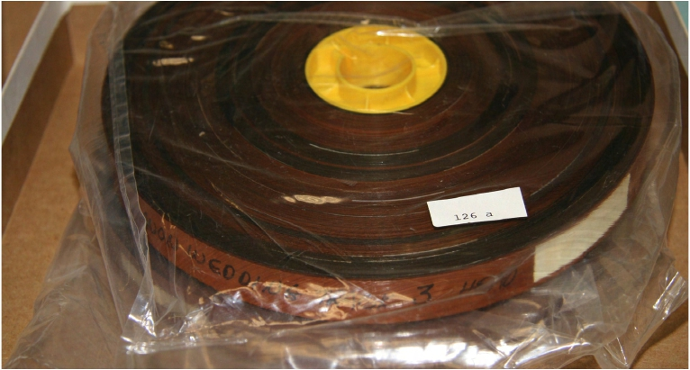
Full coat mag

Slide 13
Format
• Video
•
•
•
•
•
2” Quadruplex open reel video
1” open reel video
1/2” open reel
3/4” Umatic (SP)
Betamax
• VHS
• Betacam (SP)
• Video8

Slide 14
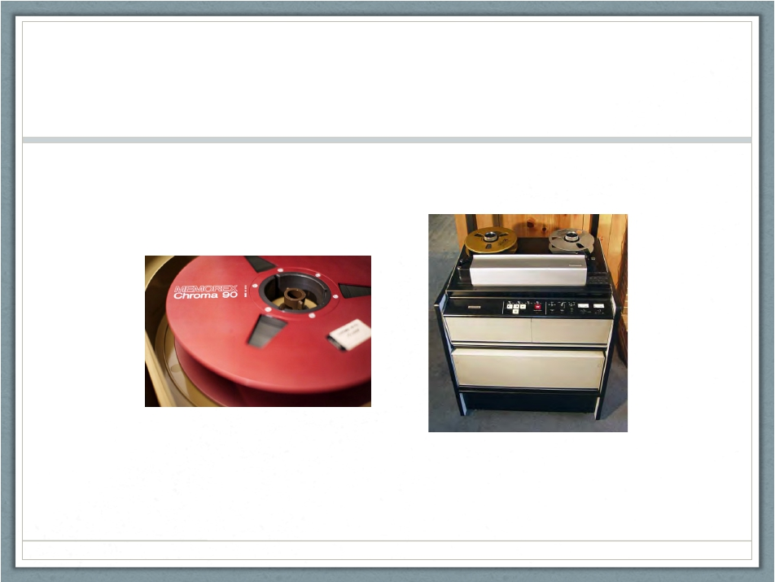

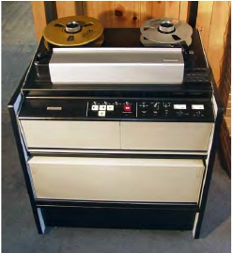
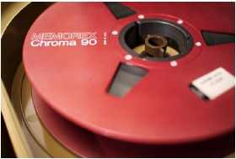
2” Quad Open Reel Video
Photo: Robert Rex Jackson
Photo: videointerchange.com

Slide 15
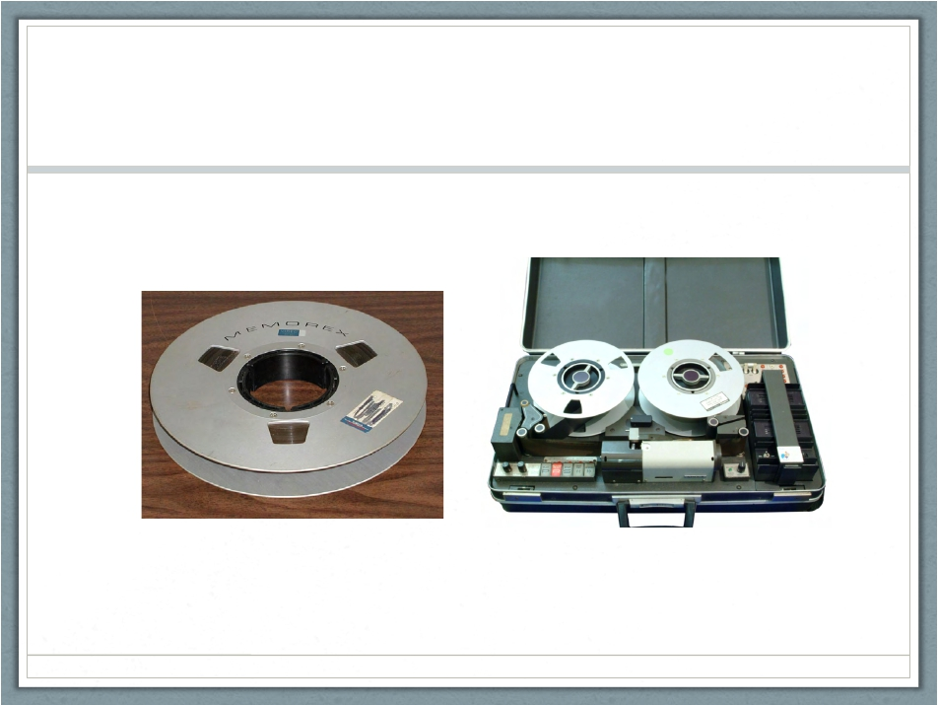

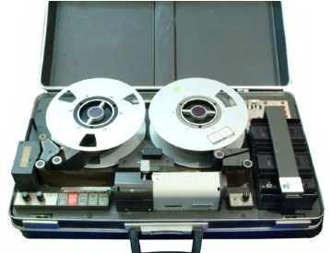
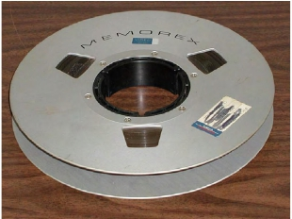
1” Open Reel Video
Photo:
labguysworld.com
Photo: Wikipedia

Slide 16
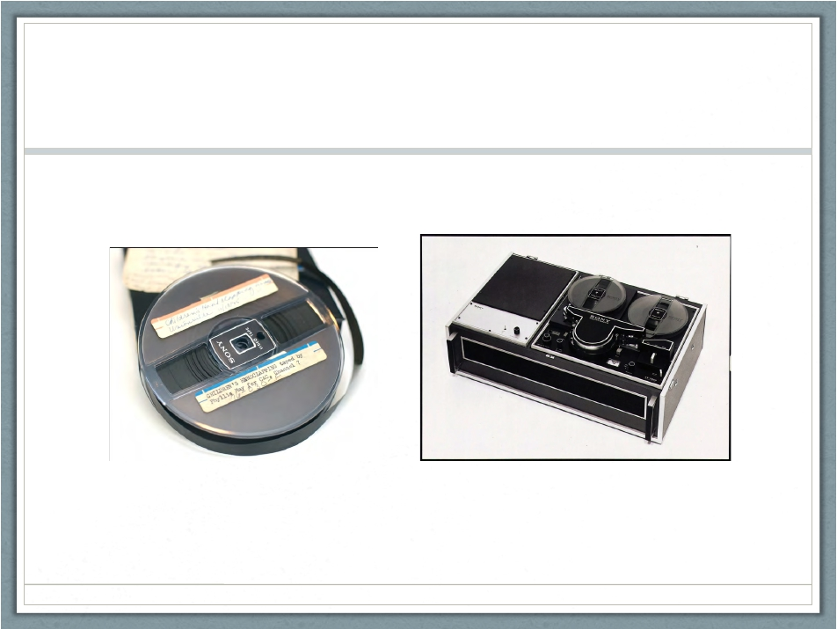

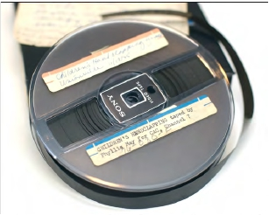
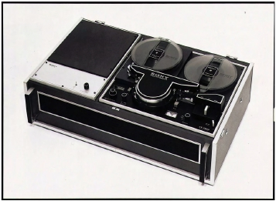
½ inch Open Reel Video
Photo: Indiana University - Bloomington
Photo: Sony.net

Slide 17
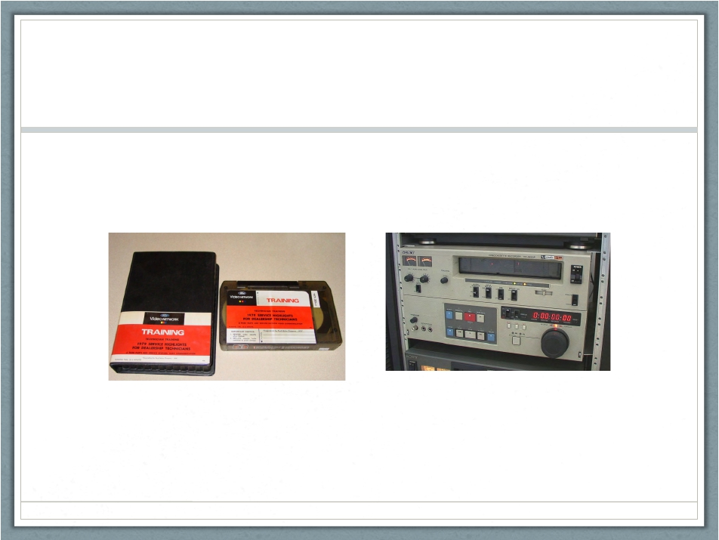

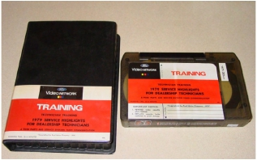
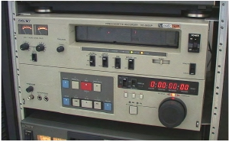
¾ inch U-Matic (SP)
Photo: Preservingvideo.blogspot.com
Photo: Ebay

Slide 18
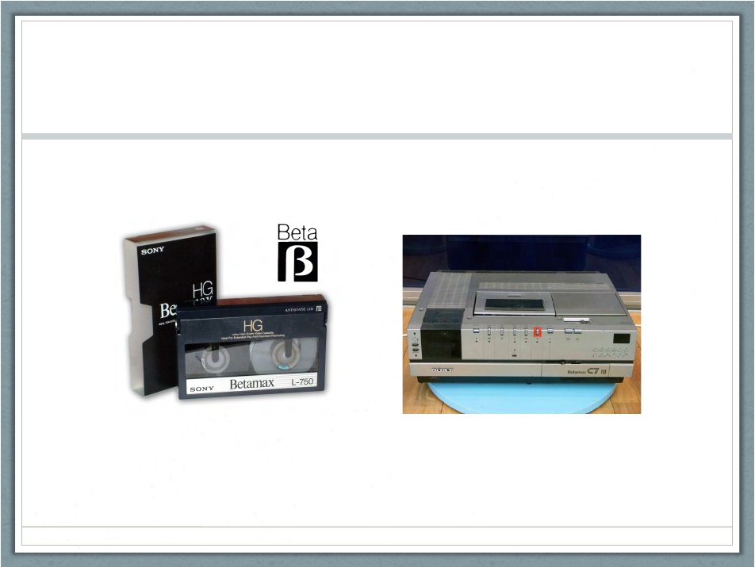

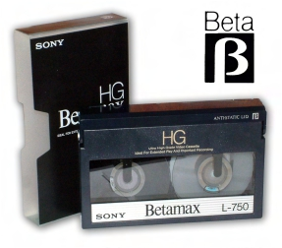
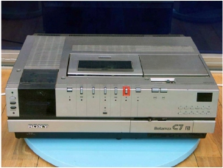
Betamax
Photo: Ibenimagaes.com
Photo: Simplydv.biz

Slide 19
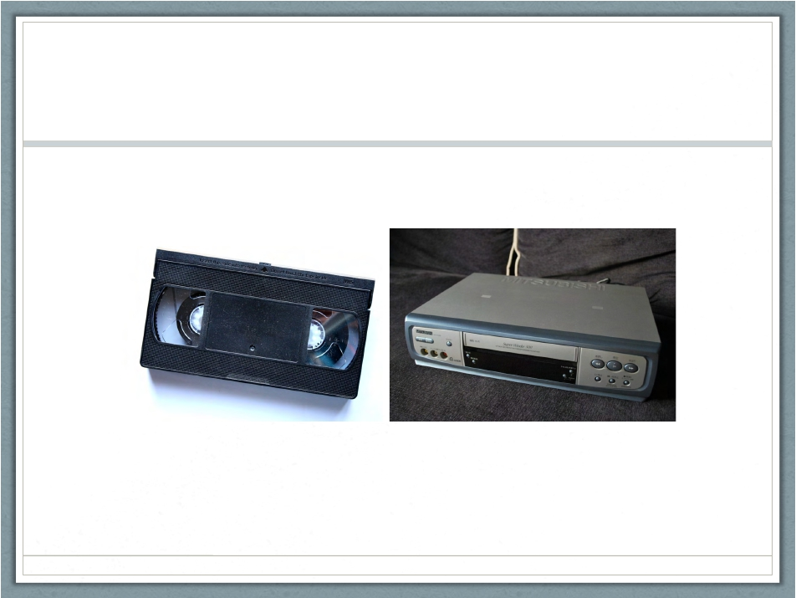

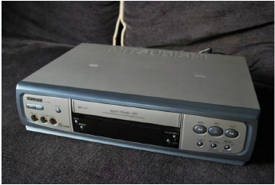
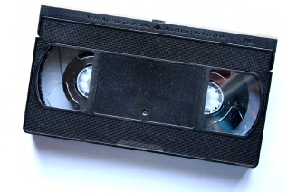
VHS
Photo: Photos-public-domain.com
Photo: Themovethemove.wordpress.com

Slide 20
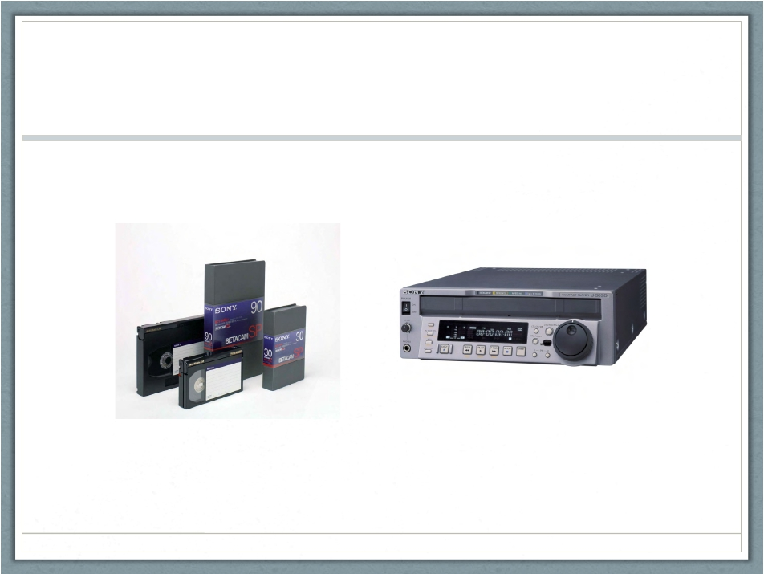
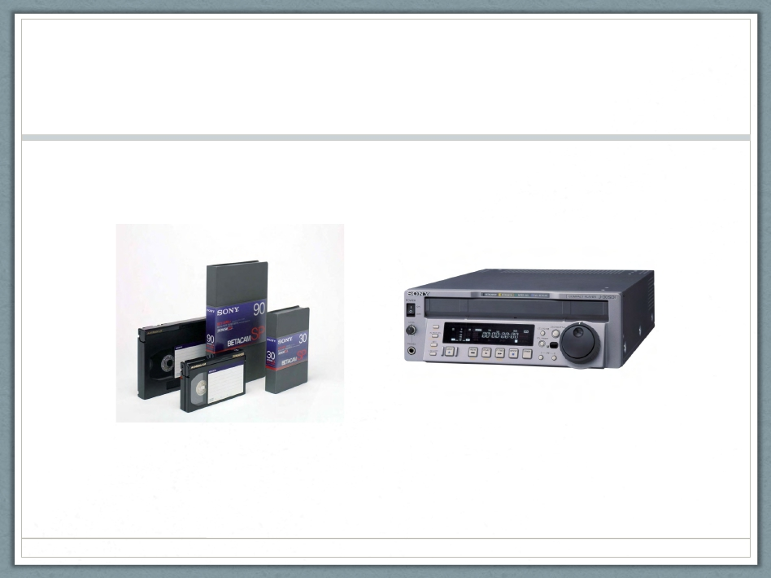
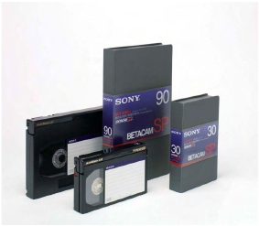
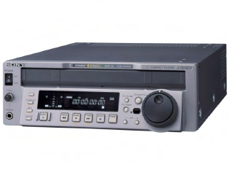
Betacam (SP)
Photo: Datastores.co.uk
Photo: verrents.com

Slide 21
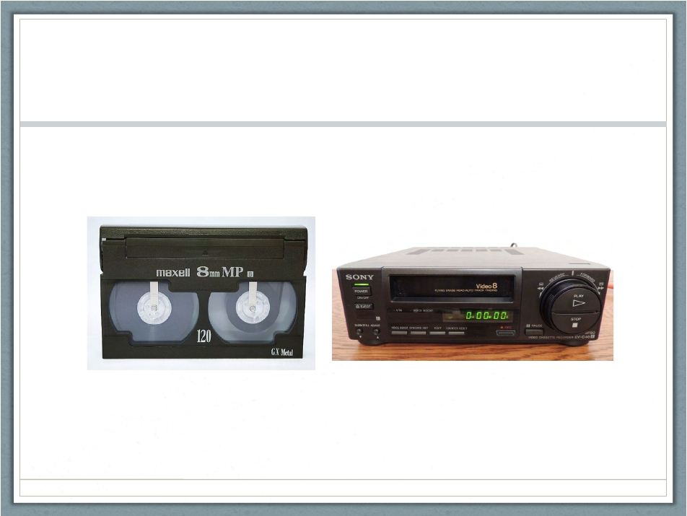

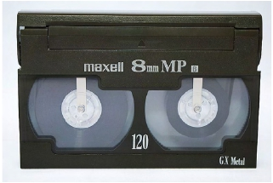
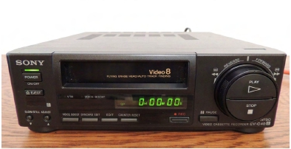
Video8
Photo: Wikipedia
Photo: Ebay

Slide 22
Format
• Video (cont’d)
•
•
•
•
•
Hi8
Digital8
Digital Betacam (Digibeta)
MiniDV
DVCAM
• DVCPRO
• HDCAM (SR)
• Etc.

Slide 23
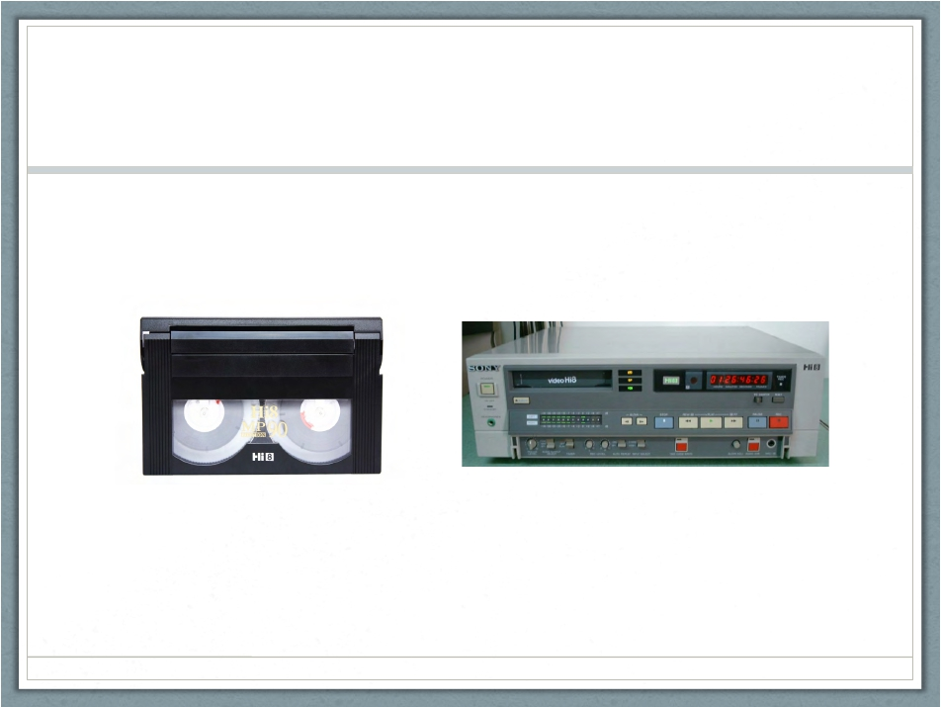

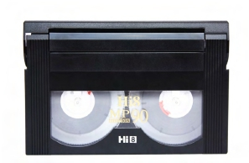
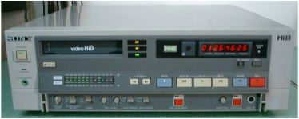
Hi8
Photo: Amazon.com
Photo: Ebay

Slide 24
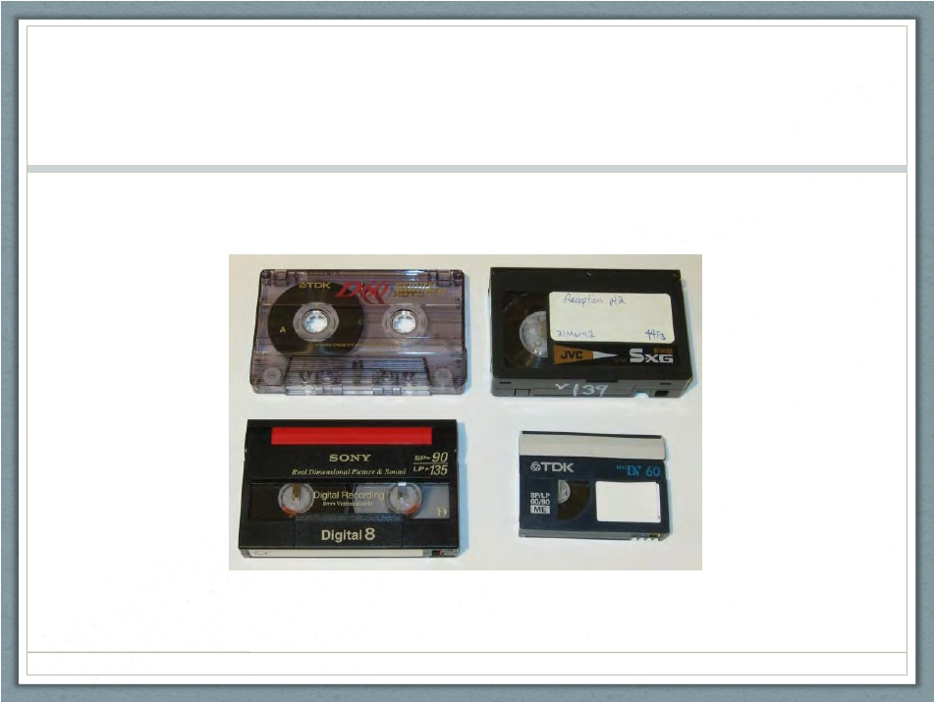

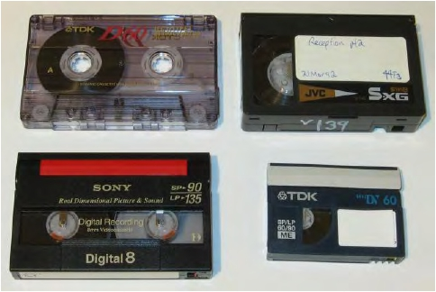
Digital8
Photo: Cameratim.com

Slide 25
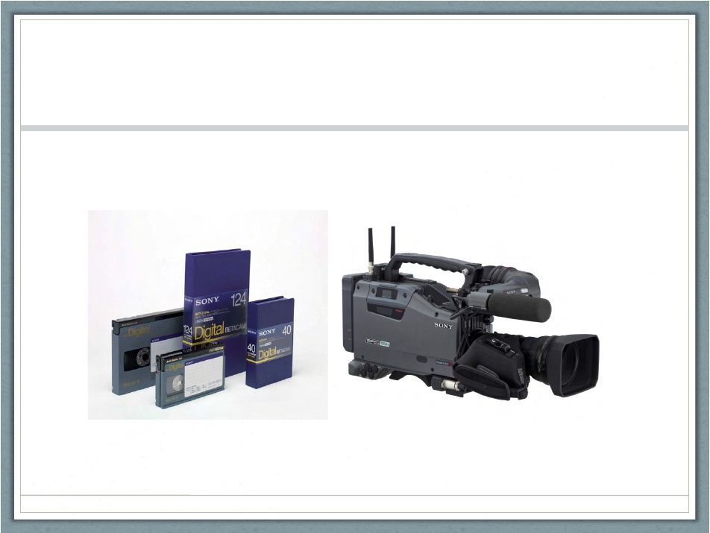

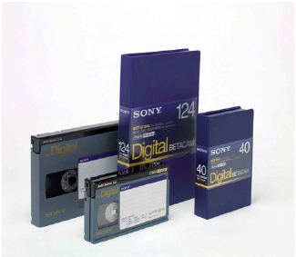
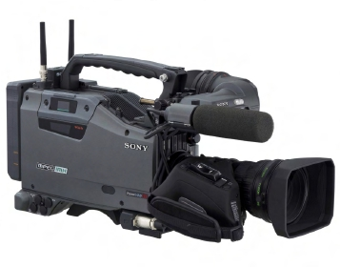
Digital Betacam (Digibeta)
Photo: Professionalmedia.hu
Photo: Highwayhv.com

Slide 26
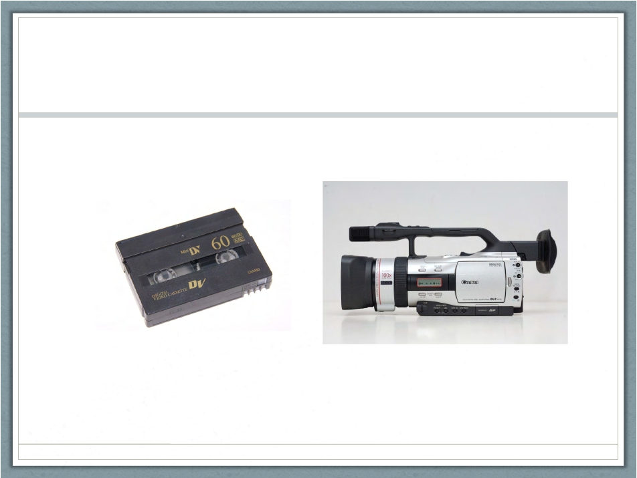
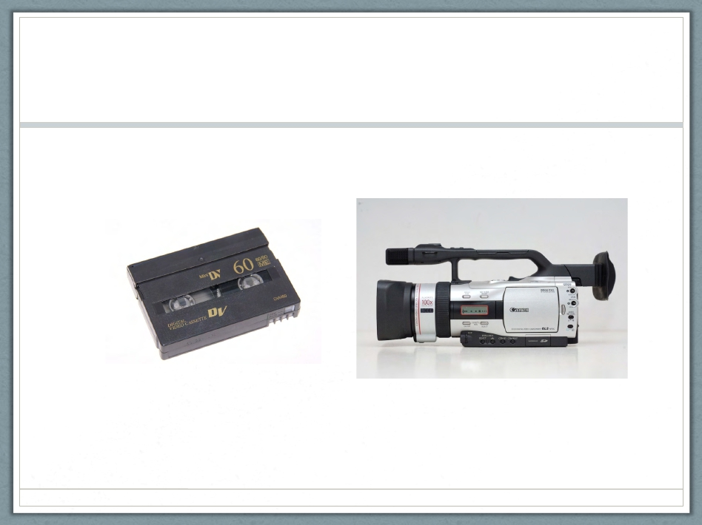


MiniDV
Photo: dvdyourmemories.com
Photo: Bladeforums.com

Slide 27




DVCAM
Photo: Professioalmedia.hu
Photo: Alan Gordon

Slide 28




DVCPRO
Photo: Geniusdv.com
Photo: Creativeplanetnetwork.com

Slide 29




HDCAM (SR)
Photo: Creativeplanetnetwork.com
Photo: Professionalmedia.hu

Slide 30
Format
• Audio
• Open reel tape: width ranging from ¼ inch to 2 inches
• Typically ¼ inch
•
•
•
•
•
•
•
•
8-Track
Compact Cassette
Microcassette
DAT
Record disc
Wire
Dictabelt
Etc.

Slide 31




¼ - 2 inch open reel audio tape
Photo: ja.wikipedia.org
Photo: Audiokarma.org

Slide 32




8-Track
Photo: fieldwoodhs.ednet.ns.ca
Photo: Fineartamerica.com

Slide 33




Compact cassette
Photo: collectiondiscovery.blogspot.com
Photo: blog.phonographic.com

Slide 34




Microcassette
Photo: Wikipedia

Slide 35




DAT (Digital AudioTape)

Slide 36




Record Disc

Slide 37




Wire

Slide 38




Dictabelt

Slide 39
Format
• Optical
•
•
•
•
•
LaserDisc
MiniDisc
CD
DVD
Blu-ray

Slide 40




Laserdisc

Slide 41



Minidisc

Slide 42




Compact Disc (CD)

Slide 43



DVD

Slide 44



Blu-Ray

Slide 45
Red flags
• Film
• Mold
• Vinegary smell
• “Nitrate”

Slide 46



Mold
Photo: AZ Digital Transfers

Slide 47



Vinegar syndrome

Slide 48



Nitrate
Photo: George Eastman House

Slide 49



Red flags
• Video
• Mold
Photo: Video Recovery & Restoration

Slide 50



Red flags
• Audio
• Mold
Photo: Chace Audio

Slide 51



Red flags
• Audio
• Vinegary smell
Photo: Rascher Archive Blog

Slide 52



Red flags
• Optical
• Separation of the layers, warping, and cracking
Photo: Pvenda Photography

Slide 53
Proper Storage Orientation
• Film
• Flat
• Video
• Vertical
• Audio
• Also vertical
• Optical
• Oh, also vertical

Slide 54




Proper storage
• Archival Boxes, Paper and Plastics
Photo: Tuscan Corp.

Slide 55



Poor Housing
✗

Slide 56



Poor Storage
✗

Slide 57



Preservation Re-housing
✔

Slide 58



Preservation Re-housing…
✔

Slide 59



…and Storage?

Slide 60
MPLP Influenced
• Decisions→Policy
• Collection-ish Level
• Item-ish Level
• UCLA Library
• Special Collections: Box-ish Level
• Preservation: Item Level (more training
needed)

Slide 61
Levels of Processing
• Special Collections: Box-ish Level (recommended
minimum)
• Numbers of formats
• Date range of content
• Proper storage orientation
• Red flags!
• Preservation Processing: Item Level
• TMI

Slide 62
Minimum Finding Aid
• Container List
• Media Type
• Format
• # of items
(guesstimate,
rounding up); date
range
• Box 212
• Film
• 16mm
• 5 reels; 1962
• 9 reels; 1967-1969
• Video
• Hi8
• 14 cassettes;
1985-1987
• 2 cassettes; 1988;
mold detected.

Slide 63
Level-Up: Item-ish
• Max size/length
• Speed
• Duplicate vs. original
• Content key words
•
Box 212
• Film
• 16mm
• Masters
• 5 reels; 1962; 400 feet;
18fps; Football film
• 9 reels; 1967-1969; 800
feet; home movies
• Video
• Home movies
• Hi8;
• 10 cassettes; 1985-1987;
120 minutes; Originals
• 4 cassettes; 1985; 120
minutes; duplicates
• 2 cassettes; 1988; mold
detected.

Slide 64



Max Size/Length

Slide 65



Max Size/Length

Slide 66




Max Size/Length

Slide 67



Duplicate vs. Original

Slide 68
What to do with this information?
• Intellectual control
• Patron-requested reformatting
• Preservation priorities (need pro input)
• Umatics before Kodachrome
• DATs before record discs
• Quotes for grants/funds
• 5 boxes of Umatic Masters from 1980s
• Round up!

Slide 69
Summary
❑ Minimal Box-ish Level
• Numbers of formats
• Date range of content
• Proper storage orientation
• Vertical vs. Flat
• Plastic bags, rubber bands, etc.
• Red flags!
Bonus item-ish
• Max size/length
• Speed
• Duplicate vs. Original
• Content key words

Slide 70
Summary (cont’d)
❑ Access and Preservation Priorities
❑ Patron requests
❑ Grant proposals
❑ Internal funds prioritized

Slide 71


Thank you!
Siobhan C. Hagan
shagan@ubalt.edu
@AV_DiscoTech

