Slide 1
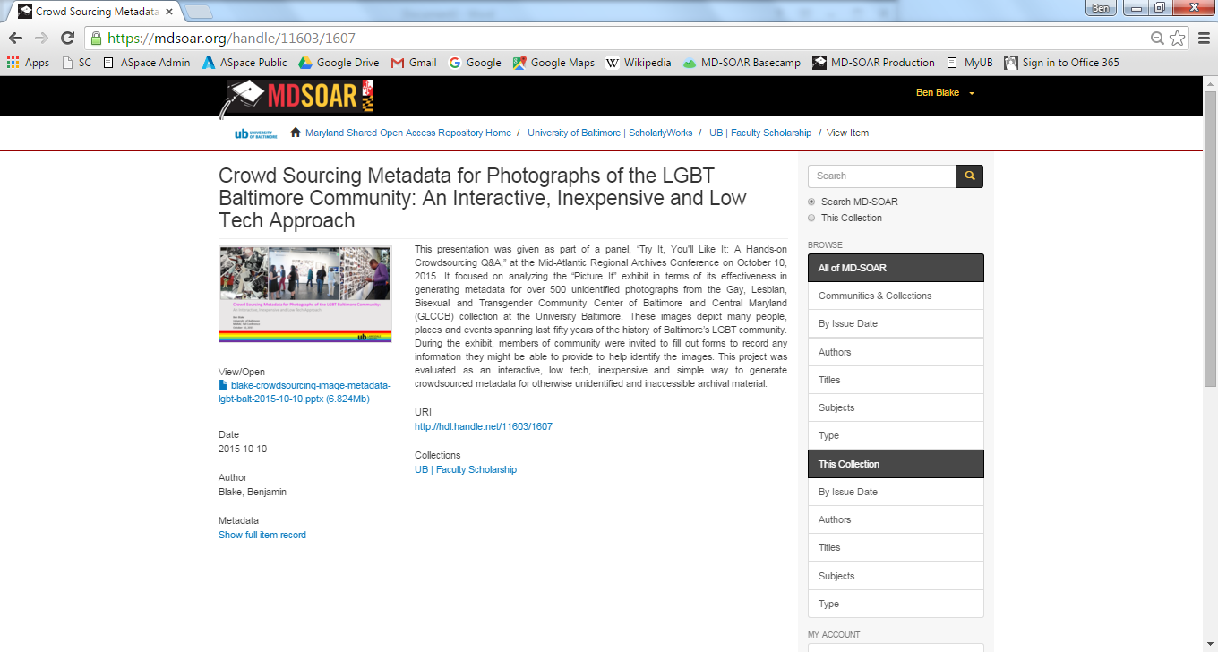
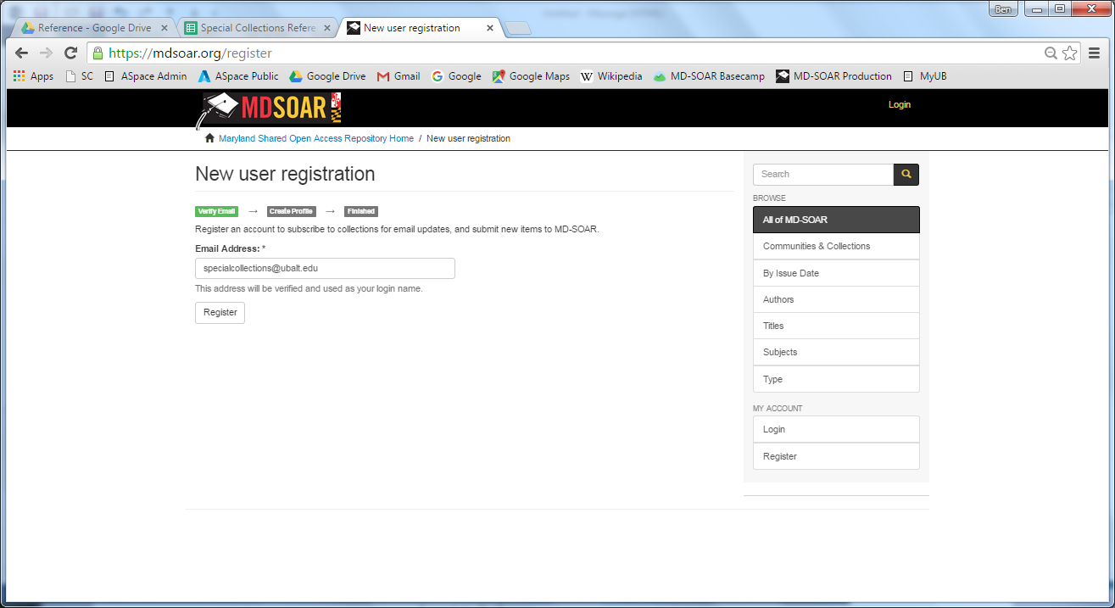


KnowledgeWorks@UB
The new digital repository of scholarship and research at the University of Baltimore
One location for all your most important work!
A Great space for
Join now
All types of material including:
Articles, papers, books, chapters and reports
Data and code
Supplemental material for journal articles
Presentations and posters
Audio and video files
Any file format
Including unusual formats not accepted by other repositories
Large files
Up to a 2GB limit per file
Unlimited storage
Initially, there is no limit on the total volume of your uploads. Act now to reserve your space before limits are set.
To become a new
KnowledgeWorks@UB community member register and then we will contact you about uploading your files.
Major advantages
DIY Uploads
High Google visibility
Permanent URL
Fulfillment of open access requirements
One central storage location
Backup for content located elsewhere
Preservation on UMD servers
To request help uploading your files contact us at knowledgeworks@ubalt.edu
or access the
Quick Start Guide .
KnowledgeWorks@UB
Quick Start Guide
knowledgeworks@ubalt.edu

