Slide 1





Recruiting and Retaining
Library IT People
- What We Learned -
I’m glad I’m here!
Should I stay?
A panel presentation by Kelly Sattler, Bill Helman,
Erin White, and Aaron Dobbs
eDUI Conference
Oct. 25, 2016
All meeple images by Caig, modified under CreativeCommons
Notes:
Hello everyone!
I’m Kelly Sattler. I’m from Michigan State University Libraries. I’m 1 of 4 here to talk to you about Recruiting and Retaining Library IT People - what we learned

Slide 2
Why we’re here & Who we are
Sharing results from a survey with 531 respondents concerning recruiting and retaining library IT.
Here today in person:
Kelly Sattler (@ksattler)
Head of Web Services at Michigan State University Libraries
Bill Helman (@thinkpol)
Information Technology Librarian at Towson University
Erin White (@erinrwhite)
Head of Digital Engagement at VCU Libraries
Aaron Dobbs (@awd)
Scholarly Communications & eResources Librarian at Shippensburg University
Rest of the team:
Wenjuan Ma
Michigan State University
Mark Dehmlow
Notre Dame
Janet Crum
Northern Arizona University
Notes:
Starting in 2015, we put together a survey hoping to find out what ways - other than money - good I.T. people could be recruited and retained within a library. The survey results were collected in October and November of 2015. We had a total of 531 respondents, but they didn’t all answer all of the questions. It was a long survey. May the 312 people who answered every question be blessed. We’re here to share some of the results, some insights, some by various demographics, and hopefully enable you to find and keep good IT people.

Slide 3
Recruitment

Slide 4
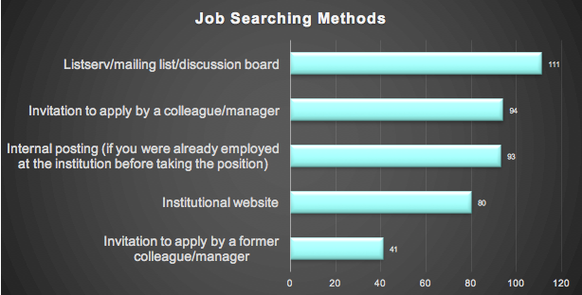
Top 5 ways people found their current position:
Notes:
We asked the question “How did you hear about your current position?” Of the 446 who responded, we found that the top 5 ways that people found their current position were
Listserves & discussion boards
Invitations from a colleague or a former colleague
Internal postings
An institutions website
We did encouraged people to select all options that they used when seeking their position.
Not surprisingly the longer a person has worked in a profession, the more likely they are to get an invitation to apply for a position. If you were in your position for more than 10 years, you’re most likely to have worked in another position for the same institution prior to this one.
For a people ages 45-54, librarians (vs. non-librarians), and people who had been with their current employer less than 3 years, the “Being invited by a former colleague” category fell out of the top 5 and was replaced with “professional publications.
We also had an “Other” category. Looking at those comments, it was clear we should have suggested “Newspapers” especially for those who had been in their position for a long time and “Friends/Relatives” or even a general “Word of Mouth”. Also from those comments, I learned that more men found their jobs through “Word of Mouth” than women. It was clear that women more often mentioned they were in their current position having moved there from a different position within the same institution. Their job changed, morphed or they were promoted.

Slide 5
What about Social Media?
For those who found their job within the past 3 years:
LinkedIn (45)
Facebook (36)
Twitter (26)
Glassdoor (22)
Notes:
Roughly a fourth of the people who answered our survey, had their current job less than 3 years. Focusing on them, the social media platforms used most to find a new job were LinkedIn, Facebook, Twitter and Glassdoor. Obviously, the most common answer for people who have been at their jobs for 10 years or more, and even for just 7 years or more, was that hadn’t used any social media platform because none existed.

Slide 6
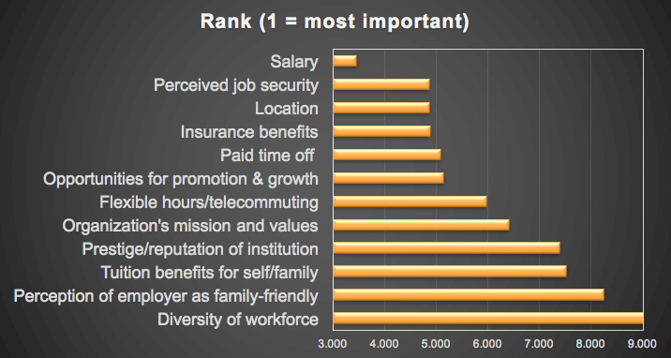
What influenced people to accept a position?
Notes:
We also asked the question, what influenced you to accept a position and gave them 12 options to rank with 1 being the most important. So, in this graph, the shorter the bar, the more influence a factor had.
Sadly, our survey confirms the well held belief that salary really is the most important factor when someone is looking for a new job, unless they are over 55, then it was an extremely close second. Location was #1. More bad news is that insurance benefits, paid time off, and location, which are things you’re not like to be able change, are high on the list too. However, perceived job security and opportunities for promotion and professional growth or development may be things that you can influence and they are about on par with other factors.
We asked people what other factors influence them in taking the job and two things were frequently repeated. They were I needed a full-time position and I connected with the person I be working for.
As far as men vs. women, not a lot of difference in the top factors.
Flexible work hours ranked higher for non-librarians than librarians.
As far as age goes...

Slide 7
Top 3 factors by age after salary...
Under 34 years old:
Location
Opportunities for promotion/growth
Paid time off
35 - 44 years old:
Paid time off
Job security
Insurance benefits
45 - 54 years old:
Insurance benefits
Job security
Opportunities for promotion/growth
Over 55 years old:
Location
Insurance benefits
Job security
Notes:
Besides age, another time factor is time in position

Slide 8
Top 3 factors by time in position after salary...
Less than 3 years:
Location
Paid time off
Opportunities for promotion/growth
4 years or more:
Job Security
Insurance Benefits
Location
Notes:
Besides age, another time factor is time in position

Slide 9
Retention

Slide 10
What keeps people onboard?
It’s more than money, but money’s really important.
Compensation
Benefits
Work-Life Balance
Notes:
So these may not be that surprising, but generally speaking they were our respondents top factors for retention.
Most of which have significant financial components to them.
Compensation includes factors like salary, retirement options, and paid sick time.
Benefits include things like medical, dental, and prescription drug insurance as well as tuition benefits.
Work-life balance includes things like telework and flexible schedule options.
We all want to say that we stay at a job for “more than money,” but at the end of the day that’s the foundation for the decision.

Slide 11
Why do they jump ship?
For respondents planning on leaving in the next two years.
Lack of opportunity for promotion
Not involved in decision making
Insufficient resources to do the job well
Lack of mentoring programs
Not enough interesting projects
Notes:
This is for respondents who indicated that they are planning to leave their current position within the next two years.
Note that many of them are related to organizational, or managerial, factors.
The respondents say that they want to have a clear career path and opportunities for promotion.
They want to be treated as valuable partners, not just brought in to accomplish tasks.
The respondents felt they were asked to do too much with too little - lacking people, technology, or funding to do the job well.
They wanted more formal guidance and support from senior members of their group.
And a lot of them were just bored

Slide 12
Mind the gaps.
Some of the gaps between what they want and what they get:
Telecommuting and flexible hours
Opportunities for promotion
Insufficient resources
Notes:
One of the things we looked at where there were significant satisfaction gaps. These are the places where respondents said a thing was important, but that they weren’t satisfied with their experience with it.
Respondents wanted more flex time than they were given, better opportunities for promotion, and felt that they did not receive the resources (technology, funding, people, etc) to do their jobs well.
It interesting to note, that while there was a significant satisfaction gap for each of these across the board, they were all more pronounced for female respondents.

Slide 13
And mind the gaps in leadership too.
Or where the boss “does not meet expectations.”
Trust in senior leadership
Clear expectations
A leadership that “understands IT work”
Notes:
There were also some particularly important gaps in satisfaction with how managers and senior leadership are performing for their employees.
Respondents cited a lack of trust in senior leadership, a lack of clear expectations from leadership, and a feeling that those in charge didn’t understand what it was they did.
In general women had a more significant satisfaction gap for all three of these factors than their male colleagues. Though they were significant for men too.
Furthermore professional librarians reported they were less satisfied with the factors “Clear expectations” and “trust in senior leadership”
Whereas non-librarian IT staff were less satisfied with “Library leadership that understands IT work.

Slide 14
More than Money

Slide 15
Should I stay or should I go now?
Here why respondents said they’re tempted to leave
Salary (offers of ~40% more salary elsewhere)
Demanding (many only-loosely related tasks)
Poor management (unrealistic expectations / lack of understanding)
Technology refresh rate / legacy technology (how old is this technology?!)
Lack of IT integration into organizational goals (out of sight out of mind)
Lack of advancement path (if there is only a few people, how to advance?)
Notes:
Lifted/condensed from Q28-Q31 comments
Paraphrases from male respondents:
Shenanigans in tenure process poisoned work environment
No significant raise in years and no clear promotion ladder
Do not always (nor often) feel supported
Terrible technology refresh rate
Female:
I’m 72 and have been here 20+ years - it’s time to pass the torch
Spouse unable to find work in the area
Compared to former position (elsewhere) current position give no recognition for my work and denies presentation or continuing education opportunities
Too much internal politics (for too little gain)
External salary equity -- I can make 140% of my salary fr doing the same thing elsewhere
Have to leave to advance professionally
Ancient legacy technology

Slide 16
Should I stay or should I go now?
Here why respondents said they would rather stay than go
Teleworking options (skip the commute a couple days a week? sign me up!)
Customer focus (care about the customer & technology will (usually) follow)
User Experience Focus (higher ed & libraries help student/faculty success)
Integration of IT into strategic planning (IT knows what’s realistic, let us help)
Notes:
Lifted/condensed from Q28-Q31 comments
Paraphrases from male respondents:
Salary and reputation of school brought me here, environment and culture will determine how long I stay
I enjoy the people and the projects (same person said: no significant raise in 10 years)
I can be proactive and have the autonomy to solve pressing problems
I can take an idea of mine and see it through, from conception to implementation
I (now) get to work with an open source ILS - I think I wil be happy and stimulated for a long time!
Female:
Not much could convince me to change jobs, due to schedule flexibility and opportunities to work out of state and internationally
Only have one year until retirement - I wish I had come to library IT sooner!
3 more years until my retirement is vested (same person also said: Spouse unable to find work in area)
I love what I do
Library IT is a full partner in strategic planning efforts
Opportunities to play with emerging technologies

Slide 17
It ain’t a huge salary, but…
...what can we offer instead?
Tuition remission and other non-salary bennies and discounts
Support for conference travel, webinars or other training
Work/life balance: *only* a 40-hour workweek, lots of leave, flexible hours
Options to telecommute regularly
Ability to work on fun projects/20%-time projects
Inclusion in organizational decision-making
Working directly with stakeholders
Notes:
Skipped slide here: actually paying people! First and foremost, advocate for folks, look at the market, try to hire and give raises that at least knowledge that the person has outside options.
These non-pay options highlight some of the factors Aaron talked about w/r/t retaining people. Finding ways to get everyone involved in organizational decision-making, while also recognizing that they have lives outside of work and may want to flex their time to accommodate that. This flexibility helps you recruit more diverse people, too.
And, because our organizations are not profit-driven, we can make room for our employees to work on 10- or 20%-time projects, explore new technologies and learn on the job

Slide 18
Where are my competent managers at?
Good managers = happier employees
Not much training for managers in libraryland or higher ed
Peter Principle
Notes:
Another emerging theme from this research was that managers had a *huge* impact on whether their employees stayed or left. And what’s funny is that in libraryland (and in higher ed, often) there is little to no investment in management training. Managers are often promoted because they were good at doing work, but are not equipped with the skills to proceed.

Slide 19
What motivates people: “autonomy, mastery, purpose”
Daniel Pink, Drive
Notes:
Managers can change how they manage and influence the culture of the library. I haven’t read this book but I assume it’s great.
So how can managers support their people’s autonomy, mastery, purpose?

Slide 20
For managers
Trust your people. Document, cross-train, delegate, and let it go.
Communicate. Make sure folks know why their work matters.
Don't roadblock. Street sweep. Take yourself out of workflows to avoid bottlenecking. Spend your time getting rid of obstacles for your team.
Support employees’ growth. Ask “how do you want to grow?” then follow through.
Advocate. Find ways to let employees’ voices be heard. Use your position to push for humane policies and practices for all employees - not just faculty.
Be open to new ideas and technologies. Folks want to learn and your organization will benefit.
Notes:
A lot of this comes down to trust. “Command and control management” like we see in Dilbert and Office Space just doesn’t work. Employees must be entrusted to use a common set of values to solve problems - not just wait for the next order from you.
Your job as a manager is to clear obstacles for your team, find out what they need to grow, advocate for their needs and ideas, and allow your own mind to be changed. When you’ve made a decision about something, communicate. Communicate all the time anyway.
And a lot of this also involves working on the culture at your library (which as UX-type folks we are used to doing). Managing up, too, to make some of these values universal.

Slide 21

Questions?
Notes:
That’s all the time we have today. I think our big takeaway is, invest in your people! For salaries and for training opportunities for managers.
We would love to take your questions.

