Slide 1
A Study of Cross-Cultural Public Arts Spaces
February 1st - 12th, 2016
Nicole Wise

Slide 2
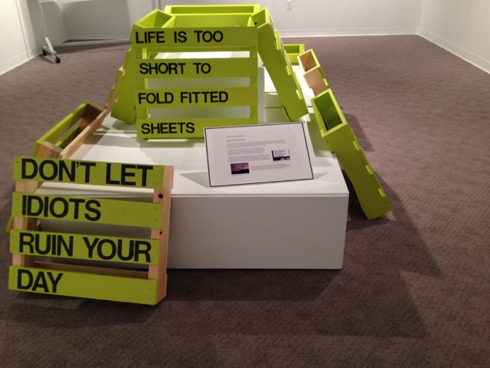
Thoughts To Be Considered, 2016
12 quarter-sized pallet boards, paint, vinyl letters
…In the gallery context…

Slide 3
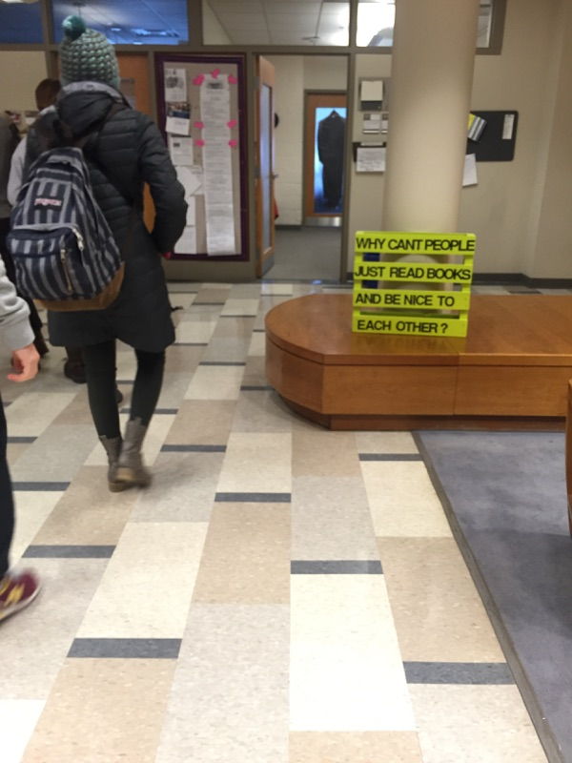
Thoughts To Be Considered, 2016
…And when moved to a public setting within
academic buildings for two days (February 8th - 9th),
Van Meter Hall and the Julia Rodgers Building…

Slide 4
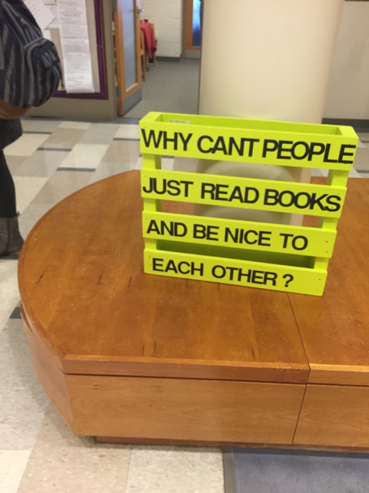

Slide 5
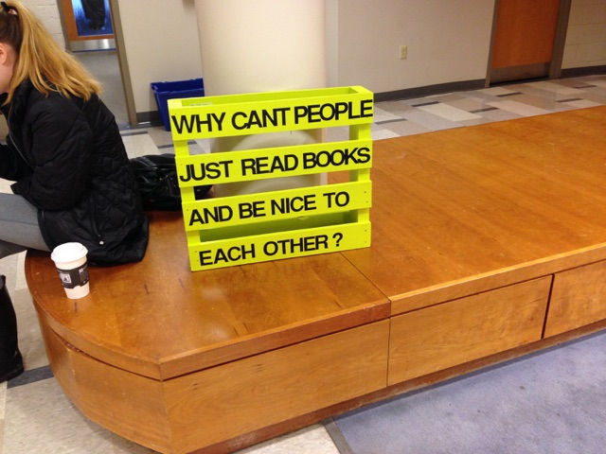

Slide 6
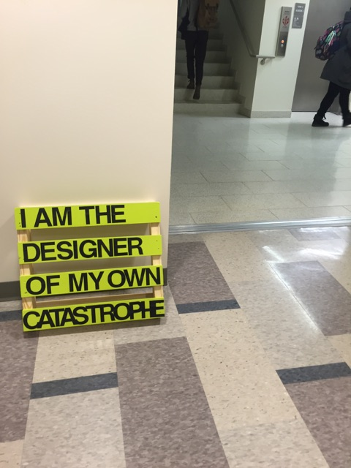

Slide 7
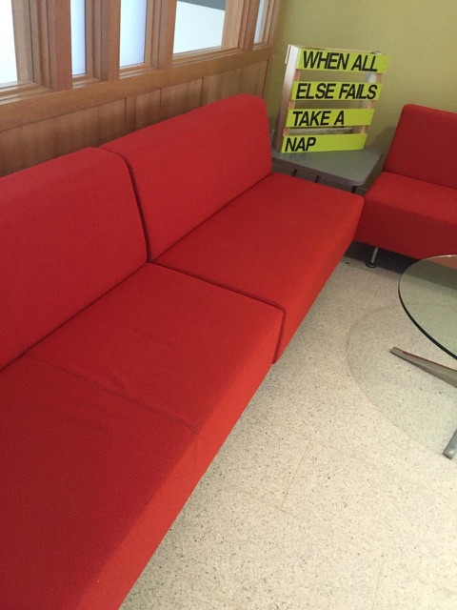

Slide 8
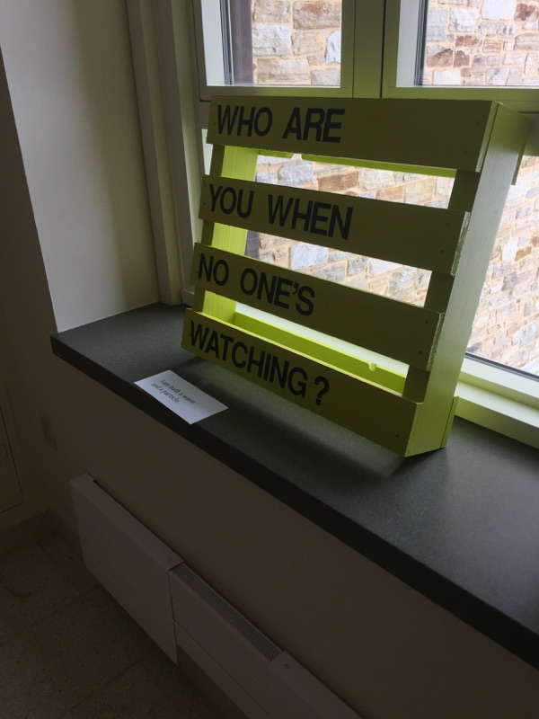

Slide 9
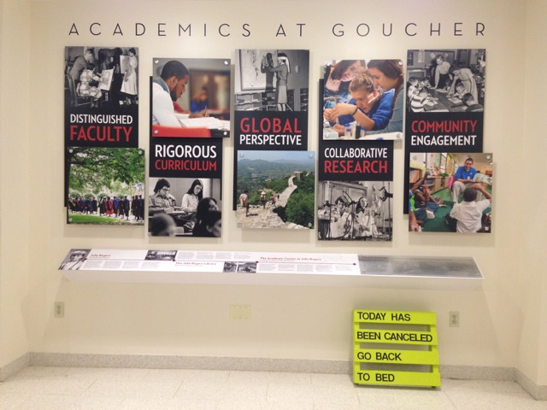

Slide 10
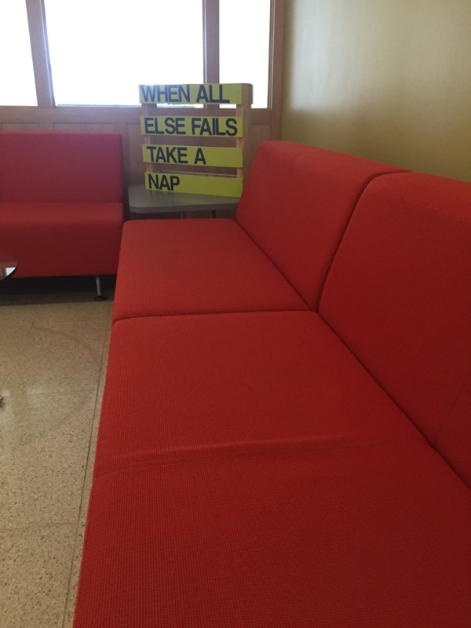

Slide 11
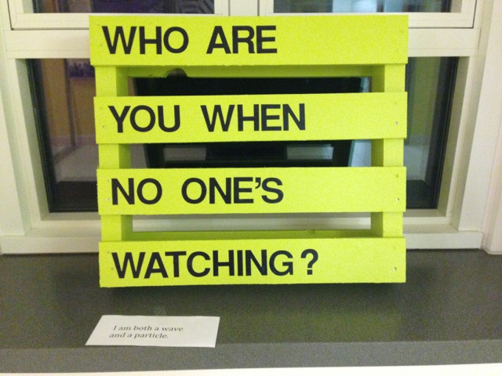

Slide 12
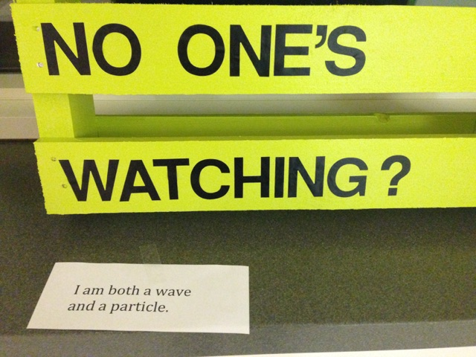
Anonymous public response in reaction to the piece

Slide 13
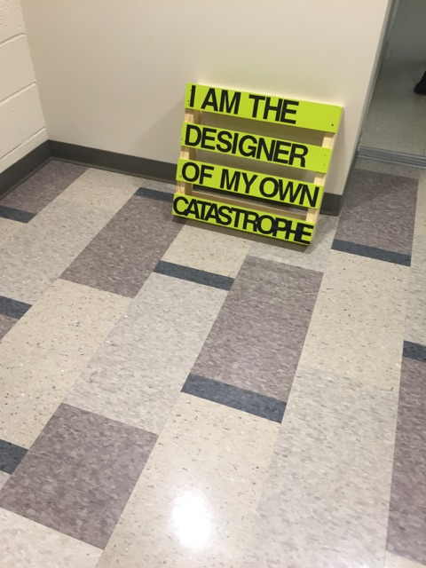

Slide 14
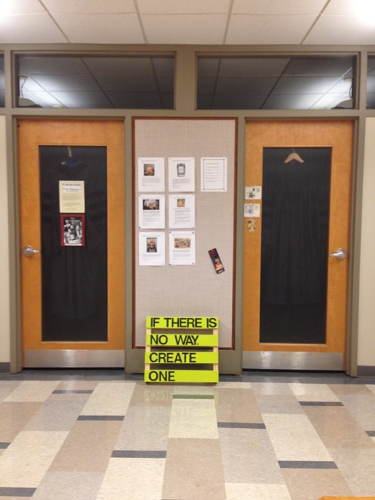

Slide 15
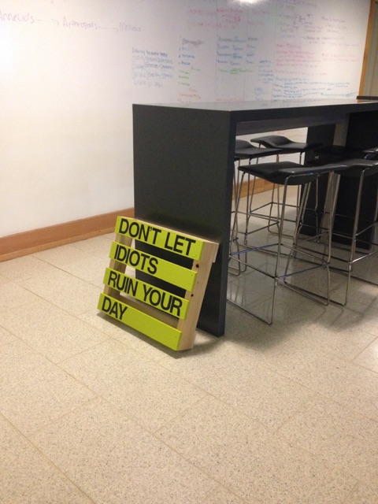

Slide 16
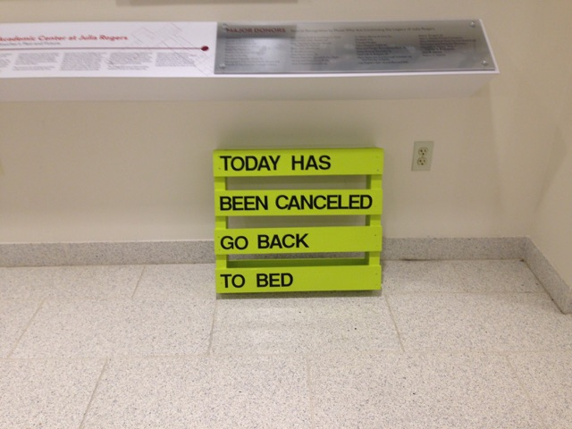

Slide 17
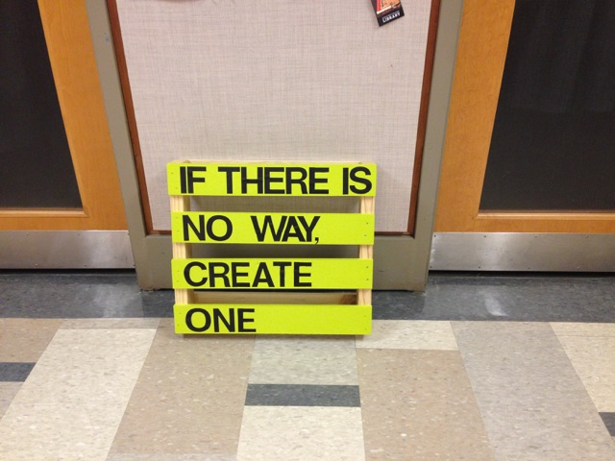

Slide 18
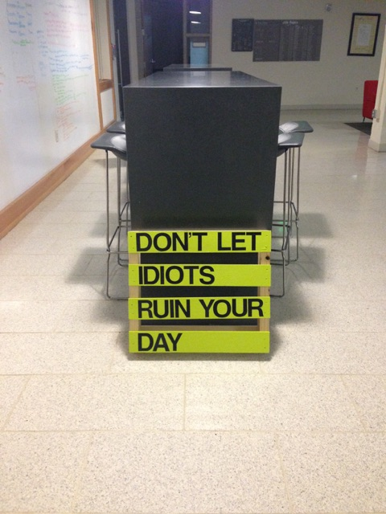

Slide 19
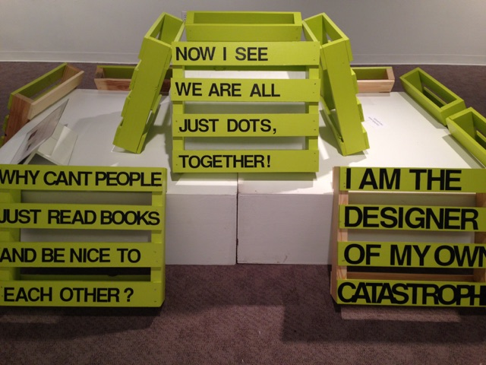

Slide 20
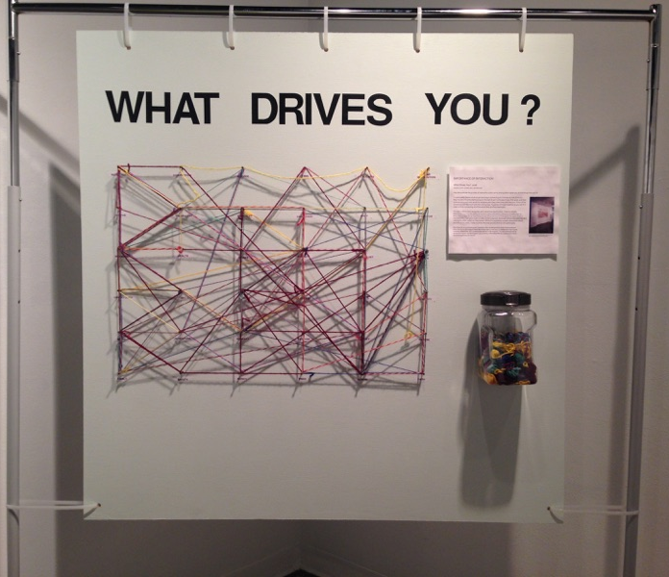
What Drives You?, 2016
plywood, paint, screws, yarn, garment rack
…Placed in gallery setting for one week…

Slide 21
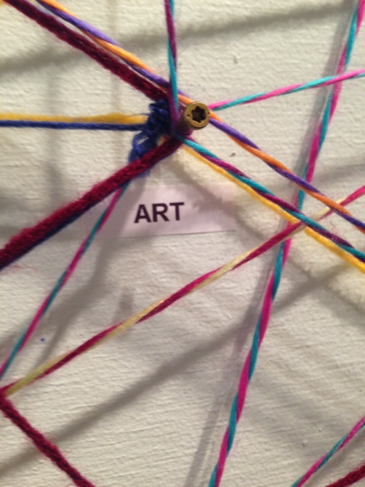

Slide 22
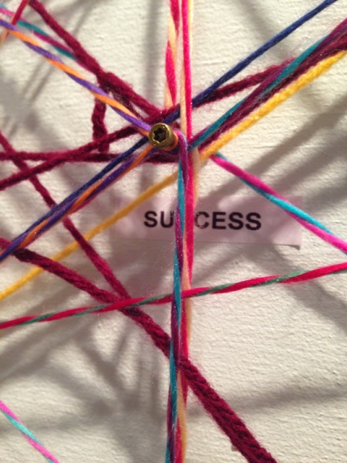

Slide 23
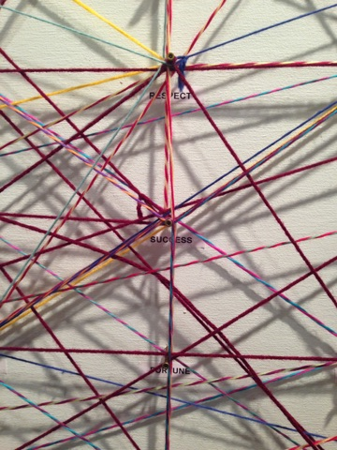

Slide 24
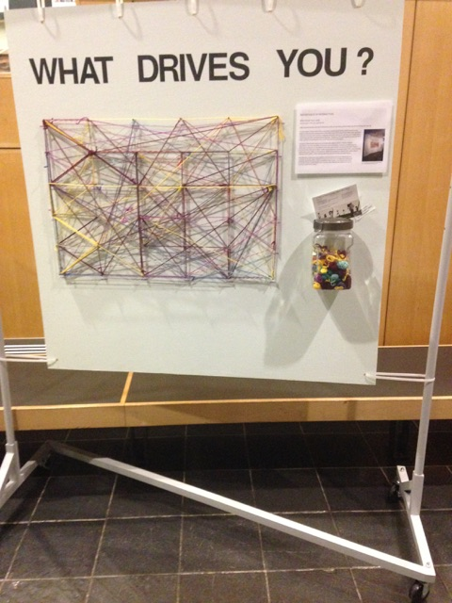
…Installation placed in a more public setting for two days (February 8th - 9th),
Pearlstone Atrium…

Slide 25
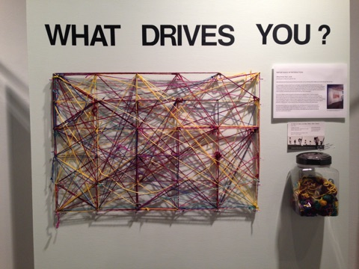
What Drives You?, 2016
…Interaction after two days in more public setting,
Pearlstone Atrium…

