Slide 1
Open Educational Resources (OER)
An overview
Victoria Martin January 8, 2018

Slide 2
What are OER?
ORIGINAL DEFINITION:
“…technology‐enabled, open provision of educational resources for consultation, use and adaptation by a community of users for non-commercial purposes” (UNESCO, 2002).
MOST OFTEN CITED DEFINITON:
“…educational materials that reside in the public domain or have been released under an open license that permits their free use and re-purposing by others” (Hewlett Foundation).

Slide 3
5Rs of Openness
Retain - Make and own copies
Reuse - Use in a wide range of ways
Revise - Adapt, modify, and improve
Remix - Combine two or more
Redistribute – Share with others
(David Wiley, The Access Compromise and the 5th R, 2014)

Slide 4
“At the heart of the open educational resources movement is the simple and powerful idea that the world's knowledge is a public good and that technology in general and the World Wide Web in particular provide an extraordinary opportunity for everyone to share, use, and reuse that knowledge.”
Mike Smith, Director of the Hewlett Foundation Education Program

Slide 5
Key characteristics of OER
Authorship. Originate from colleges and universities, libraries, organizations, faculty or other individuals.
Formats. Typically, in digital format, including multimedia formats.
Platforms. No platform restraints.
Ownership. Either reside in the public domain or are released under an open license.
Conditions. Permit free use and re-purposing by others.

Slide 6
OER forms
textbooks
courses
syllabi and lesson plans
learning modules
tests
teaching techniques
writing prompts
group activities
audio and video recordings
games
software applications
experiments
simulations

Slide 7
Typical OER models
Individual OER
Open textbooks
OpenCourseWare (OCW)
Peer-productions

Slide 8
Examples of OER initiatives
MIT OpenCourseWare (OCW)
OpenStax
Maryland Open Source Textbook (M.O.S.T.) Initiative

Slide 9
Creative Commons Licenses
"Attribution" (BY)
"Share Alike" (SA)
"Noncommercial" (NC)
“No Derivatives" (ND)

Slide 10
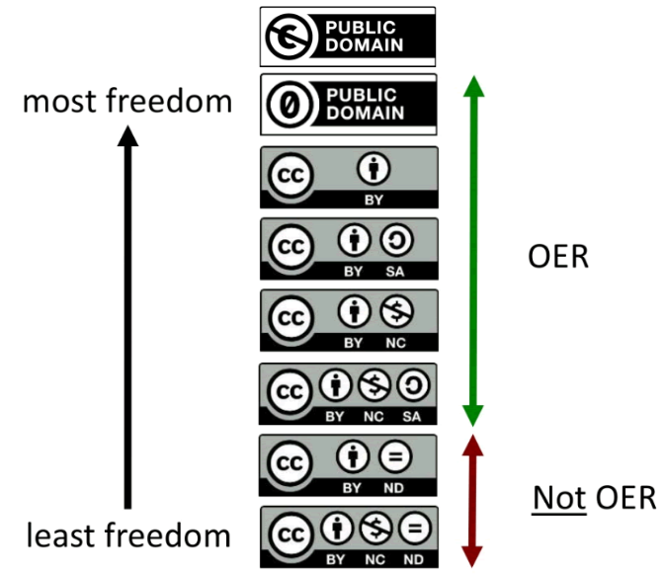
Creative Commons Licenses (contd.)
(Gable Green, CC BY)

Slide 11
References
Smith, M., & Casserly, C. (2006). The promise of Open Educational Resources. Change: The Magazine of Higher Leaming.
UNESCO. (2002). Forum on the impact of open courseware for higher education in developing countries: Final report.
Wiley, David. (2014). The Access Compromise and the 5th R.

