Slide 1


THE CROSSROADS OF LIVING WAGES IN AMERICAN MUSEUMS
Vanessa M Lancaric
Major paper presentation in partial fulfillment of the requirements for the degree of
Master of Arts in Arts Administration
2023
Notes:
The Crossroads of living wages in American museums

Slide 2


Thesis Statement
In response to employee turnover, museums are at a crossroads in addressing labor issues, which require a rethinking of their traditional business model.
Museums implementing salaries that reflect living wages in their respective regions will improve employee retention and organizational culture.
Notes:
Thesis Statement
In response to employee turnover, museums are at a crossroads in addressing labor issues, which require a rethinking of their traditional business model. Museums implementing salaries that reflect living wages in their respective regions will improve employee retention and organizational culture.

Slide 3


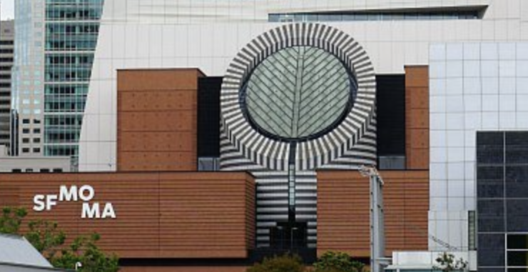
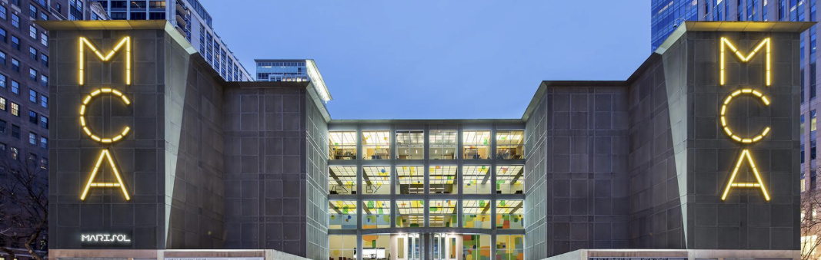
The Lack of Living Wages is an Equity Issue
Notes:
The lack of living wages is an equity issue that adversely affects the field's ability to address calls for greater equity and retention. To retain a diversified museum workforce, more diversified boards can play a significant role in addressing the lack of livable wages. A broader understanding of the data on the museum workforce and the retention challenges in museums underpins the importance of this inquiry. Leaders in museums are facing considerable difficulty in not addressing the realities of the living wage issue that affects the employees of their institutions.

Slide 4
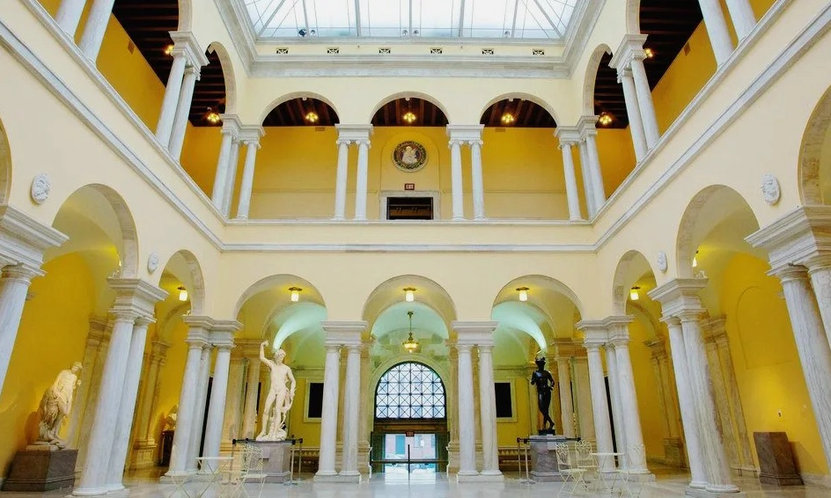
Low Salaries & Employee Retention
A survey of graduates of museum studies programs from 1994 to 2017, performed by Martha Morris of George Washington University in 2019, demonstrated that most had left the museum field because of:
Low salaries
Lack of full-time positions
Lack of opportunities for advancement/challenging work projects
Notes:
Museum workers have historically been made up of employees with generational wealth, allowing them to get a foot in the door of an industry that all too often offers ridiculously low wages (Tremayne-Pengelly). Even for those with inherited wealth, inadequate compensation coupled with a lack of development prospects and poor work cultures does not represent a sustainable career path. The issue of lack of appropriate living wages has been a significant factor even prior to COVID-19 initiating a disruption in the labor force. The majority of museum directors are finding difficulty in creating an employee-centered culture that adequately compensates employees, rewards high performance, and supports employee professional development.

Slide 5


Current museum structures create salary differentials Mean salaries compiled from the Association of Art Museum Directors salary survey of 2022
Position | Salary 2022 | Position | Salary 2022
Museum Directors | $343,600 | Chief of Security | $81,200
Deputy Director | $185,500 | Exhibition Designer | $75,500
Chief Operating Officer | $209,500 | Associate Conservator | $73,200
Chief Curator | $158,500 | Registrar | $72,500
Director of Development | $153,000 | Museum Store Manager | $70,100
Director of Finance | $151,700 | Special Events Manager | $67,400
Chief Conservator | $126,500 | Associate Librarian | $63,600
Human Resources Director | $125,700 | Associate Educator | $61,200
Director, Planned Giving | $105,800 | Assistant Curator | $60,000
Senior Conservator | $98,900 | Associate Librarian | $51,700
Marketing Director | $99,200 | Assistant Registrar | $51,900
Director of Education | $94,400 | Assistant Educator | $52,000
Facilities Director | $97,900 | Volunteer Coordinator | $55,000
Systems Manager | $97,500 | Education Assistant | $45,700
Director of Finance | $87,700 | Museum Security Officer | $39,700
Engineering Manager | $89,900 | Visitor Services Associate | $36,800
Notes:
A wide gap exists between executive employees and the remainder of staff in most museums. Historically the executive positions have been filled by white males from certain socio-economic backgrounds that permitted them to rise in becoming leaders of museums given their access to the inner circles that museums can be privy to. An important segment of museum staff are docents, interns, and volunteers, who contribute greatly to the operation of museums. An intern could spend an entire year researching for an upcoming exhibit and not get paid, aside from adding the experience to their resume. Who could survive a summer on an intern stipend of $400 or, like most, unpaid? Unpaid internships are not a fair and equitable employment practice and have alienated many worthy up-and-coming museum study graduates who come from working or middle-class backgrounds.

Slide 6

Gap in Executive and Front Line Pay
Average museum director compensation is nearly 10x that of museum associates
Education and front of house roles, which engage the public, are underpaid relative to other positions
Notes:
Museums with large net assets that claim to have equitable, inclusive, and accessible environments might have to rethink whether they are living up to the wording of their vision and mission statements. Not only are they often not providing living wages for their employees, but they also do not consider the educational requirements that they ask of their candidates, which carry heavy student loans. The same applies to cultural workers in other parts of the cultural sector, like the performing arts, where salaries are not enough to sustain the cost of living.

Slide 7
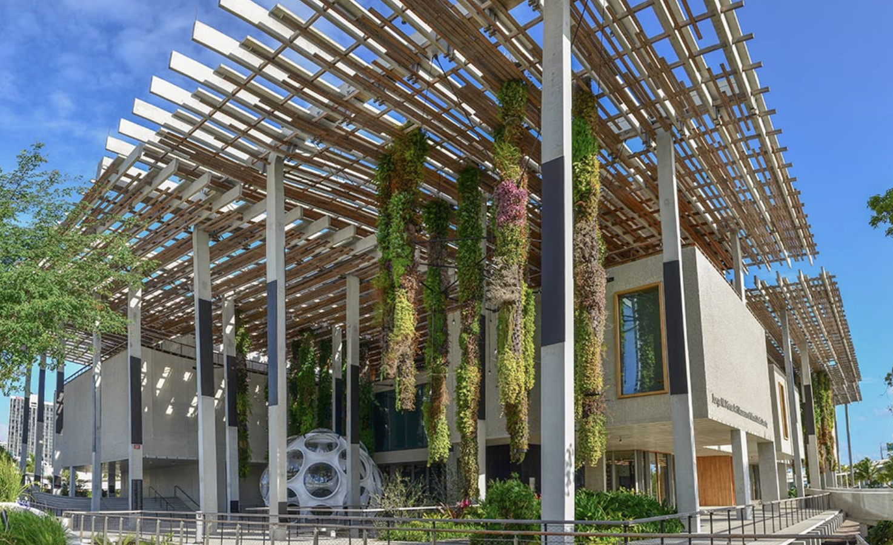
What is the MIT Living Wage Calculator?
Developed to help individuals, communities, employers, and others estimate the local wage rate that a full-time worker requires to cover the costs of their family’s basic needs where they live.
Notes:
Implementing living wages based on the prevailing labor market conditions and inflation in their regions and publishing competitive salaries and wages to avoid the constant turnover of employees is imperative for museums and other arts and cultural institutions to retain staff. Society benefits from museums retaining their staff, as these institutions support and contribute to restaurants, housing, local businesses, taxes, social security, and Medicare in the geographic area in which the museum operates. Data on cost of living and salary transparency, such as the MIT Living Wage Calculator, can be used as a model for assessing compensation levels for positions based on living wages. Once applied, it can demonstrate which museums are acknowledging the cost-of-living wages in their area.

Slide 8
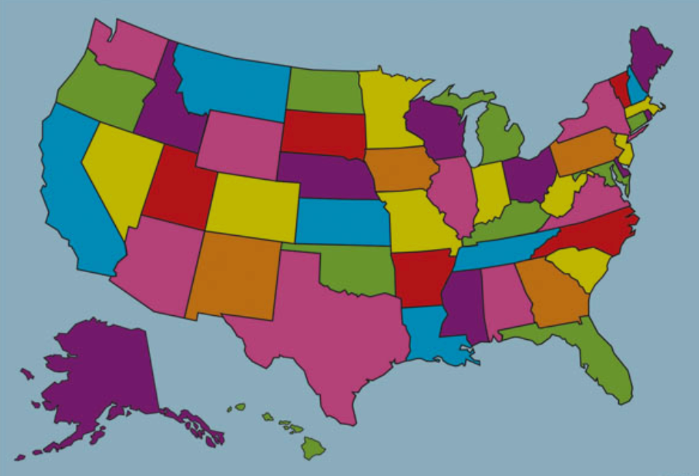
Museums Must Address the Cost-of-Living
Full-Time Job Posting Description and Location | Salary | MIT Living Wage Calculator One Adult Only | MIT Living Wage Calculator One Adult and 1 Child | Museum Net Assets per 990 Form or Financial Report 2020 or 2021
Website Content Manager, The San Francisco Museum of Modern, San Francisco CA | $76,841 - $81,334 | $64,090 | $125,687 | $736,279,605
Associate Director of Individual Giving and Events, Mississippi Museums of Art, Jackson MS | $55,000 - $65,000 | $33,498 | $62,984 | $7,998,794
Director's Office Assistant, Museum of Contemporary Art Chicago, Chicago IL | $49,430 - $61,680 | $38,306 | $73,208 | $194,091,422
Preventive Conservator, The Walters Art Museum, Baltimore MD | $50,500 - $60,500 | $36,477 | $74,494 | $234,163,733
Museum Executive Director, Southeast Museum, Brewster NY | $30,000 - $40,000 | $52,863 | $96,867 | $109,531
Notes:
Here are some samplings of job postings with salary rate with the MIT Living Wage Estimate Calculator being used to determine whether living wages are being offered for the position in that area. These findings demonstrate ways that museums can determine whether their compensation matches living wages for their community. Their net assets are also a reflection of the institutions at hand, which are available to all to research through tax filings. One can notice that if the employee is the sole breadwinner in a household that encompasses dependents, that employee's salary rate, most of the time, will not suffice and they might have to take on additional jobs and or rethink a career. This could cause alienation of a diverse pool of candidates who might opt out.

Slide 9
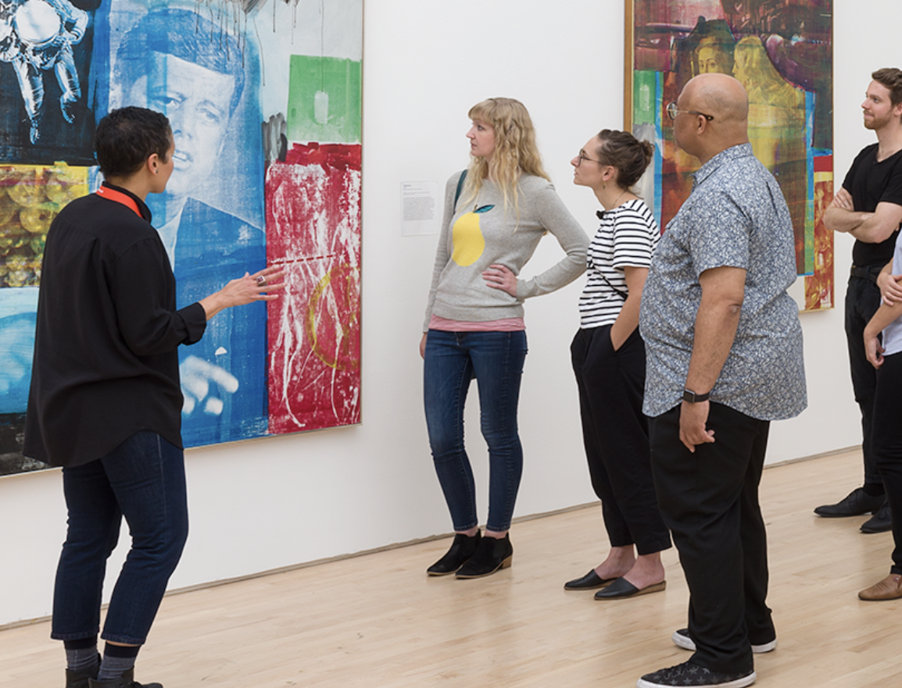

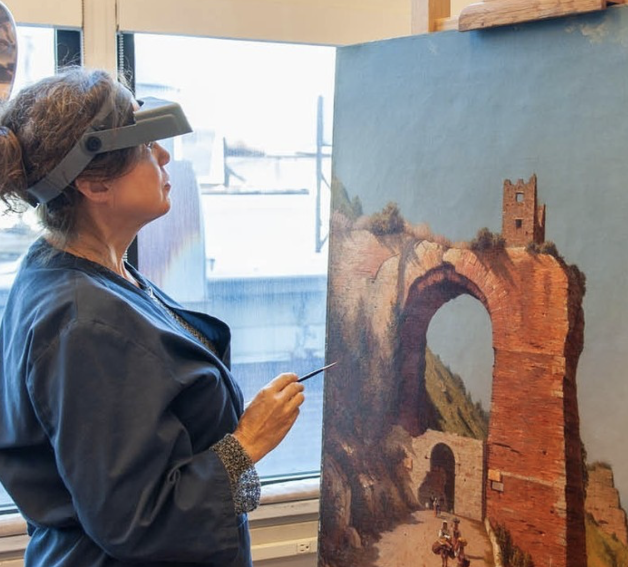
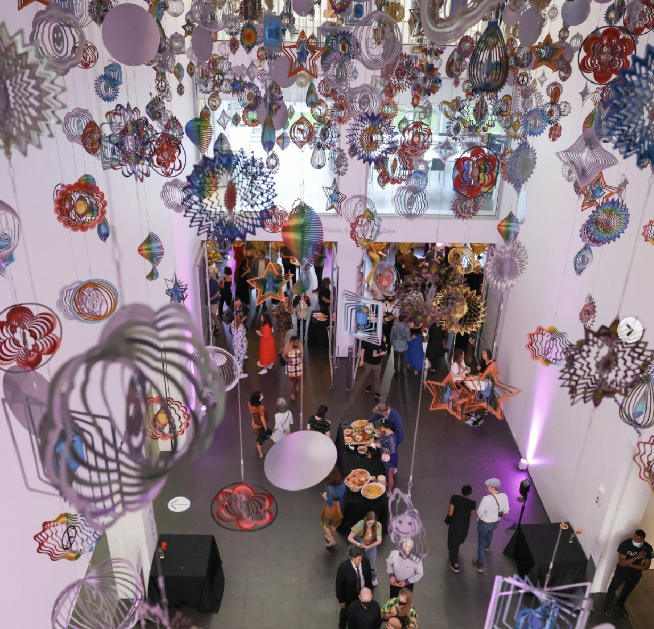
Practices that Museums Can Pursue
Wage/salary transparency
Endowment campaigns for salaries
Commitment to living wages
Seek trust-based philanthropy values and worker-centered
Notes:
There are many arguments about why living wages in museums remain elusive. Many would claim that most museums do not have the budget to allocate additional funds for salaries. It is also said that endowments used for operational costs fluctuate and cannot be relied on during recessions, and donors are resistant to giving to operational funding. Others argue that living wages cannot be given out overnight and need time to be absorbed which can take years to implement in thoughtful steps. Yet, some executive directors who at times are restricted in allocating living wages have produced alternate benefits such as extra time off, free parking, retirement plans or health benefits for part-time workers as well. Operational grants geared toward salaries should be investigated by educating those funders about the vital importance of funding beyond programing. A new movement of trust-based philanthropy that emerged during COVID-19 can be beneficial for the donor and recipient. Most museum employees are required to have higher education qualifications and yet are often paid less than the living wage matrix for the geographical location in which they work and in a manner that is inconsistent with their educational level. These factors also alienate a population that does not come from wealth and cannot permit themselves to live on the wages museums are offering. In a current environment in which equity in the museum sector is being discussed with urgency, compensation could stand to play a significant role in allowing a wider cross-section of the population to pursue museum careers.

Slide 10

Implementing Living Wages For Museums
Notes:
To support change, the cost-of-living crisis in pay rates must be researched by museum administrators through the study of living wages in their respective regions. Incorporating this information into planning (be it a two-to-five-year implementation policy that can come to fruition) will allow museums to respond to economic pressures and avoid the constant turnover of employees that has become indicative of the sector.
Instead of confrontation, transparency, an open dialogue, and exchange of ideas must be had between employees, leadership, and boards if the museum world is to continue and thrive; a failure to do so will result in the museum sector being known as a field that exploits and alienates brilliant minds and stewards of arts and culture—past, present, and future.

Slide 11
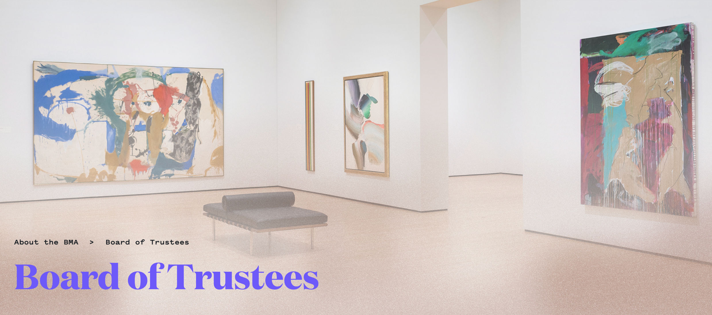
Boards Can Take a Particularly Key Role
Fred Bidwell—a board member of Cleveland Museum of Art, Visiting Committee member of the Allen Memorial Art Museum, and Board Chair of Assembly for the Arts:
  I think there's been an assumption that museums, by definition, are wonderful places and people should just love working there and that you don't really have to pay people that much because the personal reward should somehow compensate. That's naive, that's arrogant, and it's incredibly unfair, and particularly distasteful.
Notes:
Boards can take a particularly key role in implementing living wages for museums, as they represent the community the organizations reside in and have a fiduciary duty for the sustainability of all parts of an institution, including the compensation of employees, one of the most vital assets of any institution.
Arts and culture uplift, inspire, and educate and yet many cultural institutions, particularly museums, are currently being indicted by their employees for the ways in which they devalue their employees with a lack of living wages. Change in this area is among the reforms that museum administrators can make to improve organizational culture and a societal divide.

