Slide 1
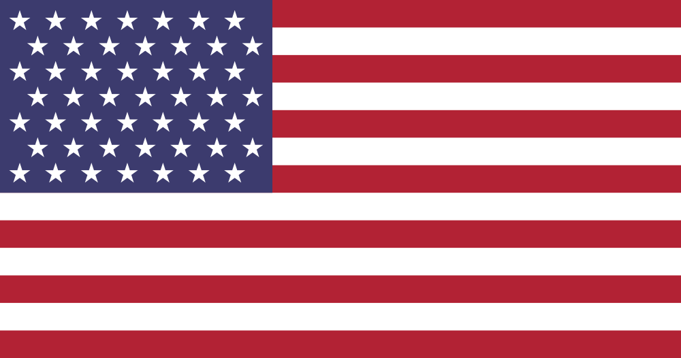
STATEof theSTATES
Evaluating US Regional AV
image via wikimedia commons
siobhan hagan, university of baltimore
lynette stoudt, georgia historical society
anne wells, chicago film archives

Slide 2
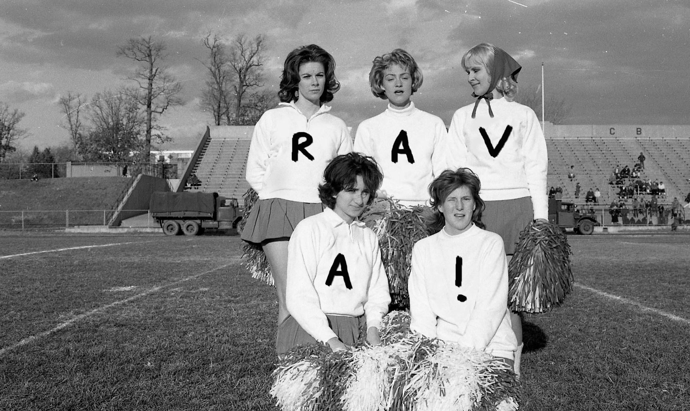

Slide 3
Survey
AMIA
SAA
ALA
Email

Slide 4
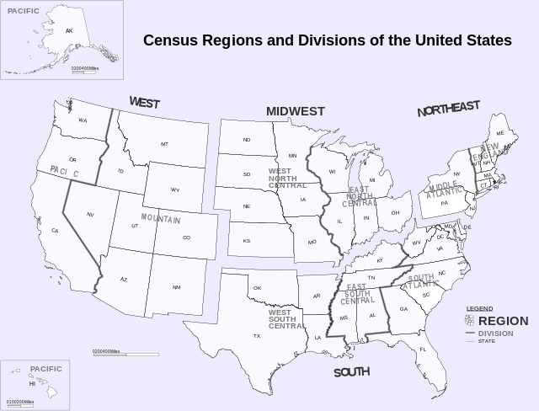

Slide 5
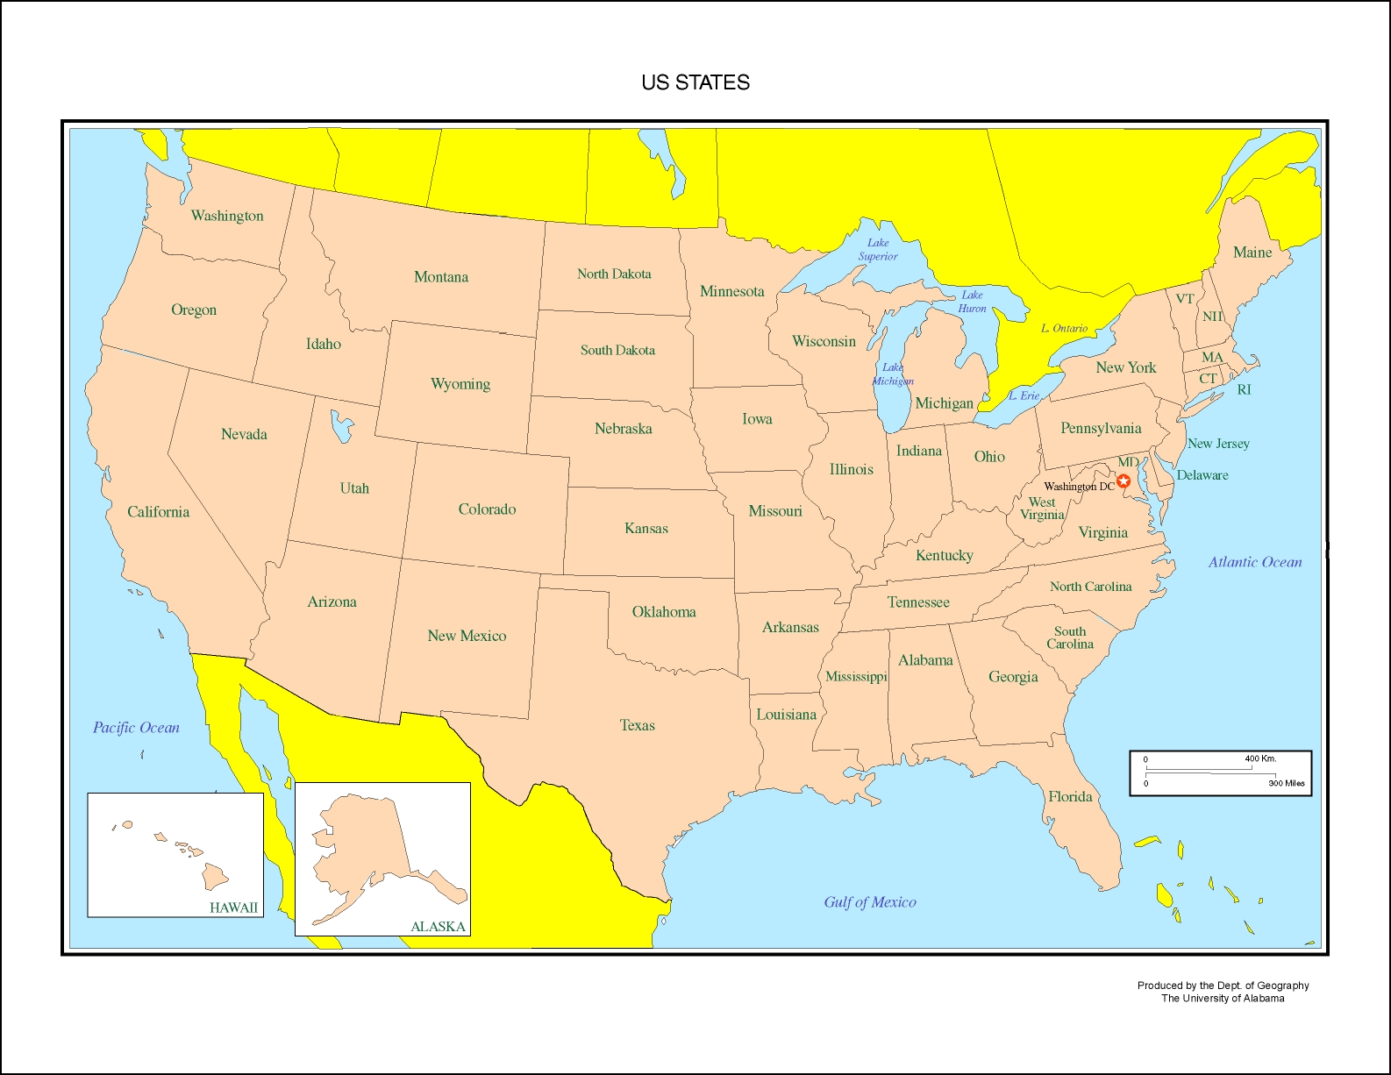

Slide 6
Most represented
Louisiana, New York and Pennsylvania
Maryland
Illinois
New Jersey, Texas, USA: national
California, Georgia
Alaska, Florida, Massachusetts, Mississippi, Tennessee, Virginia, West Virginia
Arizona, Colorado, Connecticut, Delaware, Hawaii, Indiana, Iowa, Kentucky, Michigan, Minnesota, Missouri, Montana, Nebraska, North Carolina, Northeast, Oklahoma, Oregon, Southwest, Utah, Washington, Wisconsin

Slide 9
Types of organizations
Universities
Historical societies
RAVAs
State/city archives

Slide 10
Types of AV
Mix of formats: film, magnetic tape, born-digital
Local television
Home movies
Documentaries
Publicity movies

Slide 11
Needs
Environmental storage
Digital storage
Digitization
Staff

Slide 12
Collaboration

Slide 13
Collaboration=RAAC

Slide 14
Collaboration=RAAC+AMIA/RAVA

Slide 15
STATEof theSTATES
Evaluating US Regional AV
image via wikimedia commons
siobhan hagan, university of baltimore
lynette stoudt, georgia historical society
anne wells, chicago film archives

