Slide 1
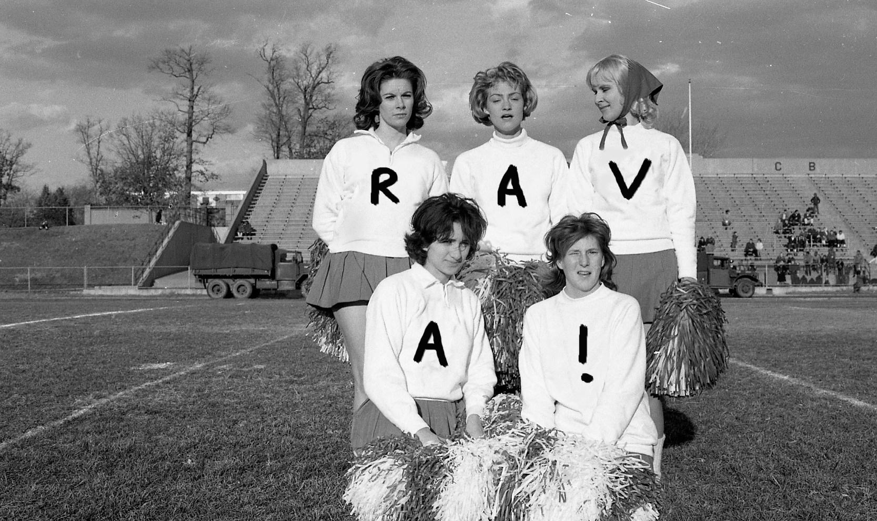
Regional
Audiovisual
Archives
Siobhan Hagan University of Baltimore Langsdale Library
Notes:
Across the US, there is regional AV content stored in various smaller institutions or non-moving image archives. I myself find myself as an AV Archivist working at such an institution.

Slide 2
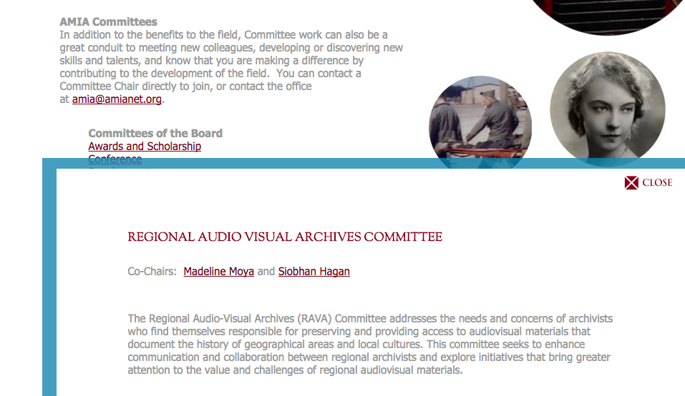
AMIA RAVA Committee

Slide 3
AV Preservation Problems
Mold
Film degradation
Nitrate phobia
Sticky Shed Syndrome
“Degralescence”

Slide 4
RAVA Preservation Problems
Lack of resources!
Notes:
RAVA heard this issue anecdoteally from some AMIA members or others we met at different conferences, but we didn’t really have any numbers. And what role should RAVA play in helping to preserve regional AV to non-AMIA members?

Slide 5

STATEof theSTATES
Evaluating US Regional AV
image via wikimedia commons

Slide 6
Survey
AMIA
SAA
ALA
Email

Slide 7
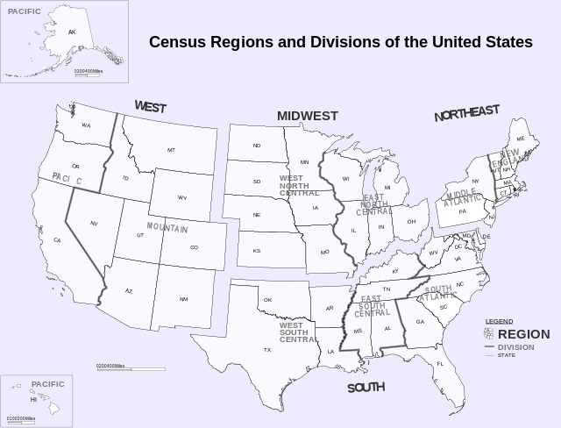

Slide 8
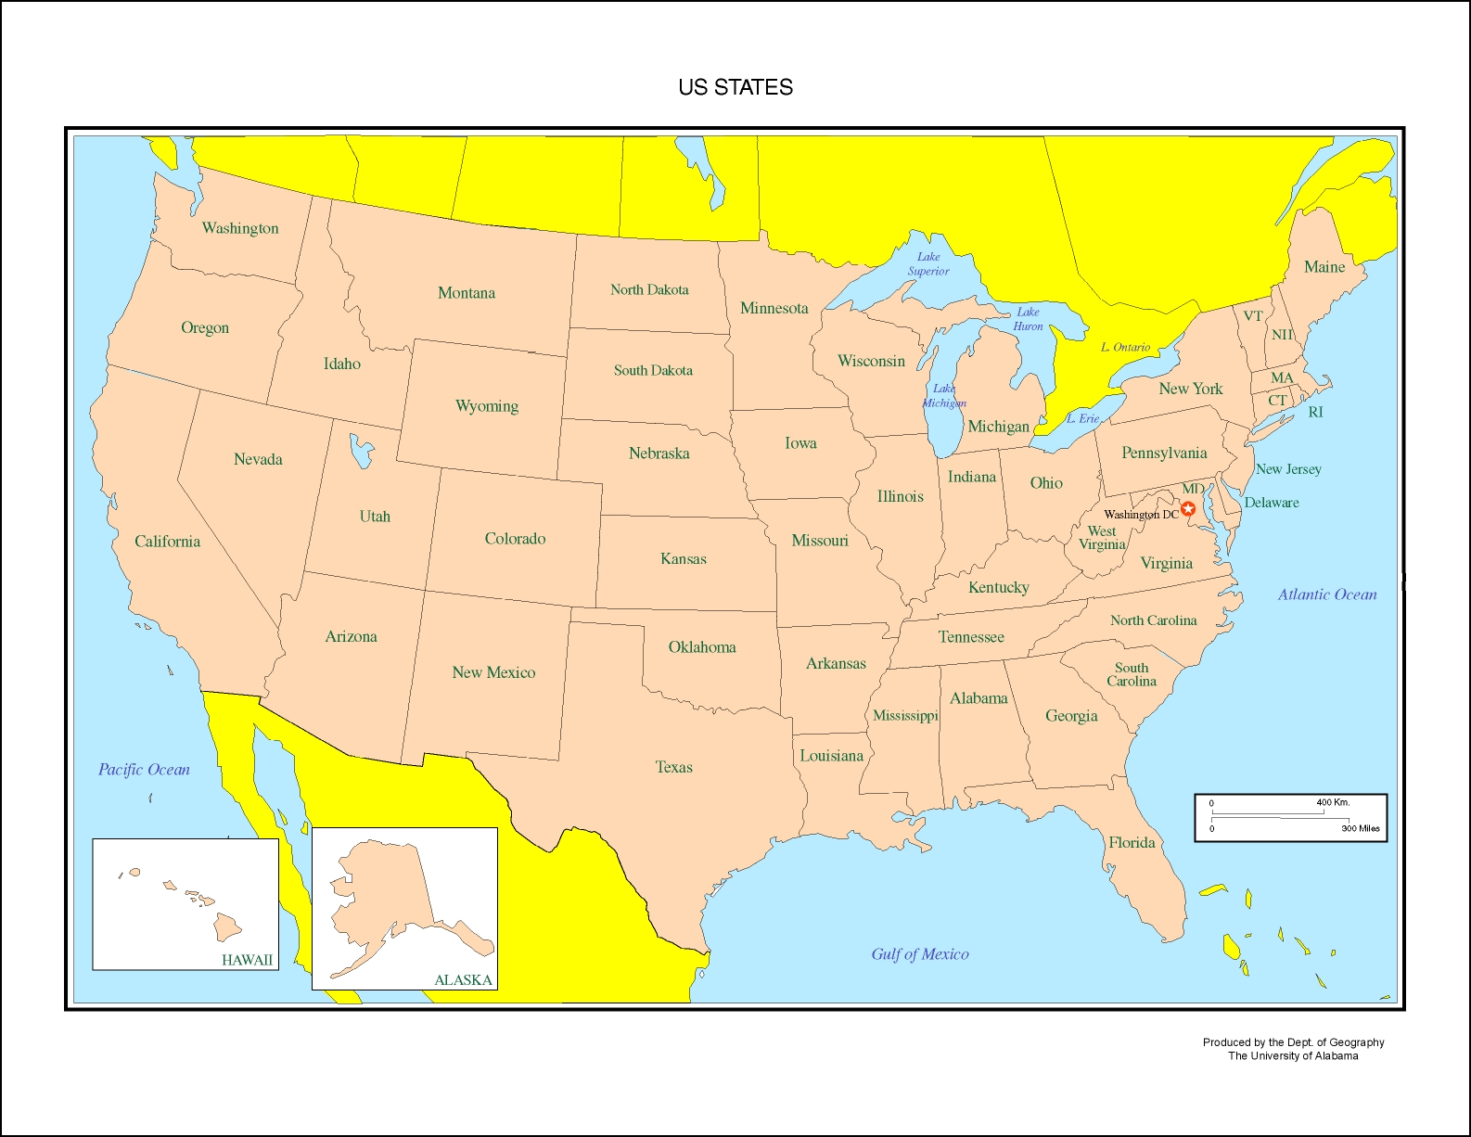

Slide 9
Official RAVAs
Regions
Northeast Historic Film
Appalshop
Chicago Film Archive
States
Florida Moving Image Archives
Alaska Moving Image Preservation Association
Tennessee Archive of Moving Image and Sound
Texas Archive of the Moving Image
Notes:
Northeast Historic=northern New England
Appalshop=Appalachia
Chicago Film Archive=midwest
Lynn and Louis Wolfson II Florida Moving Image Archives is an official moving image repository and archives of the State of Florida

Slide 10
Most represented
Louisiana, New York and Pennsylvania
Maryland
Illinois
New Jersey, Texas, USA: national
California, Georgia
Alaska, Florida, Massachusetts, Mississippi, Tennessee, Virginia, West Virginia
Arizona, Colorado, Connecticut, Delaware, Hawaii, Indiana, Iowa, Kentucky, Michigan, Minnesota, Missouri, Montana, Nebraska, North Carolina, Northeast, Oklahoma, Oregon, Southwest, Utah, Washington, Wisconsin

Slide 12
Types of organizations
Universities
Historical societies
RAVAs
State/city archives

Slide 13
Types of AV
(Mix of formats: film, magnetic tape, born-digital)
Local television
Home movies
Documentaries
Publicity movies

Slide 14
Needs
Environmental storage
Digital storage
Digitization
Staff

Slide 15
Next steps for AMIA RAVA
Update database
Publish in AMIA Deep Focus Directory
Outreach/Awareness

Slide 16
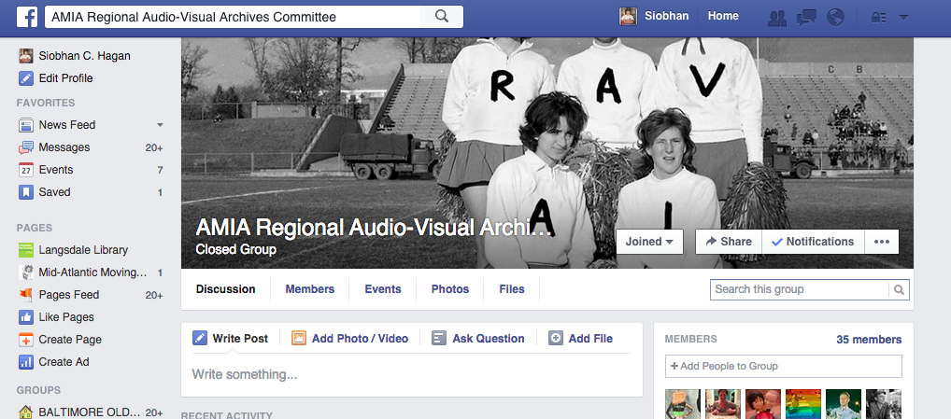

Slide 17
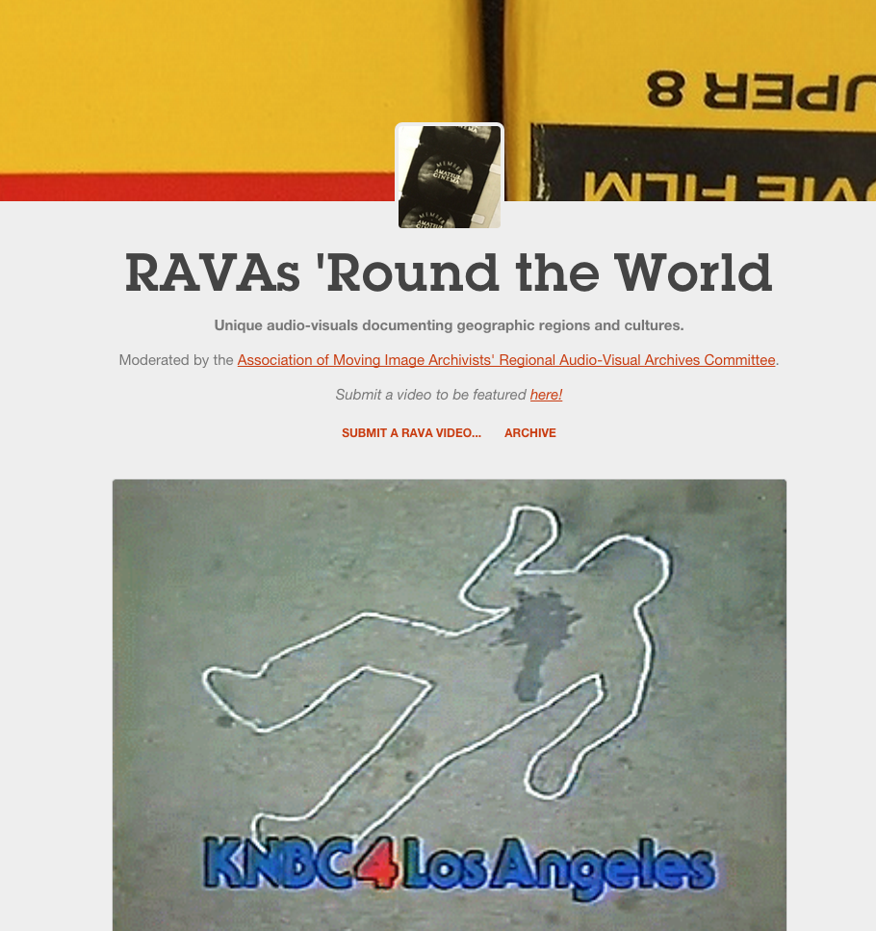
amiarava.tumblr.com

Slide 18
Further steps for AMIA RAVA
In-depth survey
Collaboration
  Resources
  Grant funding
You tell me!

Slide 19
Thank
You!
@AV_DiscoTech shagan@ubalt.edu

