Slide 1
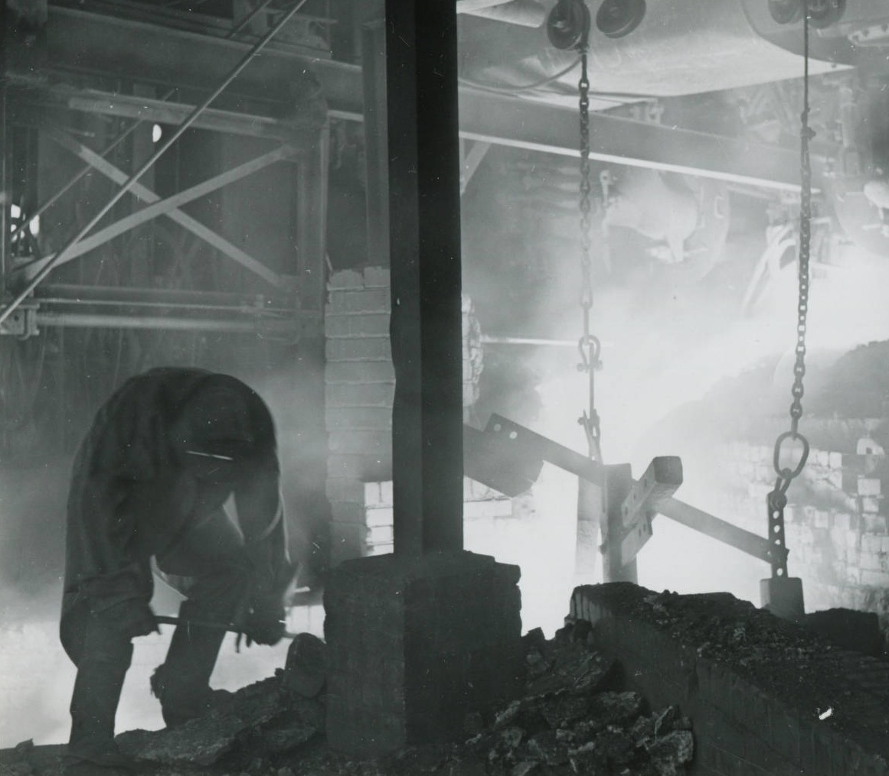
From Depression
to Hope:
The Little Steel Strike
of 1937
Ben Blake
University Archivist
Youngstown State University
Tapping a blast furnace. (Pollock Collection, YHCIL)

Slide 2
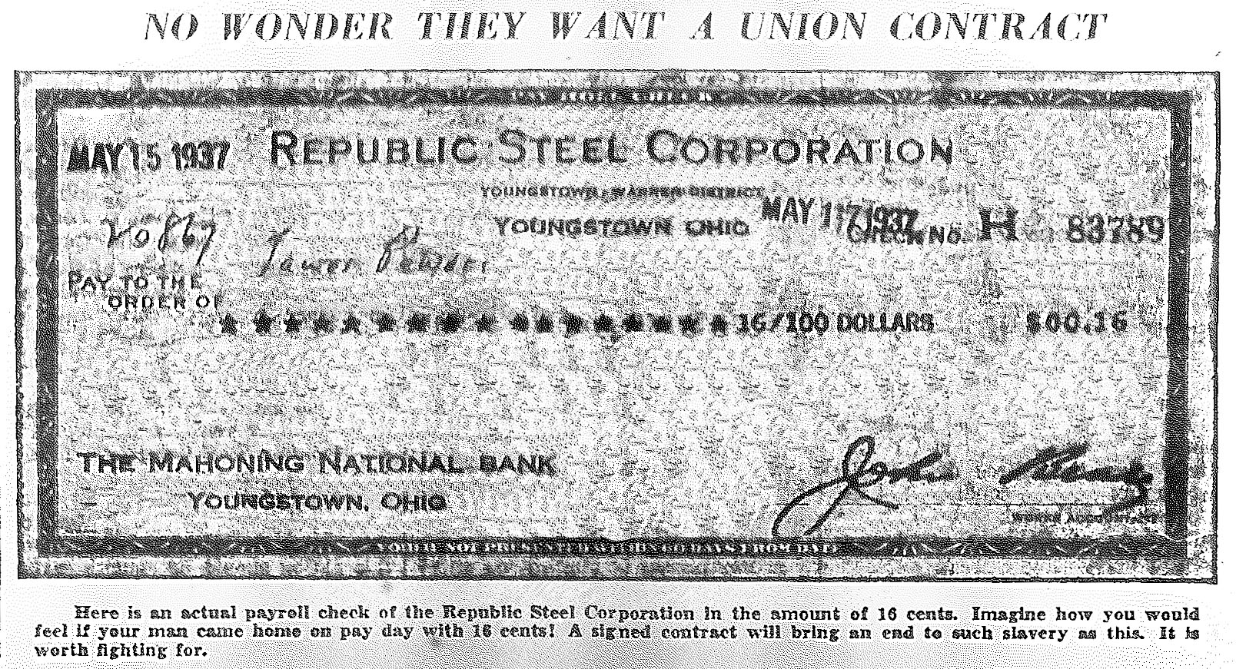
16 cent paycheck (Steel Labor, 1937)

Slide 3
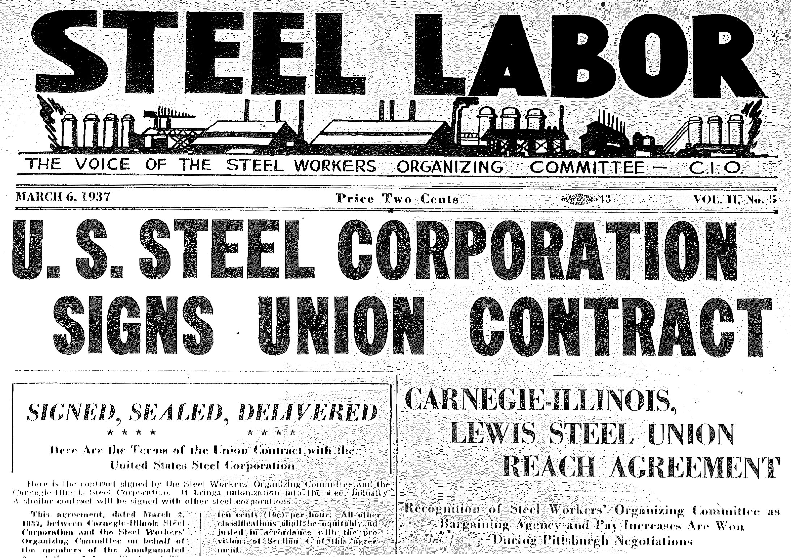

Slide 4
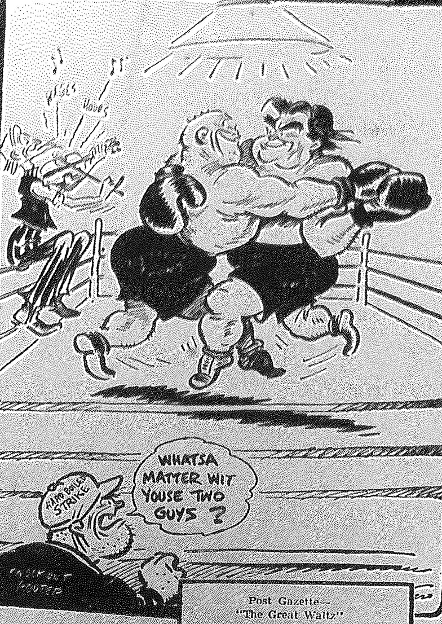
Newspaper cartoon depicting the CIO’s John L. Lewis dancing in the ring with US Steel’s Myron Taylor.

Slide 5
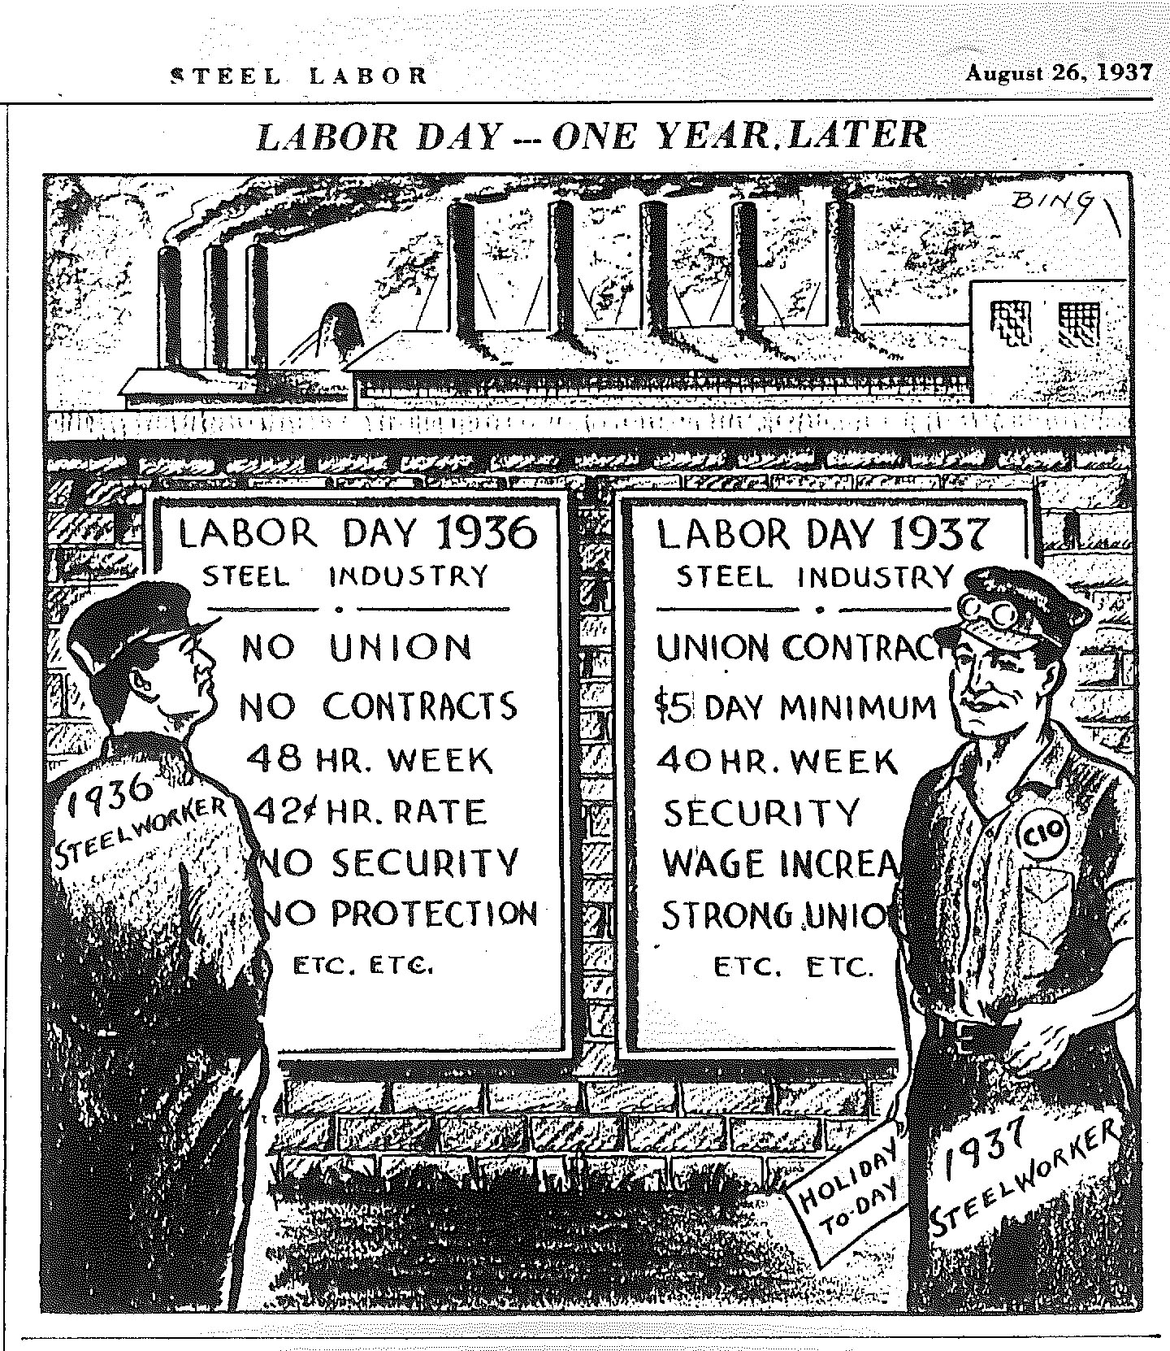

Slide 6
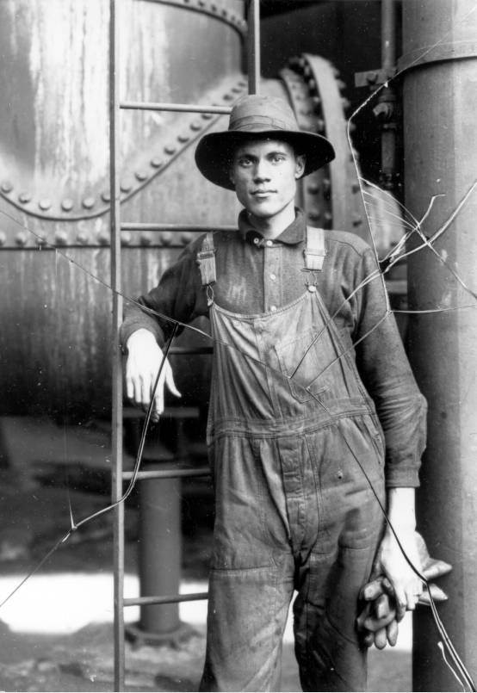
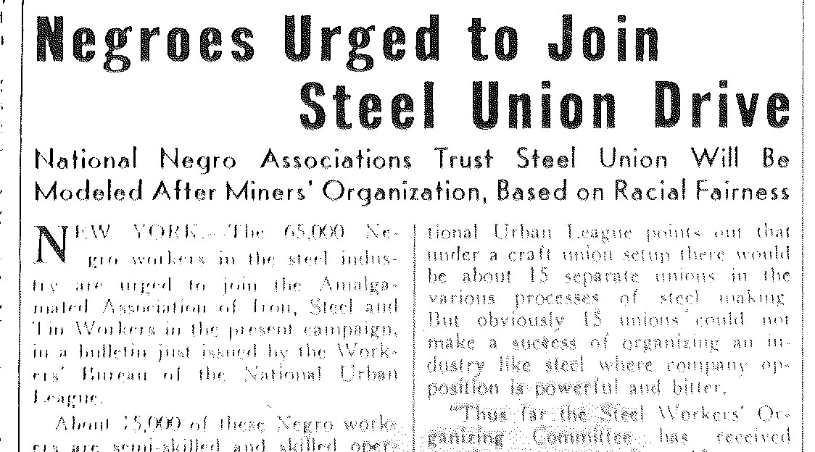
Steel Labor, 1936.
Walter Black, Youngstown Sheet and Tube
blast furnace worker.
(Photograph Collection, YHCIL)

Slide 7
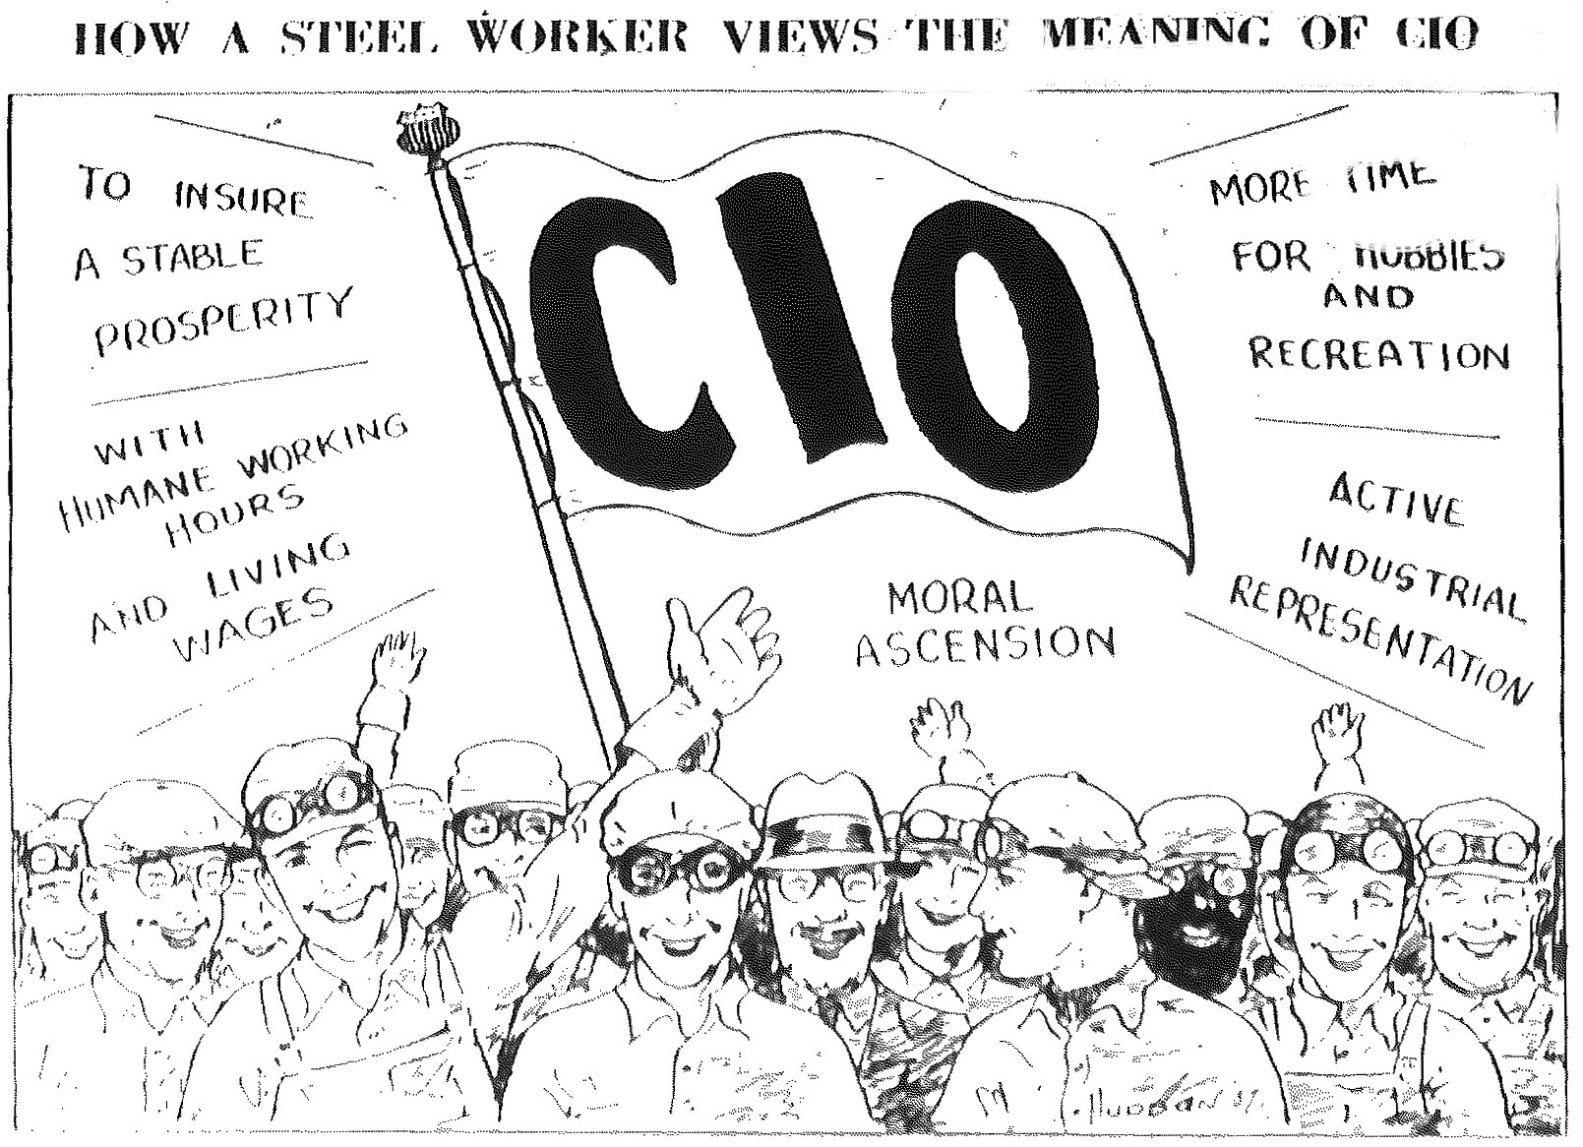
(Steel Labor, 1937)

Slide 8
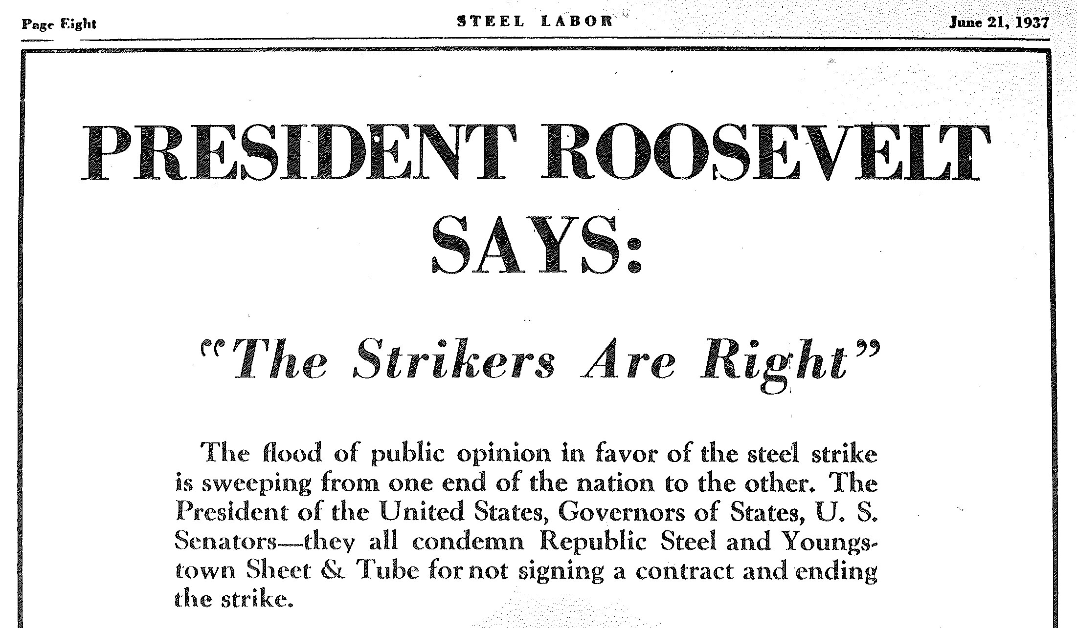

Slide 9
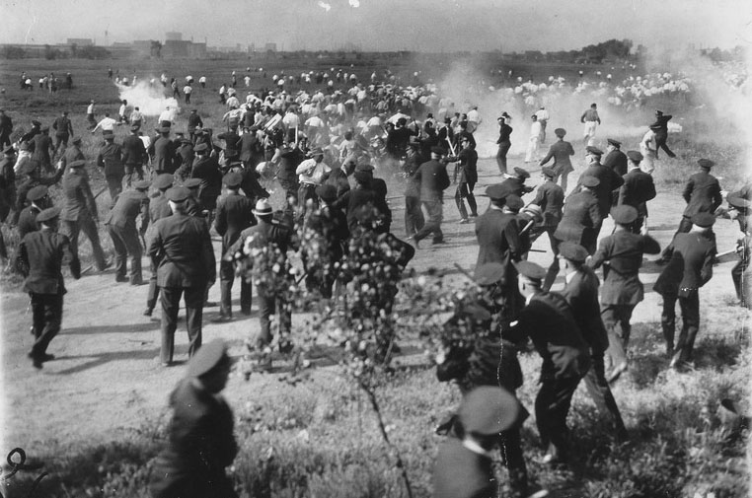
“Memorial Day Massacre,” Chicago, May 30, 1937.
(Library of Congress)

Slide 10
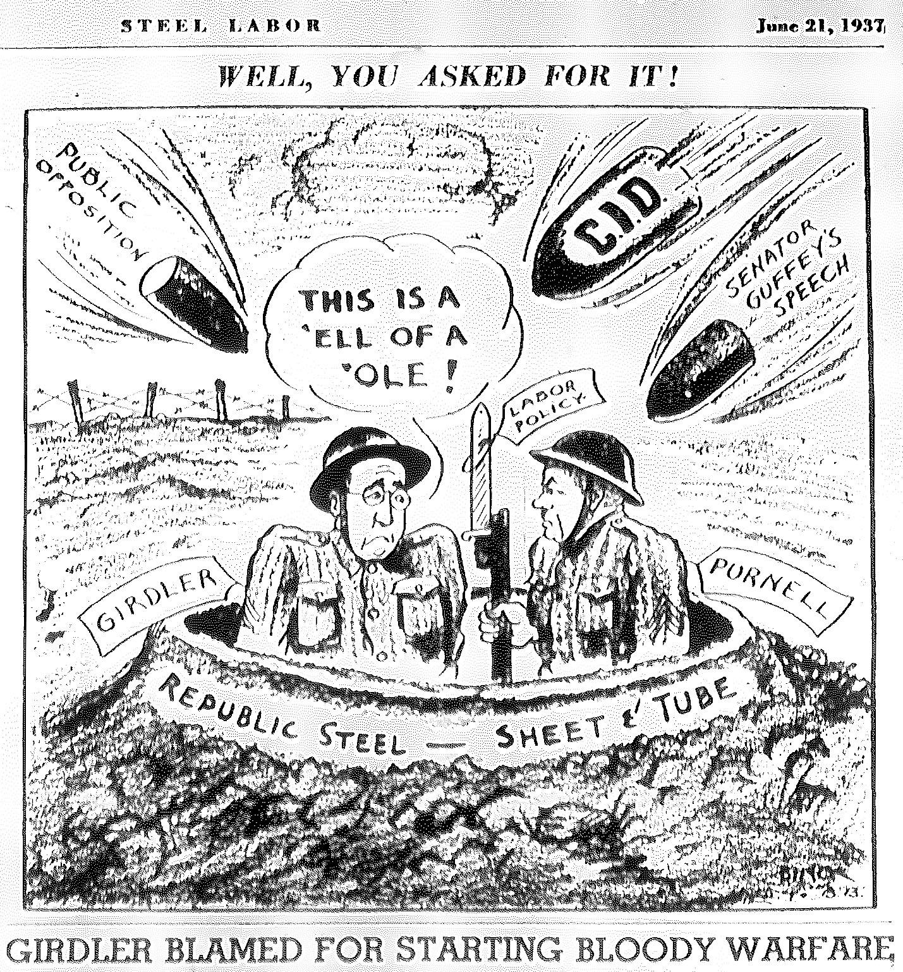

Slide 11
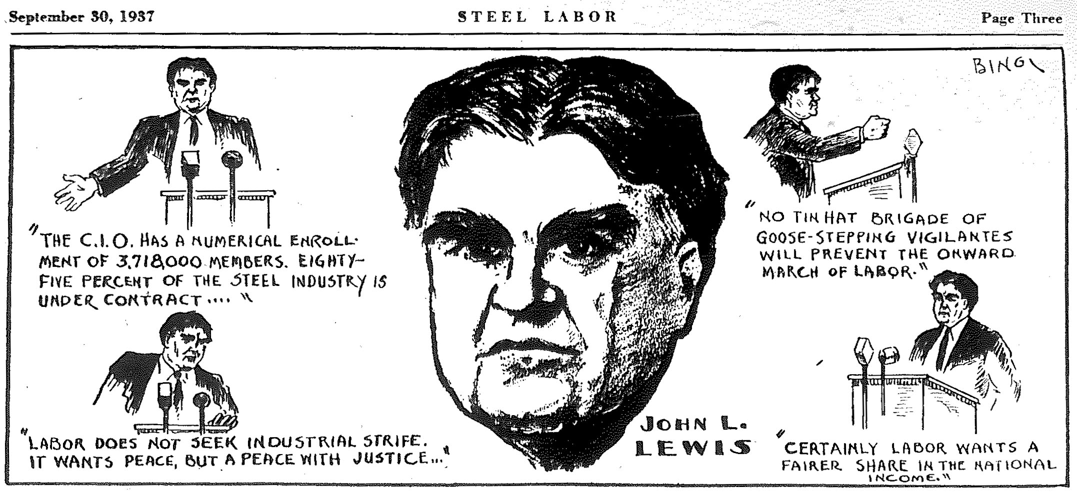

Slide 12
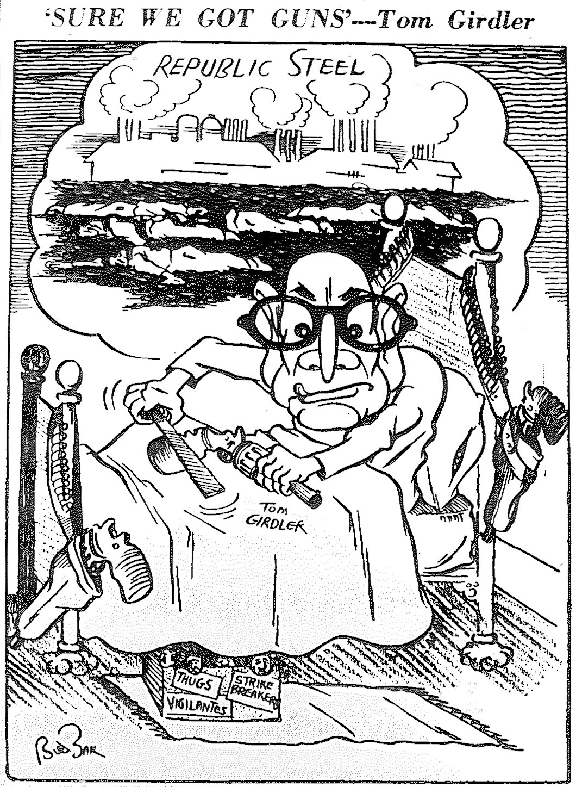
Steel Labor cartoon depicting Republic Steel president Tom Girdler.

Slide 13
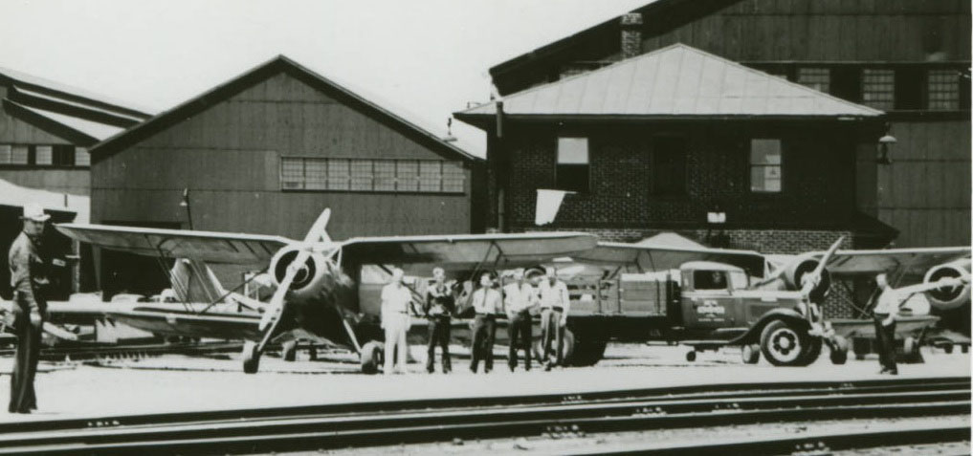
Aircraft used to fly supplies into the strike bound Republic Steel plant.
(Little Steel Strike Scrapbook, YHCIL)

Slide 14
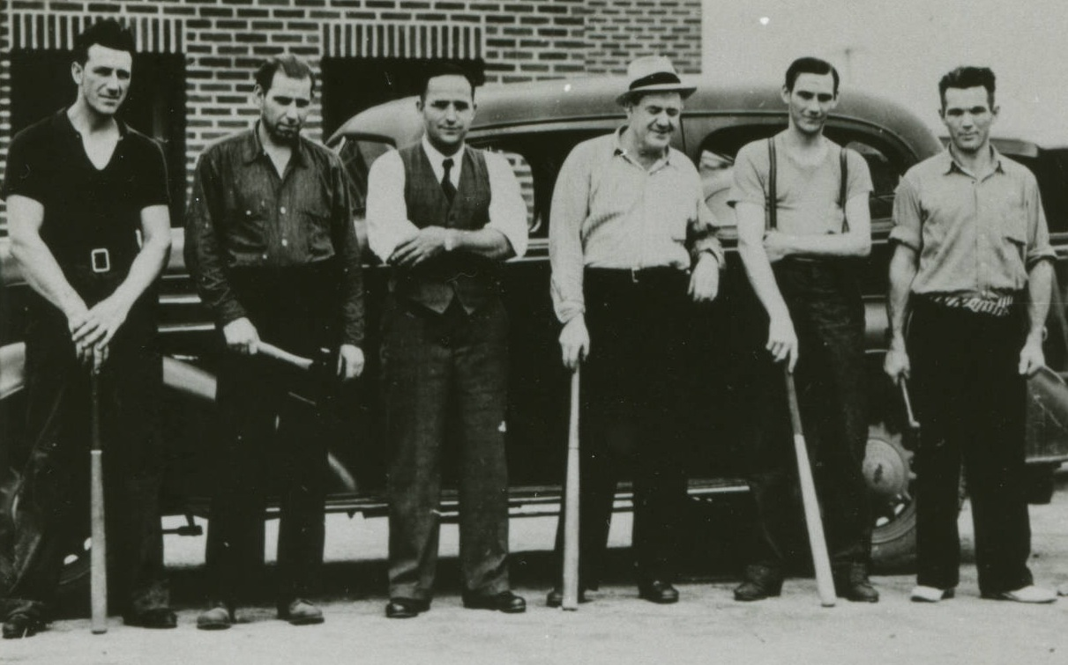
“Captain Baker’s hatchet gang” anti-union vigilantes, Niles, Ohio
(Little Steel Strike Collection, YHCIL)

Slide 15
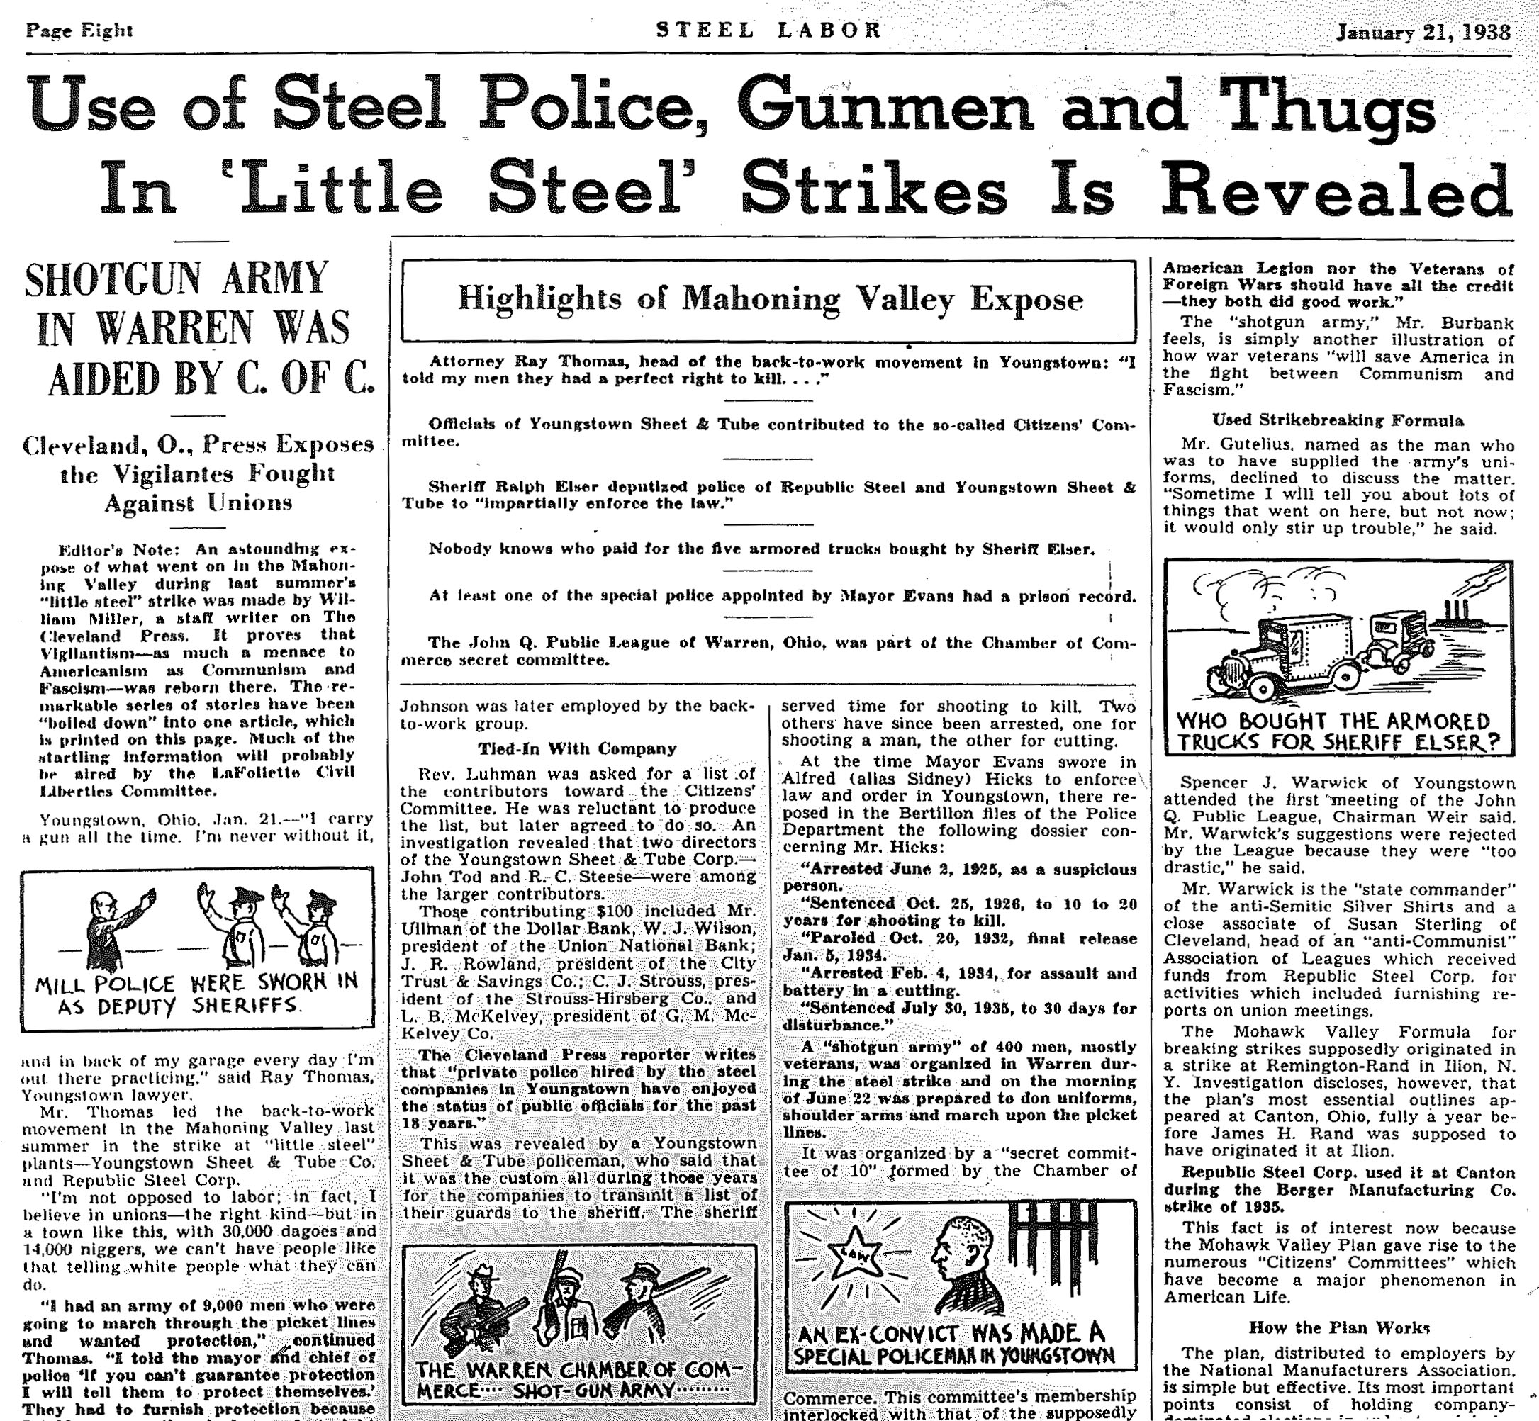

Slide 16
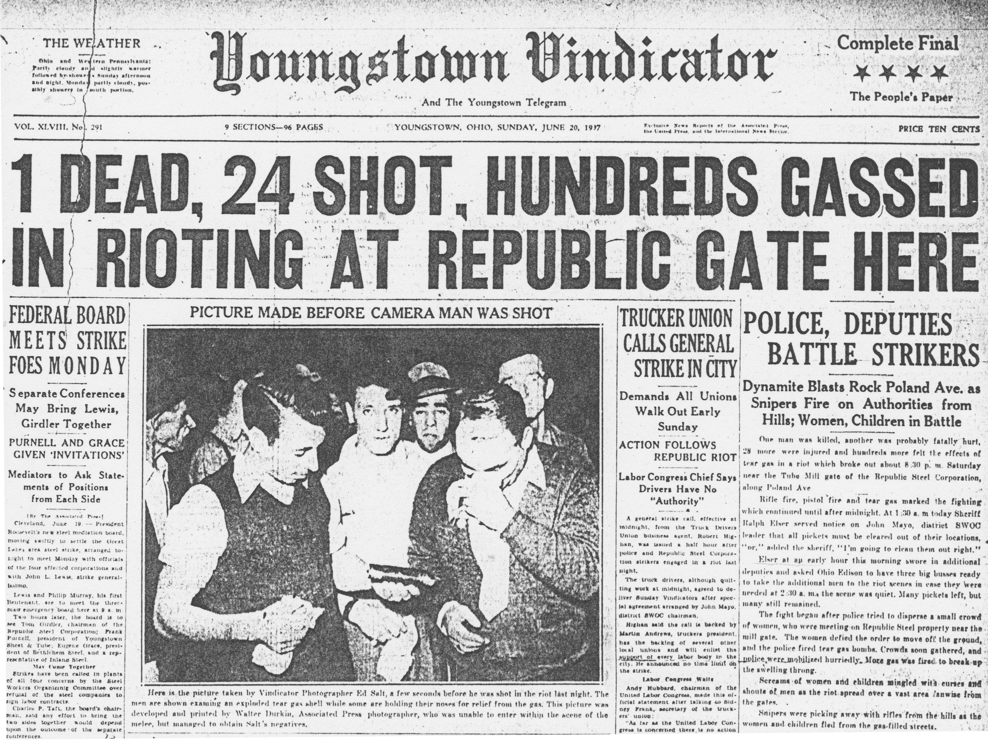

Slide 17
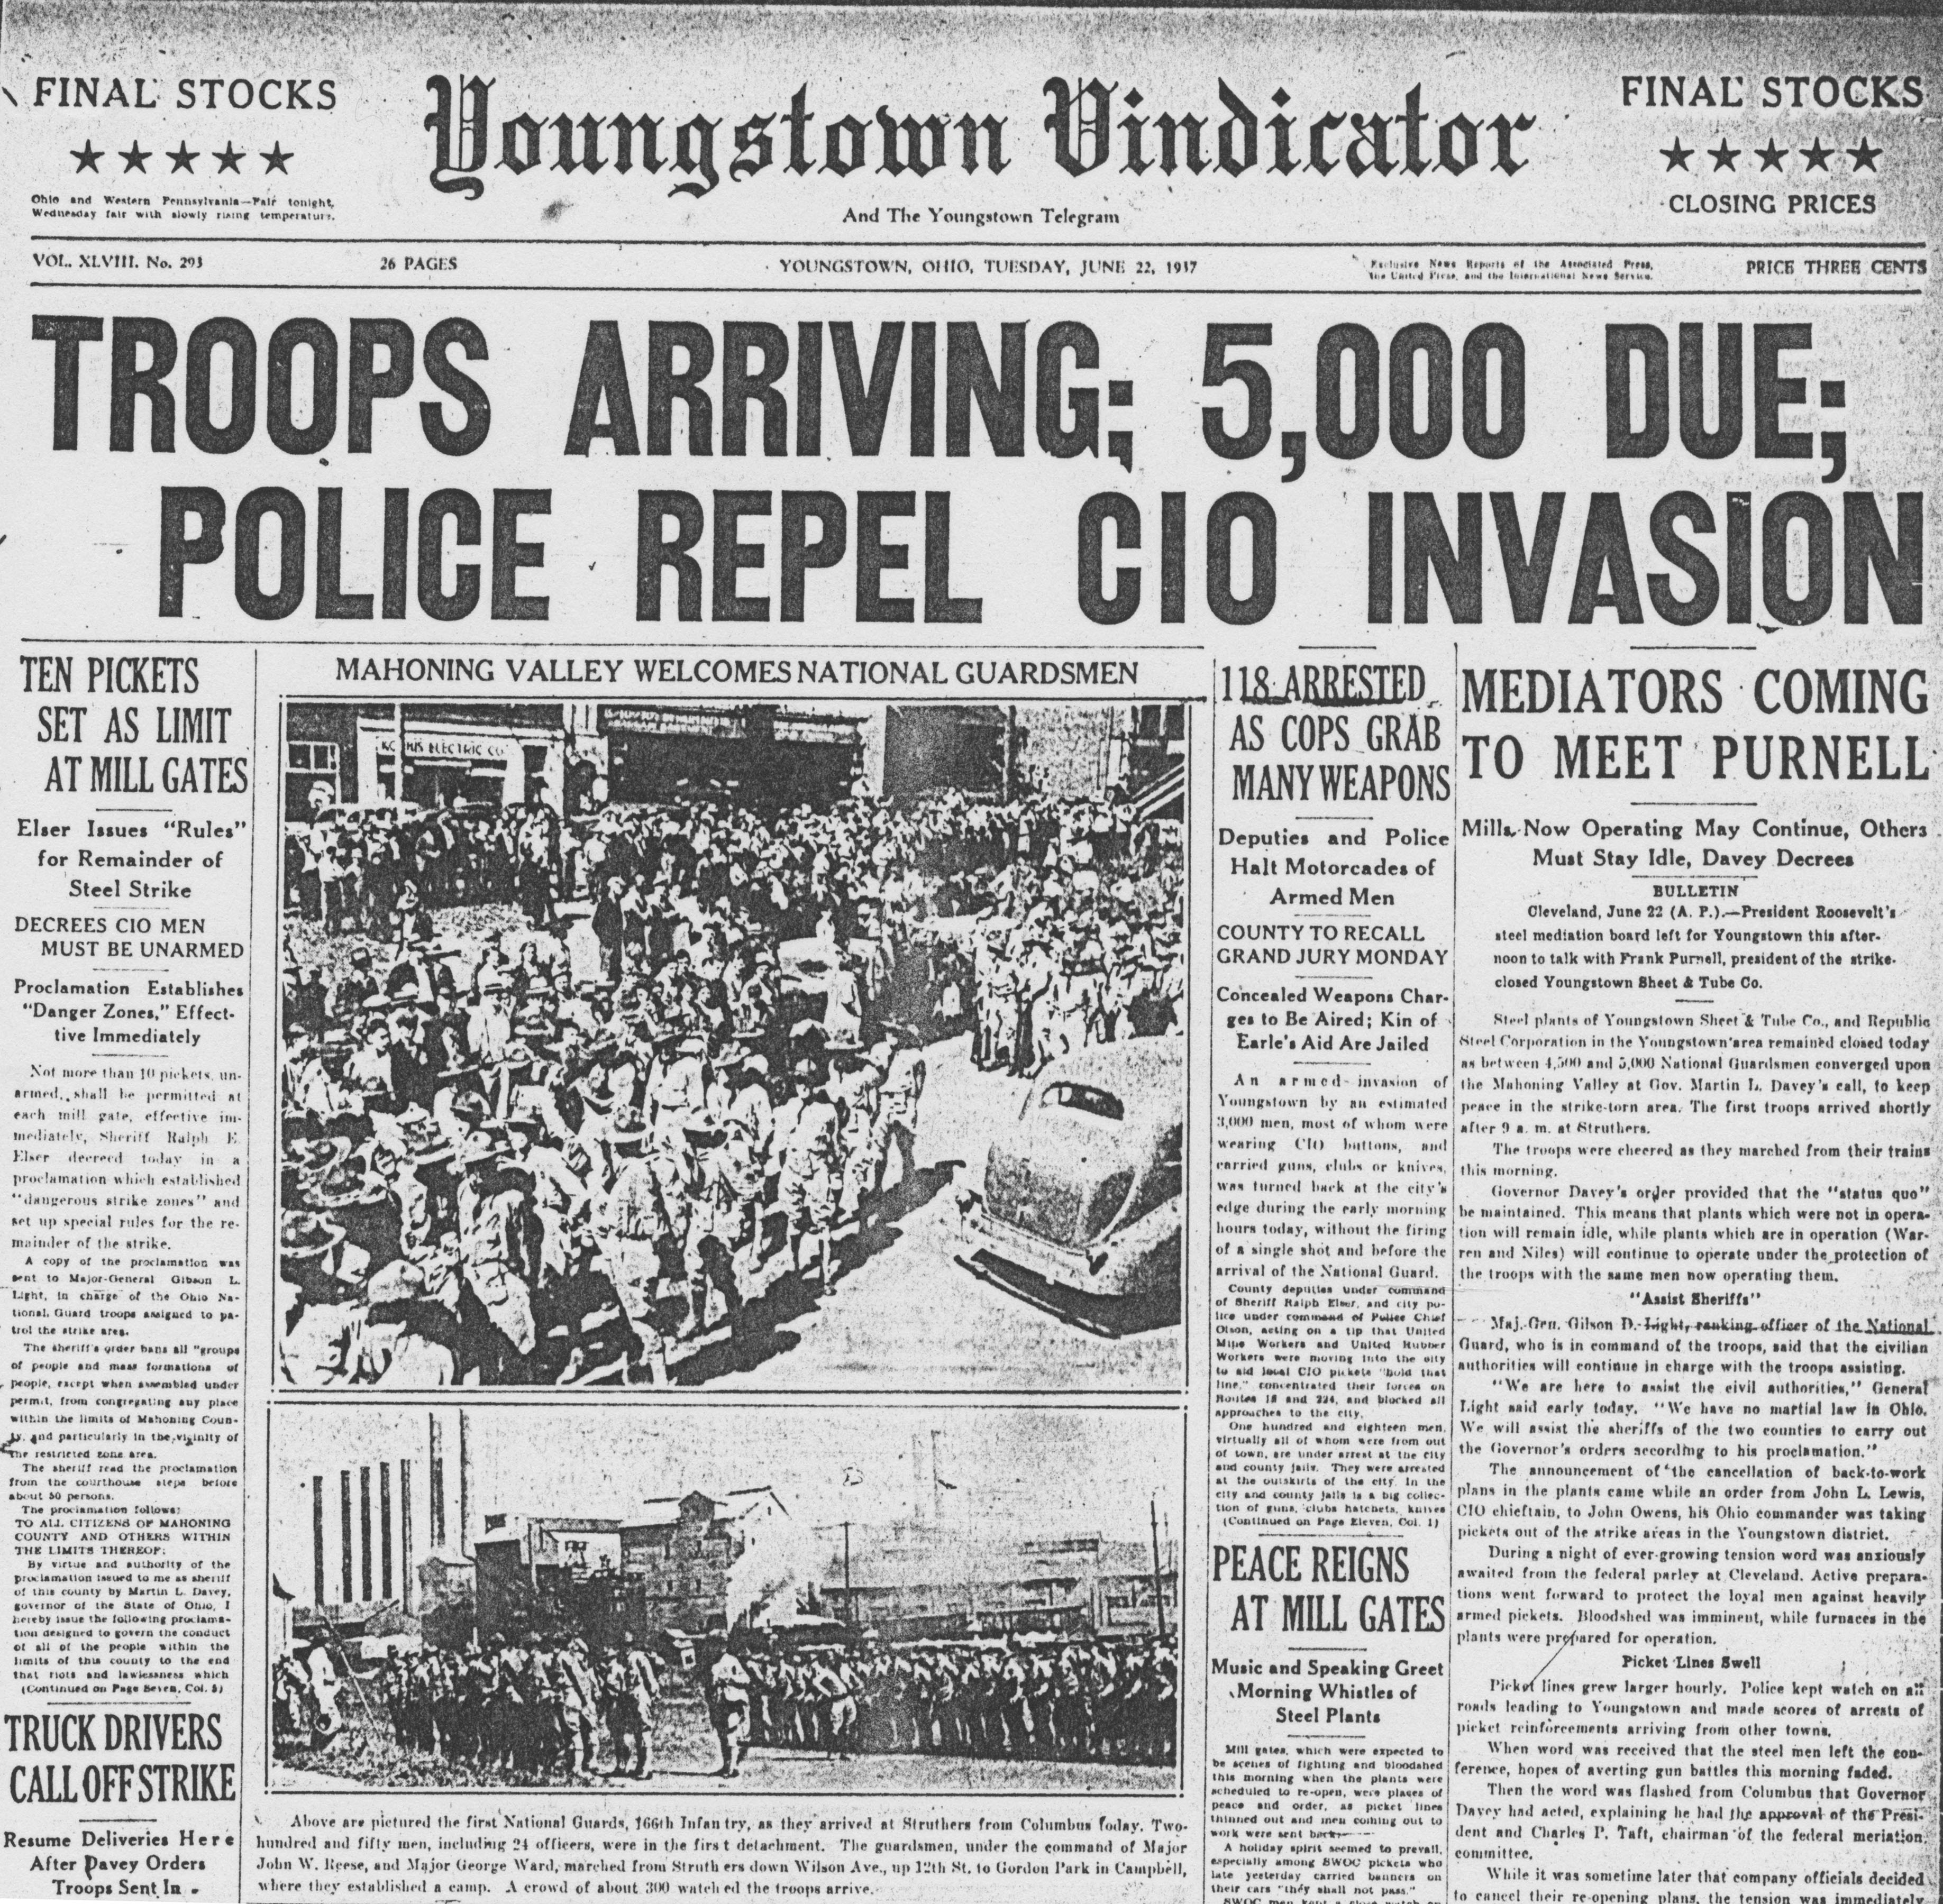

Slide 18
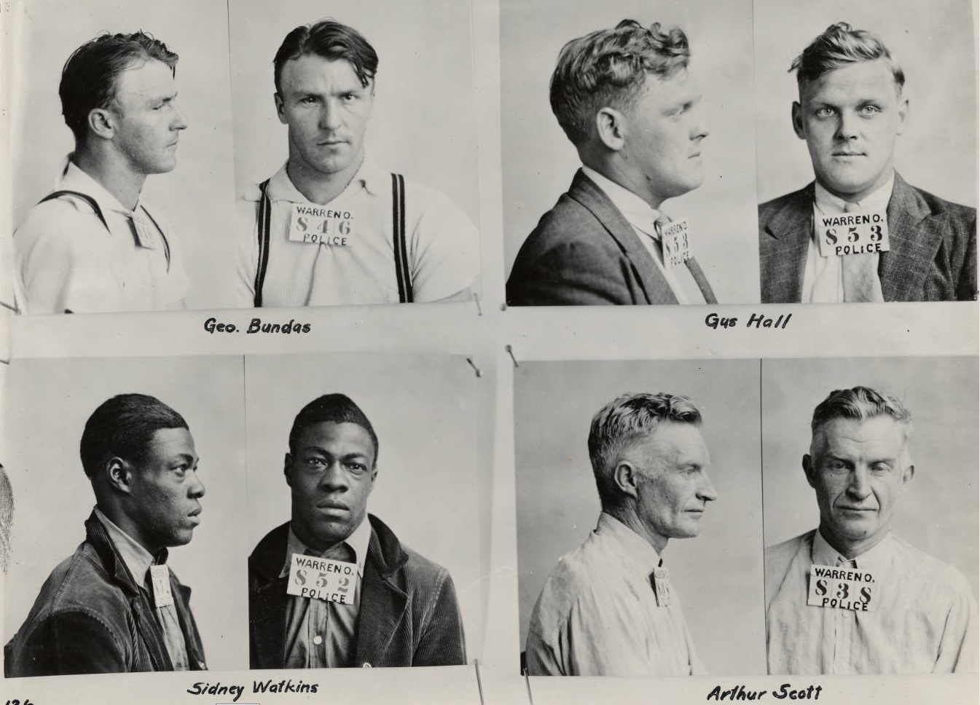
Jailed union members, Warren, Ohio.
(Republic Steel Warren Plant 1937 Strike Scrapbook, YHCIL)

Slide 19
