Slide 1
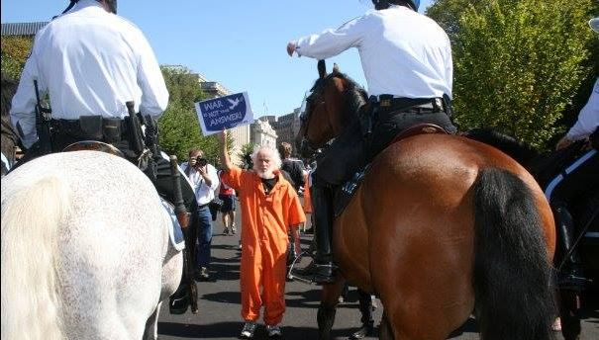
Remembering
Joe Morton

Slide 2
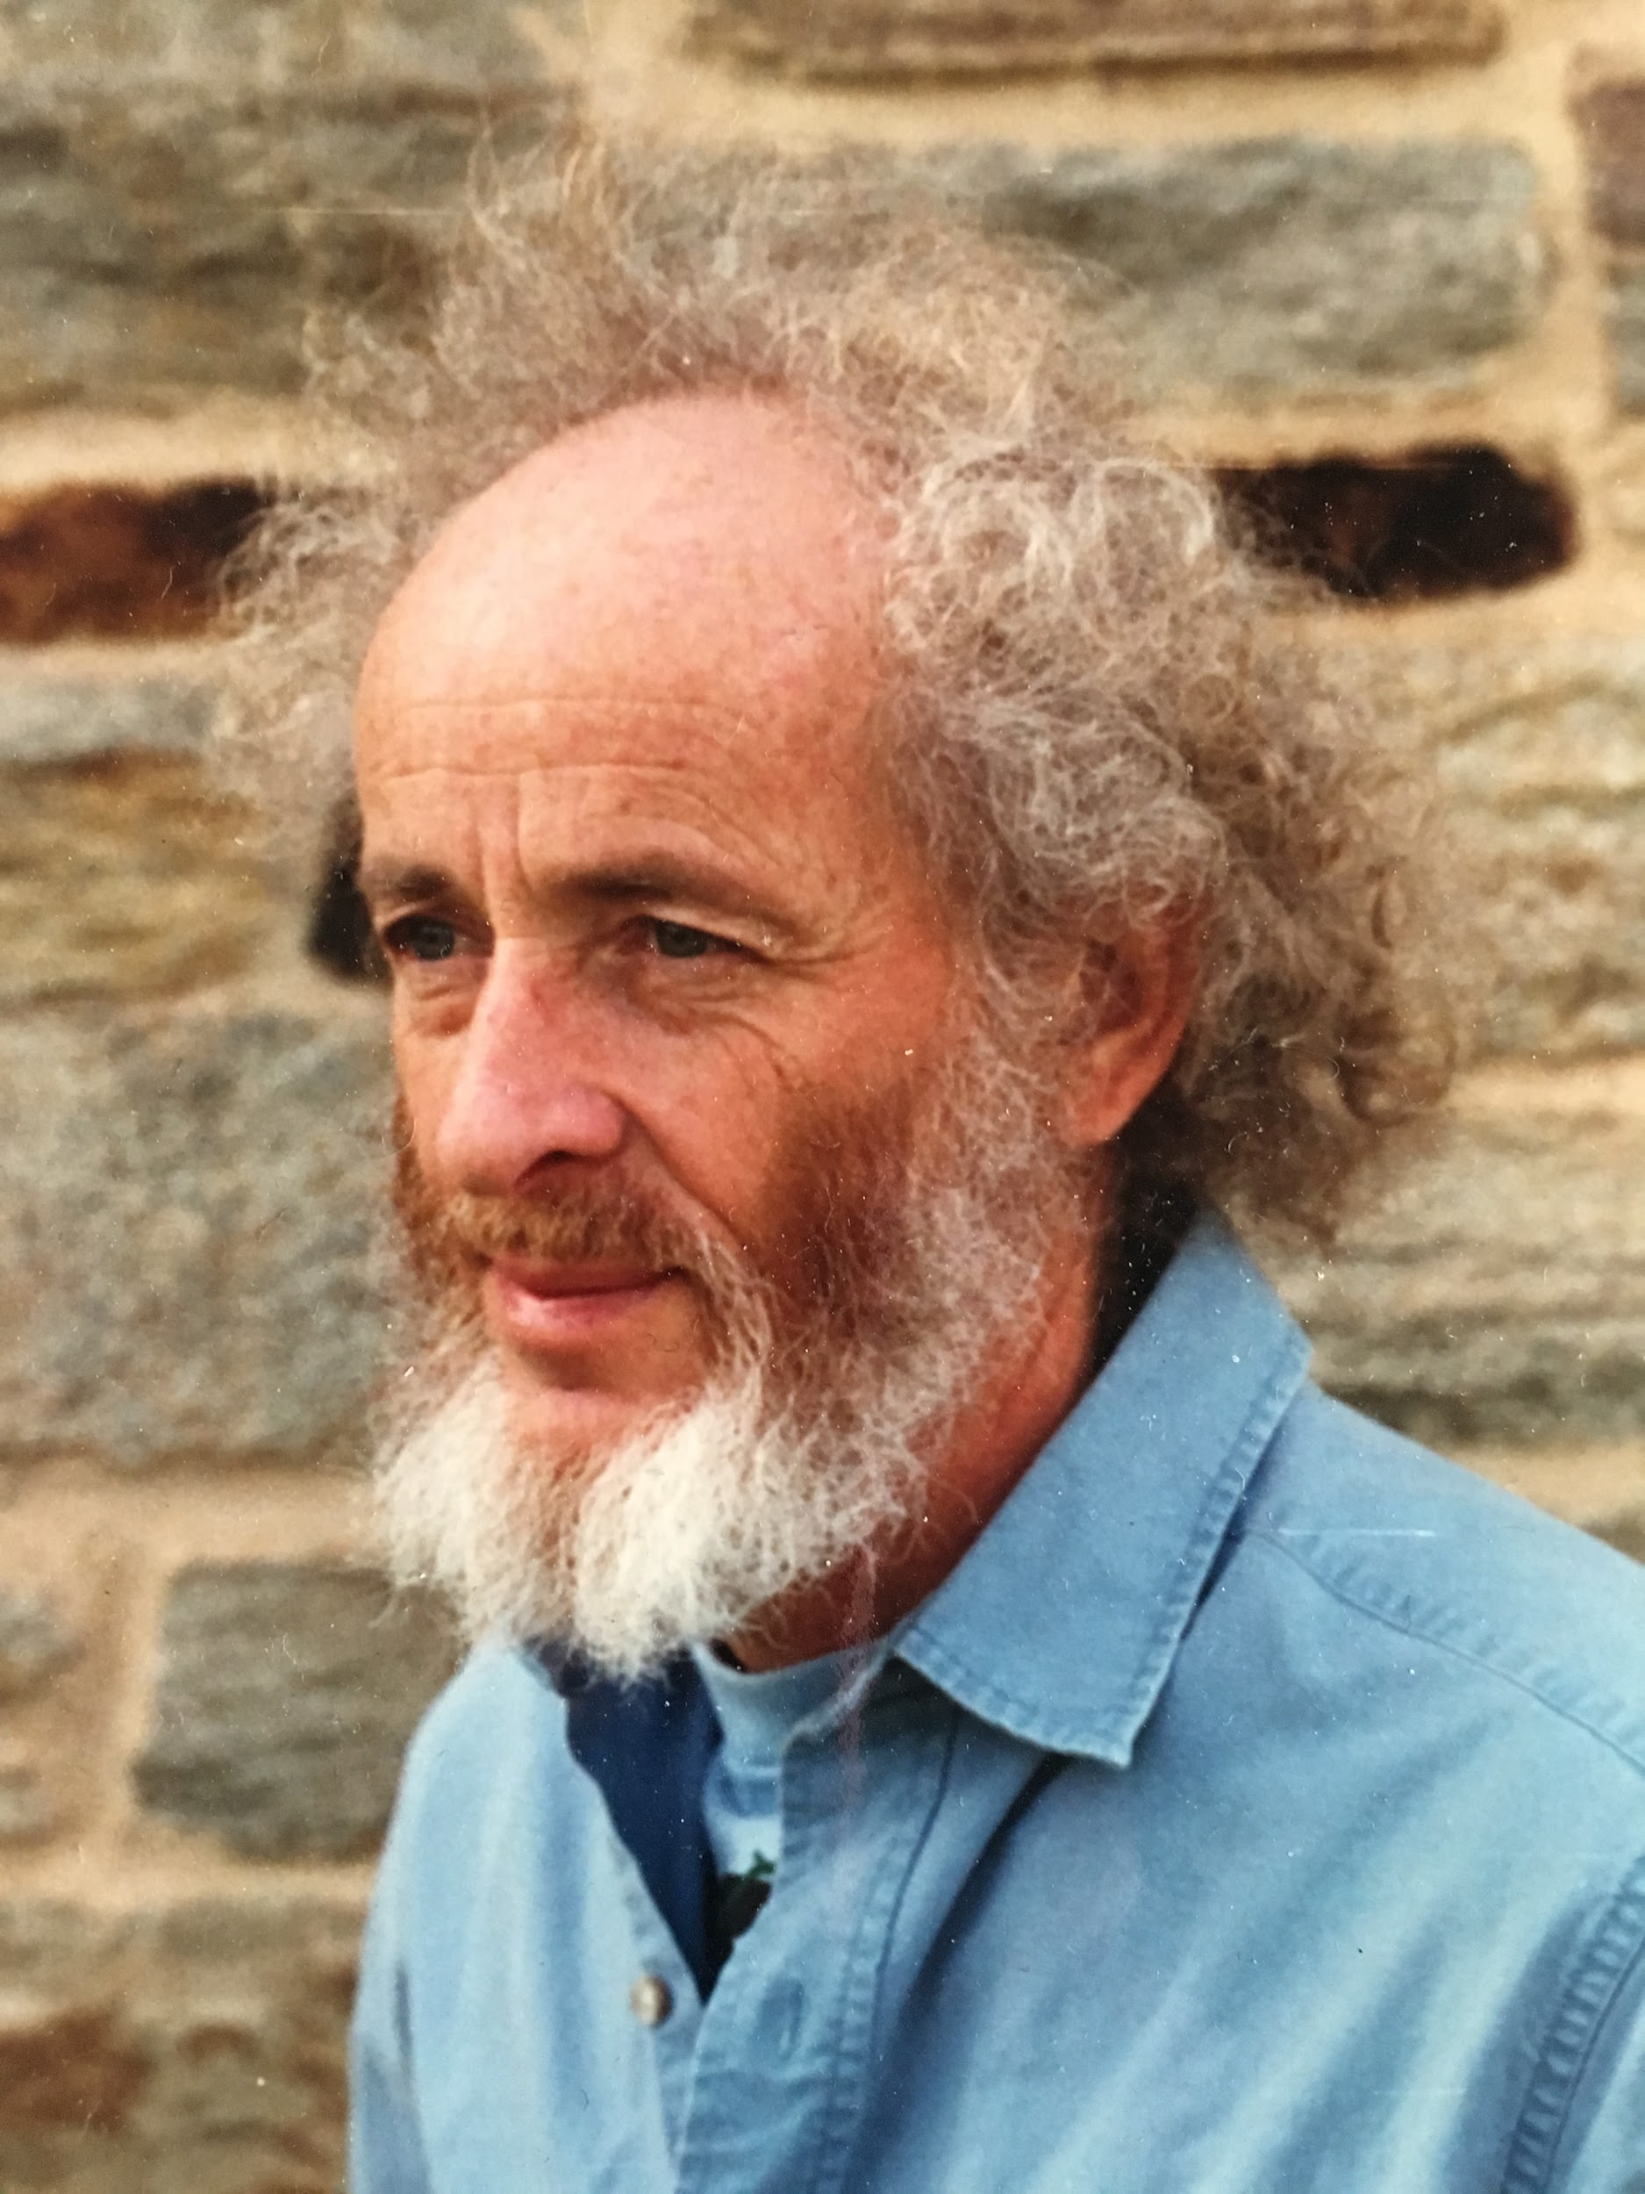
Joe Morton
December 7, 1935 - April 7, 2016
Beloved father, brother, grandfather, teacher, friend, mentor & activist

Slide 3
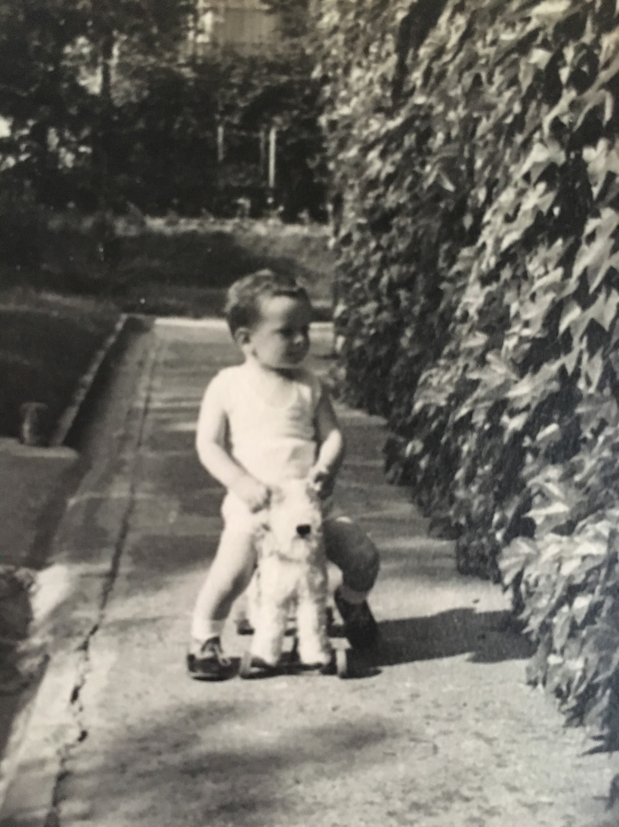
Joe as a Child in Budapest
Joe was born in Budapest, Hungary to Tibor and Rose Morton, Hungarian Jews.
He has an older sister, Victoria Eve, born in 1934

Slide 4
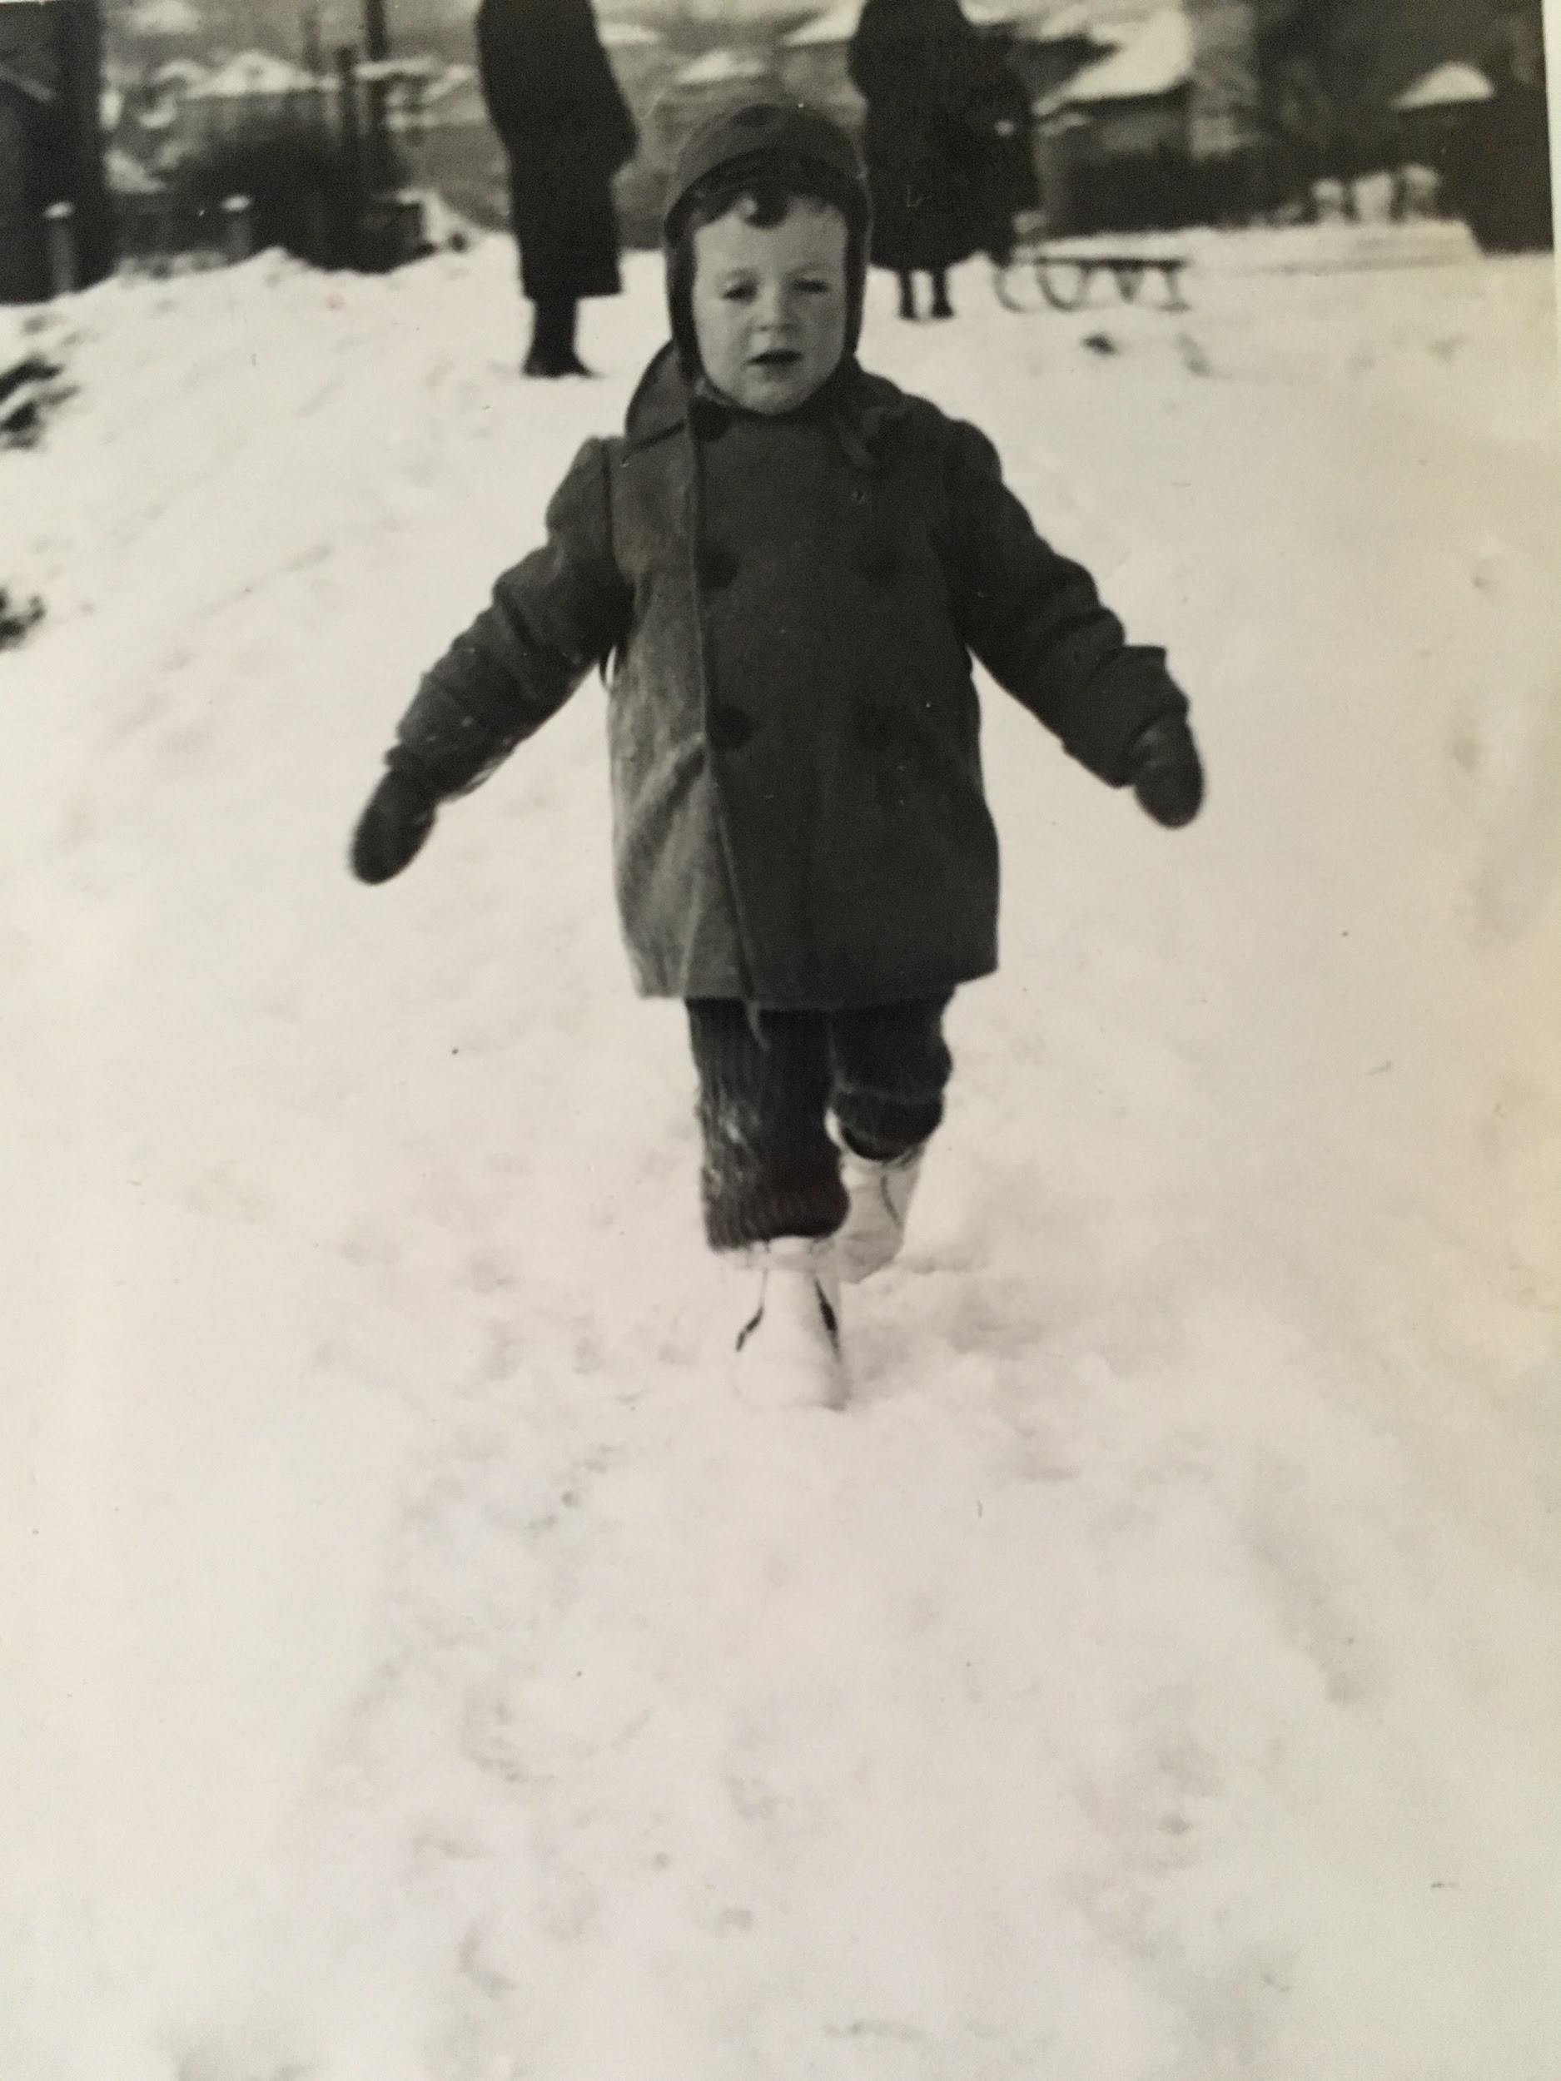
Joe as a Child, Either Budapest or Rochester, NY
Joe’s father worked for the Eastman Kodak Company as the manager for Hungary.
With help from Kodak, the Mortons were able to leave Europe in 1941, escaping the Nazis. They settled in Rochester, NY, the home of the Kodak Company.

Slide 5
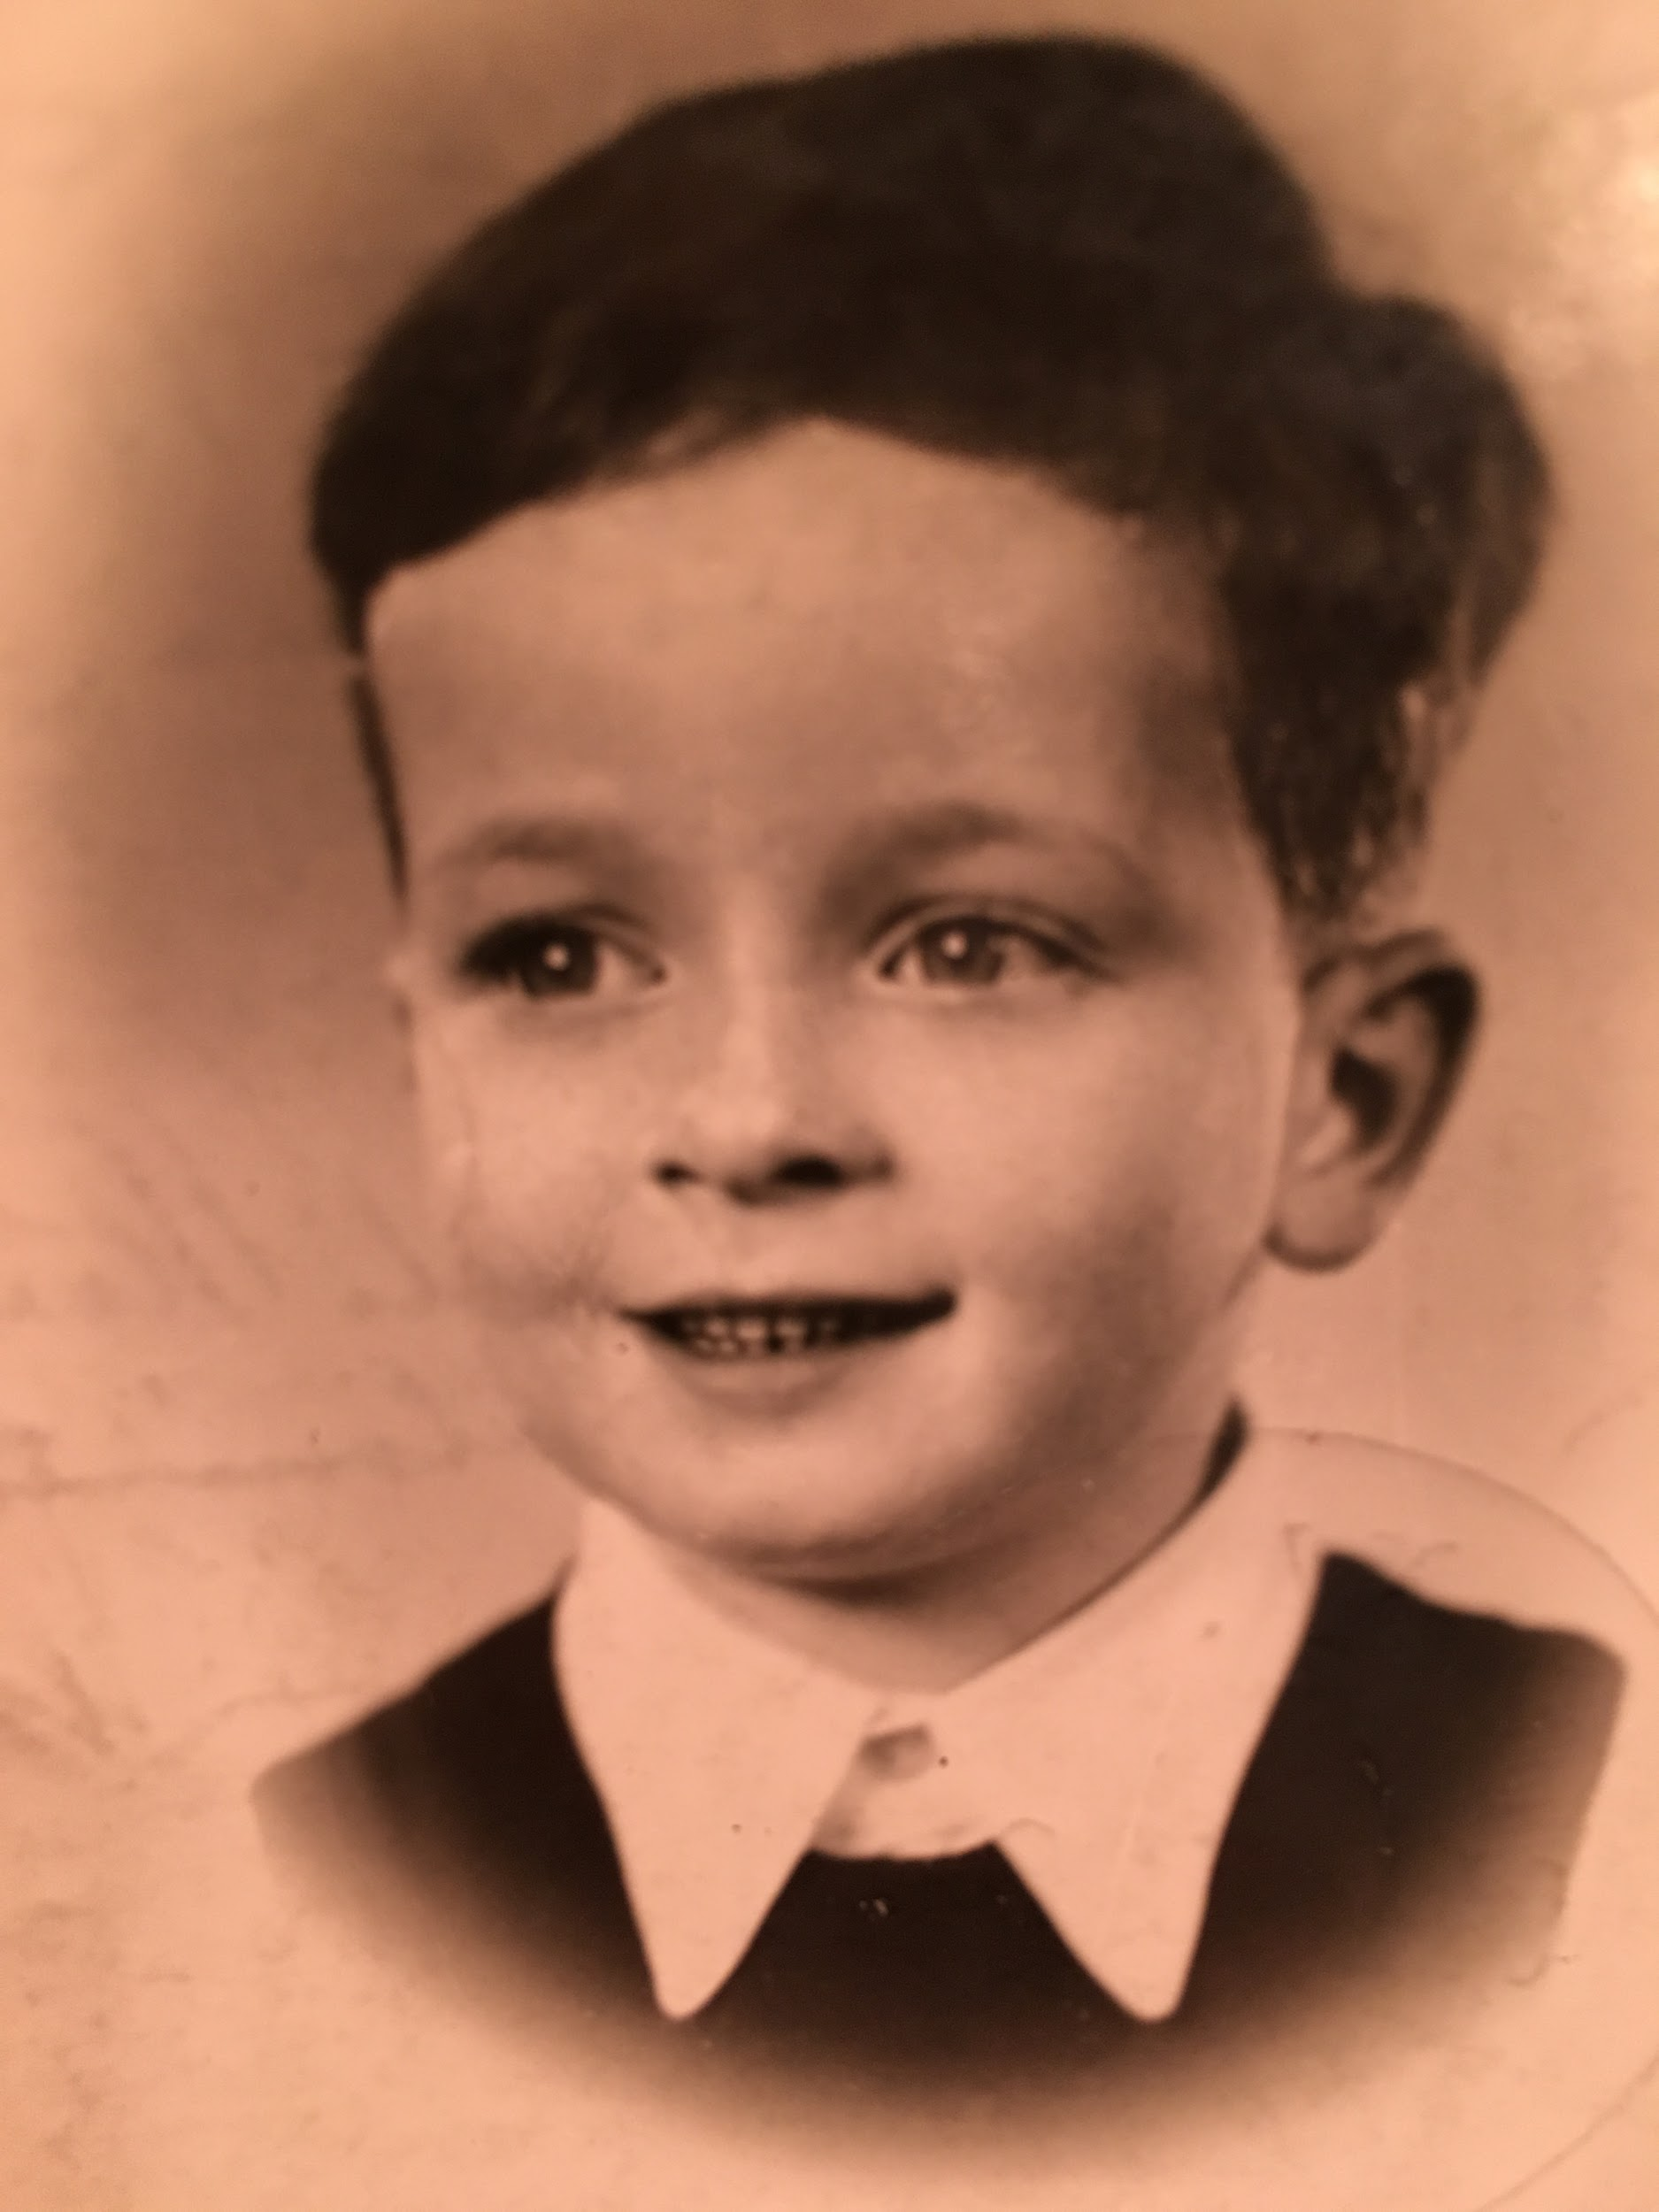
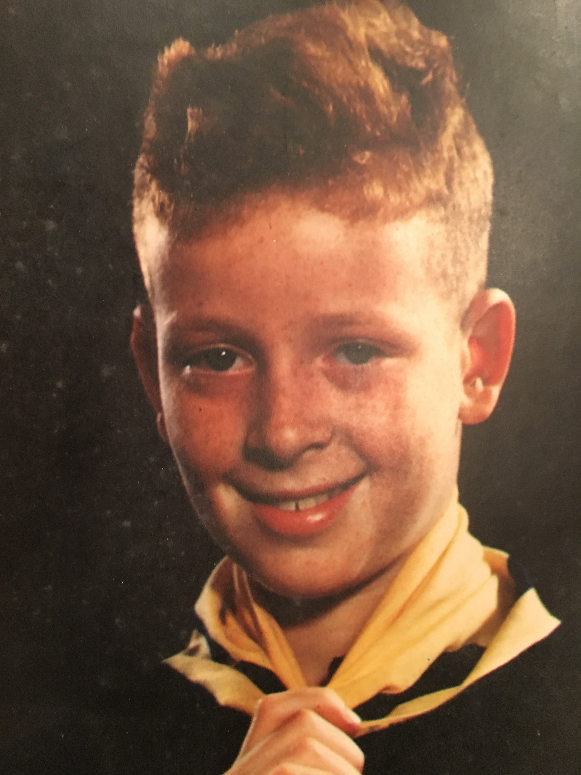

Slide 6
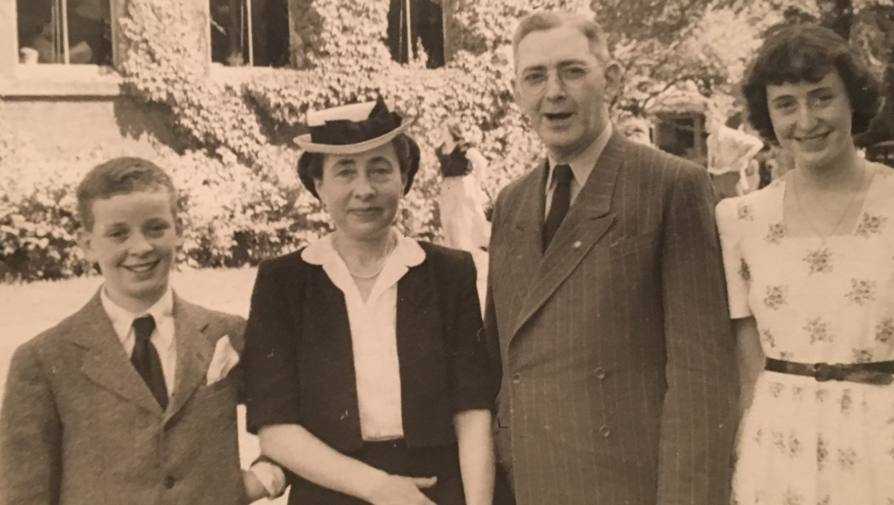

Slide 7
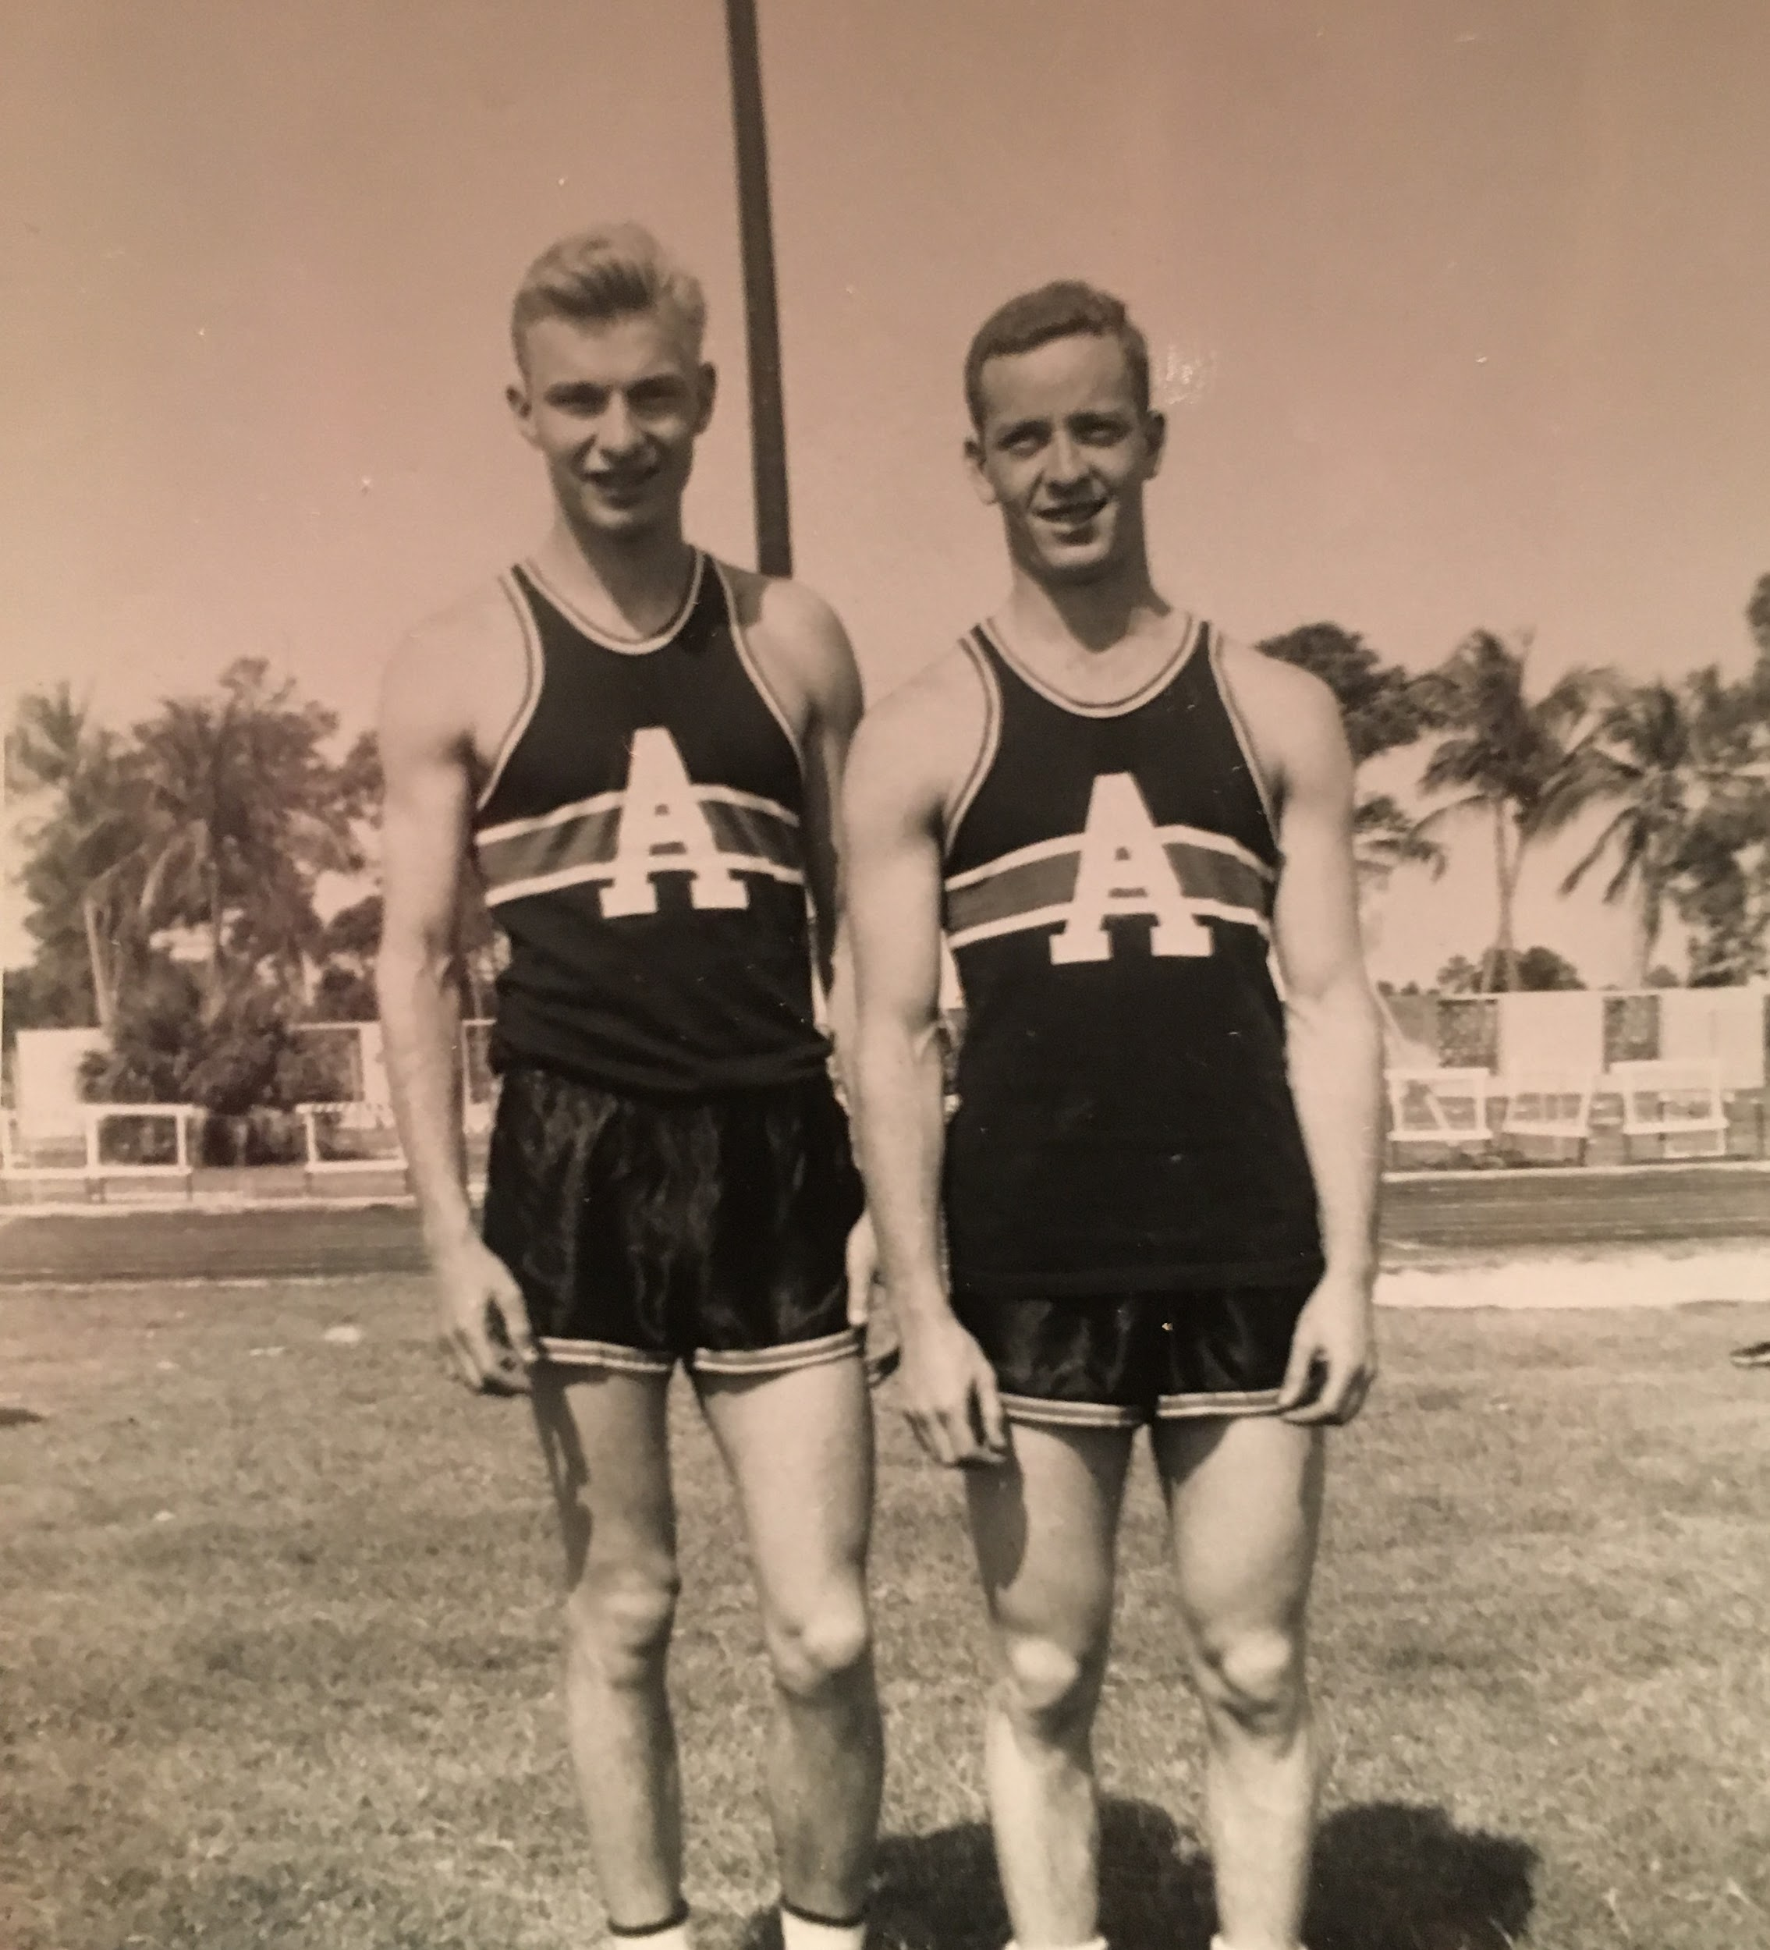
Joe the Athlete
He ran track and field at Monroe High School in Rochester, NY and at Amherst College, MA.
He enjoyed running until the end of his life.

Slide 8
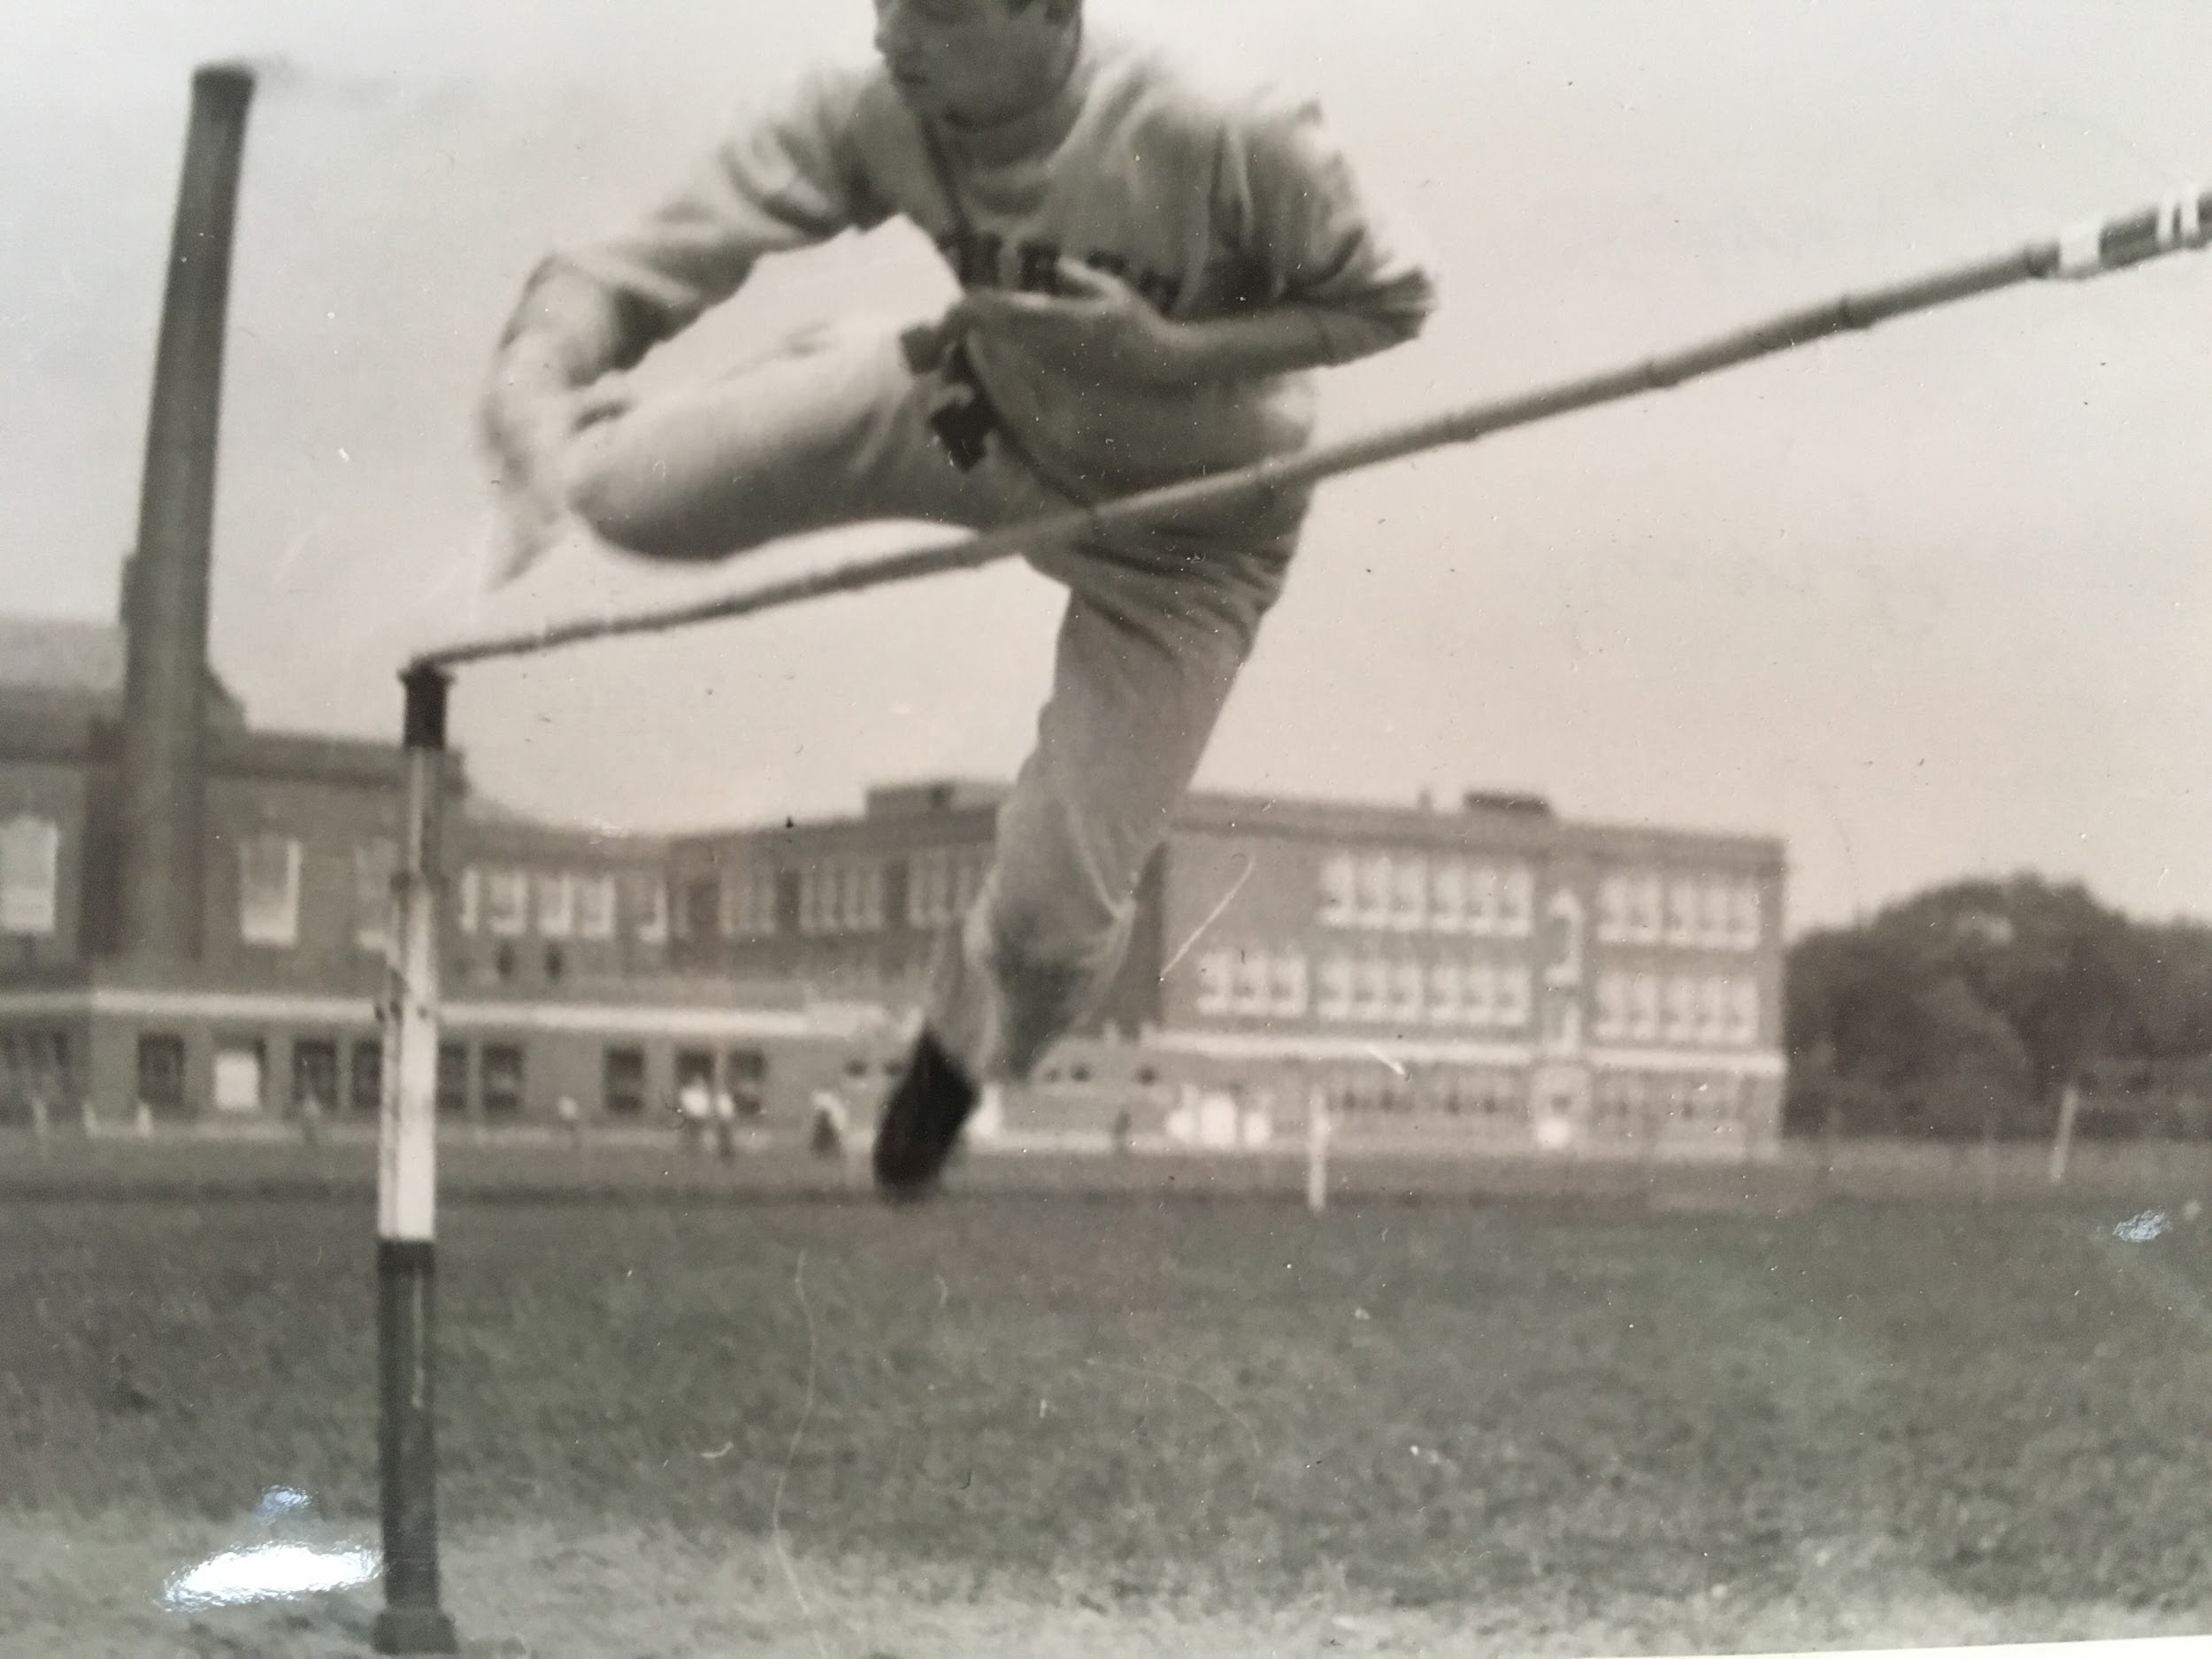

Slide 9
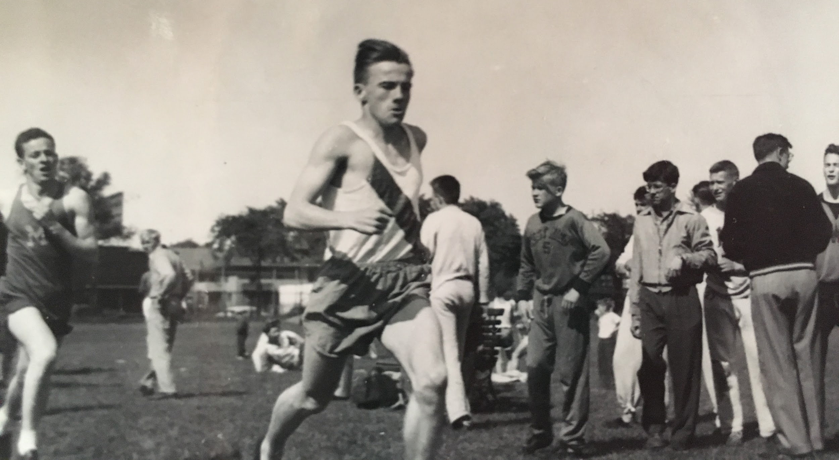

Slide 10
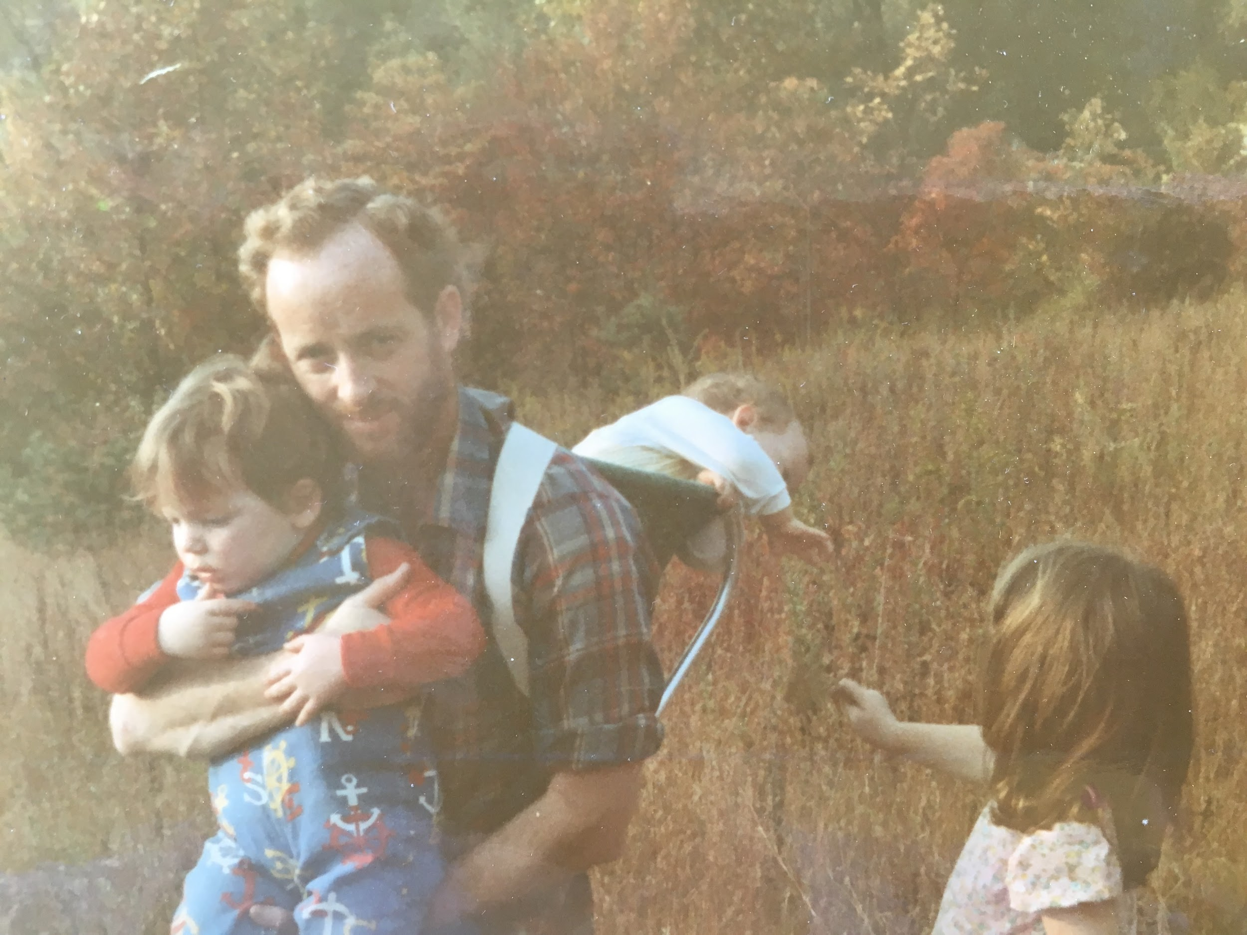
Joe the Father
Joe had 3 children: Rebecca, Jason and Paul.
His son Paulie died of leukemia in 1977.

Slide 11
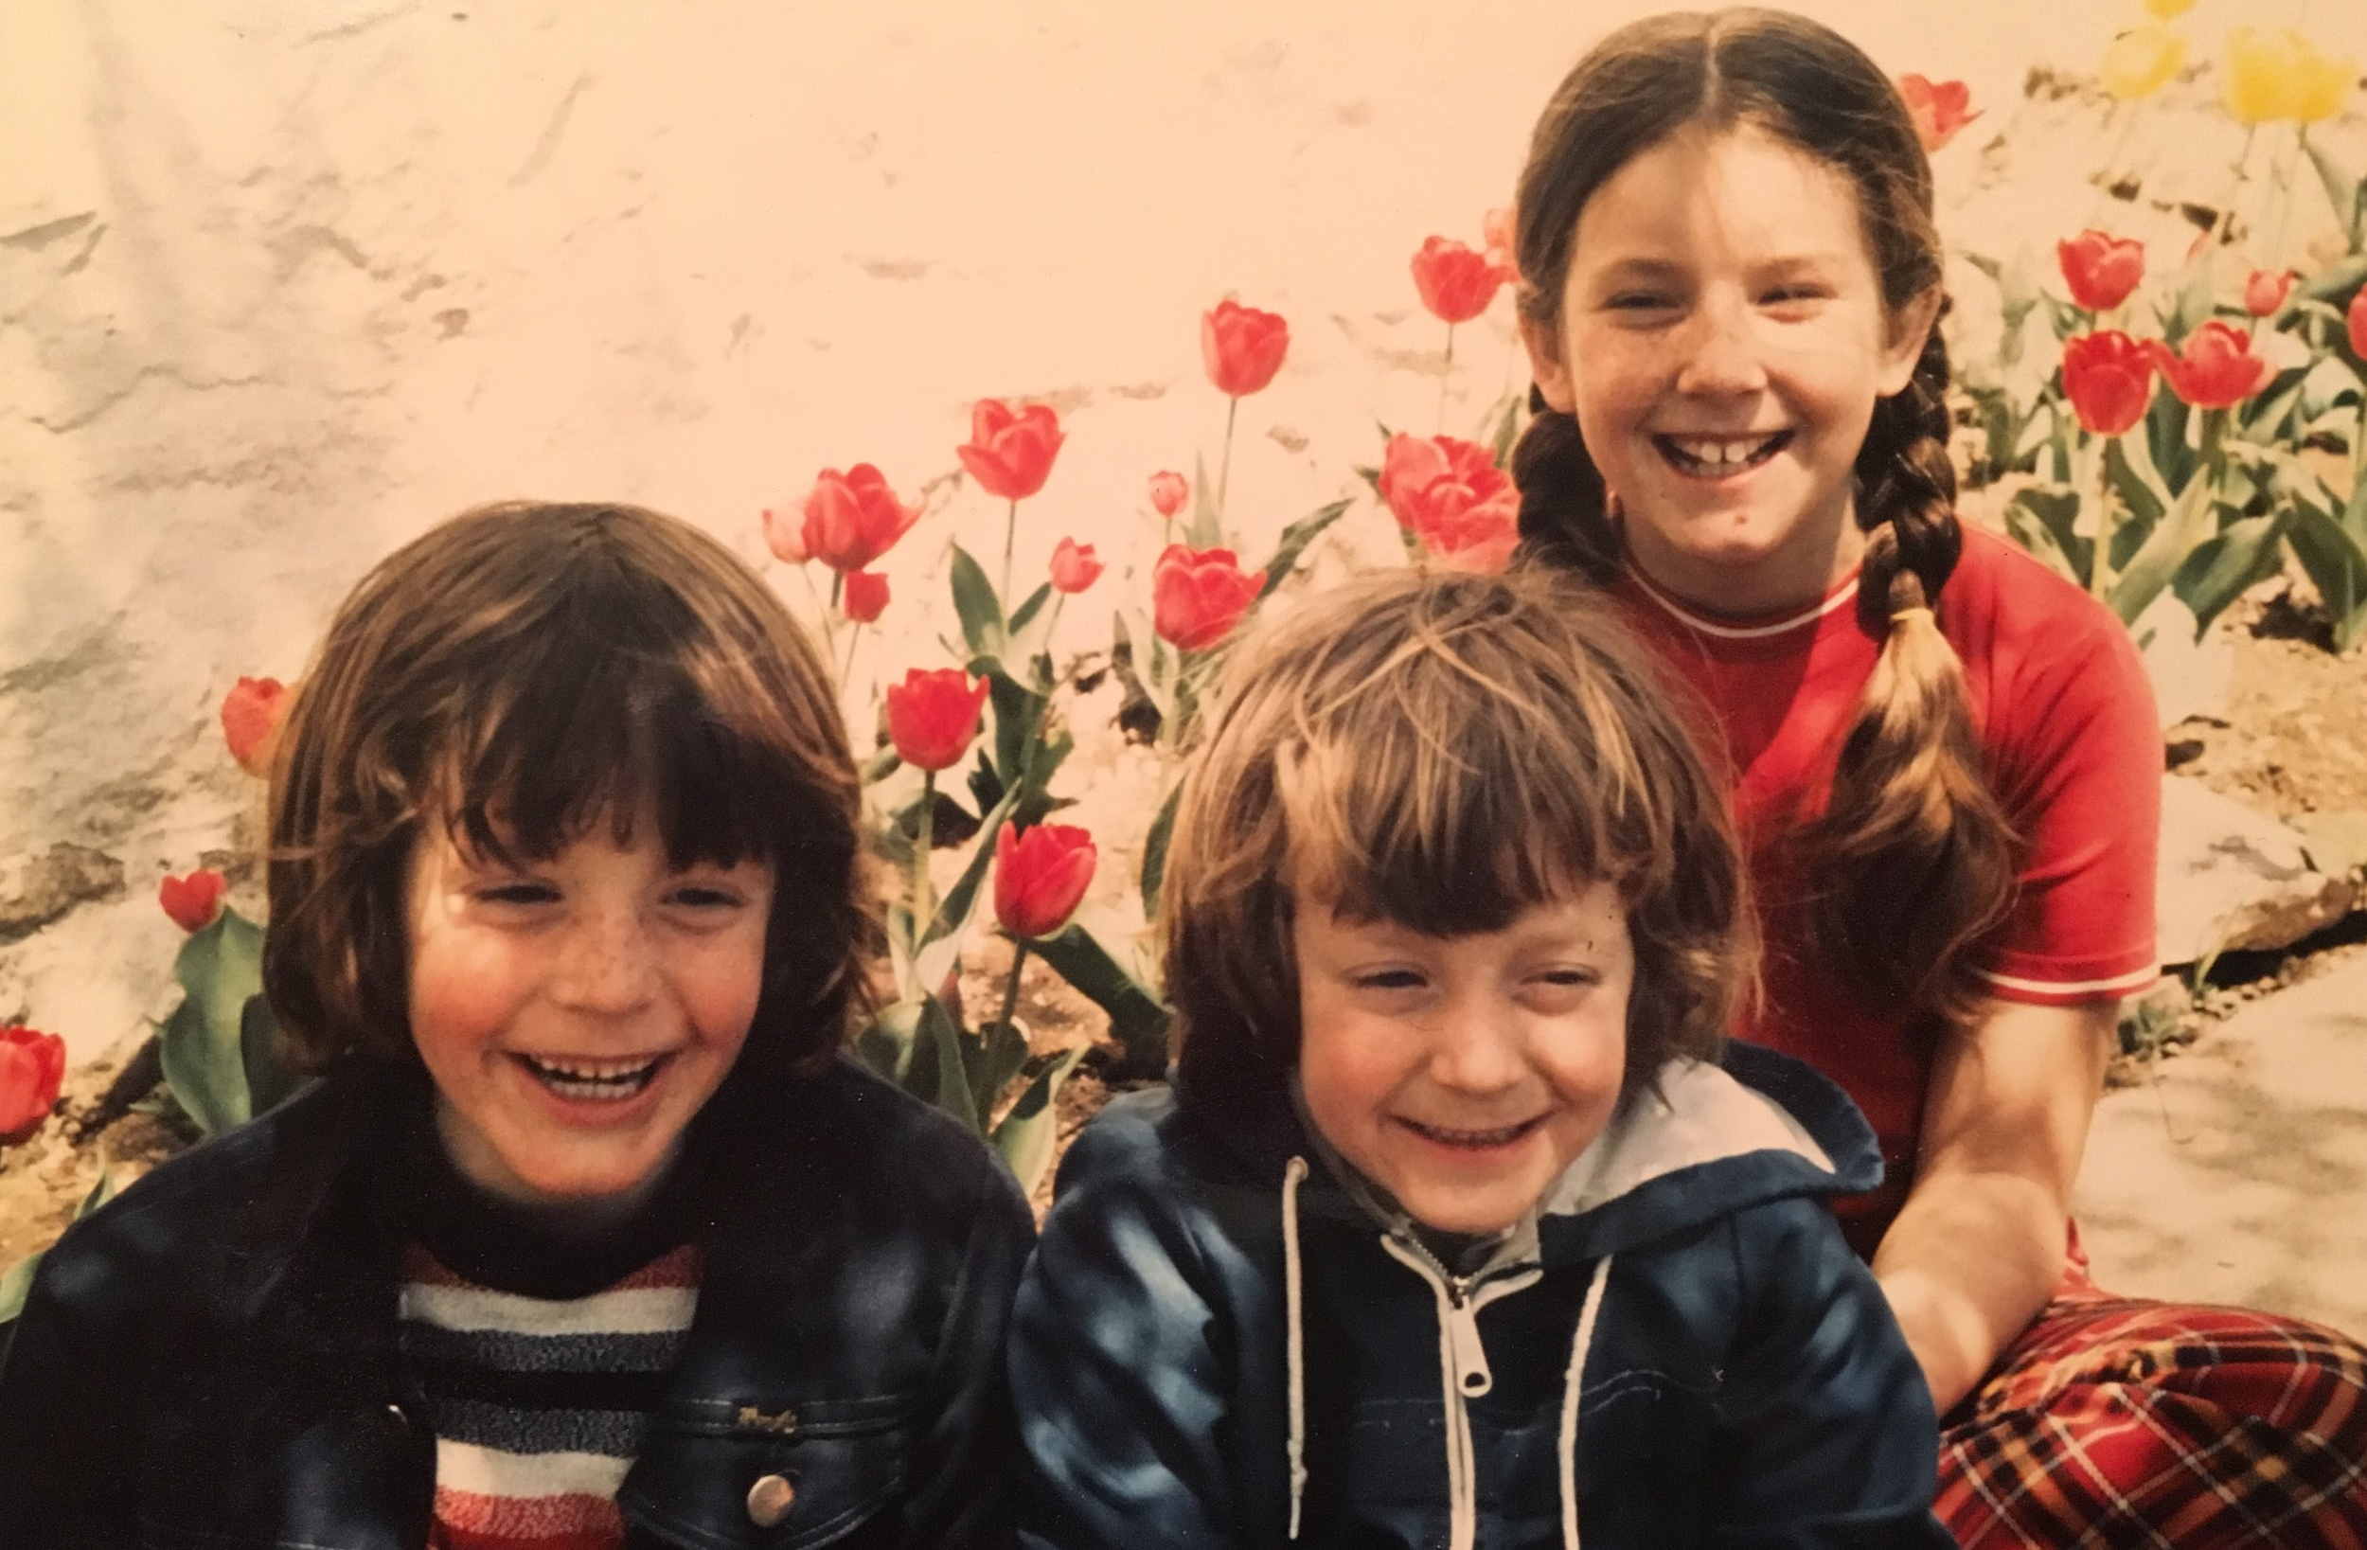
Joe’s Children: Jason, Paul and Rebecca

Slide 13
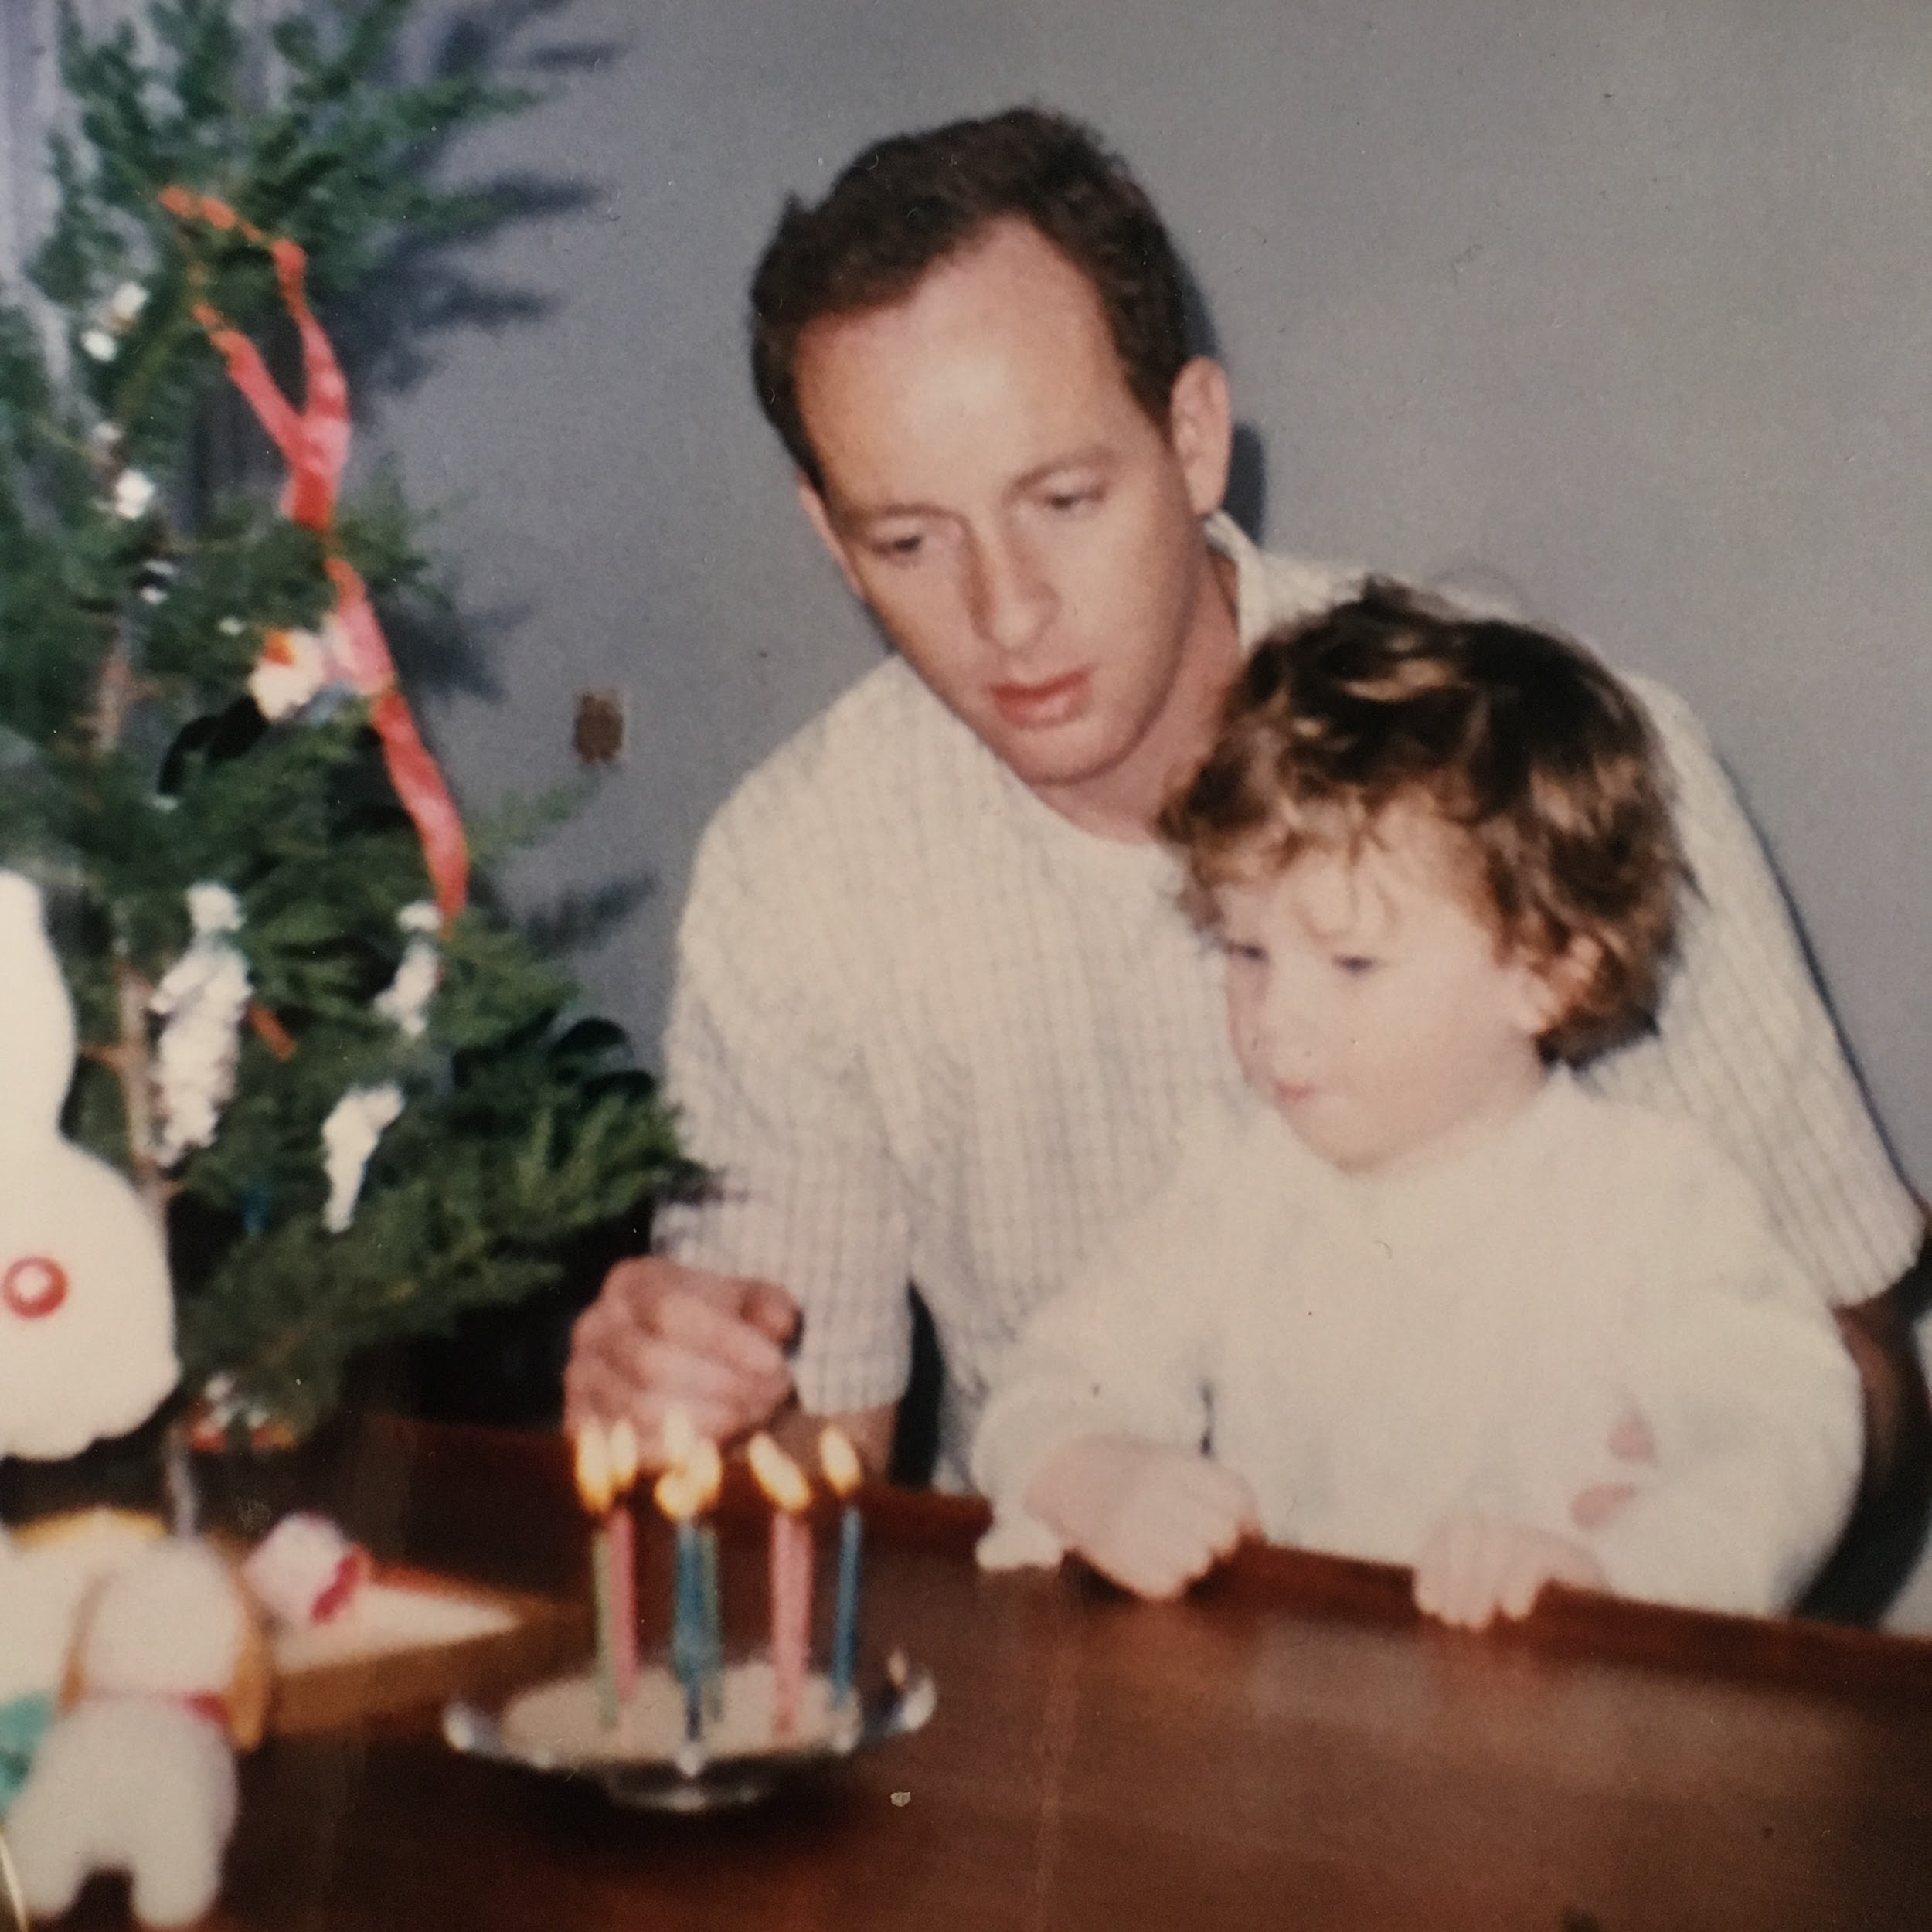
Joe & Rebecca

Slide 14
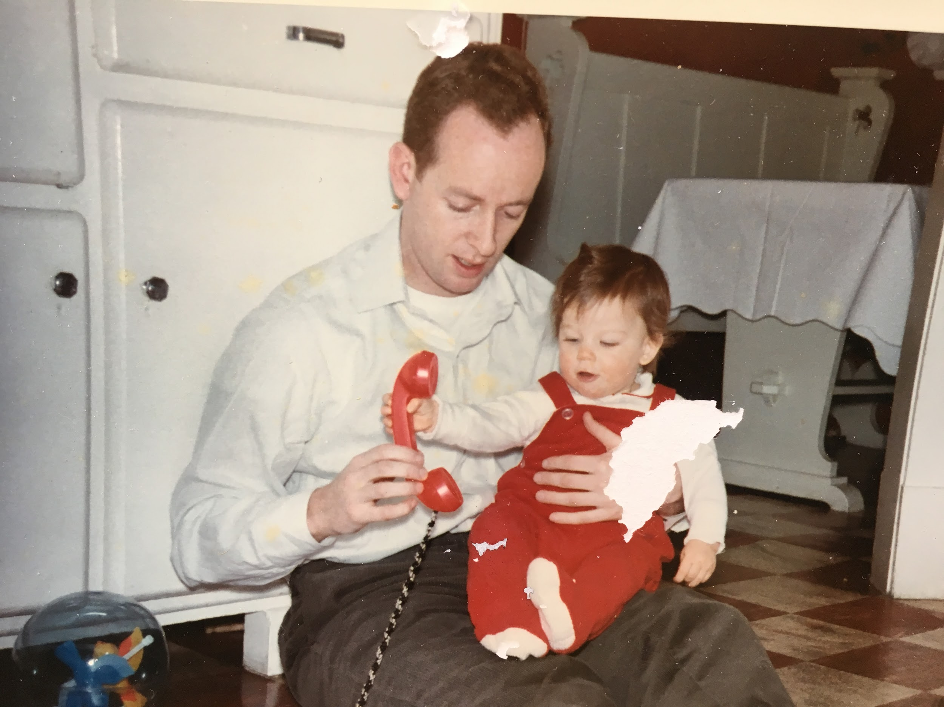

Slide 15
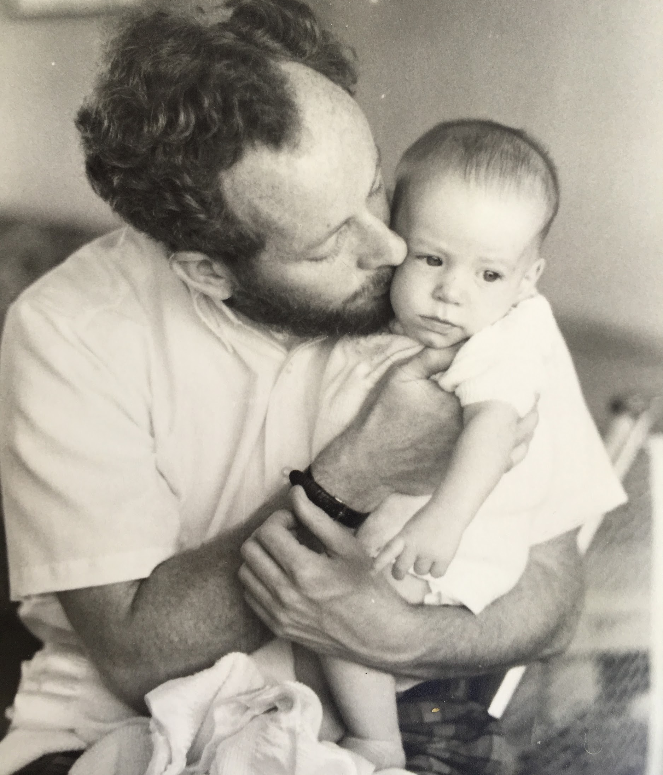
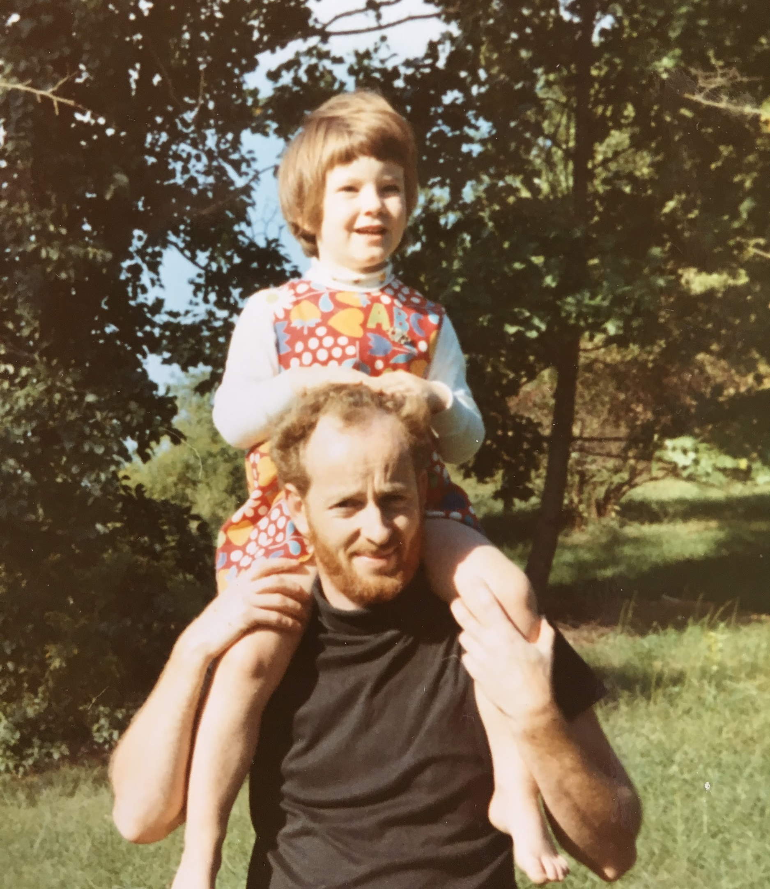

Slide 16
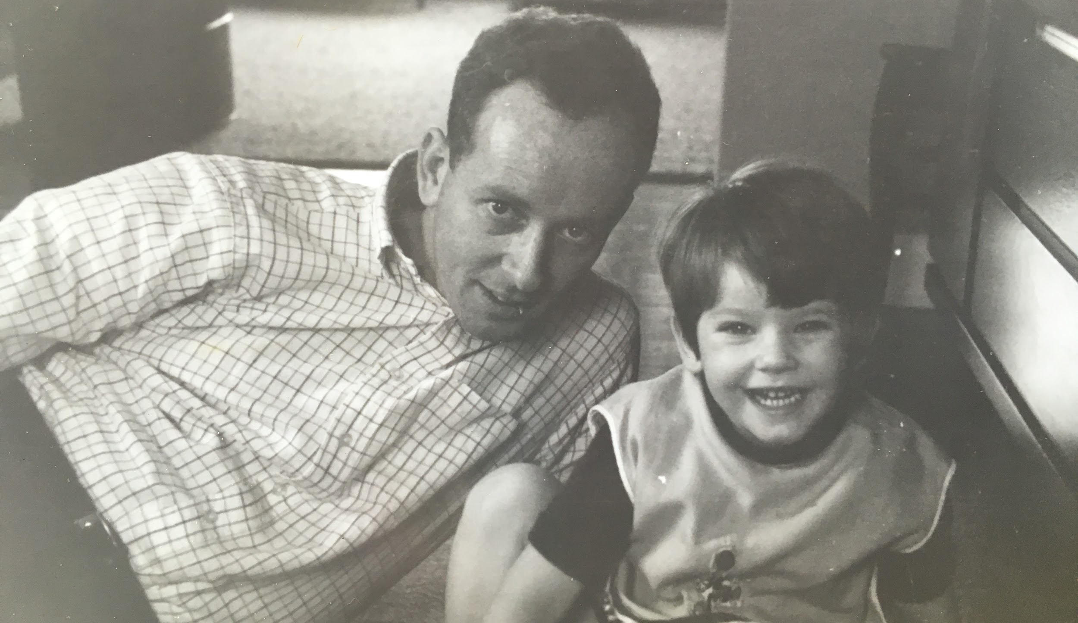

Slide 17
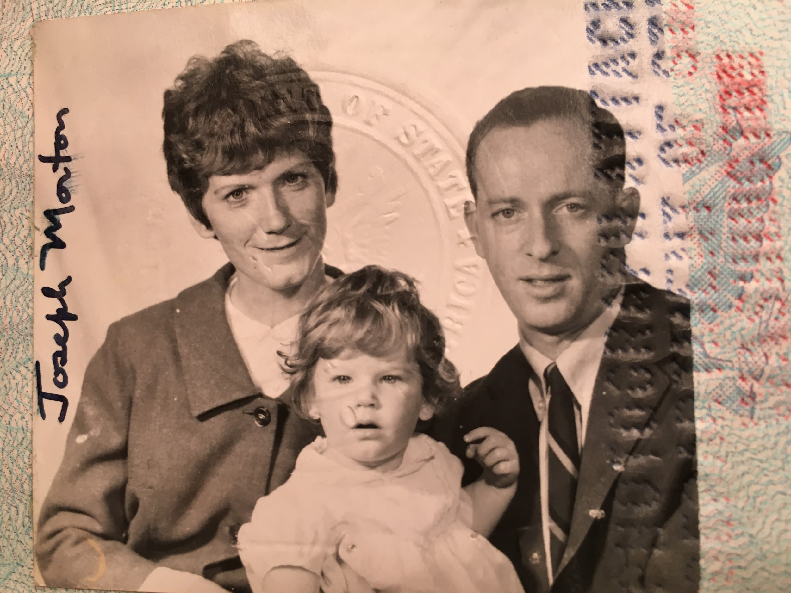

Slide 18
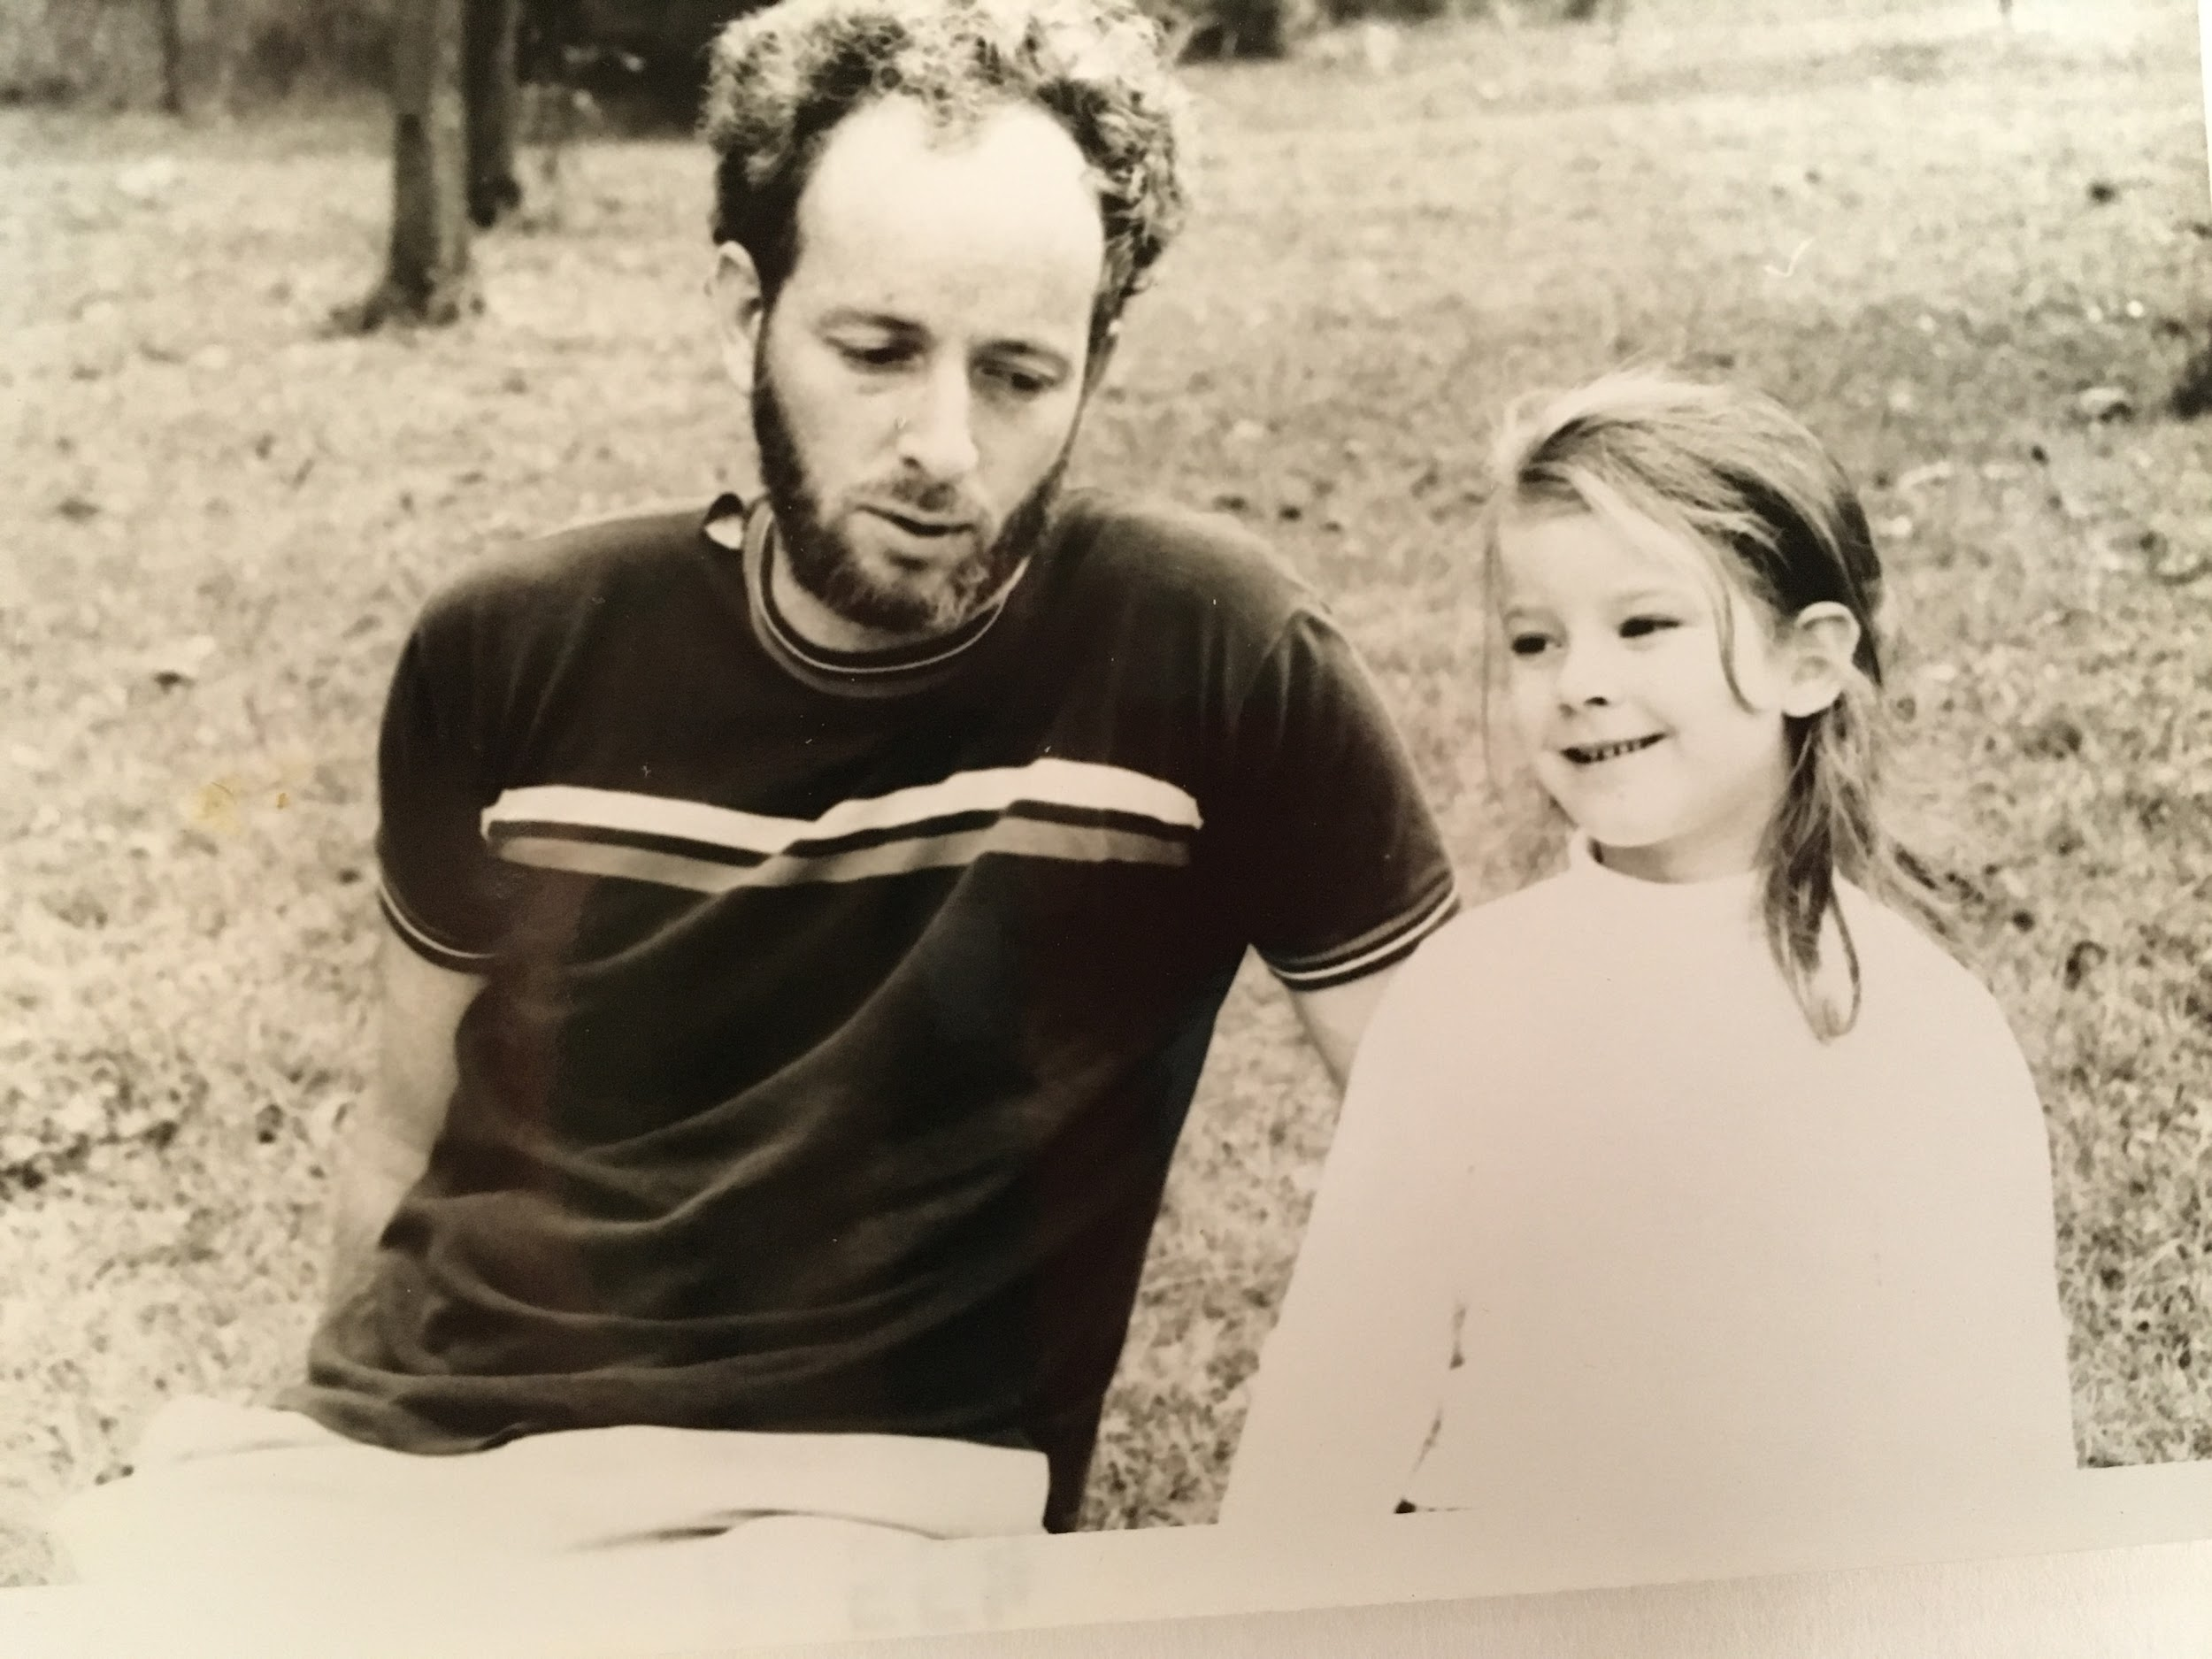

Slide 19
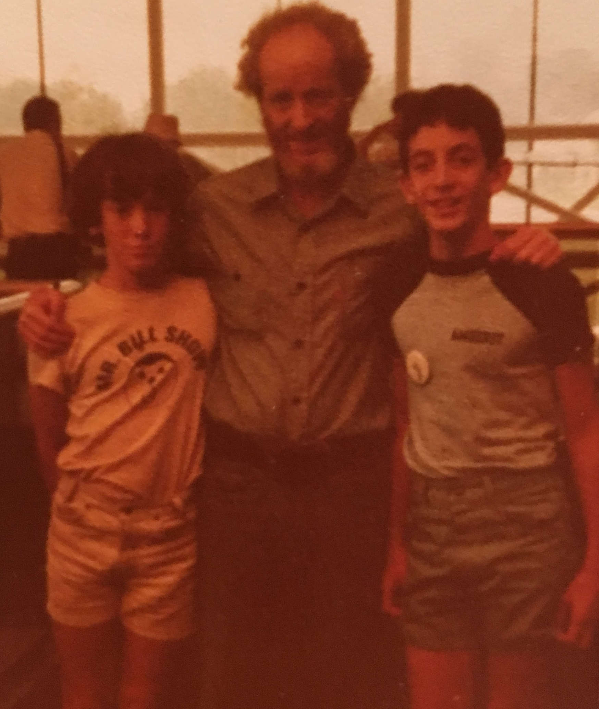
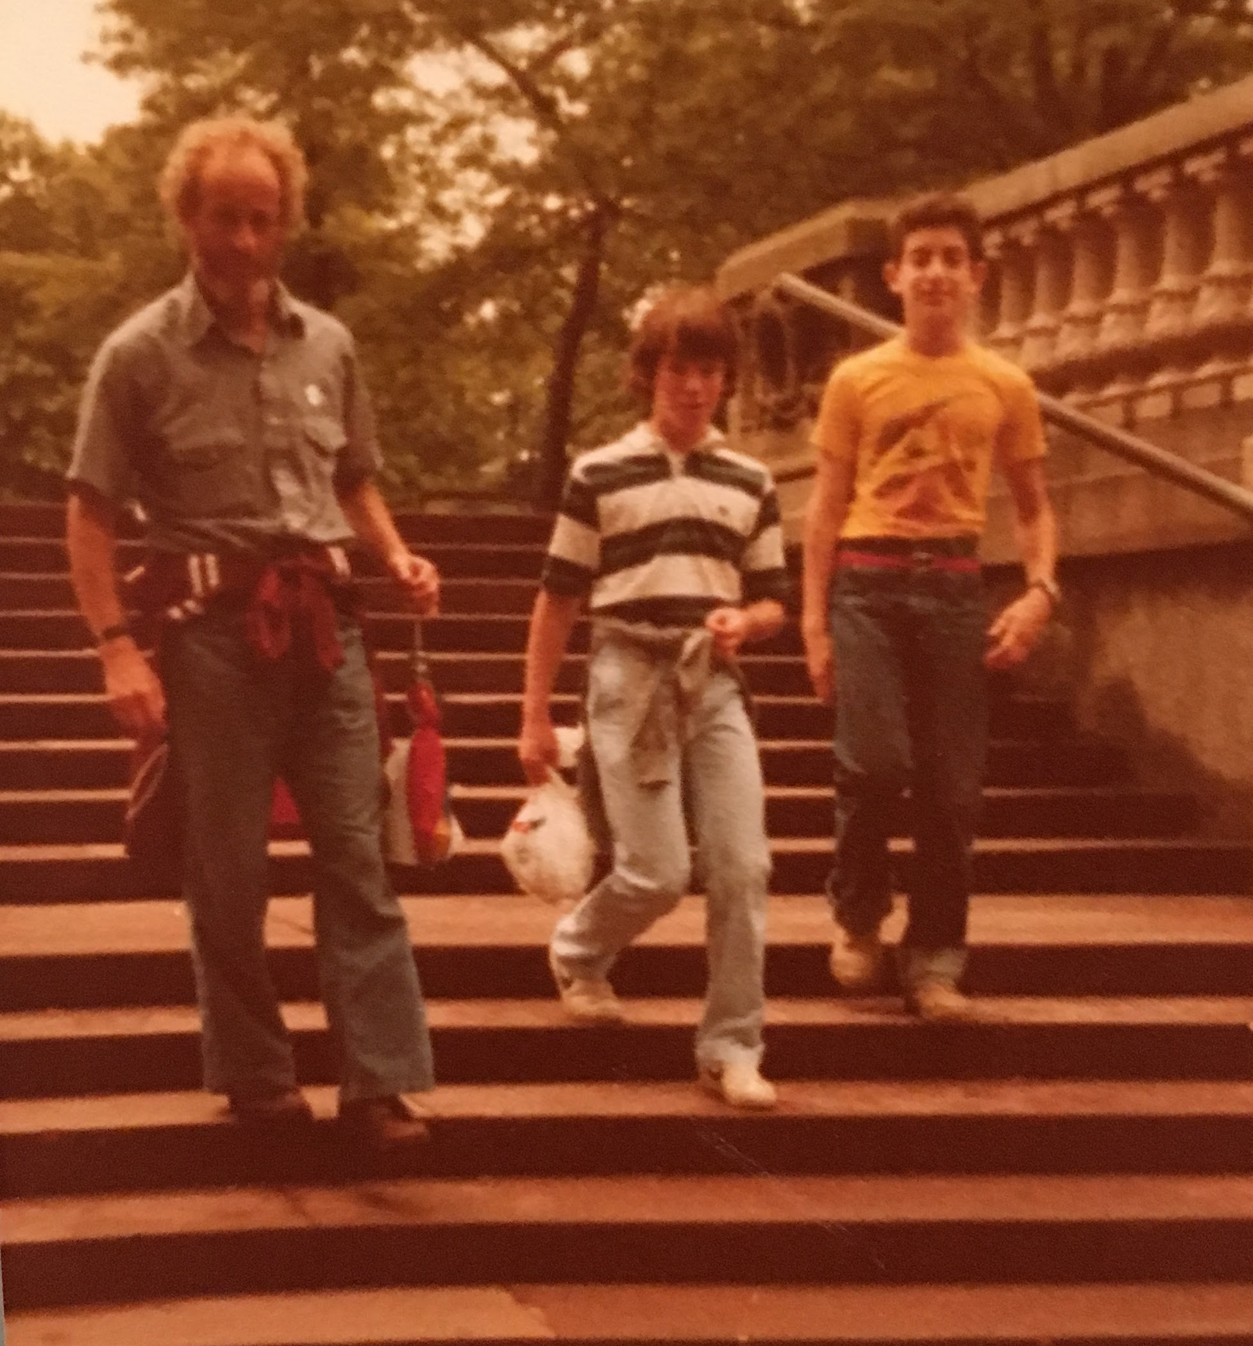

Slide 20
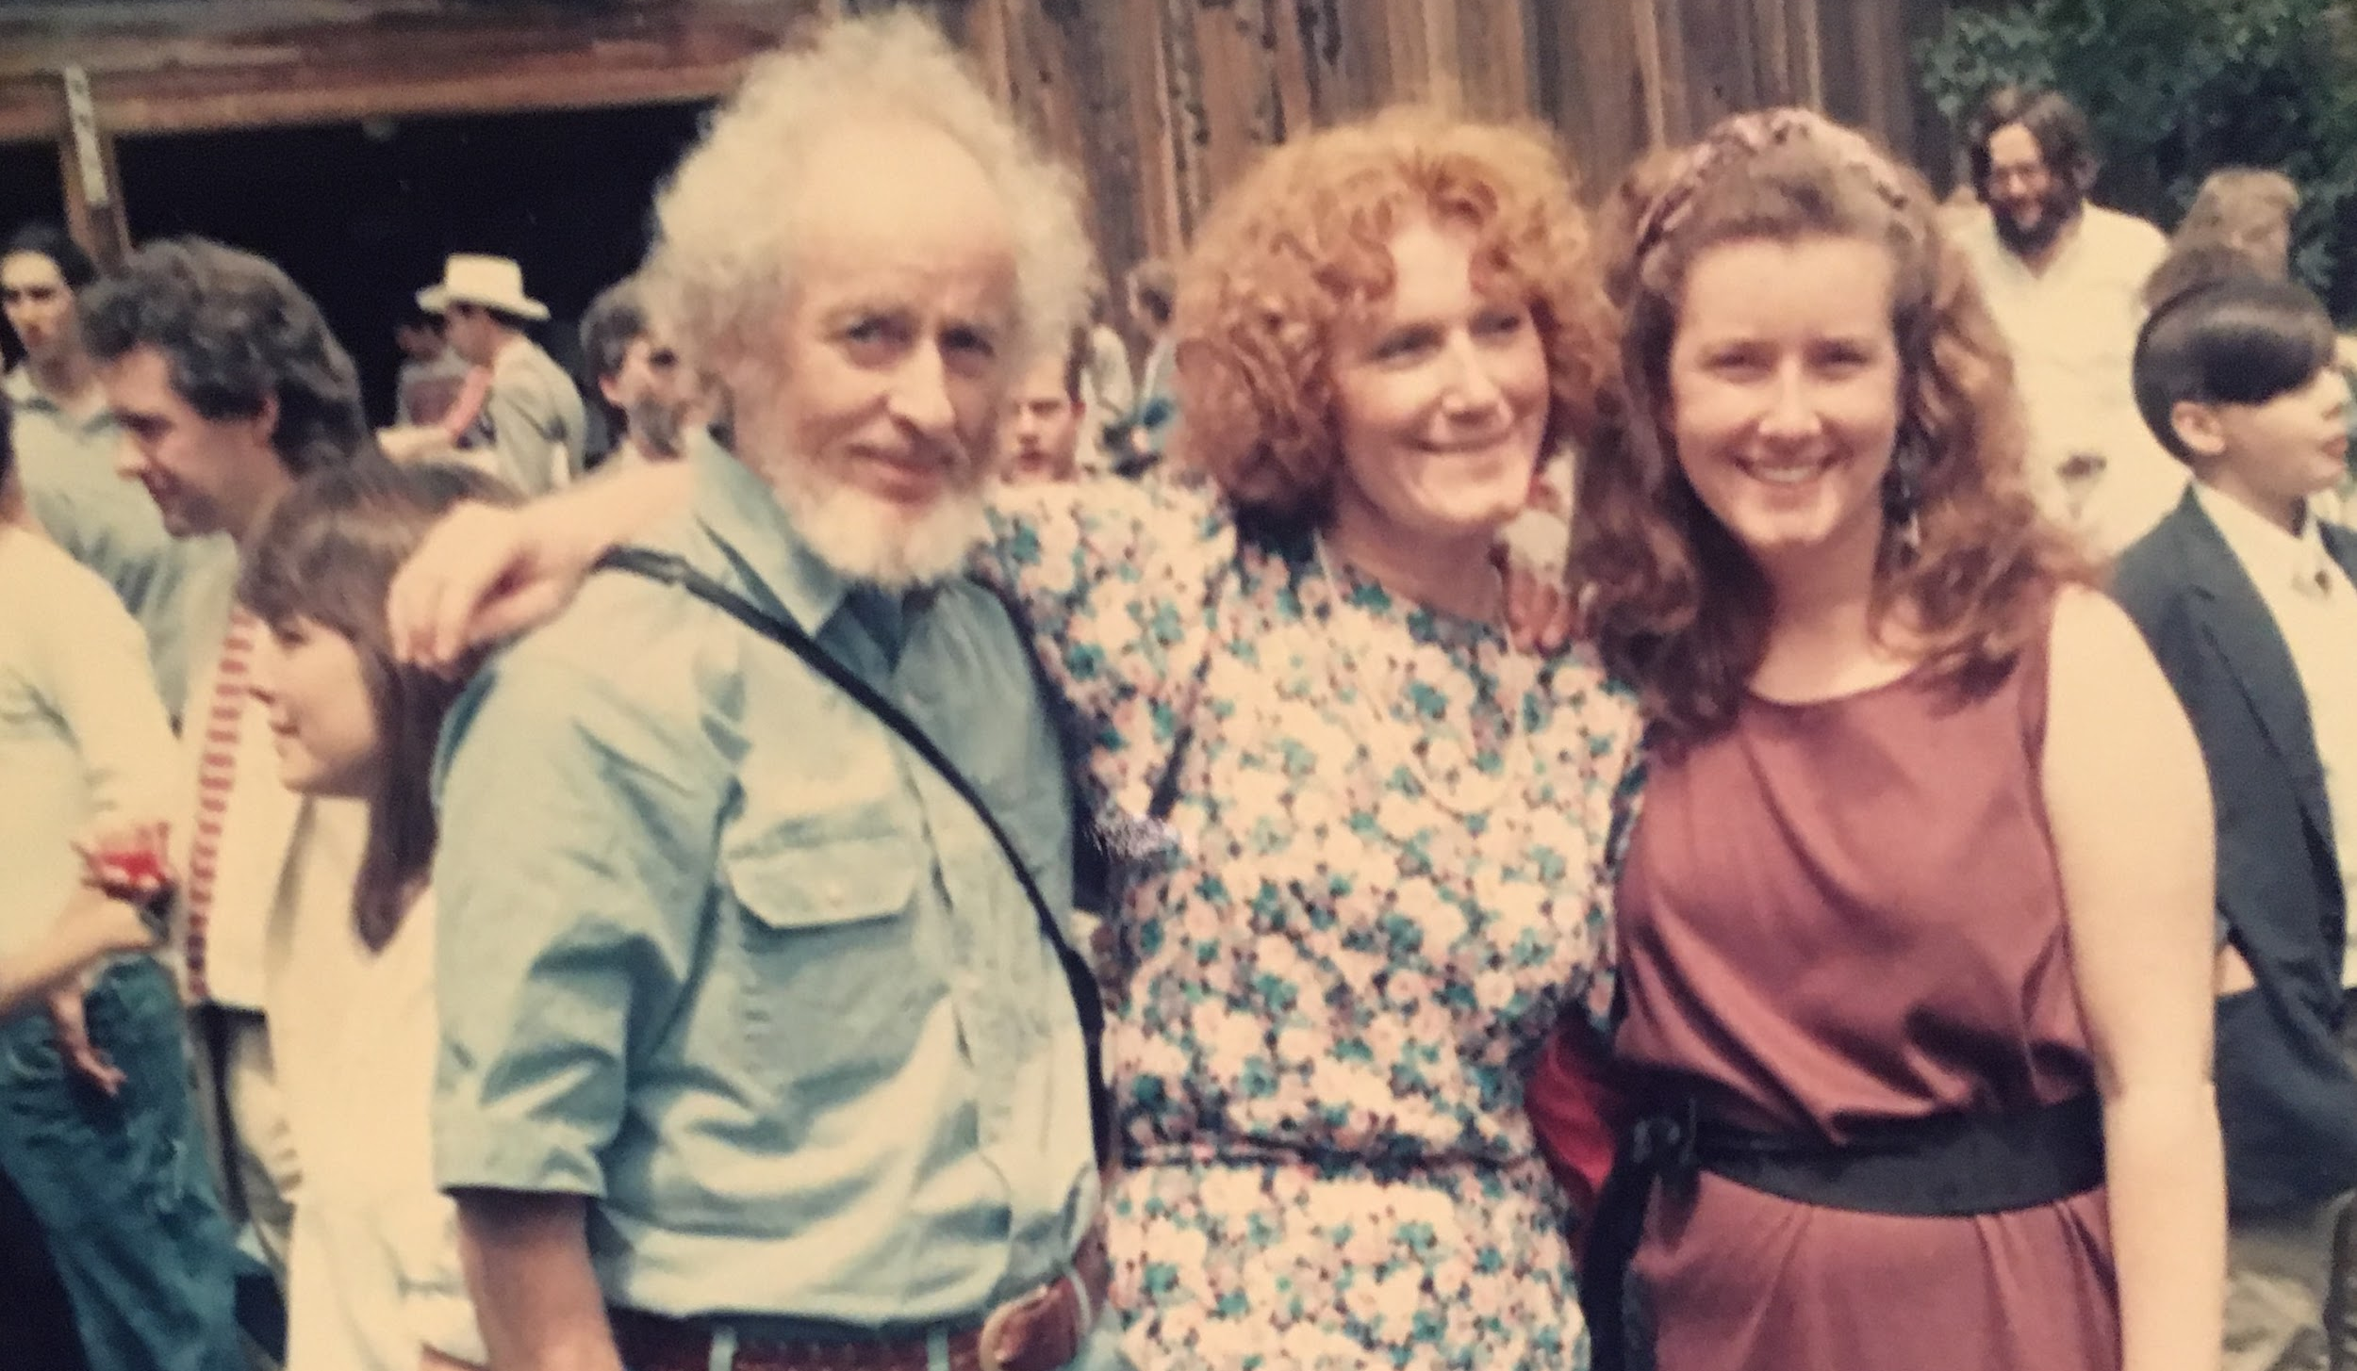

Slide 21
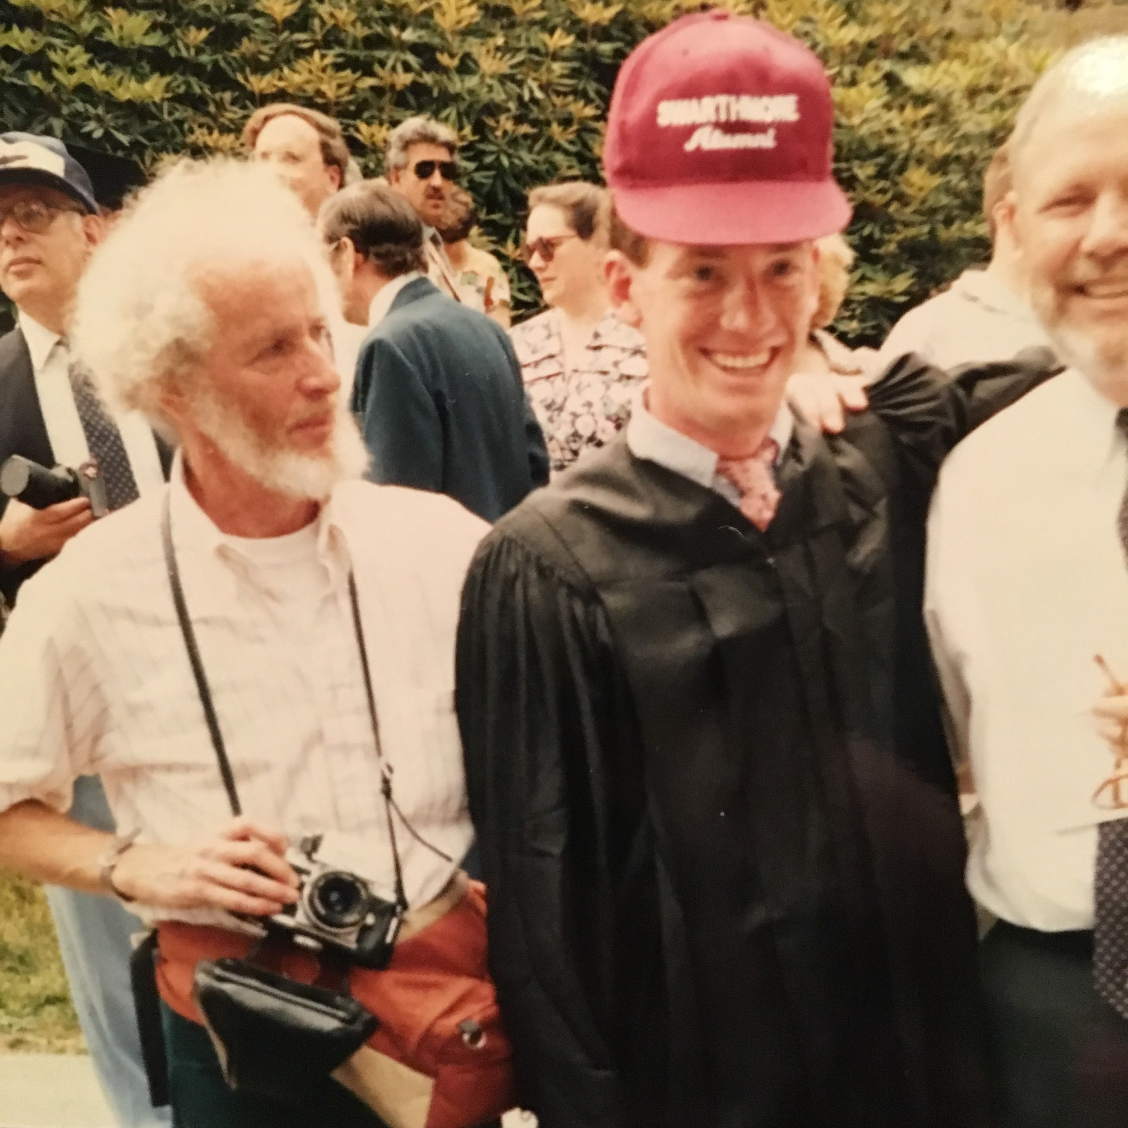
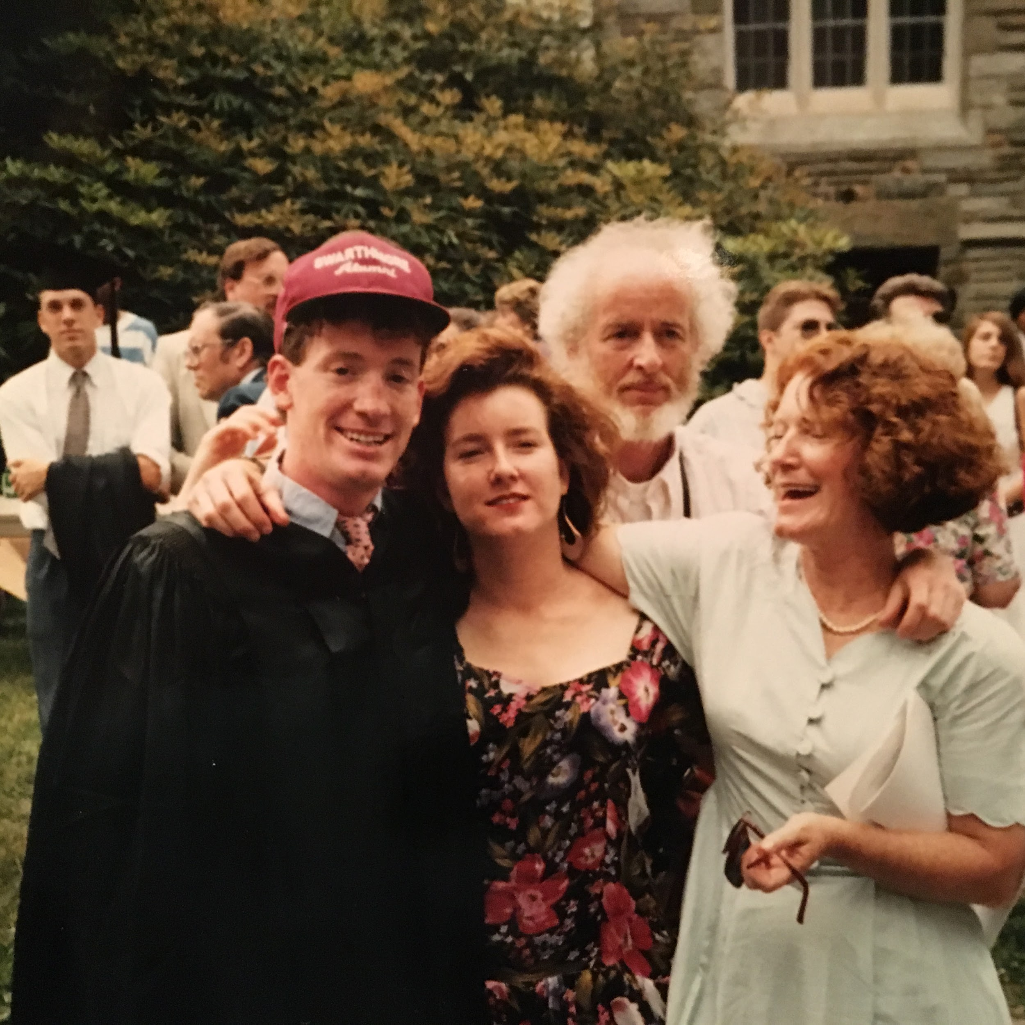
At Jason’s Swarthmore Graduation

Slide 22
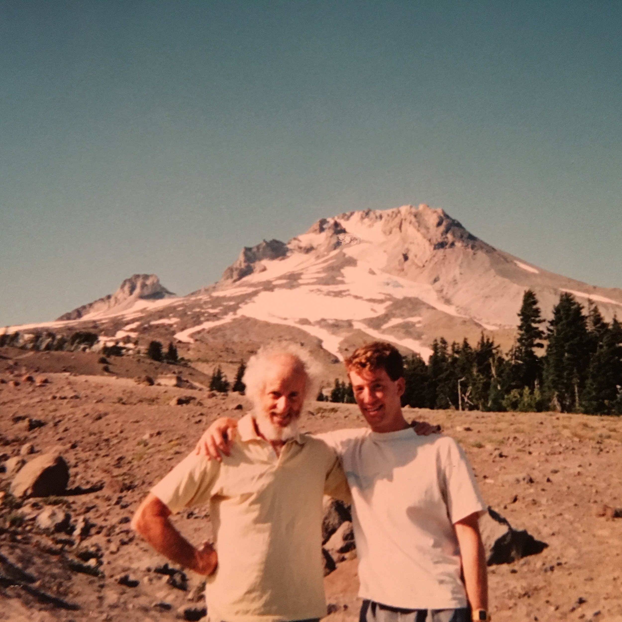
Jason & Joe

Slide 23
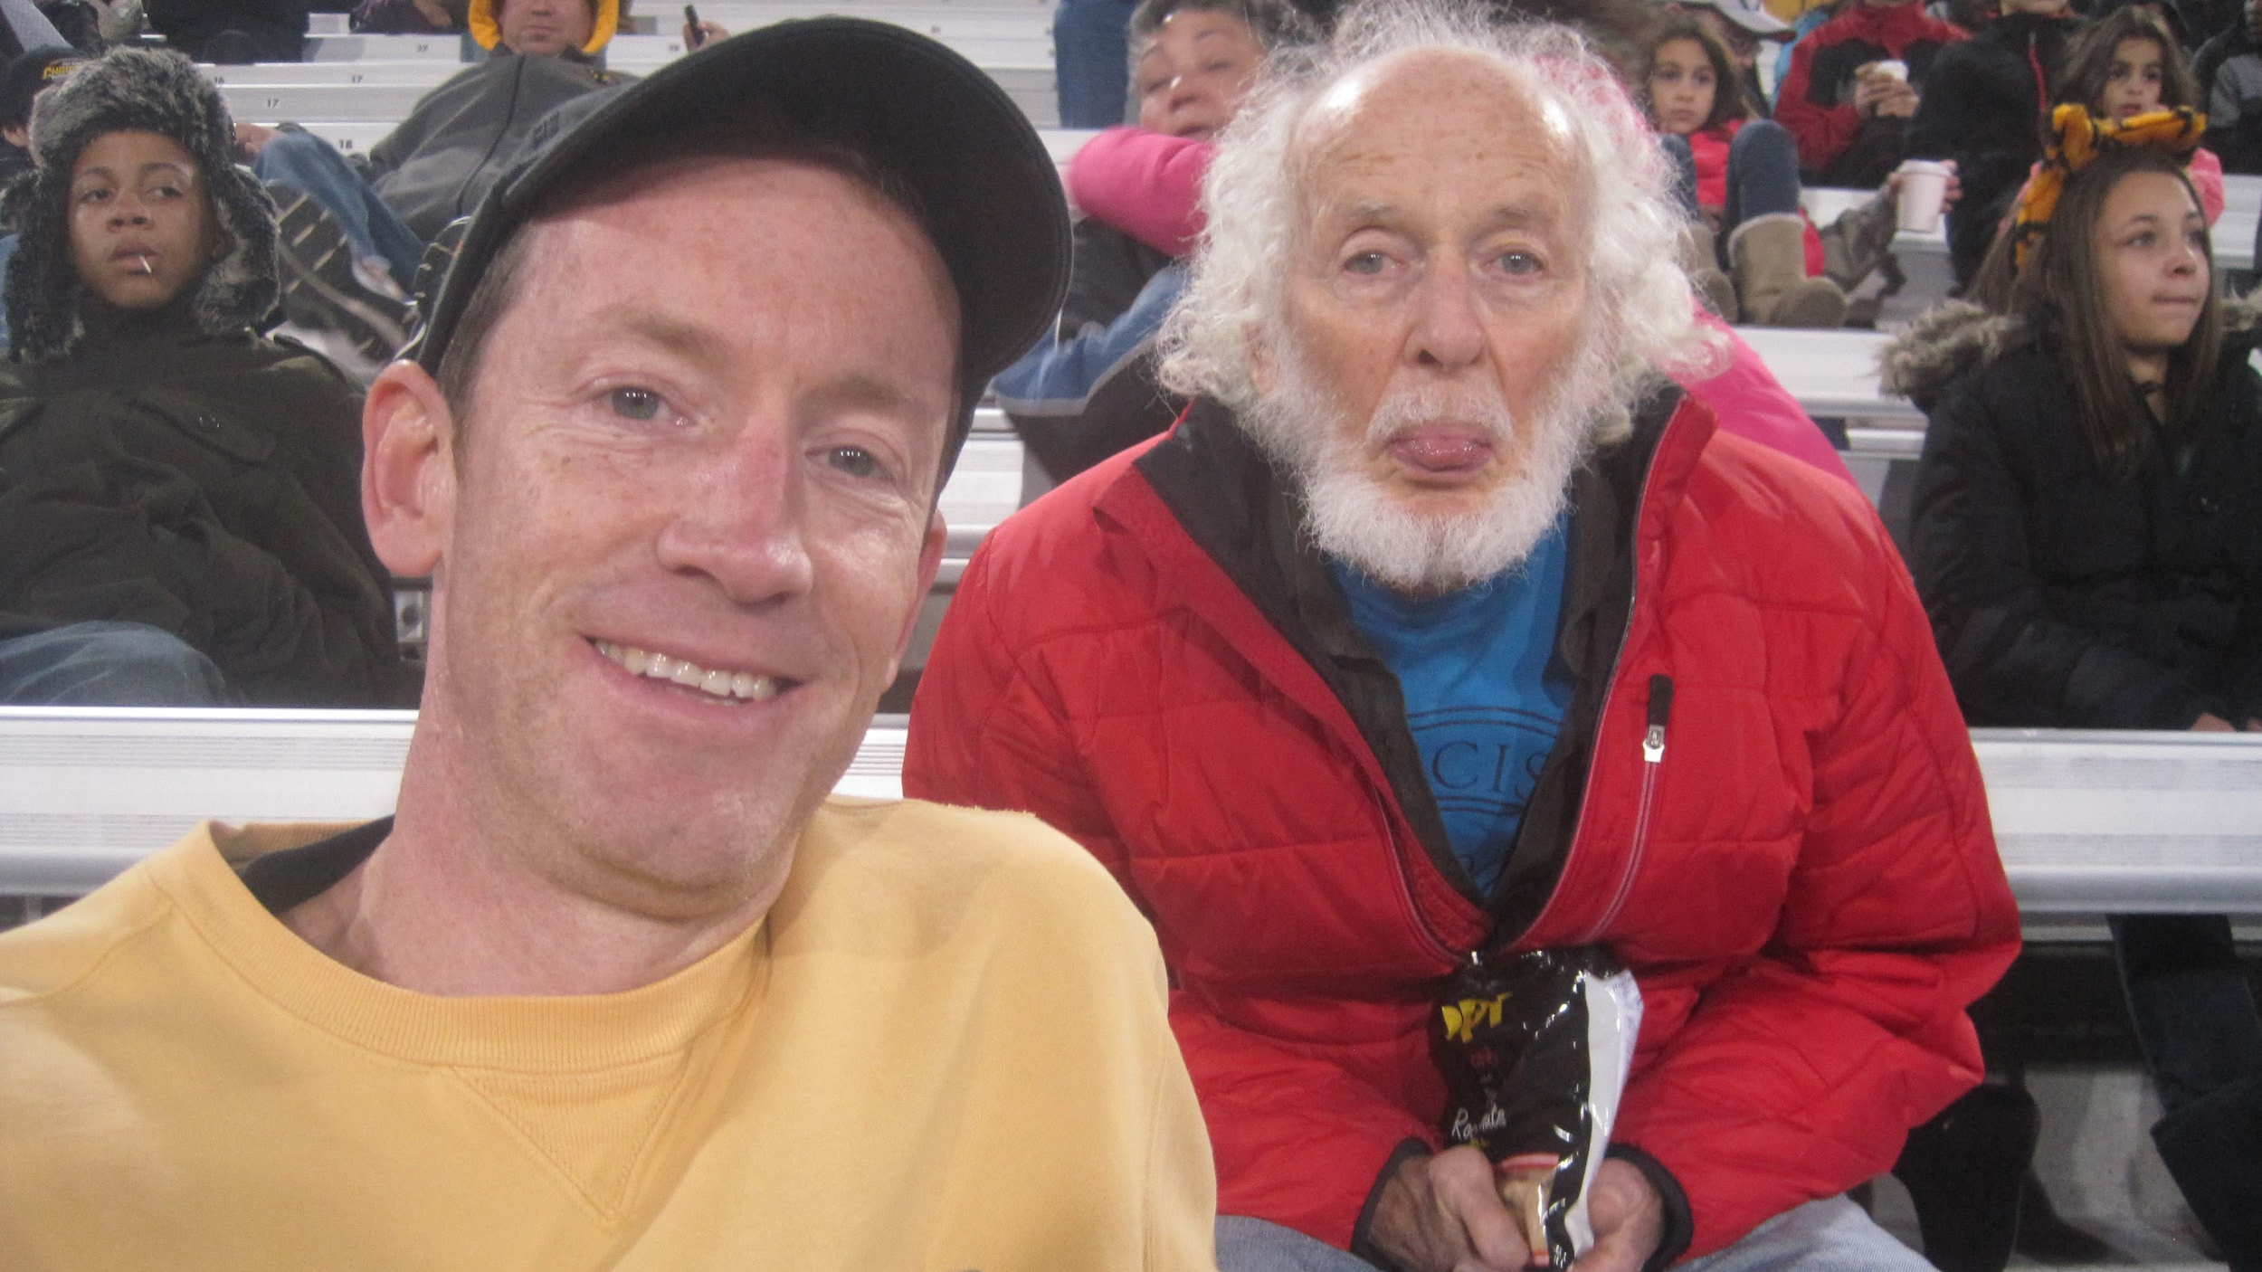
Jason & Joe

Slide 24
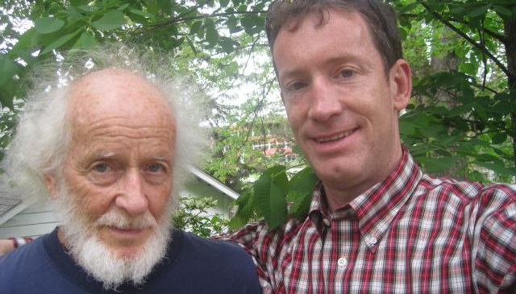
Jason & Joe

Slide 25
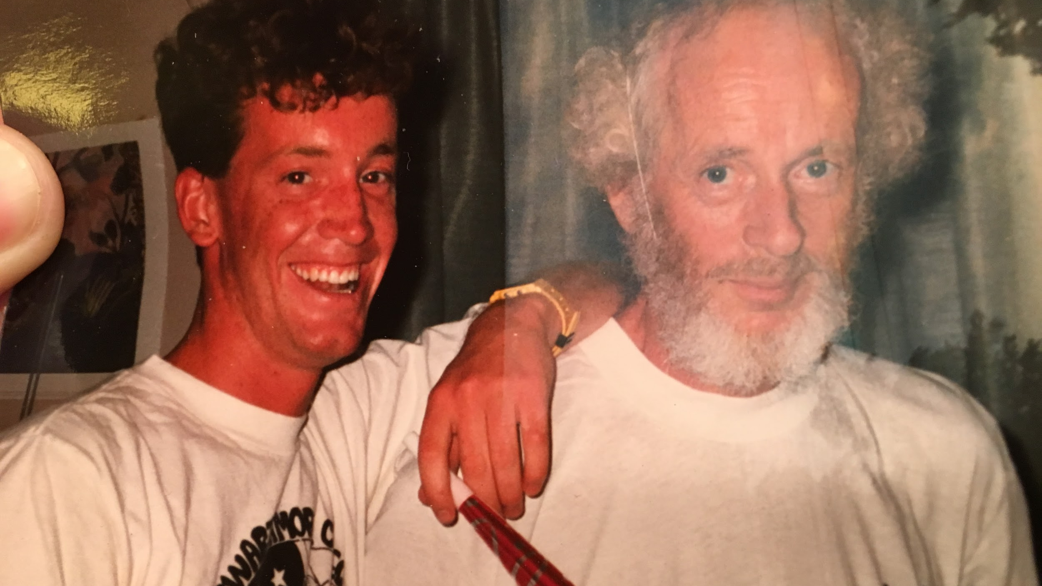

Slide 26
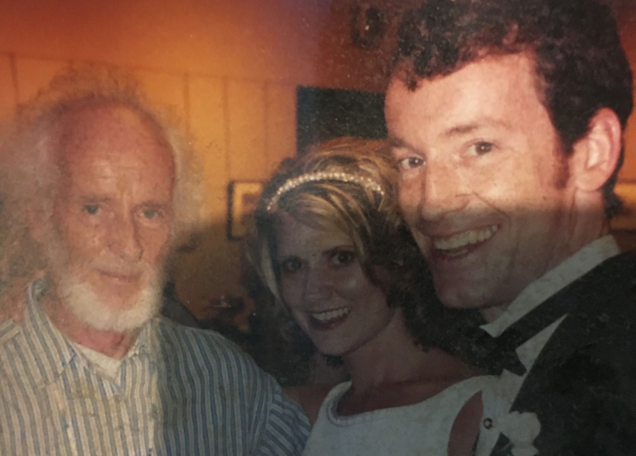

Slide 27
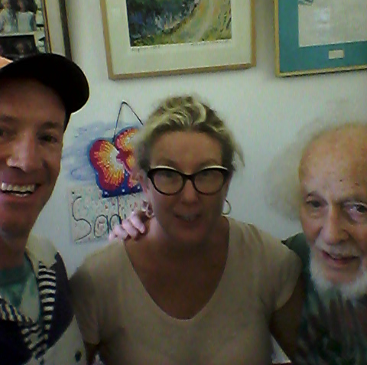
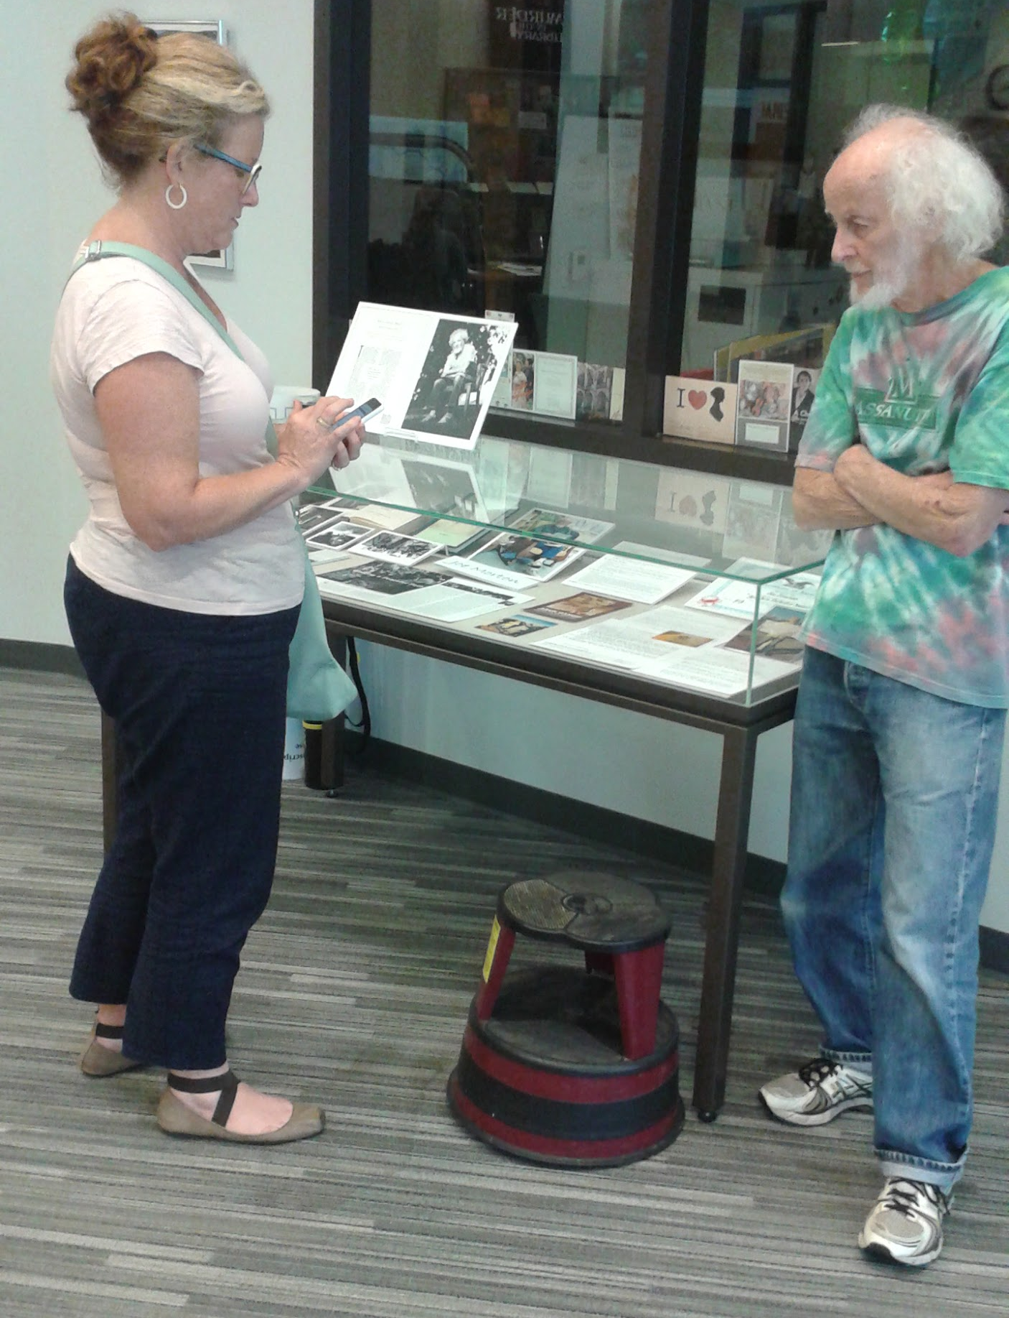

Slide 28
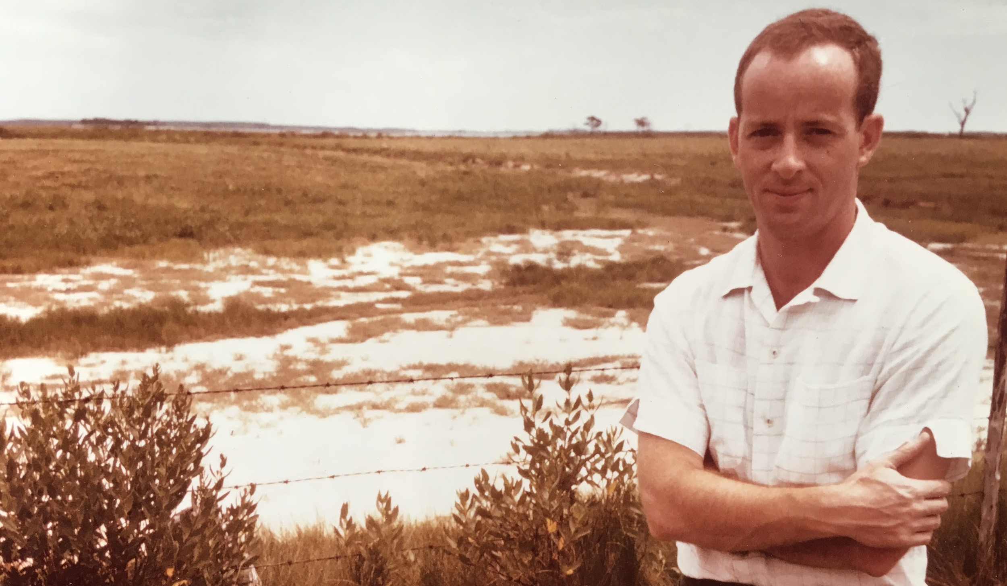
Joe Through The Ages
Watch as his hair gets, longer, whiter and wilder

Slide 29
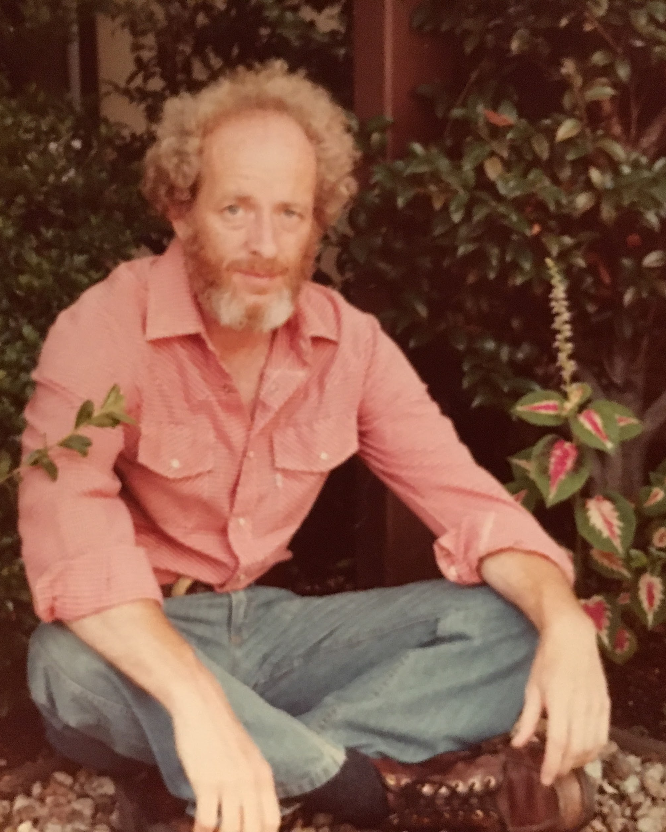
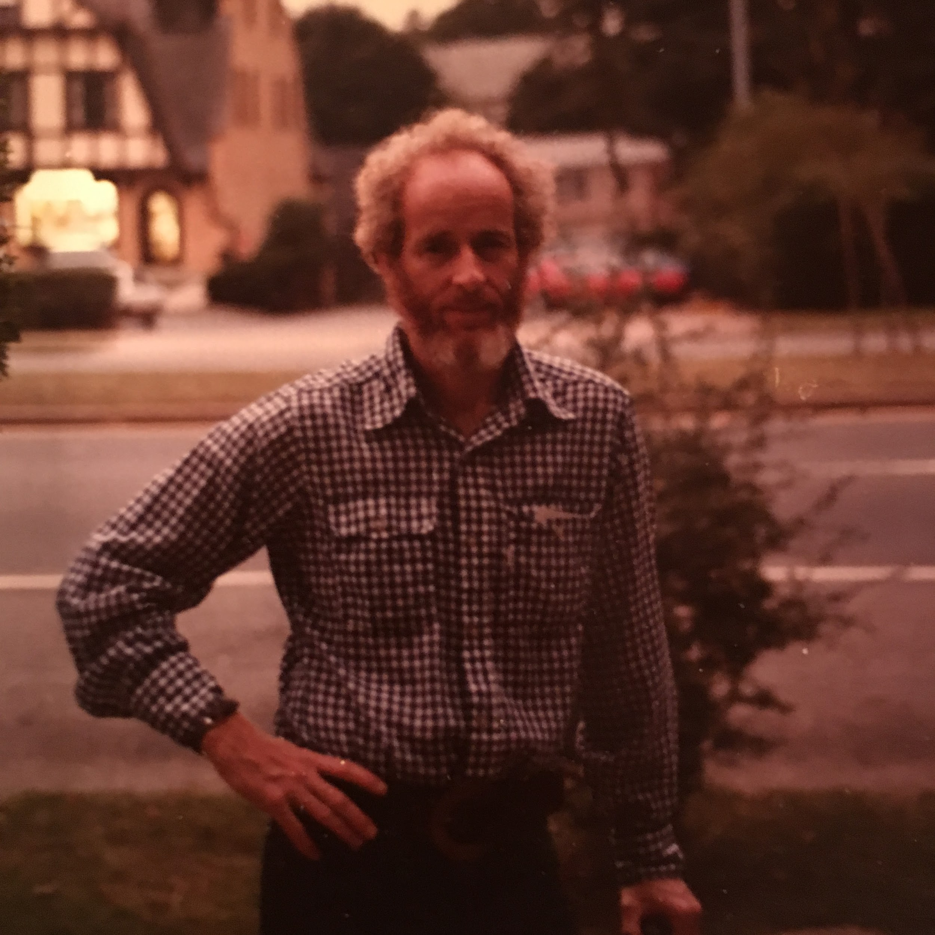

Slide 30
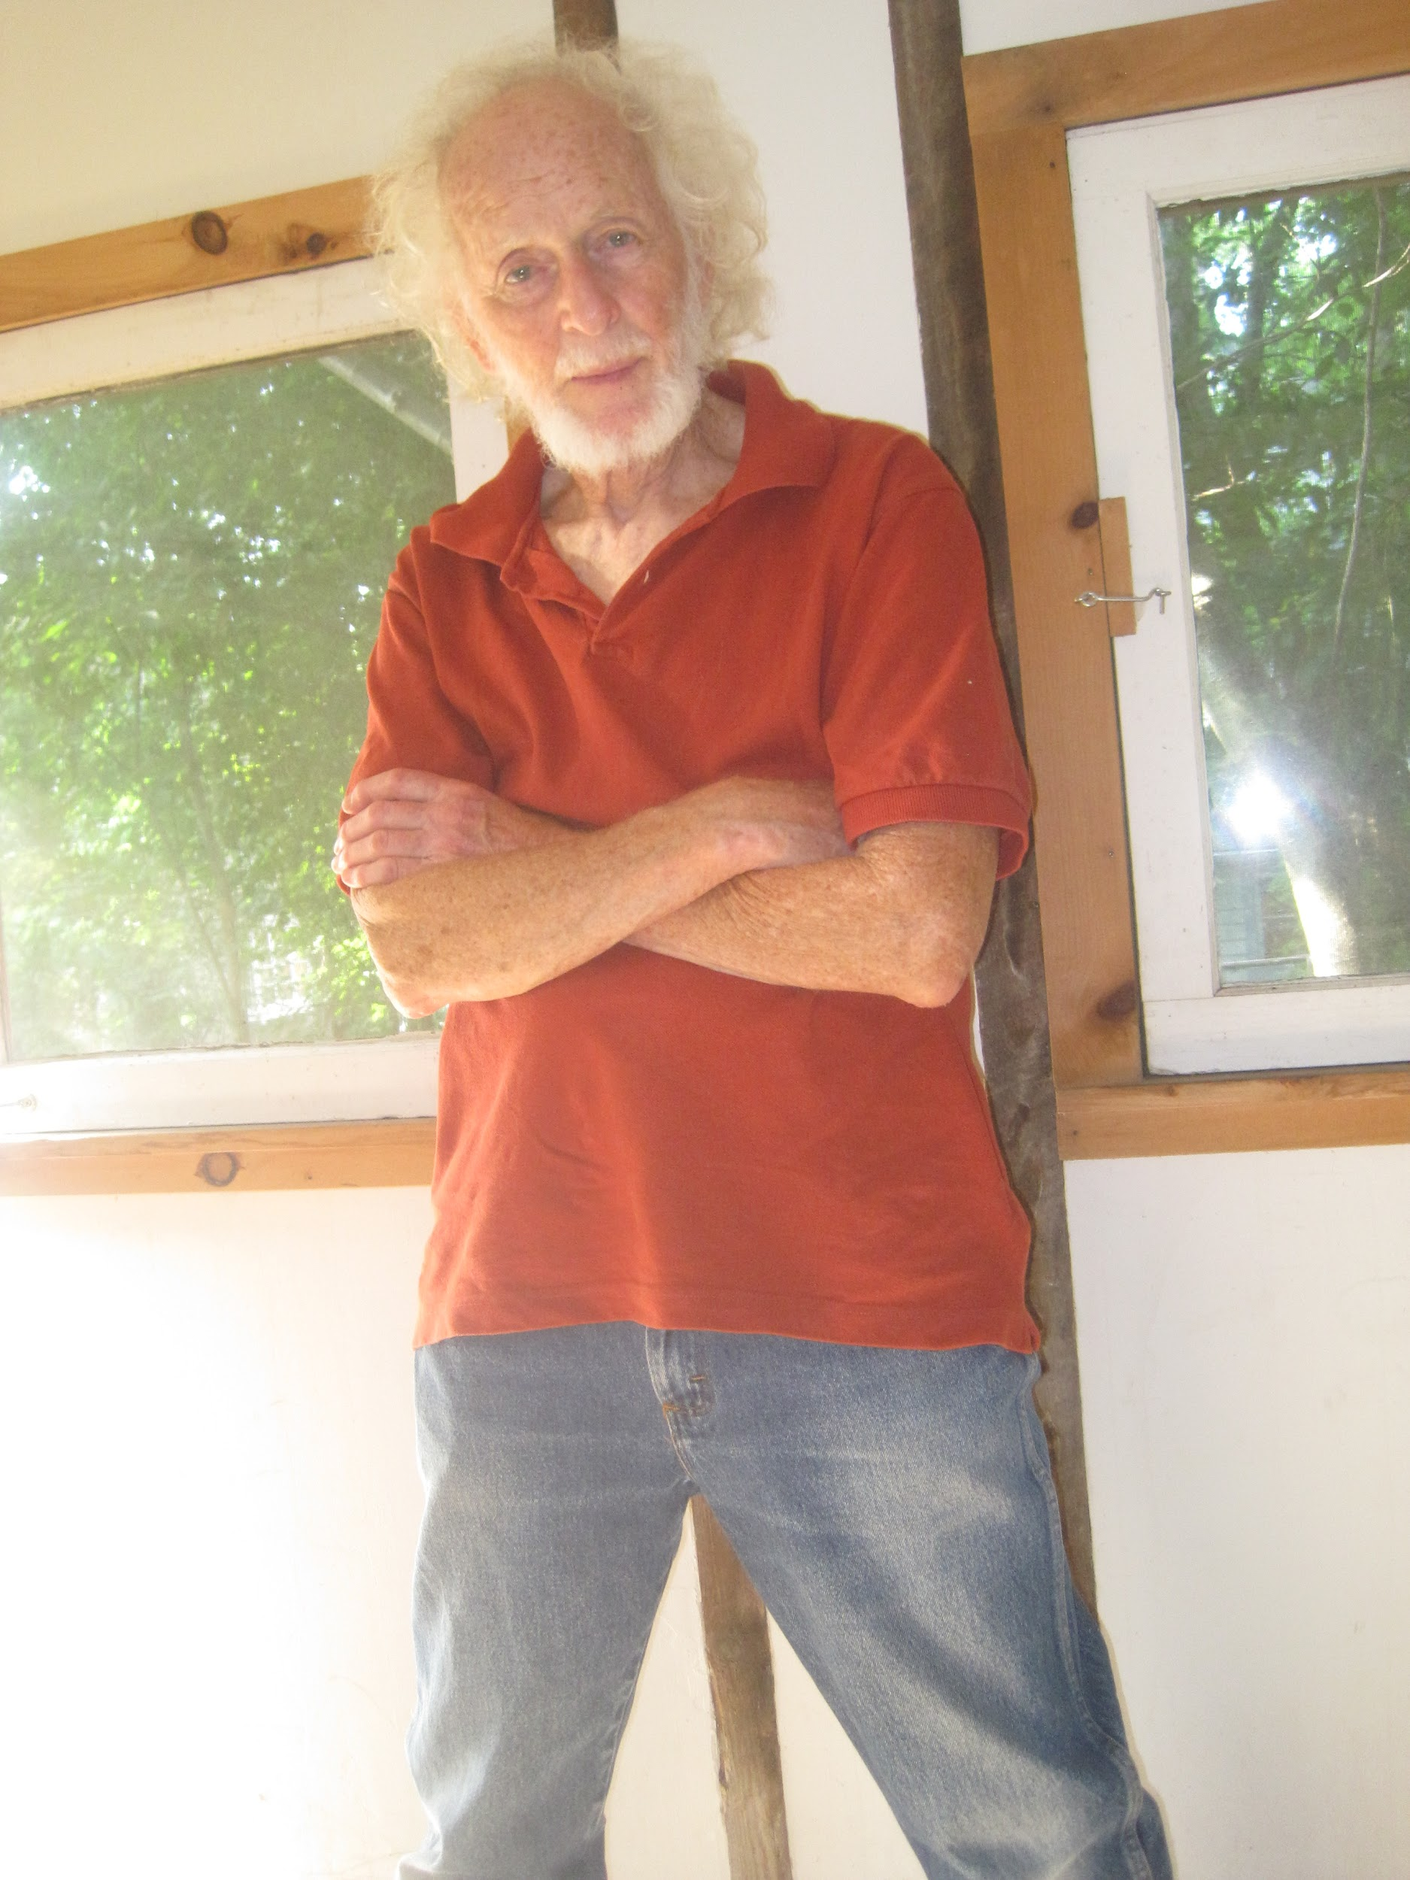

Slide 31
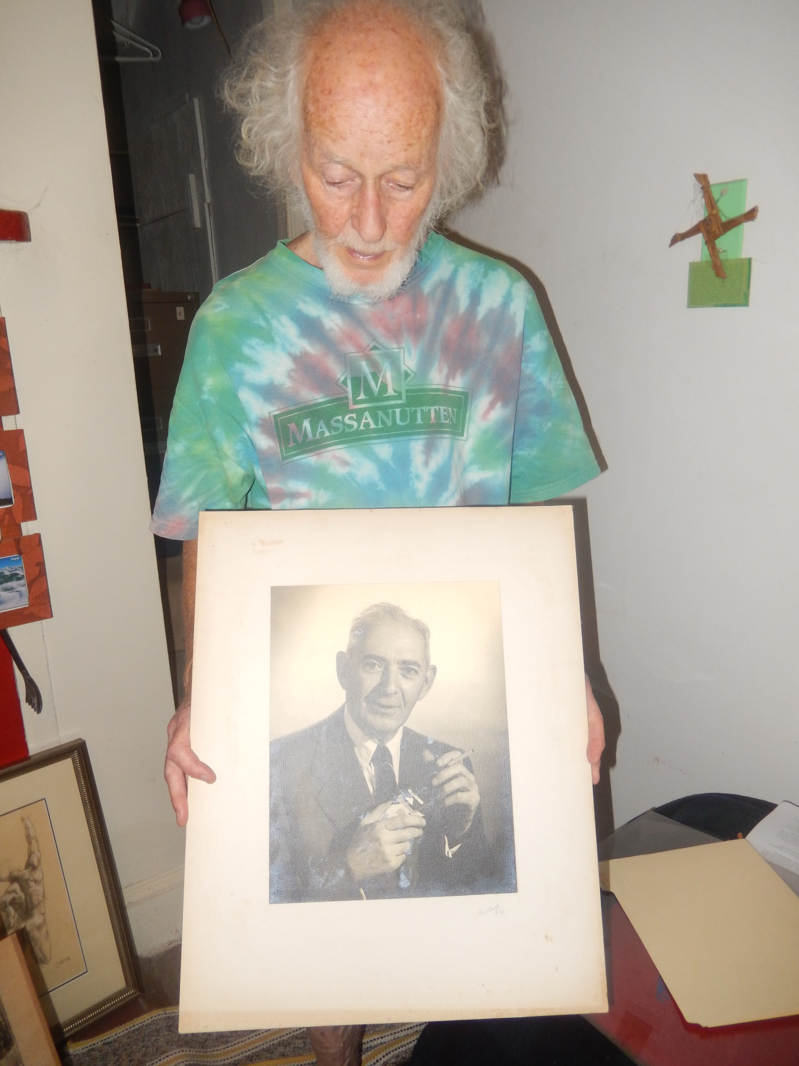
Joe and a photo of his father Tibor Morton

Slide 32
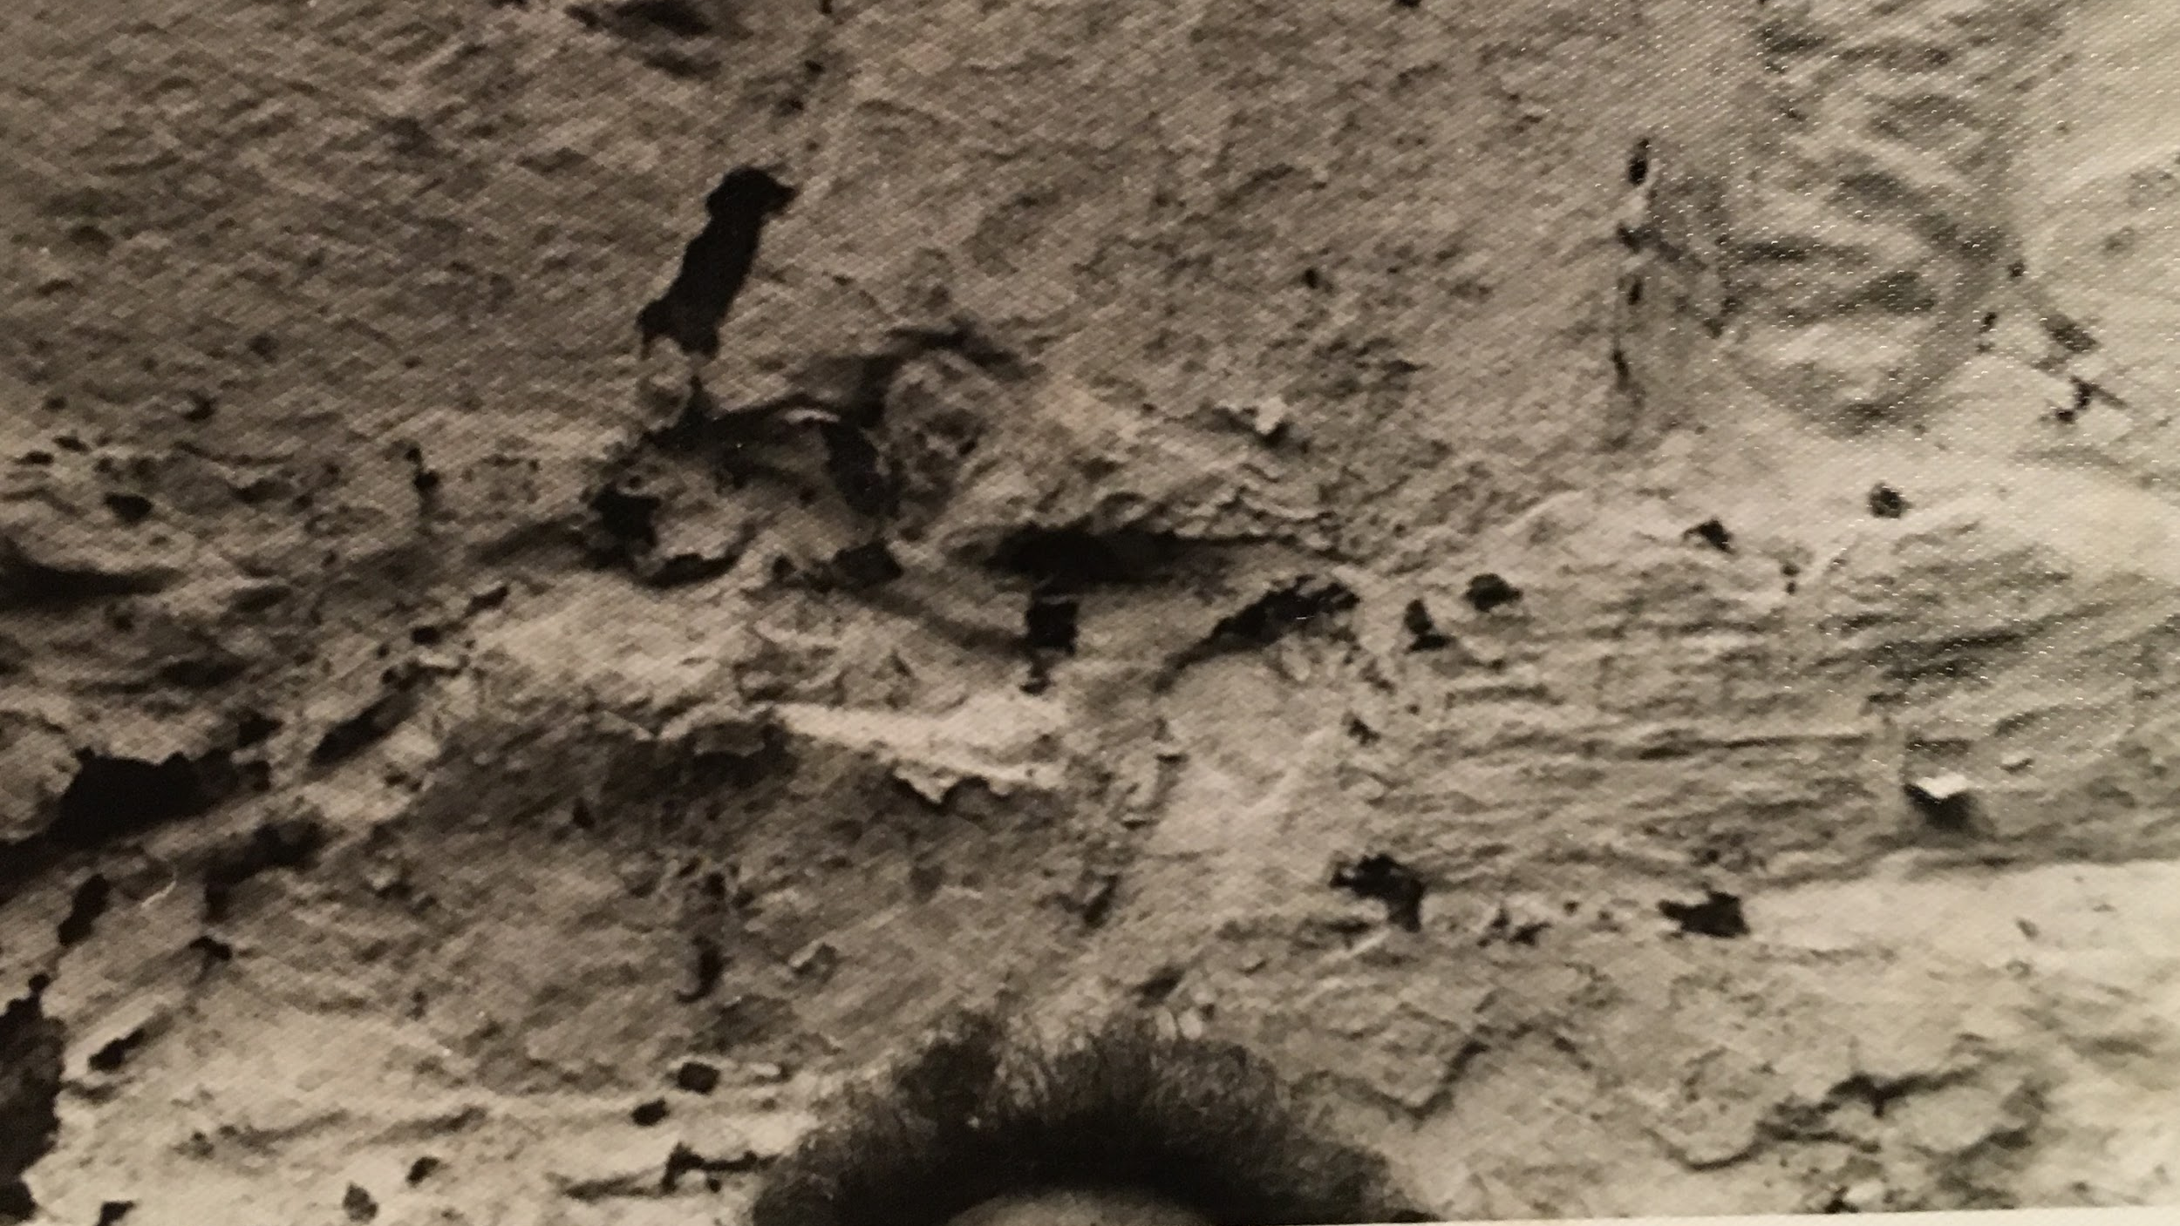
What is it: Moss or Joe’s Hair?

Slide 33
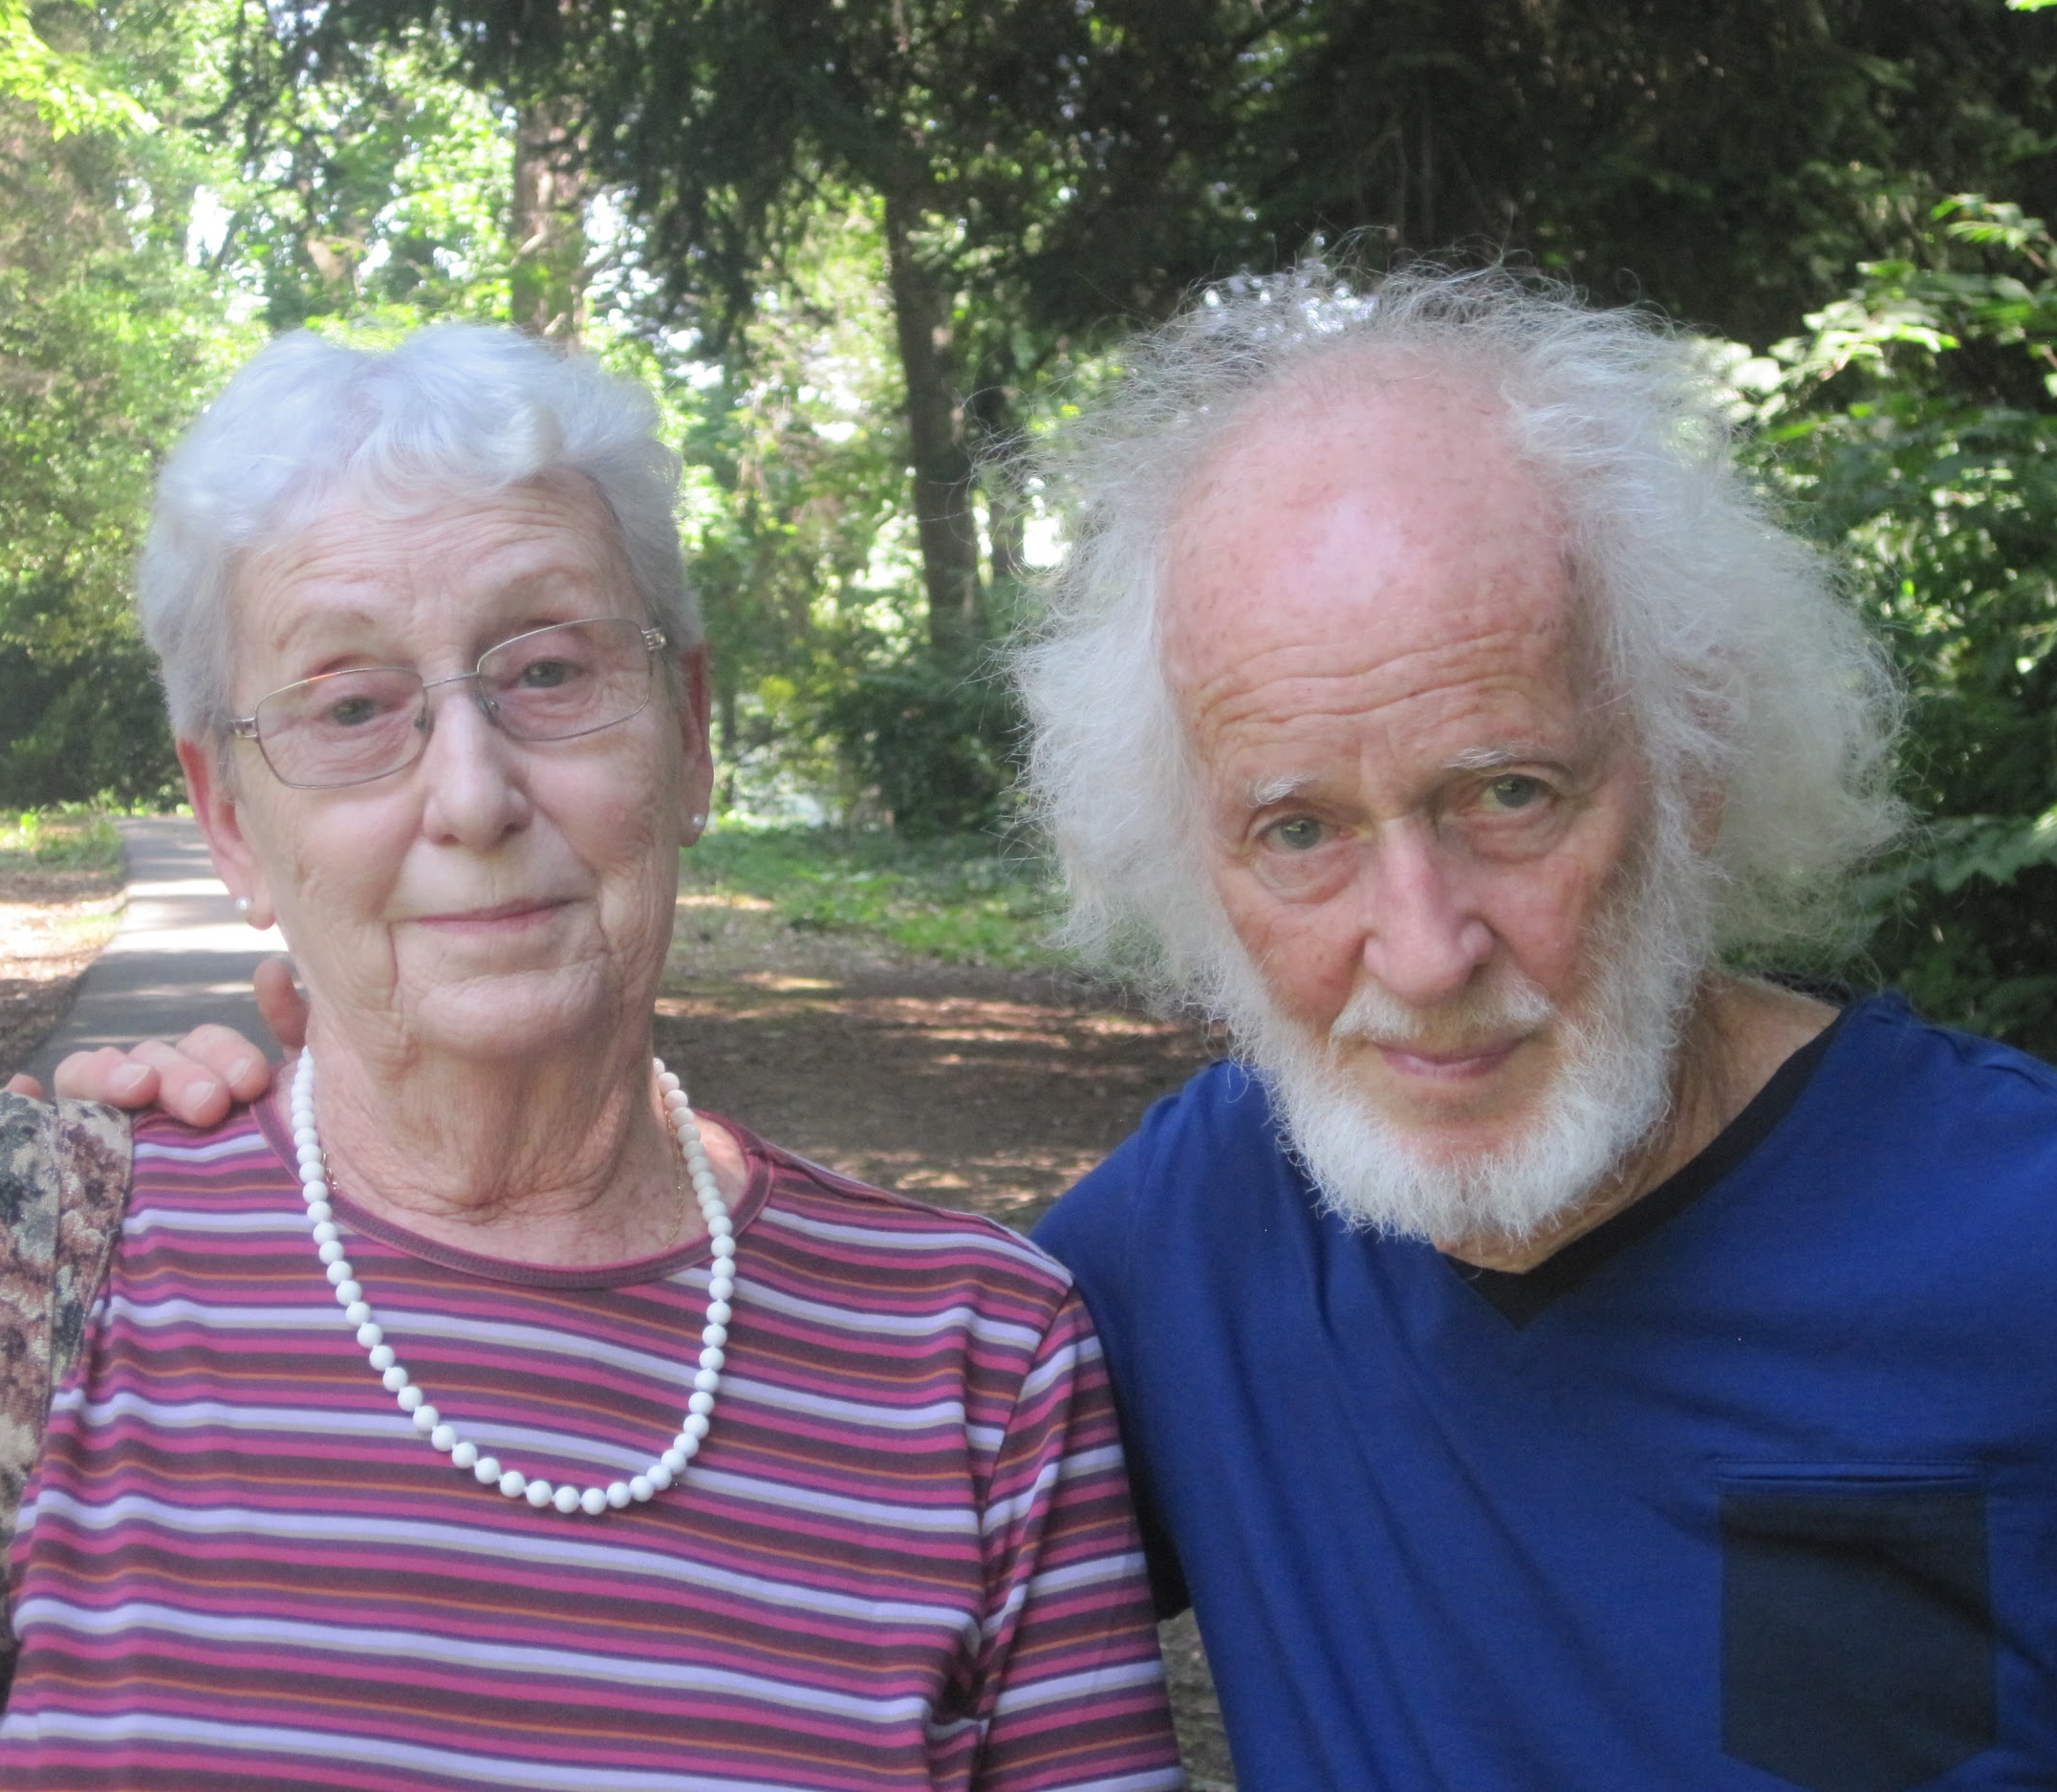
Joe the Brother
Joe and his older sister Veronika who lives in Israel

Slide 34
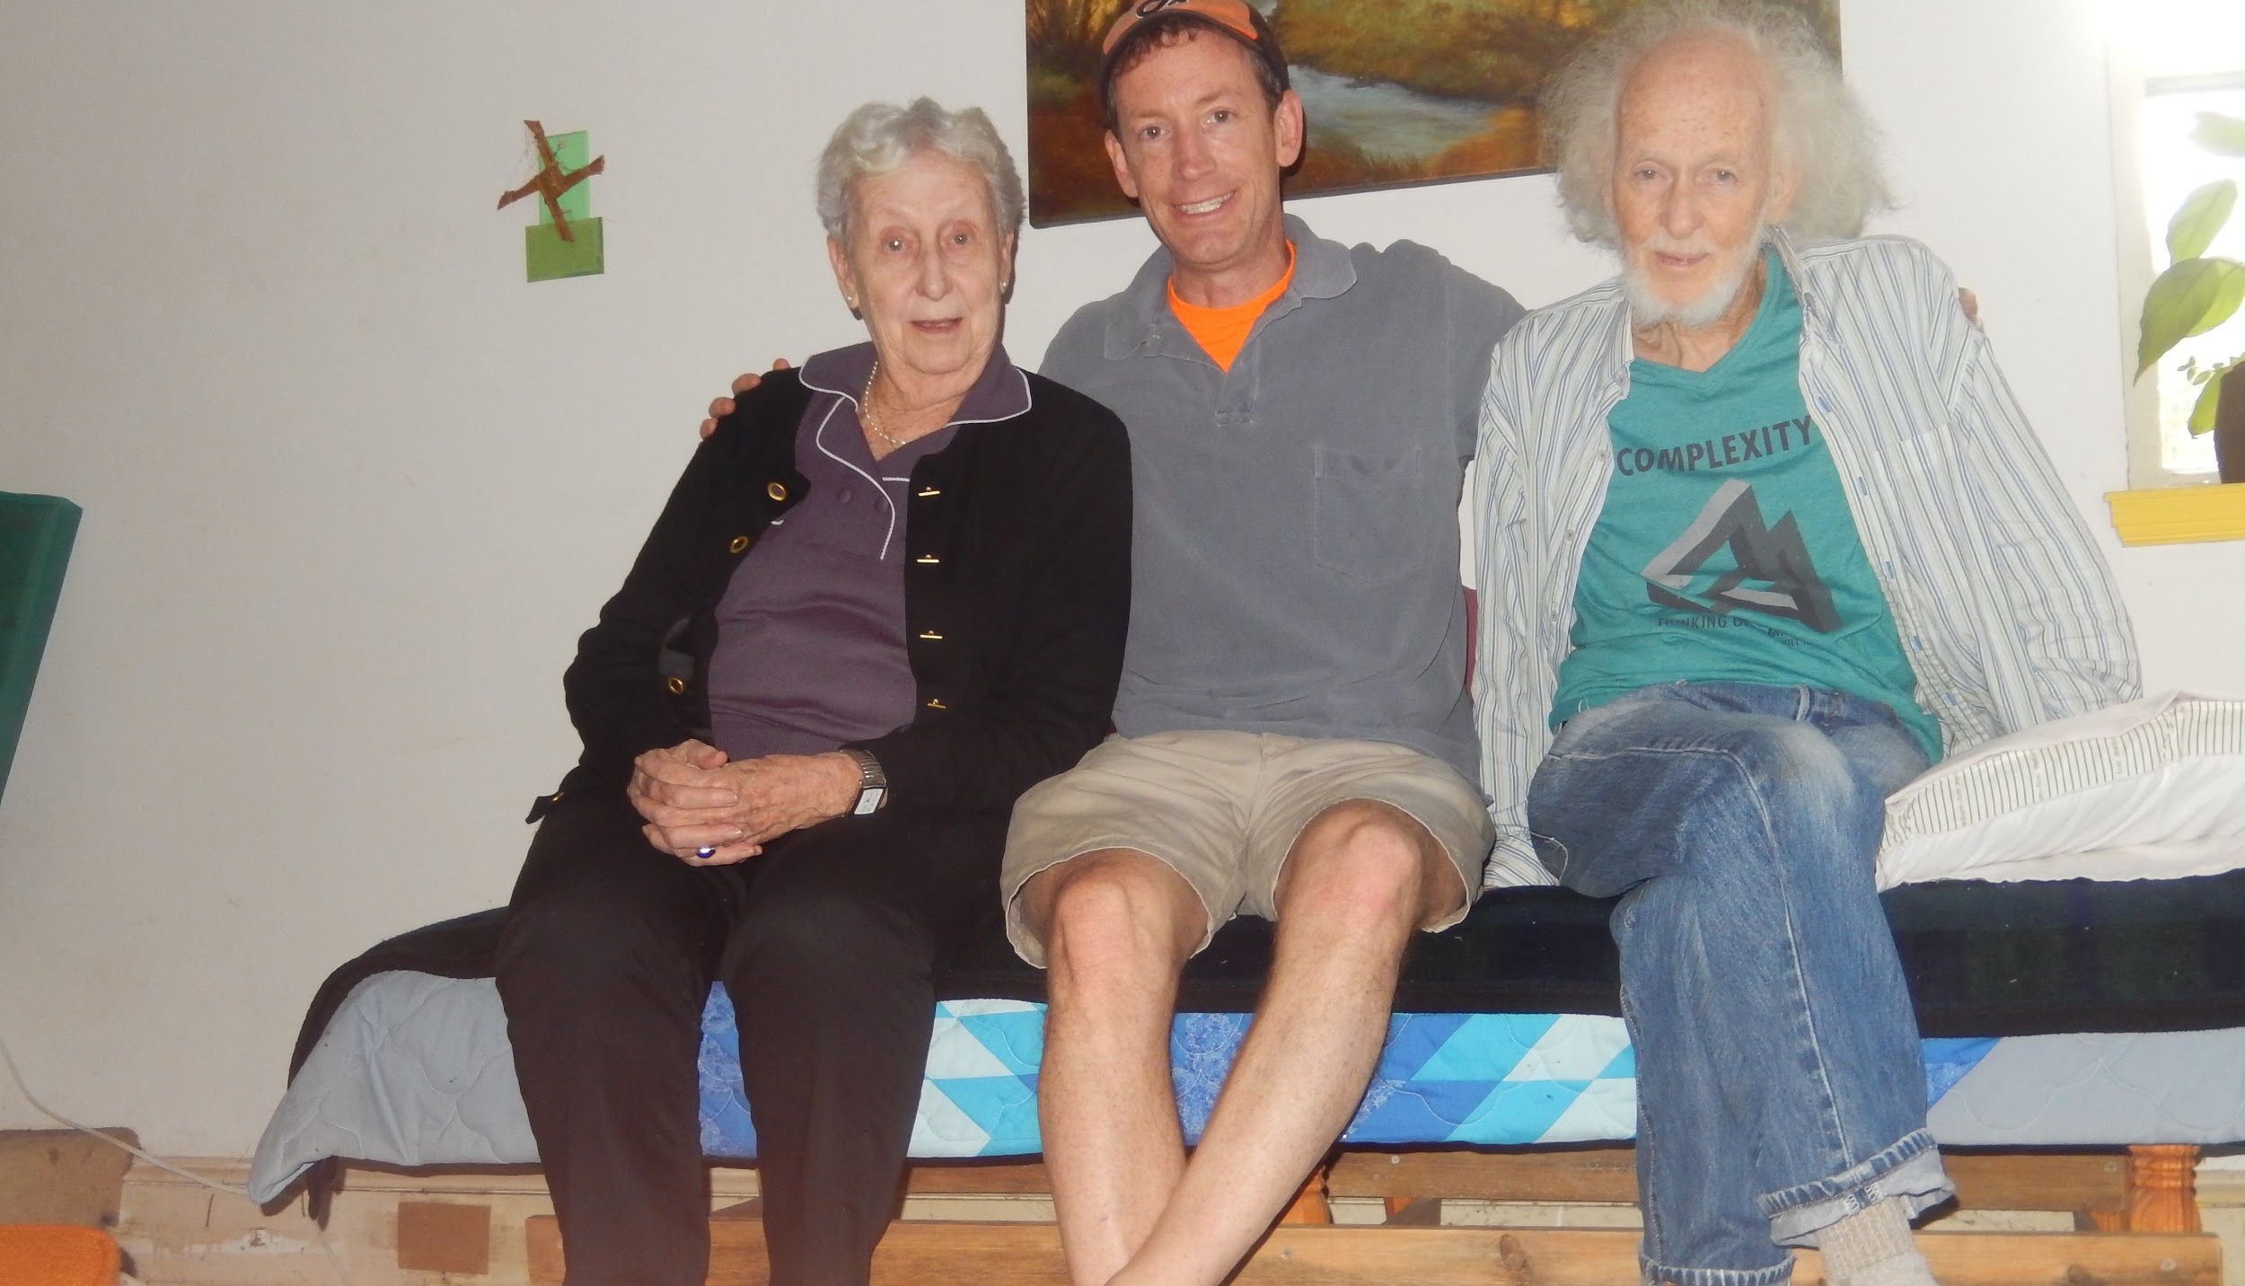
Veronika, Jason & Joe

Slide 35
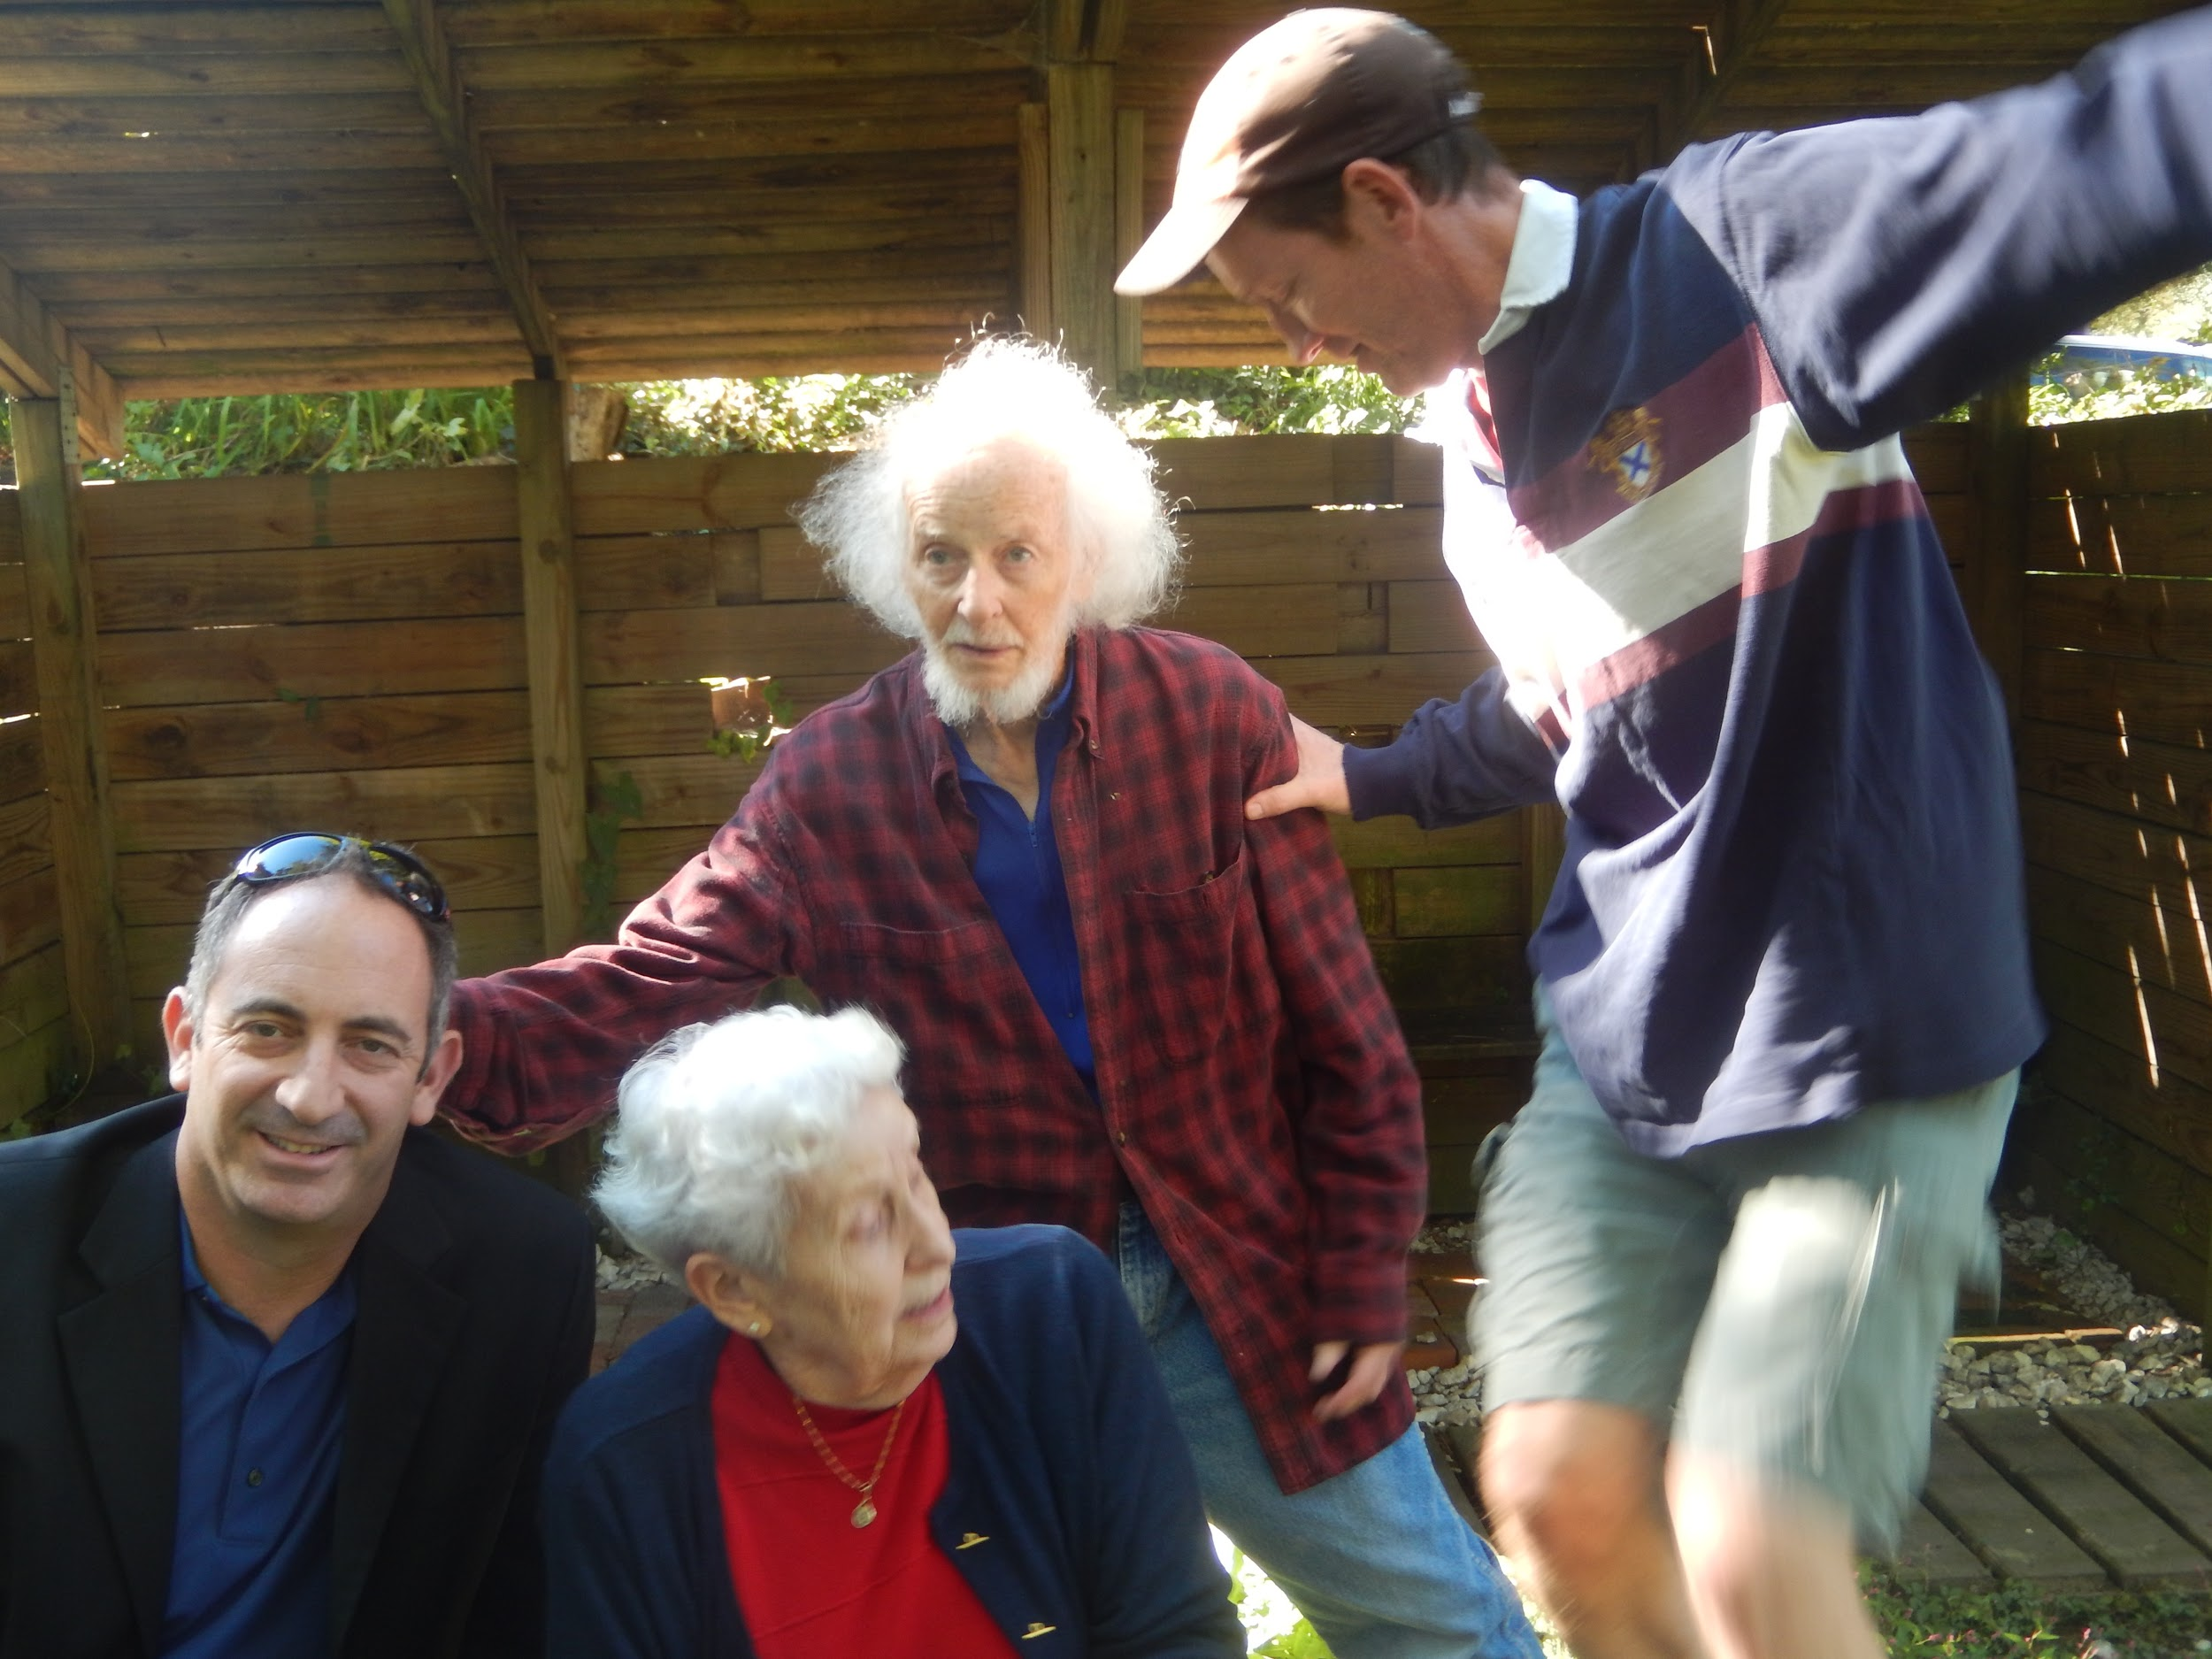
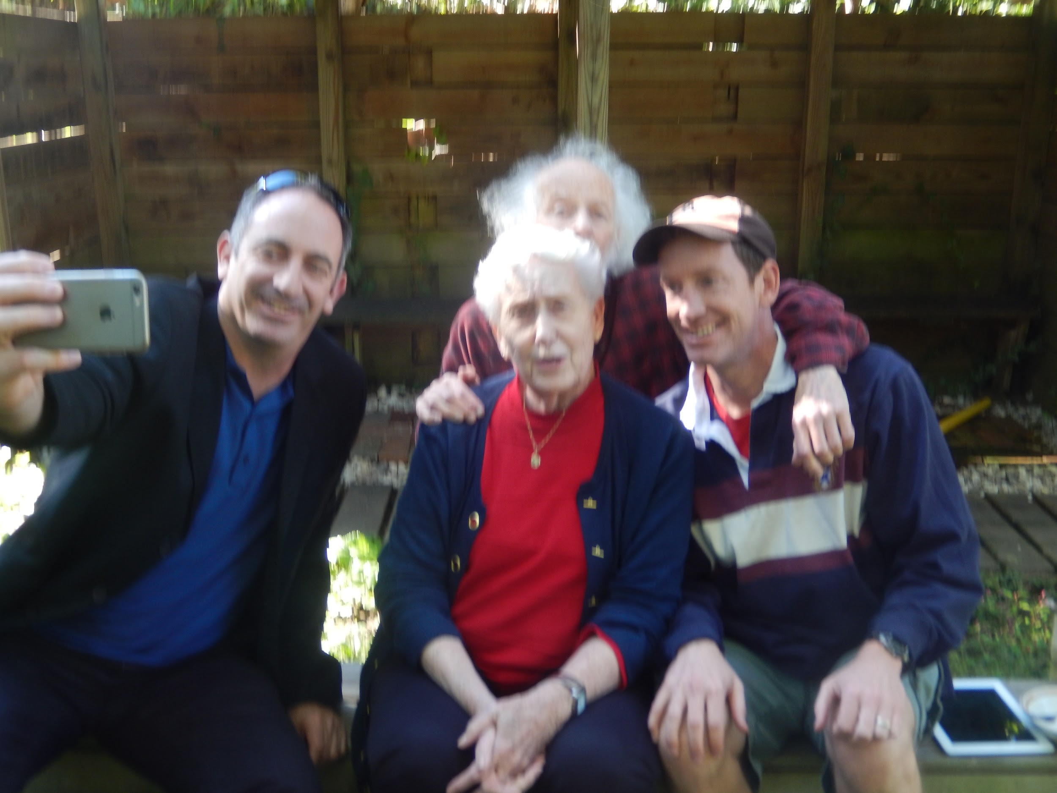
Joe’s nephew Michael, Veronika, Joe and Jason

Slide 36
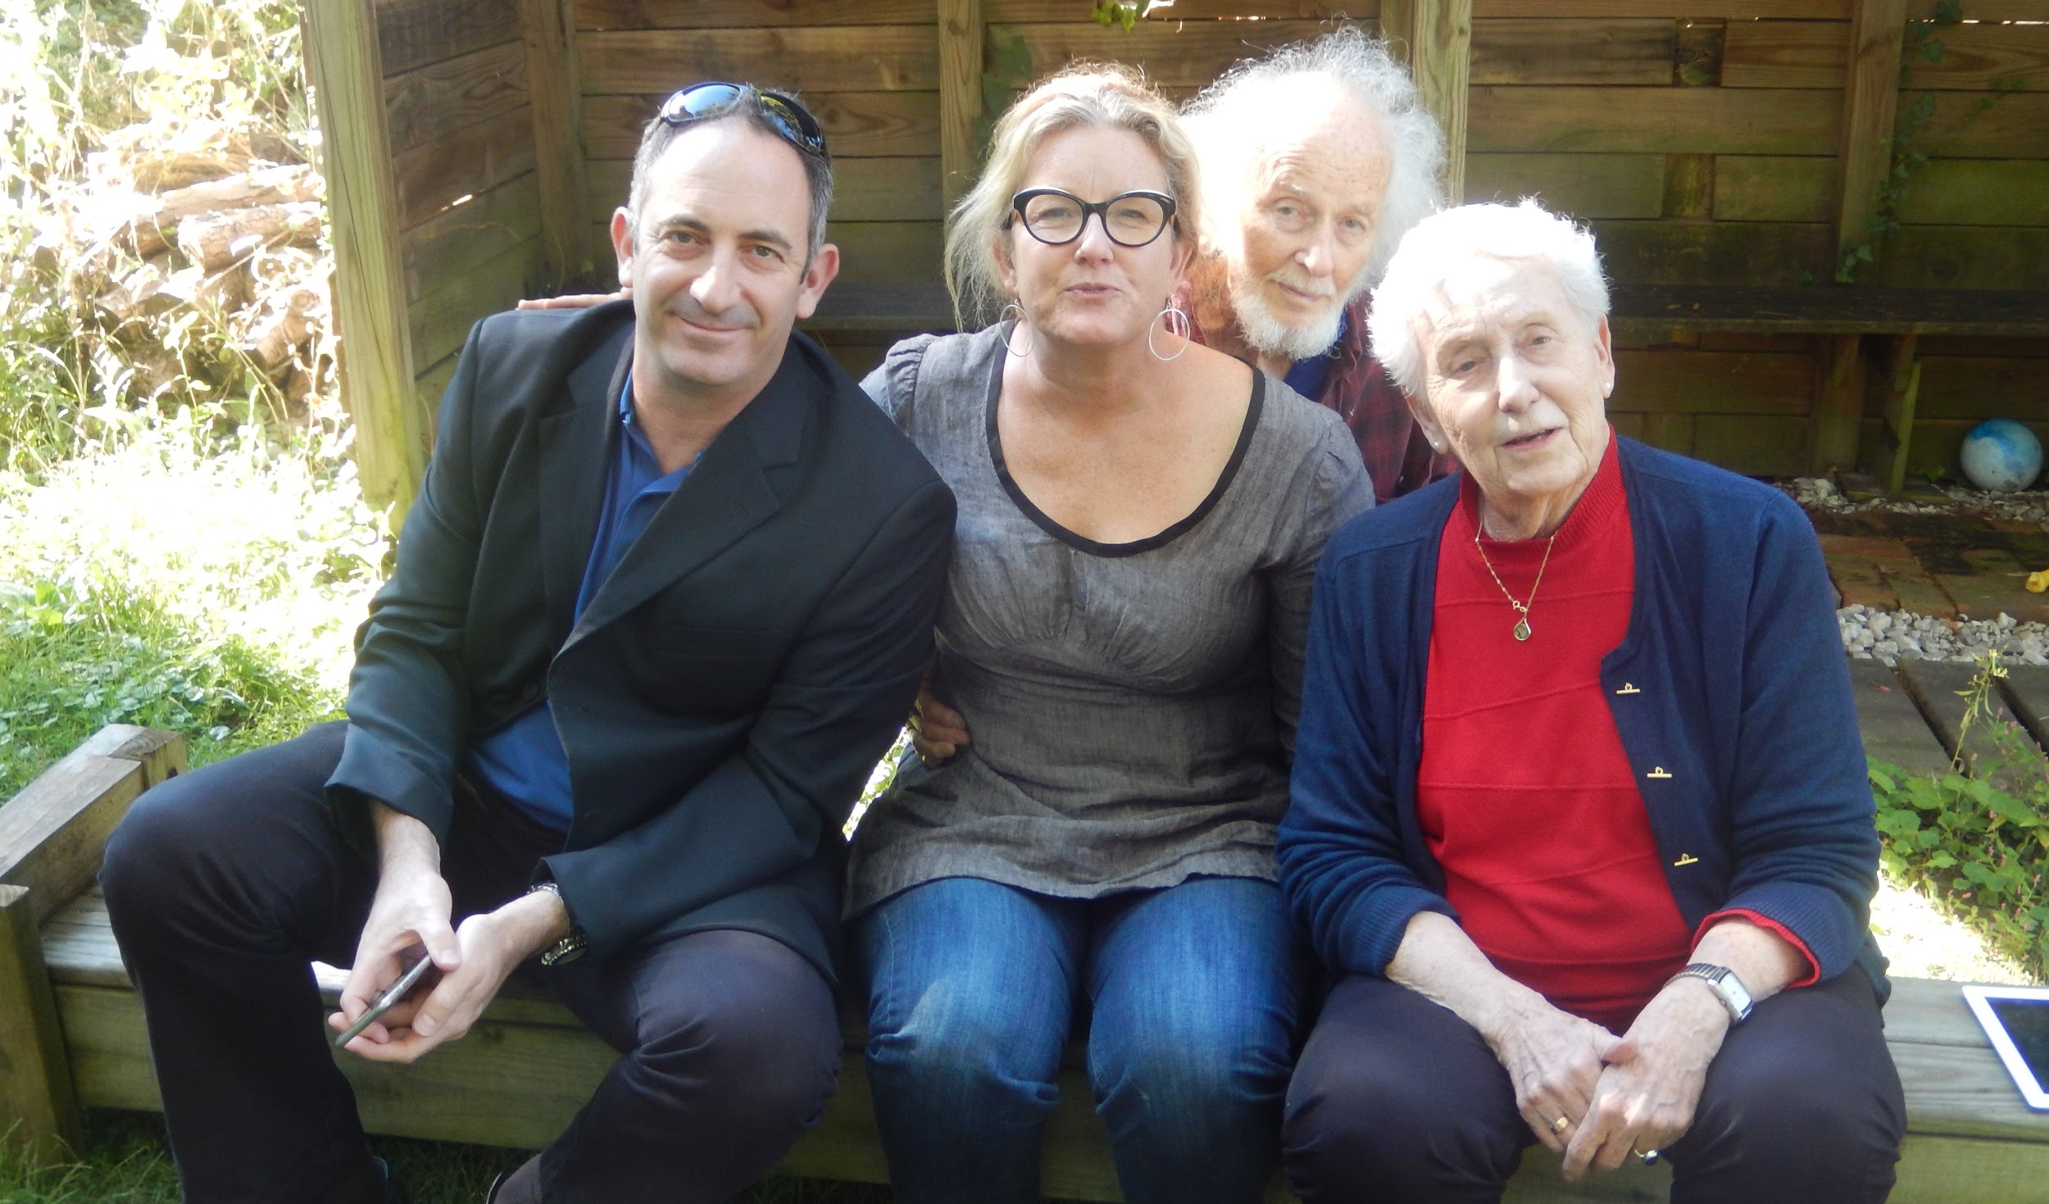
Michael, Rebecca, Joe & Veronika

Slide 37
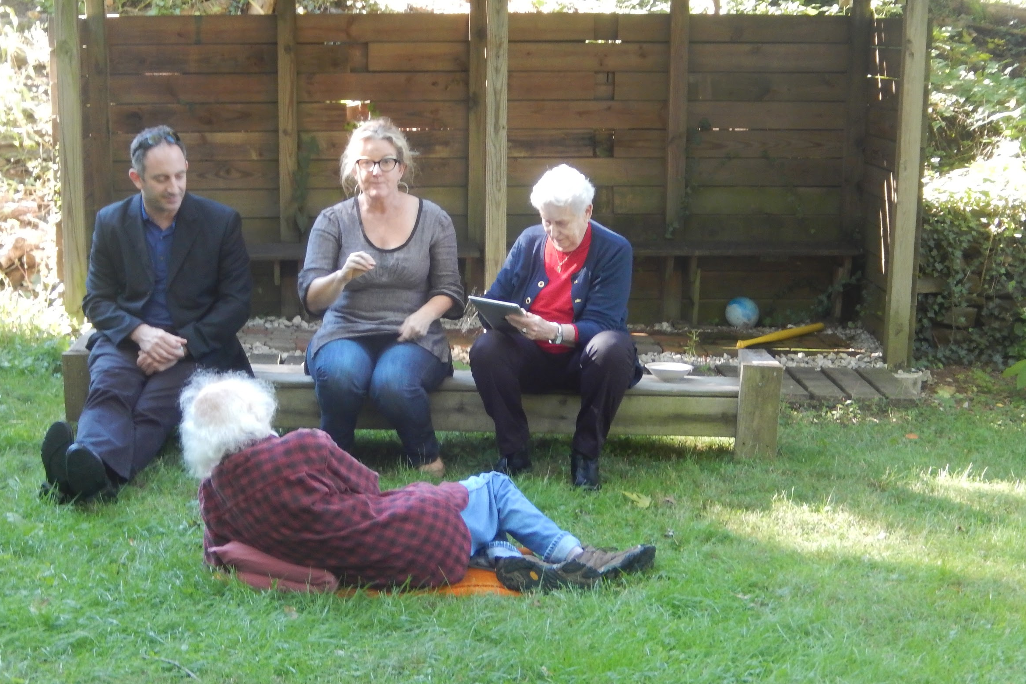
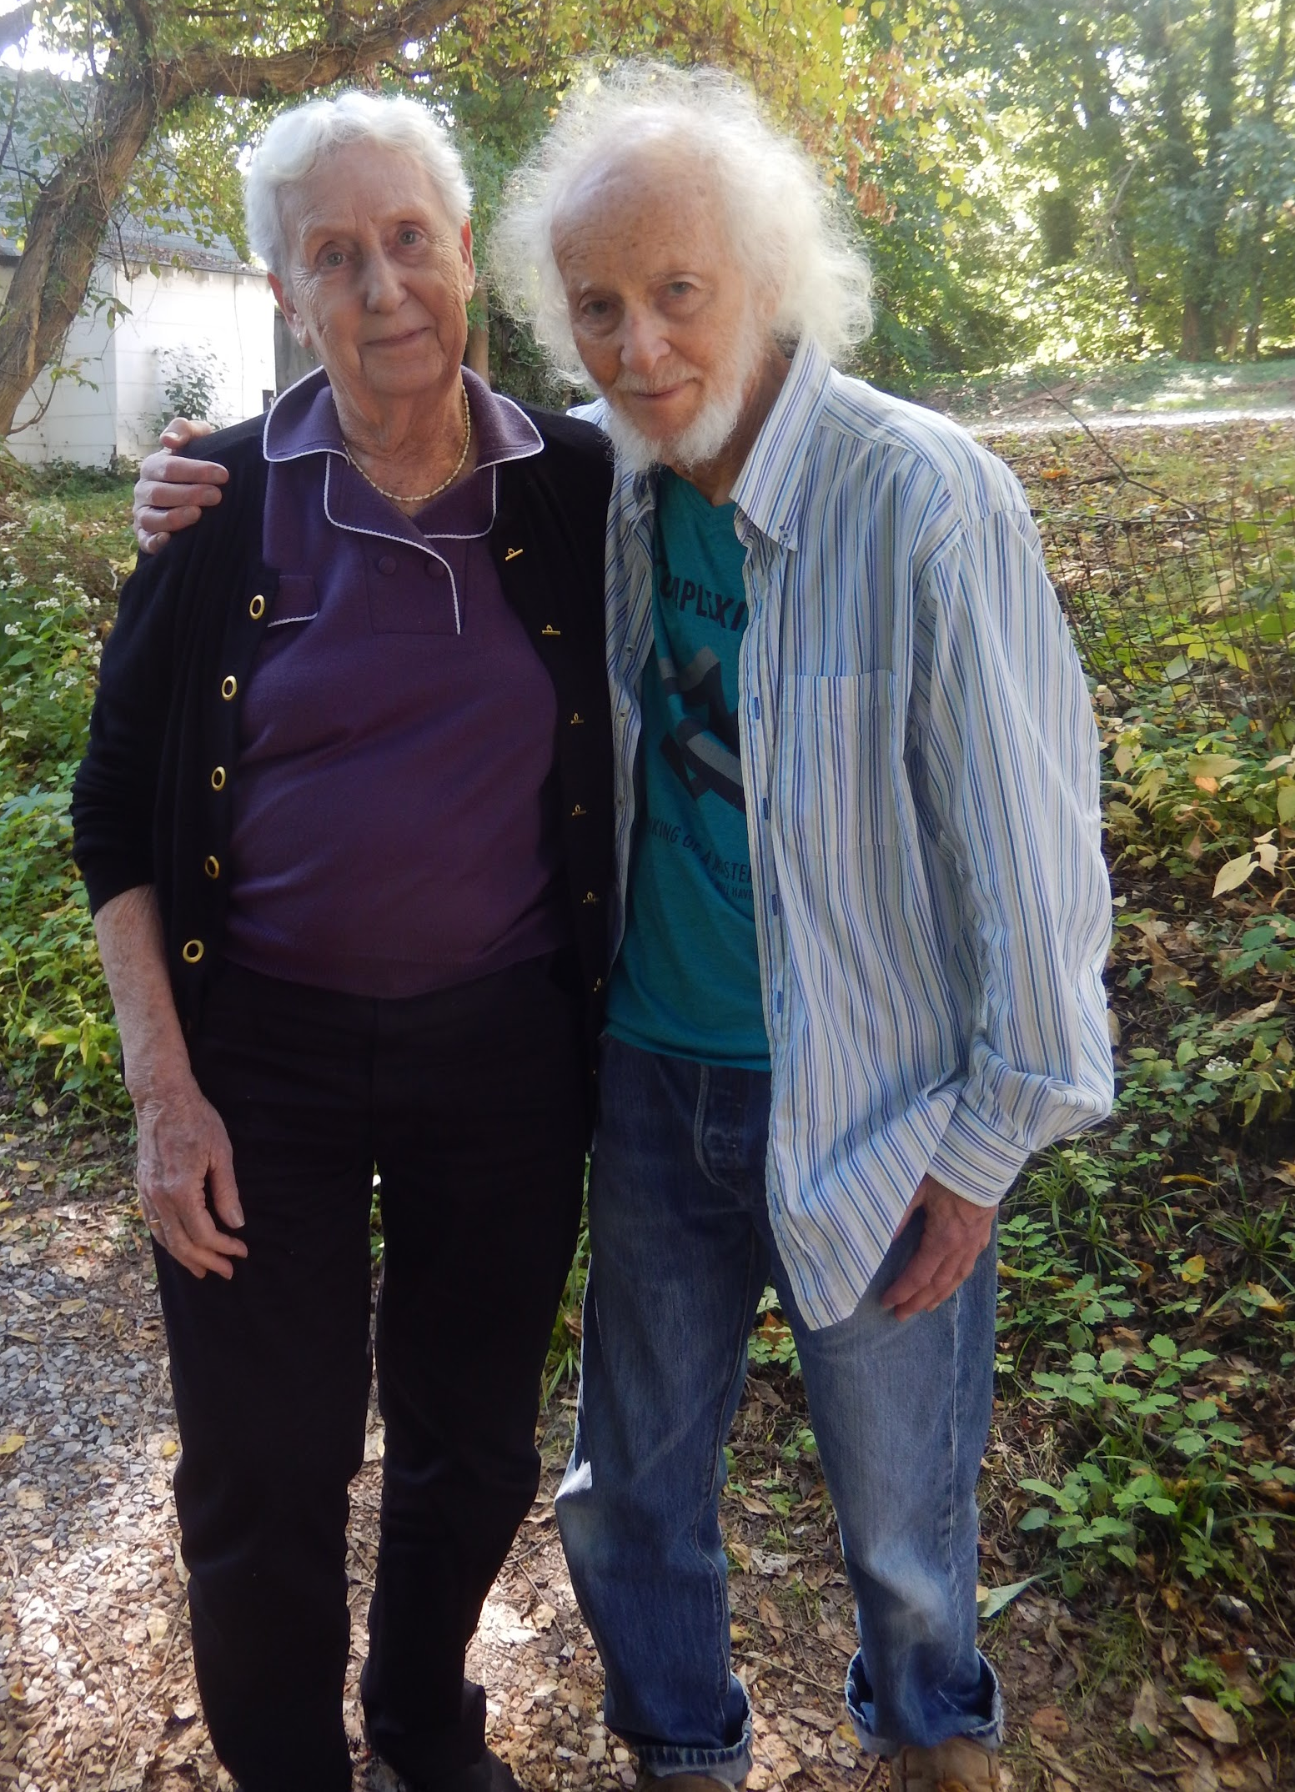

Slide 38
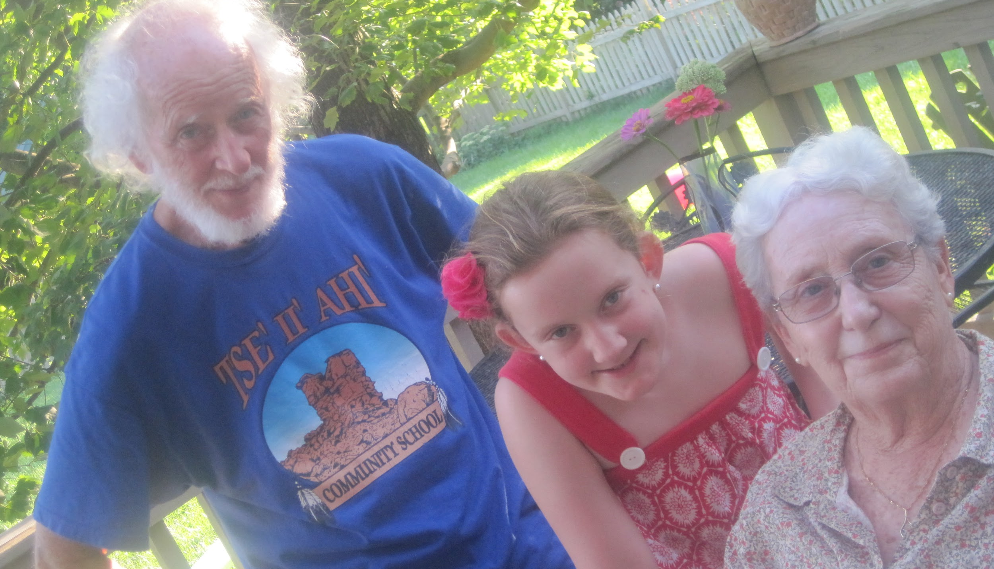
Joe, Meredith & Veronika

Slide 39
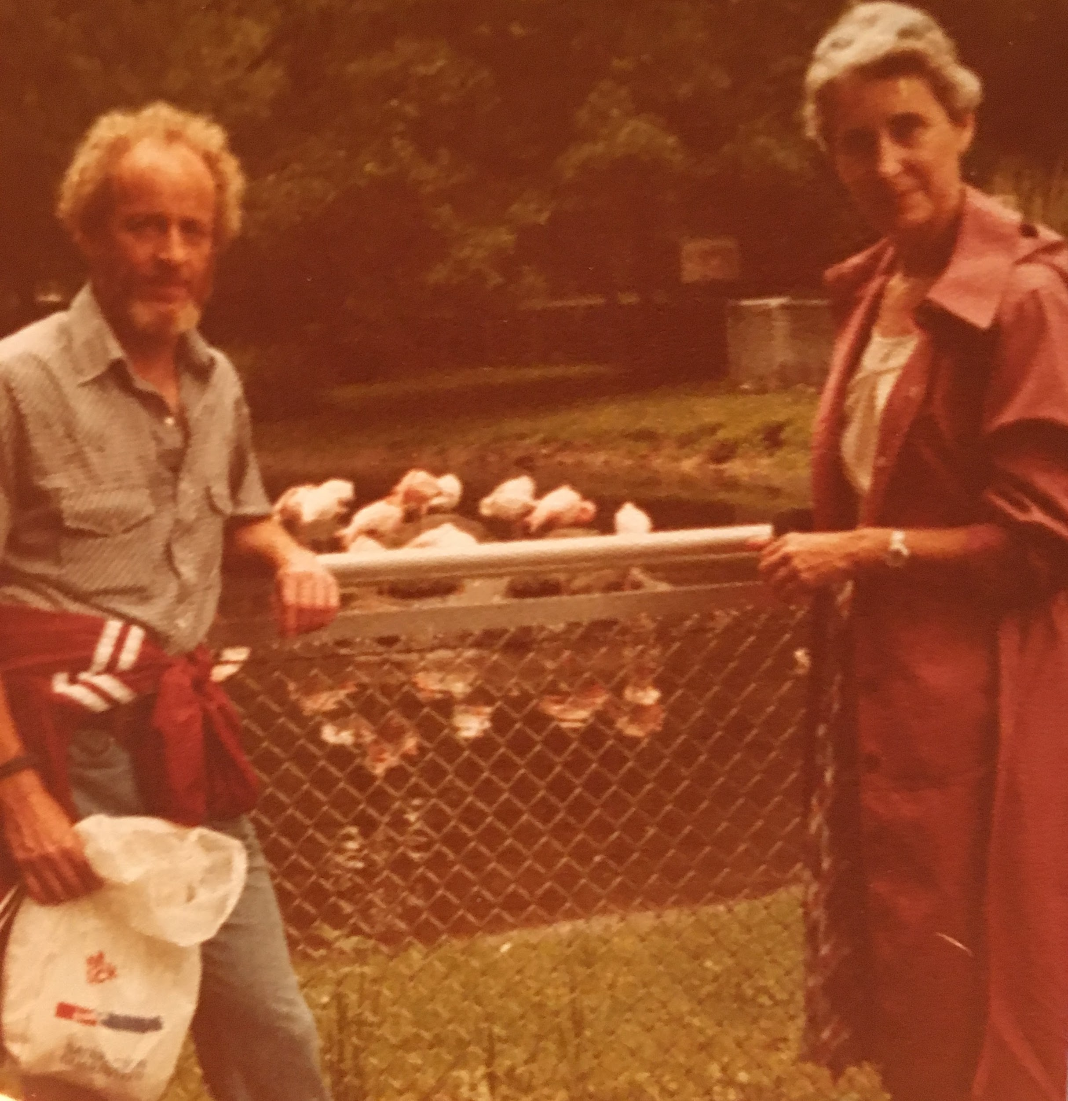
Joe & Veronika

Slide 40
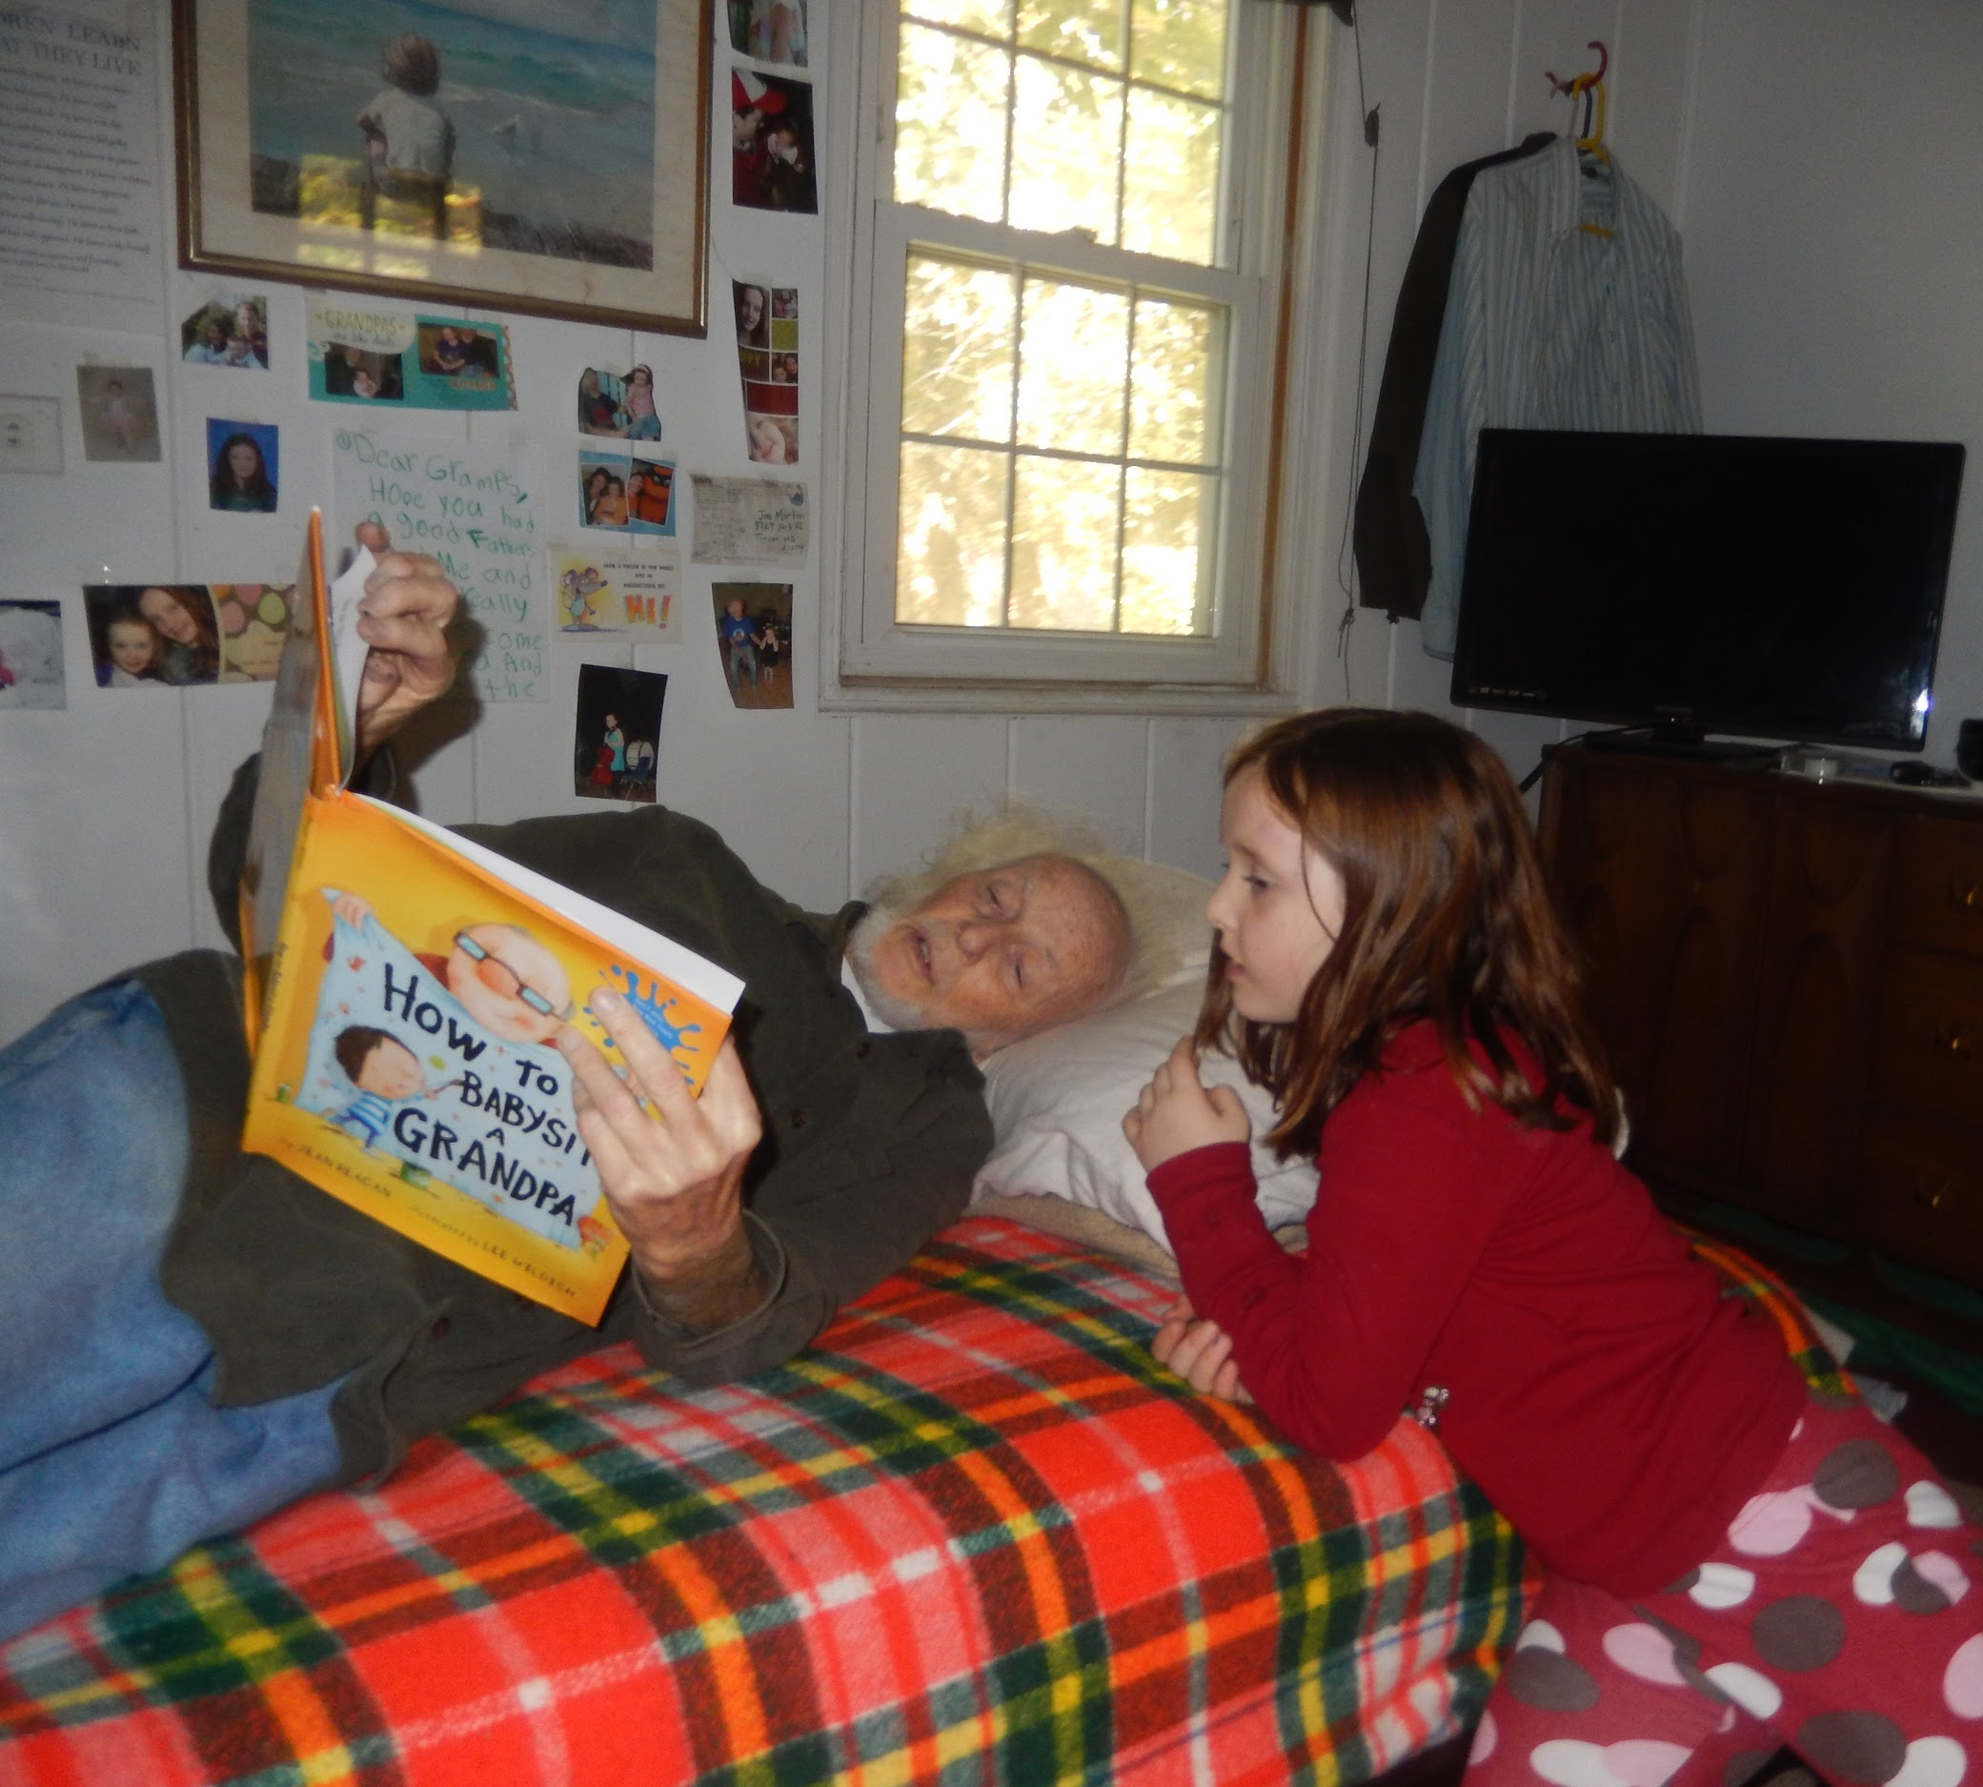
Joe the Grandfather
Joe had four grandchildren:
Meredith
Sadie
Lotte
Lucian

Slide 41
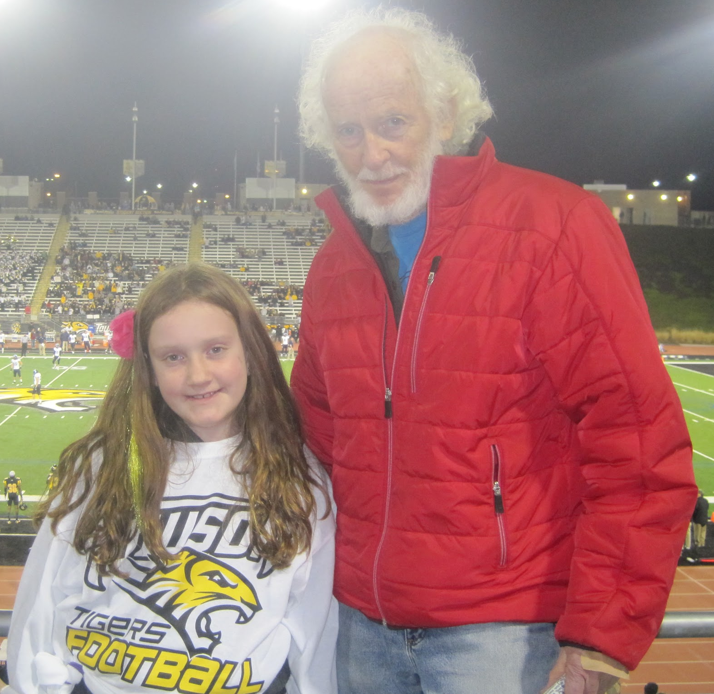
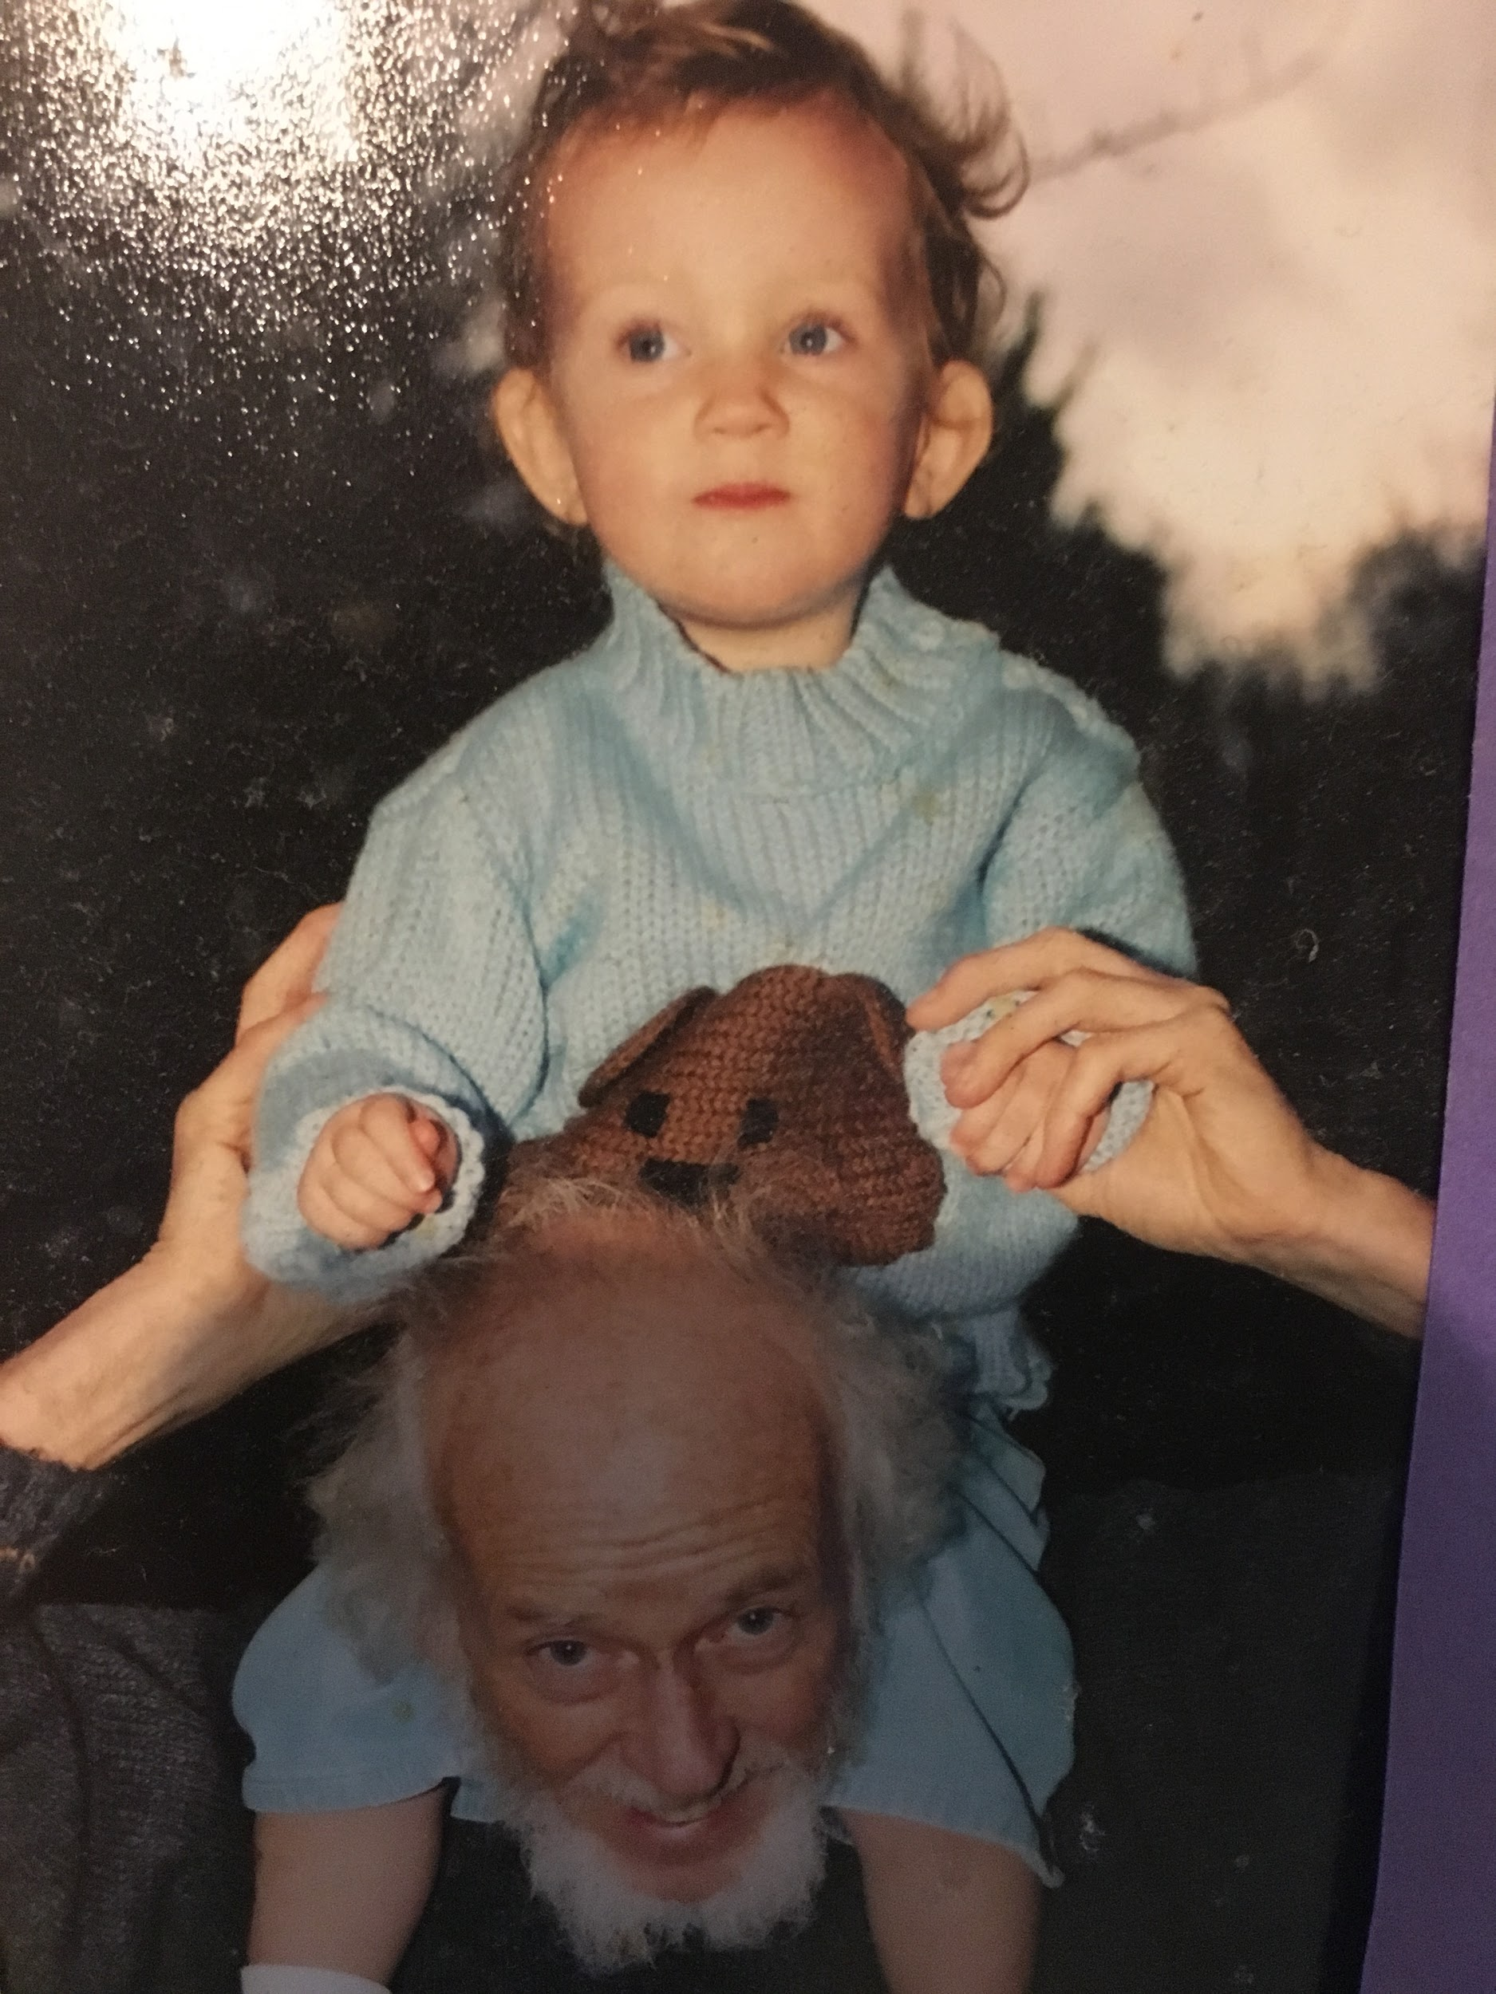
Joe & Meredith

Slide 42
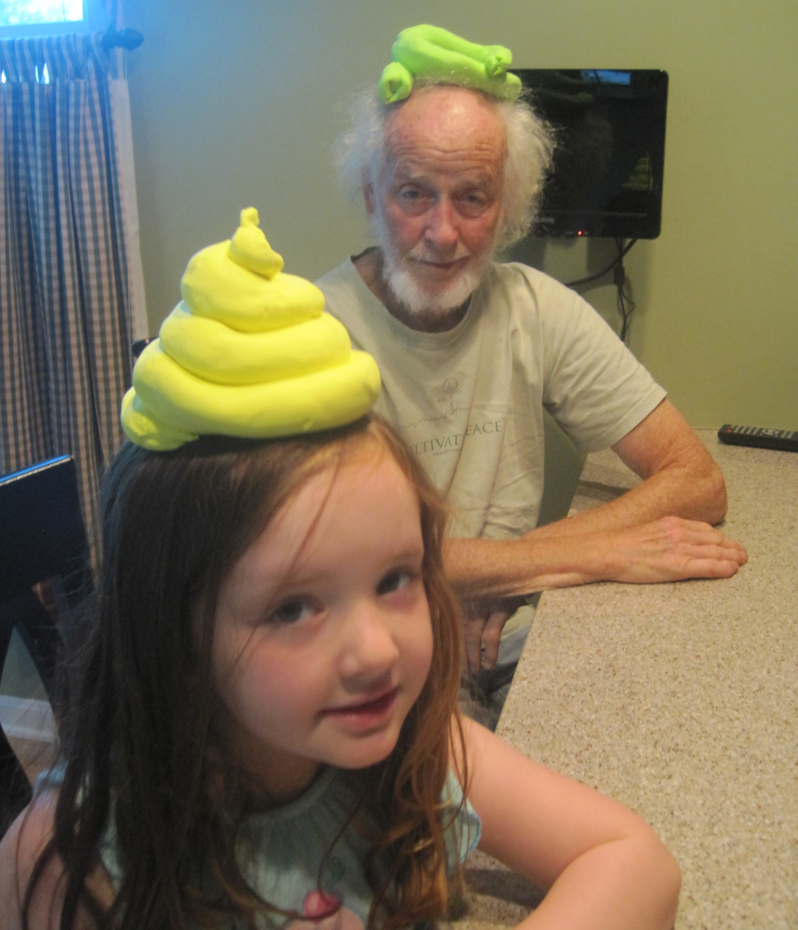


Slide 43


Joe & Sadie

Slide 44

Joe, Lotte & Meredith

Slide 45


Slide 46



Slide 47


Slide 48


Slide 49


Slide 50



Slide 51

Meredith & Joe at the BSO

Slide 52

Meredith & Joe at Goucher, his home away from home

Slide 53

At Jonah House

Slide 54

At Jonah House: Sister Ardeth, Joe, Liz McAlister, Sadie, Josh & Meredith

Slide 55


Slide 56


Slide 57

Joe the Teacher
Joe taught at Goucher College from 1963 to 2006.
He served many roles at Goucher- philosophy professor, chair of the philosophy department, co-director of first year programs, photography teacher and first director of Peace Studies.

Slide 58

Joe teaching outside

Slide 59


Slide 60

Joe, Philip Berrigan and Liz McAlister in a Peace Studies Class, 1995

Slide 61

Peace Studies class with Hiroshima Nuclear Bomb Survivor Miyoko Matsubara in 1995.

Slide 62


Slide 63


Slide 64

Joe (L), Caroline Bogart (C)

Slide 65


Slide 66
Joe & Peace Studies
Ever modest, Joe never liked to be known as the founder of Goucher Peace Studies. However, he was the initiator of the idea and gave generously, both of his time and financial resources, to nurture and grow the idea into the vibrant program of today.
Goucher Peace Studies is key piece of his legacy.

Slide 67

Joe & Peace Studies
Joe credits Jane Addams with the foundation of Peace Studies.
He presented a paper at a 1989 conference on Addams where he learned about other Peace Studies programs around the country.
Inspired, he returned to Goucher and started a Peace Studies steering committee to offer our own program.

Slide 68

Joe at Addams’ Famous Hull House in Chicago

Slide 69

Joe & Margaret
Goucher Alumna Margaret McCouch, class of 1923 (1901-1998) became an early and enthusiastic financial backer of Peace Studies at Goucher. She and Joe became good friends. Joe referred to her as his second mother.

Slide 70

Rebecca Morton & Margaret McCouch

Slide 71

Letters from Margaret

Slide 72

Letters from Margaret

Slide 73

Letters from Margaret

Slide 74

Joe & Kate Hughes

Slide 75

Joe & Denis Devine

Slide 76


Slide 77


Slide 78


Slide 79

25 Years of Peace Studies Celebration

Slide 80



Slide 81


Joe & Nancy Magnuson

Slide 82


Slide 83

From a small Idea to a Huge Crowd- Peace Studies @ 25 Years

Slide 84

From a small Idea to a Huge Crowd- Peace Studies @ 25 Years

Slide 85

Joe and Ahmed Alazawi

Slide 86

Nancy Magnuson, Tiffany Brody Blackbull & Joe

Slide 87


Joe & Susan Zeigler

Slide 88

Joe & Susan’s son Joey

Slide 89


Slide 90

Joe & Risa Gorelick-Ollom

Slide 91

Joe Marrying Kate Hughes & Denis Devine

Slide 92

Denis & Kate’s sons with Joe

Slide 93


Slide 94
Joe the Activist
A student introduced Joe to Amnesty International in the early 1980s. Joe was the Baltimore leader of AI for many years. This work inspired him and led to his participation in many protests and demonstrations over the years. Joe was also a tax resister for several years.
Joe was a member of many different peace organizations across the country. He sought to learn from Native Americans and also wrote letters to many prisoners as part of his peace work.

Slide 95

Receiving an award for his work with Amnesty International

Slide 96

The 1st Protest Joe was Arrested At

Slide 97


Slide 98


A magazine article about Joe’s work with Amnesty

Slide 99


Slide 100


Slide 101

Joe at the 90 Million Strong Vigil against the Death Penalty at the Supreme Court

Slide 102


Slide 103


Slide 104


Slide 105



Slide 106

Joe’s Arrest Document- He took no id and instead gave the name of a Guantanamo Detainee

