Slide 1
Culture and The Holocaust Introductory presentation (includes student selection of photos and interpretations)

Slide 2
History & Facts About the Holocaust
Who, what, when and where will be reviewed and discussed. Students will have pre-presentation assignment of reading this background material: https://encyclopedia.ushmm.org/content/en/article/introduction-to-the-holocaust

Slide 3
5 W's of the Holocaust
Who: Predominantly Jews under attack by Nazi Germans
What: A genocide rooted in anti-semitism that cost the lives of millions of Jews
Where: Nazi Germany and surrounding nations
When: 1941-1945
Why: Adolf Hitler, who gained mass respect among Germans due to his success in bringing Germany back to prominence following WW1, used the trust he gained to push his narrative that Jews were at fault for most of Germany's problems and that the Aryan race was superior; failure from the western nations - Britain and France

Slide 4
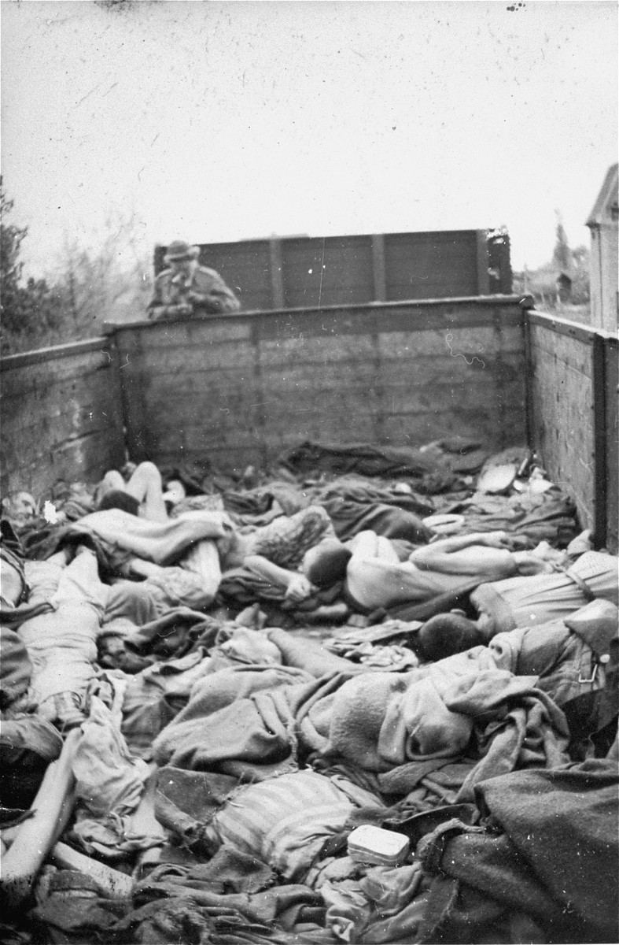
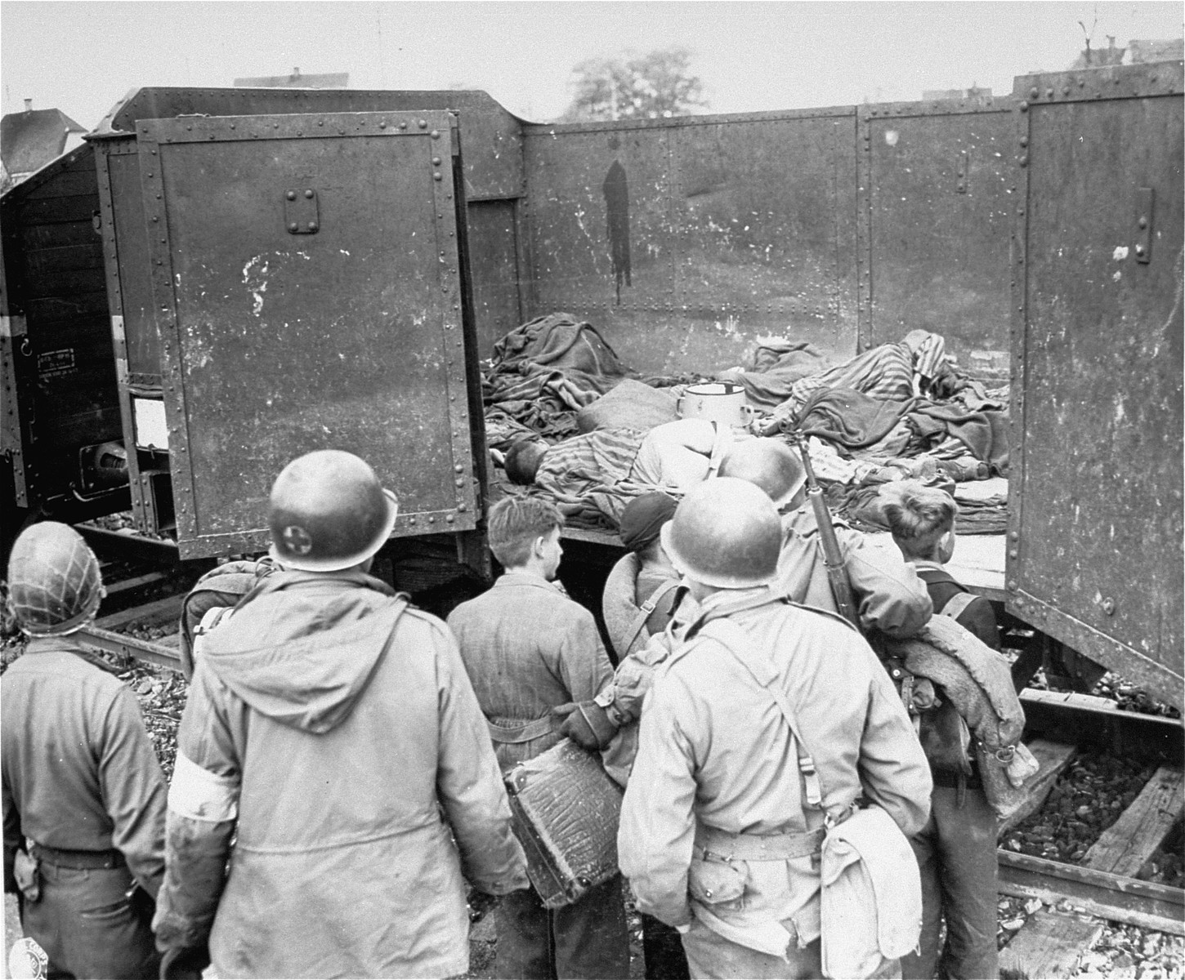
The Story Behind a Picture
Both of these pictures are from the Dachau death train, the train had forty cars that held 2,000 to 3,000 dead Jews.
In the picture to the left you will see soldiers, this is because the US 7th army took youth that they thought were Nazi snipers and showed them what they really did

Slide 5
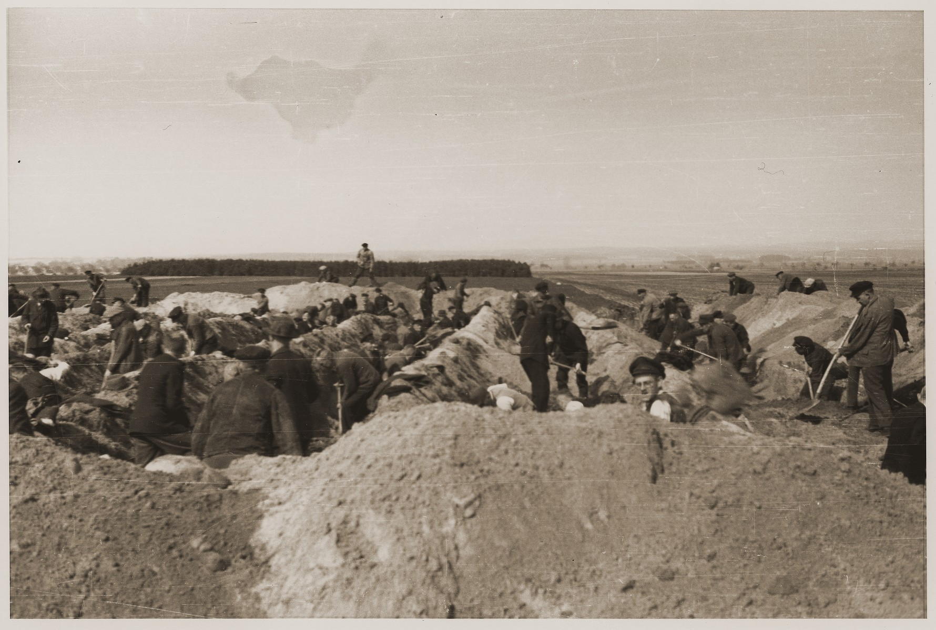
The Story Behind Another Picture
This picture shows German civilians digging up graves of the Jewish people killed in the town of Gardelegen. Over a thousand prisoners were killed in a barn that was set on fire. If they managed to escape the barn they would’ve been shot by German soldiers.
Soldiers from the US demanded that the Germans make graves for the victims.

Slide 6
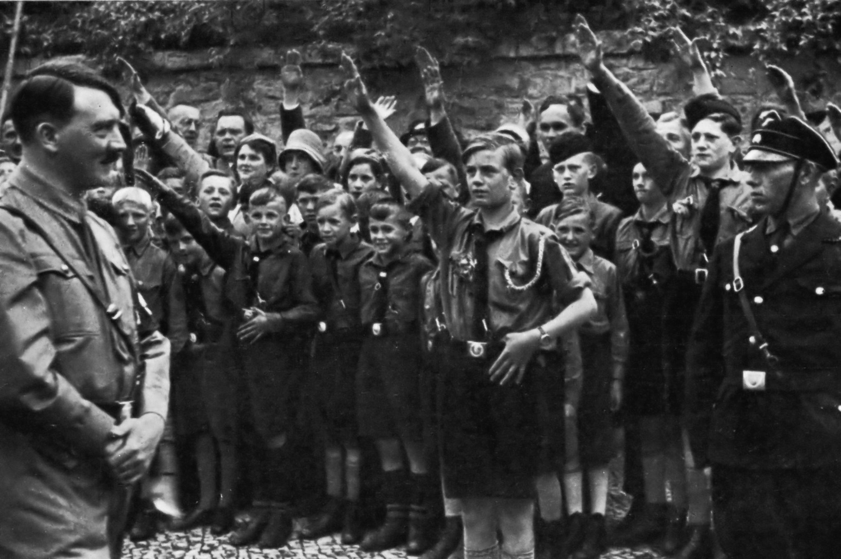
Psychological Theory that may help Explain the Holocaust
Group Think: This is a way of thinking in a group that discourages individuality and creativity. Basically you do something because other people are doing it.
Sociocultural Theory: The Youth learn from people in their cultures. An example of this would be children attending school with Nazi attire because the people in their culture, society, say it’s ok to do that.

Slide 7
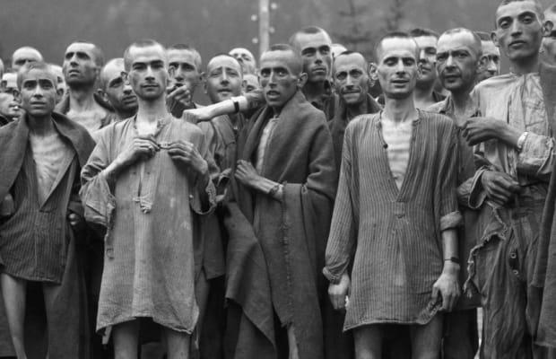
What Aspects of Culture Were Affected…
Many Jewish people involved in the Holocaust lost their faith in humanity
As time went on, Jewish people lived to survive, Family and friends came second
Some people in the Holocaust died from getting trampled on for a piece of bread or a cup of water
One example of this could be found in the book Night by Elie Wiesel he recounts how he saw locals throwing pieces of bread in the cattle cars to watch Jews kill each other for it

Slide 8
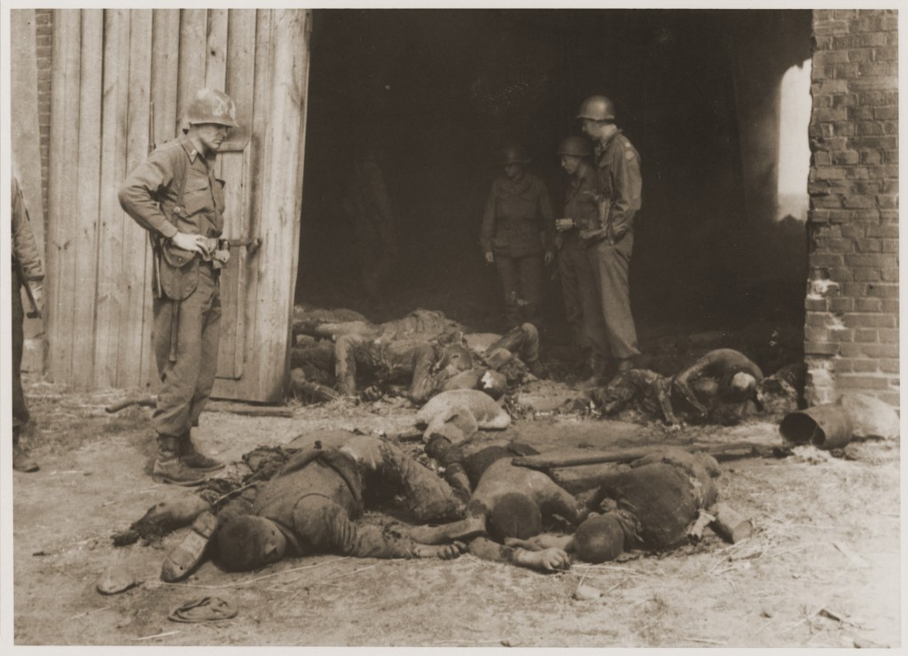
Why Learning About The Holocaust Is Importance
Preventing history from repeating itself
Giving the victims a voice and let their stories be heard
Increasing one’s knowledgeable about politics, history and culture

Slide 9
End Discussion
What can you do today to be a better ally for the Jewish community?

Slide 10
Sources
https://collections.ushmm.org/search/?f%5bf_images%5d%5b%5d=indiv_photographs
United States Holocaust Memorial Museum, courtesy of David Mendels
ADL. (April 25, 2021). Number of anti-Semitic incidents in the United States from 2008 to 2020 [Graph]. In Statista. Retrieved May 12, 2022, from https://www.statista.com/statistics/816732/number-of-anti-semitic-incident-in-the-us/
Student Collaborators: Kyle Kropfelder and Nelida Lewis in EDUC 203.003
Date: May 2022

