Slide 1
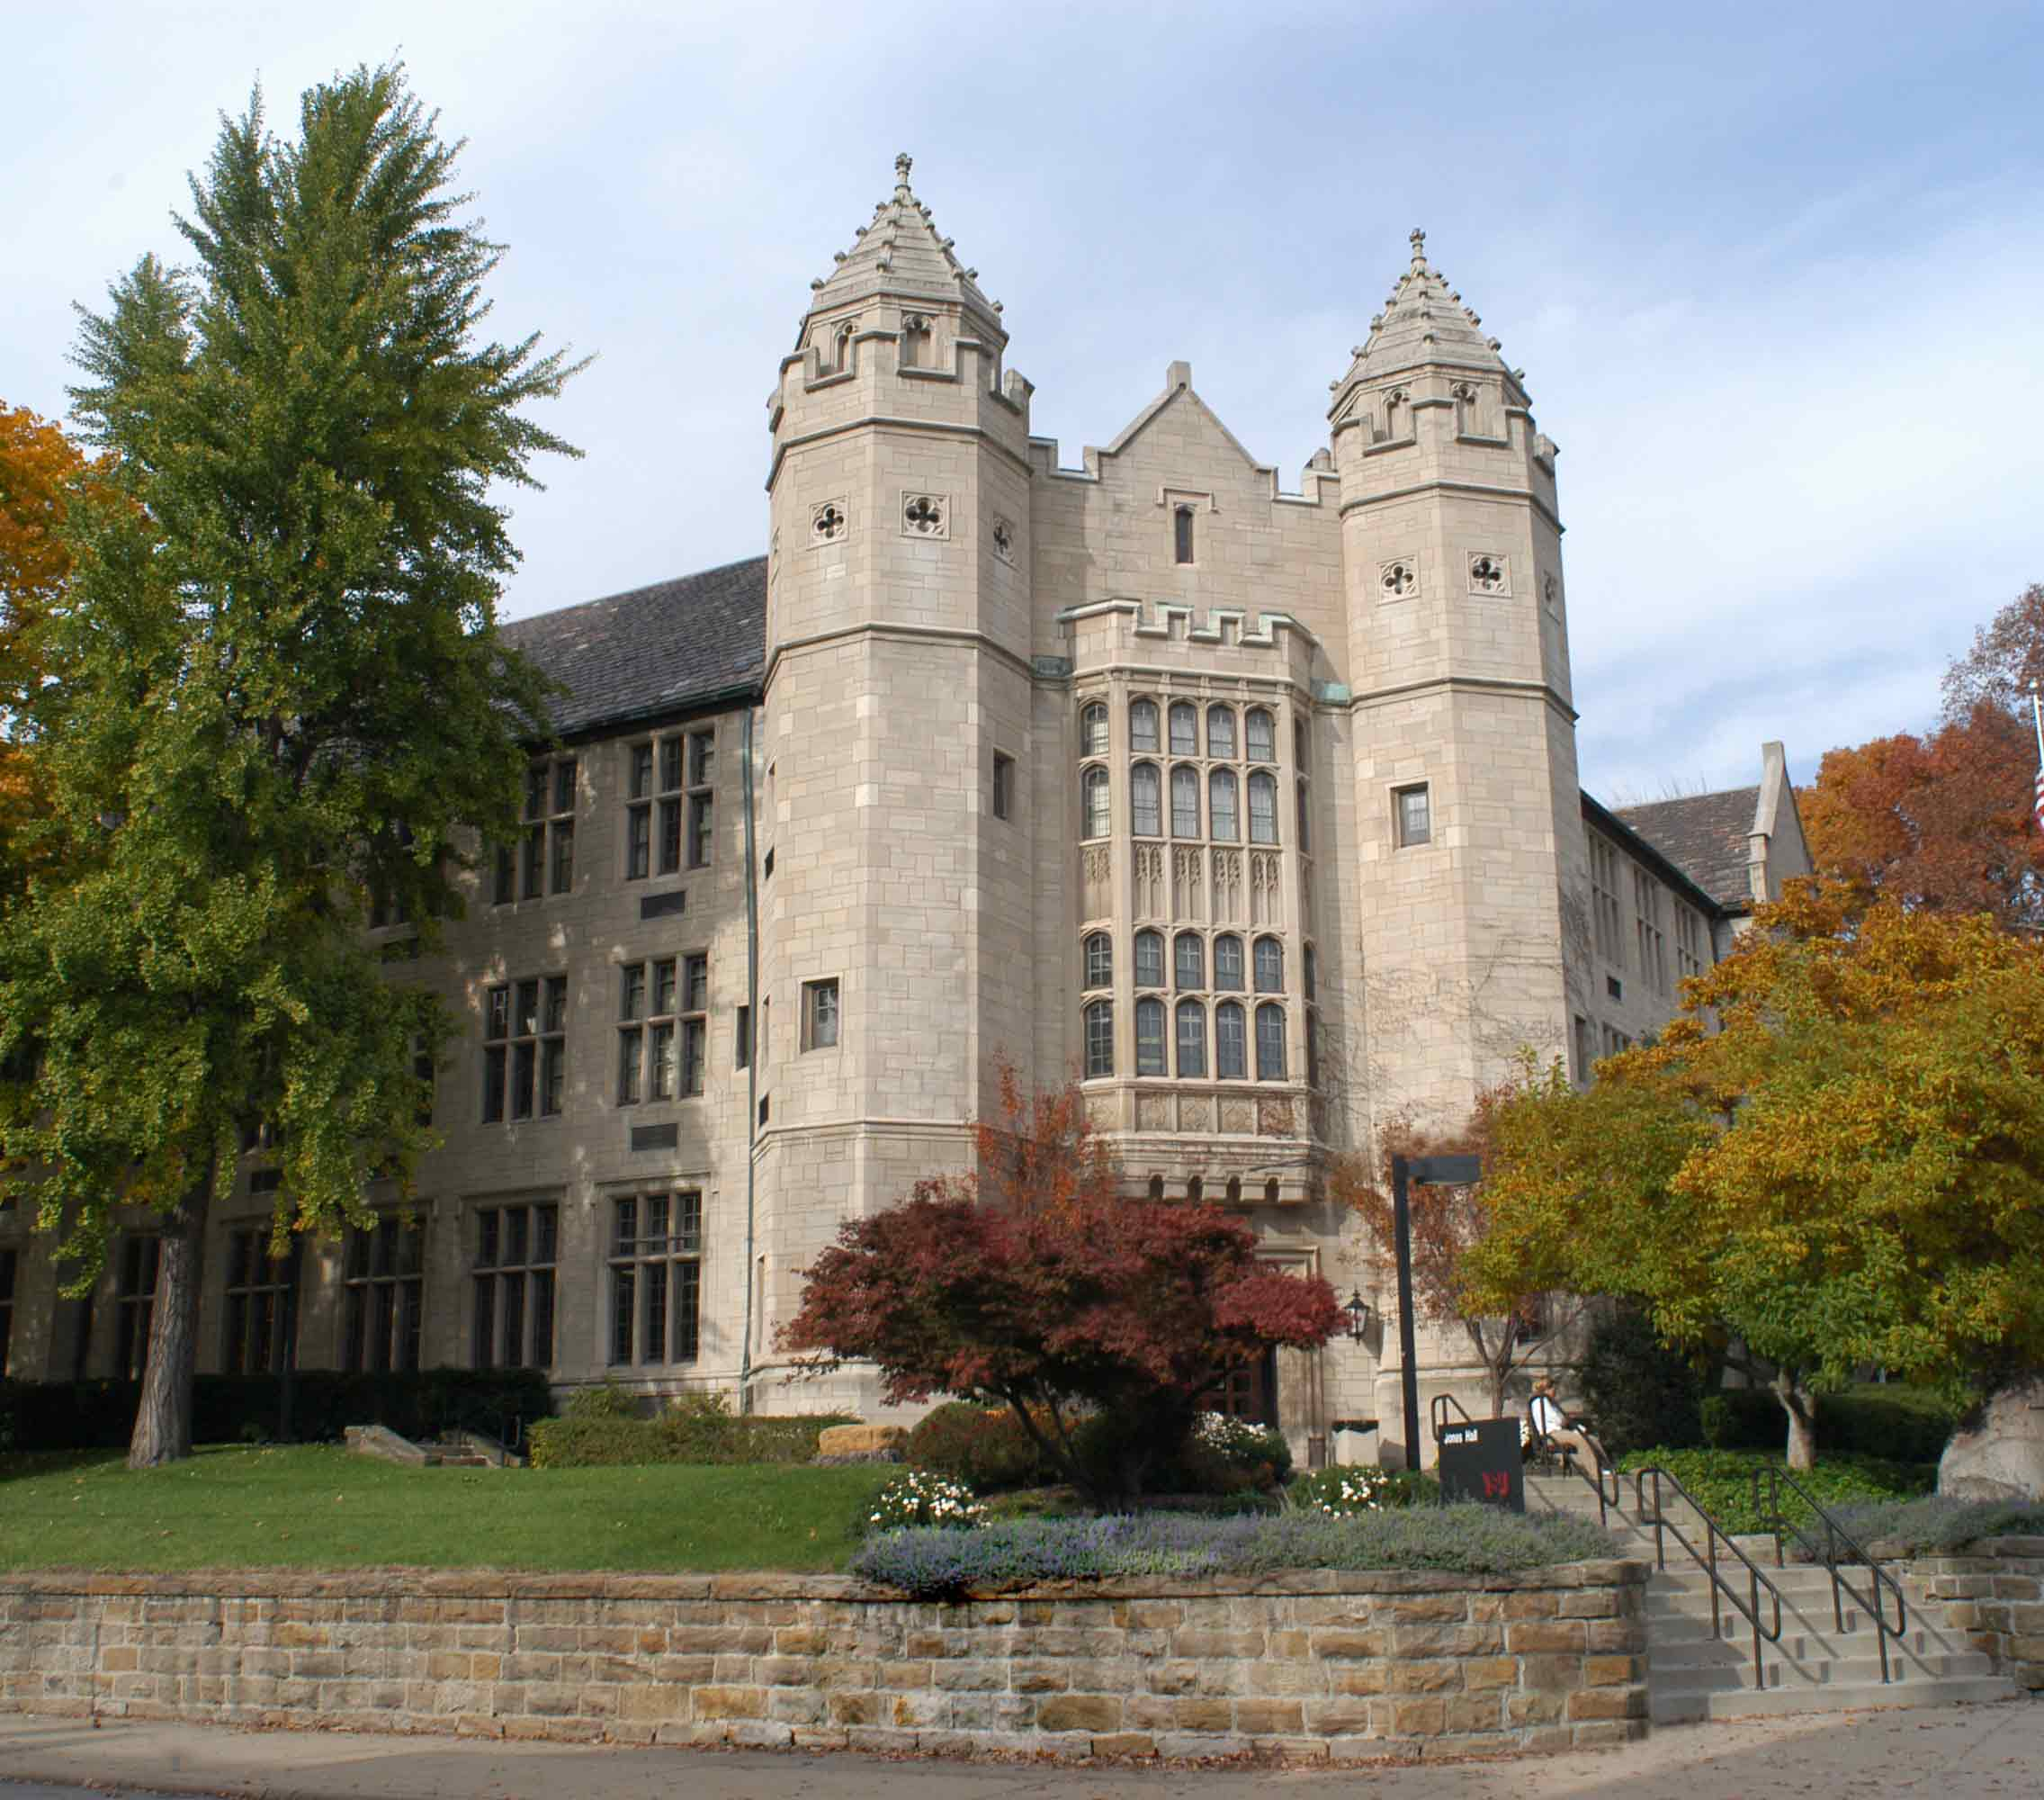
Penguin Records:
Managing Your Office Files
Jones Hall

Slide 2
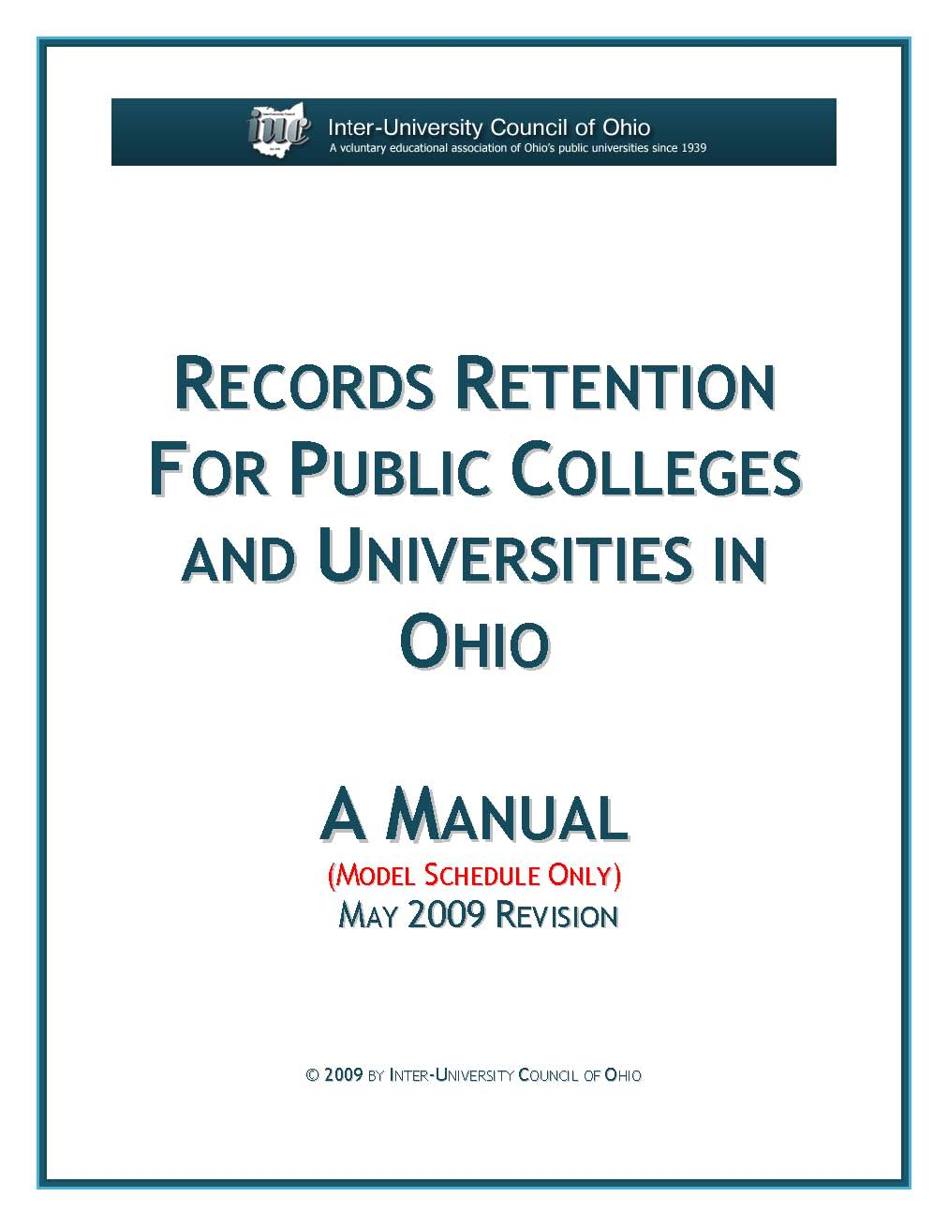
What is a public record?
The Ohio Revised Code(149.011G) defines a record as “…any document, device, or item, regardless of physical form or characteristic, created or received by, or coming under the jurisdiction of, any public office of the state or its political subdivisions, which serves to document the organization, functions, policies, decisions, procedures, operations, or other activities of the office.” This legal definition applies to YSU records.

Slide 3

What isn’t a public record?
A non-record is any document, device, or item, regardless of physical form or characteristic, created or received that DOES NOT serve to document the organization, functions, policies, decisions, procedures, operations, or other activities of the office. Non-records may include, but are not limited to:
personal correspondence
non-university publications
Listserv® materials
junk mail/spam
catalogs
journals, books, other library materials
faculty papers (they are the property of the
faculty member, not the university)

Slide 4
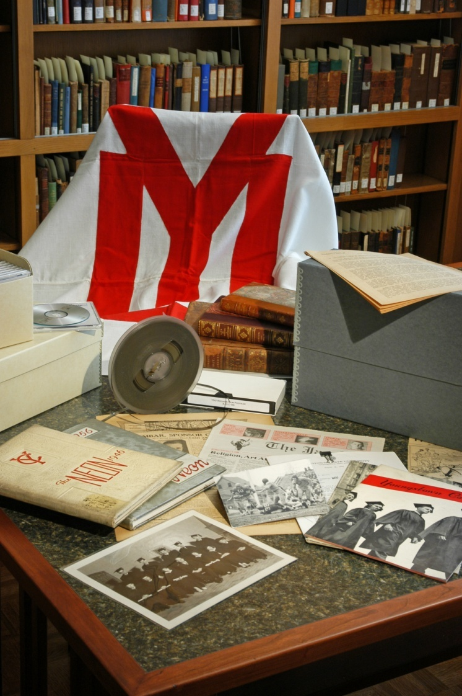
Why records management?
Document management
decisions
Increased efficiency.
Reduced cost.
Compliance with legal and
regulatory requirements.
Preserving the historic
legacy of the university.
Making your job easier!

Slide 5
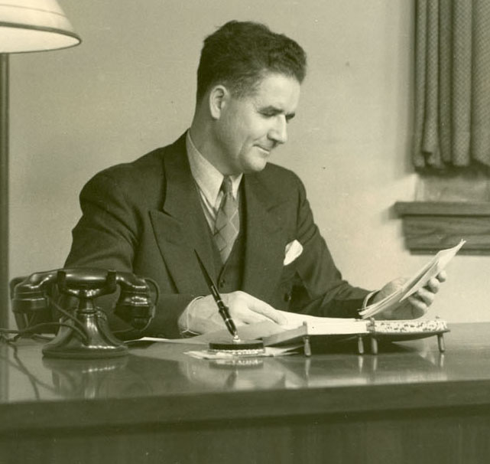
Steps for Evaluating Records
Step 1. Identifying records:
What is the appropriate records code for a group of records?
Step 2. Determining how long to keep records:
What is the records retention period for a group of records?
Step 3. What to do with inactive records:
Should the records be destroyed or transferred to the University Archives?

Slide 6
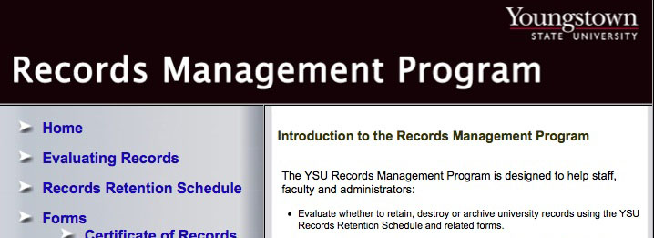
Step 1. Identifying Records
Viewing the YSU Records Retention Schedule
To begin identifying records, first locate and open a copy of the YSU Records Retention Schedule from the Records Management website homepage at: http://www.ysu.edu/recordsmgt/index.html
Click to open the Adobe Acrobat PDF

Slide 7
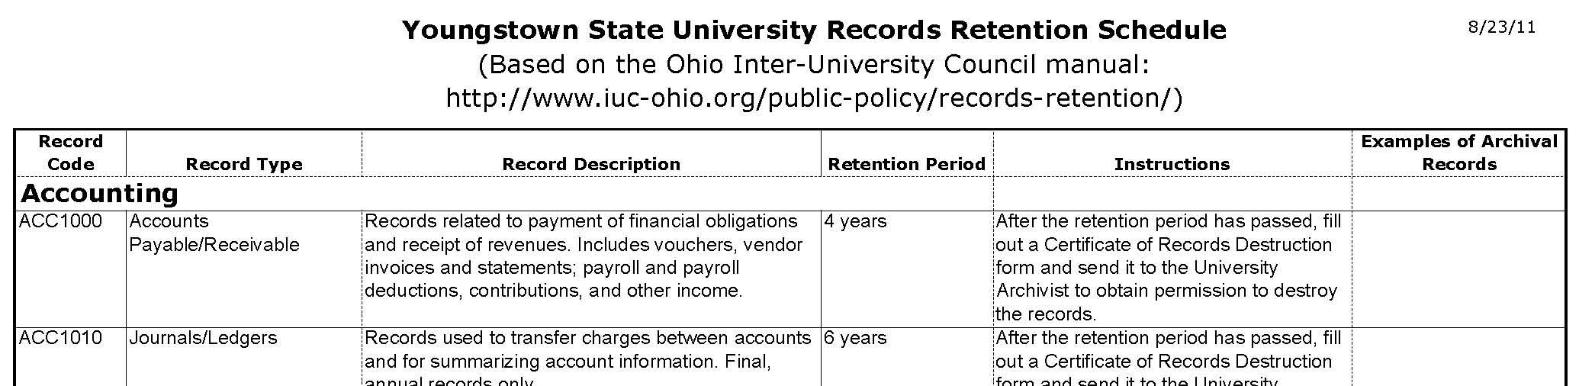
Step 1. Identifying Records (cont.)
What is the appropriate records code?
Check the first column in the YSU Records Retention Schedule for the appropriate record code corresponding to a group of records.

Slide 8
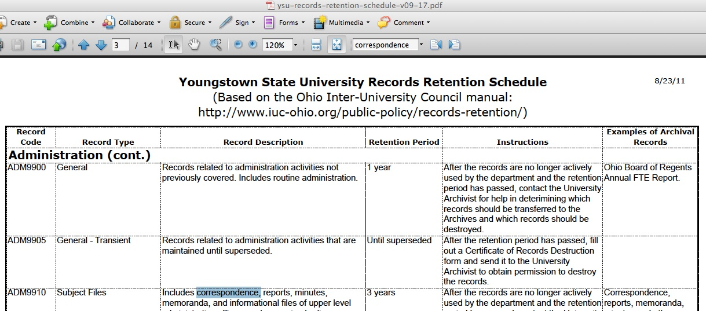
Step 1. Identifying Records (cont.)
Using a keyword search to find a records code
You may want to do a keyword search when Adobe Acrobat to find the right code. Often records can not be easily matched to a record code, so if you need help, call Ben Blake, x3788.
Click through document to find keywords
Enter keyword here
Highlighted keyword

Slide 9
Step 2. Determining how long to keep records
What is the retention period for a set of records?
Once you have identified the Record Code, use the fourth column of the retention schedule to determine the Retention Period. If the records are younger than the Retention Period, they are automatically considered active records and must be retained by your office. If the records are older than the Retention Period, they may be eligible for destruction or transfer to the University Archives, provided are not longer needed by your office and no other legal or regulatory retention periods are applicable.

Slide 10
Step 3. What to do with inactive records
Should the inactive records be destroyed or archived?
Example 1: Requesting permission to destroy records
Once you have determined the Retention Period, use the fifth column of the retention schedule, “Instructions,” to determine whether to request the destruction of the records or their transfer to the University Archives. In some cases, like the example below, you will be instructed to fill out a Certificate of Records Destruction form.

Slide 11
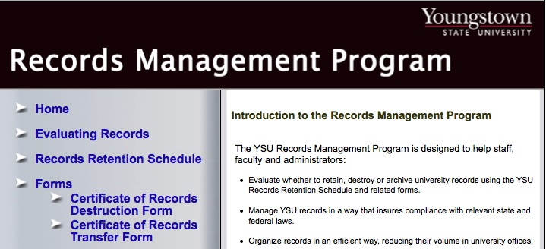
Step 3. What to do with inactive records (cont.)
Certificate of Records Destruction Form
To begin filling out a Certificate of Records Destruction, first locate and open a blank copy of the interactive form from the Records Management website homepage at: http://www.ysu.edu/recordsmgt/index.html
Click to open the Adobe Acrobat PDF

Slide 12
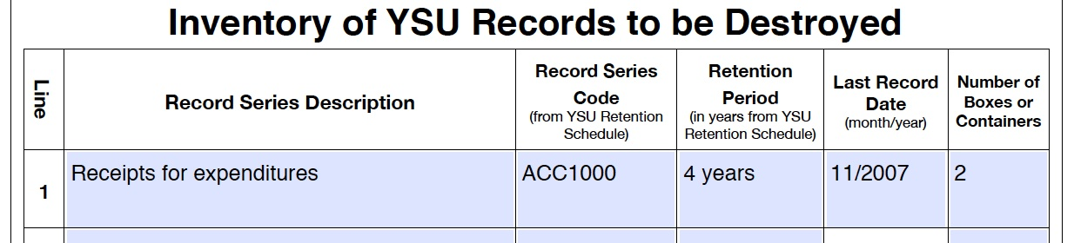
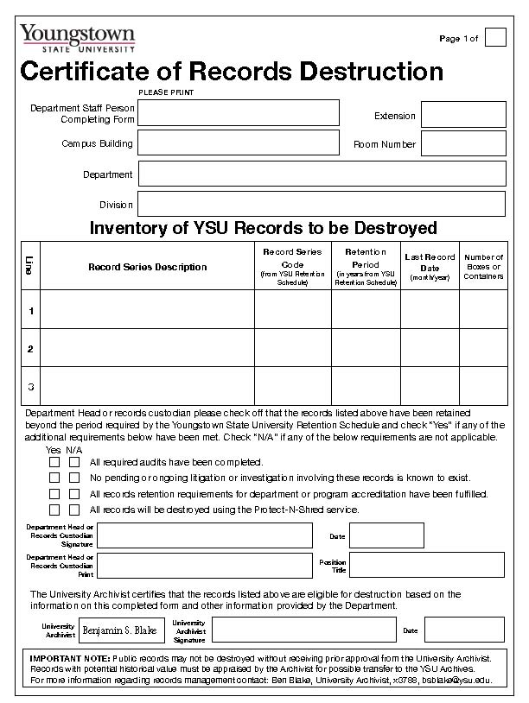
Step 3. What to do with inactive records (cont.)
Filling out a Certificate of Records Destruction form
To fill out the form, follow the instructions below. Once you have completed the Certificate of Records Destruction form, sent it via the campus mail to:
Ben Blake, Archives, Maag Library
Complete based on your knowledge of the records
Use information taken from the Retention Schedule to complete

Slide 13
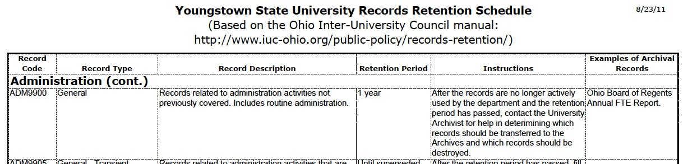
Step 3. What to do with inactive records (cont.)
Should the records be destroyed or archived?
Example 2: Requesting the transfer of records to the University Archives
As in Example 1, use the fifth column of the retention schedule, “Instructions,” to determine whether records should be transferred to the University Archives. In some cases, like the example below, you will be instructed to contact the University Archivist. This indicates that the records classified under this code may be of historical value and could be transferred to the archives.

Slide 14
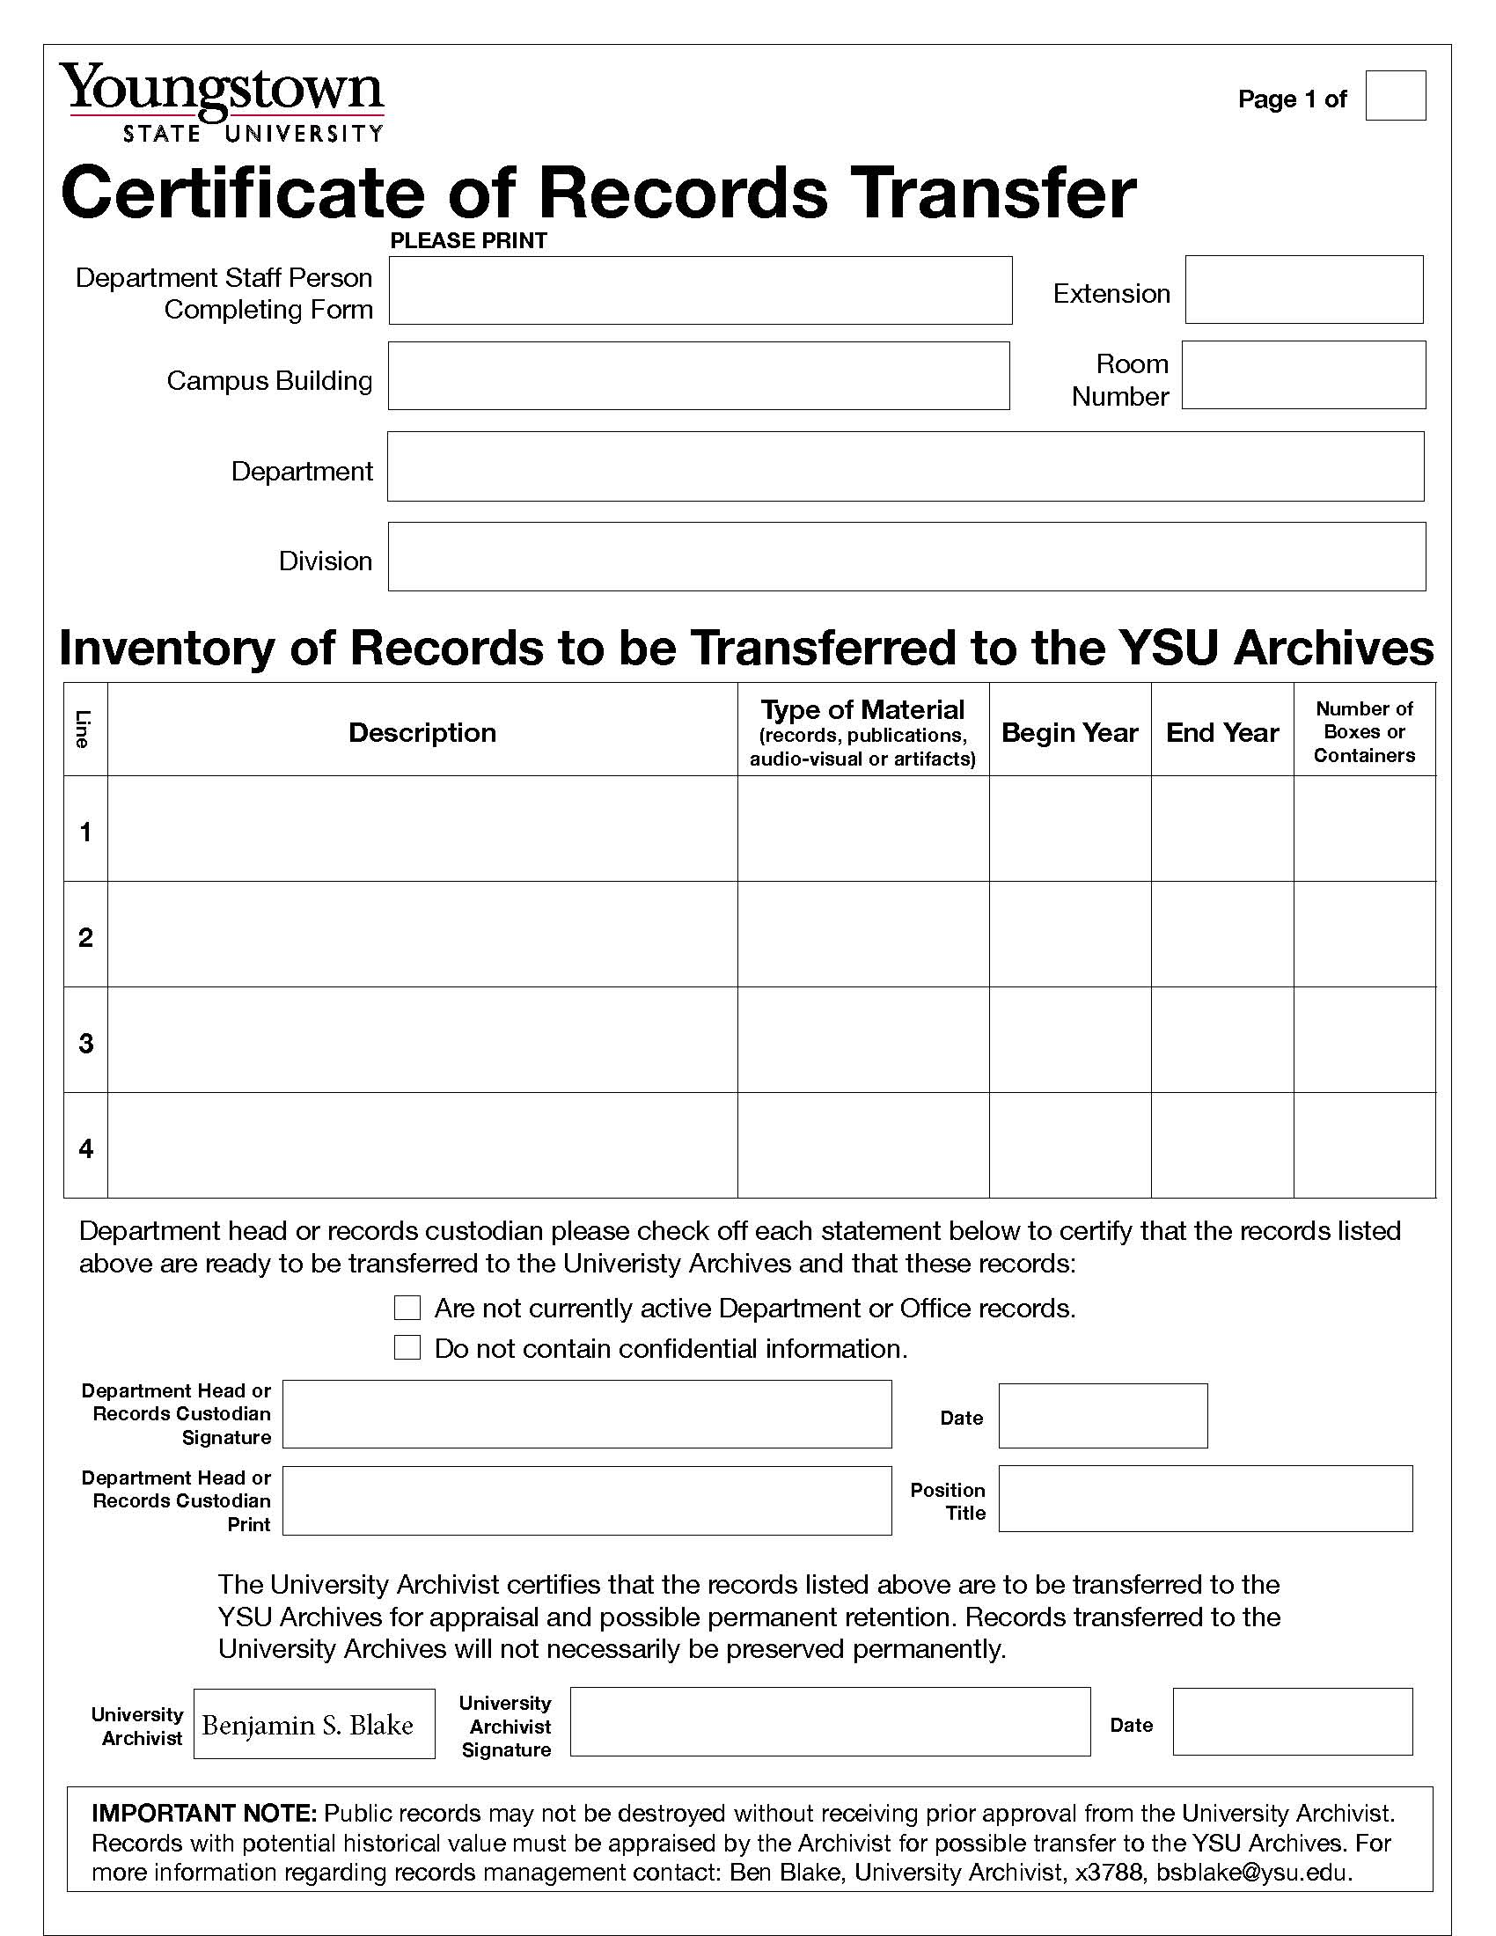
Step 3. What to do with inactive records (cont.)
Archiving records
Example 2: Requesting the transfer of records to the University Archives
If the Retention Schedule “Instructions” advice you to contact the University Archivist, call Ben Blake at x3788. Small transfers to the archives can often be set up over the phone. Larger sets of records will require that the archivist visits your office to appraise the records onsite and to help prepare them for transfer to the archives.

Slide 15
Continuous Improvement
Spring 2011 New interactive forms and retention schedule
Summer 2011 New website
Fall 2011 New training presentation
Spring 2012 Improvements in forms, website, schedule and
research related to key issues
Summer 2012 Onsite campus wide training sessions
Annual summer onsite training sessions
Don’t hesitate to contact us with suggestions for improving our program at anytime.

Slide 16
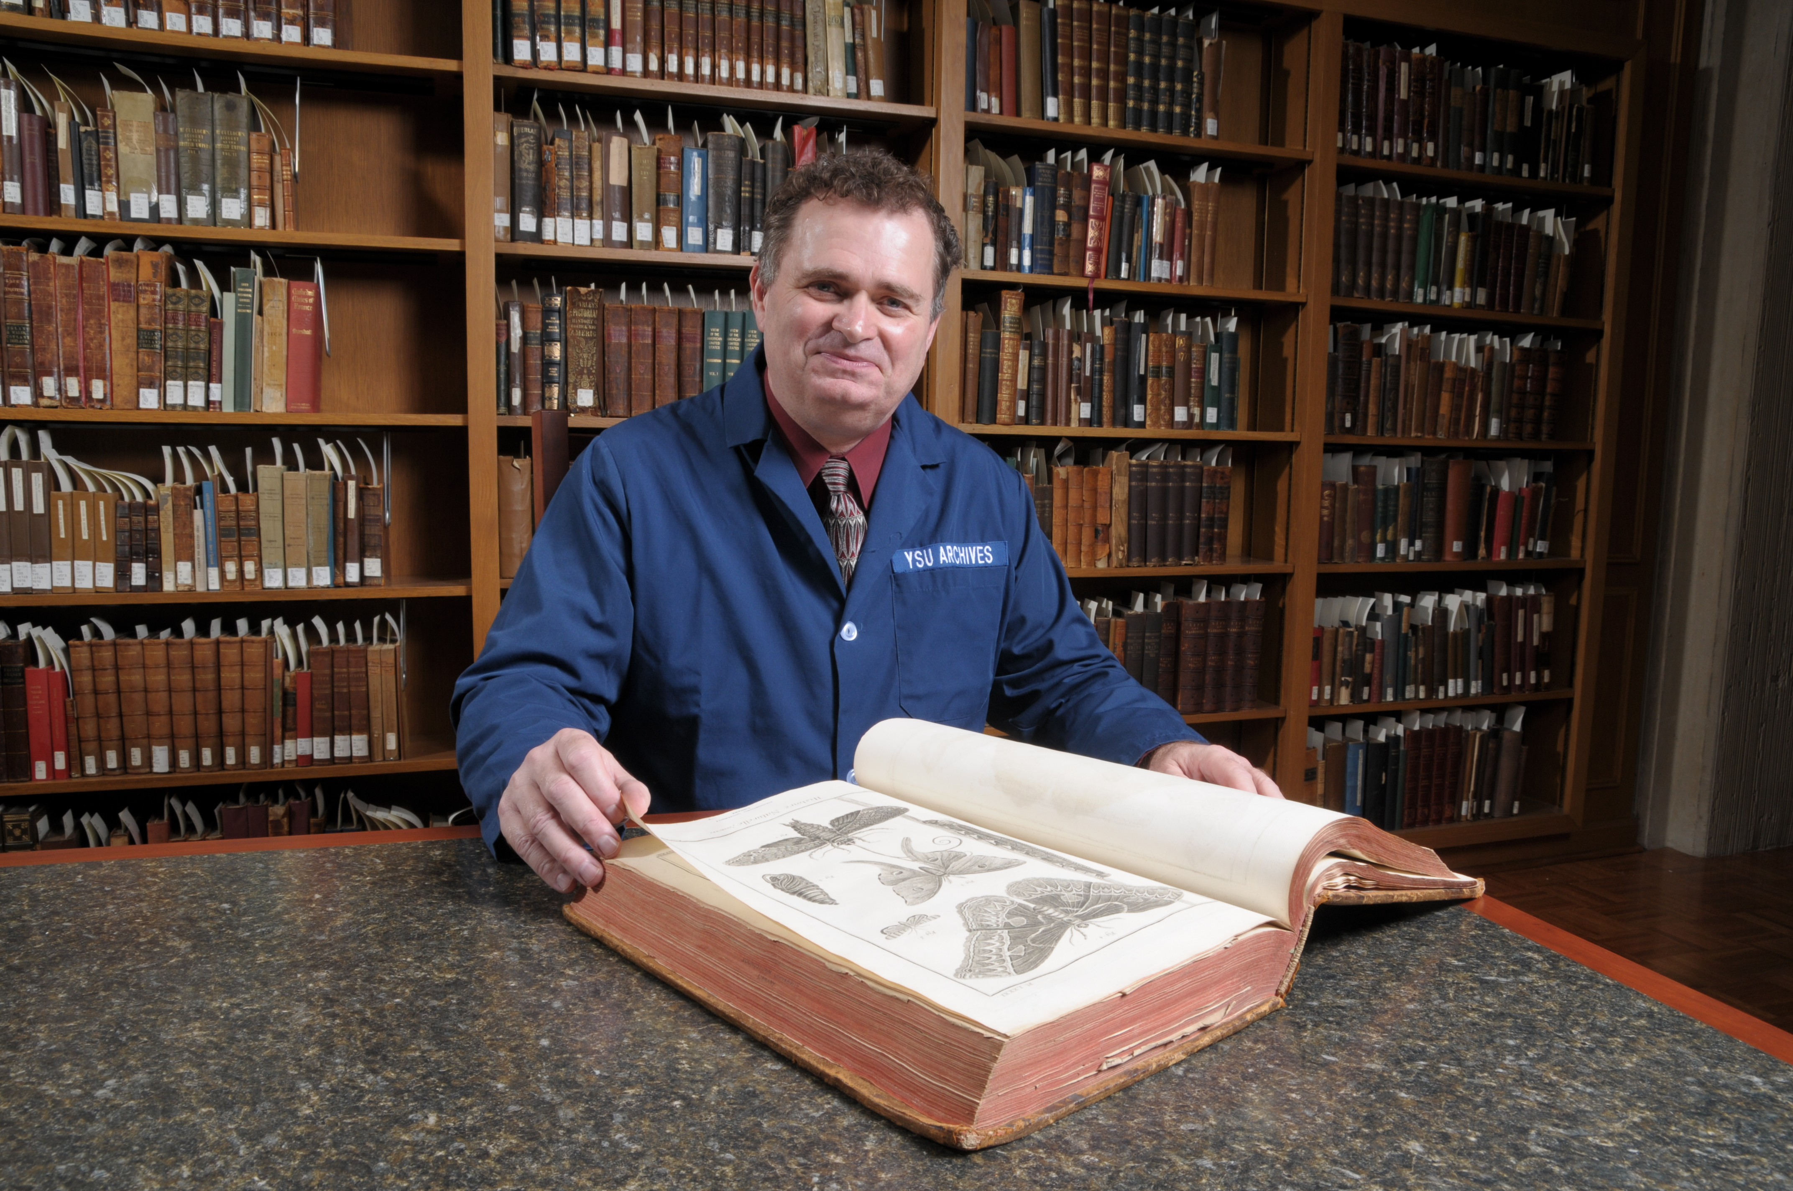
Questions?
Ben Blake
University Archivist
Maag Library
x3788
bsblake@ysu.edu
http://www.ysu.edu/recordsmgt/evaluatingRecord.html
The 24 hour service rule: You will receive a reply to all records management inquiries and all forms will be returned back to you via the campus within 24 hours.

