Slide 1
The New Frontier of LGBTQ Rights:
Opportunities for Advocacy and Activism
Michele Schlehofer, PhD
Department of Psychology
Salisbury University

Slide 2
LGBTQ Equality, Past and Present*
*Just a few examples
We’ve come so far…
There’s still work to be done…
Increased visibility in the media
Some states (NY, OR, MN…) and DC now recognizing expanded gender options
Same-sex marriage is legal nationwide
31 states lack employment protections for trans people
Gay men still prohibited from donating blood
18% of high school students report their school prohibits them from forming or promoting a Gay-Straight Alliance

Slide 3

Supportive Environments: Necessary More than Ever (in recent history)
Federal Rollback of Protections…
Introduction of Anti-LGBTQ State Legislation…
Community Change Agents:
We Need You!
Department of Ed rescinded Title IX guidance
Federal agencies no longer collecting LGBTQ demographic data
VA considering exempting gender confirming surgeries
Bureau of Prisons placements of trans inmates limited
Rescind visas for same-sex partners of diplomats
  …etc. etc. etc.
Conversion therapy- parental rights
Child welfare/adoption discrimination
Religious exemption/freedom laws

Slide 4
The Impact of Supportive Environments…
Marriage rights → Reductions in population-level anxiety, depression, and substance abuse
Supportive schools → LGBTQ youth perform on-par with their peers
Supportive families → Trans youth suicide ideation and completion dramatically reduces
Supportive environments matter!

Slide 5
Being a Community Change Agent…

Slide 6
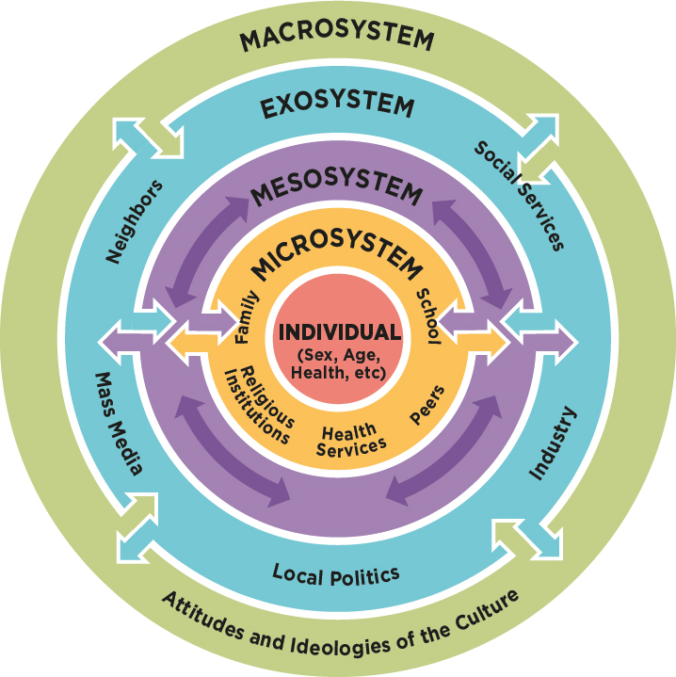
Ecological Model
People are embedded in systems…
Families, schools, religious institutions, peer groups
Neighborhoods, communities, local cultures
Larger cultural contexts, historical influences
All of these systems are possible places for building supports

Slide 7
The Importance of Integrative Power
Integrative power is “people power.”
  Capacity to work together, build groups, bind people together, and inspire loyalty.
Sources:
  Social relationships
  Networks
  Integrative power is a tool used in social movements and liberation

Slide 8
(some) Tools for Community Change*
Community Coalitions
  Lower Shore LGBTQ Coalition
Consciousness Raising
  Awareness campaigns; discussion panels – LIKE THIS ONE
Social Action
  Protests; pride events
Alternative Settings
  Letters Alliance
Use of Technology
  “Digital activism;” online organizing

Slide 9
Final Thoughts
“Change always seems impossible, until it’s inevitable.”
-Sarah McBride
Thank you!

