Slide 1
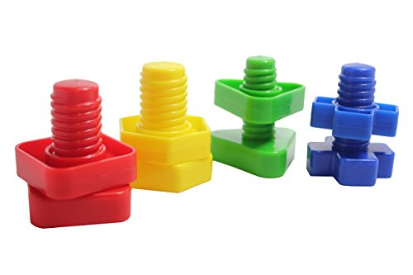
Nuts and bolts of researching library issues
Victoria Martin
June 13, 2018

Slide 2
Coming up with a research idea
Evaluating a research idea
Selecting a research method
Integrating research with your job
Things to consider before you begin

Slide 3

Research is formalized curiosity. It is poking and prying with a purpose.
- Zora Neale Hurston

Slide 4
Finding the right fit
You + research problem + research design

Slide 5
What is a research problem?
Any topic, phenomenon, or challenge
that you want to study

Slide 6
Where do good research ideas come from?

Slide 7

YOU
    “The source of ideas every man has wholly in himself.”
    ~ John Locke
Your professional experience
Your personal interest
Your previous research
(the “domino effect”)

Slide 8

Other people
“To steal ideas from one person is plagiarism, to steal ideas from many is research.” ~ Steven Wright (?)
Library science literature
Dissertations
Professional peers
Meta-analyses
Secondary research

Slide 9
Evaluating a research idea
A research idea is likely appropriate for research if it is:
Relevant
Significant
Supported by the literature
Timely
Novel and unique
Specific
Feasible

Slide 10
Research methods
Basic research
Applied research
Theoretical in nature
Aims to produce new knowledge
Pragmatic in nature
Aims to resolve specific problems

Slide 11
Examples of research designs
Quantitative
qualitative
Experimental
Correlational
Casual comparative
Historical
Narrative
Ethnographic

Slide 12
Action research
Focuses on finding a practical solution to a local problem
Involves those affected by the problem as research participants
Has direct application to the researcher’s workplace
May or may not have application beyond the immediate study

Slide 13
Action research cycle
PLAN
REFLECT
ACT

Slide 14
Action research cycle
PLAN
Defining goals
Identifying stakeholders
Selecting data collection methods
Setting up a timeline

Slide 15
Action research cycle
ACT
Collecting data
Analyzing data
Implementing the project

Slide 16
Action research cycle
REFLECT
Evaluating project outcomes
Sharing project outcomes
Moving on to a new cycle of planning

Slide 17
Establishing an open access publishing fund (OAPF)
PLAN
Goals
    to cover costs for researchers who publish in open access journals
    with article processing charges
    to support open access to research
Stakeholders: faculty, graduate students, post doc fellows
Collaborators: library administration, faculty advisory committee,
the Provost’s Office
Data: researchers’ input, statistical data, guidelines, best practices
Timeline: two semesters

Slide 18
Establishing an open access publishing fund (OAPF)
ACT
Drafting of policies, procedures, and eligibility requirements
Development of application process
Conducting interviews with faculty
Creating marketing materials
Organize presentations and discussions
Securing of actual funds
Designating the primary contact person

Slide 19
Establishing an open access publishing fund (OAPF)
REFLECT
Tweaking policies and procedures
Tracking the OAPF’s progress
Recalculating the fund periodically

Slide 20
Things to consider
Time commitment
      Cost
      Team membership
      Team leadership
      Timeline

Slide 21
Integrating research with your job
Connect your research to one of your job responsibilities
Integrate your multiple job responsibilities into a single
research project
Solve workplace problems while conducting research
Research to master new skills and learn new concepts

Slide 22
Before you begin….
… ask yourself the most important question, which is…

Slide 23


Slide 24
Credits
Beck, S. E., & Manuel, K. (2008). Practical research methods for librarians and information professionals. New York, NY:
Neal-Schuman Publishers.
Hurston, Zora Neale. (1942). Dust tracks on a road. Philadelphia, PA: J. B. Lippincott.
Ideas. CanStock photos.
VandeHoef, Alex. Curiosity.

