Slide 1


A CASE FOR THE EPHEMERAL:
TEMPORARY PUBLIC ART AND
ITS PLACE IN OUR COMMUNITIES
Laura Holland
In Fulfillment of MAAA Degree Requirements
16 May 2023

Slide 2
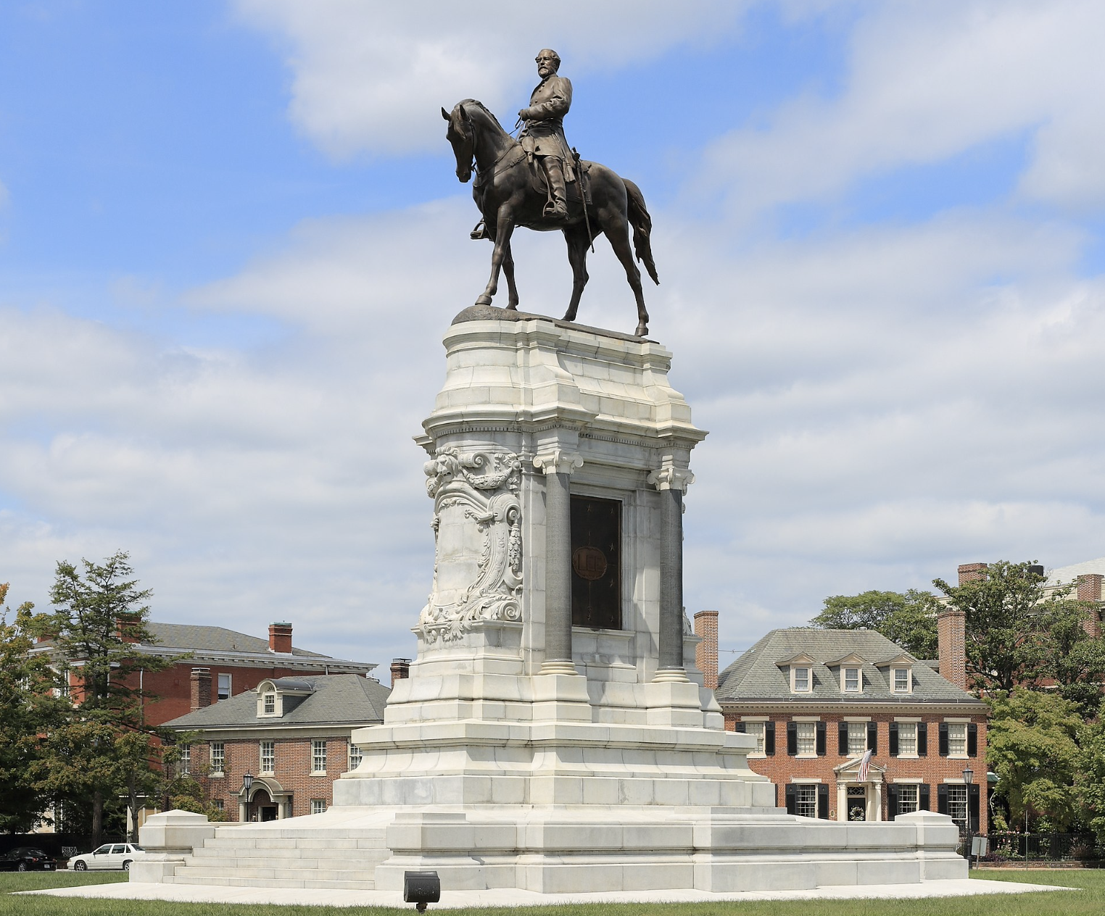
Lee Monument. Antonin Mercie, Richmond, Virginia. 1890.
Notes:
Penny Balkin Bach, Former Executive Director and Chief Curator for the Association for Public Art, once wrote: “Public art is not an art ‘form.’” And something without form lends itself to ambiguous definition. It’s interesting when people hear the term “public art” -- images of statues, murals, more fixed structure, “forms” are conjured. But, public art, by essence of definition, is not a what. It is a where. And this paper argues that by embracing processes that create temporary, ephemeral public art, we bring into being public art’s “how” and “why.”

Slide 3
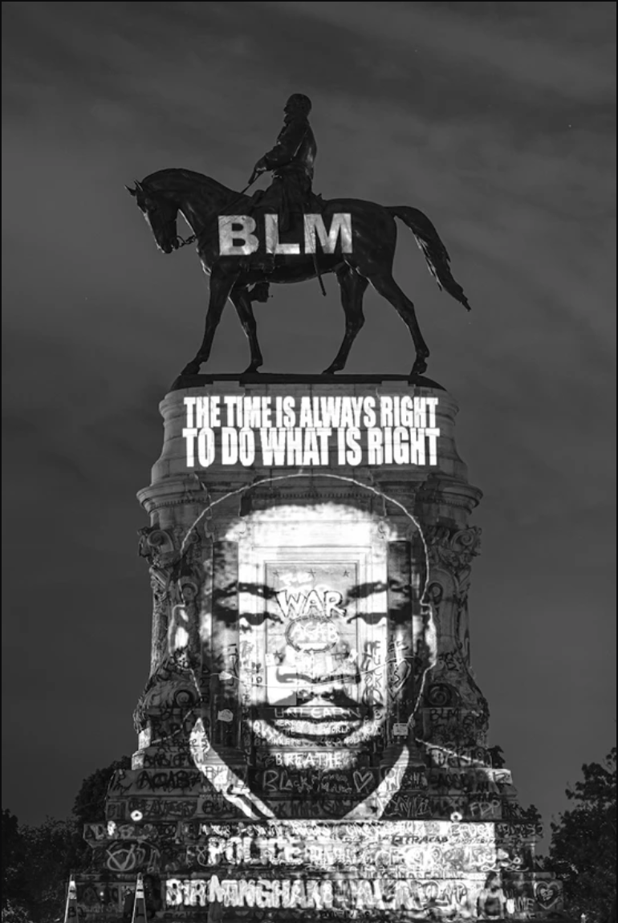
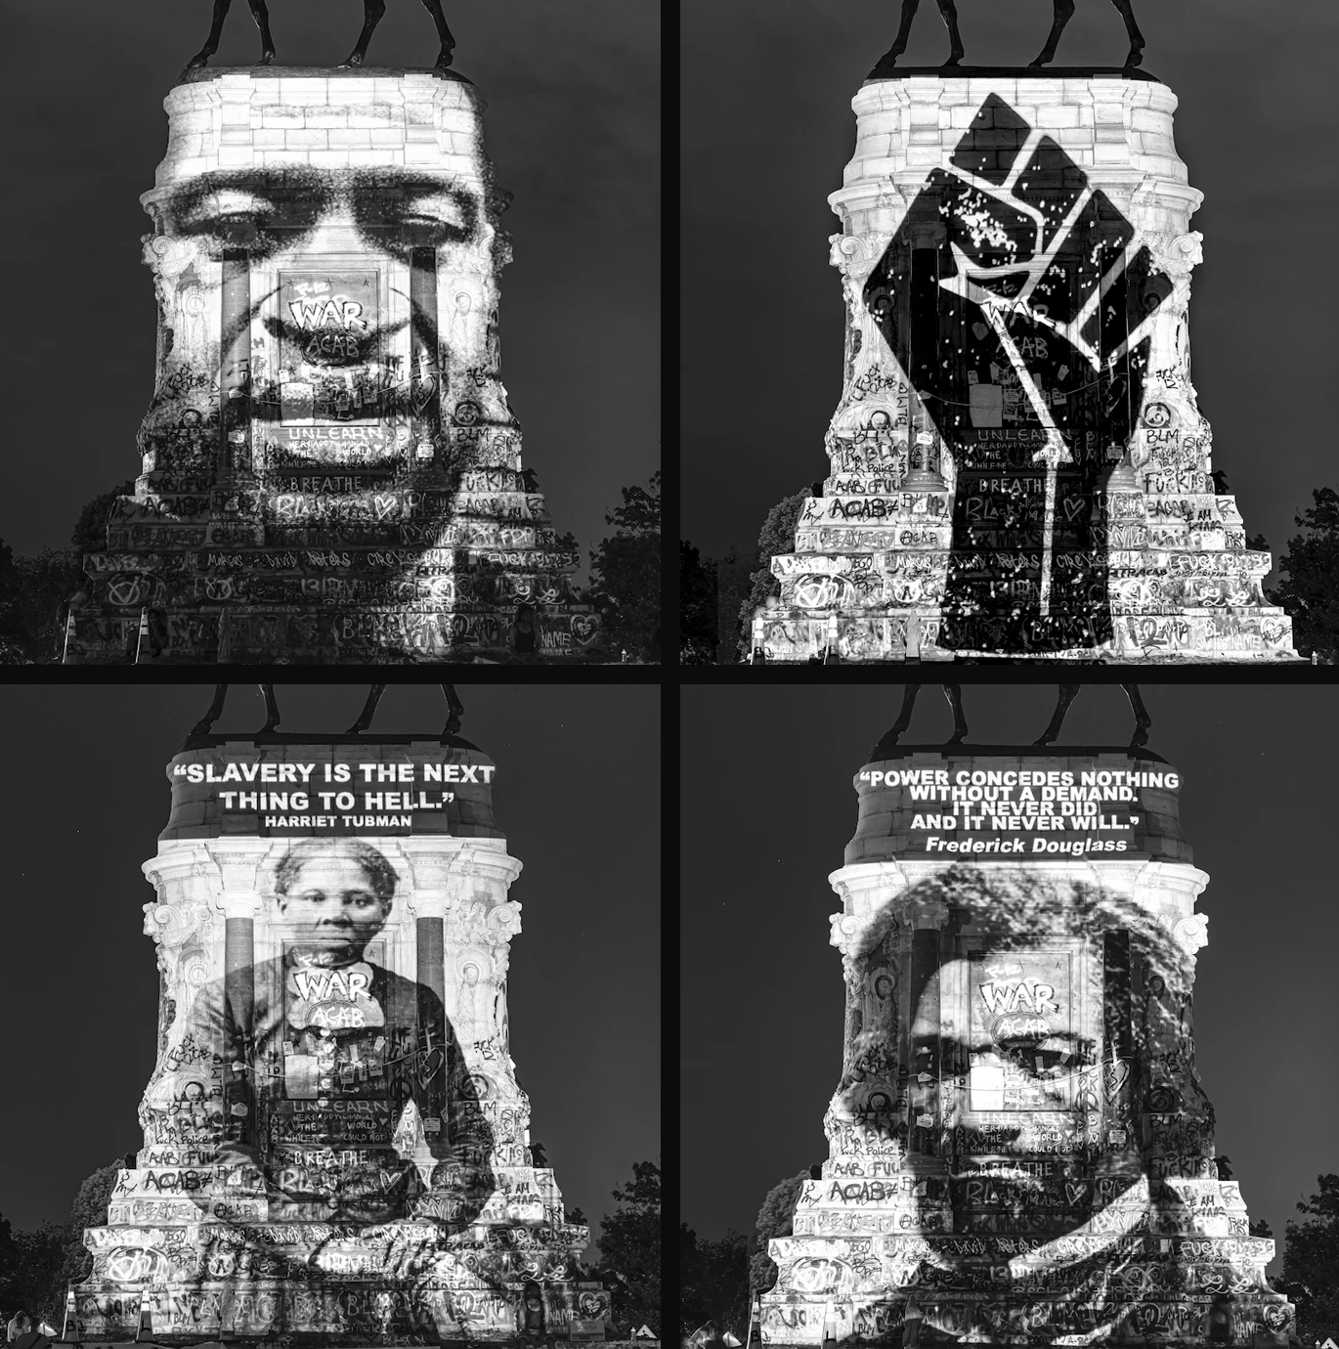
Reclaiming the Monument, ephemeral projections on Lee Monument.
Dustin Klein and Alex Criqui, Richmond, Virginia.
2020-2021.
Notes:
Public art inspires, dismantles, and transforms our perspectives on contemporary life. This paper argues the importance of temporary public art and its vitalness in our communities. Addressing the issues of equity, community displacement, and community identity, temporary public art challenges the structures of “traditional,” permanent models of public art.

Slide 4
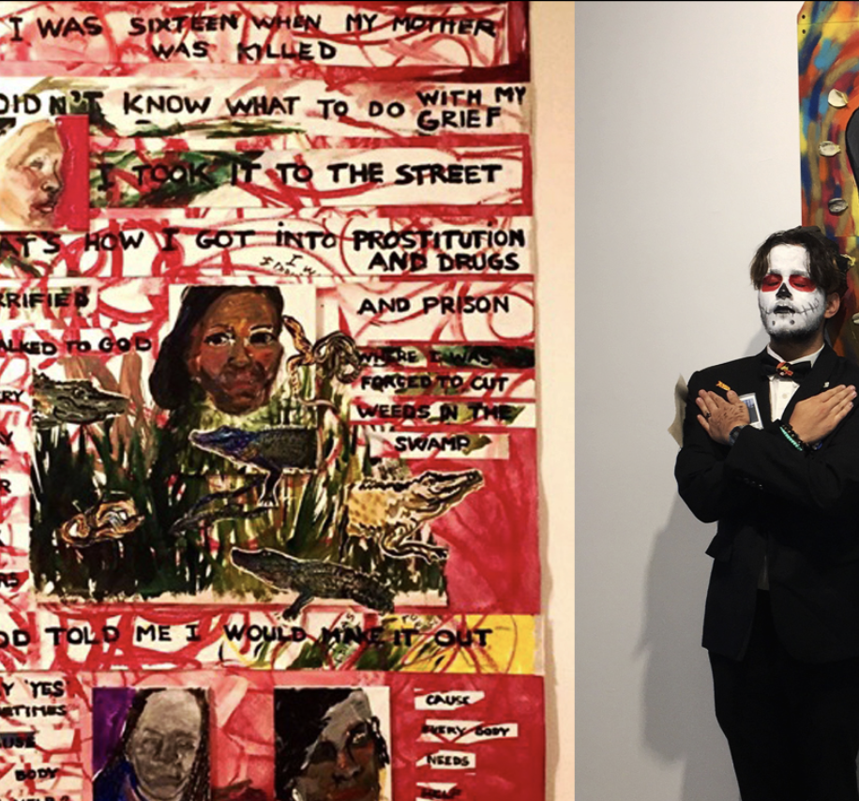
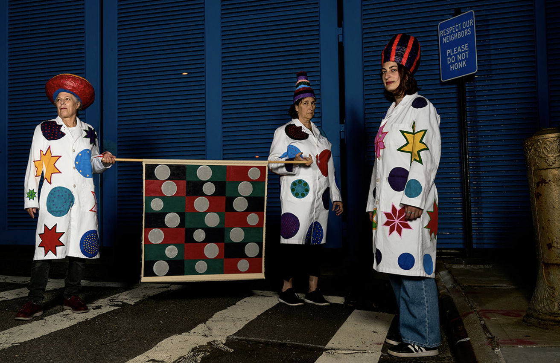
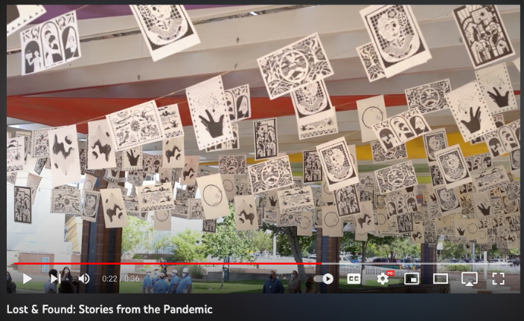
Moonrise over 14th street: Paintings in odd places. Sally Apfelbaum, AiOP, New York. 2019.
Lost & Found, Stories of the Pandemic, New Mexico. 2021.
Mass incarceration project.
Henrietta Mantooth & Nicky Draven, AIOP, New York. 2019.
Notes:
The essence of these temporary artistic projects for and by the public coalesces the need for more similar art processes: public art that engages and reflects evolving communities, promotes the equitable engagement of artists, and brings awareness to timely issues. In the framework of dismantling structure in order to re-mantle a new process for public art as well as what public art has the potential to be, temporary public art rises to this challenge of reflecting an impermanent world.

Slide 5
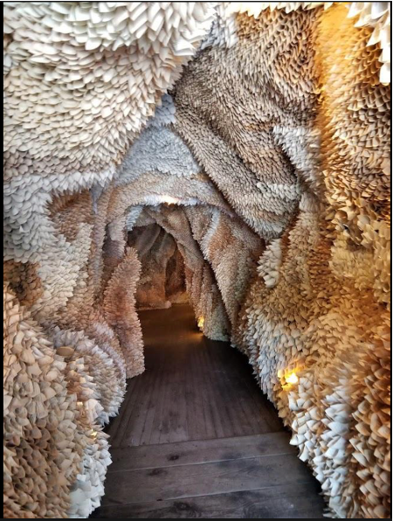
Thesis Statement
Temporary public art addresses timely issues relating to community, equity, and the controversies typically associated with the process of implementing traditional, permanent public art.
Paper Caves. Samuelle Green, Pennsylvania. 2019.
Notes:
Temporary public art addresses timely issues relating to community, equity, and the controversies typically associated with the process of implementing traditional, permanent public art.

Slide 6
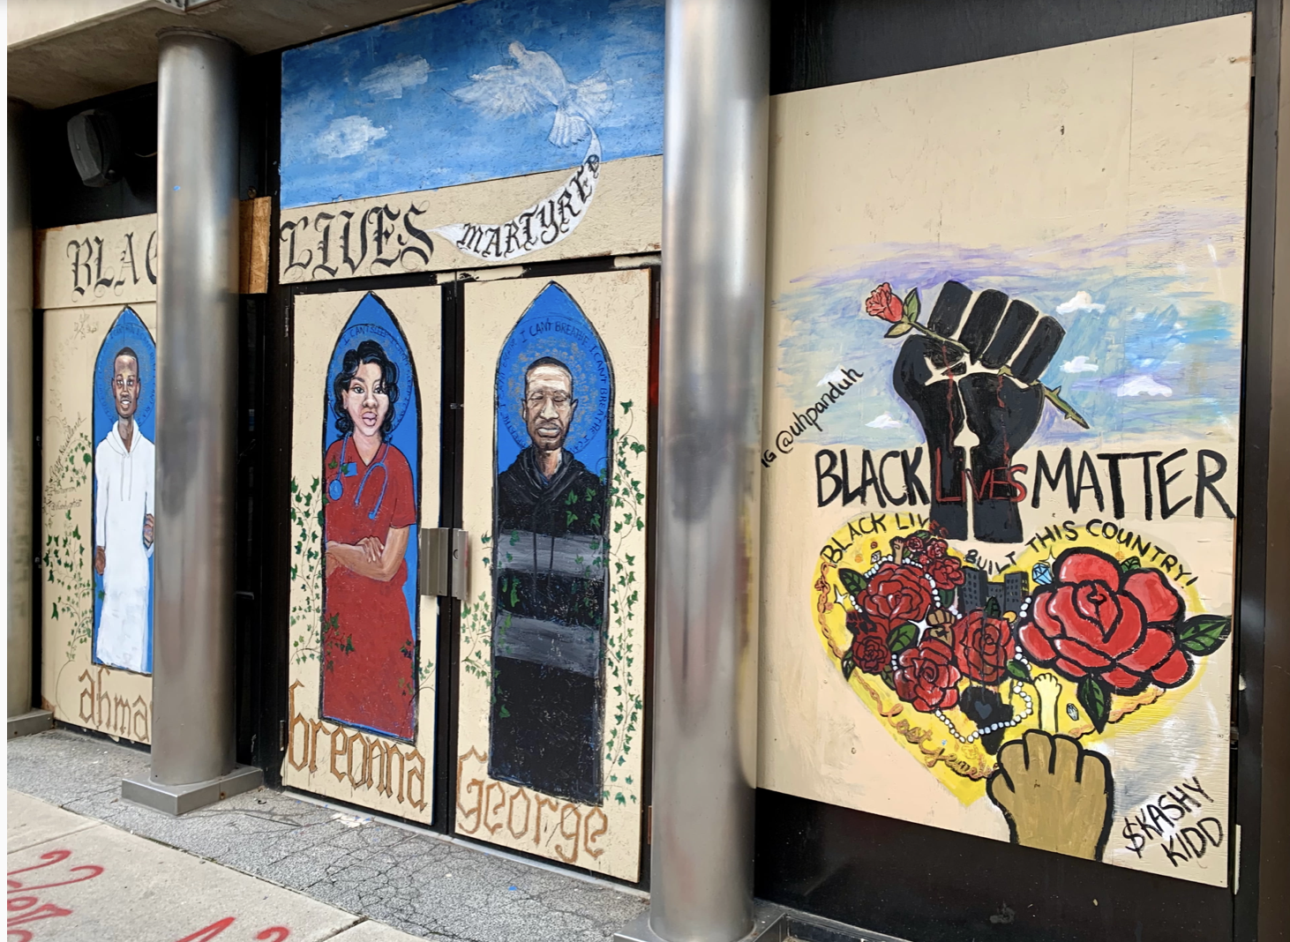
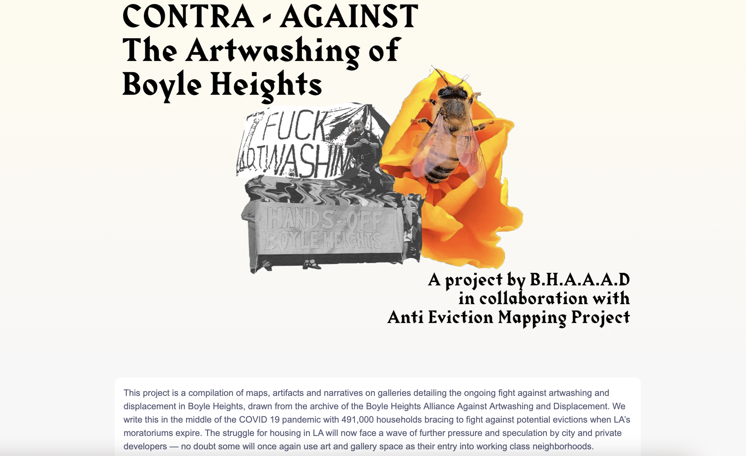
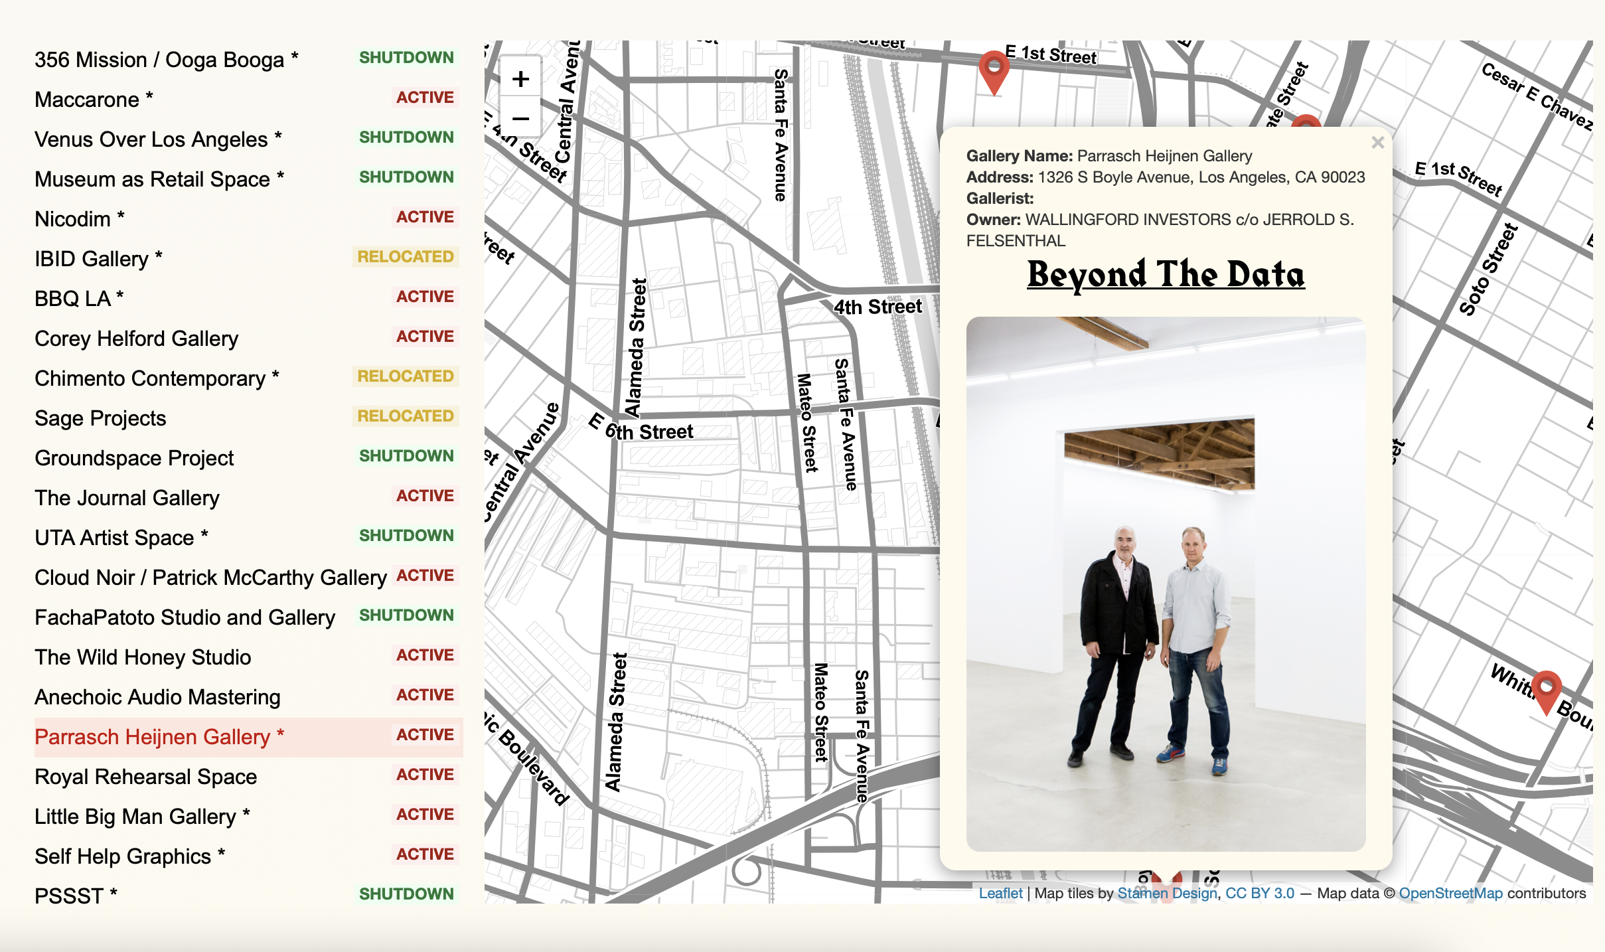
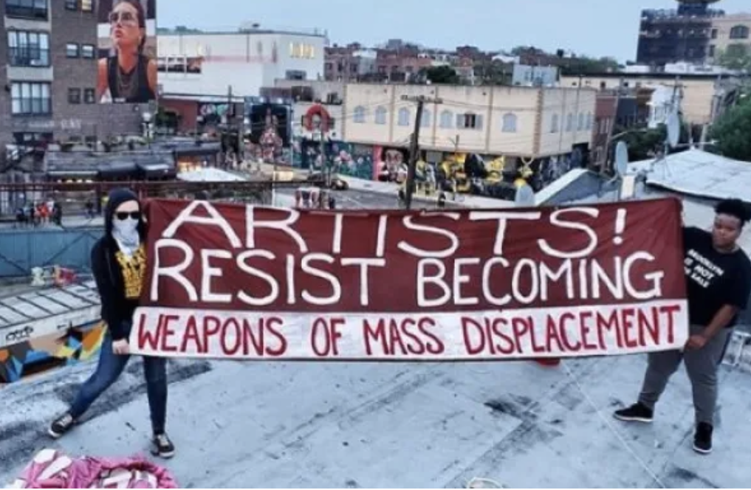
#ArtUnitesCbus initiative, Ohio. Artist(s) Unidentified. Photo Credit: Sarah Trombetti, Lantern Reporter, 2020-2021.
”Artists Resist Becoming Weapons of Mass Displacement.” Mi Casa No Es Su Casa. 2019.
“CONTRA – AGAINST the Artwashing of Boyle Heights: A project by B.H.A.A.A.D. in collaboration with Anti Eviction Mapping Project., Los Angeles. 2020-current.
Notes:
What administrators across all art forms can learn from the ephemeral is how to engage their communities more authentically, address equity issues in their own spaces, and ensure a gamut of artists and patrons see themselves reflected in the creative spaces of a community. These projects reflect community identity, align with spatial justice advocacy, promote more collaborative and equitable forms of public art; and combat circumstances where permanent art has prompted artwashing and community displacement.

Slide 7
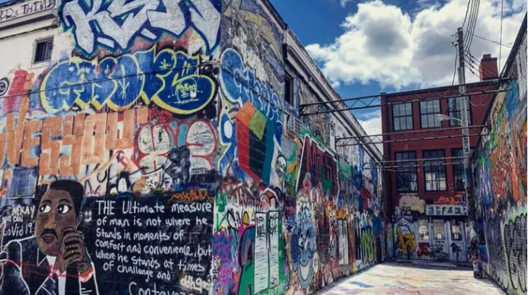
PUBLIC ART:
“art in public spaces”
Graffiti Alley, Baltimore, Maryland. 2005-present.
HOW PUBLIC ART IS FUNDED:
PERCENTAGE-FOR-ART (GOVT PLAN)
PRIVATE FOUNDATIONS
PUBLIC-PRIVATE
GRANTS
FUNDRAISING
Notes:
While artists are redefining public art, creating between the fixed and the temporary, commissions that are funded through a city’s percent-for-art funds, which are municipal funds allocated specifically for public art from a percentage, typically, 0.5% to 2%, of the city’s capital construction budget, tend to be building or site-specific, which limits space or time to experiment with process and outcome. This paper only scratches the surface of the nuances of navigating the percentage-for-art policy as well as the nuances when creating permanent versus temporary public art.

Slide 8
THESE PUBLIC ARTISTS CREATE WHERE COMMUNITY IDENTITY, SPACIAL JUSTICE, AND COMMUNITY DISPLACEMENT INTERSECT...
MI CASA RESISTE
NDN COLLECTIVE
LILY XIE
Notes:
Three artists and initiatives that utilize the ephemeral at the intersection of community identity, special justice, and community displacement are Mi Casa Resiste, the NDN Collective, and Lily Xie (SHEEUH).

Slide 9
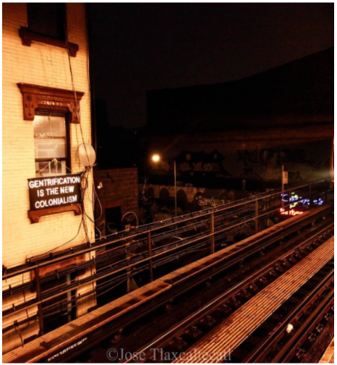
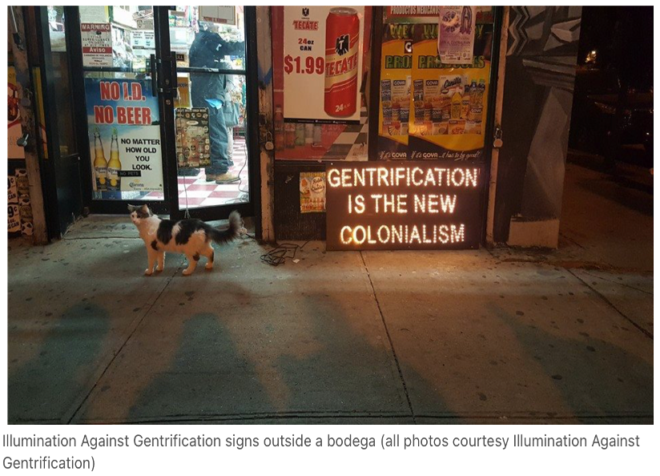
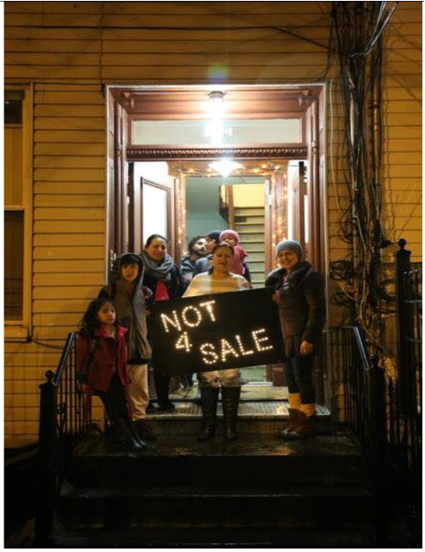
MI CASA NO ES SU CASA
“Gentrification Is The New Colonialism.” Bushwick, New York. 2015.
MI CASA RESISTE
”Not 4 Sale.” Bushwick, New York. 2015
Notes:
Mi Casa Resiste’s Mi Casa No Es Su Casa initiative was birthed from the people of Bushwick, New York, having seen, continuously, corporations [that hire artists] to beautify a community while ignoring the true needs of the community. Their 2015 temporary installation Illumination Against Gentrification, in collaboration with the NYC Light Brigade, consisted of 21 signs with messages such as “Not 4 Sale” and “Gentrification is the New Colonialism.” According to Hyperallergic’s 2015 article, Illumination Against Gentrification was created “to not only raise awareness about the displacement of people of color in the community due to gentrification but to also make clear that the community are fighting back.” Mi Casa No Es Su Casa encourages the elevation of local artists... that real arts and culture representation start with those who are in the neighborhood. Mi Casa Resiste continues to create temporary art installations in response to social justice issues in the community, displaying their art as quote “close to the accused as possible” end quote.

Slide 10
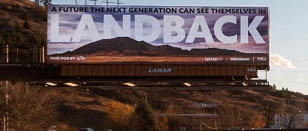
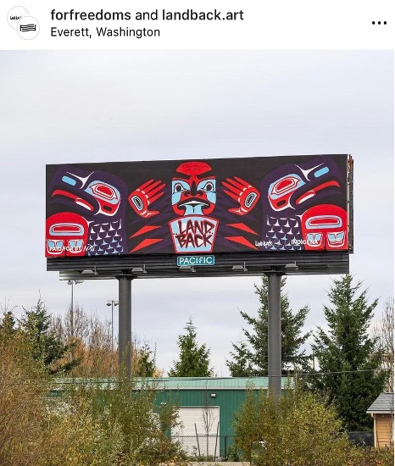
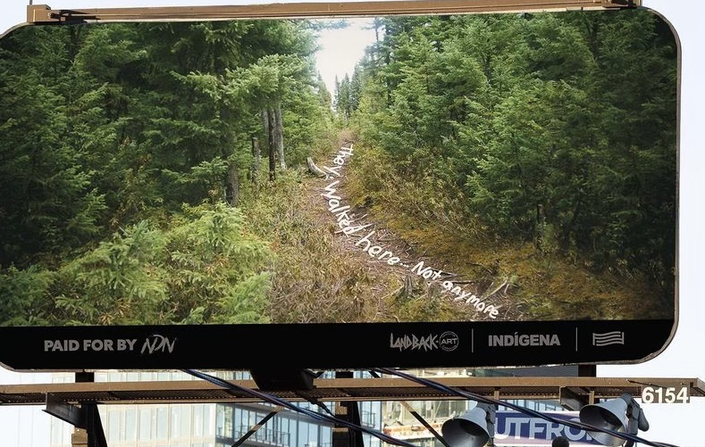
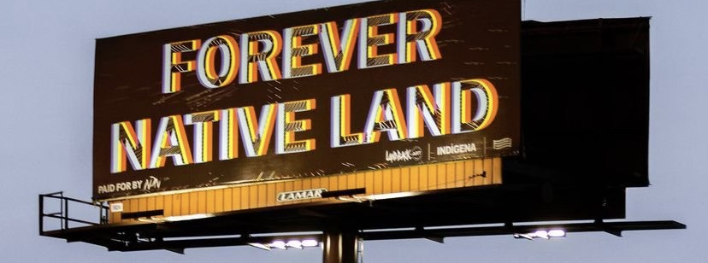
LANDBACK MOVEMENT
LANDBACK. Nick Tilsen, Rapid City
South Dakota. 2020-2021.
NDN COLLECTIVE
LANDBACK. Nahaan @chilkat_tattoo. Everett, Washington. 2020-2021.
LANDBACK. Zak Hajjaoui, Wendy Ewald, Eric Gottesman.
Ontario, Canada. 2020-2021
LANDBACK. X. from @forfreedoms. Harvey, Illinois. 2020-2021.
Notes:
In 2021, the NDN Collective launched the LANDBACK Campaign, in support of the LANDBACK movement, a movement dedicated to the returning of Indigenous land back to Indigenous Peoples. Included in the campaign was the initiative LANDBACK.ART, where over 20 Indigenous artists, community members, and allies, claimed billboards across North America with artwork dedicated to the LANDBACK movement. Artists were asked to answer the question: “What does ‘land back’ mean to you?” These temporary artworks were created to inspire the investment in Indigenous communities as well as the dismantling and defunding of systems perPETuating colonial violence. The NDN Collective’s mission is to “build the collective power of Indigenous Peoples, communities, and Nations to exercise [the] inherent right to self-determination, while fostering a world that is built on a foundation of justice and equity for all people and the planet.” LANDBACK.ART brought Indigenous narratives to the forefront of communities and is a strong example of the impact of the ephemeral.

Slide 11
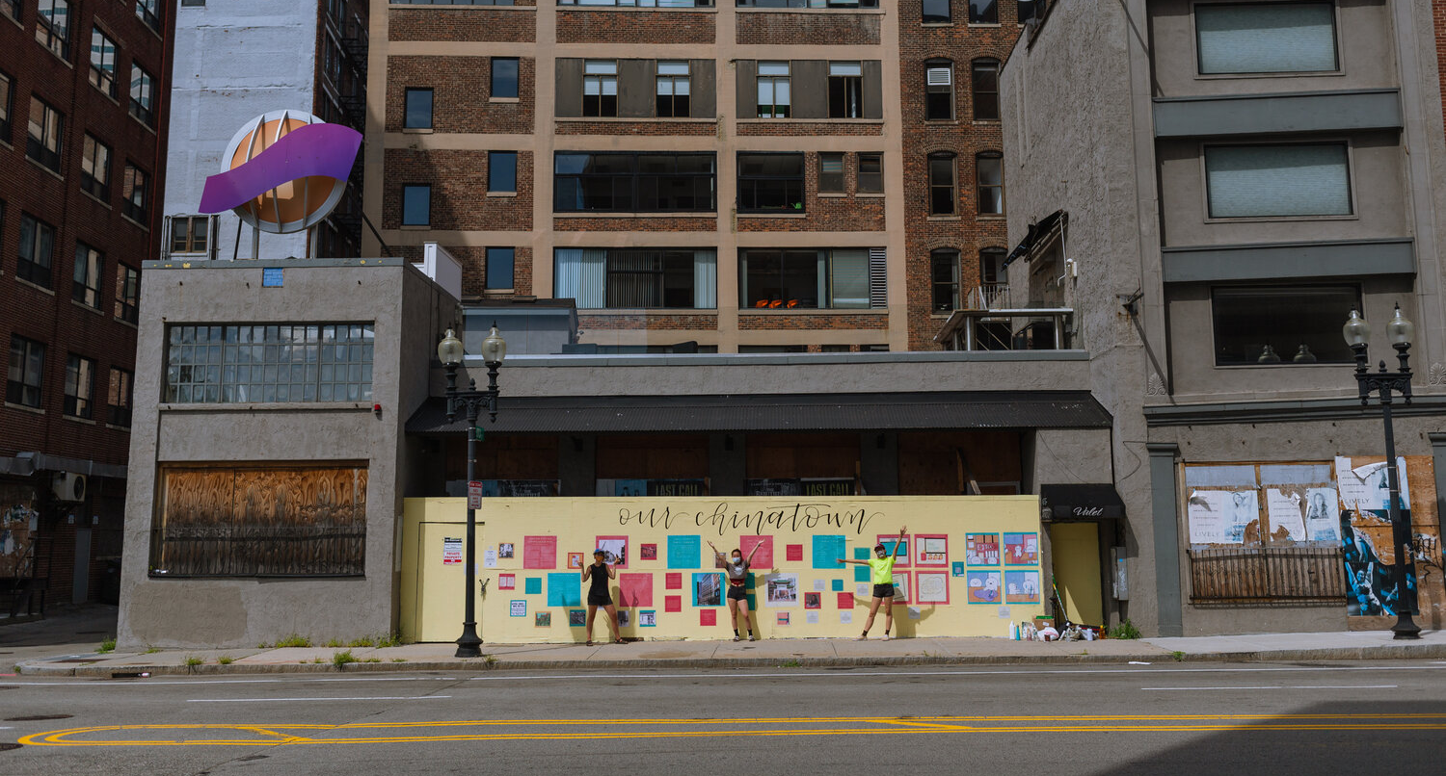
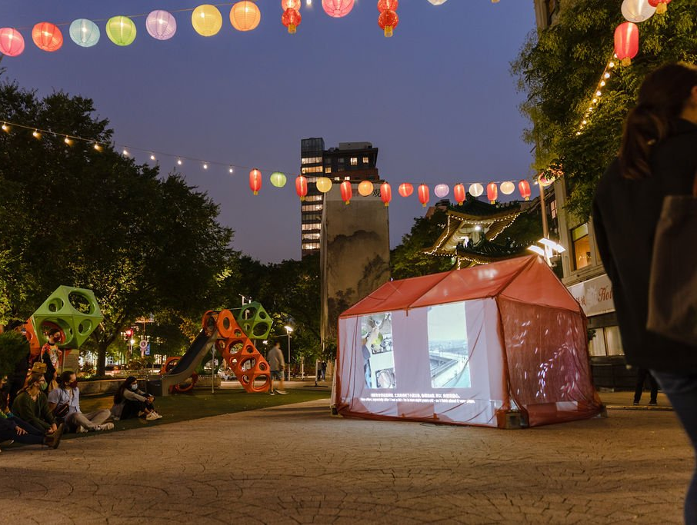
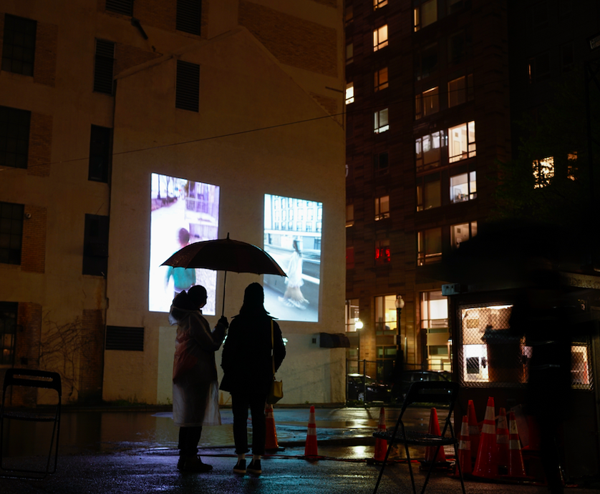
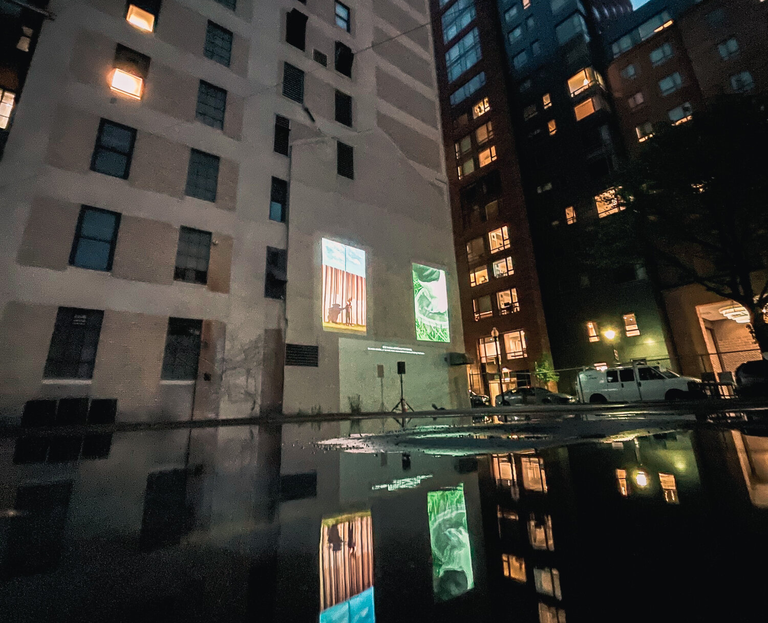
LILY XIE
“Chinatown Story Cart.” Chinatown, Boston. 2020.
“Washing.” Co-created with Chinatown resident-artists Maggie Chen, Charlene Huang, Chu Huang, and Dianyvet Serrano. Chinatown, Boston. 2021.
Notes:
Boston’s Artist-In-Residence, Lily Xie (SHEEUH), recently wrote how public art “offers an opportunity for communities pursuing spatial justice to shift the affective aspects of transformation and engage in the radical reimagination of how power is distributed in space.” Xie’s “Washing,” a temporary, public art installation co-created with Asian Community Development Corporation, projected onto the outside of a building wall, reflected the community’s viewpoints on the two highways that run through Boston’s Chinatown. In a 2022 interview with blog Urban Cultural Studies, the purpose of “Washing,” Xie explains, is “to tell the stories of how community power and systemic injustice have shaped Boston’s Chinatown” and to “support the community’s efforts to repair past spatial harms.” Xie’s hope with socially engaged public art is to grow [the] collective capacity to imagine and demand a better future.

Slide 12

CALL TO ACTION FOR ARTS ADMINS
Notes:
In her paper, Art, Repair, and Spatial Justice in Boston’s Chinatown and Seattle’s
International District, Xie (SHEEUH) points out a “growing overlap between the fields of urban planning, art, and social justice.” Considering this, arts administrators need to reconsider the “who” that is involved in public art decision-making processes. As a traditionally site-specific art realm, public art, when ephemeral, affords the artist the choice in where, the community members the choice in how, and the state of the community the choice in why.

Slide 13
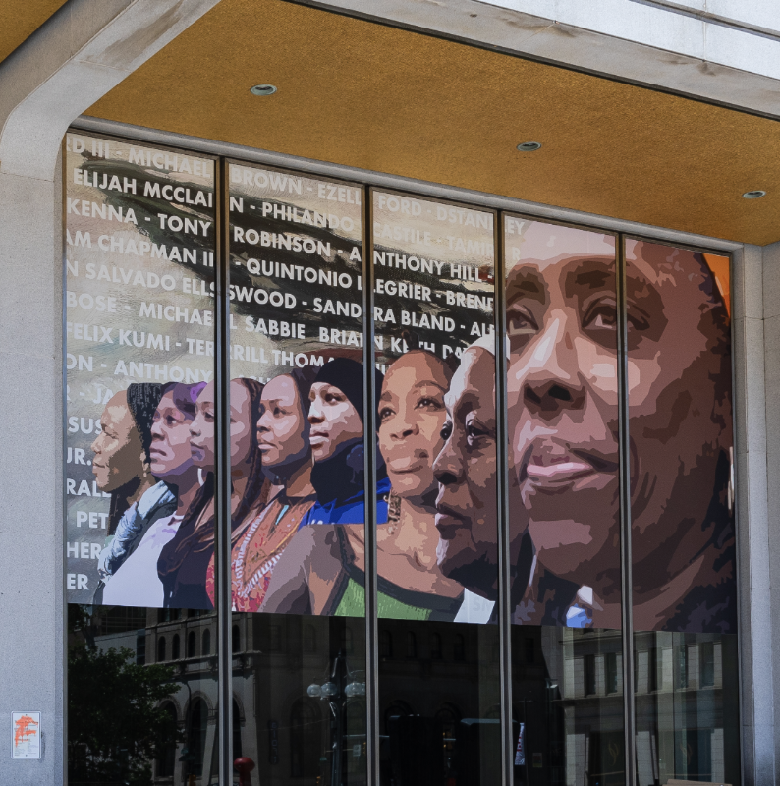
Crown: Freedom. Russell Craig, Philadelphia. 2021.
ELEVATE
Notes:
To call back Mi Casa Resiste, “real arts and culture representation start with those who are in the neighborhood.” Elevate your local artists! Ephemeral public art, when done well and with intentionality, benefit all involved – artist, administrator, and community.

Slide 14
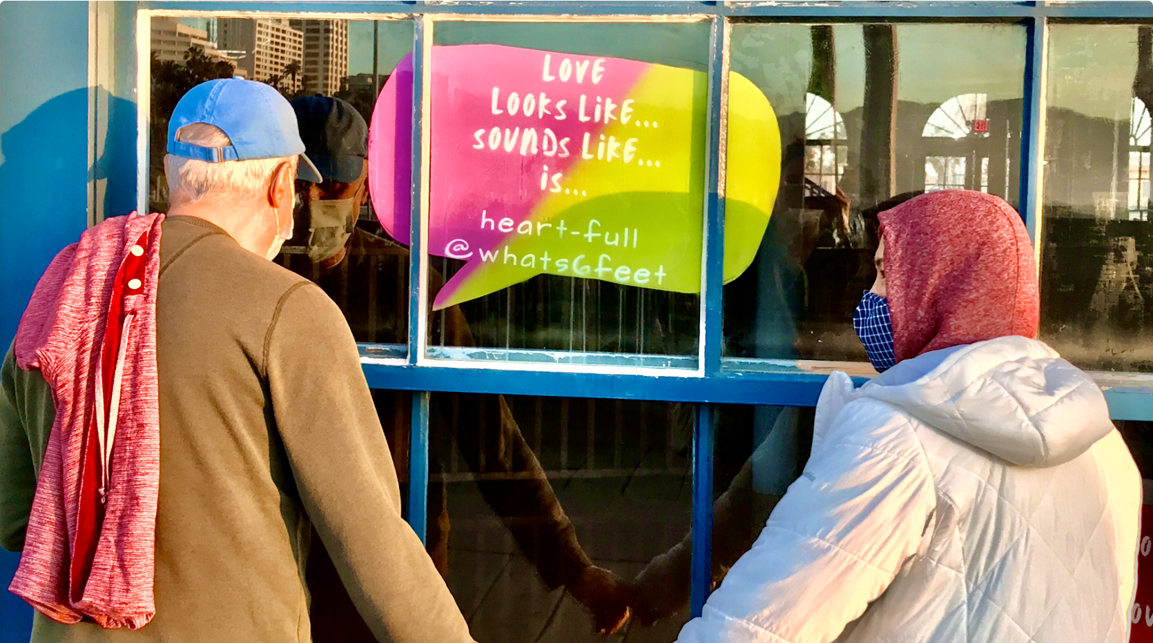
INTEGRATE
What’s 6 Feet? Marni Gittleman, Santa Monica. 2021.
Notes:
Public art administrators, specifically, need to look to and create new public models outside of the percent-for-art municipal model as well as integrate temporary public art into the established model to ensure consistent financing. By advocating and financially supporting temporary public art, communities are, in return, more supported. In addition to consistent, intentional funding for the ephemeral, administrators must be mindful of the artists they are commissioning into their communities.

Slide 15
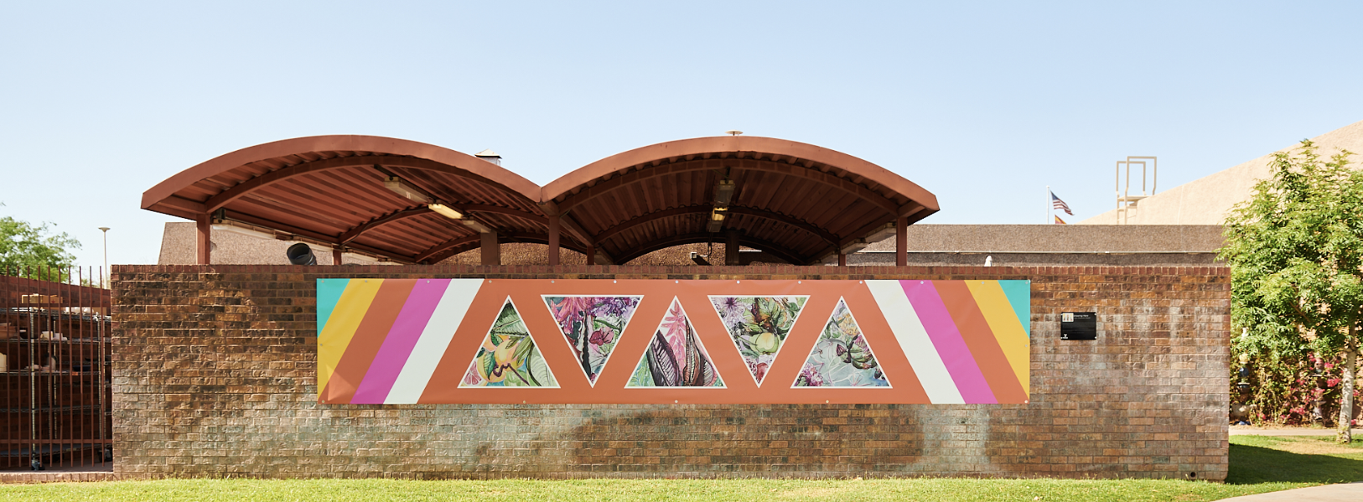
ADVOCATE
Growing Here. Koryn Woodward Wasson, Tempe. 2021.
Notes:
Temporary public art has the capacity to utilize public space in fuller and more intentional ways than permanent public art because the essence of the ephemeral is more aligned with the community- and justice-centered. The New England Foundation for the Arts (NEFA) reminds us of context of a space: “context is important [because] public spaces are not neutral... public art made in public spaces is not neutral.” Administrators must address what NEFA identifies as “the intersectionality of spatial justice and racial justice” because “it is critical to cultivating a more vibrant public art ecosystem.” Aligning ourselves with projects that what Xie (SHEEUH) explains as “seek[ing] to bring about changes that redistribute socially valued resources and opportunities, especially among racial and spatial lines” resets our communities and positions them to be economically, culturally, structurally, and socially thriving.

Slide 16
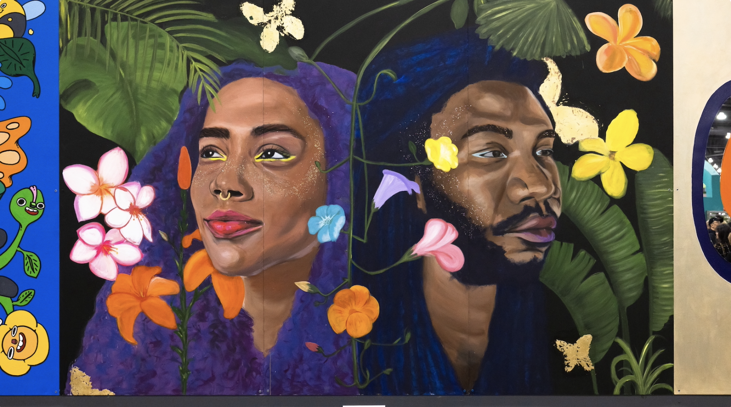
Mural Magic. Donna Grace Kroh, Michele Scott, irregular, WET. Philadelphia, 2023.
Notes:
Penny Balkin Bach calls public art “a part of our public history, part of our evolving culture and our collective memory.” It is essential for arts administrators to consider how space, the projects that inhabit public space, and how communities engage with space are used to reconcile this “holy trinity.” Public history, evolving culture, collective memory, it is critical for an artist to consider the time spent within these realms and how the timeliness of their project benefits from the overall process of their creation.
The ephemeral opens space to be more equitable and helps to dissolve competition and hierarchy. Temporary public art provides non-hierarchical space and structure for communities to reflect on urgent issues and how these issues are shaping their identities and informing their futures. The ephemeral keeps public art relevant and reciprocal, and attempts to right the wrongs that fixed-art structures have caused in communities, especially the vulnerable ones.
In J. Faith Almiron’s 2021 article “Why We Need Unconventional Public Art Now More Than Ever,” Almiron remind us, “In the same way that a melody can fill a subway car with joy or sorrow, public art can crack open a callous heart, in live time. Even if it is a fleeting moment of shared laughter, public art reminds us that maybe we are in this thing called life, together, after all.”

Slide 17
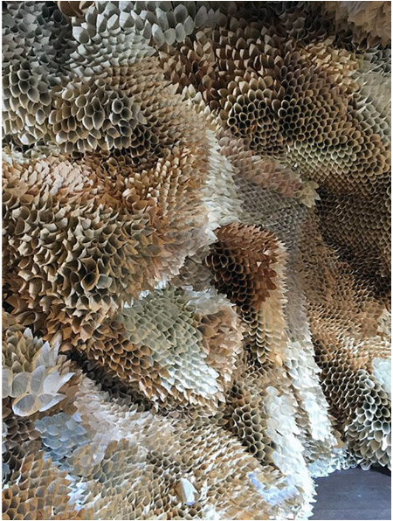
“Nothing is permanent.
Everything is subject to change.
Being is always becoming.”
~ Siddhartha Gautama
(The Buddha)
Paper Caves. Samuelle Green, Pennsylvania. 2019.

