Slide 1



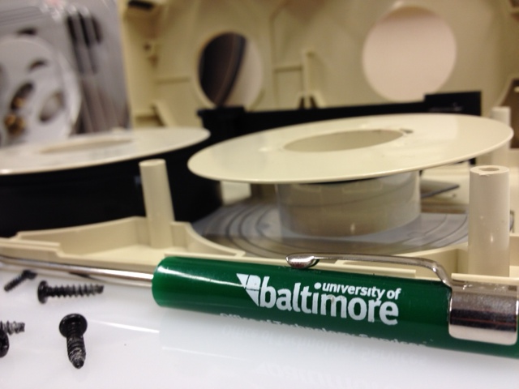

Initiating Video Preservation
<<Siobhan C. Hagan/Audiovisual Archivist
University of Baltimore/Langsdale Library/Special Collections

Slide 2


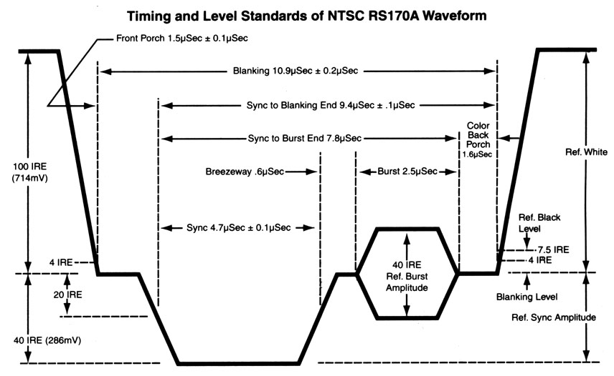
Video.
1956
Magnetic particles
Immediate viewing
Erase and reuse
Photo: videointerchange.com
Photo: bealecorner.com

Slide 3
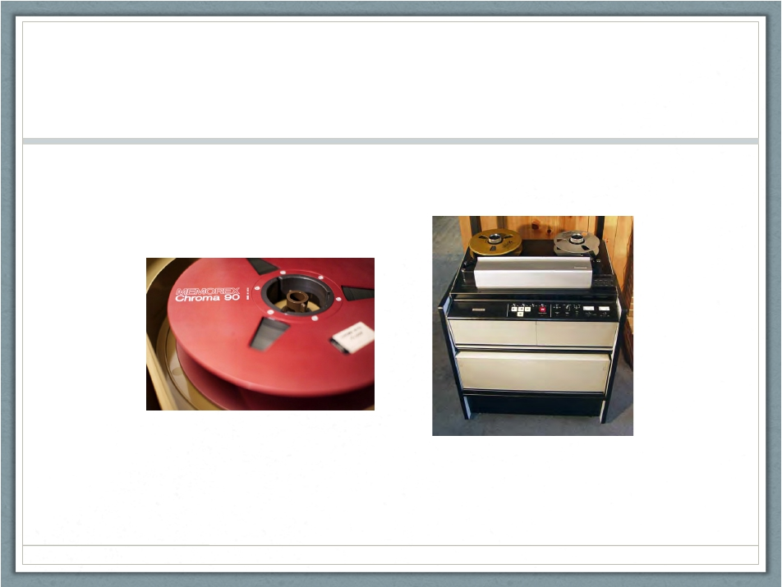

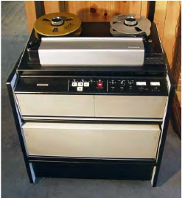
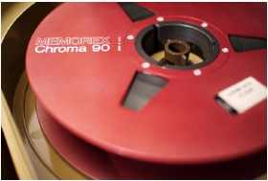
2” Quad Open Reel Video
1956
Photo: Robert Rex Jackson
Photo: videointerchange.com
Notes:
1956

Slide 4
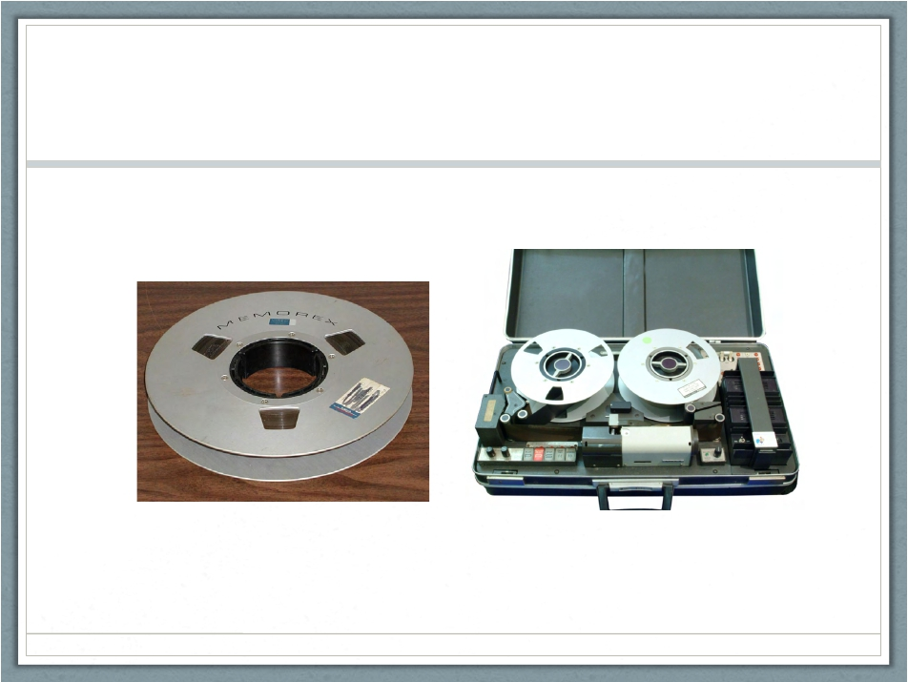

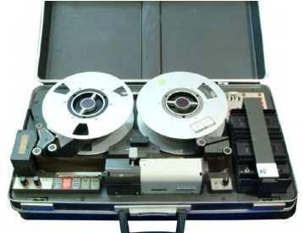
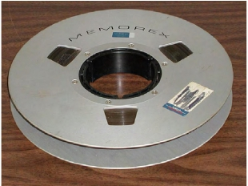
1” Open Reel Video
1978 (Type C)
Photo: labguysworld.com
Photo: Wikipedia
Notes:
Type c

Slide 5
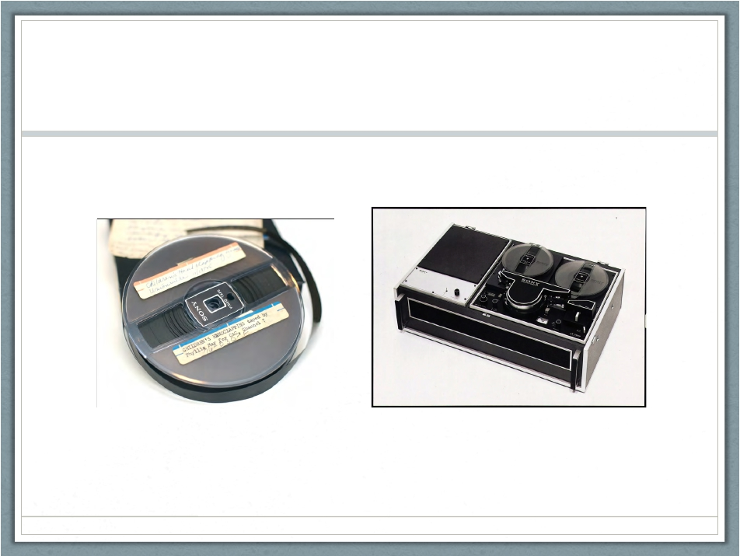

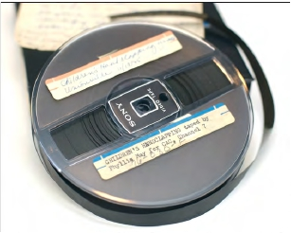
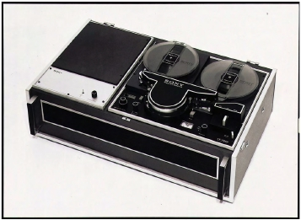
½ inch Open Reel Video
1965
Photo: Sony.net
Photo: Indiana University - Bloomington
Notes:
1965

Slide 6
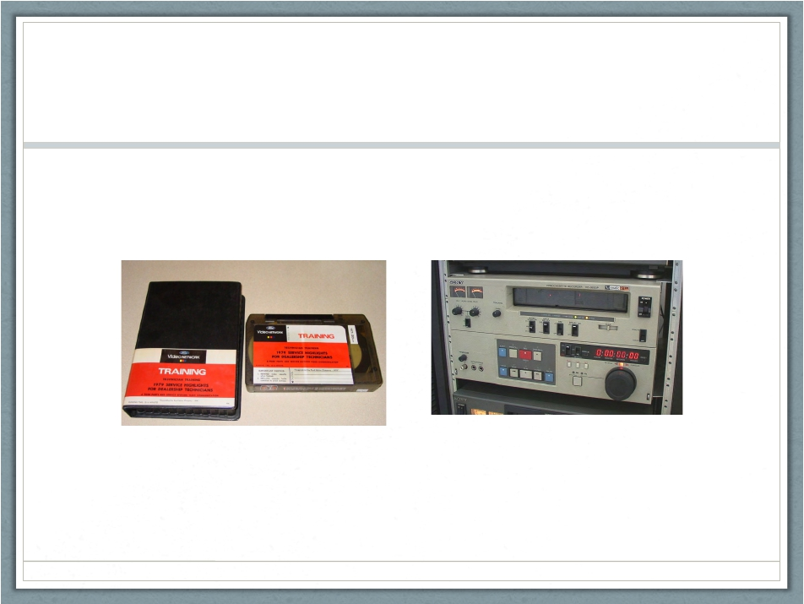

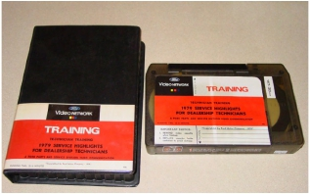
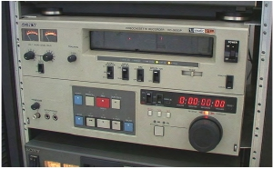
¾ inch U-Matic (SP)
1971
Photos: Preservingvideo.blogspot.com
Notes:
1971

Slide 7
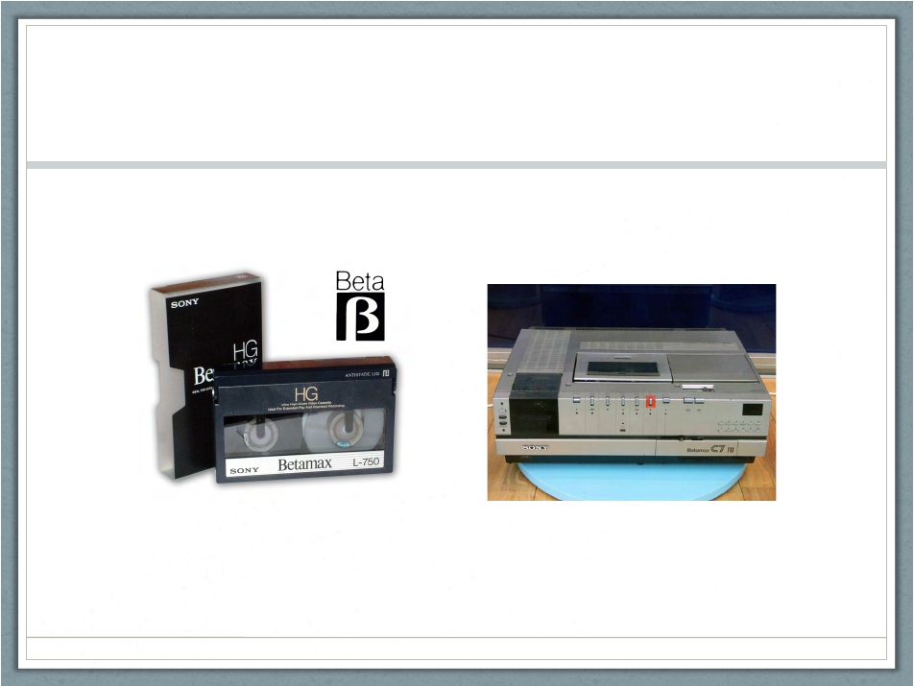

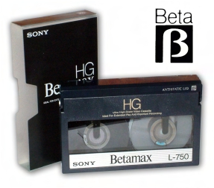
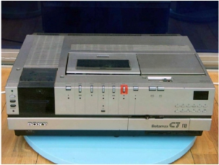
Betamax
1975
Photo: Simplydv.biz
Photo: Ibenimagaes.com
Notes:
1975

Slide 8
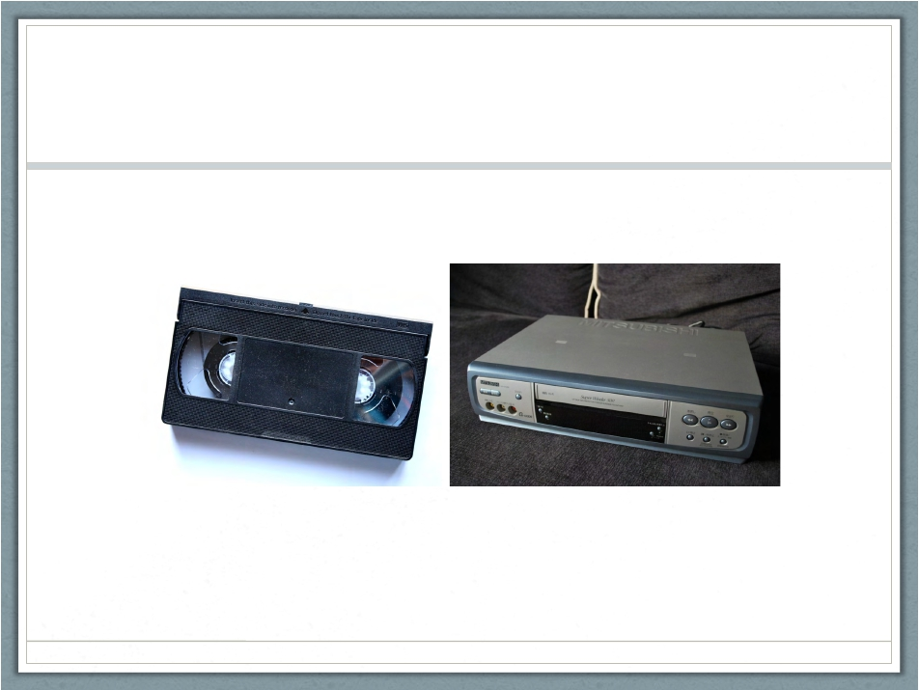

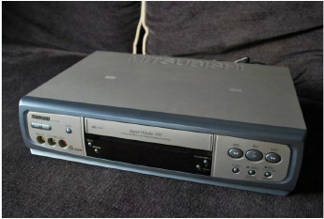
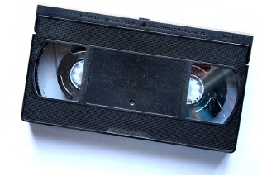
(S-)VHS
1976
Photo: Photos-public-domain.com
Photo: Themovethemove.wordpress.com
Notes:
1976

Slide 9
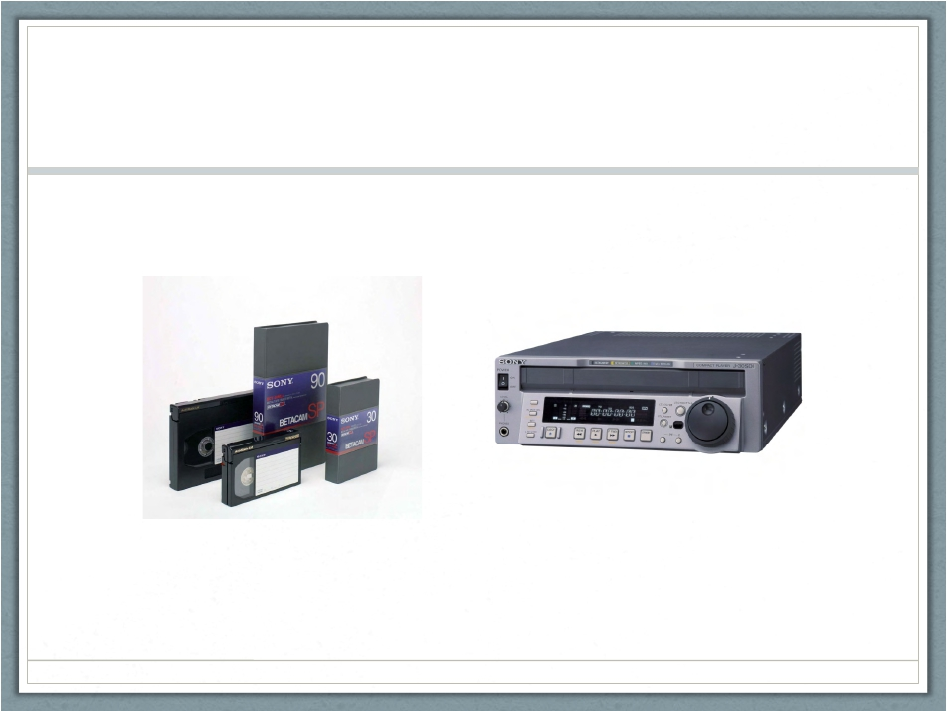
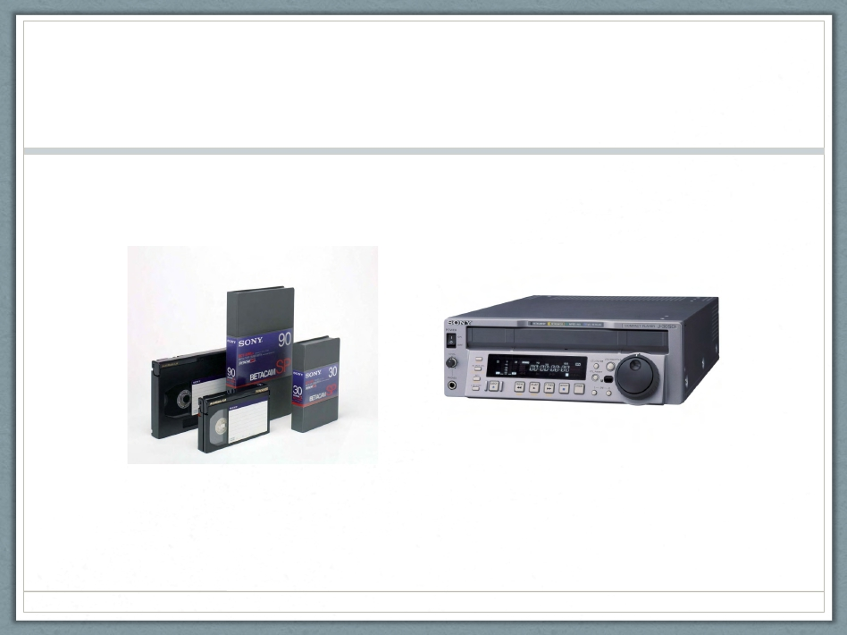
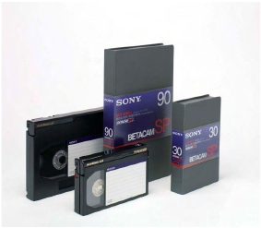
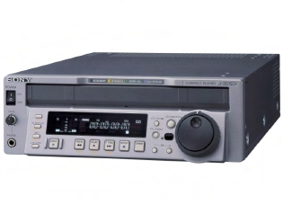
Betacam (SP)
1982
Photo: Datastores.co.uk
Photo: verrents.com
Notes:
1982

Slide 10
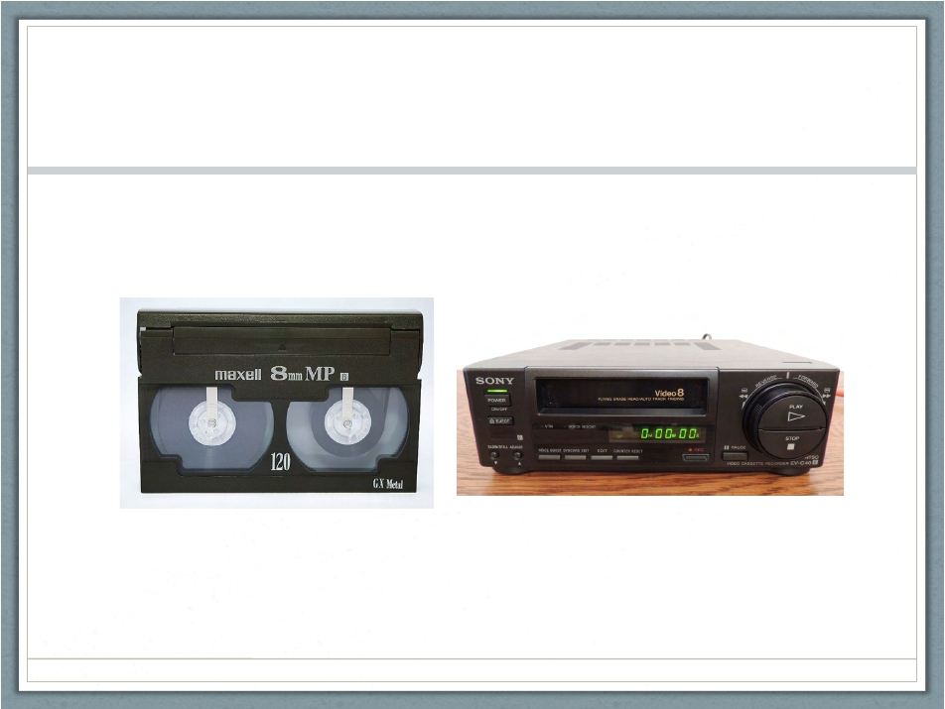

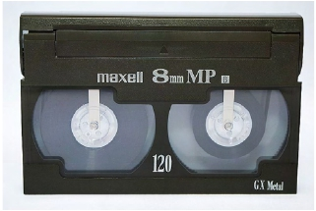
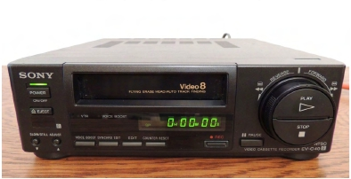
Video8
1984
Photo: Wikipedia
Photo: Ebay
Notes:
1984

Slide 11
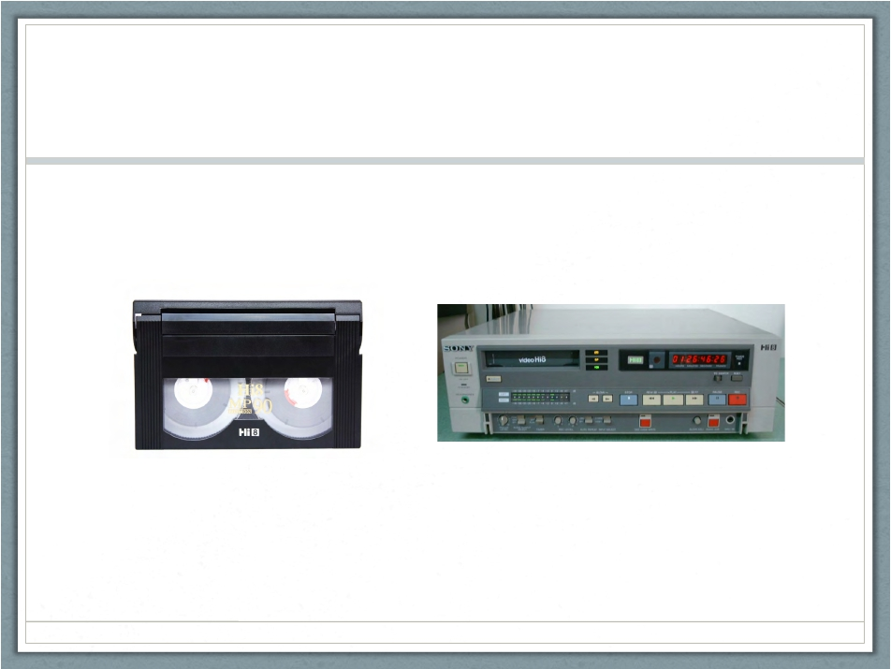

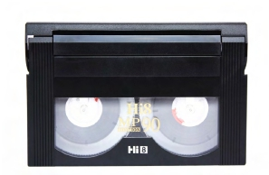
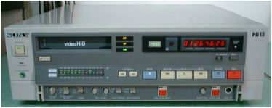
Hi8
1989
Photo: Amazon.com
Photo: Ebay
Notes:
1989

Slide 12
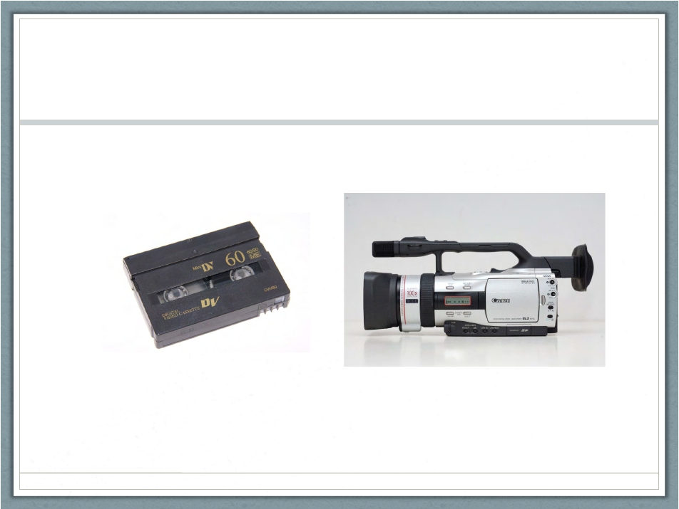
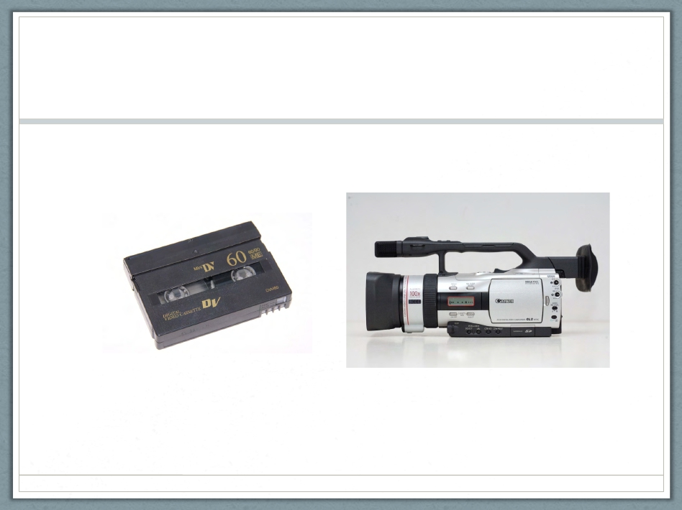
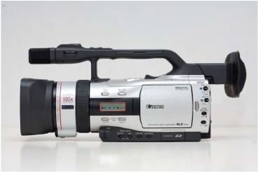
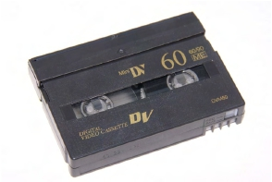
MiniDV
1995
Photo: dvdyourmemories.com
Photo: Bladeforums.com
Notes:
1995

Slide 13
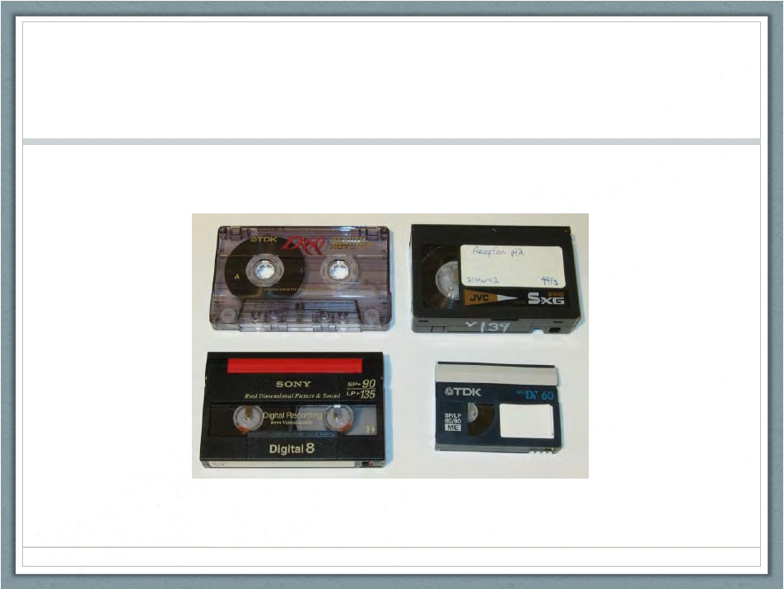

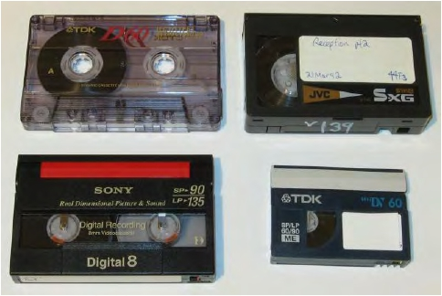
Digital8
1999
Photo: Cameratim.com
Notes:
1999

Slide 14
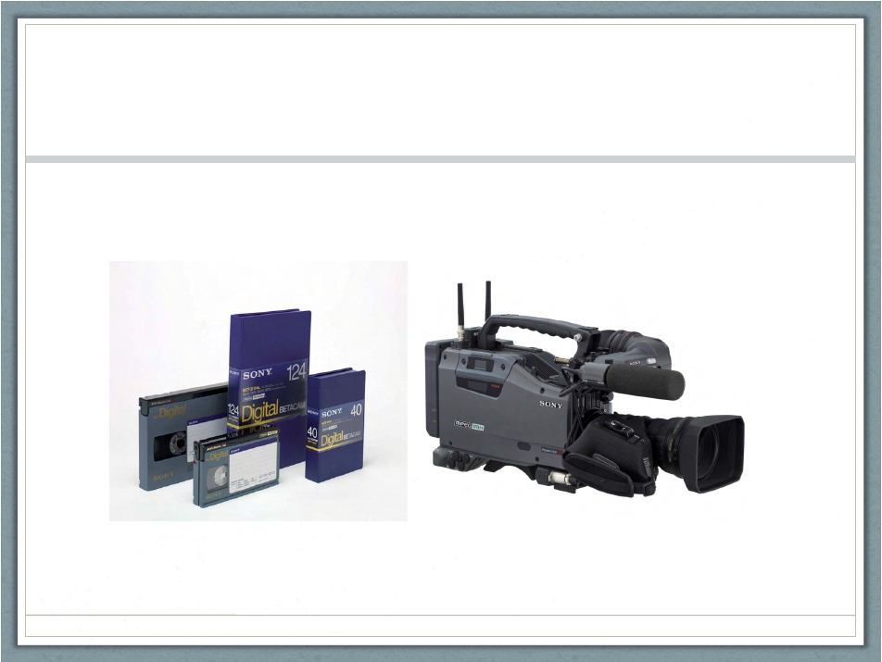

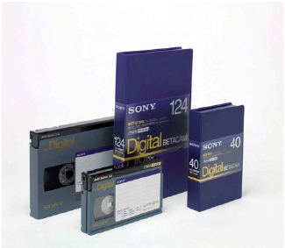
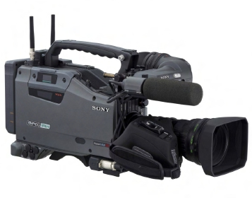
Digital Betacam (Digibeta)
1993
Photo: Professionalmedia.hu
Photo: Highwayhv.com
Notes:
1993

Slide 15
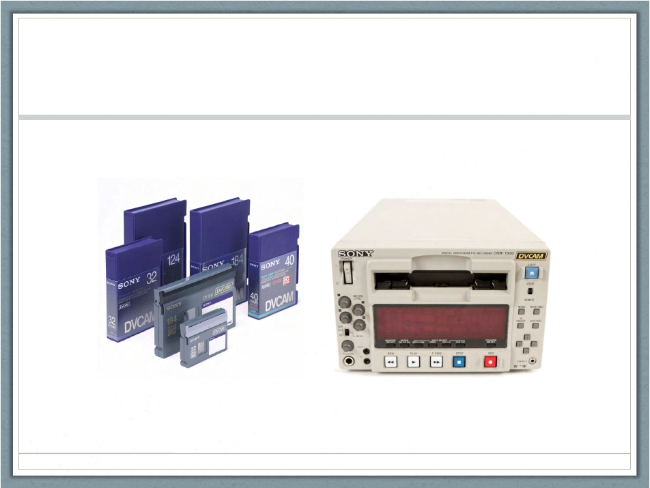
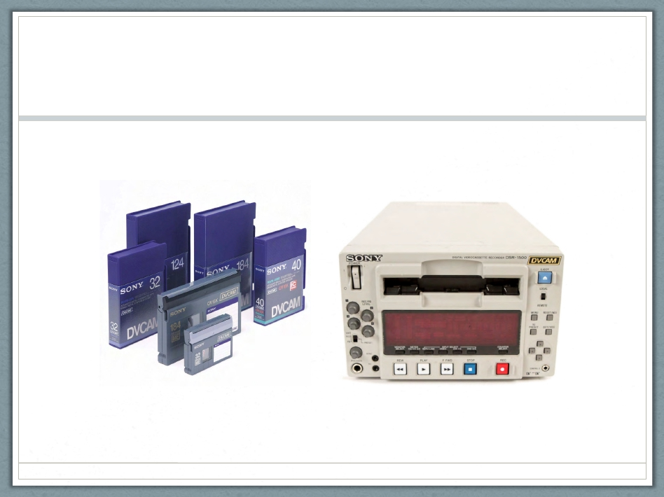
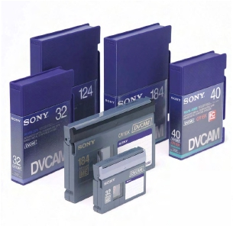
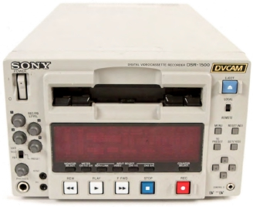
DVCAM
1995
Photo: Professioalmedia.hu
Photo: Alan Gordon
Notes:
1995

Slide 16
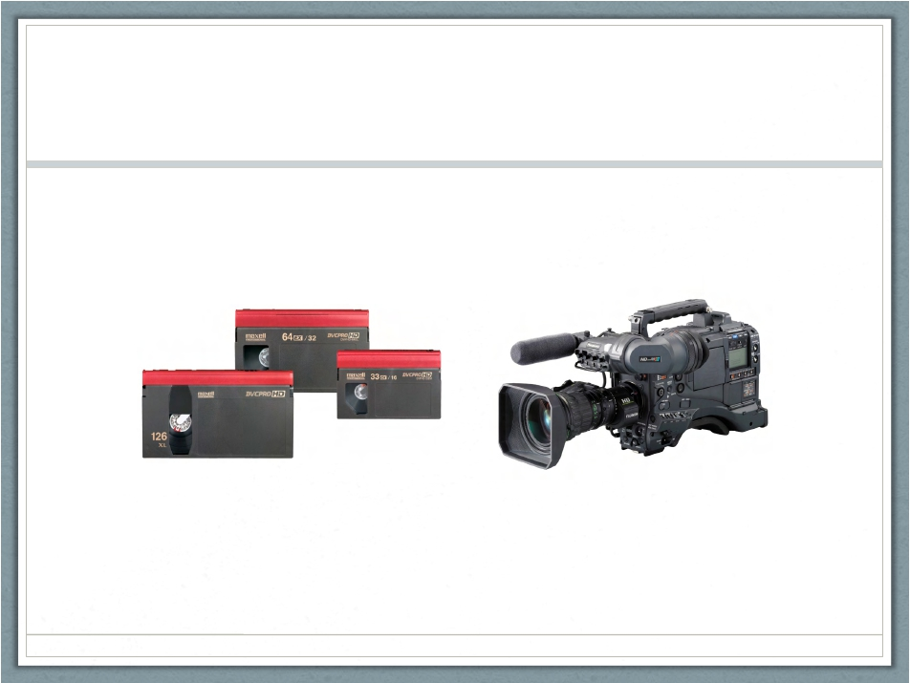

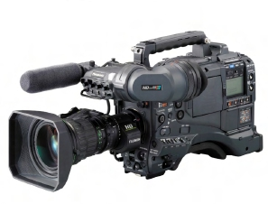
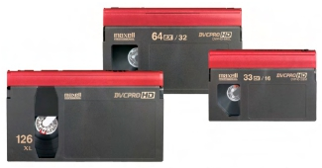
DVCPRO
1995
Photo: Geniusdv.com
Photo: Creativeplanetnetwork.com
Notes:
1995

Slide 17
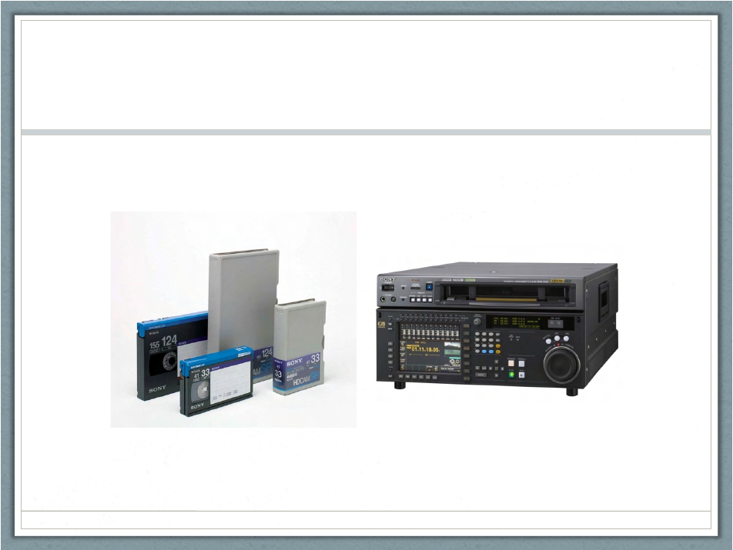
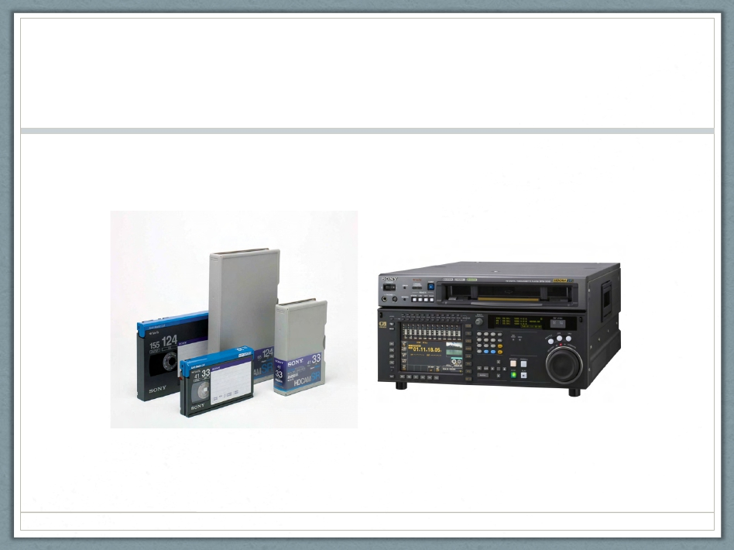
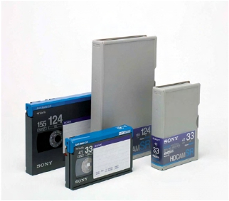
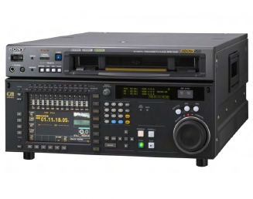
HDCAM (SR)
1997
Photo: Professionalmedia.hu
Photo: Creativeplanetnetwork.com
Notes:
1997

Slide 18


Preservation Issues
Obsolescence + degradation = degralescence
1. Mold
2. Sticky Shed Syndrome
Photo: Video Recovery and Restoration
Photo: www.thegreatbear.net

Slide 19

Video Best Practices
Store Vertically for Video
High quality digitization
Digital preservation
Photo: www.governmentnews.com

Slide 20
Info Gathering: Minimum
Box-ish level
1. ~# of each format
2. Date range
3. Proper storage orientation
4. Degradation red flags

Slide 21
AV@UB
U-matic(SP): 13,300 (1977-1992)
(S)VHS: 5,400 (1990-2000)
Betacam(SP): 1,600 (1988-2000)
16mm film reels: 4,000 (1948-1981)
2” Quad carts: 700 (no dates)
2” Quad reels: 300 (1962-1984)
5 reels w/ mold
1” video reels: 75 (1981-1987)

Slide 22

AV@UB
U-matic(SP): 13,300
(S)VHS: 5,400
Betacam(SP): 1,600
16mm film reels: 4,000
2” Quad carts: 700
2” Quad reels: 300
1” video reels: 75

Slide 23
AV@UB
Expected problem with U-matic(SP):
1. Sticky Shed Syndrome (SSS)
Unexpected problems with U-matic(SP):
1. Glue residue
2. Tape→leader splices breaking

Slide 24


AV@UB
U-matic(SP): Glue residue

Slide 25

AV@UB
U-matic(SP): Tape→leader splices breaking

Slide 26

Problem Solving
U-matic(SP): Sticky Shed Syndrome
1. Save for baking
2. Critical mass→In-house
Photo:www.fishersci.com

Slide 27

Problem Solving
U-matic(SP): Glue residue
1. Cleaner
Photo: https://github.com/epiil/open-cleaner

Slide 28

Problem Solving
U-matic(SP): Tape→leader splices breaking
1. Documentation
2. Interns!
Photo:
www.flickr.com
Notes:
https://www.flickr.com/photos/ubarchives/sets/72157646823472698/

Slide 29
Thank you!
<<Siobhan C. Hagan/Audiovisual Archivist
University of Baltimore/Langsdale Library/Special Collections
@AV_DiscoTech
AVatUB.tumblr.com
Archive.org/details/ublangsdale

