Slide 1
Physical Activity and Weight Loss during the Postpartum Period
Kami Bennett, Jaime R. Deluca, Nicolas D. Knuth
Towson University, Towson, MD.

Slide 2
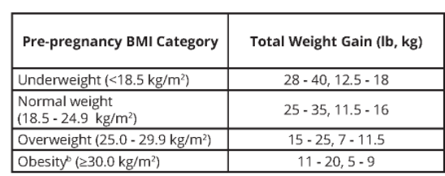
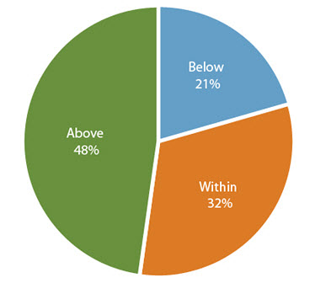
Weight Gain during Pregnancy
Recommended Weight Gain
Percentage Meeting Recommendation
2009 Institute of Medicine Report
2015 National Vital Statistics System Birth Data. CDC

Slide 3
Postpartum Weight Retention and Obesity Risk
Many women have a difficult time returning to their pre-pregnancy weight after child birth.
    6 months after childbirth, most women are at least over 10 pounds heavier then pre-pregnancy weight
    On average women gain 2-5 lbs. per pregnancy
Postpartum Weight Retention
Obesity
Cardiovascular
Disease
Complications in
future pregnancies
Diabetes
Maturi et al., 2011, BMC Pregnancy and Childbirth

Slide 4
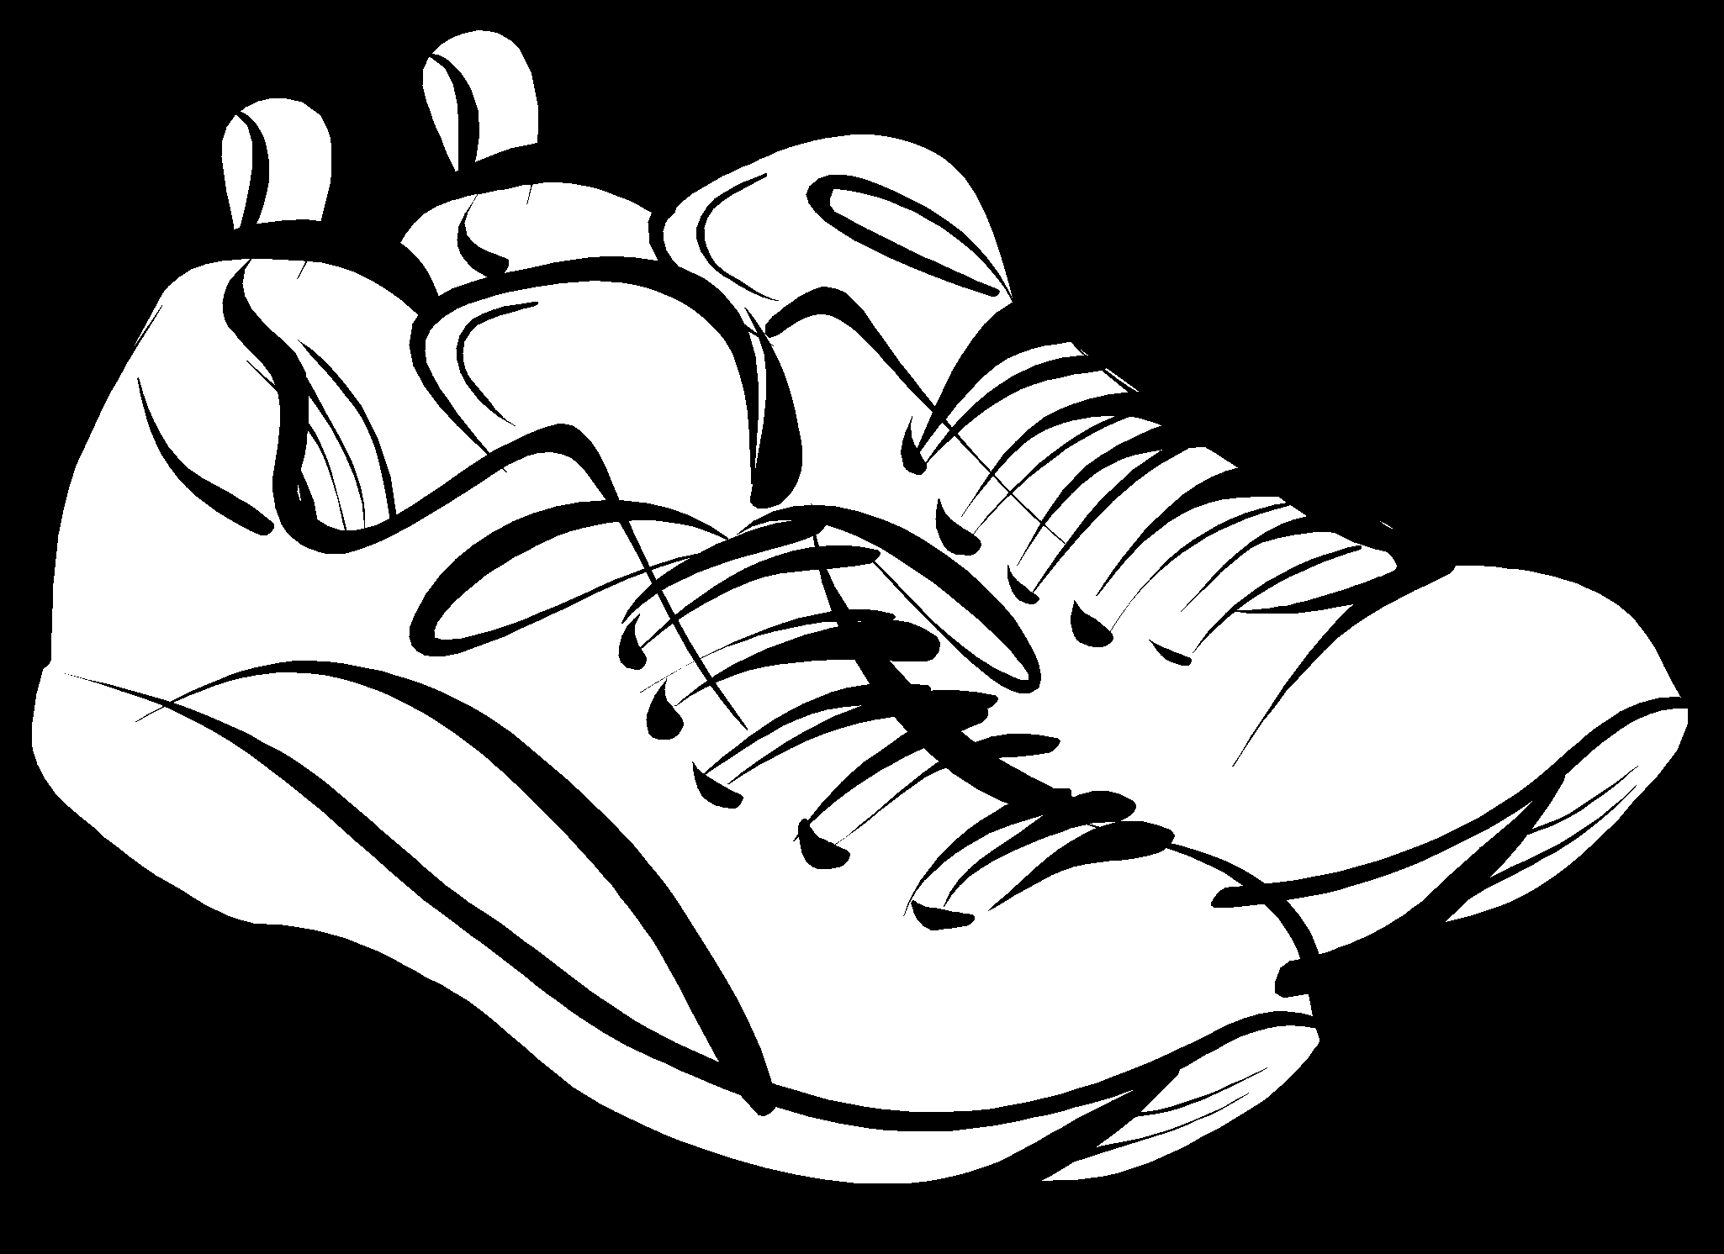



Physical Activity and Weight Loss
Physical activity is an important factor in developing and maintaining a healthy lifestyle, and may help women retain less pregnancy weight
Most postpartum mothers do not achieve the current PA recommendations¹, due to lack of time and childcare, fatigue, or depressive symptoms
¹ Dipietro et al., 2019, American College of Sports Medicine

Slide 5
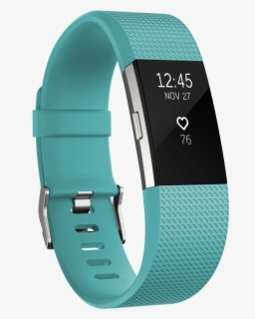

Physical Activity and Intensity
Traditionally, PA has been assessed by survey or self-report log
Accelerometers allow objective measure of PA:
  Amount (e.g. steps per day)
  Intensity (time spent at varying intensities)
Accelerometers may encourage participants to reach PA guidelines and achieve a higher rate of weight loss (Nascimento et al., 2014, International Journal of Obesity)

Slide 6
Body Mass Index
Some studies have suggested that women’s weight retention post childbirth is in part dependent on BMI
Variability was greatest in women with higher BMIs
Otsbye et al., 2012, Journal of Women’s Health

Slide 7
Purpose
To examine postpartum women’s daily PA (both amount and intensity) and its relationship with weight loss and body mass index.

Slide 8
Design
Recruited Postpartum women between 28 – 40 years old
First visit occurred 6-12 weeks after delivery
Returned for additional visits at 6, 9, and 12 months post delivery
Notes:
Recruited women through word of mouth, online mom groups, and a few local OBGYN clinics.
After first visit women were split into 2 groups (intervention or control) which is discussed on next slide.

Slide 9
Methods
Intervention Group (19 Participants) | Control Group (18 Participants)
10,000 steps per day and 150 minutes of moderate to vigorous physical activity per week | Instructed to go about their normal routines
All the participants were given a Fitbit accelerometer
At each visit, body weight and height were measured
Notes:
All participants asked to wear the device for the duration of the study to assess daily step count and minutes and intensity of activity.

Slide 10
Fitbase
Fitbase allowed us generate our data set of PA activity and intensity
Date/Day # | Heart Rate | Total Steps Taken | Minutes Spent in Very Active PA | Minutes Spent in Fairly Active PA | Minutes Spent in Lightly Active PA | Minutes Spent in Sedentary Activity

Slide 11
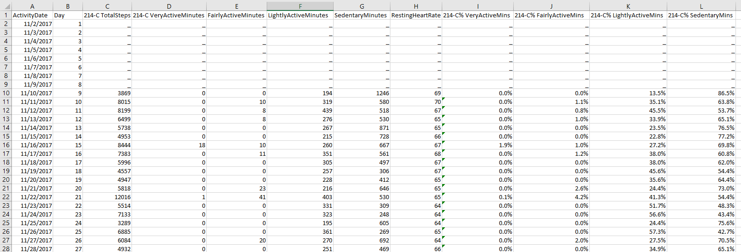
Data
Notes:
Pictured above is one participant’s data that was retrieved from fitbase and entered into an excel spreadsheet.
Each participant had close to 11 months worth or data. Took out days a participant had no HR and days a participant took less than 4000 steps.
Mainly focused on steps taken per day and calculated the percent of sedentary minutes each person spent per day.

Slide 12
Subjects
35 women had suitable Fitbit data*
Women were separated into two groups based on BMI at initial visit (normal vs. overweight/obese)
 | Normal BMI | Ov./Ob. BMI
Number | 17 | 18
Intervention | 10 | 9
Control | 7 | 9
Within each group, calculated the daily average steps and percent time at intensity from initial visit to last visit
  Day was included if data from >50% of women was available
Notes:
*Some of the women in the control group didn’t wear their Fitbits very much.

Slide 13
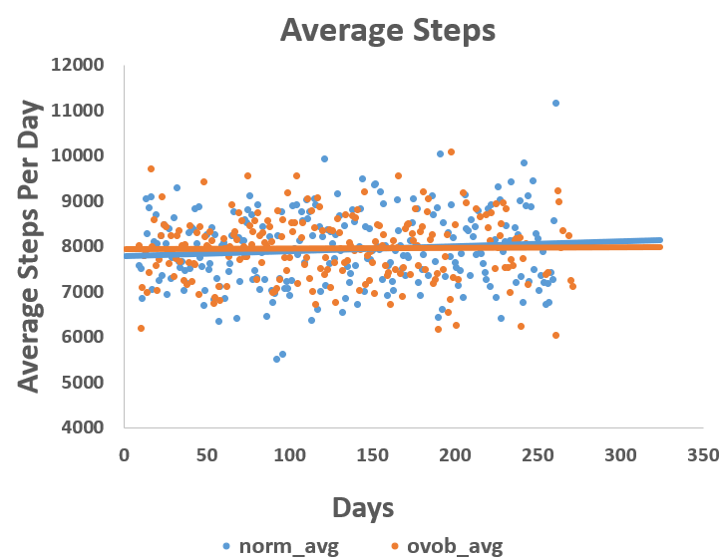
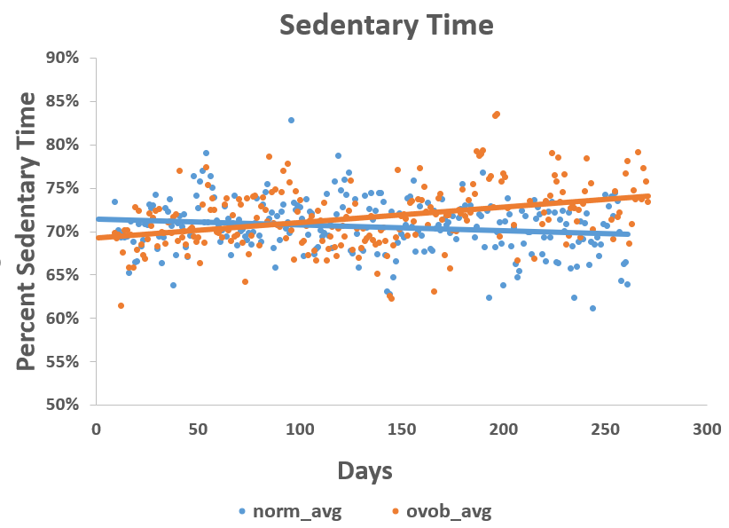
Results

Slide 14
Next Steps
Look into other intensity levels
Adding in weight change at each visit
Run longitudinal regression analysis to determine if daily PA and BMI influenced weight loss
Possibly look at body composition

Slide 15

Acknowledgements
College of Health Professions Special Project Funding and Summer Undergraduate Research Institute
Towson University Wellness Center
Participants

