Slide 1
Altmetrics
CAS Scholarship Day
March 24, 2015
Betty Landesman
Head of Technical Services
and Content Management
Langsdale Library

Slide 2
Bibliometrics
Quantitative techniques for measuring scholarly impact
Citation counts
Journal impact factor (Eugene Garfield [Science Citation Index],1955)
h-index (Web of Science, 1982)

Slide 3
Altmetrics
“Alternative” to bibliometrics
Use of new, different types of data to measure impact/quality
Article pageviews
Number of downloads
Social media and article sharing indicators of impact

Slide 4
PLoS
“Altmetrics is the study and use of non-traditional scholarly impact measures that are based on activity in web-based environments. As scholarship increasingly moves online, these metrics track associated interactions and activity to generate fine-grained data, allowing researchers and policy makers to create a higher resolution picture of the reach and impact of academic research.”

Slide 5
Newer Measures of Citation-Based Metrics (1)
Google Scholar Citations
Authors create profiles to track citation data such as h-index
Google Scholar Metrics
http://scholar.google.com/intl/en/scholar/citations.html

Slide 6
Newer Measures of Citation-Based Metrics (2)
Web of Knowledge and Scopus provide citation counts for articles they index
SCImago – runs on Scopus data
SCImago Journal Rank (SJR)
Source Normalized Impact per Paper (SNIP)
http://www.SCImagojr.com

Slide 7
PLoS Article Level Metrics
Track influence of individual articles – times downloaded, mentions in social media and blogs
Also tracks internal metrics (comments, notes, ratings)
Only PLoS articles
http://article-level-metrics.PLoS.org/

Slide 8
Altmetrics.org
Defines altmetrics as “the creation and study of new metrics based on the Social Web for analyzing and informing scholarship.”
“Manifesto” by Jason Priem (coined term as graduate student in a 2010 tweet)
No one can read everything
Main filters (peer review, citation counting, journal impact factor) failing
Articles joined by datasets, blogs, tags

Slide 9
Scholarly Peer Networks (1)
Academia.edu (http://www.academia.edu) – free online paper-sharing platform
Mendeley (http://www.mendeley.com) - free reference manager and academic social network
Social Science Research Network (SSRN) (http://www.ssrn.com) – online article repository

Slide 10
Scholarly Peer Networks (2)
VIVO (http://vivoweb.org) – free downloadable web application to make connections between researchers through uploading data from faculty profiles
ResearchGate (www.researchgate.net) – to allow researchers to collaborate, share and access scientific information

Slide 11
Commercial Tools
Plum Analytics/PlumX (www.plumanalytics.com) – metrics = usage, captures, mentions, social media, citations, correlated at group level
Altmetric.com - have developed apps that demonstrate how altmetric data can enhance bibliometric data through integration with Scopus and other websites

Slide 12
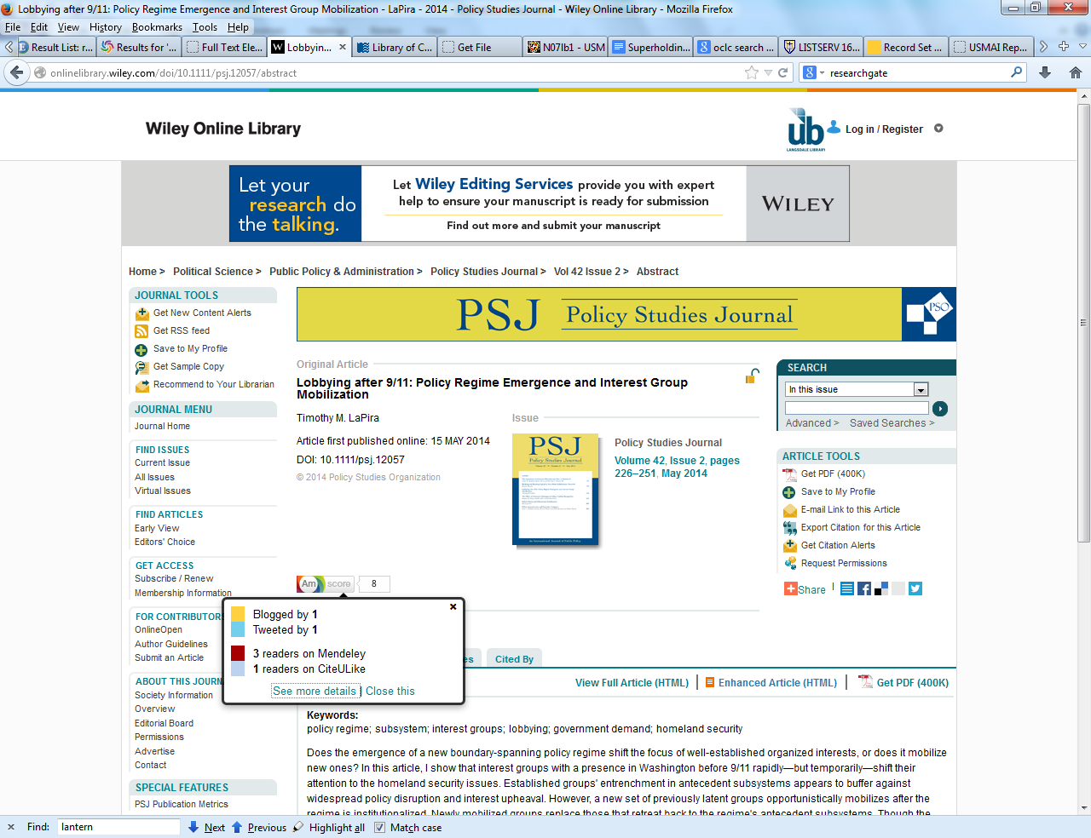

Slide 13
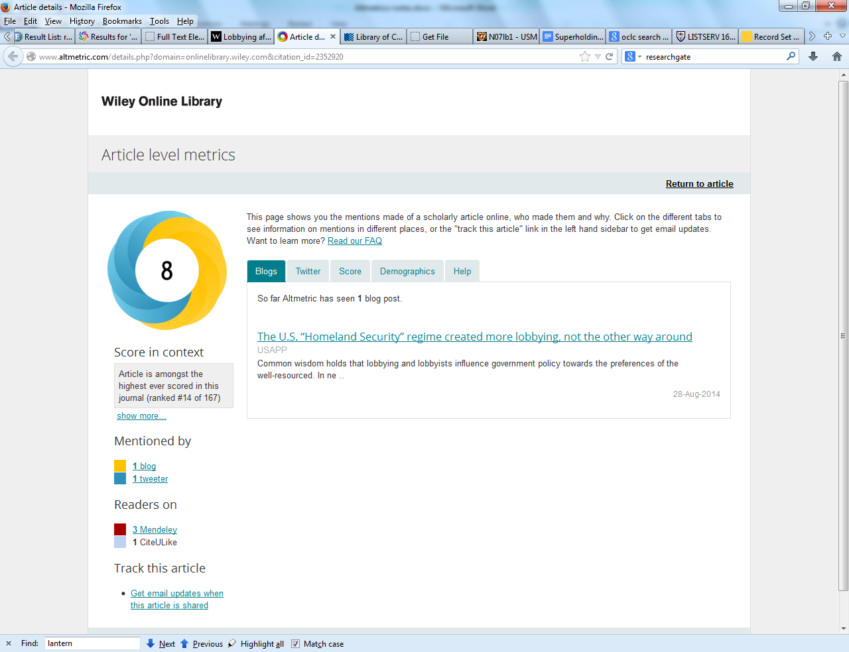

Slide 14
Still Questions
Can the system be “gamed”?
Do views and tweets correlate to times cited?
Demand for quantitative evidence of impact across the disciplines; potential not yet realized

Slide 15
Howard, Jennifer. “Rise of ‘Altmetrics’ Revives Questions About How to Measure the Impact of Research.” Chronicle of Higher Education. Last modified June 3, 2013. http://chronicle.com/article/Rise-of-Altmetrics-Revives/139557 - Prof. Stephen B. Roberts’ tenure package included both peer-reviewed articles and evidence of his research's impact online

Slide 16
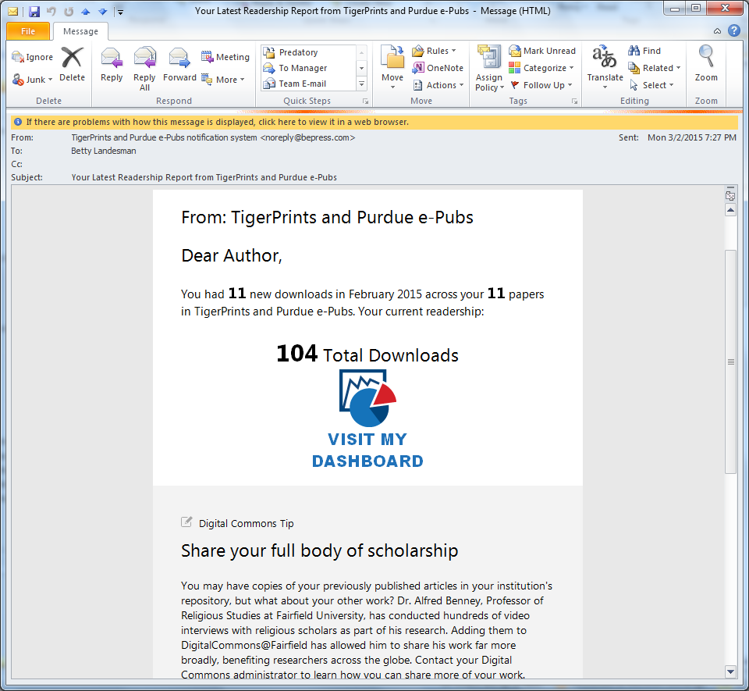

Slide 17
