Slide 1

Picking research topics
Used without permission, https://i.pinimg.com/originals/4a/59/0a/4a590a89928c88a27c63dd5b18556903.jpg

Slide 2
Research methods
Ecological momentary assessment (daily diary data collection)
Three-round Delphi design
Environmental scan and document review
Budget data analysis
Critical incident technique
Critical constructivist approach infused with narrative inquiry practices
Autoethnographic approach
Ethnographic
Focus groups
Mixed methods--focus groups and surveys
One-on-one interviews with 20 directors
Text analysis/coding
Mixed methods--interviews and surveys (co-orientation model)
Network analysis
Case study and interviews
Literature review
Environmental scan, survey, focus groups, interviews, staff retreat

Slide 3

Project examples
Mixed methods:
Website reviews
In-person observation
Structured interviews

Slide 4
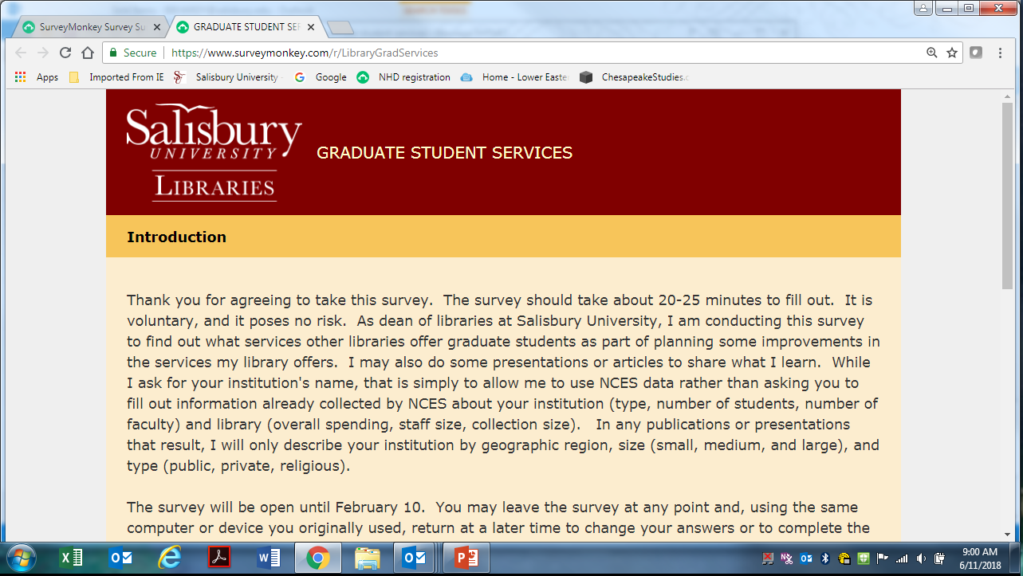

Slide 5
Doing Surveys: Issues to Consider
Where and how to create the survey: Qualtrics (Survey Monkey is going away)
http://www.salisbury.edu/instructionaldesign/software/Qualtrics.html

Slide 6

Doing Surveys: Issues to Consider
2. Avoid bias or leading questions. Test survey!
https://www.youtube.com/watch?v=G0ZZJXw4MTA

Slide 7
Doing Surveys: Issues to Consider
3. How to distribute and to whom? Random sample?
https://greatbrook.com/survey-statistical-confidence-how-many-is-enough/
4. More support: https://www.qualtrics.com/support/

Slide 8
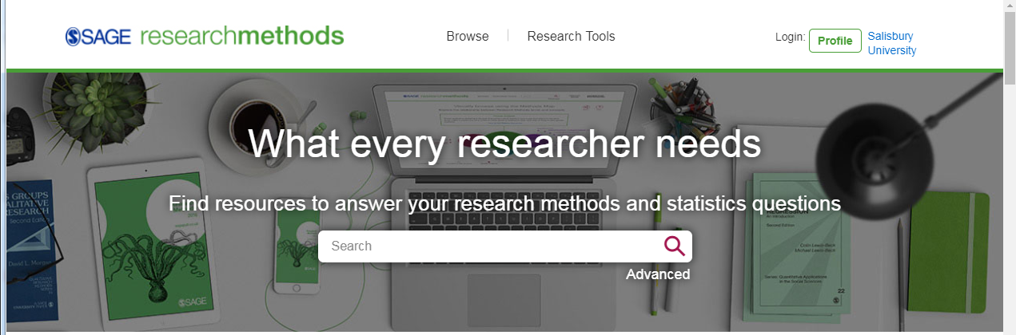
Other Types of Research
http://methods.sagepub.com/

Slide 9
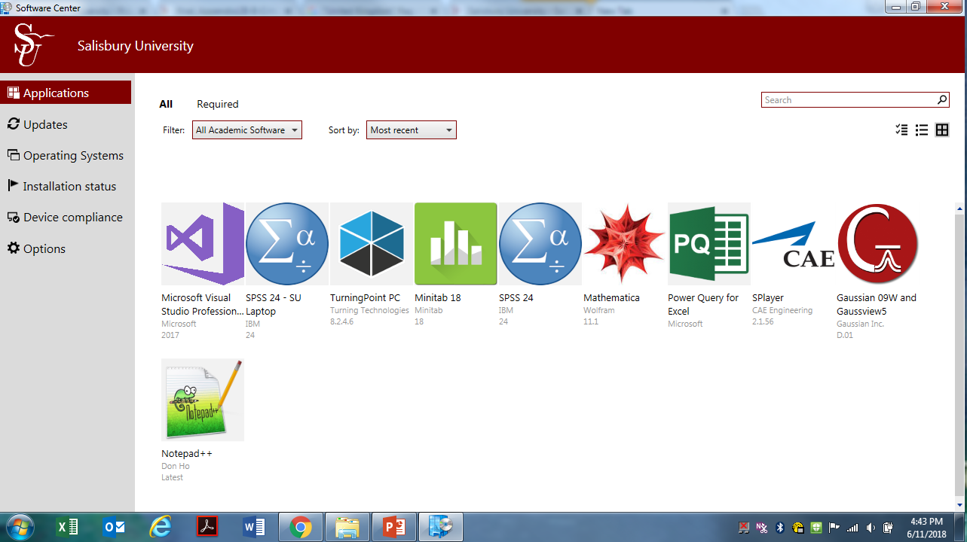
Software Center—statistical analysis

Slide 10
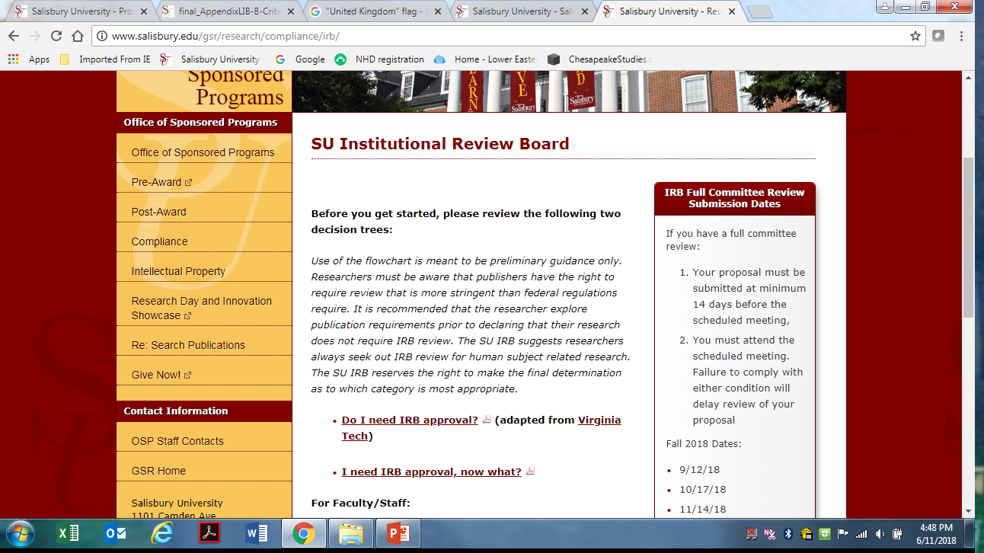
Institutional Review Board (IRB)
http://www.salisbury.edu/gsr/research/compliance/irb/

