Slide 1

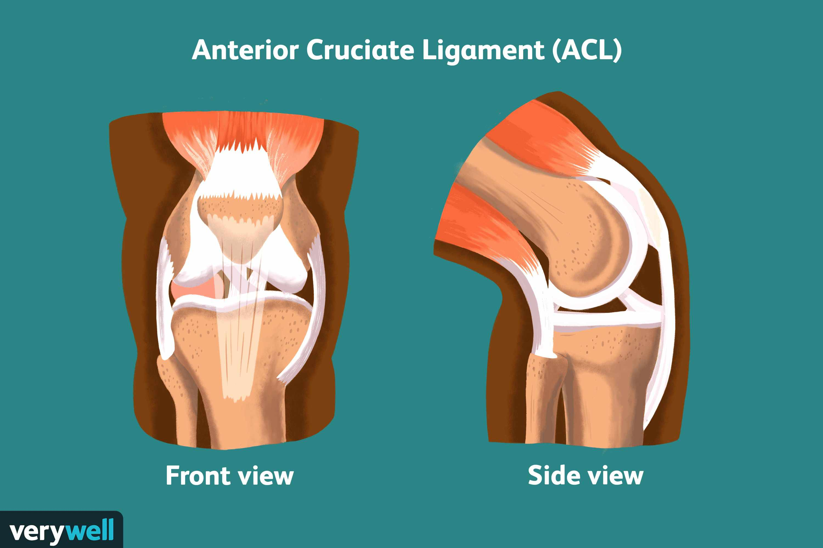

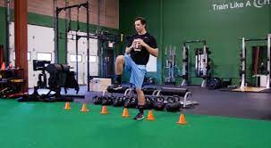
Strength Training Compared To endurance Training For Muscle Hypertrophy And Knee Function In Adult Athletes: A critically Appraised Topic
Keyonna Biggs, Athletic Training Student
Frostburg State University
Background
Endurance training can increase range of motion during ACL rehabilitation.² Although there is limited evidence that supports endurance training during ACL rehabilitation, most protocols include it as supplemental training to assist in overall conditioning of the athlete’s body.
An anterior cruciate ligament (ACL) sprain is generally considered to be the most serious ligament injury in the knee. The ACL ligament is the main determinant of knee stability. ¹ The quadriceps and hamstrings give the knee leverage and is a favorable vector to the ACL during closed chain kinetic activities.¹
Clinical Question
Conclusion
In adult athletes, will strength training increase muscle hypertrophy and overall knee function and stability during ACL rehabilitation compared to endurance training?
Strength training concentric then eccentric contraction was shown to cause greater muscle hypertrophy when used in ACL rehabilitation.⁵ Whole-body strength training exercise significantly increased knee isokinetic strength causing maximum power and torque of the muscles^{6.} Proper rehabilitation needs to emphasize the importance of functional stability and normal muscle function, which is enhanced through strength training.⁵
Post-ACL reconstruction surgery should include strength training for muscle hypertrophy, knee functional stability, and overall improved patient outcomes. Based on the data, strength training significantly increased muscle hypertrophy and overall proper knee function, which led to a quicker recovery time.
Data Sources
One search and Google scholar was used to research peer reviewed articles. Keywords used were treatment, anterior cruciate ligament, rehabilitation, strength, muscle hypertrophy and ACL reconstruction.
References
Strength and Conditioning
Endurance Training
1.. Abbey C Thomas, P., MS, M. V., Edward M. Wojtys, M., & Riann M. Palmier-Smilth, P. A. (2013, October 01). Lower Extremity Muscle Strength After Anterior Cruciate Ligament Injury and Reconstruction. Retrieved from NATA: https://meridian.allenpress.com/jat/article/48/5/610/111367/Lower-Extremity-Muscle-Strength-After-Anterior
.
2. Costantino, C. P., Bertuletti, S. M., & Romiti, D. M. (2018, July ). Efficacy of Whole-Body Vibration Board Training on Strength in Athletes After Anterior Cruciate Ligament Reconstruction: A Randomized Controlled Study. Retrieved from Clinical Journal of Sports Medicine : https://journals.lww.com/cjsportsmed/Abstract/2018/07000/Efficacy_of_Whole_Body_Vibration_Board_Training_on.3.aspx
3. Kvist, J. (2004). Rehabilitation following Anterior Cruciate Ligament Injury . Retrieved from Injury clinic : https://citeseerx.ist.psu.edu/viewdoc/download?doi=10.1.1.541.991&rep=rep1&type=pdf
4. Lorenz, M. P. (2011, Sep 6). NTEGRATION OF STRENGTH AND CONDITIONING PRINCIPLES INTO A REHABILITATION PROGRAM. Retrieved from NCBI: https://www.ncbi.nlm.nih.gov/pmc/articles/PMC3164002/
5. Progressive strength training restores quadriceps and hamstring muscle strength within 7 months after ACL reconstruction in amateur male soccer players. (2019).
6.Retrieved from science Direct :
https://www.sciencedirect.com/science/article/abs/pii/S1466853X1930210X
Strength Training Effects on Muscular Regeneration after ACL Reconstruction. . (2018, May 31). Retrieved from Europe PMC: https://europepmc.org/article/med/29389836
If lower extremity strength and conditioning training during ACL rehabilitation is not implemented early, then athletes have a longer return to play. Quad symmetry was significantly lower in injured knee ^{3.} Strength conditioning should be essential in ACL rehabilitation. Utilizing strength and conditioning training within ACL rehabilitation has been found to:
Increase hip flexor, adductor, and abductor strength
Increase quad/hamstring hypertrophy
Functional and normal muscle function, which is enhanced through strength training
There were no significant differences in peak quadriceps and hamstring muscle strength after seven months of rehabilitation compared to dominant leg.⁴
There was limited evidence on endurance training in correspondence to muscle hypertrophy in an ACL rehab program. Even though there is not much data of support the articles were still selected and included for analyzation to contribute to this study.

