Slide 1

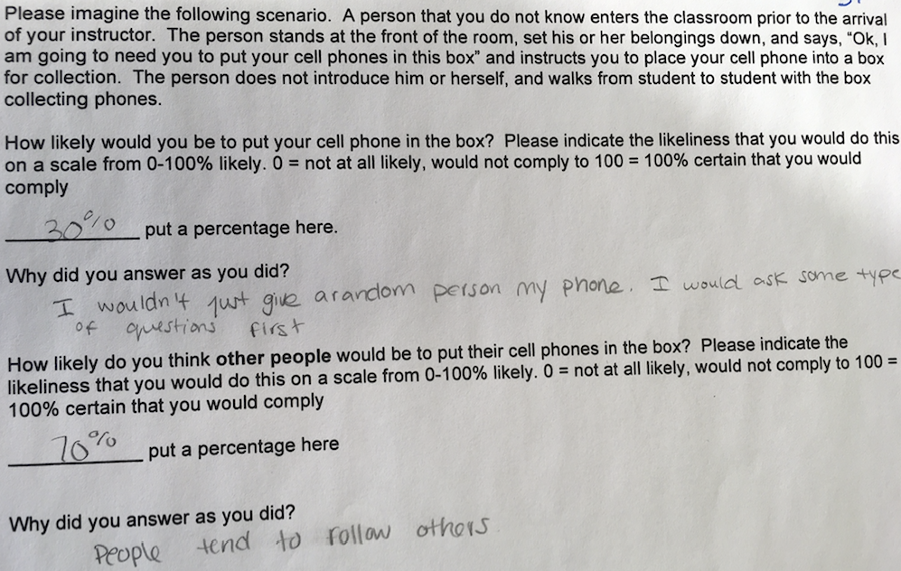
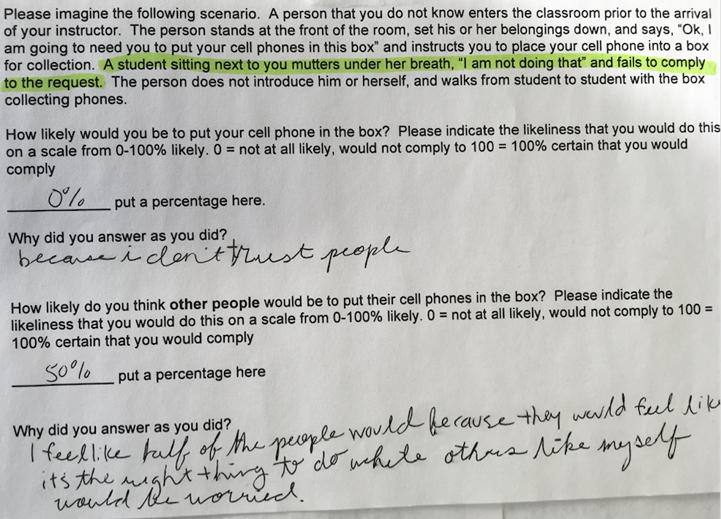
“I would Never Fall for That”:
The Use of an Illegitimate Authority to Teach Social Psychological Principles
Deborah Carson, Sally D. Farley, & Terrence J. Pope
University of Baltimore
Abstract
Method
Discussion
The current class activity explores attitudinal beliefs and behavioral responses of “obedience” in response to an illegitimate authority figure in an ambiguous situation. Students either self-reported the likelihood that they would comply to a request made by a stranger to surrender their cell phone, or were asked directly and in person by a confederate to relinquish their cell phone. The exercise revealed a marked discrepancy between how students predicted they would respond and how they actually did respond to the request. Specifically, in five different classes, the average percentage of students in the class complying with the request was 81.2%. In this poster, we provide recommendations for how this exercise might be employed to make meaningful applications to myriad social psychological principles.
Participants
University of Baltimore students (N = 164) participated in this research in one of two ways – in an experiential obedience exercise (n = 109) or in a survey task (n = 55). The experiential obedience exercise was introduced in five undergraduate classes ranging in size from 11 to 38 students. The courses were varied in terms of college level and academic focus (i.e. upper-level psychology, sophomore seminar, introductory biology, entrepreneurship, and marketing).
Experiential obedience exercise
At the start of class, one of two confederates entered the classroom, and positioned themselves at the front of the classroom. Without identifying themselves, the confederates instructed students to place their cell phones into a box, saying “I need you to put your cell phones in this box.” Patterning the protocol after the original Milgram (1963) study, if students asked if they had to comply, the confederate simply repeated the request with an authoritative tone (e.g. “It is important for you to follow instructions and put your phone in the box”). Otherwise, the confederates in no way provided students with any justification for the request. Once the cell phones were collected, the confederate counted the phones and returned them to the students.
Survey task
The survey task was divided into two conditions. In the parallel condition, students (n = 30) read a scenario identical to the protocol in the obedience task. They were asked to estimate how likely (on a scale ranging from 0 to 100%) they would be to comply with a request made by an unknown stranger to put their cell phone into a box.
In the second variation, we added a “noncompliant” student into the description. In this scenario (n = 25), the following sentence was included, “A student sitting next to you mutters under her breath, ‘I am not doing that’ and fails to comply to the request.” After reading scenario, students completed the same items about compliance likelihood (about their own and others’ behavior). Students were also asked to report how compliant others would be using the same measurement scale, and questioned as to why they would or would not comply.
An overwhelming majority of students (81.2%) exposed to the experiential obedience task relinquished what they might consider their most personal and valuable belonging to a complete stranger with no justification. Despite the fact that the authority figure in this exercise lacked legitimacy, this compliance rate exceeded both Milgram’s base rate of obedience (of 63%) and self-reported estimates of compliance to an illegitimate authority (22.4% likelihood).
A paired-samples t-test also showed that students thought that they would be significantly less likely to comply to an authority figure (M = 16.5%, SD = 25.6) than their peers would (M = 41.0%, SD = 29.8), t(53) = -5.91, p < .001.
An independent samples t-test revealed that students reported being less likely to comply in the “noncompliant peer” scenario (M = 8.7%, SD = 18.5) than when noncompliance was not mentioned (M = 22.4%, SD = 28.9), t(50) = 2.13, p = .04. Interestingly, estimates of others’ compliance were not affected by the presence of a dissenter, t(52) = -.48, p = .63.
Several things are noteworthy about these results:
First, students in the upper-level psychology course would have learned about Milgram’s research in several courses prior to this exercise, yet this class was 100% obedient.
In contrast, students in the marketing class were actively depositing their phones in the box when one vocal dissenter challenged the confederate. The remaining students conformed to the behavior of the vocal dissenter (allowing for a segue into minority influence).
Third, after the guided discussion about the social psychological implications of the experiential exercise, three classes applauded. Given the rarity of this experience, we believe this to be evidence of the impactful nature of this exercise.
The current exercise demonstrates how obedience research continues to be relevant in modern times. While there are numerous contextual circumstances for which obedience appropriate (Ent & Baumeister, 2014), this exercise exposed our collective vulnerability to blind obedience and the potential dangers attached to our willingness to accept illegitimate authority.
Introduction
Experiential learning creates deeper interest in subject matter (Harton, et al., 2002), increases integration and synthesis of core themes and course material (Blessing & Blessing, 2015), and improves student retention rates (Schmidt et al., 2009).
Experiential learning also leads to higher exam scores and improvements in problem-solving, communication, and group-related skills (Terenzini, et al., 2001).
So, how might lessons about our vulnerability to obedience be framed in an experiential learning context?
We devised a scenario by which students were confronted by a demand of an illegitimate authority figure, one involving risky stakes (i.e. the loss of a cell phone).
We surveyed additional students to assess self-reported estimates of their own behaviors in such a hypothetical context. As cellphones represent a critical part of the average student’s life (Bjornsen & Archer, 2015; Nikhita, 2015) and having one’s phone taken away has been linked to negative physiological and affective responses (Clayton et al., 2015), this task involved a meaningful personal sacrifice to a perfect stranger.
After the exercise, discussions were facilitated on myriad social psychological concepts (See student learning opportunities). Depending upon the behavior of the students (relative obedience or defiance), material can be tailored to more directly address the experiences of the class.
Results
Student Learning Opportunities
Obedience (behavior in response to perceived authority) and conformity (to the behavior of other students)
Comparison to Milgram (1963) and Hofling et al. (1966) (obedience typically occurs despite legitimacy of the authority or rationale for the command)
Consistency controversy (What students say they would do – via self-report – is widely discrepant from what they actually do)
Situational influences (student role, classroom norms, behavioral scripts) versus dispositional influences (”obedient personality”)
Defensive attribution (Obedience results are historically, contextually, bound – we wouldn’t obey today!”)
Self-serving bias (Students make internal attributions for defiance and external attributions for obedience)
Fundamental attribution error and actor-observer effect (Attributional differences for self and other)
Minority influence (Moscovici – when students rebel)
Sample Survey - Parallel Condition
Sample Survey – Noncompliant Peer

