Slide 1
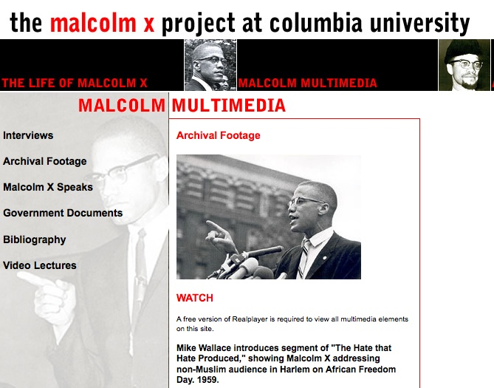
Introduction to Archives:
Finding Interesting Things in Unexpected Places
http://www.columbia.edu/cu/ccbh/mxp/archival.html

Slide 2
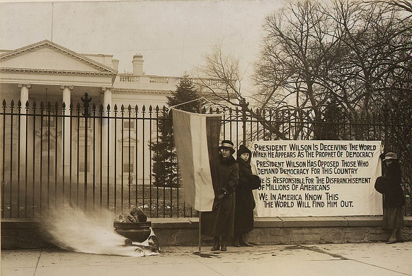
Today’s Activities
Introduction to archives
a. Definition of an archival collection
b. How do I find a collection?
c. How do I use an archives?
d. Caring for your family archives.
2. Tour of Special Collections
3. Show, Tell and Ask
Woman’s suffrage demonstration. 1917-1918
National Archives Women’s Rights Flickr Collection

Slide 3
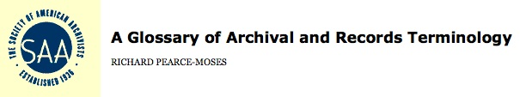
What is an Archival Collection?
“Materials created or received by a person, family, or organization and preserved because of their enduring value, or as evidence of the functions and responsibilities of their creator; permanent papers or records.”
http://www.archivists.org/glossary/

Slide 4
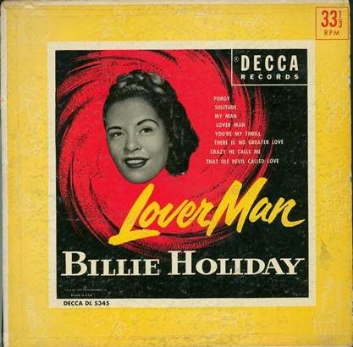
How do I Find an Archival Collection?
Two approaches:
Find a archives which you think will have material you are interested in and then browse/search their website, catalog or content management system.
Search for specific collections in ArchiveGrid which might have material of interest, then see what’s available online.
http://ubalt.worldcat.org/title/lover-man/oclc/6871574&referer=brief_results

Slide 5
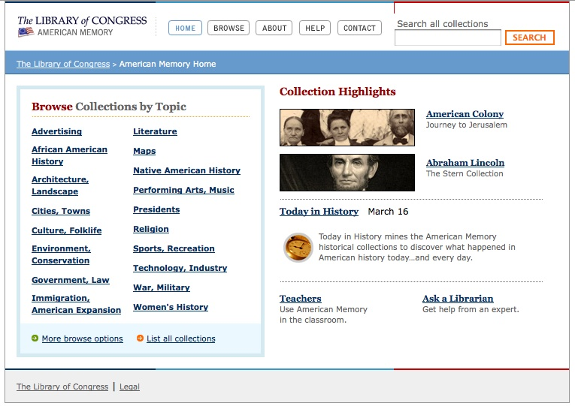
Finding an Archives: Types of Archives
International
National
State
Local
Organizations
Subject Areas
Family
Personal
http://memory.loc.gov/ammem/index.html

Slide 6
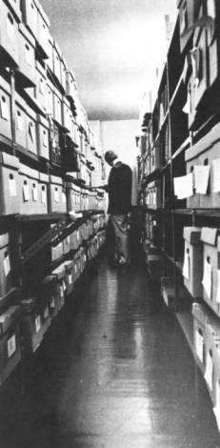
Finding an Archives: What happens in an archives?
Contacting potential donors.
Appraising possible donations.
Accessioning new collections.
Collection processing.
Digitizing collections.
Uploading collection content to the web.
Reference work.
Ted Durr in the Stacks of the Baltimore Region Institutional Studies Collection, 1976
University of Baltimore Photograph Collection

Slide 7
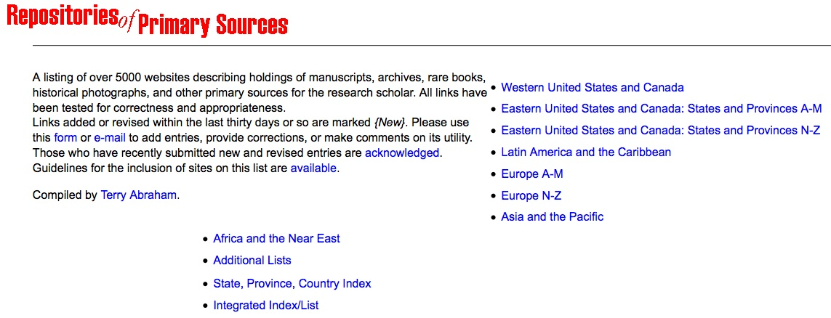
Finding an Archives: Directory of Archives
Terry Abraham, archivist at the University of Idaho maintains an extensive online list of archives around the world
http://www.uiweb.uidaho.edu/special-collections/Other.Repositories.html

Slide 8
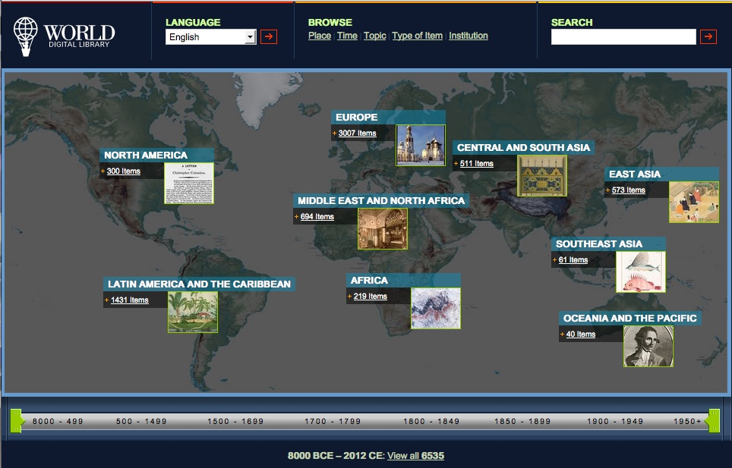
Finding an Archives: World Digital Library
http://www.wdl.org/en/

Slide 9
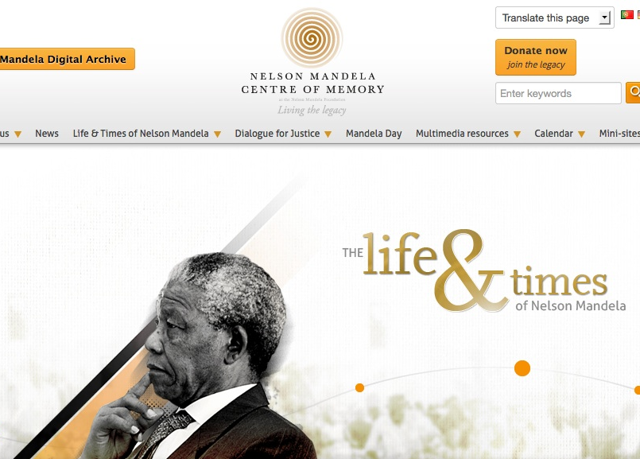
Finding an Archives: International Archives
http://www.nelsonmandela.org/

Slide 10
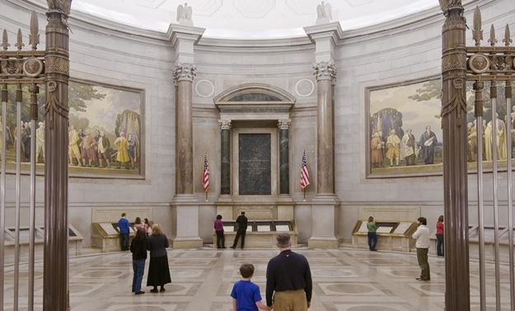
Finding an Archives: United States National Archives and Records Administration (NARA)
Largest archives in the United States, federal government records.
Original 1935 building in downtown Washington, DC, has Declaration of Independence, Constitution and Bill of Rights on display (Archives I).
Modern research facility in College Park, MD (Archives II)
Good vacation destination.
http://www.archives.gov/nae/

Slide 11
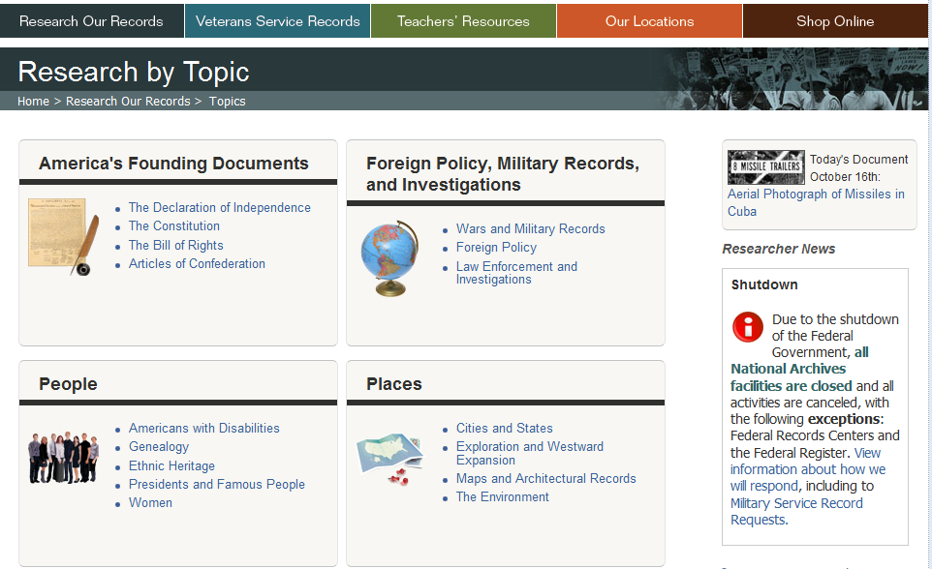
National Archives and Records Administration
http://www.archives.gov/research/

Slide 12
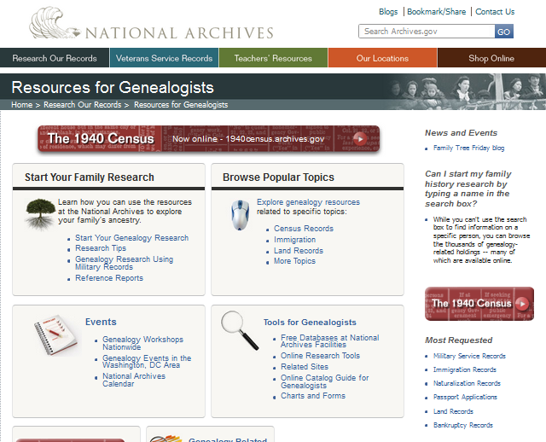
National Archives and Records Administration
http://www.archives.gov/research/genealogy/ /

Slide 13
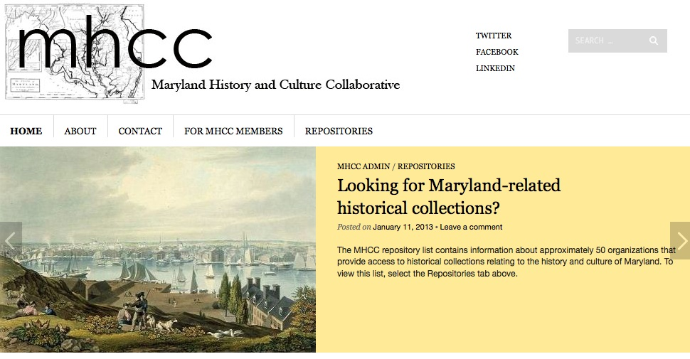
Finding an Archives: Maryland History and Culture Collaborative
http://marylandhcc.wordpress.com/

Slide 14
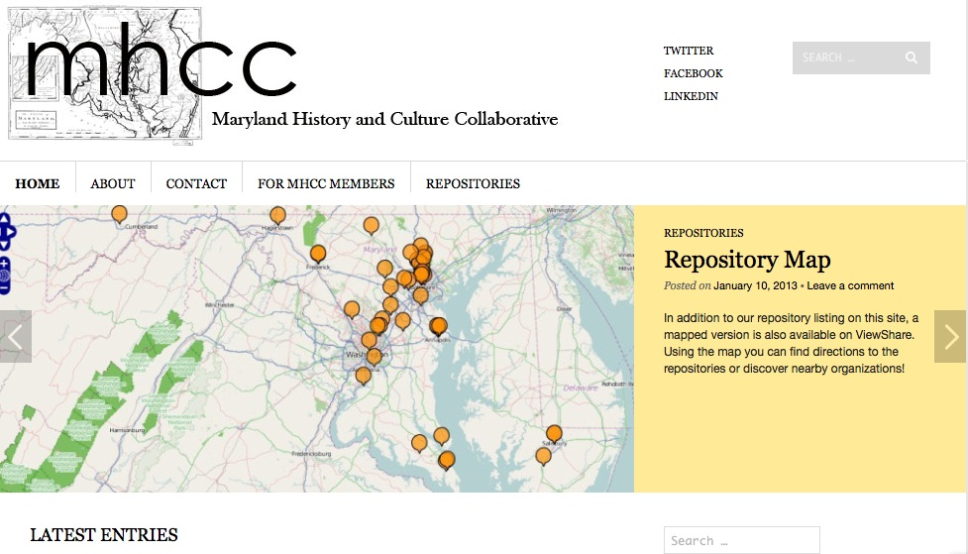
Finding an Archives: Maryland History and Culture Collaborative
http://marylandhcc.wordpress.com/

Slide 15
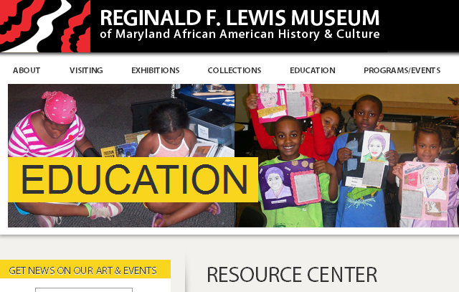
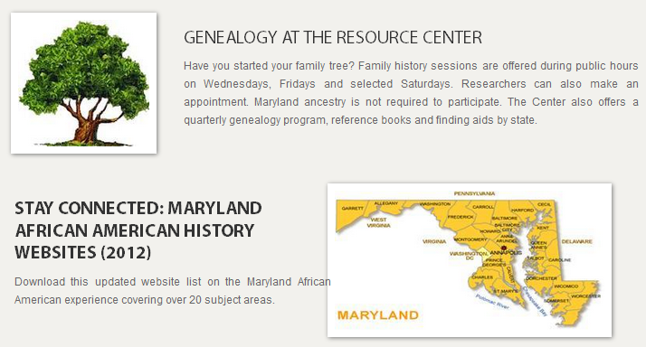
Finding an Archives: Types of Local Archives
African American
Agricultural
Art
Business
Law
Maritime
Medical
Military
Religious
University
http://www.rflewismuseum.org/education/research

Slide 16
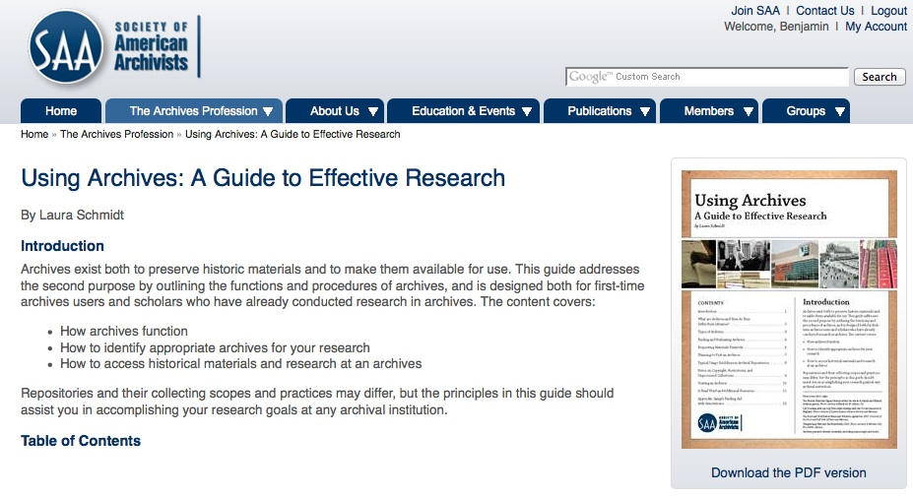
Finding an Archival Collection: A Useful Guide

http://www2.archivists.org/usingarchives

Slide 17
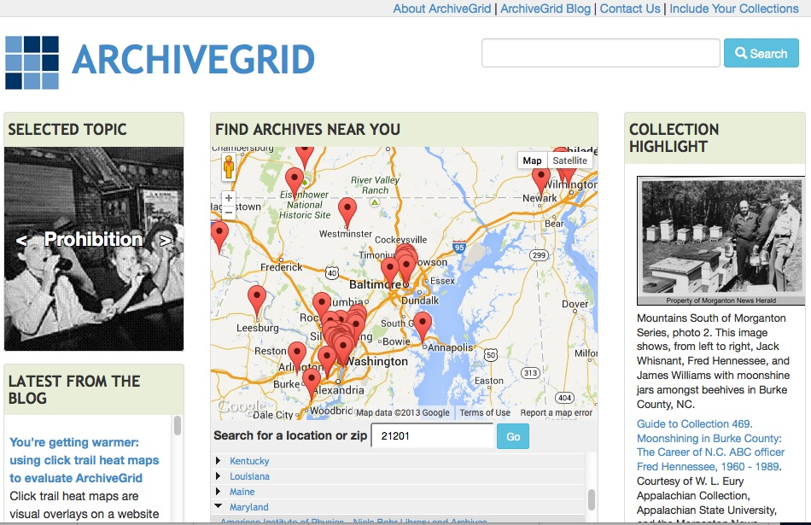
Finding an Archival Collection: Archivegrid (same hits as WorldCat)

http://beta.worldcat.org/archivegrid/

Slide 18
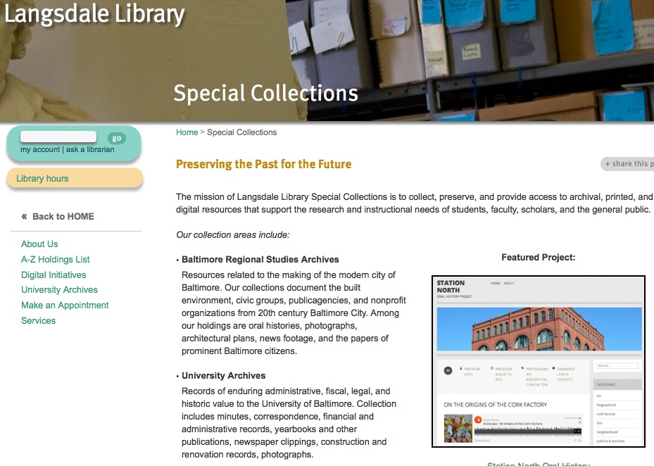
Finding an Archival Collection UB Special Collections: Browsing

http://langsdale.ubalt.edu/special-collections/

Slide 19
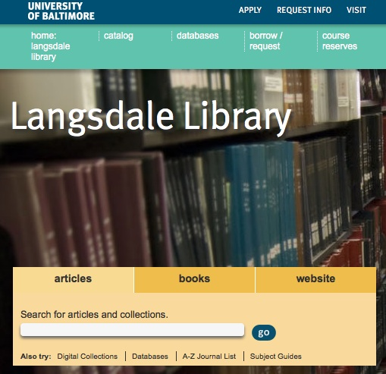
Finding an Archival Collection UB Special Collections: Searching

http://langsdale.ubalt.edu/

Slide 20
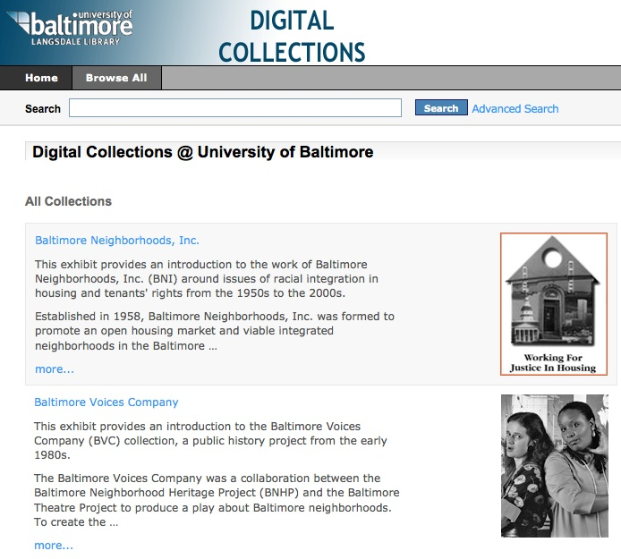
Finding an Archival Collection UB Special Collections: Searching

http://langsdale.ubalt.edu/

Slide 21
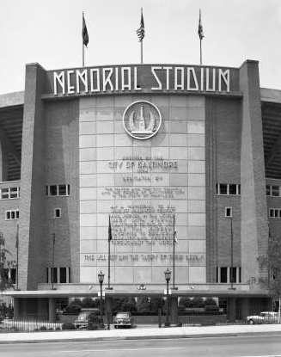
Tip #1: Make an Appointment with an Archivist
You will save A LOT of time
We can walk through online searches for sources on your topic
Contact archives in advance
Coordinate visits/field trips
And more
Blakeslee-Lane Photograph Collection
http://cdm16352.contentdm.oclc.org/cdm/singleitem/collection/p16352coll7/id/31/rec/2

Slide 22
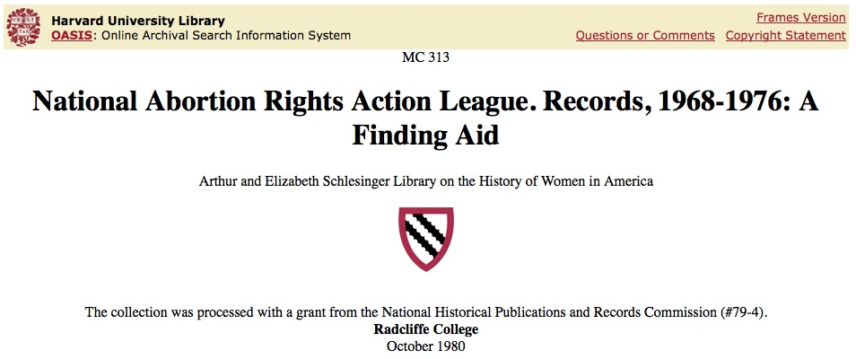
Tip #2: Use Google to find collections and institutions by adding “archives”
Google search term:
“National Abortion Rights Action League archives”

Slide 23
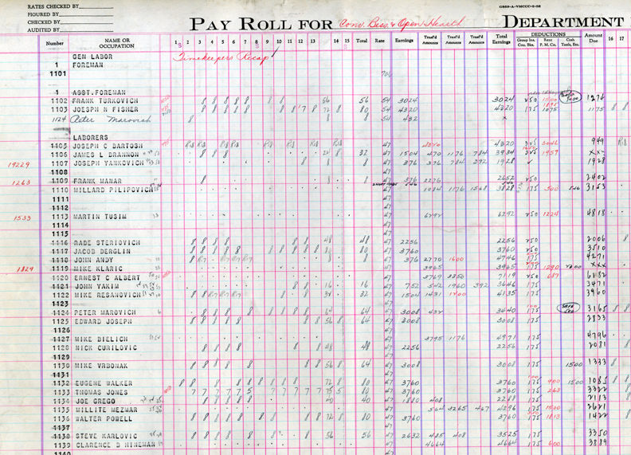
Tip #3: The best sources for original research are invisible
This 1935 payroll ledger for the Bessemer/Open Hearth department at Jones and Laughlin’s Aliquippa Works, PA. The mill is demolished and there is no online record for this collection.
Heinz History Center, Pittsburgh

Slide 24
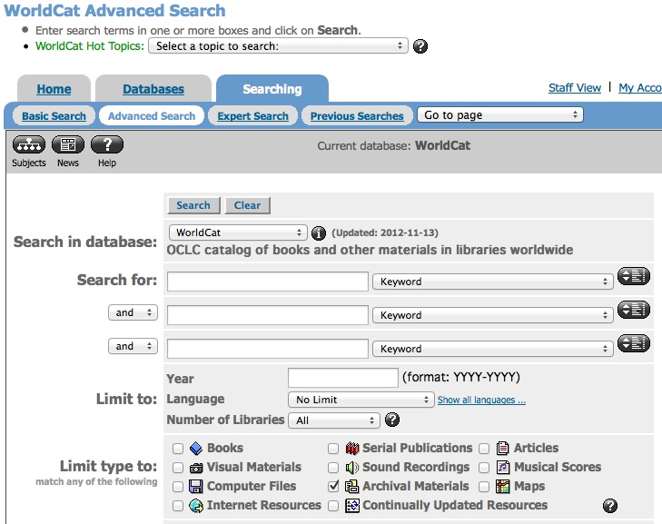
Tip #4: Limit WorldCat searches to “archives” or use ArchiveGrid (same hits as WorldCat)

Slide 25
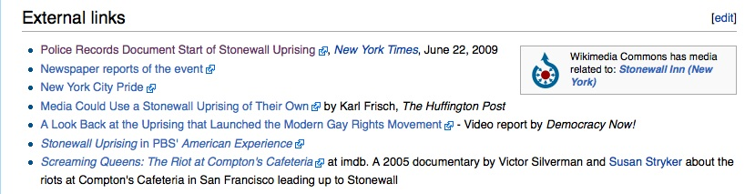
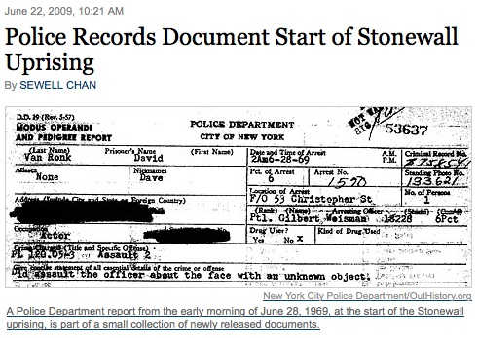
Tip #5: Use Wikipedia to find collections
Alert!: Do not rely on the accuracy of Wikipedia, use it primarily for leads to primary sources and more reliable secondary sources.

Slide 26
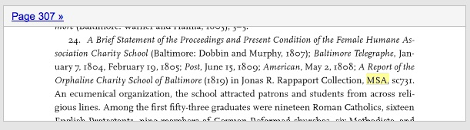
Tip #6: Trace primary sources from secondary sources
Example: Scraping By, Wage Labor, Slavery, and Survival in Early Baltimore, by Seth Rockman
Identifies an 1819 source at the Maryland State Archives documenting poor girls under the age of 16 being bound out to wealthy households to improve their “habits of industry.”

Slide 27
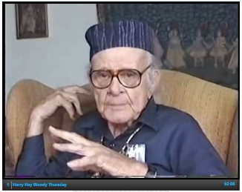
Tip #7: Expect surprises!
If you are having trouble finding a topic, search and browse online collections. You are likely to discover totally unexpected results. For example, the oral history of Harry Hay.
Harry Hay Oral History, Internet Archive
http://archive.org/details/HARRY2

Slide 28
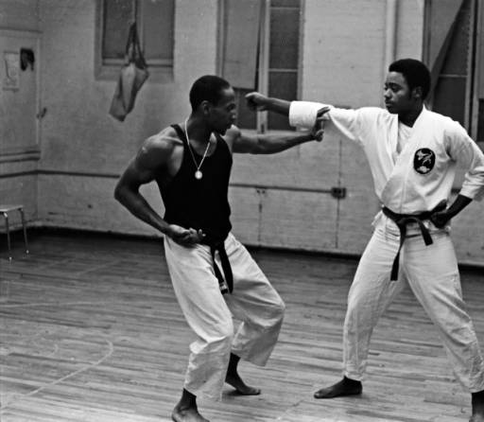
Tip #8: Team up with a classmate
Can add depth to your understanding of the research
Makes research more interesting and fun
Teamwork skills will serve you well in your future career
Share costs
Images from the Model Urban Neighborhood Demonstration Records, 1968-1971
http://cdm16352.contentdm.oclc.org/cdm/singleitem/collection/p15224coll2/id/273/rec/100

Slide 29
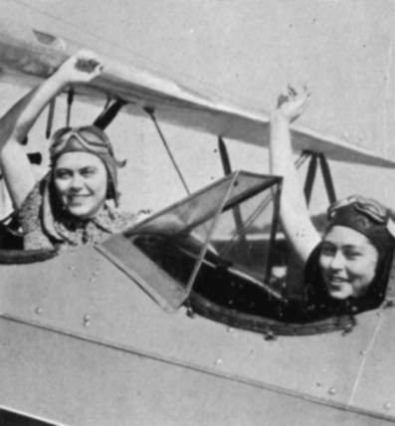
Tip #9: Visit at least one archives in person
Contact the archives in advance and make an appointment.
Confirm policy/procedures, particularly for reproduction: are photocopying, digital cameras and/or scanners allowed?
Civilian Pilot Training Program Students, 1940
University of Baltimore Photograph Collection
http://cdm16352.contentdm.oclc.org/cdm/singleitem/collection/p16352coll3/id/95/rec/31

Slide 30
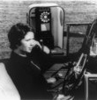
Tip #10: Make an Appointment with Archivist
Particularly if:
Your searches are taking too long and you are not finding relevant sources
You are having trouble finding an archives with sources relevant to your topic
Need help understanding how to use archival guides (finding aids)
Understanding archival procedures or terminology is difficult
Experimental drive-in phone, 1958. Library of Congress

Slide 31
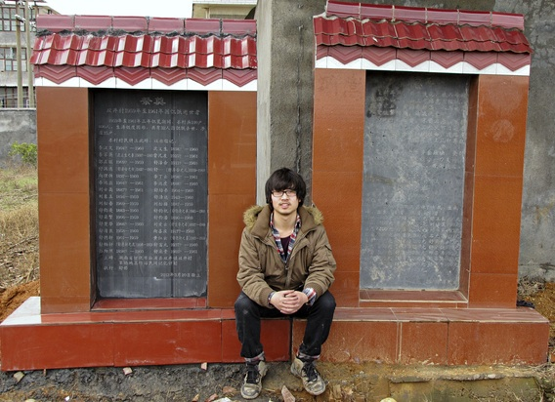
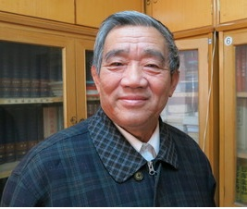
Consider yourself a student/citizen/peoples/family archivist
Yang Jisheng, 72, spent a decade working undercover, secretly amassing official proof of China's great famine.
"A people who have forgotten their history have no direction. My book faces up to the darkness to avoid darkness.”
http://www.npr.org/2012/11/10/164732497/a-grim-chronicle-of-chinas-great-famine

Slide 32
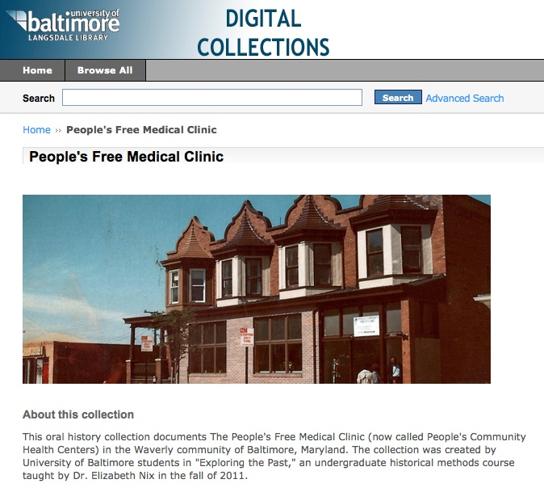
Finding an Archival Collection: Ask an Archivist: Questions?
Ben Blake
Head of Special Collections
Langsdale Library, 4th Floor
410-837-5047
bblake@ubalt.edu
http://langsdale.ubalt.edu/special-collections/
http://cdm16352.contentdm.oclc.org/cdm/landingpage/collection/p16352coll14

