Slide 1
The Role of Resilience in the STEM Identities of Post-secondary Students: A Qualitative Metasynthesis
Karen Benn Marshall, Oakwood University
Sylvia M. James, National science foundation
Narst 2020 annual international conference
March 16, 2020

Slide 2
Table of Contents
Purpose of Study
Rationale for Study
Theoretical Frameworks
Research Question
Study Design
Findings and Analyses
Summary of Findings
Contribution to the Teaching and Learning of Science and the NARST Community
References

Slide 3
Purpose of Study
To utilize the findings from a larger study to explore the relationship between science, technology, engineering and mathematics (STEM) identity and resilience in racially and ethnically diverse undergraduate and graduate students
To contribute to the current qualitative literature on STEM identity development research in racially, ethnically diverse undergraduate and graduate students
To synthesize findings across multiple qualitative studies to consider the role of STEM identity in contributing to student resilience

Slide 4
Rationale for Study
Current qualitative research is limited and much of the literature focuses on quantitative studies of K-12 students
Current research findings are not easily integrated or aggregated across the different disciplines
There is a need to better understand how diverse students navigate STEM learning environments

Slide 5
Definitions
Resilience
Defined as “patterns of positive adaptation” when individuals are faced with challenging or adverse situations and have recovered (Masten & Powell, 2003)
Identity
Construct that addresses the role of individual in relationship to others (Gee, 2001)

Slide 6
Theoretical Frameworks
Study utilizes two frameworks to understand the relationship between science identity and student resilience
Social identity theory
Is an area of social psychology that explores the self in relationship to group membership and group behavior (Kernis & Goldman, 2003)
Science identity
Included as a type of social identity because it encompasses group membership and affiliation with those who engage in or seek to engage in the study, practice, or employment in a STEM field
Aligned with the National Science Foundation’s definition of science and engineering that is broad and includes the biological, computer, mathematical, physical, and social sciences, in addition to psychology and engineering (NSF, 2019)

Slide 7
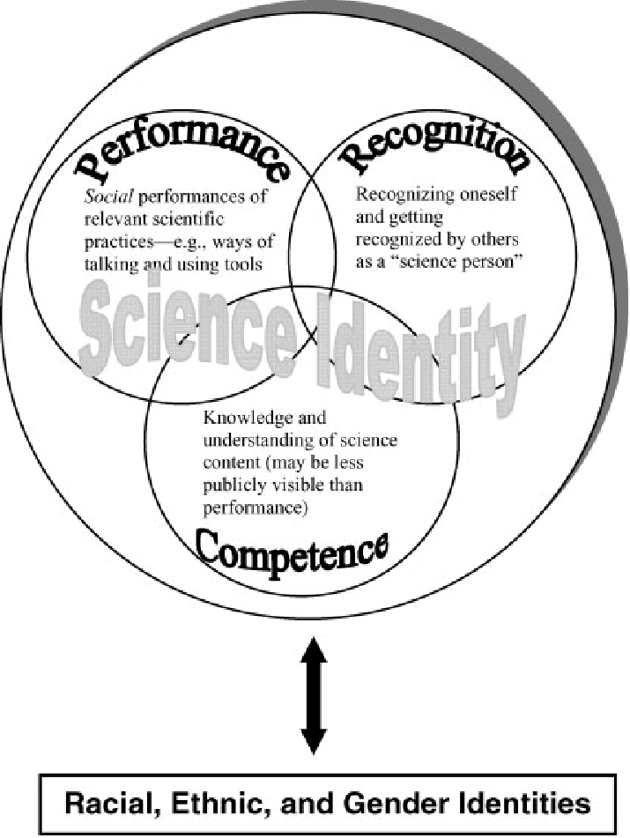
Theoretical Frameworks
Carlone and Johnson’s Model of STEM Identity
Three dimensions- performance, recognition and competence
Carlone & Johnson, 2007

Slide 8
Research Question
How does STEM identity contribute to resilience in the pursuit of STEM degrees in diverse undergraduate and graduate students?

Slide 9
Study Design
Qualitative metasynthesis utilizing constant targeted comparison (Sandelowski and Barroso, 2007)
Comprehensive literature review to identify qualitative studies focused on STEM identity in racially and ethnically diverse students
Inclusion criteria
Primary literature, peer reviewed
Qualitative or qualitative dominant mixed-methods studies
Publication date of 200o or later
Subjects: racially or ethnically diverse students

Slide 10
Study Design
21 of 26 articles met inclusion criteria in original study
21 of 26 articles met credibility standards
8 articles used for current study
All articles read twice by both researchers for agreement on major concepts and themes

Slide 11
Study Design: Summary of Articles
Table 1 – Studies Used in Constant Targeted Comparison
Author (s) | Year | Description of participants | Methodology
Burt, Williams & Smith | 2018 | 21 Black male graduate students | semi-structured interviews
Carlone & Johnson | 2007 | 15 Latina, Black & Native American female undergraduate students | ethnography
Gazley, Remich, Naffziger-Hirsch, Keller, Campbell & McGee | 2014 | 49 Black, 27, Latina, 22 Native American, 4 multi-racial graduate students | semi-structured interviews
Gibau | 2015 | 18 African American graduate (16 women and 2 men) | phenomenology
Malone & Barabino | 2009 | 24 African American, Caribbean, African, Other undergraduate & graduate students | focus groups and interviews
Remich, Naffziger-Hirsch, Gazley & McGee | 2016 | 25 African American, 20 Hispanic/Latino, 4 Native American, 2 Asian, 2 White/non-Hispanic undergraduate & graduate students | interviews
Sriram, Rishi & Diaz | 2016 | 9 Hispanic, African American, East Asian, Southeast Asian undergraduate students | phenomenological case study
Villa, Wandermurem, Hampton, & Espquinca | 2016 | 26 Hispanic undergraduate students | semi-structured interviews

Slide 12
Constant Targeted Comparison
A targeted phenomenon is compared with a concept not addressed in the studies to be synthesized (Sandelowski and Barroso (2007)
In this study, the focus was on the entirety of the results as the source of comparison rather than individual quotations or a subset of the findings
Comparison: Study Identity (focus of studies) and Student Resilience (targeted concept)
Findings from the 8 qualitative studies were used to create lists of “abstract phrases”
Three themes emerged: Mutual Experiences, Coping Mechanisms, Minority Student Impediments

Slide 13
Findings and Analyses
Categories of Comparisons derived from three themes
STEM Identity resilience vs. STEM Identity fatigue
Racially Disadvantaged STEM Identity vs. Racially Privileged STEM Identity and Student Resilience
Resilience and STEM Identity Membership and Belonging vs. Exclusion and Isolation
STEM Identity, Agency and Resilience vs. STEM Identity, Apathy and Resignation
Resilience in STEM Identity Validation/Recognition vs. STEM Identity Suppression
Resilience as a component of Gender Biased STEM Identity v. Gender Neutral STEM Identity

Slide 14
Highlights from Findings (Summarized into Four Major Categories)
Resilience, fatigue & Racially privileged and disadvantaged stem Identity
STEM Identity Membership, Belonging, Isolation, and Agency
Minority students are marginalized, made to feel invisible or “hypervisible” (Burt, et al., 2018; Malone & Barabino, 2009; Gibau, 2015)
Strong social, cultural and familial networks ameliorate effects of isolation (Villa, Wandermuren, Hampton, & Esquinca, 2016)
Agency used to forge pathways in majority institutions
Stereotypes, bias and need to prove ability leads to STEM identity fatigue (Burt, et.al., 2018; Gazley, et.al., 2014; Malone & Barabino, 2009)
Robust STEM identities and competence used to disprove stereotypes (Carlone & Johnson, 2007; Gazley, et al., 2014).

Slide 15
Highlights from Findings
Resilience in stem identity validation/recognition vs. identity suppression
Resilience in gender biased vs. gender neutral stem identity
Validation of STEM identity through recognition and affirmation by “important scientific others” or supportive mentors (Remich, et al., 2016)
Self-validation occurs by defining science identity (Carlone & Johnson, 2007)
Lack of mentors or suppression of STEM identity by mentors occurs at all levels (Burt, et al., 2018)
Gender bias occurs when Black male students are marginalized, denied support, and treated in a condescending manner
Females struggle in male dominated fields and may encounter masculinized pedagogies (Burt, et al., 2018; Carlone & Johnson, 2007; Gazley, et al., 2014; Malone & Barabino, 2009)

Slide 16
Summary of Findings
A strong STEM identity may help foster resilience in diverse students
As a type of social identity, STEM identity is reliant on social interactions in STEM settings with peers and important science others (Kernis & Goldman, 2003)
The presence of competence, performance, and recognition appear to be relevant not only in the ongoing development of STEM identity but also to support recovery from negative interactions and to maintain the resilience needed to continue STEM pursuits (Carlone & Johnson, 2007; Masten & Powell, 2003)

Slide 17
Summary of Findings
Diverse students may employ a range of coping mechanisms including family and peer support systems, as well as a personal cache of innovative approaches to self-define their STEM identities and help them navigate the academic milleu.

Slide 18
Contribution to the Teaching and Learning of Science and the NARST Community
Findings provide valuable insight about the relationships between a well-developed STEM identity and resilience in diverse undergraduate and graduate students
These findings also have important implications for the teaching, learning and researching of science education
Additional research is needed to better understand the relationship between a strong STEM identity and resilience in diverse undergraduate and graduate students

Slide 19
References
Burt, B. A., Williams, K. L., & Smith, W. A. (2018). Into the storm: Ecological and sociological impediments to black males’ persistence in engineering graduate programs. American Educational Research Journal, 55(5), 965-1006. doi:10.3102/0002831218763587
Carlone, H. B., & Johnson, A. (2007). Understanding the science experiences of successful women of color: Science identity as an analytic lens. Journal of Research in Science Teaching,44(8), 1187-1218. doi:10.1002/tea.20237
Gazley, J. L., Remich, R., Naffziger-Hirsch, M. E., Keller, J., Campbell, P. B., & McGee, R. (2014). Beyond preparation: Identity, cultural capital, and readiness for graduate school in the biomedical sciences. Journal of Research in Science Teaching, 51(8), 1021-1048.
Gee, J.P. (2001). Identity as an academic lends for research in education. Review of Educational Research, 25, 99-125.
Gibau, G. S. (2015). Considering student voices: Examining the experiences of underrepresented students in intervention programs. CBE—Life Sciences Education, 14(3), ar28. doi:10.1187/cbe.14-06-0103
Herrera, F.A., Hurtado, S., Garcia, G.A. & Gasiewski, J. (2012). A model for redefining STEM identity for talented STEM graduate students. American Educational Research Association.
Johnson, D. (2011). Women of color in science, technology, engineering, and mathematics (STEM). New Directions for Institutional Research, 152, 75-85.
Kernis, M. H., & Goldman, B. M. (2003). Stability and variability in self-concept and self-esteem. In M. R. Leary & J. P. Tangney (Eds.), Handbook of self and identity (pp. 106-127). New York, NY, US: The Guilford Press.
Lincoln, Y.S. & Guba, E.G. (1985). Naturalistic inquiry. Newbury Park, CA: Sage Publications.
Malone, K., & Barabino, G. A. (2009). Narrations of race in STEM research settings: Identity formation and its discontents. Science Education, 93(3), 485-510.
Masten, A. S., & Powell, J. L. (2003). A resilience framework for research, policy, and practice.In S. S. Luthar (Ed.), Resilience and vulnerability: Adaptation in the context of childhood adversities (pp. 1-25). New York, NY, US: Cambridge University Press

Slide 20
References
McClain, O.L. (2014) Negotiating identity: A look at the educational experiences of Black undergraduates in STEM disciplines, Peabody Journal of Education, 89(3), 380-392.
National Science Foundation, National Center for Science and Engineering Statistics, 2019. Women, Minorities, and Persons with Disabilities in Science and Engineering: 2019.Special Report NS 19-301. Alexandria, VA. Available at www.nsf.gov/statistics/wmpd/.
Remich, R., Naffziger-Hirsch, M. E., Gazley, J. L., & McGee, R. (2016). Scientific growth and identity development during a postbaccalaureate program: Results from a multisite qualitative study. CBE-Life Sciences Education, 15(3), ar25.
Sandelowski, M., & Barroso, J. (2007). Handbook for Synthesizing Qualitative Research. New York, NY: Springer Publishing Company.
Shenton, A.K. (2004). Strategies for ensuring trustworthiness in qualitative research projects. Education for Information, 22, 63–75.
Sriram, R. & Diaz, C. (2016). STEM as minority: A phenomenological case study of how students of color perceive their experiences in a STEM living-learning program. Journal of Living Spaces, 5(1), 9-18.
Stevenson, A. D., Martínez, A. J., Brkich, K. L., Flores, B. B., Claeys, L., & Pitts, W. (2017). Latinas’ heritage language as a source of resiliency: Impact on academic achievement in STEM fields. Cultural Studies of Science Education,14(1), 1-13. doi:10.1007/s11422-016-9789-6
Syed, M., Azmitia, M., & Cooper, C.R. (2011). Identity and academic success among underrepresented ethnic minorities: An interdisciplinary review and integration. Journal of Social Issues, 443-468.
Villa, E., Wandermurem, L., Hampton, E., & Esquinca, A. (2016). Engineering identity through the Latina lens. Journal of Education and Learning, 5(4), 113-125.

